Slide 1


Microscopic particle-vibration coupling calculations (with applications to single-particle states, collective states, charge-exchange transitions)
Gianluca Colò

Slide 2
Nuclear Density Functional Theory (DFT)
Slater determinant
1-body density matrix
The Hohenberg-Kohn theorem guarantees that the exact functional exists but gives no clue on how to build it.
One can start from a force V_{eff} and write H_{eff} = T + V_{eff}. E is the expectation value on a general Slater determinant.
𝛿E = 0 provides Hartree-Fock or Kohn-Sham (integro-)differential equations
Another possibility is to write directly the functional E[𝜌] and fit the parameters to the data.
E=a𝜌² + … (can become involved)

Slide 3
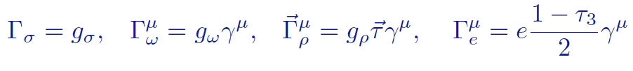
Skyrme vs. relativistic functionals
Skyrme forces are widely used: they generate LOCAL functionals.
attraction
short-range repulsion
In the covariant models the nucleons are described as Dirac particles that exchange effective mesons. One starts from Lagrangians.

Slide 4
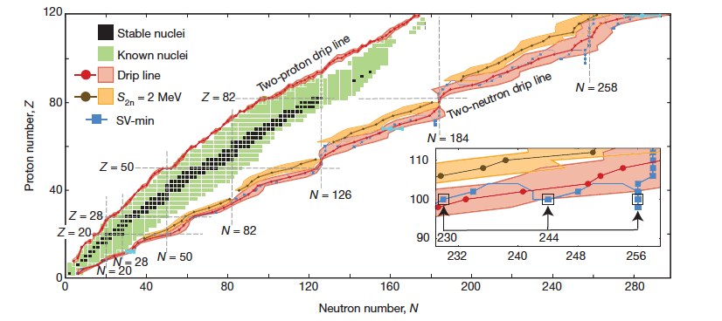
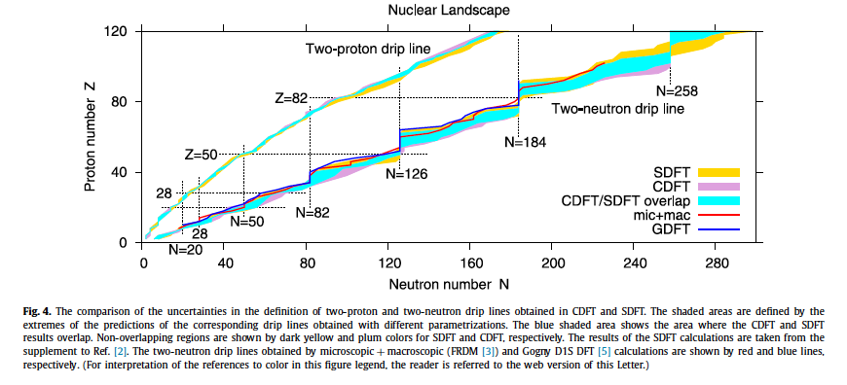
Modern functionals and their performance
They are as “fundamental” as other models because of the HK theorem.
They are applicable to almost the whole isotope chart and (!) to highly excited states, as well as to nuclear and neutron matter.
Typical number of parameters 10 at most.
Error on masses of the order of 1 MeV (can go further down).
Trends of charge radii and deformations fairly well reproduced.
They also describe well states such as giant resonances, rotational bands.
They can also be applied to β and ββ transitions.
There is current interest in large amplitude motion, reactions etc.
(…)
J. Erler et al., Nature 486, 509 (2012) - SEDF
A.V. Afanasjev et al., Phys. Lett. B726, 680 (2013)
- CEDF

Slide 5
Warnings
Availability of large computational resources may lead to attempts of fitting more and more involved functionals.
Some parameters may be irrelevant.
Need of physical understanding.
Courtesy: J. Dobaczewski

Slide 6
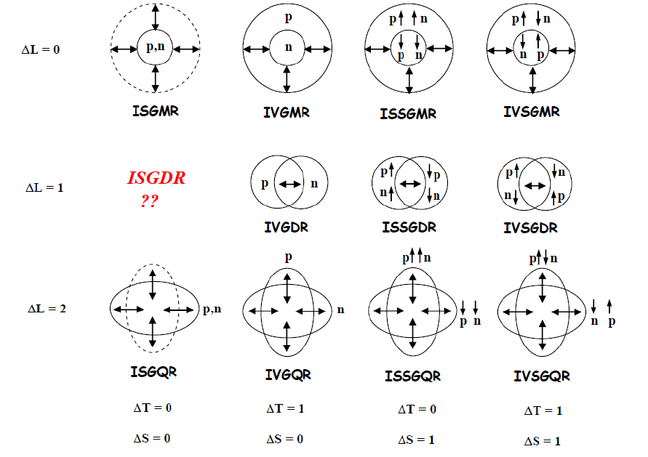
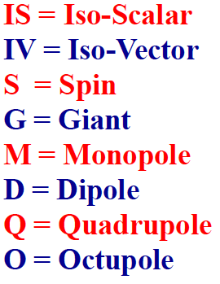
Nuclear excitations
Single-particle: one nucleon from below to above the Fermi surface.
Collective: vibrations (spherical nuclei), rotations (deformed nuclei).

Slide 7
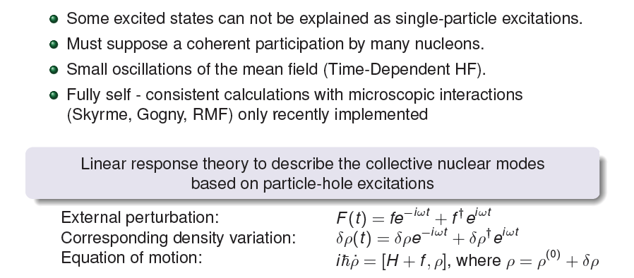
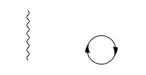
Time-dependent DFT
(linear response theory to study vibrations)
Random Phase Approximation equations (RPA)

Slide 8

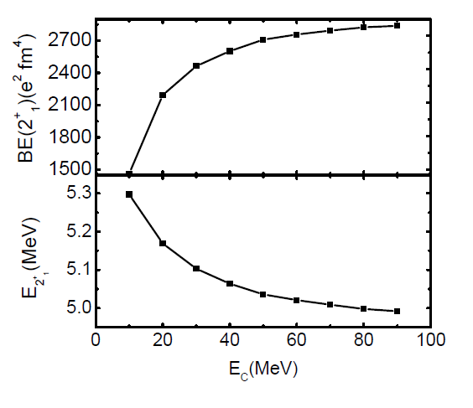
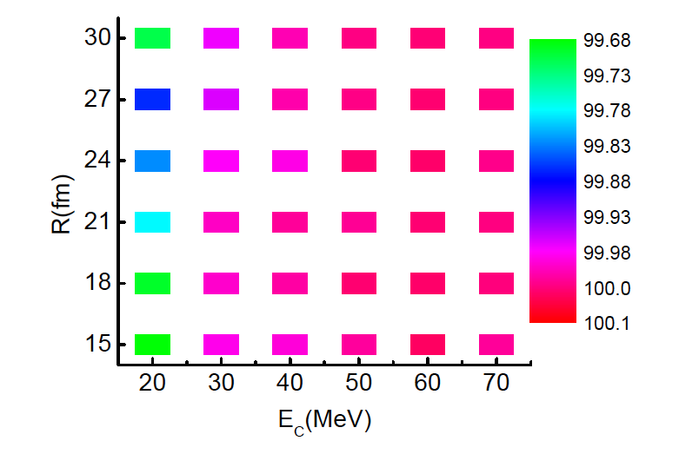
Our self-consistent RPA implementation
The continuum is discretized. We define a p-h basis and then the RPA matrix on this basis is diagonalized. Parameters: R, E_{C}.
The energy-weighted sum rule should be equal to the double-commutator value: well fulfilled !
²⁰⁸Pb - SGII
G.C. et al., Computer Physics Commun. 184, 142 (2013)
m₁(RPA)/m₁(DC) [%]

Slide 9
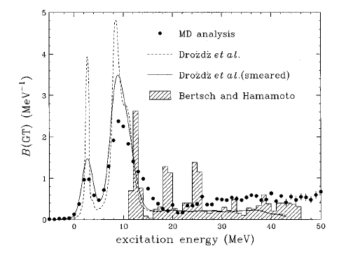
The Gamow-Teller resonance
Highest and lowest particle-hole transitions in the picture
Unperturbed GT energy related to the spin-orbit splitting
Z
N
RPA GT energy related also to V in στ channel
Osterfeld, 1992:
Using empirical Woods-Saxon s.p. energies, the GT energy is claimed to determine g₀’
We want to go beyond the empirical description.

Slide 10
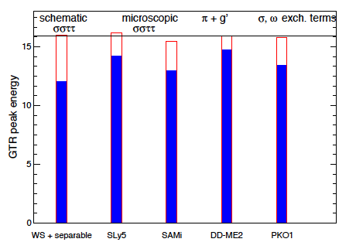
Different physical pictures
Different theories can reproduce the E_{GTR} in stable nuclei with quite a different picture behind them.
In RMF the pion is playing the main role and a fit of the associated constant is needed.
In RHF the dominant terms are exchange terms including the isoscalar σ,ω mesons.
⁹⁰Zr
Is it possible to pin down what is the right picture ?
Is the question well-defined ?

Slide 11

GTR in ²⁰⁸Pb with Skyrme forces
RPA
The unperturbed energy is mainly related to the spin-orbit splitting, in this case mainly f_{5/2}-f_{7/2}.
Even if g₀’ is under control, agreement with experiment is not guaranteed.
Moreover, some forces have negative g₀’ !

Slide 12
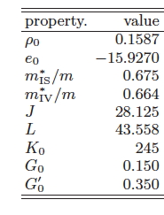
Fit of SAMi
Binding energies of ^{40,48}Ca, ⁹⁰Zr, ¹³²Sn and ²⁰⁸Pb
Charge radii of ^{40,48}Ca, ⁹⁰Zr and ²⁰⁸Pb
Ab-initio calculation of neutron matter between 0.07 fm⁻³ and 0.4 fm⁻³
Spin-orbit splittings of 1g and 2f proton levels in ⁹⁰Zr and ²⁰⁸Pb, respectively
g₀ and g₀’ restricted around 0.15 and 0.35, respectively
Various properties of nuclear matter, known to be correlated with properties of the GRs, turn out to be quite reasonable
X. Roca-Maza, G.C., H. Sagawa, PRC 86, 031306(R) (2012).

Slide 13
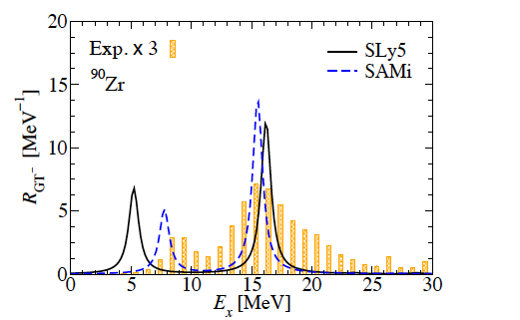
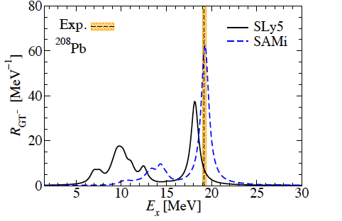
Results for the GTR in ⁹⁰Zr and ²⁰⁸Pb
(p,n) data courtesy of T. Wakasa, H. Sakai and K. Yako.
Good reproduction of the experimental main peak.
Problem: RPA by definition cannot account for the resonance spreading width.

Slide 14
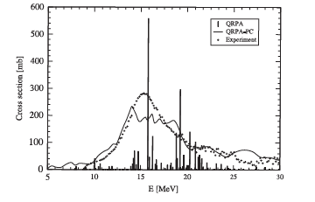
Beyond the simple DFT
There are phenomena or observables that are outside the DFT framework, or that current DFT implementations have difficulty to reproduce.
The HK theorem, that is the foundation of DFT, concerns total energy, one-body density and one-body observables.
The Runge-Gross theorem should extend this to time-dependent phenomena. It certainly can work for small amplitude vibrations.
Multipole strength
Photoabsorbtion cross section in ¹²⁰Sn
Single-particle strength
9/2⁺ strength in ⁴¹Ca (⁴⁰Ca core)
Red: exp; blue=th.
S.p. strength
K. Mizuyama, GC, and E. Vigezzi, PRC 86, 034318 (2012).
N. Paar, D. Vretenar, E. Khan, G.C., Rep. Prog. Phys. 70, 691 (2007)

Slide 15
Particle-vibration coupling (PVC) - I
In spherical nuclei this is the most effective way, if not the only one, to explain fragmentation and widths of single-particle and giant resonances in a consistent fashion. Valid both at the ~1 MeV and ~10 MeV scales.
Particle decays
𝛾 decays
Correlation experiments
(…)
In the following arrows will denote the particles (nucleon degrees of freedom) and wavy lines will denote the vibrations (or phonons – they are bosons).
HF or Kohn-Sham
Use consistently the same Hamiltonian or EDF
Lowest-order coupling
RPA for vibrations

Slide 16
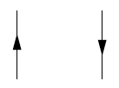
Particle-vibration coupling (PVC) - II
A formal description of the model can be given.
One starts from the Hedin’s equations, that involve
and performs a series of approximations.
HF states (Skyrme)
Both p and h⁻¹
Particle-Vibration Coupling (PVC).
M. Baldo et al., J. Phys. G: Nucl. Part. Phys. 42 (2015) 085109.
Cf. I. Hamamoto, V. Soloviev et al., V. Tselyaev, E. Litvinova et al. […]
Self-consistent RPA
Sum of ph⁻¹ “bubbles”

Slide 17

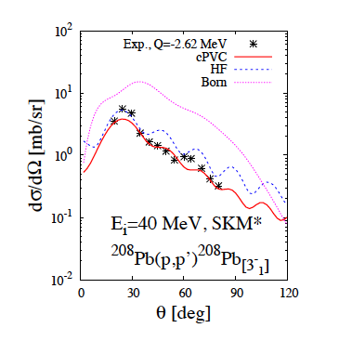
Fragmentation of s.p. strength
Dyson equation in coordinate space.
APPLICATION TO SCATTERING
Courtesy: K. Mizuyama
Y-axis: g9/2 strength in ⁴¹Ca
Red=exp. Blue=theory.
K. Mizuyama, GC, and E. Vigezzi, PRC 86, 034318 (2012).

Slide 18
More general physics case: towards complete spectroscopy of odd nuclei
There are several examples of spectra in which “particle” states (large spectroscopic factor in transfer reactions) co-exist with states made up with “particle plus core vibration” states (gamma decay similar to that of the core vibration).
Could be a good playground for particle-vibration coupling models …
… but in some cases particle-phonon states are instead 2p-1h, or 3p-2h states (“shell model-like” states).

Slide 19
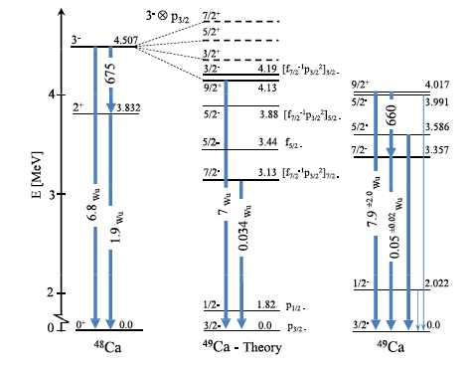
States from (d,p) on ⁴⁸Ca.
Neutrons plus a ⁴⁸Ca vibration ?
⁶⁴Ni+⁴⁸Ca (5.7 MeV/u) performed at LNL recently.
The angular momenta have been found to be aligned perpendicular to the reaction plane. Spin and lifetimes extracted.
T.R. Canada et al., Phys. Rev. C4, 471 (1971)
D. Montanari et al., Phys. Lett. B 697, 288 (2011)

Slide 20
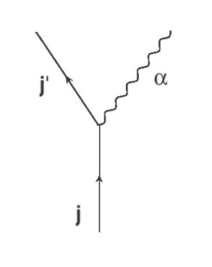
Hybrid Configuration Mixing (HCM) model - I
We start from a basis made up with particles (or holes) around a core, and with excitations of the same core (RPA “phonons”).
On this basis we diagonalize the Hamiltonian
V_{Skyrme}

Slide 21
Hybrid Configuration Mixing (HCM) model - II
Some of the RPA phonons might be actually pure p-h states. Then, the states of our basis are 2p-1h. In this sense they are not “vibrations” and the model cannot be considered “PVC”.
In this case Pauli principle violations can be important. We correct for the non-orthonormality and overcompleteness of the basis by introducing the NORM matrix.
This is the overlap between 1p-1 “phonon” states. The diagonal part reduces to 1 – (2j+1)⁻¹ in simple cases.

Slide 22
Basic equation (cf. SM and/or GCM)

Slide 23
Results for ⁴⁹Ca
SkX
R.m.s. deviation th.-exp.: 0.429 MeV
SLy5
R.m.s. deviation th.-exp.: 0.661 MeV
The spectrum is more stretched in theory than in experiment; nonetheless, the agreement is quite good.

Slide 24
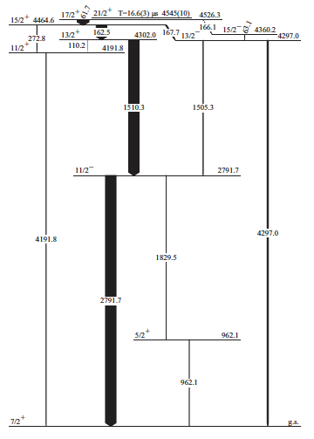
Spectroscopy of ¹³³Sb (¹³²Sn + p)
Despite the importance of the region around ¹³²Sn, the information about low-lying states of neighbouring nuclei need still be completed.
W. Urban et al., PRC 79, 037304 (2009)
Recently new measurements (G. Bocchi et al.) have shed light on some HIGHER SPIN states (up tp 25/2⁺).
B(M1, 15/2⁺→13/2⁺) = 0.24 W.u.
B(M1, 13/2⁺→11/2⁺) = 0.004 W.u.
(ratio = 60)
The odd proton is g_{7/2}. Low spin states may come from coupling to 2⁺, 3⁻, 4⁺ phonons. High spin states can only come from g_{7/2} coupled to h_{11/2}⁻¹ f_{7/2} neutron p-h states.

Slide 25
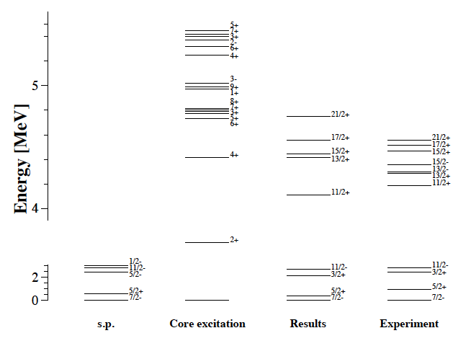
Results for ¹³³Sb
The r.m.s. deviation th.-exp. is 0.869 MeV.
It drops to 0.246 MeV if we exclude the 13/2⁻, 15/2⁻.
SkX
Only 2⁺, 3⁻ and 4⁺ core excitations are genuine “phonons”. There are s more core excitations in the model space, and they are 1p-1h (mainly h_{11/2}⁻¹-f_{7/2}). 6+ has 2-3 components.
The spectrum includes particle-phonon states as well as 2p-1h states.

Slide 26
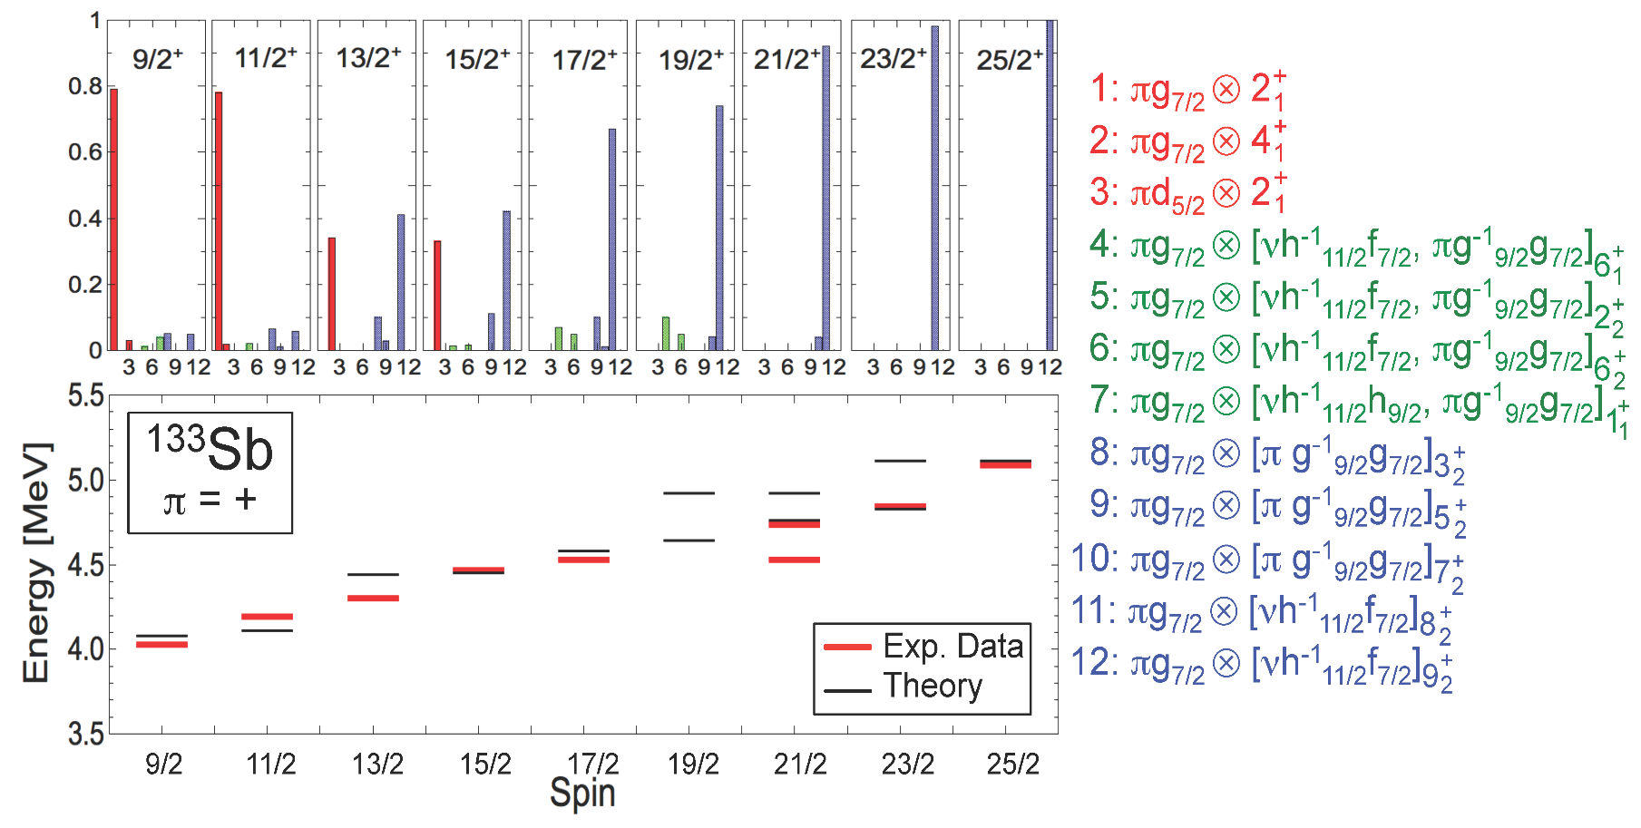
Electromagnetic transitions and the mutable nature of the wavefunction
red:
blue:
This nature is reflected in the M1 transition probabilities.
The wave functions of 15/2⁺ and 13/2⁺ are dominated by g_{9/2}, h_{11/2}⁻¹ f_{7/2}, so the B(M1) transition is made up with s.p. amplitudes. B(M1)_{th} = 0.021 W.u.
In the case of the transition 13/2⁺ → 11/2⁺, the final state has phonon component so there is a mismatch in the components and B(M1) is quenched, B(M1)_{th} = 0.001 W.u. Ratio = 20.

Slide 27
A similar model for resonances: RPA plus particle-vibration coupling
One first solves self-consistent Hartree-Fock plus Random Phase Approximation (HF-RPA).
One adds the self-energy contribution (the state α is 1p-1h plus one phonon).
The scheme is known to be effective to produce the spreading width of GRs.

Slide 28
RPA+PVC applied to GTR
There is no adjustable parameter in our model.
We start from self-consistent HF + RPA description of the GTR, and with the same interaction we calculate the intermediate (doorway) states. The coupling matrix elements are also from the same interaction.
We reproduce most of the experimentally observed width.
Results for energies and widths
Exp.
Theory

Slide 29
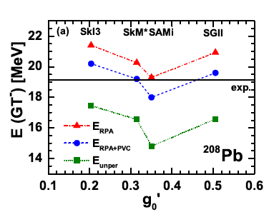
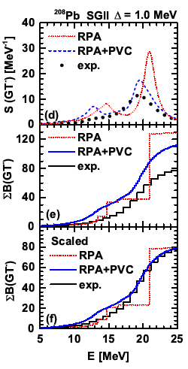
²⁰⁸Pb
Y. Niu et al., PRC 90, 054328 (2014).
The energy shift induced by PVC is very weakly interaction-dependent.
The PVC calculations reproduce the lineshape of the GT response quite well.
Part of the experimentally observed quenching is accounted for.

Slide 30
⁵⁶Ni
Y. Niu, G.C., M. Brenna, P.F. Bortignon, and J. Meng, PRC 85, 034314 (2012).
M. Sasano et al., PRL 107, 202501 (2011)

Slide 31
⁶⁰Ni
A.L. Williams et al., PRC 51, 1144 (1995)

Slide 32
56Ni: where does the splitting arise from ?
The two peaks observed by M. Sasano et al. are reproduced by shell-model calculations using GXPF1A nor KB3G.
From these shell-model calculations the physical origin of the splitting is unclear.
In our case the splitting arises from coupling to 3₁⁻ but other interpretations are possible.

Slide 33
Role of T=0 pairing (I)
Gamow-Teller transitions in BCS vacuum
p-h type excitation
1f_{5/2}
2p_{1/2}
2p_{3/2}
Fermi energy
1f_{7/2}
1d_{3/2}
T=0 S=1
T=1 S=0
p-p type excitation
BCS vacuum
Courtesy: H. Sagawa
v²
v²
protons neutrons

Slide 34
Role of T=0 pairing (II)
The attractive nature of p-n pairing has explained the spectra of N=Z+2 nuclei where low-lying “super” Gamow-Teller state may arise.
Cf. also C.L. Bai et al.

Slide 35
QRPA plus PVC: results for ¹²⁰Sn
The theory has been extended to include PAIRING self-consistently.

Slide 36
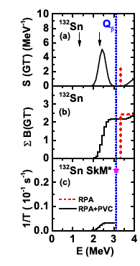
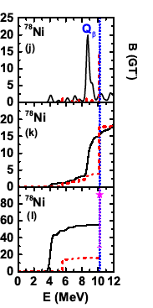
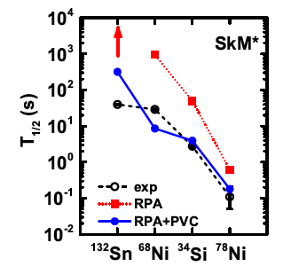
Particle-vibration effect on β-decay
PVC can strongly affect the half-lives:
Its effect is to fragment and shift down the RPA peaks, so that there is more strength in the decay window. The effect is enhanced by the phase-space factor. We definitely improve agreement with experiment.
Y. Niu et al., PRL 114, 142501 (2015).

Slide 37
Astrophysical applications
Weak intreraction processes play a pivotal role in the life of a star, especially during later stages of the evolution of massive stars:
electron capture (EC) and β decays in pre-supernova:
determine electron fraction Y_{e} and entropy in the core
contribute to formation of neutron-rich nuclei
EC governes neutronization phase:
determine Y_{e} at trapping
determine position of shock wave formation
Weak decays are dominated by Gamow-Teller and Fermi transitions. The nuclei involved are in the Fe region.
Courtesy: D. Page

Slide 38
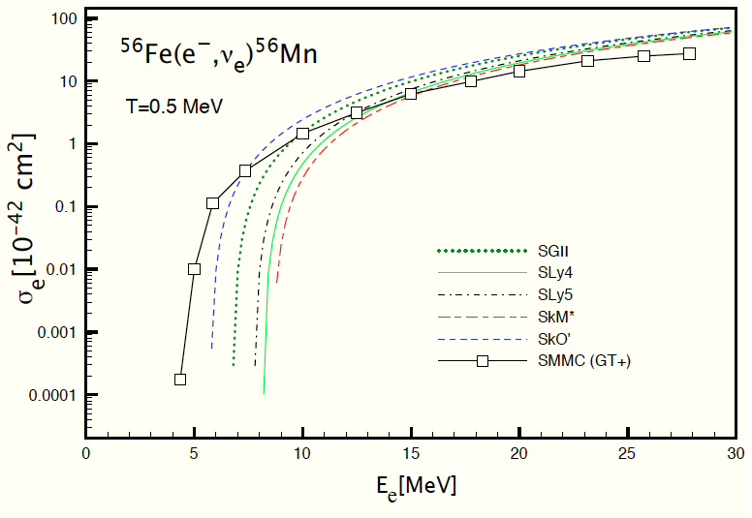
Electron capture calculations
It is well known that weak-interaction processes play a crucial role in the late stages of evolution of a massive star (pre-supernova collapse). For instance, electron capture reduces the electron pressure. Tabulated results from Fowler, Fuller and Newman were first used. Shell-model calculations are considered a benchmark [D.J. Dean et al., PRC 58, 536 (1998)].
Finite temperature RPA
Brink-Axel hypothesis
All multipolarities included
We need more strength at low energy
N. Paar, GC, E. Khan, D. Vretenar, PRC 80, 055801 (2009)

Slide 39
Conclusions
Density Functional Theory is not only a powerful theory for atomic nuclei, but is also quite transparent !
Sophisticated functionals exist. Nonetheless, not always proper attention is devoted to the spin-isospin properties. Cf. SAMi.
There are properties outside the DFT framework and we are interested in generalizing DFT in order to reproduce them. For instance: states with mixed particle and phonon character in odd nuclei, electromagnetic transitions etc.
We also have (Q)RPA+PVC for GRs.
Applied to GTRs, it accounts for most of the width and part of the quenching.

Slide 40
Co-workers
G. Bocchi, P.F. Bortignon, M. Brenna, X. Roca-Maza, E. Vigezzi (University of Milano, Italy)
M. Baldo (INFN-Catania, Italy)
Y. Niu (ELI, Magurele, Romania)
J. Meng (PKU, Beijing, China)
L. Cao (North China Electric Power University, Beijing, China)
H. Sagawa (RIKEN, Japan)
K. Mizuyama (now at JAEA, Japan)

Slide 41
Backup slides

Slide 42
Reminder on effective mass
In this slide E is the s.p. energy, NOT the total energy.
The effective mass, in particular m*/m, is related to the density of s.p. states.
First term: E-mass
Second term: k-mass

Slide 43
Shell model: H is diagonalized on a basis of different Slater determinants
“Many p-h” models (cf N. Pillet, P. Schuck, et al., PRC)
Multi-reference DFT: basis that spans shapes (e.g. quadrupole deformations)
Second-RPA: RPA plus 2p-2h
PVC : particles/core vibrations

Slide 44
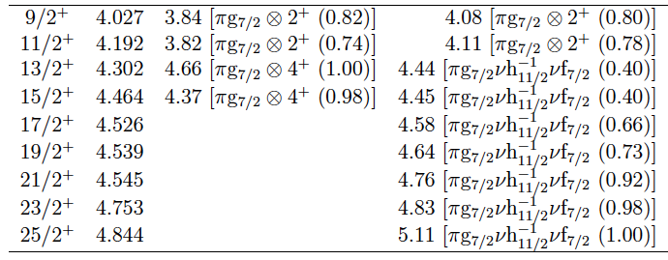
Microscopic content of the states
EXP. Calculation with 2⁺, 3⁻, 4⁺ All excitations below 5.5 MeV
included

Slide 45
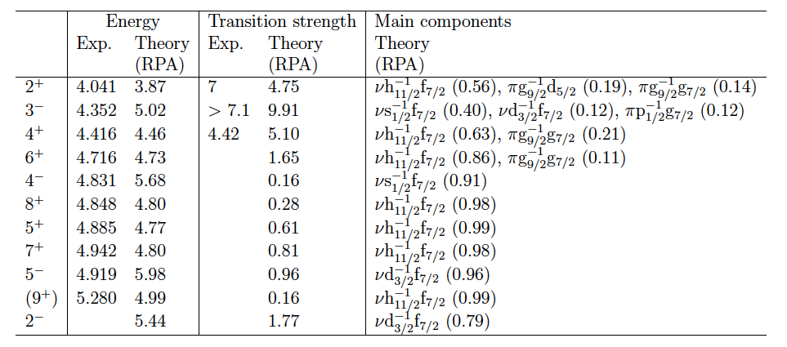
Different kinds of excitations in ¹³²Sn
One should contrast real phonons with pure p-h states.

