Slide 1
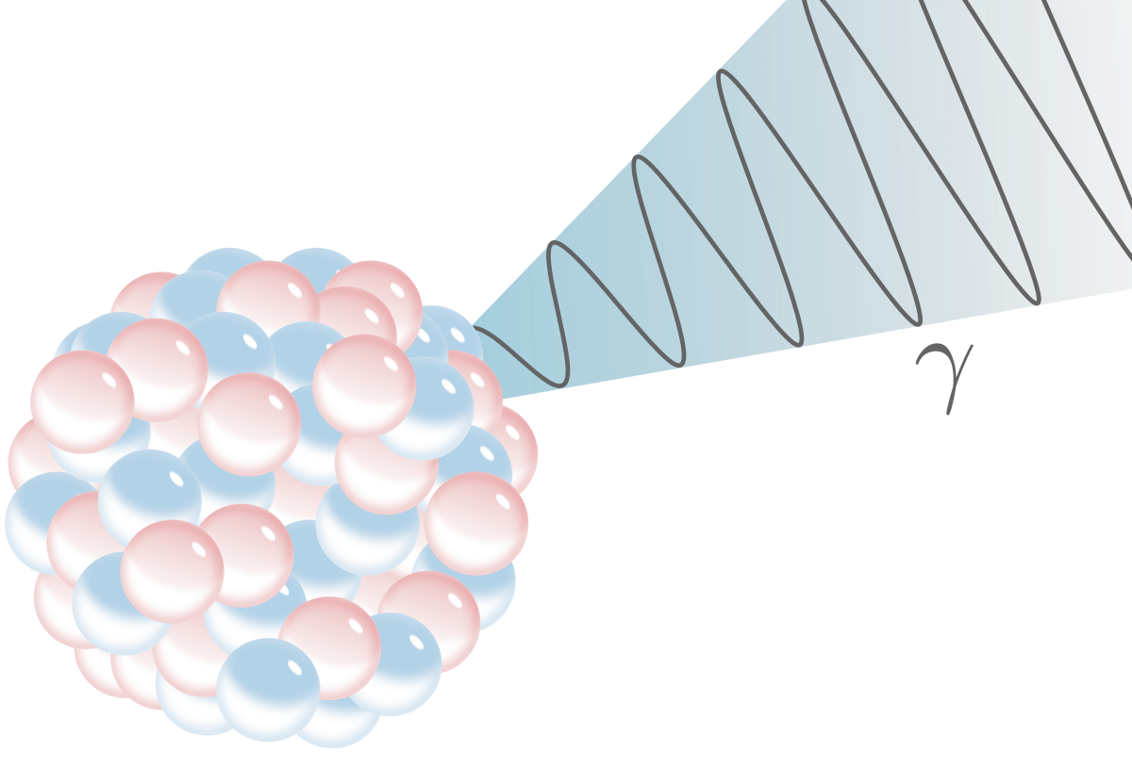
RIBF Seminar, 11 Apr 2017
Simultaneous Microscopic Description t
of Nuclear Level Density t
and Radiative Strength Function t
Nguyen Dinh Dang
Quantum Hadron Physics Laboratory

Slide 2
Contents
On our paper in PRL 118 (2017) 0022502
Nuclear level density (NLD) & Radiative γ-ray strength function (RSF)
The Oslo method
Microscopic and phenomenological models for NLD and RSF
Simultaneous description of NLD and RSF: Role of exact pairing and temperature-dependent giant resonance’s width
Perspectives

Slide 3
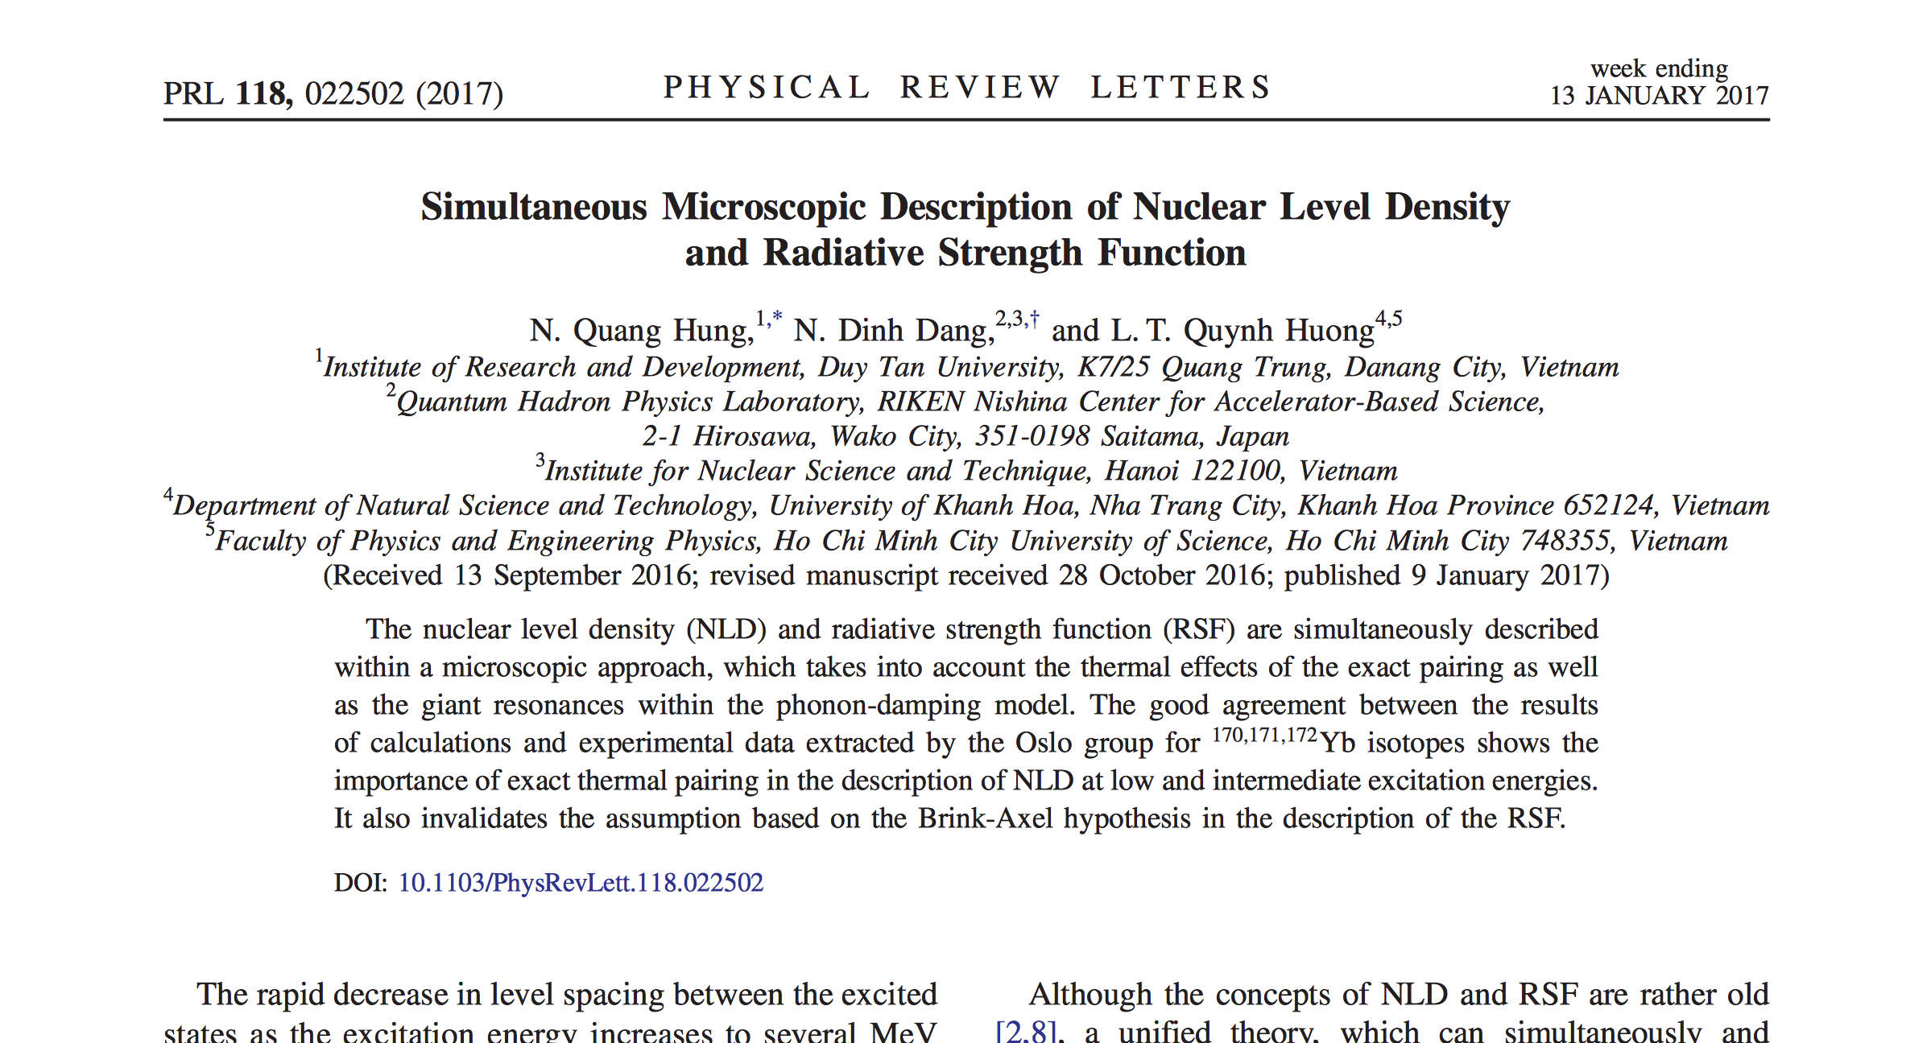
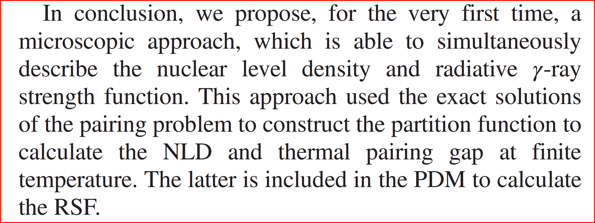

Slide 4
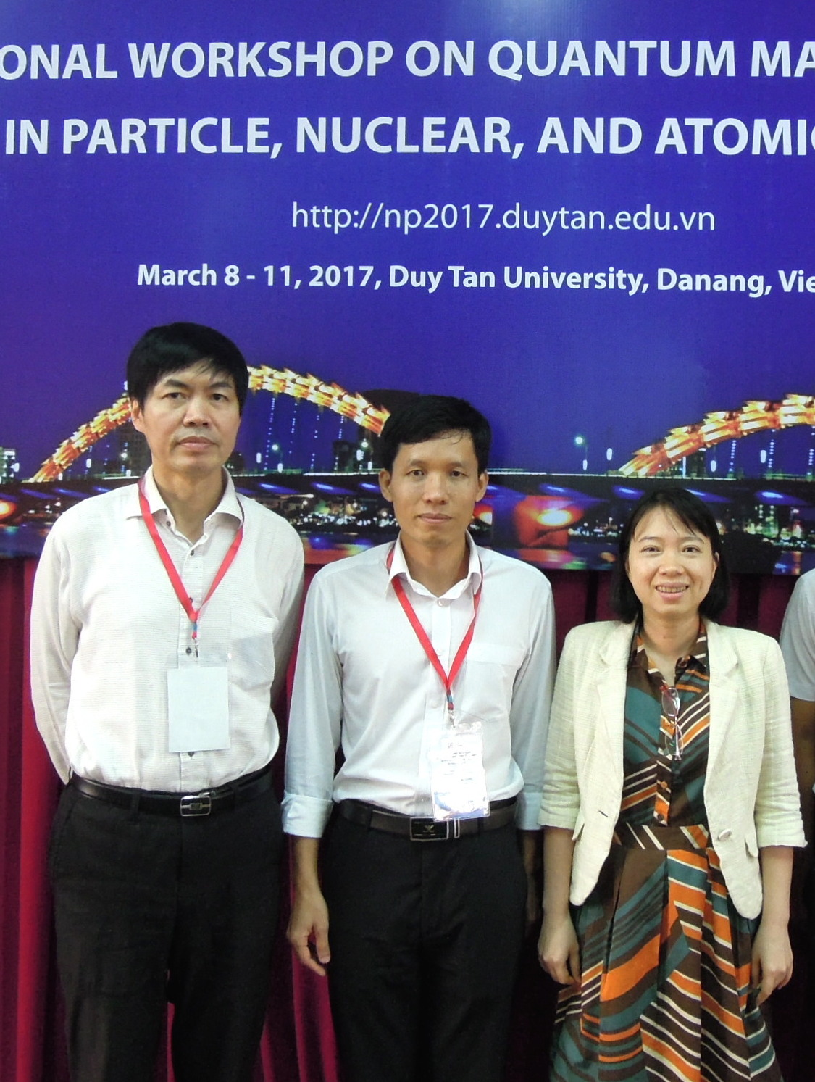
N. Quang Hung, RIKEN APA (2006 – 2009), PhD (2009), Nishina Fellow (2009 – 2010), Assoc. Prof. (2014)
L.T. Quynh Huong, PhD student of N. Quang Hung

Slide 5
Submitted on 13 Sep 2016, published on 9 Jan 2016 (4 months), 3 referees, 2 rounds.
Referee A:
The authors develop a unified and microscopic approach, which can simultaneously describe the level densities as well as the strength functions. And this merits publication in Physical Review Letters.
Referee B:
A major step forward in a consistent description of the nuclear level density (NLD) and the photon strength function (PSF) (…) This paper is interesting to a larger community and its contents warrant the expedite publication as a Physical Review Letter.
Referee C:
The criteria of interest and impact are certainly met by this work, because it deals successfully with one of the important issues of present days nuclear structure studies. It also meets the criteria of innovation because it confronts the predictions of nuclear level density and radiative gamma-ray strength function with the data. Therefore, (…) this manuscript deserves publication in the Physical Review Letters so that the physics community at large can be informed of the progress in an important issue of nuclear physics.

Slide 6
Publications in PRL by NDD
NDD, A. Arima, T. Suzuki and S. Yamaji, PRL 79 (1997) 1638.
NDD and A. Arima, PRL 80 (1998) 4145.
NDD, V. Kim Au and A. Arima, PRL 85 (2000) 1827.
NDD, V. Kim Au and A. Arima, PRL 87 (2001) 269202.
N. Quang Hung, NDD, and L.T. Quynh Huong, PRL 118 (2017) 022502:
The first paper in nuclear physics, and second in physics,
with all co-authors being Vietnamese, ever published in PRL

Slide 7

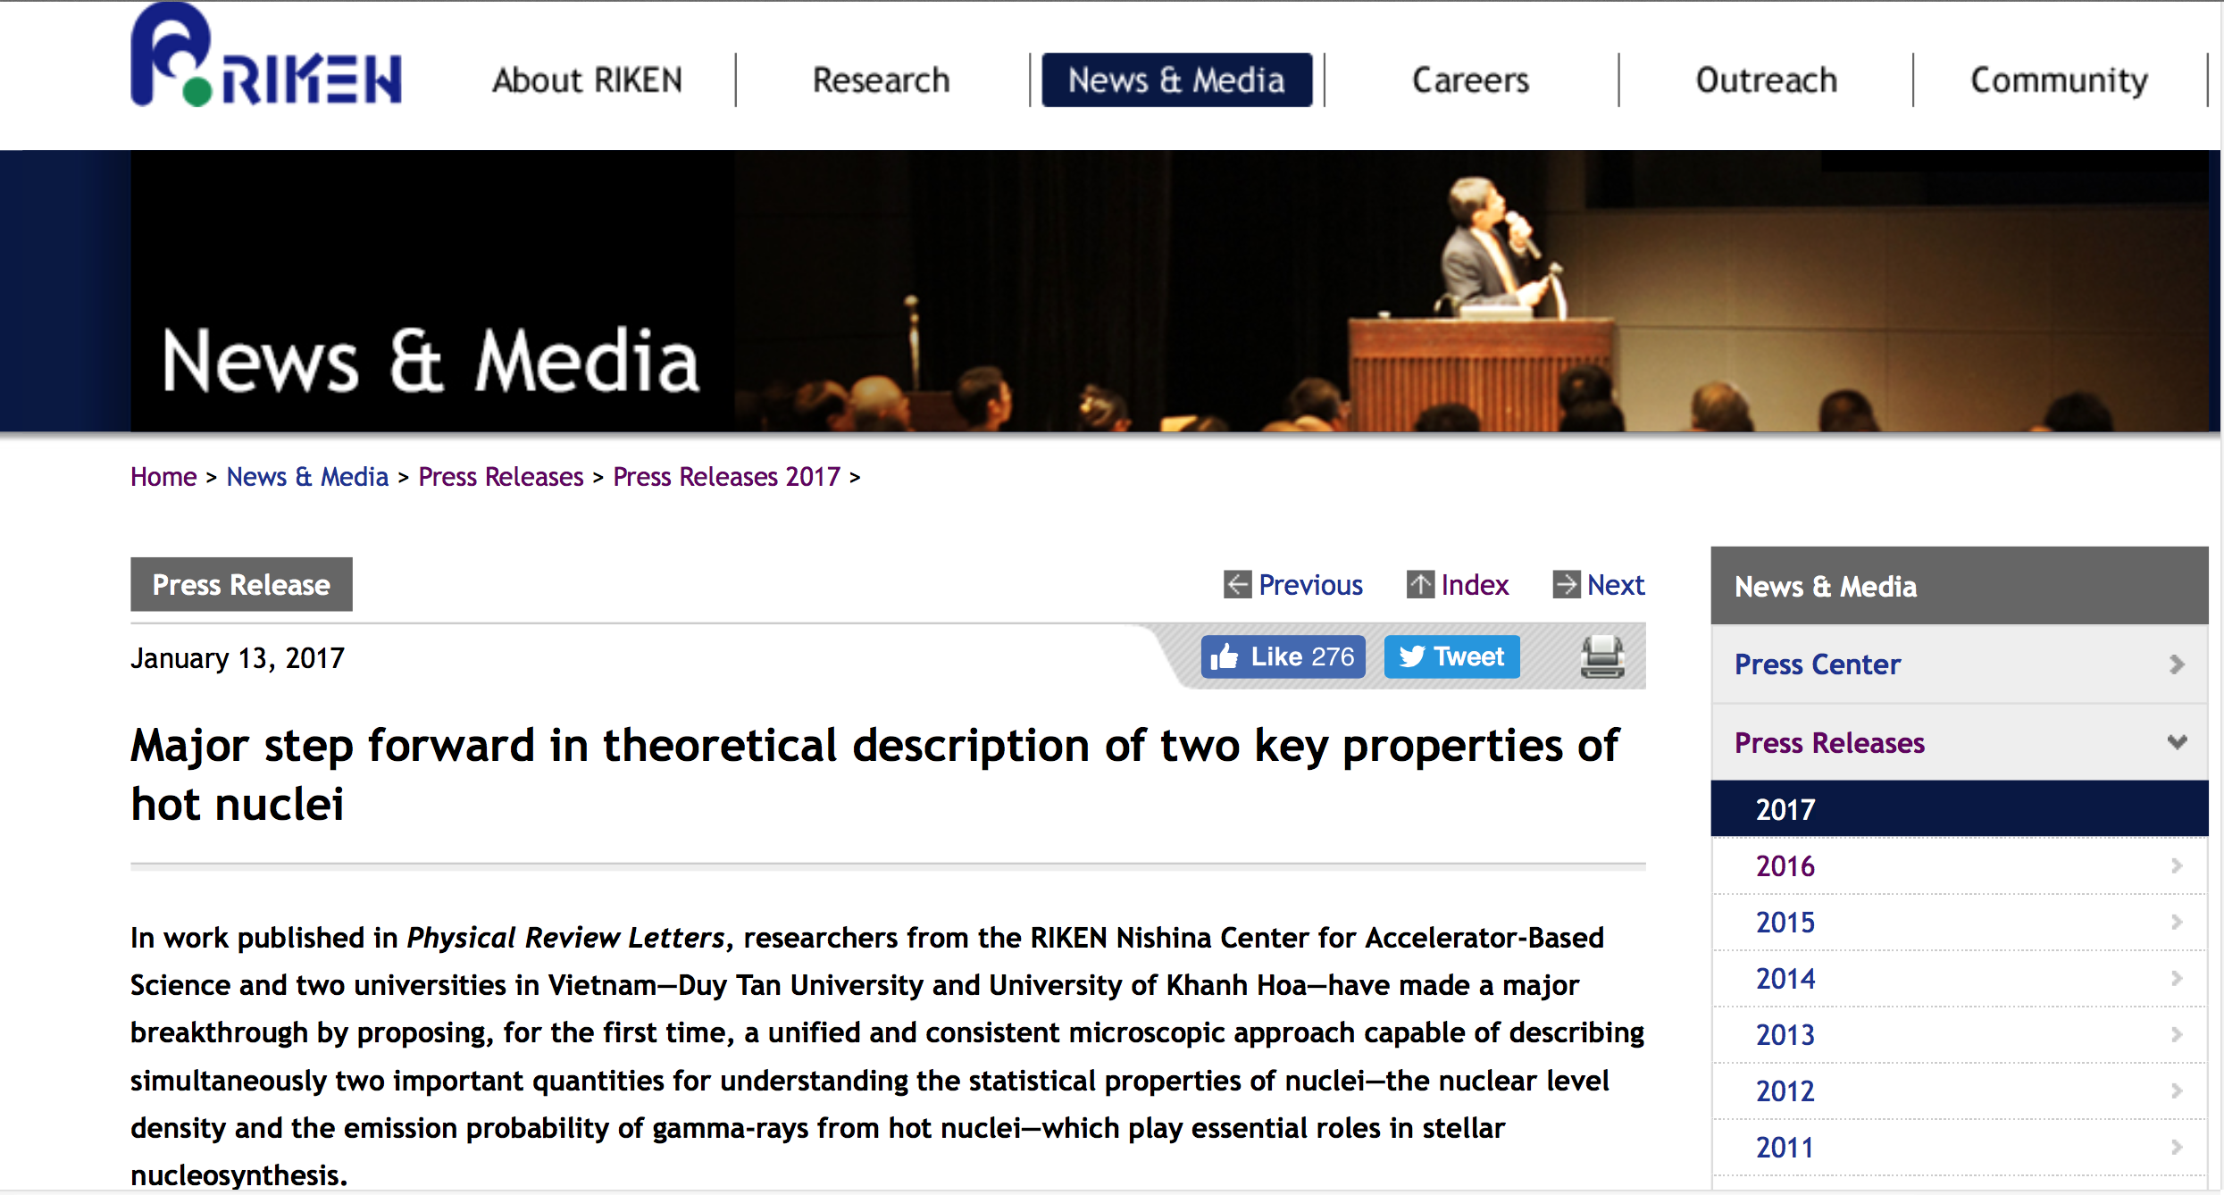
In the news
RIKEN Press Release, 13 Jan 2017
Vietnam Net, 14 Jan 2017
Vietnam Net, 31 Jan 2017
Nhan Dan, 22 Feb 2017
Việt Nam News, 23 Feb 2017
VN Express, 25 Feb 2017
VietTimes, 1 Mar 2017
Tia Sáng, 1 Mar 2017
Việt Nam News, 26 Mar 2017
etc.
Congratulation letter by the minister of
Science and Technology of Vietnam
on 23 Feb. 2017

Slide 8

Screenshot from the VTV1 channel of Vietnam National TV 22 Feb. 2017.
The line at the bottom reads: Current event: Vietnamese scientific work published in world’s premier physics journal

Slide 9

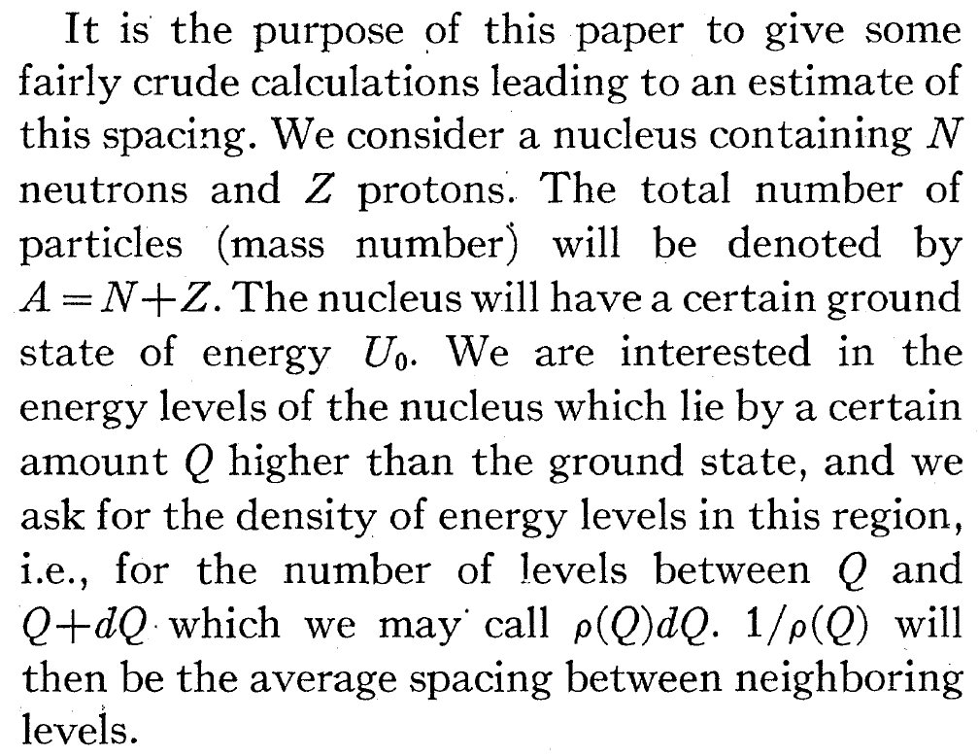
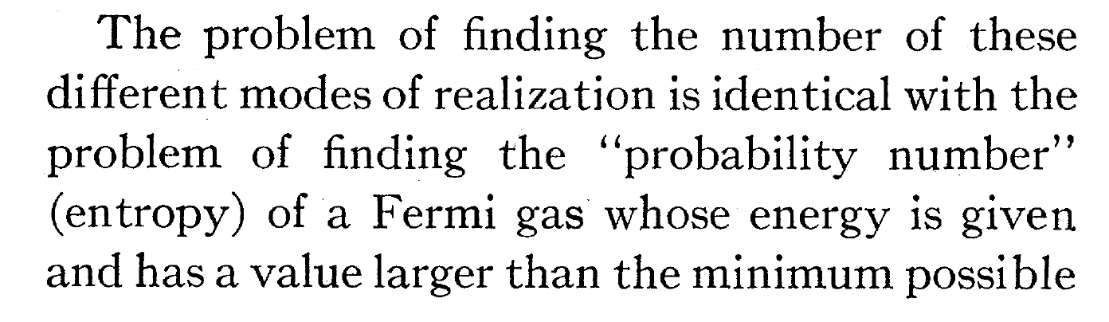
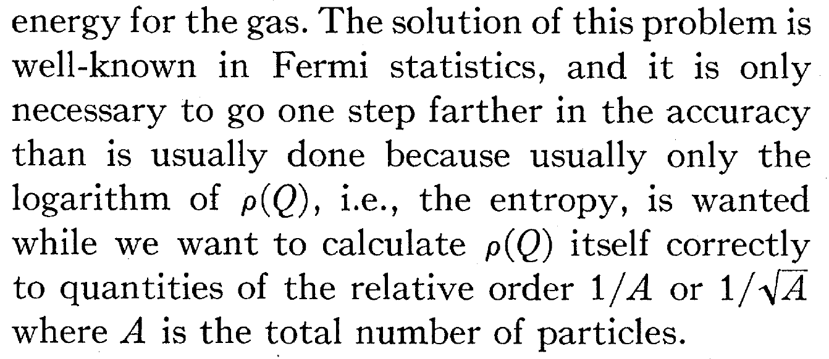
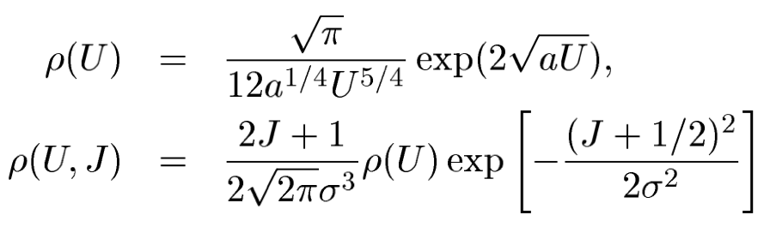
Nuclear level density (NLD)
The NLD was introduced by Hans Bethe (1906 – 2005) in Phys. Rev. 50 (1936) 332, as
the number of excited levels per unit of excitation energy: ρ(E) = dN/dE
Nobel prize in 1967 for “his contributions to the theory of nuclear reactions, especially his discoveries concerning the energy production in stars”.

Slide 10
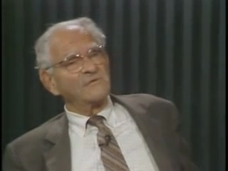
Average decay rate
John Blatt and Victor Weisskopf, Theoretical Nuclear Physics (Willey, NY, 1952) introduced RSF as
the average transition probability per γ-ray energy.
At high excitation energy:
Lots of levels, impossible to measure all levels and their γ transitions
Measure average decay properties
Golden Rule (derived by Dirac in 1927, dubbed by Fermi in 1950):
The decay rate (one-to-many transition probability) per unit of time
from | i ⟩ to a set of | f ⟩ is effectively constant:
ρ(E_{f}) : density of final states; H_{int} : transition operator.
One state with energy E, lifetime Δt,
spectral width ΔE=Γ (Heisenberg: ΔE⋅Δt ≥ ħ/2)
Connection with spectral width: λ= Γ/ħ
Connection with lifetime: λ = 1/Δt
Average over several states: ⟨λ⟩, ⟨Γ⟩
i
γ
f
Victor Weisskopf (1908 – 2002)
Notes:
This Golden Rule was actually derived by Paul Dirac in 1927 [Proc. Roy. Soc. A 114 (1927) 243), that is 23 years before Fermi dubbed it Golden Rule No. 2 in his text book “Nuclear Physics” without derivation and without referring to Dirac. From then on all the textbooks adopted this name. In 2009, in a letter to the editor of the American Journal of Physics 77 (2009) 867, Taco Visser of the University of Delft has pointed out this misattribution.

Slide 11
(Downward) Radiative γ-Ray Strength Function (RSF)
Related to the γ-decay:
Average decay rate:
Transmission coefficient:
(Upward) Radiative γ-Ray Strength Function (RSF)
Related to the γ-absorption:
Notes:
<Γ> - average reduced partial radiation width
D – average resonance spacing

Slide 12
Nuclear Structure
NLD
RSF
Reaction rate calculations
Reactor physics
Astrophysics
Abundance of elements in the solar system
Adapted from S. Siem, U. Oslo, 2011

Slide 13
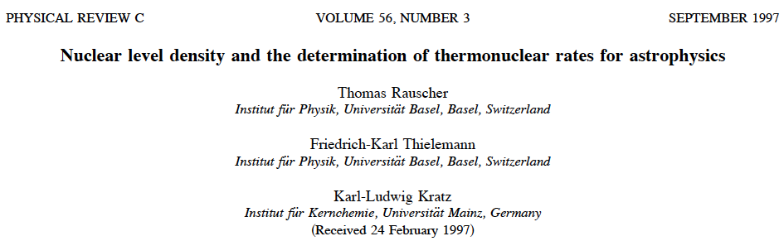
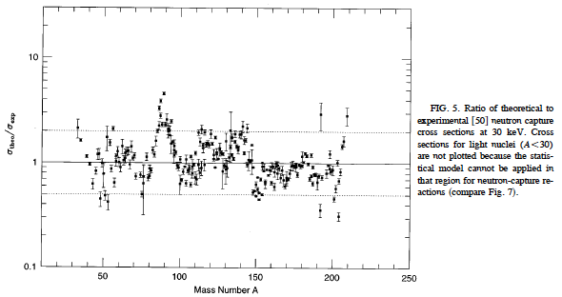
(p. 1613)
Hauser-Feshbach Theory

Slide 14


Ann-Cecilie Larsen at the Int’l Workshop on Nuclear Science and Simulation, 31 Oct. 2014, Ton Duc Thang University (Saigon)

Slide 15
The Oslo method
Transfer (³He, αγ) and inelastic a scattering (³He, ³He’ γ) reactions on rare earth nuclei:
Simultaneous extraction of NLD and RSF up to S_{n} (S_{p}) from particle-γ coincidence measurements.
Main steps:
Unfolding continuum γ-ray spectrum based on the known detector response function
Extraction of primary γ-ray spectra from the unfolded total γ-ray spectra
Simultaneous extraction of NLD and trans. coeff. (~ RSF) from the primary γ-ray matrix
Normalization of NLD and RSF

Slide 16
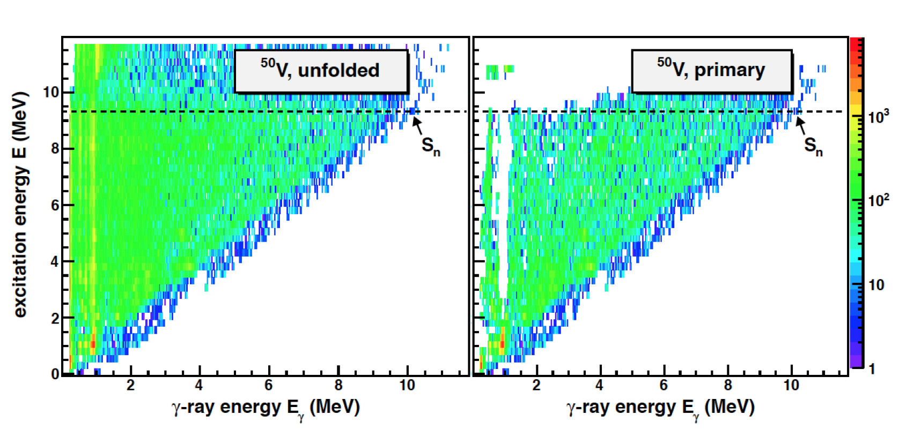
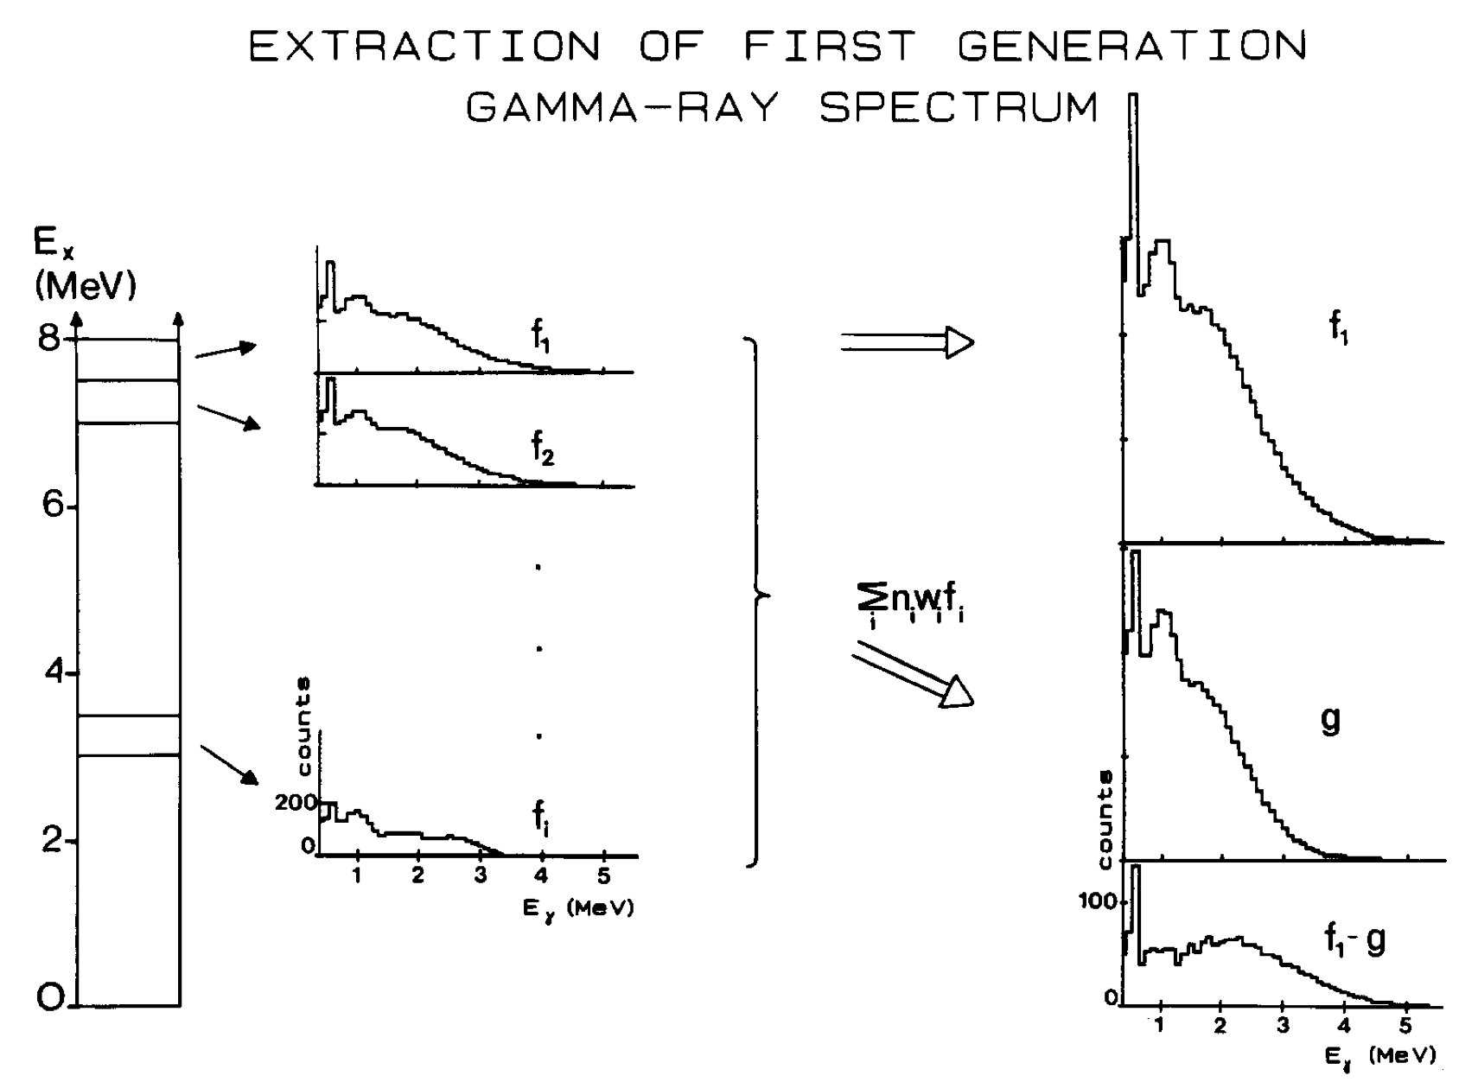
E*
Guttormsen, Ramsøy, Rekstad, NIMPR A255 (1987) 518
Energy bin ~ 120 – 240 keV
Extracting the 1st-generation matrix P(E* , Eγ) of excitation energy E* vs γ-ray energy E_{γ}
n_{i} A(f_{i}) = M_{i}
A(f_{i}) : area of f_{i}
M_{i} : multiplicity (number of cascades)
w_{i} are defined by iteration process
Notes:
Gamma-rays from highly excited states involve a cascade of transitions. The first-generation (primary) gamma-rays from highly excited states represent the first decay step of all possible decay routes. An iterative procedure is used to extract the primary gamma-rays, from those that emerge from the later steps in the decay cascade. This method is based on the assumption that states populated after the first gamma-transitions have the same decay properties as those of the states populated directly in the particle nuclear reaction at that excitation energy.
The first generation gamma-ray spectra are arranged in a 2-dimensional matrix P (E; E_{γ}). The entries of P are the probabilities P (E; E_{γ}) that a gamma-ray of energy E_{γ} is emitted from an energy bin of excitation energy E . This matrix is used for the simultaneous extraction of the gamma-ray strength function and the level density function.

Slide 17
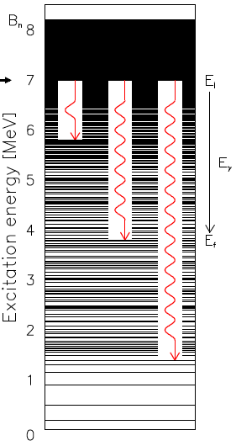
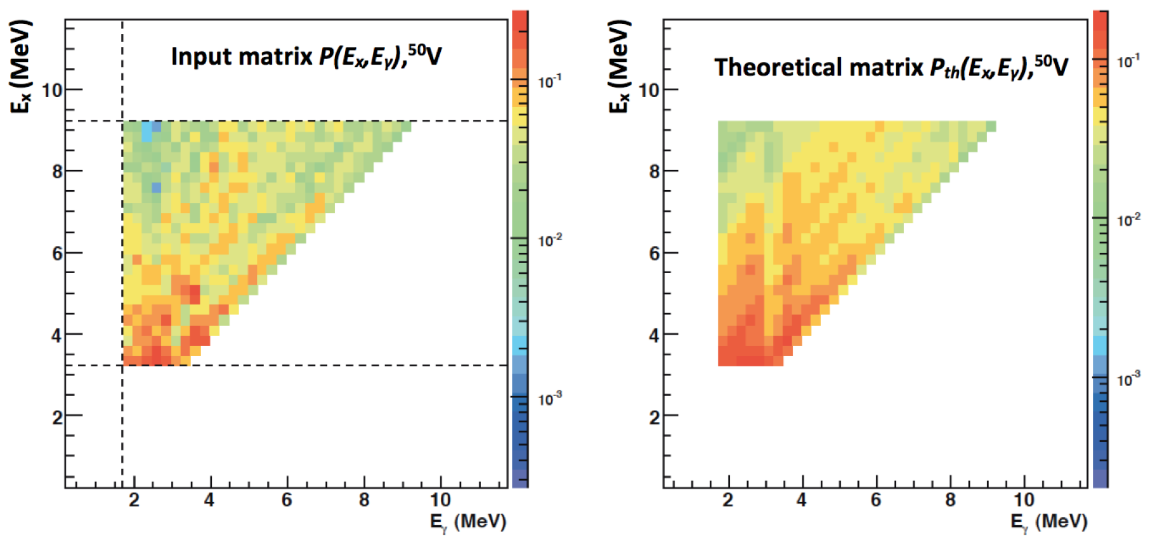
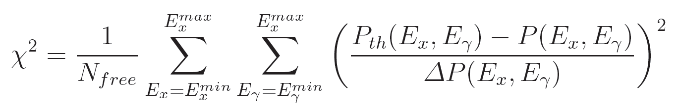
Simultaneous extraction of NLD and RSF
Schiller et al., NIMPR A 447 (2000) 498
Variant of the Golden Rule:
T(E_{γ}) does not depend on E* only if the Brink’s hypothesis holds.
T(E_{γ}) and ρ(E* - E_{γ}) are extracted by iteration, where P_{th} are fitted
to P using χ² minimization:
Notes:
N_{free} – number of degrees of freedom, that is number of data points in the respective spectrum
ΔP – experimental uncertainty

Slide 18
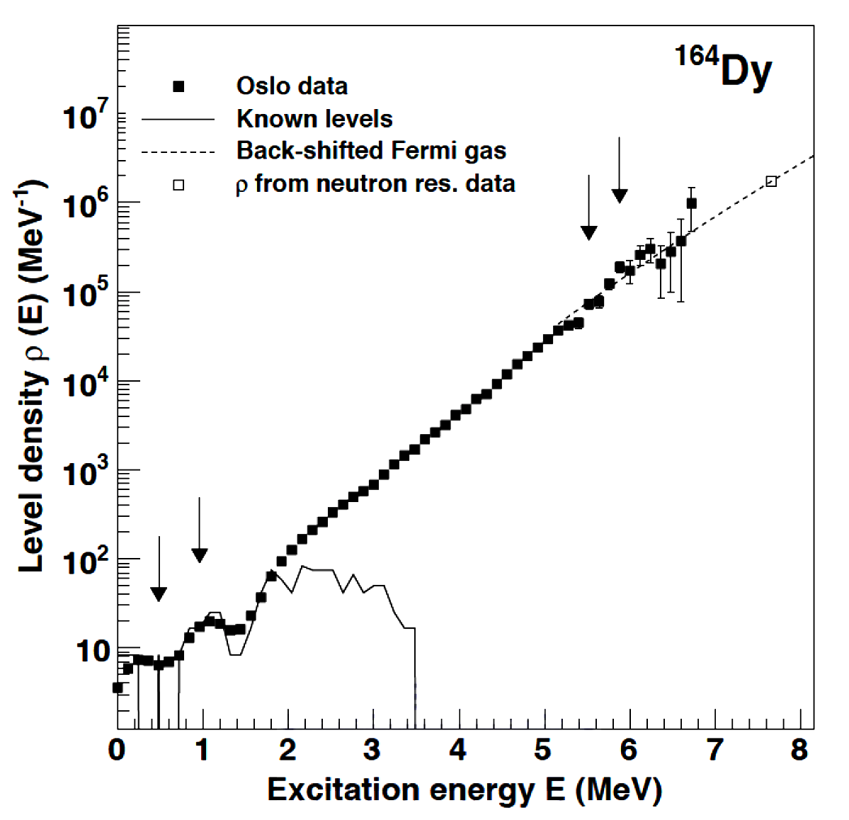
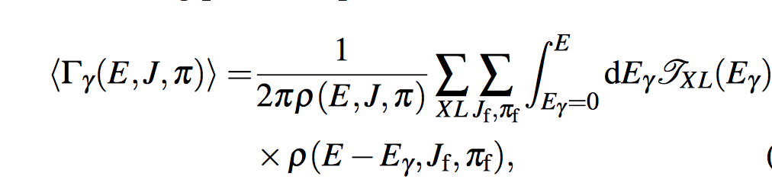
Choosing parameters in Oslo method
P_{th}(E*,E_{γ}) are invariant under the transformation:
A, B, α are chosen by fitting to the external data.
α and A are found by fitting ρ to the known discrete levels at low E*, and by interpolating to fit the data at E* = S_{n} using the back-shifted Fermi-gas formula for ρ.
B is found from the E1 and M1 RSFs:
f_{XL} are found from the average total radiative width
<Γ_{γ}> at S_{n.}

Slide 19
Models for NLD and RSF
NLD:
1) Phenomenological
Back-shifted Fermi-gas (BSFG)
Constant temperature (CT)
2) Microscopic
HFB + Combinatorial method
Shell Model Monte Carlo (SMMC)
RSF:
Phenomenological
  Kadmenskij-Markushev-Furman (KMF)
  Standard Lorentzian (SLO)
  Generalized Lorentzian (GLO)
  Enhanced Generalized Lorentzian (EGLO)
  Generalized Fermi Liquid (GFL)
2) Microscopic
  QRPA

Slide 20
BSFG
CT
Non-interacting Fermi particles
moving in a potential
Classical ideal gas (used for low excitation-energy region)
a and δ are free parameters
E₀ and Τ are free parameters
Notes:
Conventional shifted Fermi-gas model: the odd-even effect is taken into account by a pairing-energy shift. So he excitation energy is measured from a fictive ground state, which is
U* = U (i.e. actual ground state) for odd-odd
= U - Δ for odd A
= U - 2Δ for even-even
Δ is the odd-even mass difference (pairing gap ∼ 12/√Α)
The level-density parameter a is the only adjustable parameter.
BSFG model: Both Δ and a are adjustable parameters,
U – Δ = aΤ² – Τ
CT: Free parameters are E₀ and T
1/T = d(lnρ)/dE
From Dyson’s mémoire:
I asked Fermi whether he was not impressed by the agreement between our calculated numbers and his measured numbers. He replied, “How many arbitrary parameters did you use for your calculations?” I thought for a moment about our cut-off procedures and said, “Four.” He said, “I remember my friend Johnny von Neumann used to say, with four parameters I can fit an elephant, and with five I can make him wiggle his trunk.”
Comment:
A classical ideal gas follows the Maxwell-Boltzmann statistics, whereas a Fermi gas obeys the Fermi-Dirac statistics. At high excitation energies they are similar, but at low temperatures, a classical ideal gas contains states with all particles are in the lowest energy state (that is the ground state). This is not the case with a Fermi gas, where no two particles can occupy the same state.

Slide 21
HFB + Combinatorial
Single-particle levels:
HFB with Skyrme interactions (BSk14)
Combinatorial method:
  Incoherent particle-hole state densities as functions of energy E*, spin projection M, and parity P.
  The collective enhancement by using the boson partition function including quadrupole, octupole, and hexadecapole vibrational modes.
  The width of collective vibration as Landau zero-sound damping:
  γ = C(ω² + 4π²Τ²)
Fitting:
Two parameters: α to fit the cumulative levels at low U; δ to fit NLD at S_{n}.
S. Hilaire, J.P. Delarochem M. Girod, EPJA 12 (2001) 169
S. Hilaire and S. Goriely, Nucl. Phys. A 779 (2006) 63
S. Goriely et al., Phys. Rev. C 75 (2007) 064312
S. Goriely et al., Phys. Rev. C 78 (2008) 064307

Slide 22
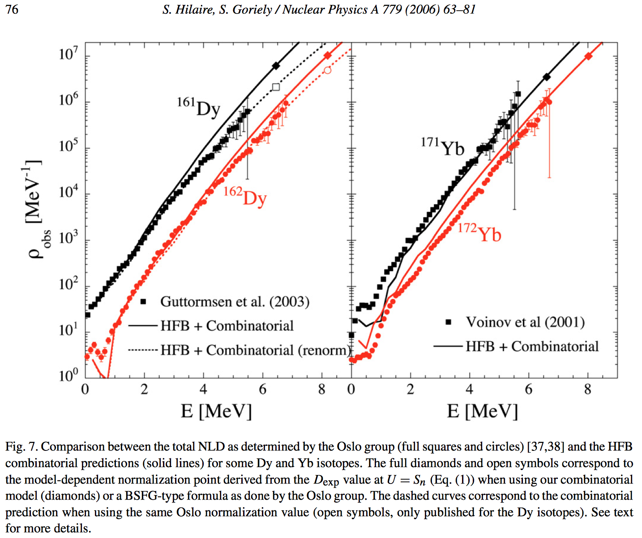

Slide 23





SMMC
Hubbard-Stratonovich transformation with Gaussian weight G_{σ}
σ_{c} is obtained by fitting the theoretical NLD to exp. data

Slide 24
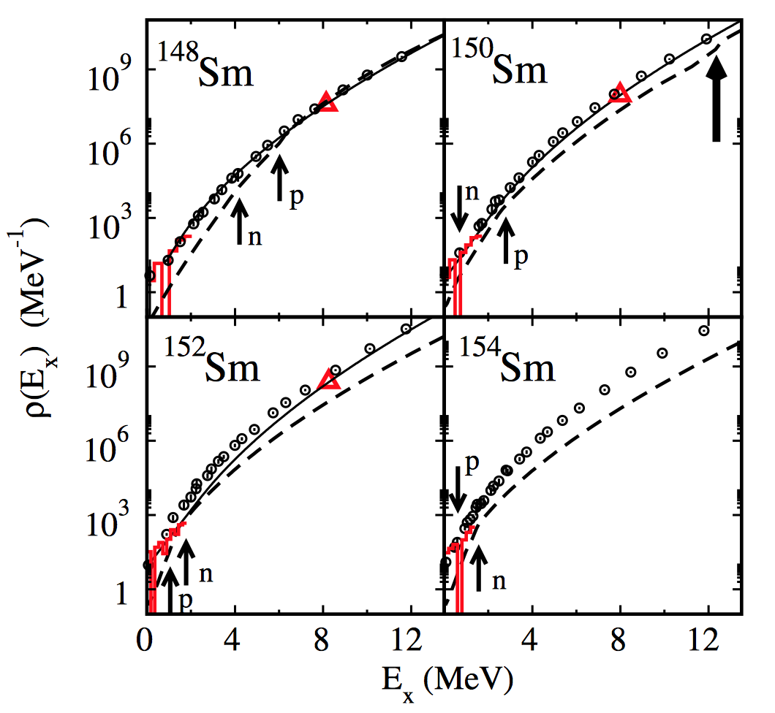
Circles: SMMC
Dashed: FT-HFB
Solid lines: BSFG data
Histogram: level counting data
Triangle: Neutron res. data
Thin arrows: n and p pairing transition
Thick arrow: shape transition
H. Nakada and Y. Alhassid, Phys. Rev. Lett. 79, 2939 (1997)
Y. Alhassid, S. Liu, and H. Nakada, Phys. Rev. Lett. 99, 162504 (2007)
Y. Alhassid, L. Fang, and H. Nakada, Phys. Rev. Lett. 101, 082501 (2008)
C. Ozen, Y. Alhassid, and H. Nakada, Phys. Rev. Lett. 110, 042502 (2013)
Notes:
Demerits of SMMC method:
- Very demanding computationally
- Works relatively well at least with some parts of the shell-model interactions but requires the projection to the correct values of spin and parity.

Slide 25





Kadmenskij-Markushev-Furman (KMF)
(κ is a fitting parameter, which is around 1 ~ 1.85 for Yb isotopes)
S. G. Kadmenskij, V. P. Markushev, and V. I. Furman, Yad. Fiz. 37, 277 (1983)
J. Kopecky and R. E. Chrien, Nucl. Phys. A 468, 285 (1987).

Slide 26
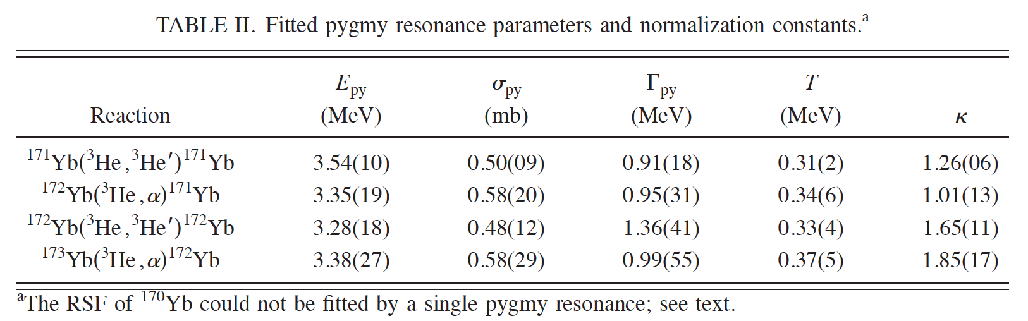
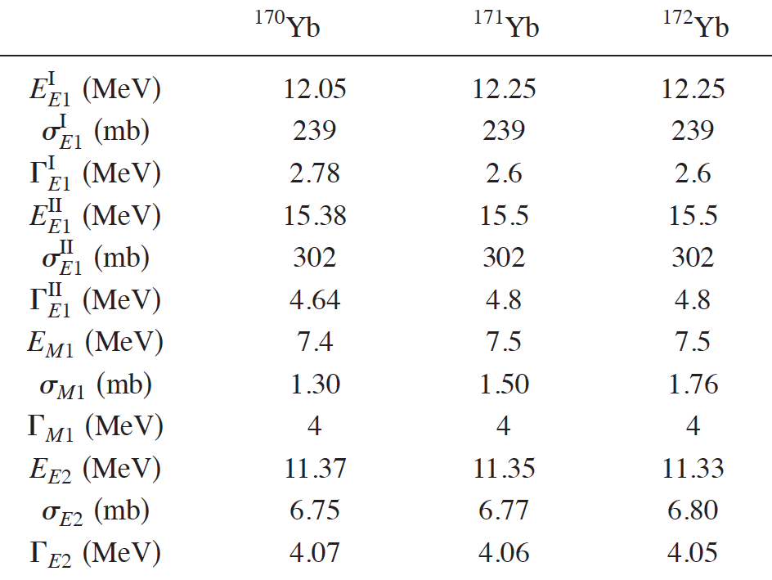
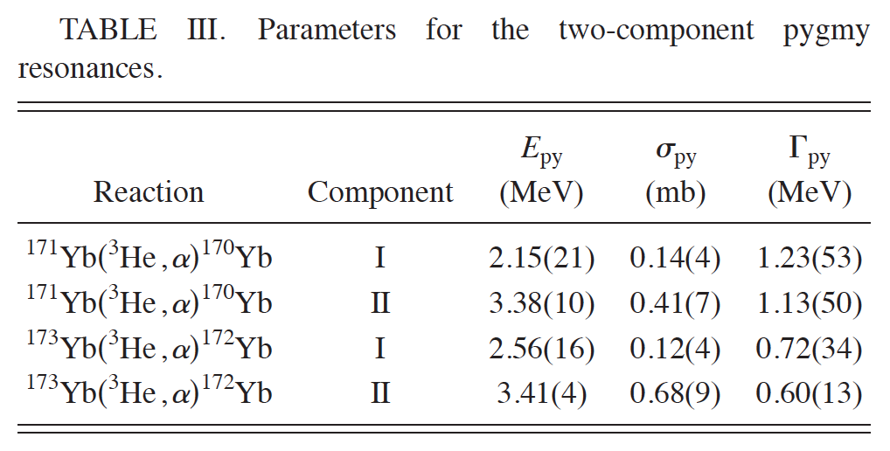
KMF fits
U. Agvaanluvsan et al., PRC 70, 054611 (2004).

Slide 27
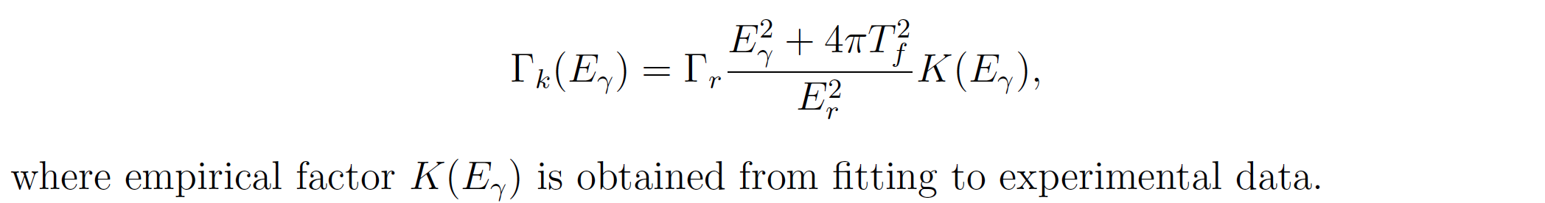
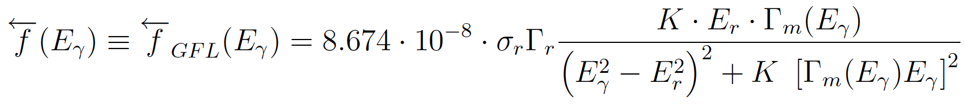
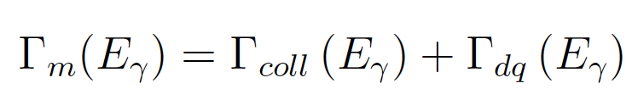
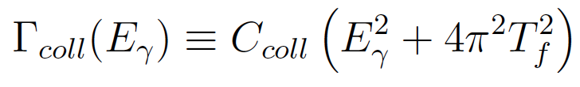
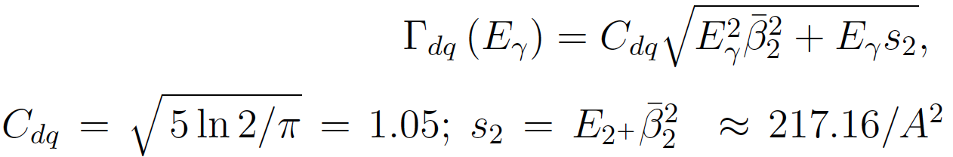
SLO
EGLO
GFL

Slide 28

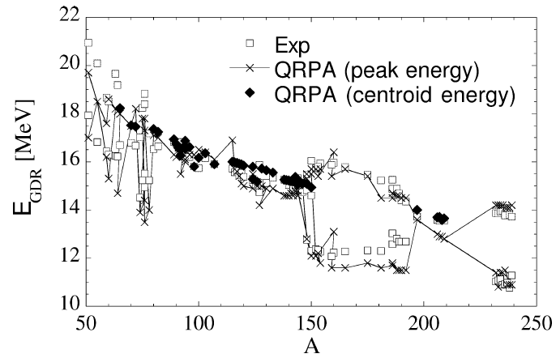
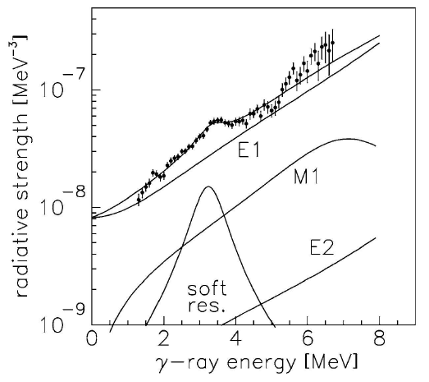
QRPA
S. Goriely and E. Khan, Nucl. Phys. A 706, 217 (2002)
For E1 only
Notes:
- QRPA is built on top of HF+BCS with simple parametrization of the pairing gap
- Skyrmes SIII, SGII, SLy4, MSk7
- Calculated the E1 strength function of all 8 ≤ Z ≤110 nuclei lying between proton and neutron drip lines.

Slide 29
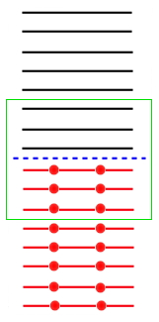
Our approach to NLD and RSF
N. Quang Hung, NDD, and L. T. Quynh Huong., PRL. 118 (2017) 022502
Description of NLD
Pairing Hamiltonian:
H = H₀ + H_{pair}
EP: solve the pairing problem exactly by diagonalizing directly H (within the truncated space) → particle number is exactly conserved [1]
IPM: independent particles (no pairing)
Independent Particle Model (IPM)
Total partition function:
lnZ = lnZ_{EP} + lnZ_{IPM}
Exact Pairing (EP)
Total NLD:
Independent Particle Model (IPM)
K_{coll}(E*) = k_{vib} (E*) k_{rot}(E*): collective enhancement factor
(formulated by Ignatyuk)
σ : spin cut-off factor
From lnZ one finds E, S, E*, f_{k,} and also exact Δ, exact λ, u_{k} and v_{k} ➔ PDM
_________
[1] N. Quang Hung, N. Dinh Dang, PRC 79 (2009) 054328.
Notes:
The state density ω(E) is the inverse Laplace transform of the partition function.
Spin cut-off factor σ describes the the width of spin distribution, σ² = ν<m²>=Τ<m²>/D .
Bjornholm, Bohr and Mottleson have suggested a critical temperature, T_{c} beyond which the collective enhancement in NLD fades out T_{c} = ħω₀β₂ = 40A^{-1/3}β₂ MeV.

Slide 30
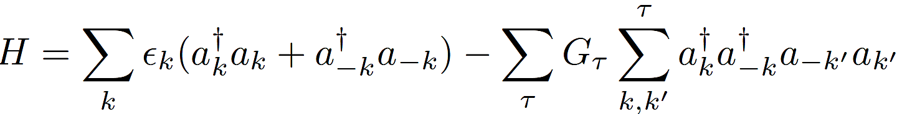
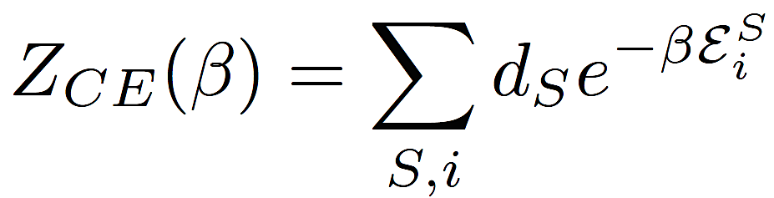





Description of NLD
By diagonalizing this Hamiltonian, one finds the exact eigenvalues E_{i}^{S}, occupation numbers f_{k}^{S} at different total seniority S. These exact solutions are embedded into the canonical ensemble to construct the exact partition function at finite temperature T [1]:
Exact pairing gap:
Exact chemical potential: λ = [F(N+2) – F(N-2)]/4
_________
[1] N. Quang Hung, N. Dinh Dang, Phys. Rev. C 79 (2009) 054328.
Notes:
In axially deformed nuclei, there are two spin cutoff factors, namely, the perpendicular σ⊥ = I⊥T/ħ² and parallel σ∥ =I∥T/ħ² ones, associated with the moments of inertia perpendicular (I⊥) and parallel (I∥) to the nuclear symmetry axis, respectively. These empirical formulas for the perpendicular and parallel spin cutoff factors are given based on the limit of rigid body with the same density distribution as of the nucleus.
_______________________
Junghans et al., Nucl. Phys. A629, 635 (1998);
Nasrabadi and Septiani, Act. Phys. Pol. B 45, 1865 (2014).
For spherical nuclei, 2σ² = Σ_{k} [m_{k}/sech(βE_{k}/2)]² within the single-particle mean field (Moretto, 1972).

Slide 31
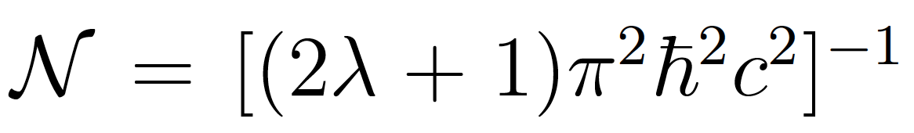
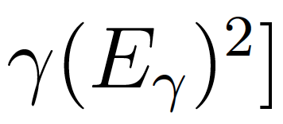
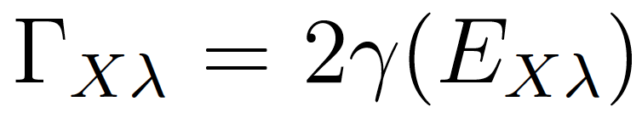
Description of RSF
The RSF is defined as:
In the phenomenological models, a Lorentzian is used for the strength function S(E) with the T-dependent
kept unchanged as T varies.
We calculated the strength function S(E) from the Phonon Damping Model (PDM) [1] including pairing [2]:
__________________
[1] NDD, A. Arima, Phys. Rev. Lett. 80 (1998) 4145;
[2] NDD, A. Arima, Phys. Rev. C 68 (2003) 044303.

Slide 32
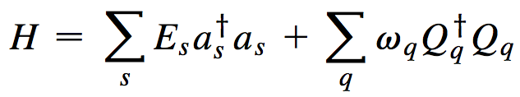
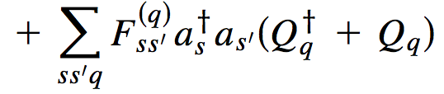


Phonon Damping Model (PDM)
NDD & Arima, Phys. Rev. Lett. 80 (1998) 4145
p’
p
p
h’
h
Quantal: ss’ = ph Thermal: ss’ = pp’ , hh’
h
GDR strenght function:
Topical conference on giant resonances, Varenna, May 1998

Slide 33
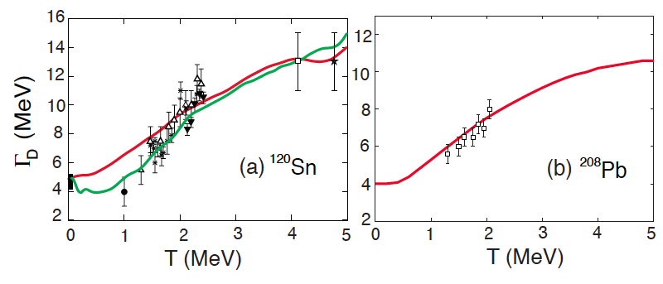
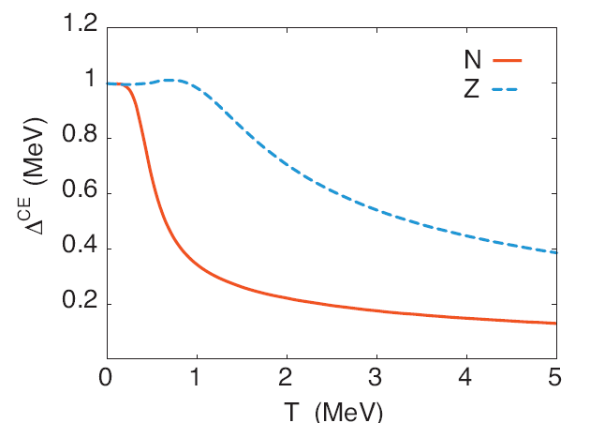
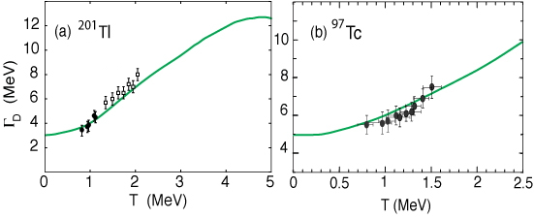
Inclusion of pairing in the PDM
NDD, A. Arima, PRC 68 (2003) 044303.
NDD, N. Quang Hung, PRC 86 (2012) 044333.
B. Dey et al., PLB 731 (2014) 92.

Slide 34
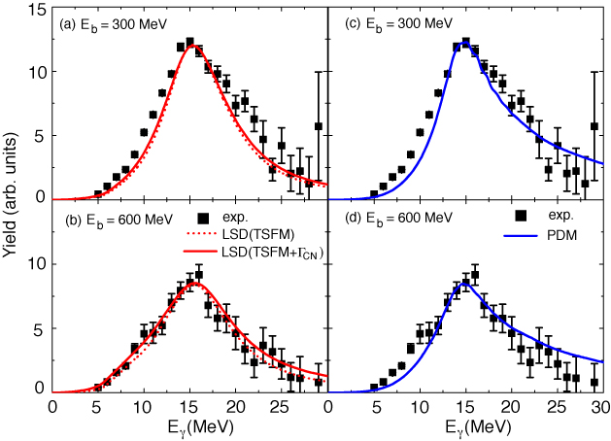
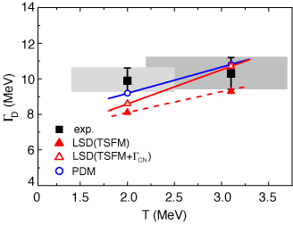
Inclusion of angular momentum in the PDM
Ciemala et al.,
PRC 91 (2015)
0454313

Slide 35
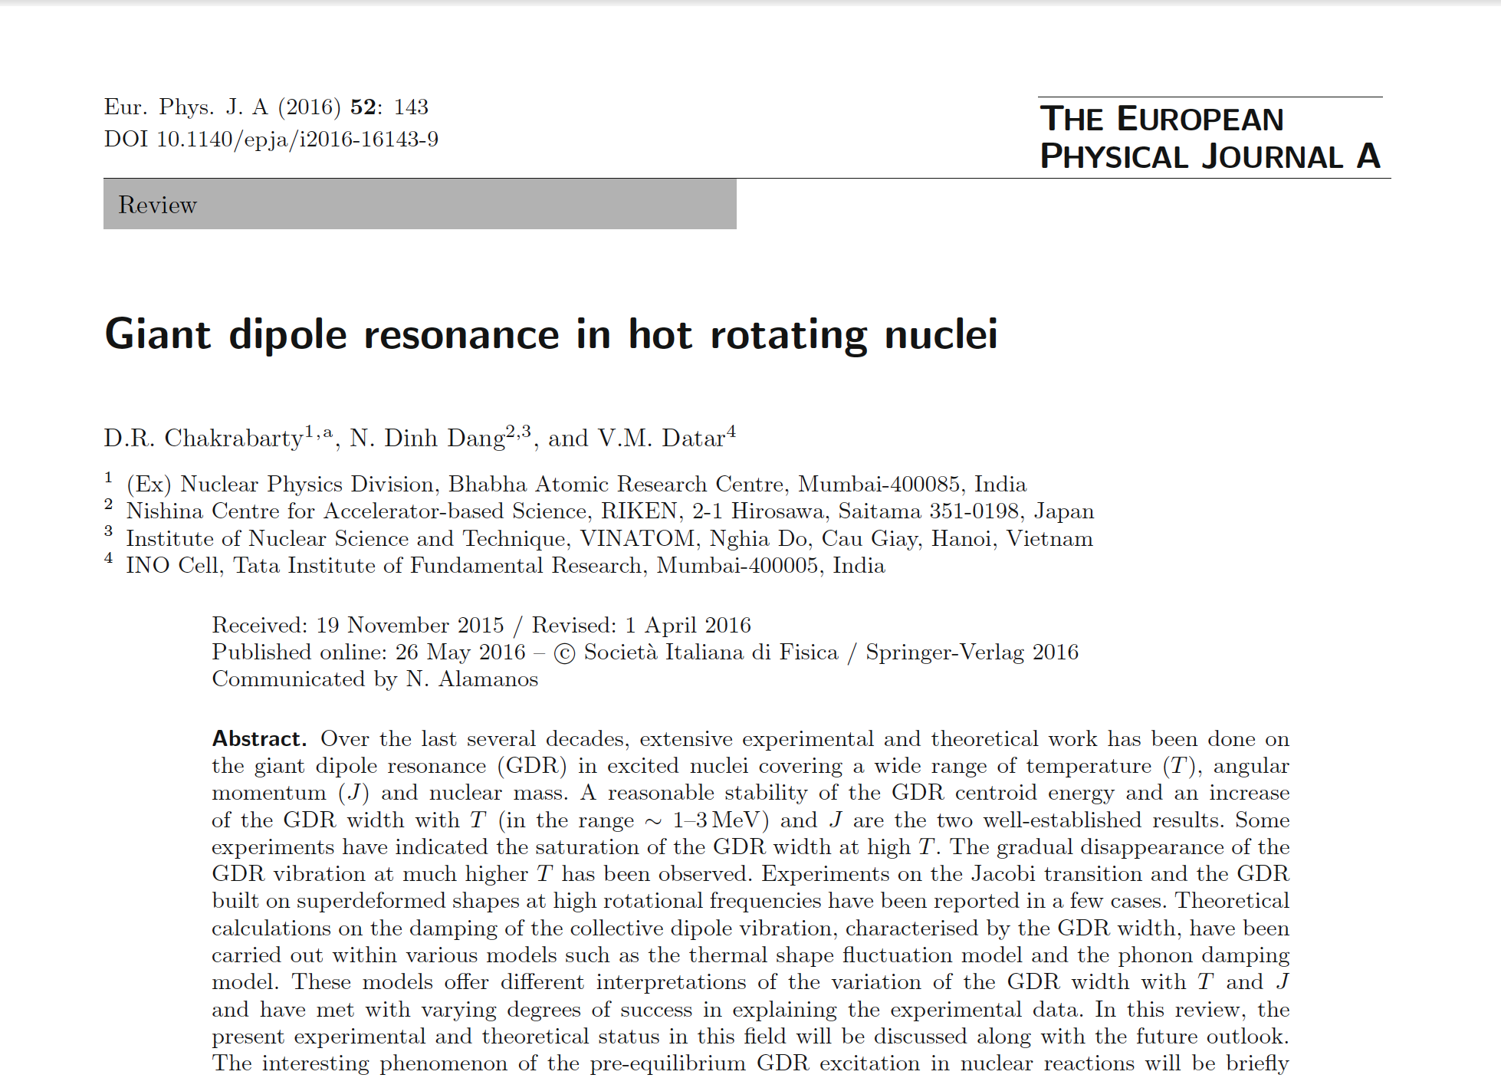
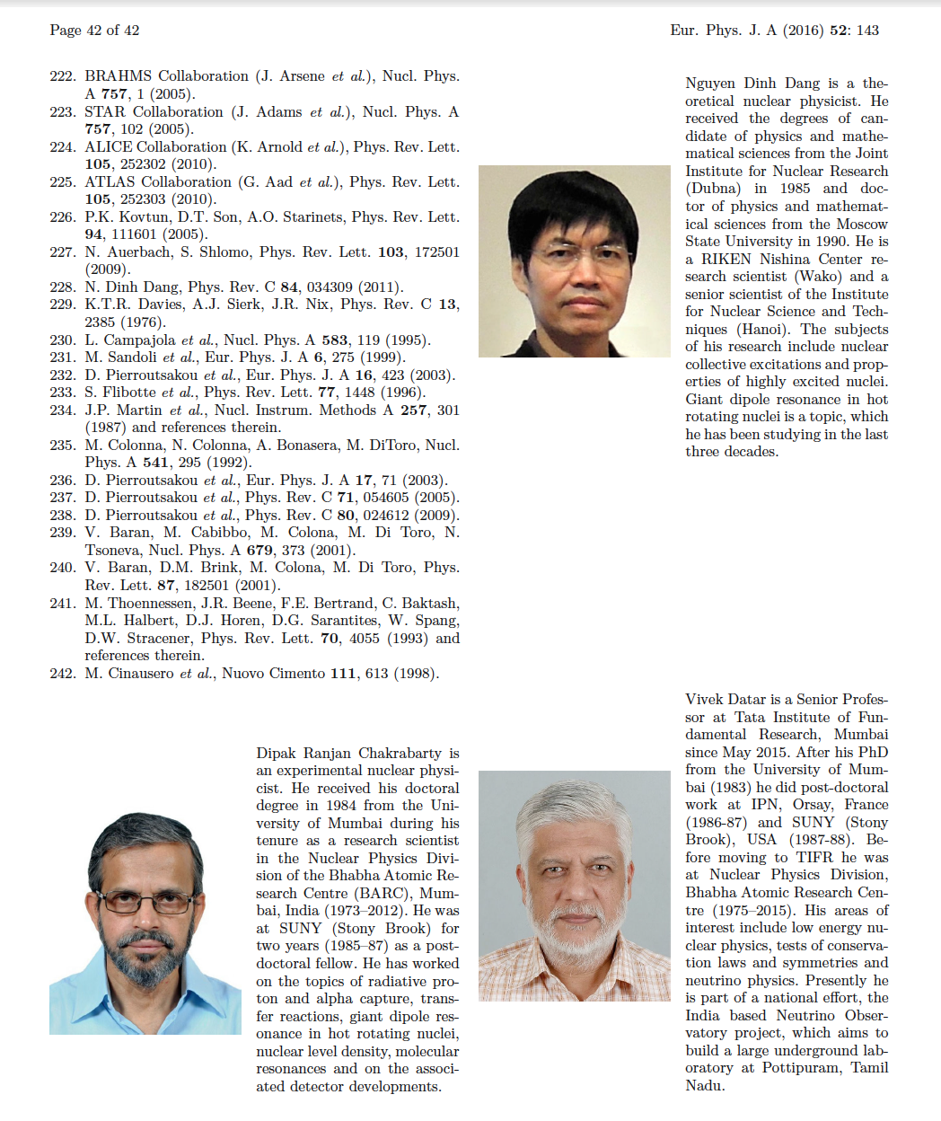

Slide 36
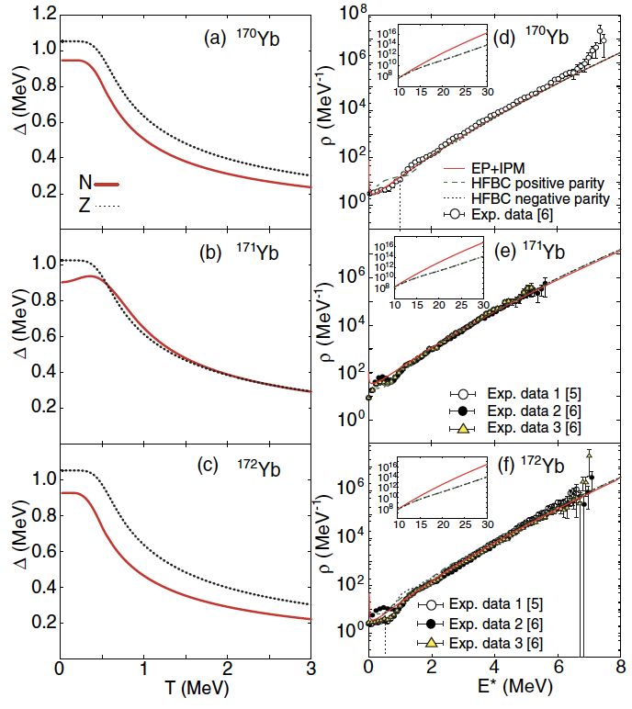
NLD: EP+IPM
The HFB+Combinatorial NLD always lower than our NLD
at E* > B_{n}
Because of fitting to NLD data at B_{n}
HFB+Combinatorial predictions of NLD are not reliable at high E*
N. Quang Hung, NDD, L. T. Quynh Huong, PRL118 (2017) 022502
Notes:
12 doubly degenerate single-particle levels with 6 levels above and 6 levels below the Fermi surface -> 73,789 eigenstates for each type of particles.
β₂ = 0.295 for ^{170,171}Yb
0.296 for ¹⁷²Yb
A slight increase in the exact neutron gap at low T < 0.5 MeV is seen in ¹⁷¹Yb because of the blocking effect from the odd neutron.
The HFB+Combinatorial have to be renormalized based on two phenomenological parameters, spoiling their microscopic nature. Moreover, since the HFB+Combinatorial was derived based on the partition function of the incoherent ph states built on top of the HFB single-particle spectra, it is certainly not able to predict the NLD in the region of high excitation energy, where the contributions of the pp, hh, as well as of higher states like 2p2h, 3p3h, etc. become significant. Meanwhile, within the EP+IPM, the exact CE partition function is obtained from the direct diagonalization of the matrix elements of the Hamiltonian, which consist of all possible couplings between the ph, pp and hh states. Therefore, this exact CE partition, when combined with that of the IPM, is capable to describe the NLD up to high E* region.
The merit of the EP+IPM is also that, beyond Woods-Saxon mean field, it uses only two parameters, the monopole pairing strength parameters G for protons and neutrons, adjusted to fit the corresponding experimental gaps at T=0.

Slide 37
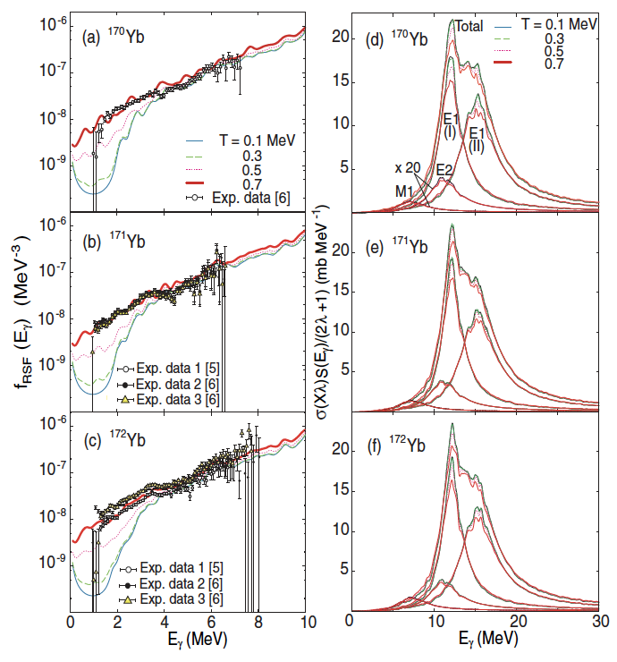
RSF: EP+IPM+PDM
Temperature-dependent RSF
→ Brink Axel hypothesis invalidated
Enhancement of RSF at low E well reproduced without introducing PDR
→ effect of EP
N. Quang Hung, NDD, L. T. Quynh Huong, PRL118 (2017) 022502
Notes:
The widths of its two components remain nearly constant at T ≤ 0.4 MeV and increase with T at T > 0.4 MeV, resulting in a significant increase in the total RSF at low Eγ < 4 MeV as seen in panels (a) – (c). The RSFs obtained within the PDM at T = 0.7 MeV agree well with the experimental data for all nuclei under consideration. This value of T is higher than that obtained from the fitting by using the KFM model, which is always below 0.4 MeV. This result is very important as it invalidates the assumption of the Brink-Axel hypothesis
For the enhancement of the RSF at low energy, the KMF needs to add a two-component PDR on top of the GDR, despite it has not been reroduced in any microscopic calculations so far.
Within the PDM, it has been found that exact pairing enhances the E1 strength function in the region Eγ < 5 MeV. Including this exact pairing, RSFs, calculated within the PDM, agree well with the experimental data [thick solid lines in panes (e) and (f)]. In this way, the enhancement of the experimental RSF at low Eγ, which was suggested to be caused by the PDR, is explained microscopically by the effect of exact thermal pairing within the PDM.

Slide 38
On the importance of using exact pairing in the study of PDR
NDD & N. Quang Hung, JPG 40 (2013) 105103

Slide 39
Conclusions
A microscopic approach is proposed for the very fist time, which is able to
simultaneously describe the NLD and RSF.
  It uses the EP to construct the partition function to calculate the NLD and
  pairing gap at finite T.
  The exact pairing gap is included in the PDM to calculate the RSF.
2) Exact thermal pairing is very important for the description of both NLD and RSF
at low E* and E_{γ}.
3) The T-dependent width of GR should be used to correctly describe the RSF.
This invalidates the Brink-Axel hypothesis.
4) Merits:
  Microscopic nature
  Absence of parameter fitting at E* and E_{γ}
  Fast computing time (< 5 minutes even for heavy nuclei)

Slide 40
Future projects
  NLD and RSF
Theory: EP+IPM with collective and rotational enhancement factors calculated from RPA (QRPA)
(by N. Quang Hung et al.)
Preliminary

Slide 41
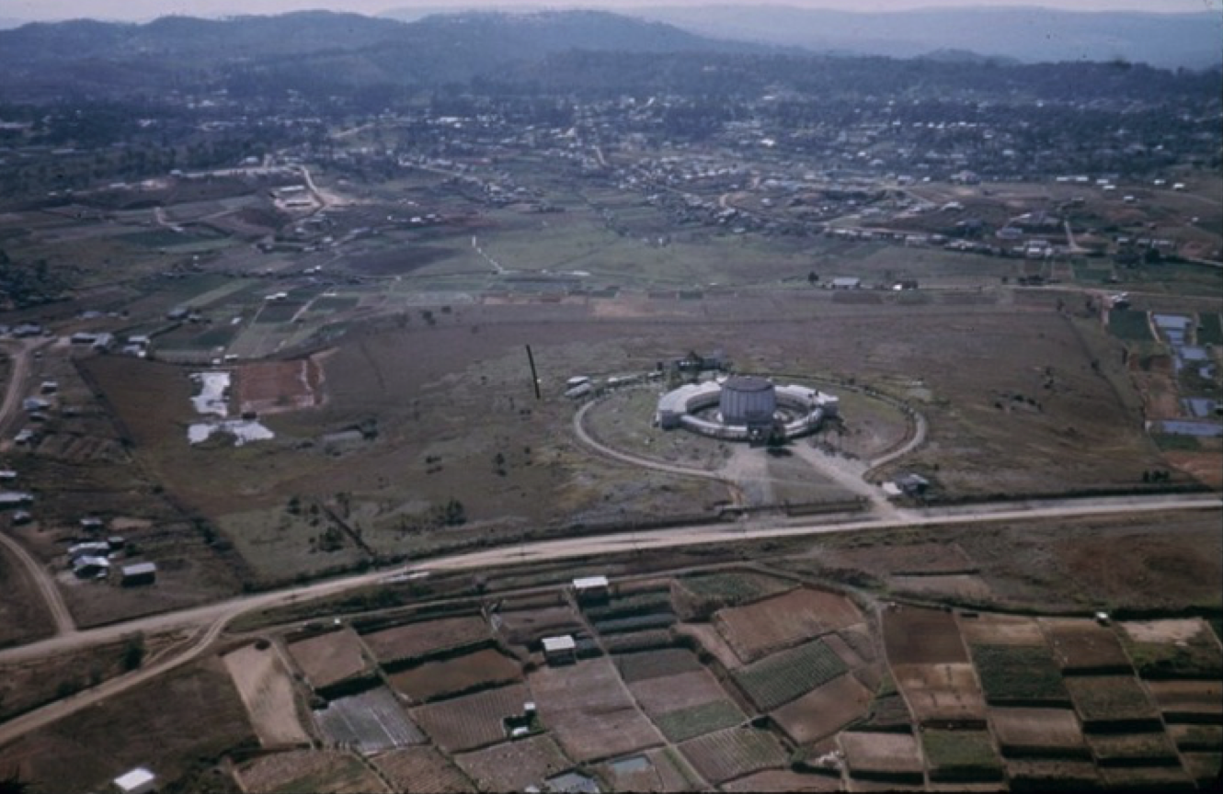

Experiments at DaLat nuclear reactor
  Nuclear level scheme from (n_{th}, γ) reactions
Da Lat nuclear reactor began operating on 3.3.1963 with a capacity of 250KW, using US technology, and stopped working in 1968.
On 20/3/1984 it resumed operations, doubling its capacity.

Slide 42
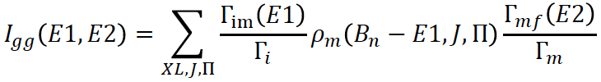




Theory: extend EP+IPM with collective and rotational enhancement factors calculated from RPA (QRPA)
Experiment: extract NLD and RSF from gamma spectra of (n_{th}, γ) reactions
Preliminary

