Slide 1
Relativistic quantum chemistry and recent applications to physics and chemistry
E3project seminar
RIKEN
April, 4th, 2017
Minori Abe
Tokyo Metropolitan University, Department of Chemistry
minoria@tmu.ac.jp

Slide 2

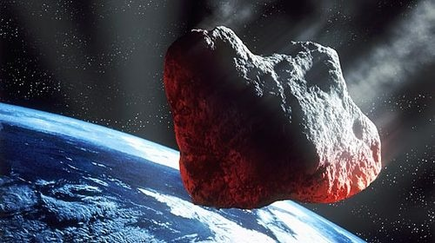
My research interests
-Developments and applications
of relativistic quantum chemistry-
Isotope Chemistry
・Nuclear volume effects
・Vibrational effects
・Isotope fractionation
in solid states
(Geochemistry)
Fundamental Physics
using molecules
・EDM (CP violation)
・Born-Oppenheimer approx.
breakdown related
with gravity correction
・Variation of proton/electron
mass ratio …
Notes:
But before going to my EDM talk let me introduce my reserch interest. I am more interested in applications of relativistic quantum chemistry and one of my maijor works are isotope chemistry related with nuclear volume effect, which is important for the discussion geochemistry and so on The other major work is based on fundamental physics like EDM, BO correction for the Nuewtonian gravitation correction, proton electron mass ratio variance, double betadecay and so on.

Slide 3
Outline
Fundamental
Theoretical approaches
of relativistic quantum chemistry
Review
Relativistic effects in chemistry
Application 1
Electron EDM (Fundamental Physics)
Application 2
Nuclear volume effects
in isotope fractionation (Geochemistry)

Slide 4
Outline
Fundamental
Theoretical approaches
of relativistic quantum chemistry
Review
Relativistic effects in chemistry
Application 1
Electron EDM (Fundamental Physics)
Application 2
Nuclear volume effects
in isotope fractionation (Geochemistry)

Slide 5
(Non-relativistic) Quantum Chemistry
Molecules
Solving multi-electronic Schrödinger equation with clamped-nuclei
(Born-Oppenheimer approximation)
Basis set expansion (Gaussian basis sets)
(Mostly) time-independent
Wave function methods
  Hartree-Fock (mean field approx.)
  Electron correlation methods (CCSD, MP2, CI etc)
  Density functional theories (DFT)

Slide 6
Hartree-Fock method
Determine molecular orbitals using
Linear Combination of Atomic Orbital (LCAO)
approximation under a Slater determinant
MO coefficients
(Optimized parameters)
Basis sets
（Known functions
like atomic orbitals)

Slide 7
Slater determinant
Ex. Slater determinant (SD) of two electrons
Spin orbitals
Spin functions
Spatial orbital
SD satisfies the natures of Fermion

Slide 8
HF Energy (Variational optimization)
Electronic Hamiltonian of a molecule
kinetic
V_{e-n}
V_{e-e}
V_{n-n}
Energy def.
Variation condition
MO coeff.
are determined!

Slide 9
How to improve HF
We can improve the HF wave function adding other determinants
“Improve” means
Electron correlation def.:

Slide 10
Electron Correlation methods
Three ways to determine the coefficients of determinants
Perturbation (MP2, …)
Variational (CI: configuration interaction)
Coupled cluster (exponential anzatz)
Better accuracy

Slide 11
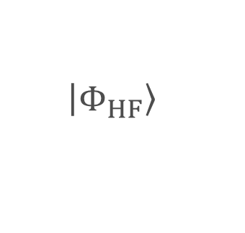
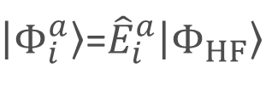
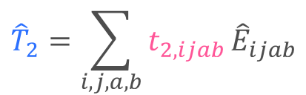


Coupled cluster singles and doubles (CCSD)
a
b
Virtual
orbitals
a
j
Occupied
orbitals
i
i
$$\left|\left.Φ_{HF}\right\rangle \right.$$
$\left|\left.Φ_{i}^{a}\right\rangle \right.$=${\hat{E}}_{i}^{a}\left|\left.Φ_{HF}\right\rangle \right.$
$\left|\left.Φ_{ij}^{ab}\right\rangle \right.$ $={\hat{E}}_{ij}^{ab}\left|\left.Φ_{HF}\right\rangle \right.$
HF determinant
Singly excited det.
Doubly excited det.
$$\hat{T_{1}}=\sum_{i,a}{t_{1,ia}}{\hat{E}}_{ia}$$
$${\hat{T}}_{2}=\sum_{i,j,a,b}{t_{2,ijab}}{\hat{E}}_{ijab}$$
$$\left|\left.Φ_{CCSD}\right\rangle \right.=exp⁡(\hat{T_{1}}+{\hat{T}}_{2})\left|\left.Φ_{HF}\right\rangle \right.$$
An effective method when the HF determinant
is the only dominant determinant.

Slide 12
Relativistic case: Dirac equation
Time independent Dirac eq.
Four dimensional operator and wave function
Free particle’s Dirac eq.

Slide 13
Solution of Dirac eq. (Free particle)
・Doubly degenerated
(Kramers pair）
・Energy gap between
positive and negative states:
2mc²
・ For positive states,
lower two components
are smaller than upper two.
(large and small component)
K: Anonymous parameters
(continuum states)

Slide 14
Solution of Dirac eq. (Free particle)
Energy levels
・Doubly degenerated
(Kramers pair）
・Energy gap between
positive and negative states:
2mc²
・ For positive states,
lower two components
are smaller than upper two.
(large and small component)
mc²
-mc²
K: Anonymous parameters
(continuum states)

Slide 15
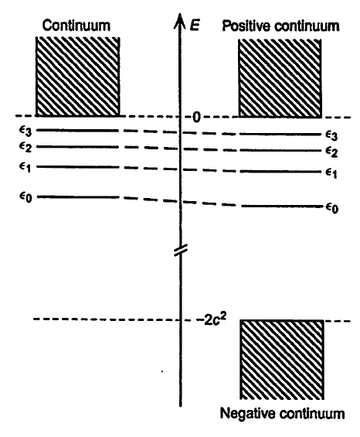
Bound states of Dirac eq.
NR
(Schrödinger)
R
(Dirac)
Negative continuum states
We cannot fill electrons from bottom!

Slide 16
Practical way of solving Dirac method
1-e
Excited det.
2-e
Excited det.
HF det.
Orbital energy
Fill electrons
from here
Consider these determinants
to get reliable wave functions
Negative energy
States
(disregarded in no-pair approx.)

Slide 17
Difference of NR and R at programming
Formulations of electron correlation methods are mostly same between NR and R under the no-pair approximation.
☺
Different points
Complicated matrix elements and integrals
Handling complex values
(new programming is necessary☹)
Basis sets for both Large and Small components
Huge computational costs for four dimension eq.
Kramers symmetry instead of spin symmetry

Slide 18

Information of Dirac solution
Why four-component?
What is the information added to
the Schr$ö$dinger solution?
Why four-dimension?
Positronic states
&
Spin states
Large component: α spin
Large component: β spin
Small component: α spin
Small component: β spin
1s
0
0
1s
Ex. two-component spin orbital
representation
1s
1s

Slide 19
Dirac solution of Hydrogen (angular part)
Ex.
α spin:
β spin:
Mixing of α and β spin for one-electron level
Spin-dependent relativistic effect
Spin-orbit interaction
Notes:
4成分の説明

Slide 20
Spin-orbit splitting (Schematic)
NR energy
R energy
f₊
f
f₋
d₊
d
orbital energy
p₊
d₋
p
p₋
s
s

Slide 21
Approximated approach
Matrix representation of one-electron system
at the four-component Dirac Hamiltonian
Expanding coefficients
Positive and
negative energies
kinetic operator
We are interested in only positive energy states.
Two-component basis set

Slide 22
Two-component approach
Unitary Transformation
Only positive energy states are decoupled.

Slide 23
Approximated approaches
For the multi-electronic Hamiltonian, however,
we cannot find a perfectly-decoupled Hamiltonian.
(Two-component methods require approximations.)
Two component methods (X2C, IOTC, IODKH, ZORA, Breit Pauli…)
spin-dependent method (two-component)
spin-free method (reduced to one-component method)
Hamiltonian becomes too complicated but some of the methods well reproduce four-component results with less computational cost.
NR Hamiltonian + relativistic effective core potential method (RECP)
(one component method. We can use NR programs with modification.)

Slide 24
Outline
Fundamental
Theoretical approaches
of relativistic quantum chemistry
Review
Relativistic effects in chemistry
Application 1
Electron EDM (Fundamental Physics)
Application 2
Nuclear volume effects
in isotope fractionation (Geochemistry)

Slide 25
Average speed of 1s elec. in Hydrogen-like atom
Hydrogen-like atom with atomic number Z
Speed of 1s electron
Speed of light
in atomic unit
Speed ratio
β = Z/c = Z/137
Relativistic increase of electron mass
Ex. Hg: Z＝80
β = 80/137 = 0.58
1sorbital energy and Bohr radius
Orbital energy:
1.23 times stabilized
Orbital radius:
0.2 times contracted

Slide 26
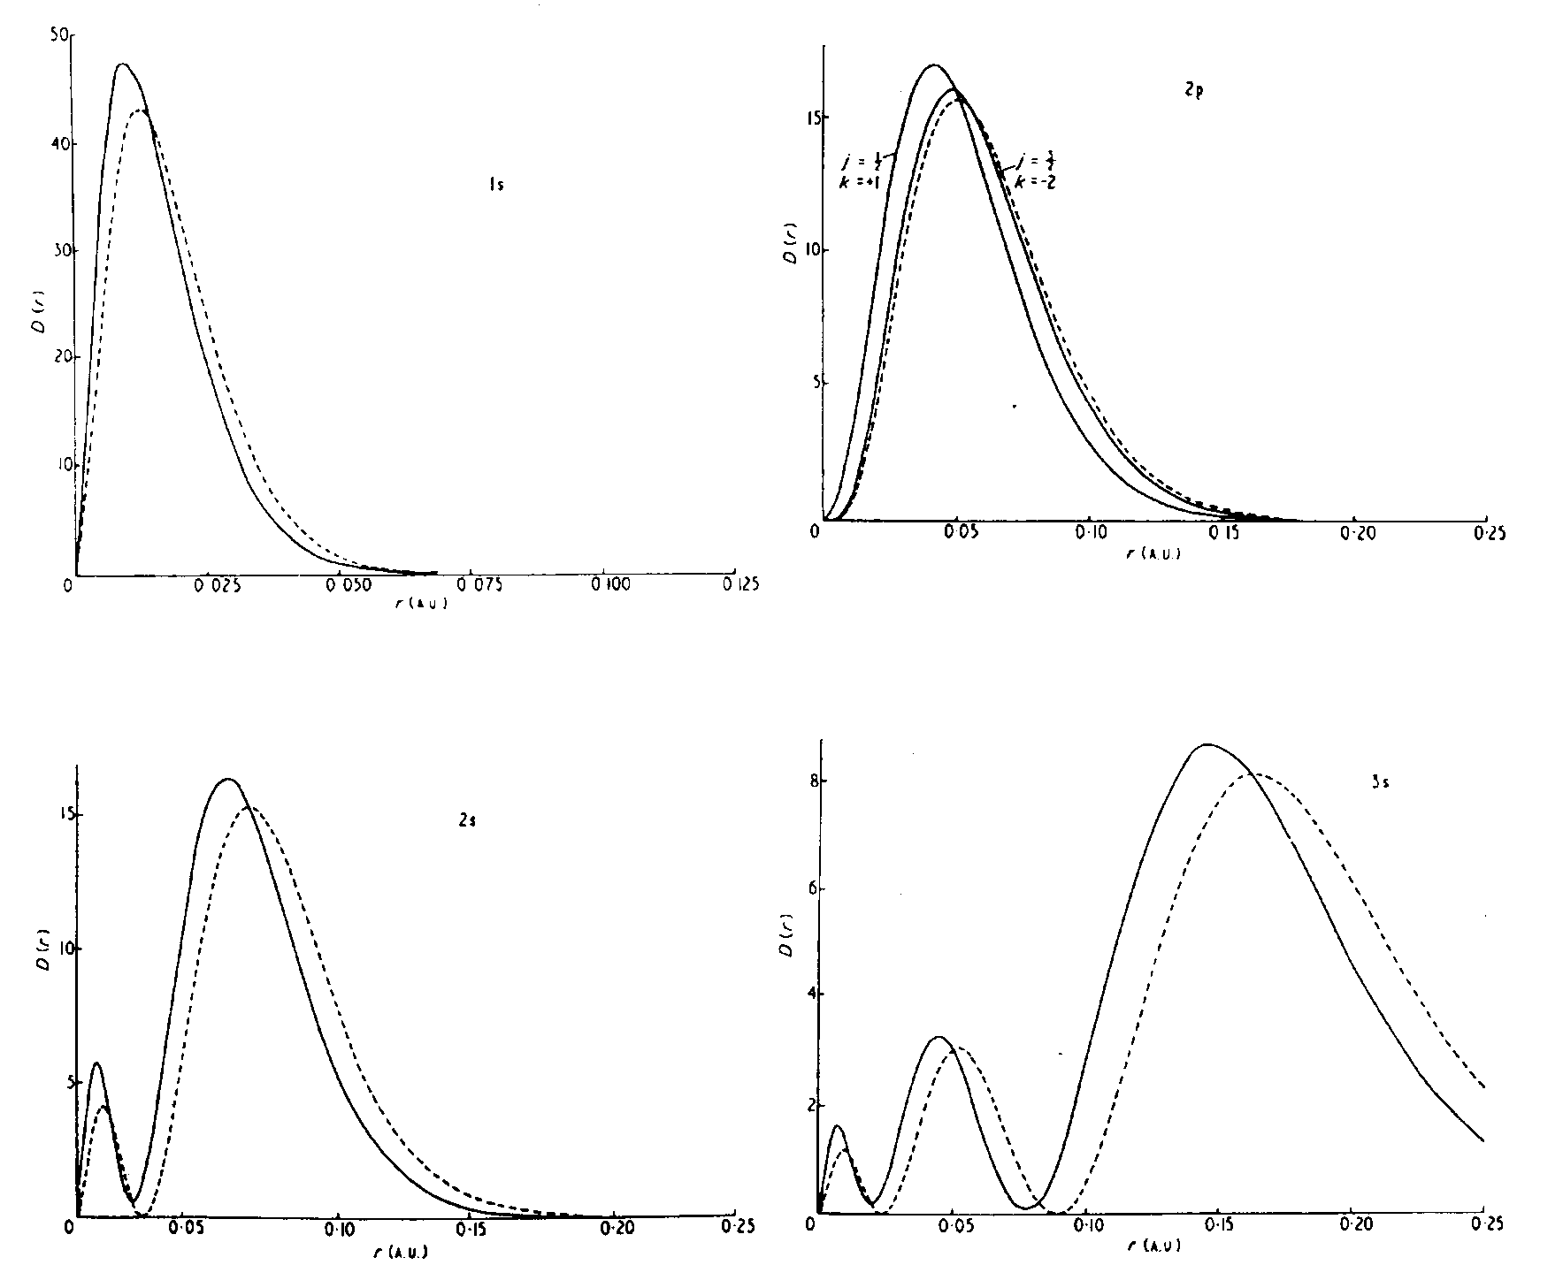
Orbital contraction of s and p orbital
2p orbital
Z=80 （Hg⁷⁹⁺)
dot： NR
solid：R
Radial distribution function
1s orbital
3s orbital
2s orbital

Slide 27
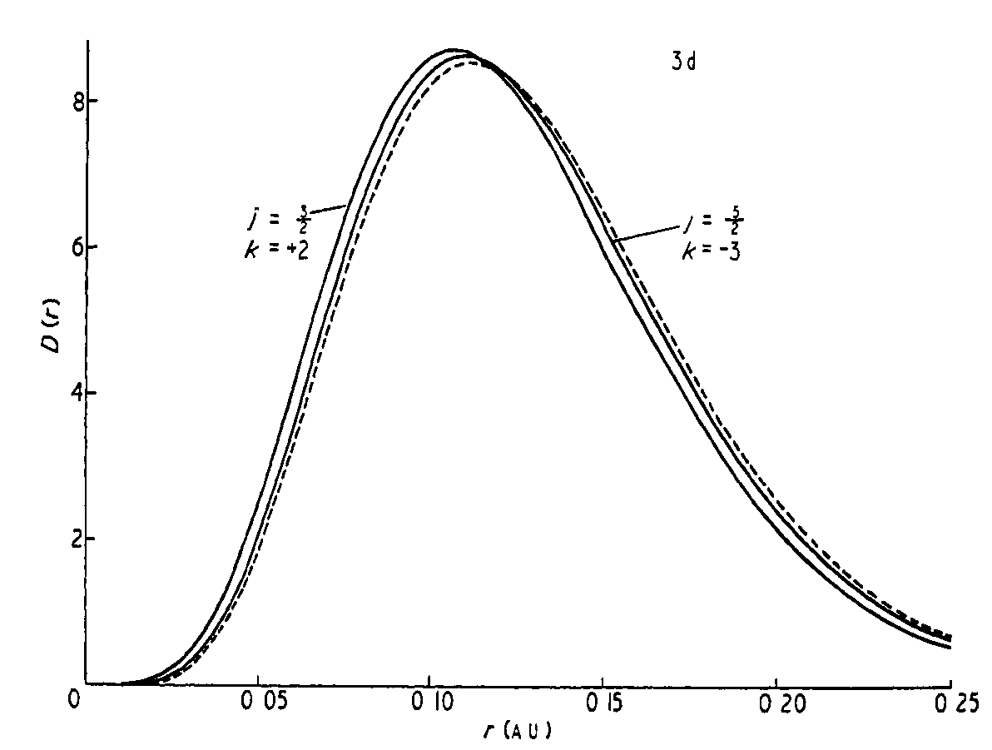
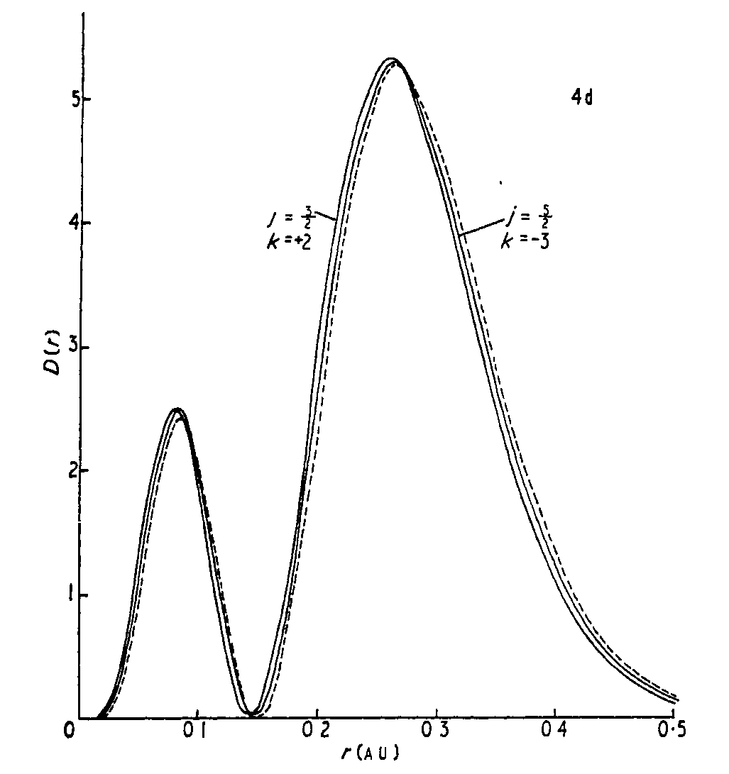
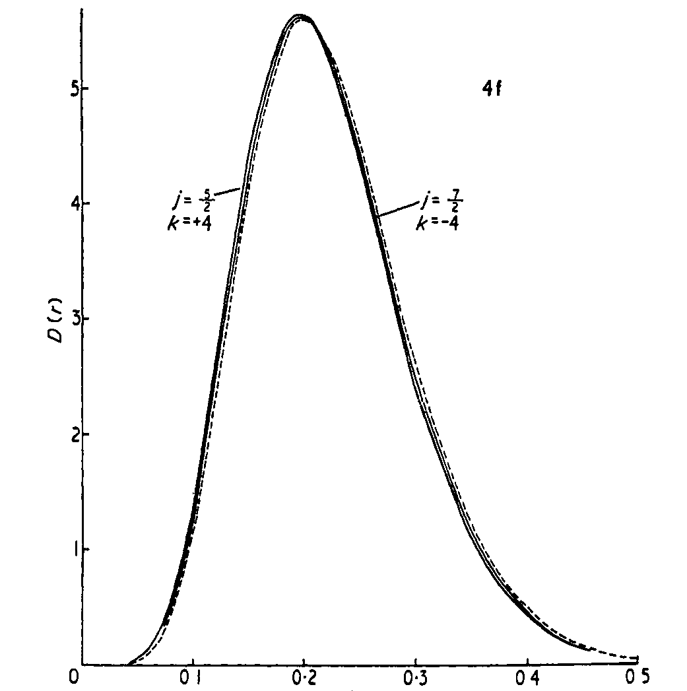
Orbital contraction of d and f orbital
3d orbital
4d orbital
Z=80 （Hg⁷⁹⁺)
dot： NR
solid：R
4f orbital
All of them are slightly contracted in relativistic effects.

Slide 28
Multi-electronic system (Hg neutral atom)
contracted
1s orbital

Slide 29
Multi-electronic system (Hg neutral atom)
6s orbital
contracted

Slide 30
Multi-electronic system (Hg neutral atom)
5p orbital
contracted

Slide 31
Multi-electronic system (Hg neutral atom)
5d orbital
a bit expanded

Slide 32
Multi-electronic system (Hg neutral atom)
4f orbital
almost same but
a bit expanded

Slide 33
Multi-electronic system (Hg neutral atom)
Orbital energies (eV) in Hg neutral atom
NR
R
6s
s, p : stabilized
d, f : destabilized
due to shielding effects
by s and p
5d
5p
4f
Many thanks to Dr. Ekman, Malmo Univ. for teaching us GRASP2K

Slide 35
Atomic valence orbital energies
Relativistic effects in 6th series atoms
Orbital energy
(eV)

Slide 36
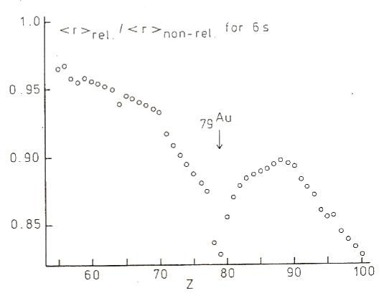
Relativistic contraction in 6s orbital
R and NR Ratio of <r> of 6s orbital
Relativistic contraction
is strongly enhanced in
Pt, Au, and Hg elements.
(It may related with liquid Hg.)
Pt
Hg
Au
Pykkö, Chem. Rev. 88, 563-594, 1988

Slide 37
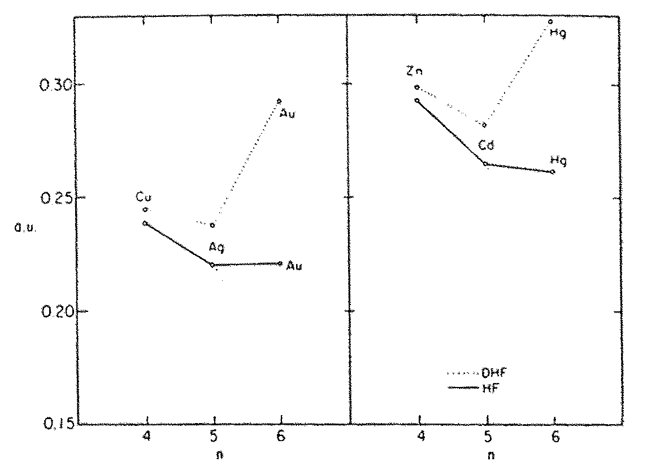
Anomaly of ionization energy
Experimental ionization
energies (eV)
valence s orbital energies (a.u.)
(with opposite sign)
Hg
Zn
Cu
Au
Zn
Cd
Hg
Cd
Au
Ag
R
NR
Cu
Ag
Larger ionization energies in Hg and Au are
attributed to relativistic effects.
Pykkö, Chem. Rev. 88, 563-594, 1988

Slide 38
Relativistic effects in polarizability in atoms
■ NR
■ R
■ Exp.
Polarizability
HF MP2 CCSD CCSD(T) Exp.
HF MP2 CCSD CCSD(T) Exp.
(a.u.)
Xe ： NR and R result are similar.
Hg : Only R results represent experimental trend.
NR calculation overshoot too much!
Mr. Kikuchi
(B4, 2016)

Slide 39
Why relativity decreases polarizability of Hg
Xe
Hｇ
6s
6p_{3/2}
6s_{1/2}
6p
orbital energy
6p_{1/2}
Mr. Kikuchi
(B4, 2016)
LUMO
LUMO
HOMO
6s
6s_{1/2}
HOMO
5p
5p_{3/2}
5p_{1/2}
(a.u.)
NR
R
非相対論
相対論
Xe : HOMO-LUMO gaps are similar between R and NR
Hg : 6s HOMO is stabilized by relativity
➔Interaction of LUMO-6s decreases➔Polarization ↓

Slide 40
Why relativity decrease polarizability in Hg
Xe
Hｇ
6s
6p_{3/2}
6s_{1/2}
6p
orbital energy
6p_{1/2}
Mr. Kikuchi
(B4, 2016)
LUMO
LUMO
HOMO
6s
6s_{1/2}
HOMO
Stabilization of
s orbital
5p
5p_{3/2}
5p_{1/2}
(a.u.)
NR
R
NR
R
Xe : HOMO-LUMO gaps are similar between R and NR
Hg : 6s HOMO is stabilized by relativity
➔Interaction of LUMO-6s decreases➔Polarization ↓

Slide 41
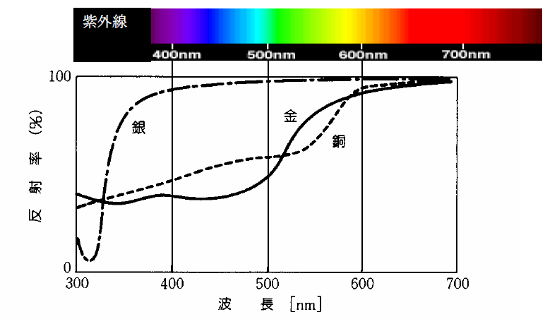
Why gold is yellow
UV
Silver
Gold
Reflection rate
Modified picture
given by Prof. Sato
Wave length
Gold reflects yellow and red light and absorbs blue and purple light.
Silver reflects all visible light and absorbs ultraviolet light.

Slide 42
Why gold is yellow
UV
Silver
Gold
Reflection rate
Modified picture
given by Prof. Sato
Wave length
Gold absorbs 2.4 eV～
Silver absorbs 3.7 eV～
d → s transition
Larger gap in silver

Slide 43
How relativity related with color of gold
Ex：Orbital energies of AgH and AuH molecules
AgH
AuH
-0.1
Orbital energies are similar
between Ag and Au at the
non-relativistic level.
（Gold should be “silver” color.)
-0.2
R
R
NR
-0.3
6s
(+H)
5s
(+H)
5s
(+H)
6s
(+H)
Orbital energy ε(a.u.)
At the relativistic level, however,
6s is stabilized and 5d is destabilized
by a relativistic effect.
Hence the s-d energy gap becomes small.
-0.4
5d_{5/2}
4d_{5/2}
-0.5
5d
4d
5d_{3/2}
4d_{3/2}
Notes:
これは模式図で、個体を記述するバンド計算での解釈が必要 実際のバンド計算でも同じ傾向が出ている

Slide 44
Example of spin-orbit (SO) effects
¹¹⁹Sn NMR chemical shift in halogenic Sn:
Experiments (vertical) vs. Calculations (horizontal)
○Without SO interaction
●With SO interaction
On diagonal line:
good agreements with exp.
SO interaction is essential
to explain NMR
experimental data.
Chem. Phys. Lett. 261, 1 (1996).

Slide 45
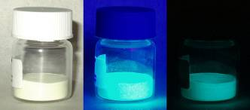
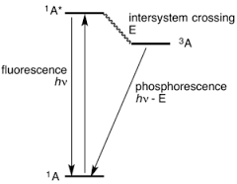
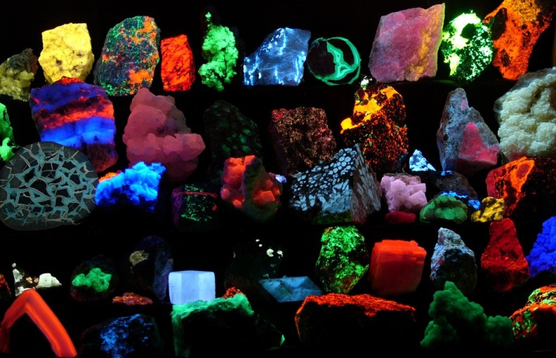
Example of spin-orbit (SO) effects
燐光(phosphorescence )
visible
light
UV
darkness
From wikipedia
Spin-forbidden transition
➔ Long live
Used in material science
https://www.boundless.com/

Slide 46
Other relativistic effects
10% of Lanthanide (30% of Actinide) contraction is due to relativistic effect
Pb metal crystal has bcc structure（not like diamond)
RbAu, CsAu has a crystal structure and not metal
molecular structure: bond length, angle, coordination number
NMR, harmonic frequency,
electric dipole moment, force constant,
dissociation energy, reaction paths
Pykkö, Chem. Rev. 1988, 88, 563-594

Slide 47
Relativity is majority
Relativistic treatment is important after 5th low elements of periodic table.

Slide 48
Outline
Fundamental
Theoretical approaches
of relativistic quantum chemistry
Review
Relativistic effects in chemistry
Application 1
Electron EDM (Fundamental Physics)
Application 2
Nuclear volume effects
in isotope fractionation (Geochemistry)
Dr. Geetha
Prof. Das
Abe

Slide 49
Electric dipole moment (EDM)
of an elementary particle
EDM -d
Time reversal
(t ➔ -t)
EDM d
spin
spin
(p➔-p)
(r➔r)
L➔-L
d➔d
Assume that
EDM is parallel to spin axis
EDM becomes anti-parallel to spin axis
Non-zero value of EDM = T symmetry violation
= CP symmetry violation (under CPT theorem)
Notes:
EDM of … is one of the candidate for the evidence of the CP violation. Assume that the EDM is paralle to spin axis, and consider the time reversal opration. momentum becomes negative and position remains in same way, so angular momentum p cross r is

Slide 50
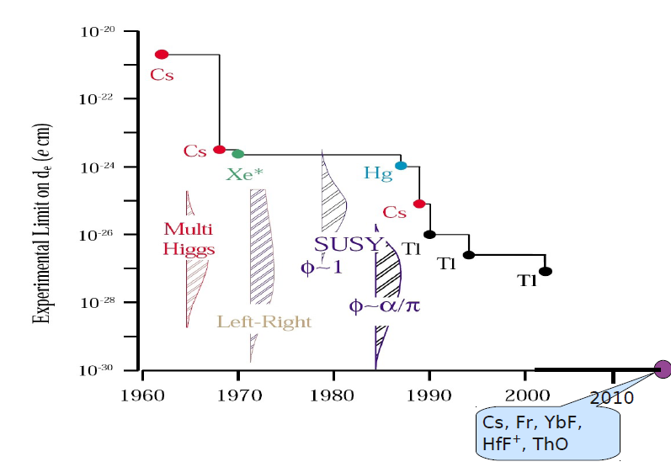
Upper limit of electron EDM
observed in atoms and molecules
Why upper limit
because the errors are larger than
the observables at present.
Molecules are
hot now!
YbF
ThO
WC, HfF⁺, BiO, FrSr,…

Slide 51
Observable in atoms or molecules for EDM
Interaction energy between electric field and d_{e}
Electronic wave function
spin matrices
ΔE=-d_{e}・E
EDM d_{e}
ΔE=0
Yb
spin
When spherically
symmetric orbital
E
Internal electric field E_{int}

Slide 52
Observable in atoms or molecules for EDM
Interaction energy between electric field and d_{e}
Electronic wave function
ΔE=-d_{e}・E
EDM d_{e}
ΔE≠0
Yb
spin
when symmetry
is broken by E_{ext}
E
E_{ext}

Slide 53
Observable in atoms or molecules for EDM
Interaction energy between electric field and d_{e}
Electronic wave function
ΔE=-d_{e}・E
EDM d_{e}
ΔE≠0
Yb
spin
F
E
In molecule, symmetry is strongly broken without the external electric field.

Slide 54
Problem of EDM operator
Effective electric field
Unperturbed 2-component nonrelativistic Schrödinger eq.
We cannot measure ΔE. (Schiff’s theorem)

Slide 55
Relativistic EDM operator
Unperturbed 4-component relativistic Dirac eq.
Relativity is important to observe EDM.

Slide 56
Relativistic quantum chemistry is necessary
Dirac-Coulomb
Hamiltonian
We cannot measure E_{eff} experimentally and need to calculate.
4-cmp spinor

Slide 57
Three theoretical points for accuracy
Relativity (Dirac-Coulomb)
Basis sets (Dyall QZ)
Electron correlation
(CCSD, CASPT2)
 | Relativity | Basis set (Correlation space) | Electron correlation
Abe et al. | 4 component ◎ | All-electron and large correlation space ◎ | CCSD, ◎ (D) CASPT2 ◎ （S), ○（D)
Nayak & Fleig | 4 component ◎ | All-electron but small correlation space △ | GASCI (Static corr. is ◎）
Titov et al. | 2 component △ | Pseudopotential (?) | CCSDT (Dynamic corr. is ◎ ◎）

Slide 58
Computational details for YbF
Phys. Rev. A 90, 022501 (2014)
Wave function： Dirac-Fock, Dirac-CCSD
Program : UTChem + DIRAC08
Basis sets: Dyall’s DZ, TZ, and QZ for Yb
+ Watanabe’s basis for F
+ Sapporo (DK3) polarization
in uncontracted form
We approximate the expectation value
with CCSD wave function as follows.

Slide 59
Measurable properties in YbF related with E_{eff}
Hyperfine coupling constant (parallel) A//:
Interaction between
electron spin and Yb nuclear spin
permanent dipole moment (PDM) of molecule:
s-p hybridization
Phys. Rev. A 90, 022501 (2014)
 | |E_{eff} | (GV/cm) | A// (MHz) | PDM (D)
QZ 79e-CCSD(293) | 23.1 | 7913 | 3.60
Experiments | - | 7424 | 3.91
Error from experiments |  | 7% | 8%

Slide 60
E_{eff} in HgX (X=F, Cl, Br, I)
Molecule | Basis set type | Method | |E_{eff}| (GV/cm)
HgF | DZ | CCSD | 115.42
HgCl | DZ | CCSD | 113.56
HgBr | DZ | CCSD | 109.29
HgI | DZ | CCSD | 109.30
Mr. Prasannaa
HgX has much larger E_{eff} than YbF (23.1 GV/cm).
“Mercury Monohalides: Suitability for Electron Electric Dipole Moment Searches” V. S. Prasannaa, A. C. Vutha, M. Abe, and B. P. Das
Phys. Rev. Lett. 114, 183001, (2015)

Slide 61
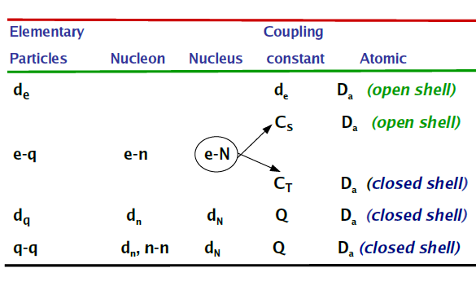
Various kinds of CP violation
Program development
in our group
Paramagnetic systems:
・Electron EDM (PRA, 90, 022501 (2014) Abe et al. )
・Scalar and pseudoscalar (S-PS) interaction
(PRA, 93, 042507, 2016. Sunaga et al.)
Diamagnetic systems:
・Schiff moment parameter
(On going by Tsutsui and Abe)

Slide 62
S-PS interaction
PRA, 93, 042507, 2016. Sunaga et al.
# of electrons
# of nuclei
Fermi constant
S-PS coupling constant
Mr. Sunaga
Nuclear charge distribution
Electron-nucleus (quark) interaction violates CP symmetry. The energy shifts appears in eEDM experiments on same footing.

Slide 63
Outline
Fundamental
Theoretical approaches
of relativistic quantum chemistry
Review
Relativistic effects in chemistry
Application 1
Electron EDM (Fundamental Physics)
Application 2
Nuclear volume effects
in isotope fractionation (Geochemistry)

Slide 64
Isotope fractionation in equilibrium
Isotope exchange reaction
A’Y + AX = AY + A’X
A’: light isotope, A: heavy isotope, AX,AY: reactants
Isotope fractionation factor
(＝Equilibrium constant）
α =([AY]/[A’Y])/([AX]/[A’X])≒1
Isotope
fractionation
coefficient
Nuclear mass term
(vibrational effect)
Bigeleisen & Mayer
JCP, 1947
Nuclear volume term
(Electronic effect)
Nomura et al. and Bigeleisen
JACS, 1996
Large in light atom
Large in heavy atom

Slide 65
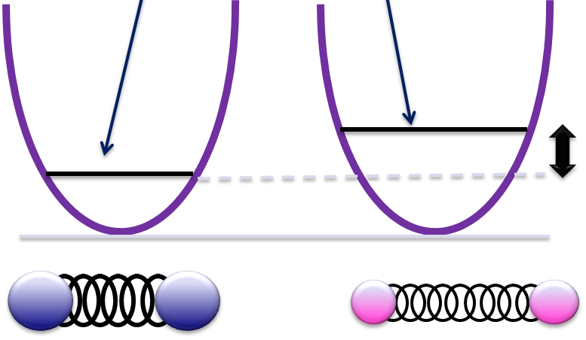
Isotope fractionation in equilibrium
Isotope
fractionation
coefficient
Nuclear mass term
(vibrational effect)
Bigeleisen & Mayer
JCP, 1947
Nuclear volume term
(Electronic effect)
Nomura et al. and Bigeleisen
JACS, 1996
Large in light atom
Large in heavy atom
E₀: zero point energy
Electronic energy
Scale to
mass difference
Heavy isotope
ν
Light isotope
ν’
Large isotope
Small isotope
ν < ν’
Ε > Ε’

Slide 66
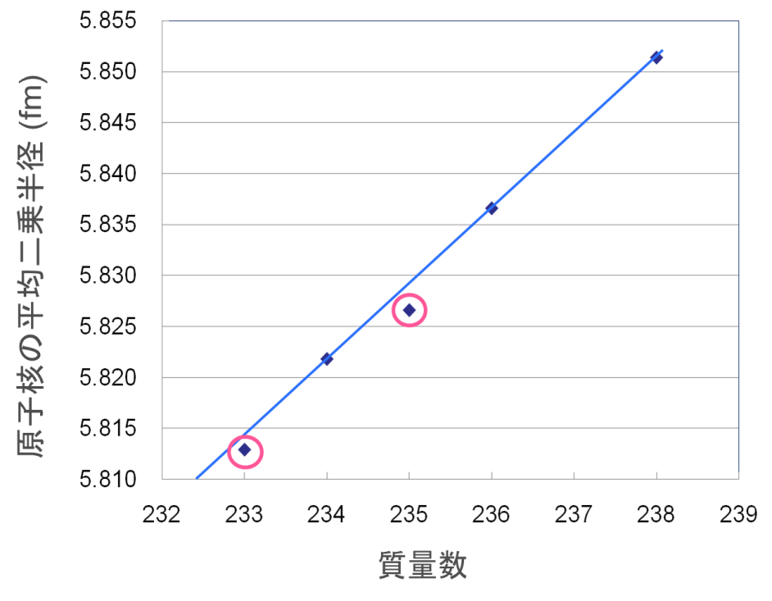
Nuclear volume effects in uranium isotope
Exp. of U(IV)-U(VI)
Nomura et al. (1996)
Root mean squared radii
of uranium isotope
²³³U
²³⁵U
²³⁵U
²³³U
Isotope fractionation of U：
Mass independent
（Anomaly in odd nuclei） No vibrational effect!
Depend of nuclear size!

Slide 67
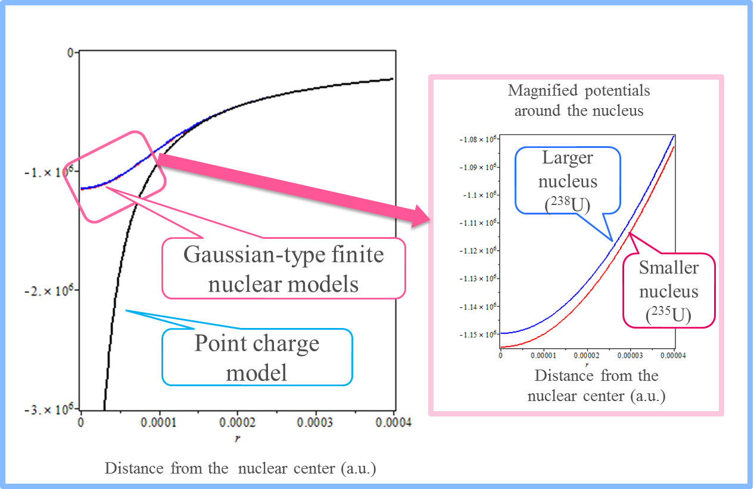
Why nuclear volume effects change
the electronic states?
Difference in nuclear charge radii
Difference in potentials ➔ Difference in electronic
energies

Slide 68
Previous calculations of nuclear volume effects
・Electronic state
vicinity of nucleus
・Heavy element systems
Significant relativistic effects
Four-component relativistic calculations
for uranium isotope fractionation (Abe et al. JCP, 2008)
The error is around 10%
²³⁵U³⁺ + ²³⁸U⁴⁺ = ²³⁸U³⁺ +²³⁵U⁴⁺
U³⁺
U⁴⁺
Explt. Calc.
0.0027 0.0031
[Rn]5f ³
[Rn]5f ²
lnK_{nv}=(kT)⁻¹{[E(²³⁸U⁴⁺) − E(²³⁵U⁴⁺)] − [E(²³⁸U³⁺) − E(²³⁵U³⁺)]}
The four-component method is too costly!
We need alternative approximated method.

Slide 69
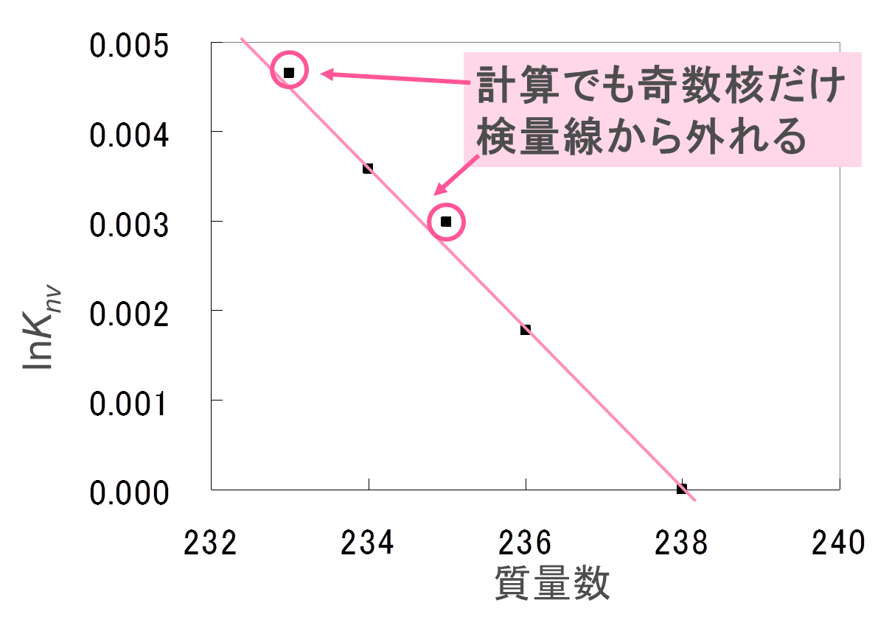
Relativistic quantum chemical calculations
Nuclear volume effects in uranium isotope fractionation
2008年, 2010年ＪＣＰ
²³⁵U³⁺ + ²³⁸U⁴⁺ = ²³⁸U³⁺ +²³⁵U⁴⁺
U³⁺
U⁴⁺
[Rn]5f ³
[Rn]5f ²
lnK_{nv}=(kT)⁻¹{[E(²³⁸U⁴⁺) − E(²³⁵U⁴⁺)] − [E(²³⁸U³⁺) − E(²³⁵U³⁺)]}
Multiconfigurational Dirac−Coulomb Hartree−Fock method+Fermi nucleus model
Mass | Nuc. raddi(fm) | E(U⁴⁺)(a.u.) | E(U³⁺)(a.u.) | lnK_{nv}(293K)
233 | 5.8129 | −28050.15036342 | −28051.29303334 | 0.0049
234 | 5.8218 | −28050.11064174 | −28051.25331271 | 0.0038
235 | 5.8266 | −28050.08920773 | −28051.23187927 | 0.0031
236 | 5.8366 | −28050.04452862 | −28051.18720134 | 0.0019
238 | 5.8514 | −28049.97834180 | −28051.12101626 | -
Exp.
0.0027
Cal.
0.0031
About 10% error

Slide 70
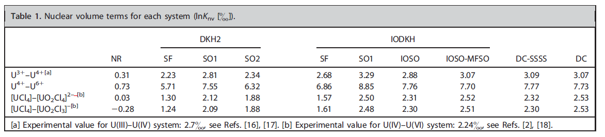
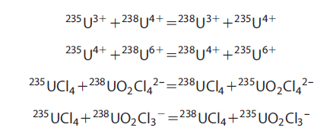
Tests of two-component methods
Only “IODKH-IOSO-MFSO” method can reproduce similar values of Dirac-Coulomb. Computational costs reduce to about 1/30.
Mr. Nemoto
Nemoto et al. J. Comp. Chem. 36, 816–820, (2015).

Slide 71
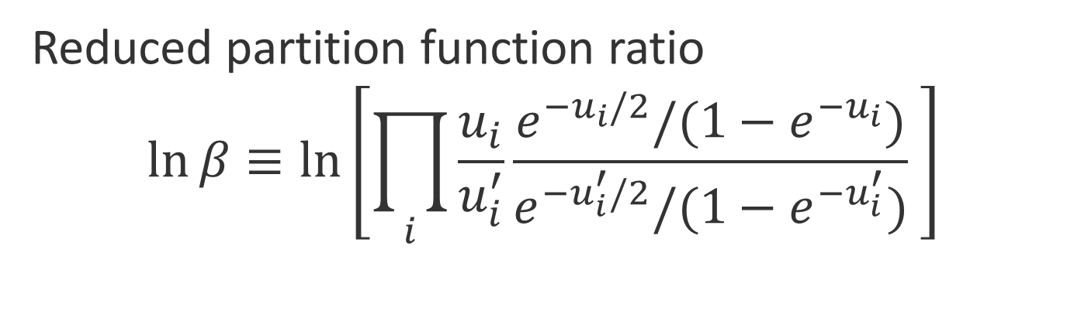



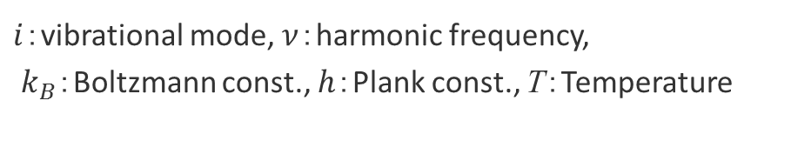
Cf. Vibrational effect
Nuclear mass effect
$$ε≅\ln{K_{nm}}=\ln{β_{AY}}−\ln{β_{AX}}$$
Reduced partition function ratio
$$\ln{β}≡\ln\left[\prod_{i}{\frac{u_{i}}{u_{i}^{′}}\frac{e^{−u_{i}/2}/(1−e^{−u_{i}})}{e^{−u_{i}^{′}/2}/(1−e^{−u_{i}^{′}})} }\right]$$
$$u_{i}=\frac{hν_{i}}{k_{B}T}$$
$i$：vibrational mode, $ν$：harmonic frequency,
$k_{B}$：Boltzmann const., $h$：Plank const., T：Temperature
Calculable from harmonic frequencies of isotopologues
Molecule with larger $\ln{β}$ prefer heavy isotope
J. Bigeleisen , M.G. Mayer , J. Chem. Phys. 15, 261-267 (1947)
Notes:
核の質量項は換算分配関数比（$\ln{β}$）の差で計算されます。換算分配関数比は調和近似下でボルツマン分布を仮定してこのように定義されます。このuの中に、調和振動数を含むことから、核の質量項（${lnK}_{nm}$）は、分子や結晶の調和振動数を求めることで計算可能な量です。

Slide 72
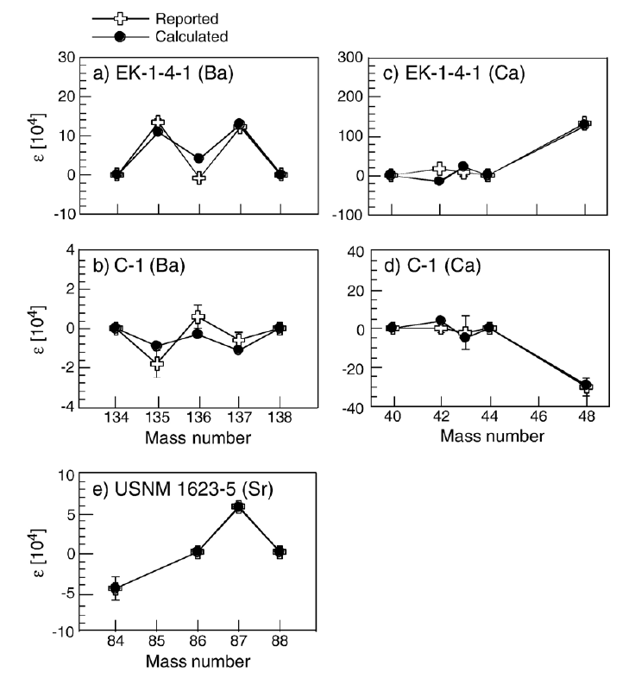
Relationship with geochemistry
Anomalous isotope ratio in meteorite
（mass independent）
Indicator of nucleosynthesis?
Or nuclear volume effects caused by chemical equilibrium during crystallization?
Prof. Fujii
Osaka univ.
Fujii et al. Earth and Planetary Science Letters 247 (2006) 1–9

Slide 73
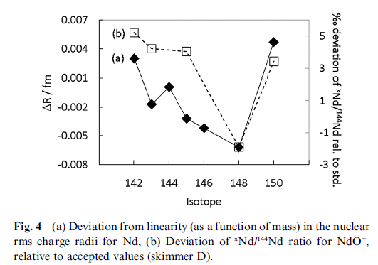
Relationship with analytical chemistry
ICP-MS (inductively coupled plasma mass spectrometry)
TIMS (thermal ionization mass spectrometry)
precise measurements of isotope ratios
Mass independent fractionation appears:
➔Nuclear volume effects?
What is the mechanism?
How can we correct this effect?
Open questions also for theoretical chemists!
Nd (neodymium)
K. Newman et al. J. Anal. At. Spectrom., 2009, 24, 742–751
Mass independent fractionations can happen in analytical equipment. Further corrections are required in future.

