Slide 1
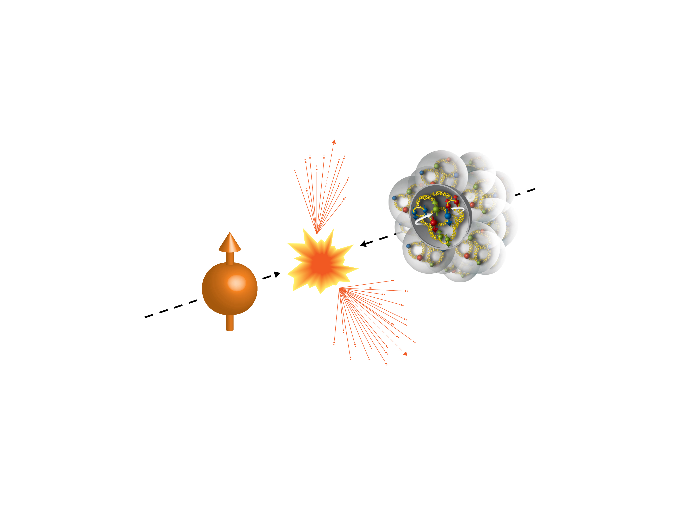
Surprising forward neutron asymmetries observed in polarized proton + nucleus collision at RHIC
100GeV/nucleon
100GeV
Porarized Proton
Itaru NAKAGAWA
RIKEN/RBRC

Slide 2
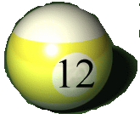
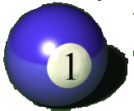

Slide 5
upolarized proton
neutron
Polarized proton
Observed 5% more neutrons to the right in 2006.

Slide 6

What happens in p+A collision?

Slide 7
Naïve Prediction
Gold nucleus
proton
neutron
neutron
Polarized proton
Polarized proton
Neutron should be deflected as similar as p+p case because proton spin stays same

Slide 8
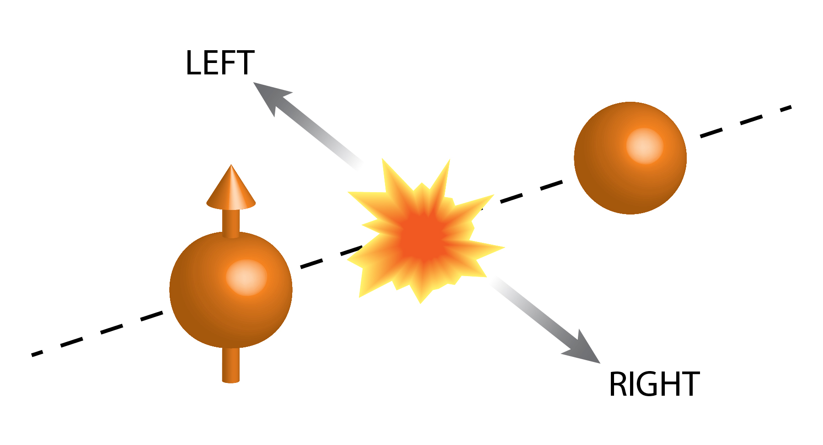
Outline
RHIC
  PHENIX @ Polarized Proton @ RHIC
p↑+p
  Cross section
  Asymmetry
p↑+A
  Measurements
  Theoretical Interpretation

Slide 9
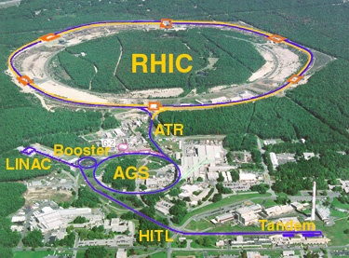
The Relativistic Heavy Ion Collider
accelerator complex
at Brookhaven National Laboratory
Brahms
pp2pp
PHENIX
STAR

Slide 10


RHIC
Notes:
Satellite Image

Slide 11

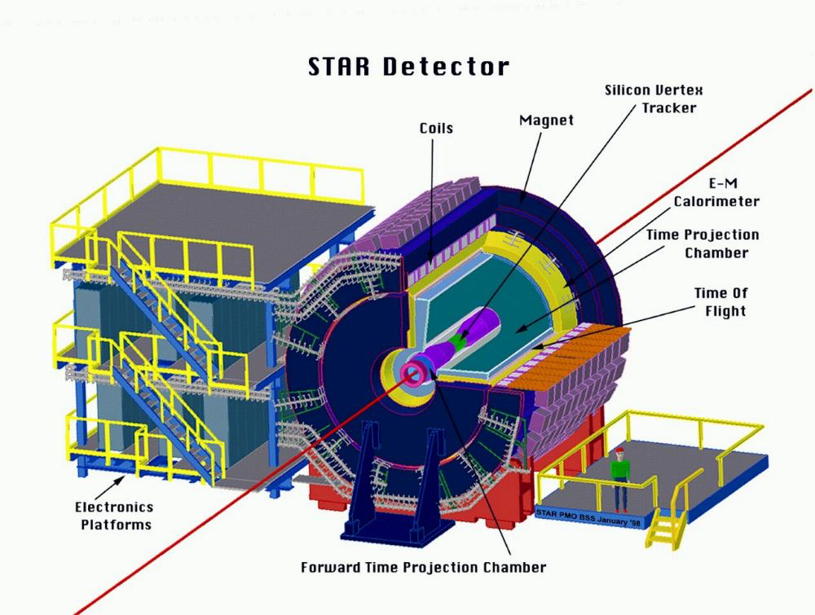
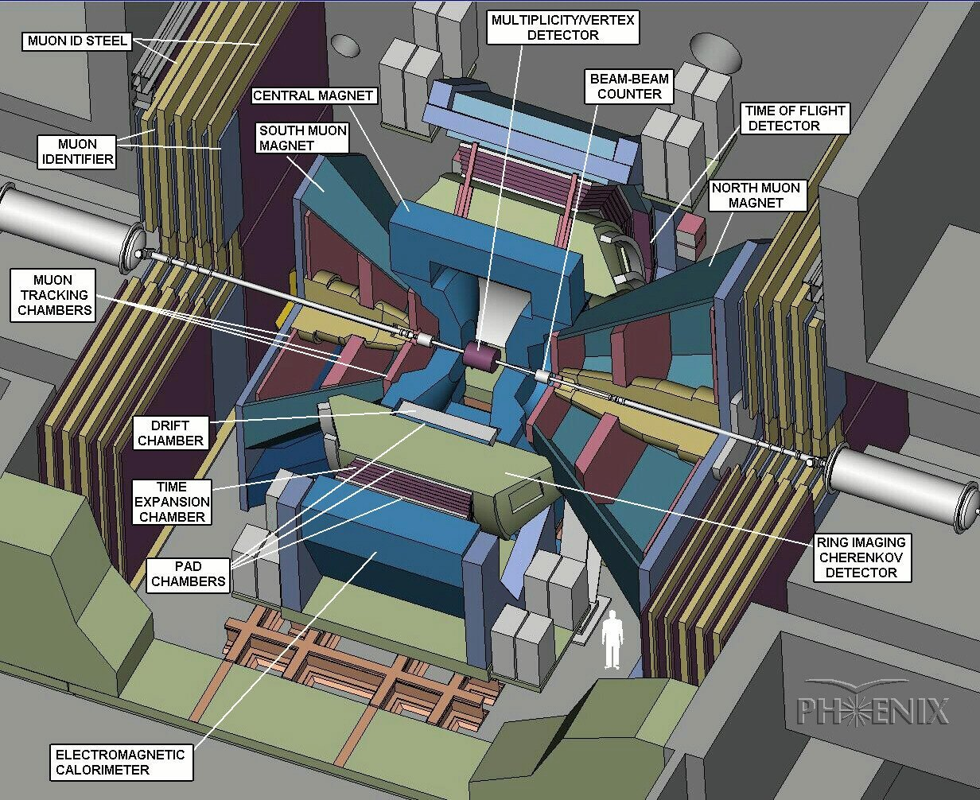

Brahms
pp2pp
PHENIX
STAR
Collision Energy : 62 ~ 510 GeV
Polarization : 50 – 60 %
Luminosity : 10 pb⁻¹/week

Slide 12
Transverse Single Spin Asymmetry
Very forward neutron

Slide 13
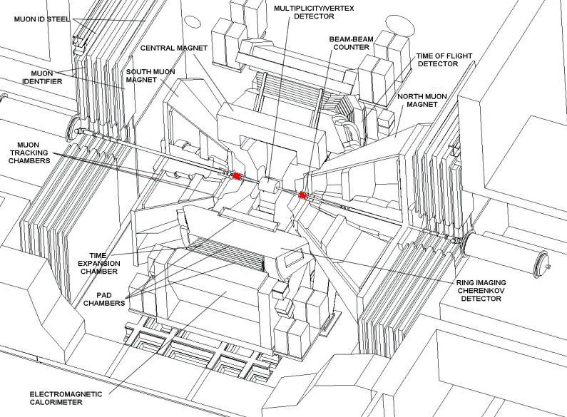

Transverse Asymmetry Observables
100GeV
Soft Process
(mesonic)
18m
ZDC
±5cm
Hard Process
(partonic)

Slide 14
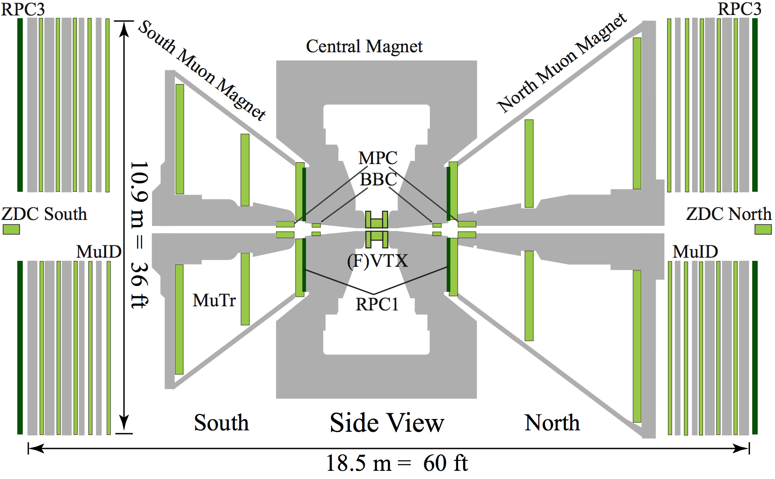


Zero Degree Counter (ZDC)
Neutron Detector
Neutron Detector
Dipole Magnet
Dipole Magnet
18m

Slide 15

10cm

Slide 16
Production Mechanism of Forward Neutron
Cross Section
PRD88,032006
p
Cross Section
π⁺
< 2mrad
p
n
Neutron Energy／Proton Energy
Momentum Transfer ~ 100MeV/c
Large fraction of proton energy is carried by neutron
Well Explained by One-Pion Exchange

Slide 17
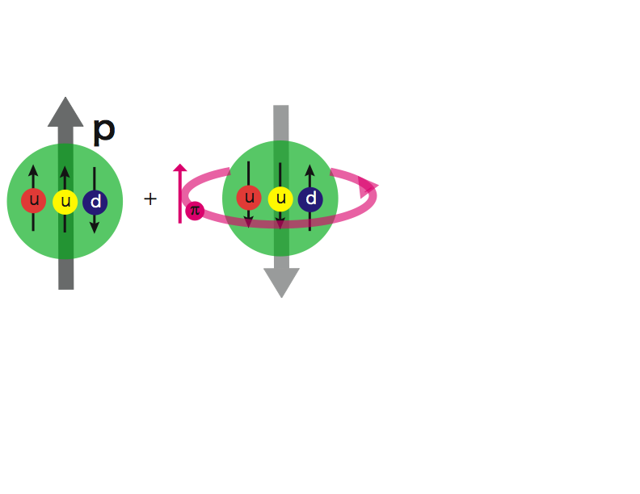
p↑+p Forward Neutron A_{N}
Spin non-flip
Spin flip
Neutron
Neutron
proton
proton
π⁺
proton
proton
n

Slide 18
p↑+p Forward Neutron A_{N}
Spin non-flip
Spin flip
Neutron
Neutron
proton
a₁
proton
π⁺
proton
proton
P
n
a₁ (1260) Reggeon
Spin Parity = 1⁺
p↑

Slide 19
p↑+p Forward Neutron A_{N}
Spin non-flip
Spin flip
Neutron
Neutron
proton
a₁
proton
π⁺
proton
proton
δ : phase shift
Unpolarized Cross Section

Slide 20
p↑+p Forward Neutron A_{N}
p
p
PRD84,114012(2011)
π⁺,a₁
p
↑
n
Neutron P_{T} (GeV/c)
Data are well reproduced by the interference between π and a₁ Reggeon

Slide 21
p↑+p Summary
Observed -5% asymmetry in very forward neutron production
Theoretically explained by the interference between p and a₁-Reggeon exchange.

Slide 22
The First Time Ever
High Energy Collisions
Run15 (2015)
100GeV/nucleon
100GeV
Au, Al
Porarized Proton

Slide 23
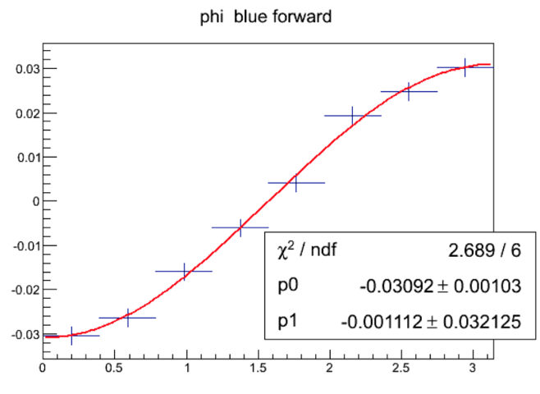
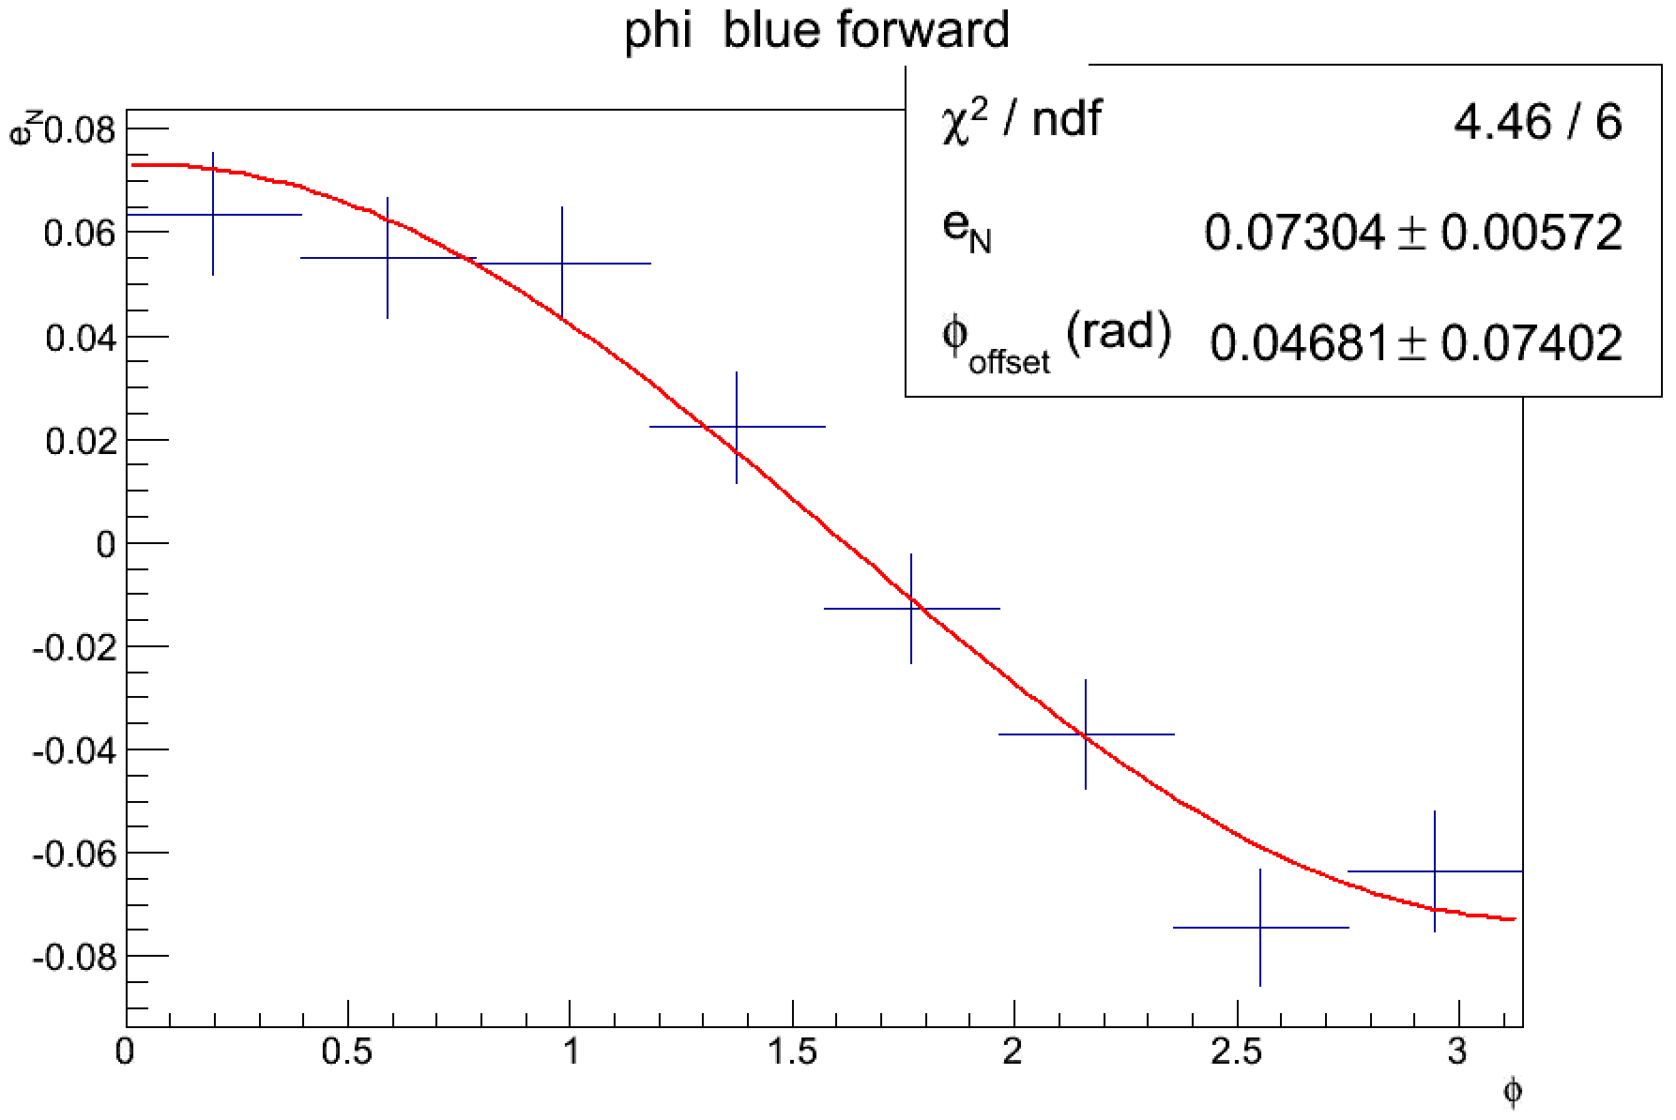

Semi-Online Analysis
p+p 200GeV
p+Au 200GeV

Slide 24




Itaru-san, I got factor of 3 larger and opposite asymmetry
Cannot be! You must be wrong!
Redo the analysis…

Slide 25
Beam Optics for p+A
Absolute Polarimeter (H jet)
RHIC pC Polarimeters
Siberian Snakes
BRAHMS & PP2PP (p)
RHIC
PHENIX (p)
STAR (p)
Siberian Snakes
Spin Rotators
Solenoid Snake
LINAC
BOOSTER
2000 ~ RHIC operation
Pol. Proton Source
500 μA, 400 μs
AGS
Au+Au, p↑+p ….
Warm Snake
Cu+Au, d+Au
200 MeV Polarimeter
AC Dipole
AGS pC CNI Polarimeter
Cold Snake
2015 ~ p↑+Au, p↑+Al
The first attempt of polarized proton + nucleus collision in the world!

Slide 26
Beam optics for conventional collisions
p
p
p+p, Au+Au, Cu+Au, d+Au, ---
 | Z | A | Rigidity
p | 1 | 1 | 1
d | 1 | 2 | 1/2
Cu | 29 | 63 | ~1/2
Au | 79 | 197 | ~1/2

Slide 27
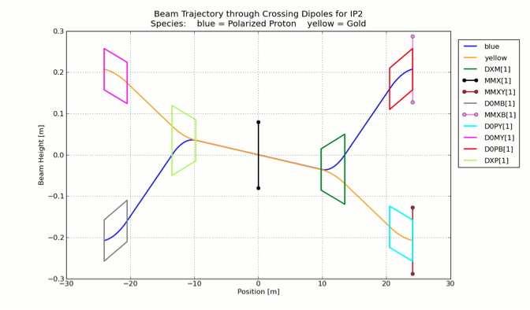
Beam Optics for p↑+A
p↑
Au
ZDC
Dx
Dx

Slide 28
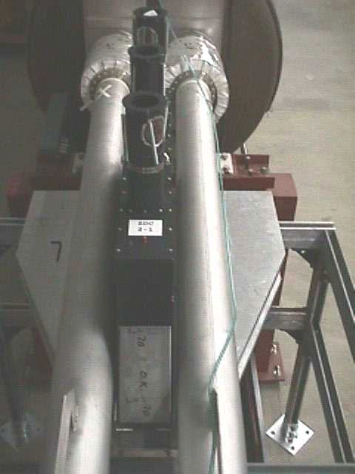
Caveat of Neutron Beam Position
nominal
Au
p
Yellow
ZDC
n
ZDC
Beams are angled by 3.6mrad
-> ~ 6.5cm off centered at ZDC
Blue
Special ZDC location for p+A

Slide 29
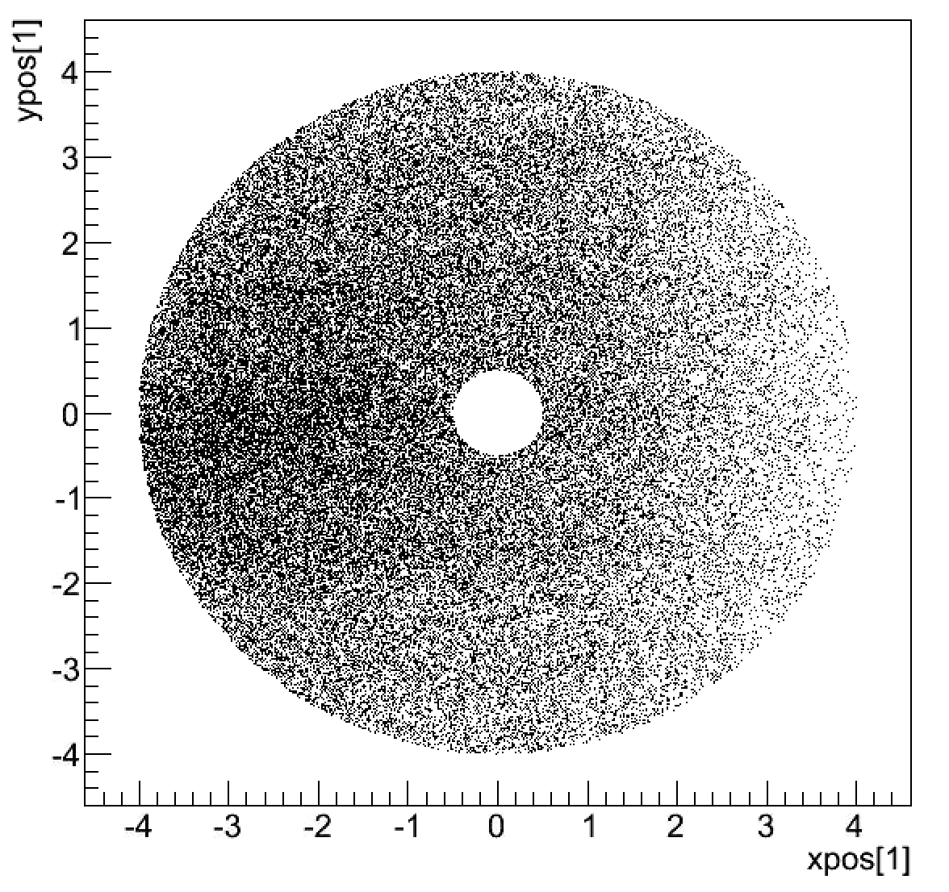
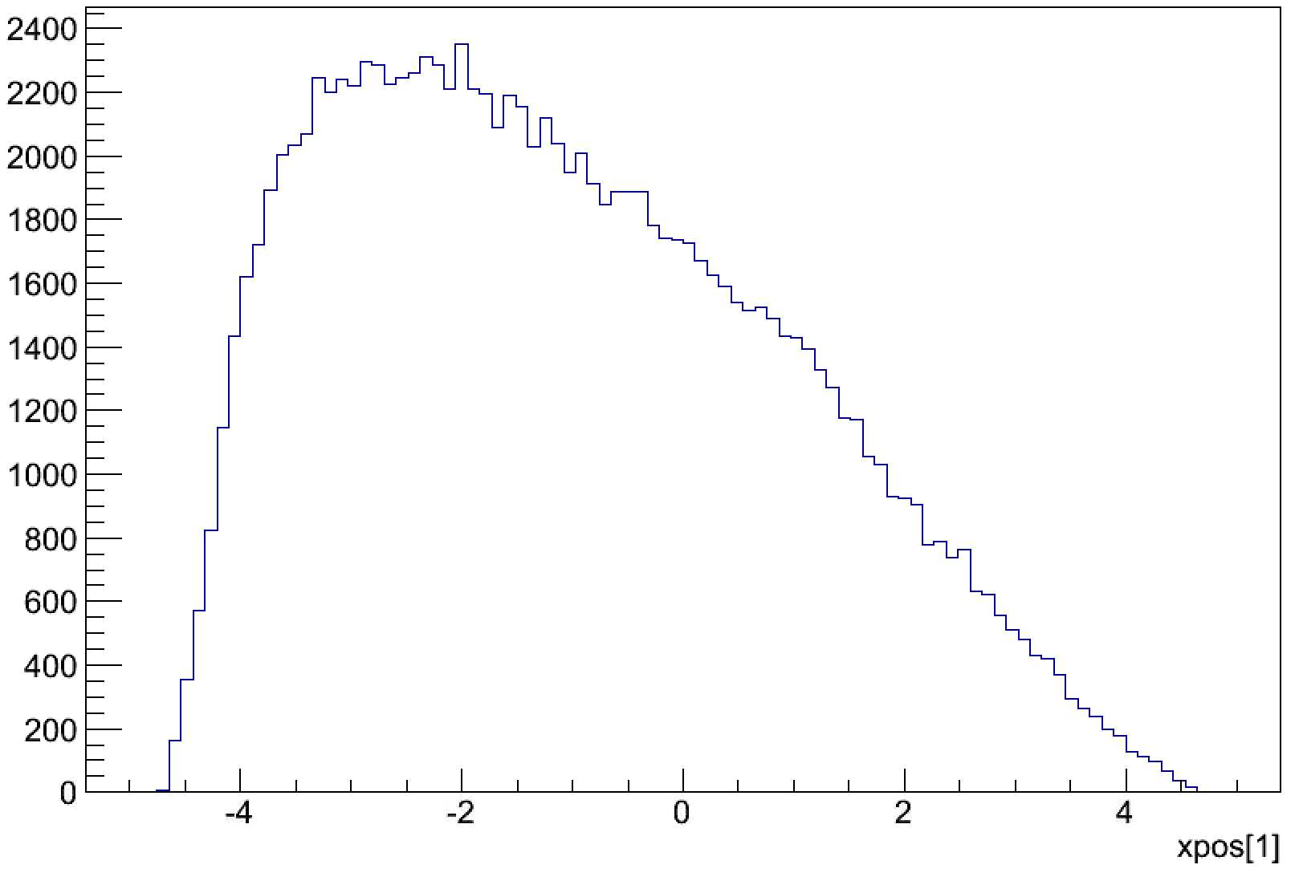
Where the beam center is?
Au
p
ZDC
n
Nominal Beam center
✖
✖
Real Beam center?
Real profile?
Nominal xy dist.
x dependent efficiency
Measured profile

Slide 30
Brahms
pp2pp
Everything is alright. Just keep going.
Wait a minute. Something behaves unexpectedly…
Let us re-measure it.
p+Au run would be over within 2 weeks ….

Slide 31

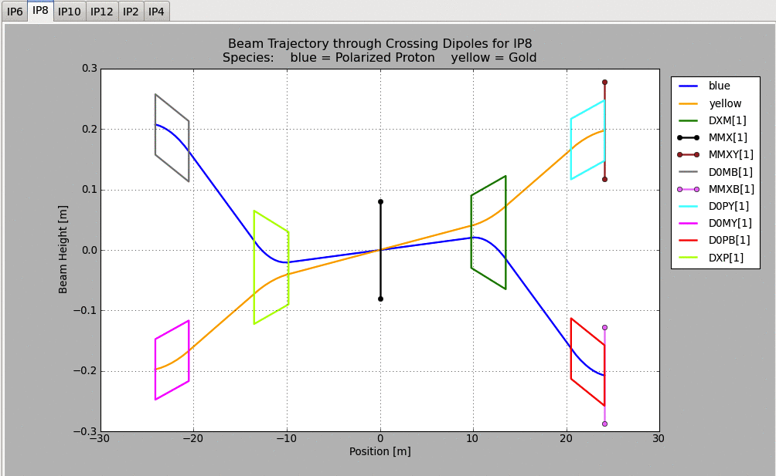

Dedicated Measurement
We need publishable data!
2mrad
p
ZDC
n
Requested special beam tune only for this measurement.
Introducing finite angle between Blue and Yellow beams in order to let neutron to be landed at the center of ZDC.

Slide 32
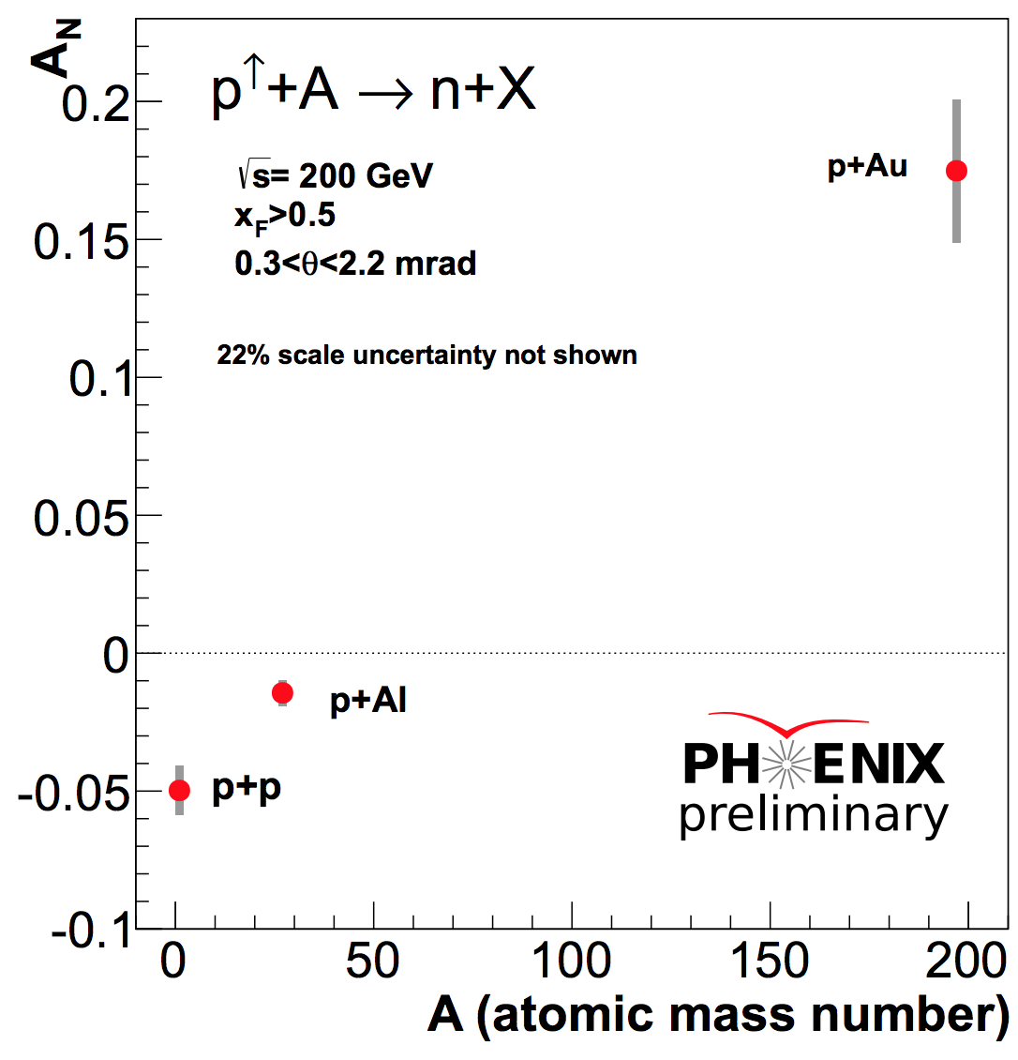
A-Dependent A_{N} (inclusive)
Present Frame Work

Slide 33

A-Dependent A_{N} (inclusive)
!
Absolutely Unexpected!
Analysis by
Minjung Kim (SNU/RIKEN)

Slide 34
Contradict to Naïve Prediction
proton
neutron
Gold nucleus
neutron
~5%
~15% !!
Polarized proton
Polarized proton
Neutrons are produced more to the opposite side of p+p case by 15%

Slide 35

What is going on ?
 | # of proton | # of neutron
p | 1 | 0
Al | 13 | 14
Au | 79 | 118
Isospin Symmetry
Surface Structure of Nucleus
QED Process
Gluon Saturation
Else…

Slide 36
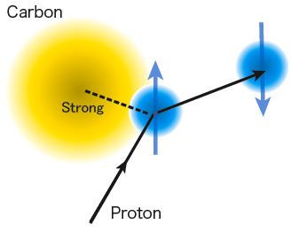
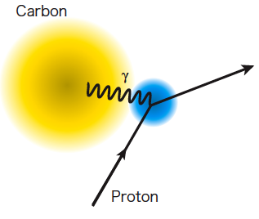
Primakoff (EM) Effect
neutron
Primakoff
Ultra Peripheral Collision (UPC)
A
A
EM-field
t → 0
α
α_{ΕΜ}
A
A
γ∗
π⁺
↑
p
n
p
↑
n

Slide 37
Primakoff (EM) Effect
neutron
Primakoff
Ultra Peripheral Collision (UPC)
A
A
In pAu case
t → 0
α
α_{ΕΜ}
A
A
γ∗
π⁺
π⁺
↑
p
n
p
↑
n
Δ

Slide 39
UPC Monte Carlo
Neutral Particle @ 200GeV
QCD(DPMJET)
ZDC
UPC
(SOPHIA)
Predicts comparable yields between QCD and UPC processes

Slide 40
EM induced asymmetry
+
+

Slide 41
Full Description of A_{N}
d_{1~4} : relative phase of amplitudes
(For pp)
large
-t
small

Slide 42
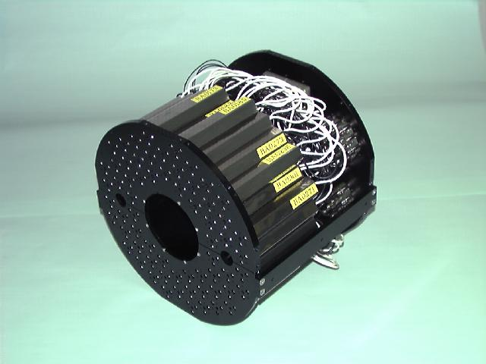
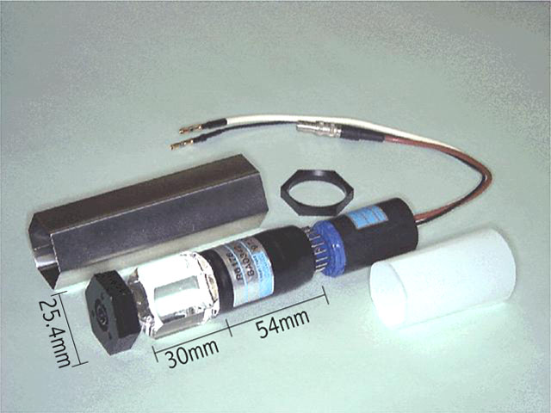
Beam-Beam Counter
PHENIX Detector
Dipole Bending Magnet
ZDC
BBC
Quartz Cherenkov radiator

Slide 43
Can we identify UPC events?
Semi-Inclusive
+
Dipole
π
+
π
6%
Δ
BBC
n
ZDC
94%
EM Monte Carlo : SOPHIA
G. Mitsuka, Eur. Phys. J.C. (2015) 75:614
BBC | tag | veto
EM | Small | Large

Slide 44
BBC Tagging and Vetoing
Inclusive

Slide 45
BBC Tagging and Vetoing
A
BBC
?
Non-diffractive
↑
p
n
BBC
BBC Tagging
EM surpressed

Slide 46
BBC Tagging and Vetoing
BBC Vetoing
A
γ*
Diffractive
π⁺
p
↑
n
EM enhanced

Slide 48

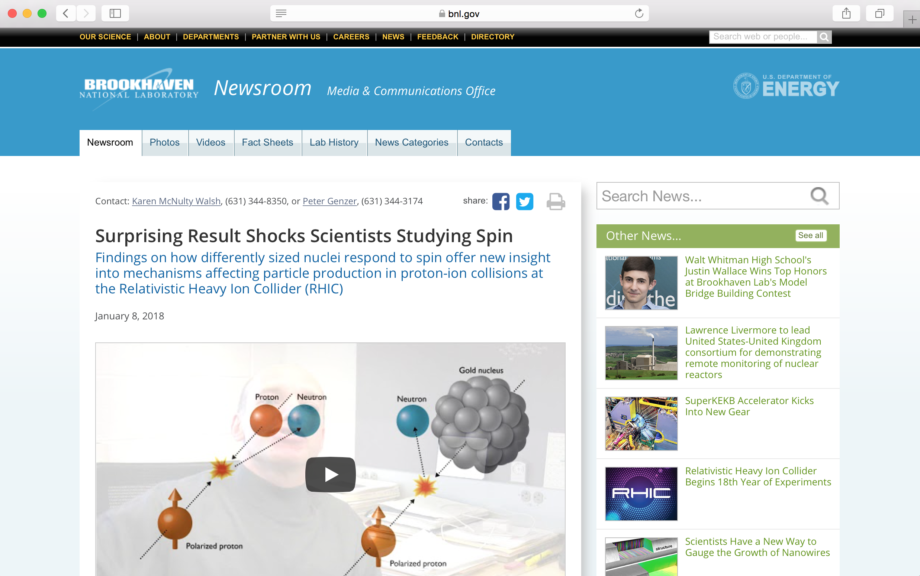
Press Release (2018/1/8)
Simultaneous release from RIKEN, JAEA, and BNL
http://www.riken.jp/pr/press/2018/20180109_2/
https://www.bnl.gov/newsroom/news.php?a=112177

Slide 49

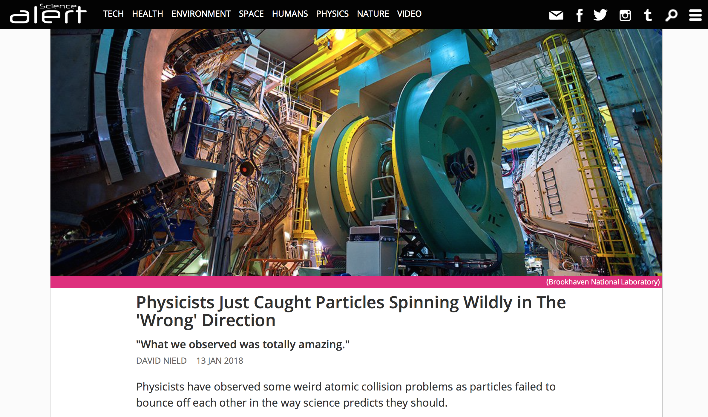
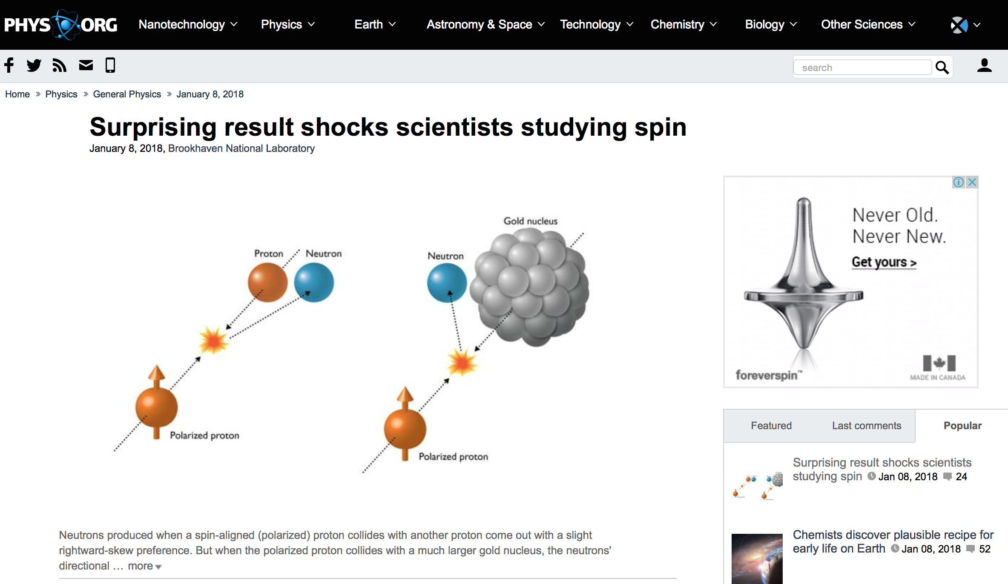


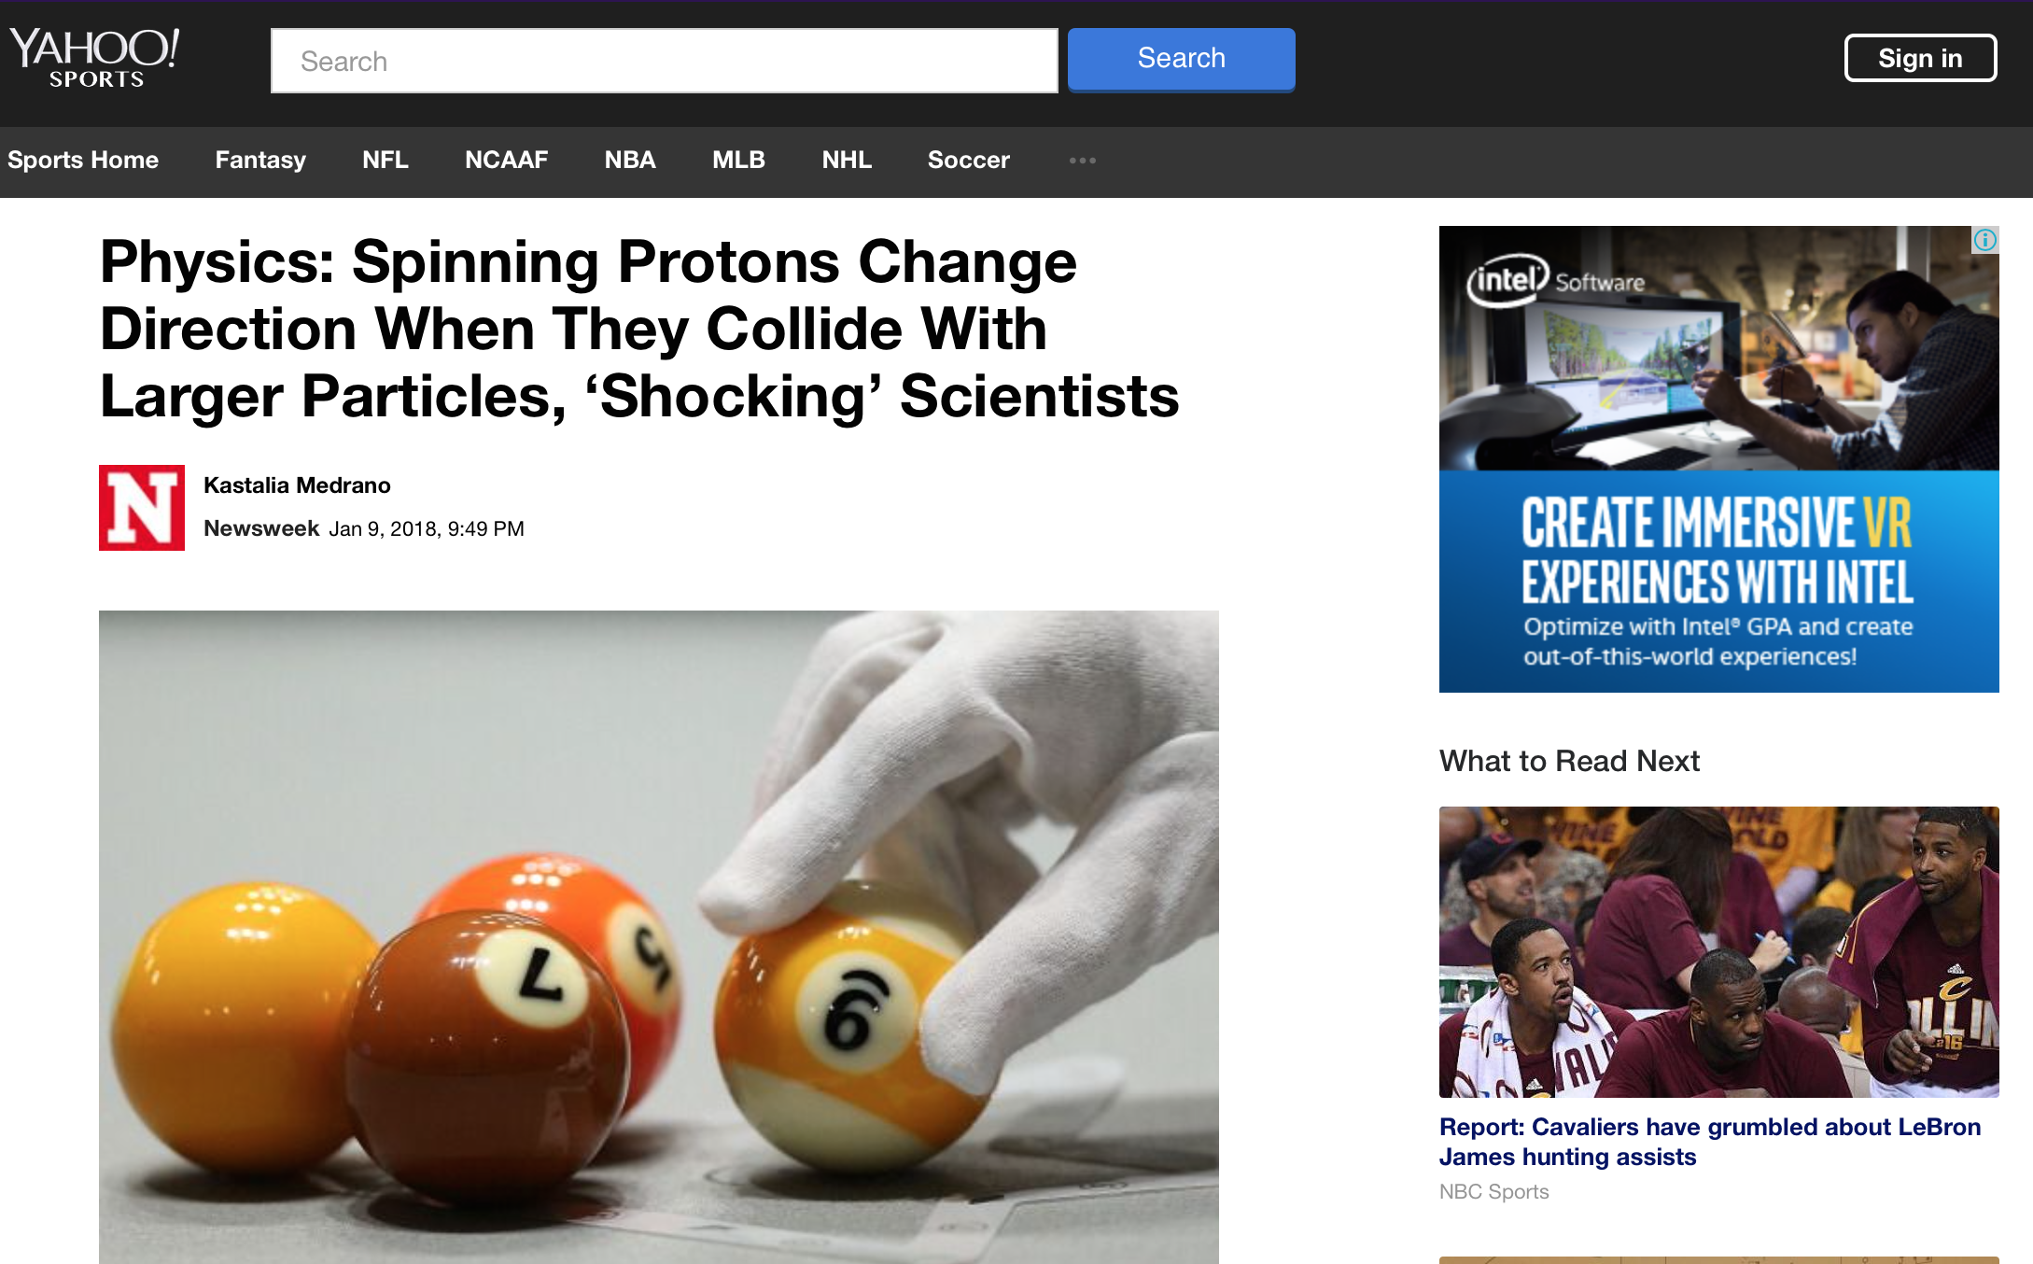


Impact of press release

Slide 50
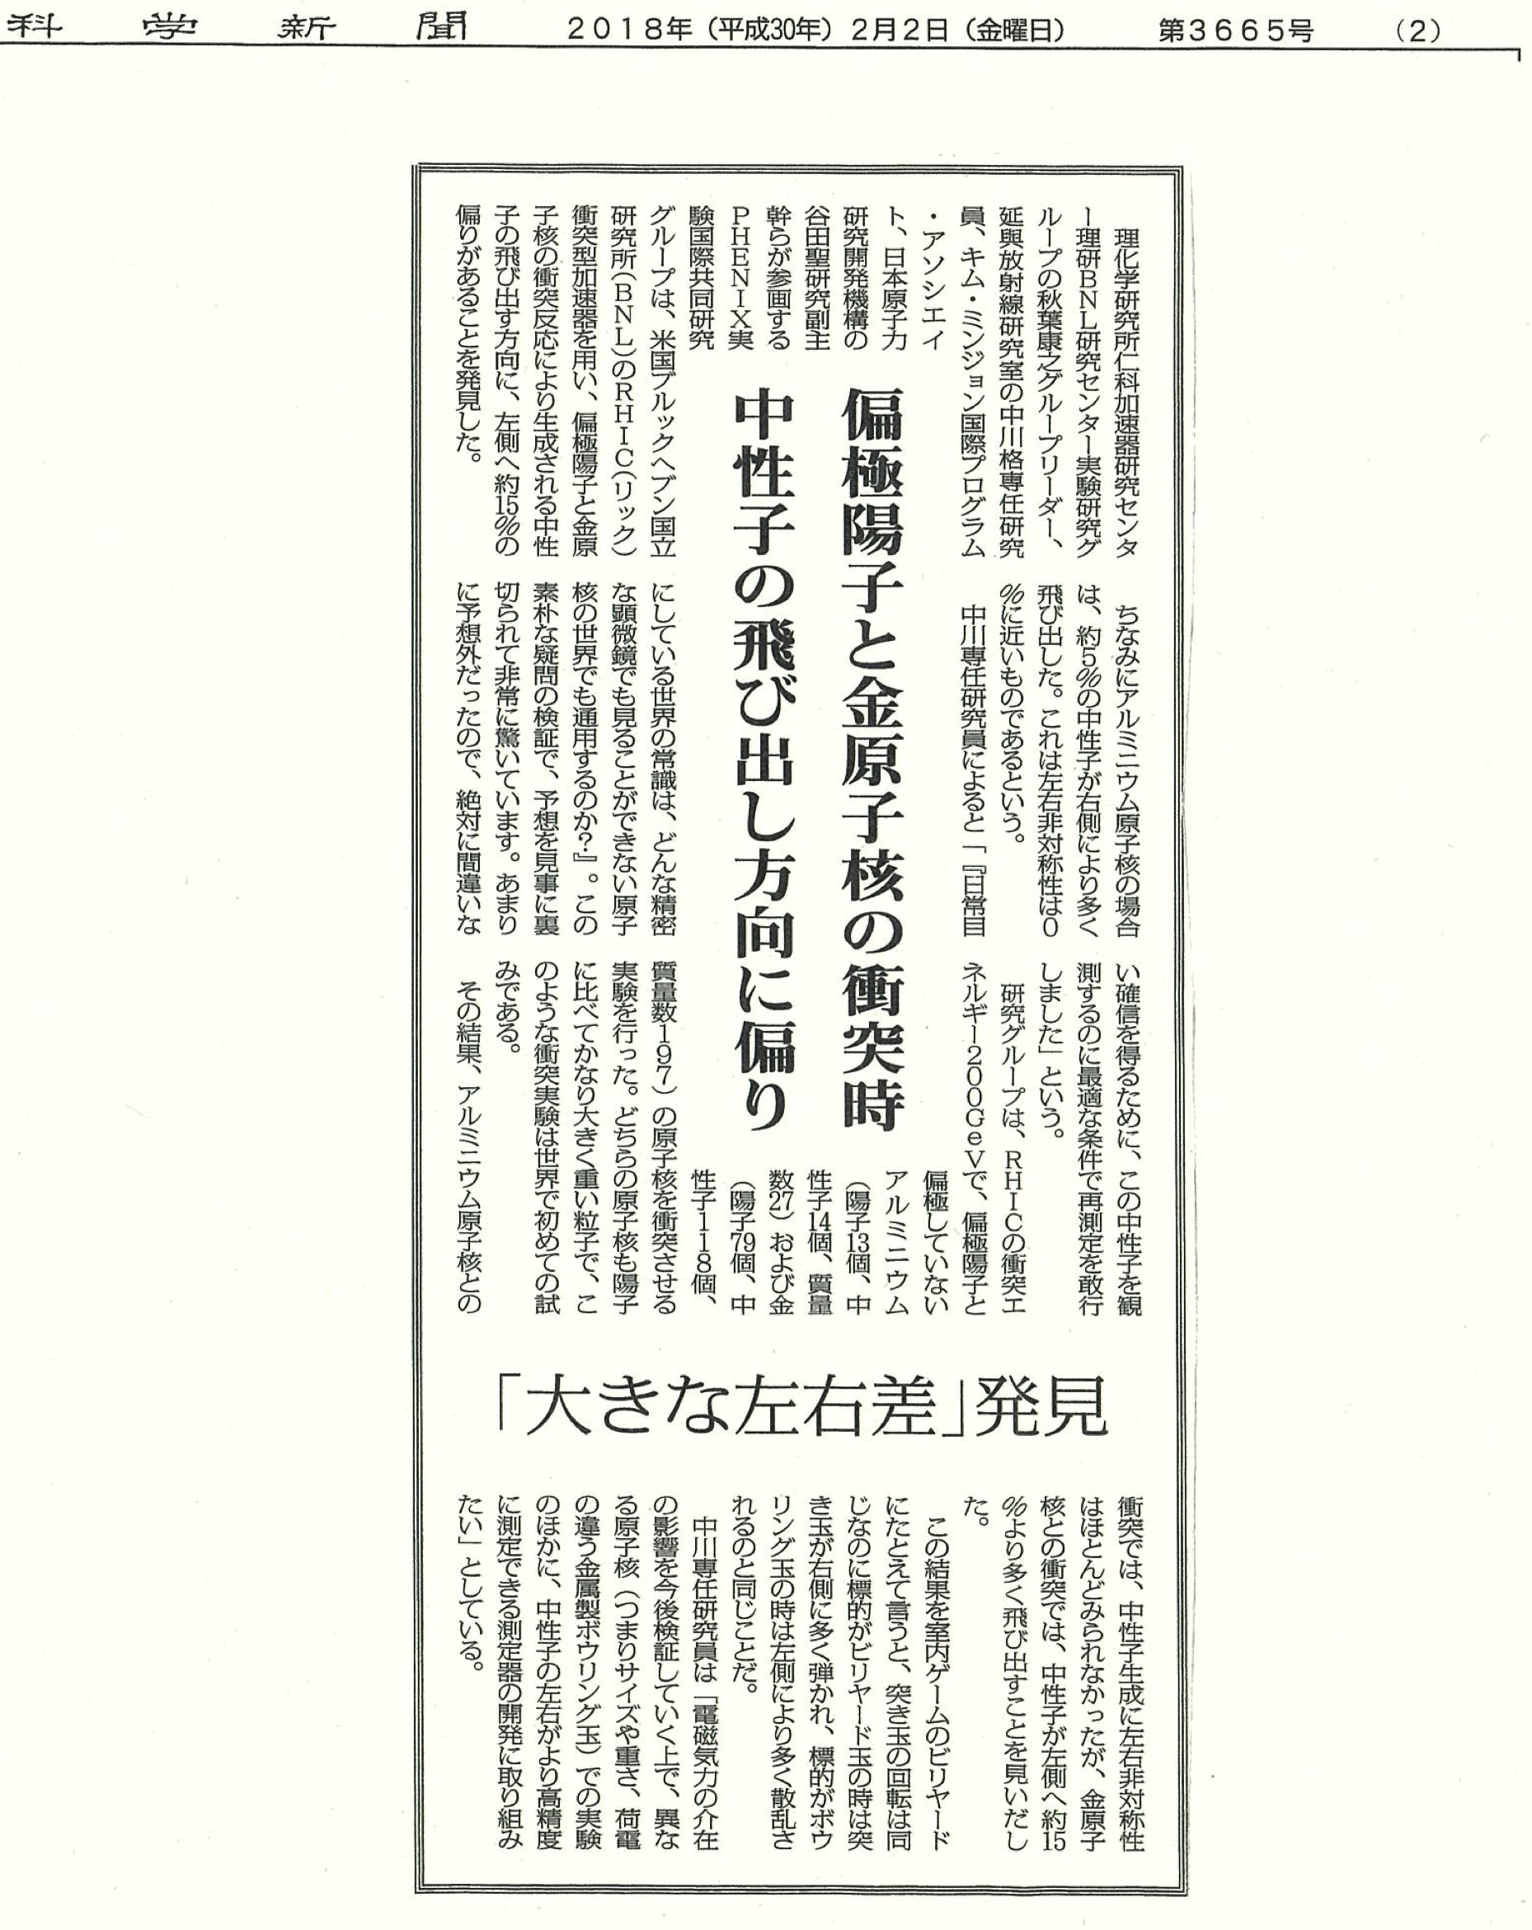

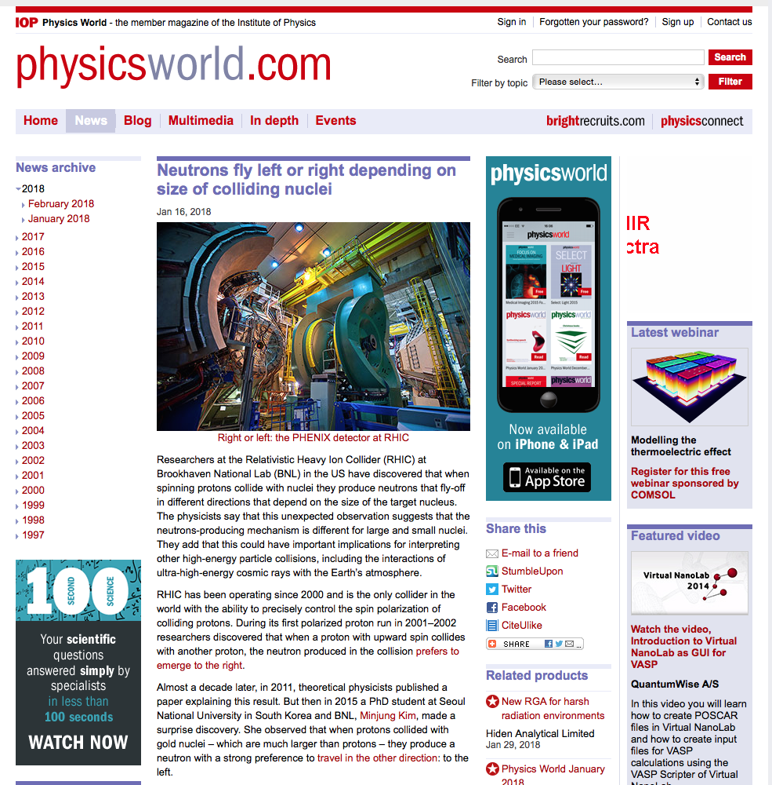
Original Articles

Slide 51
EM Induced Asymmetry
Existing Primakoff asymmetry experiment in Fermi lab.

Slide 53
Experiment
185GeV

Slide 54
Invariant Mass Distribution

Slide 55
-t Distribution
Finite asymmetry was observed
M
 | < 1.36 [GeV] | 1.36 – 1.62 [GeV]
< 0.001 (GeV/c)² | ー | ⭕️
> 0.001 (GeV/c)² | ー | ー
-t

Slide 56
Origin of the Asymmetry
Spin flip
Spin non-flip
A
A
A
A
γ∗
γ∗
π⁰
×
π⁰
p
p
p
p
Δ
Ν∗
D*(1232) P33
N*(1440 and higher) P11
Nπ (>99%)
Nπ (60∼70%)
Νππ (30∼40%)
Notes:
[Boris] In both diagrams the interfering gamma and pion cover the whole rapidity interval between the colliding p and A. The pion exchange is, as I said, strongly suppressed. However the OPE mechanism, responsible for neutron production, pion exchange cover only a small part of the rapidity interval. The main part in inelastic collision pi+P(A)=>X. The energy of this collision is very high s(1-z). When we square this inelastic amplitude, we get Pomeron.

Slide 57
Comparison between two Exp.
 | Fermi | RHIC
Beam Energy [GeV] | 185 | 100
√s [GeV] | 19.5 | 200
Target | Pb | Au
Observables | p + π⁰ | n ( + charged)
t' | < 0.001 | 0.02 < -t < 0.5*
M | 1.36 < M(π⁰p)<1.52 | 1.1 < M(π⁺n)<1.9
A_{N} | - 0.57 ± (0.12)_{sta}+ 0.21 - 0.18 | + 0.27 ± 0.003 (BBC veto)
*t is calculated based on neutron kinematics

Slide 58
UPC Cross Section
Photo-pion
production
A
γ∗
π⁺
p
↑
n
Δ

Slide 59
Polarized Target Photo Pion Production
γ∗
π⁺
p
↑
n
Δ
Asymmetry T
Leading Order Multipole Decomposition
Unpolarized
Polarized
Ref. D.DrechselandL.Tiator,J.Phys.G:Nucl.PartPhys.18,449(1992).

Slide 60
Unpolarized Response Function
Δ
MAID2007
1232MeV
D.Drechsel, S.S.Kamalov, and L.Tiator, Unitary Isobar model(MAID2007), Eur.Phys.J. A 34, 69 (2007).

Slide 61
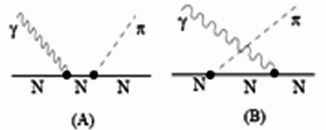
Polarized Response Function
Dominated by Kroll-Rudermann term
π⁺
γ∗
1232MeV
MAID2007
p
n

Slide 62
Invariant Mass Dependence
Unpolarized Cross Section
Polarized Cross Section

Slide 63
Origin of the Asymmetry
A
A
A
A
γ∗
γ∗
Fermi
π⁰
×
π⁰
p
p
p
p
Δ
Ν∗
A
A
A
A
γ∗
γ∗
RHIC
π⁺
×
π⁺
p
n
p
n
Δ
Notes:
[Boris] In both diagrams the interfering gamma and pion cover the whole rapidity interval between the colliding p and A. The pion exchange is, as I said, strongly suppressed. However the OPE mechanism, responsible for neutron production, pion exchange cover only a small part of the rapidity interval. The main part in inelastic collision pi+P(A)=>X. The energy of this collision is very high s(1-z). When we square this inelastic amplitude, we get Pomeron.

Slide 64
EM+Strong Calculation
Z-axis: R_{0y}/R₀₀
G. Mitsuka PRC95,044908(2017)
EM
Acceptance
Calculation
strong
Average A_{N}~ +0.36 within acceptance

Slide 65
hadronic
CNI
Primakoff
A
A
A
A
×
P
π⁰
π⁺
π⁺
p
n
p
n
Δ
Ν∗
×
A
A
A
A
γ∗
×
γ∗
π⁺
π⁺
p
n
p
n
Δ
RHIC (n+p⁺ channel)
Notes:
[Boris] In both diagrams the interfering gamma and pion cover the whole rapidity interval between the colliding p and A. The pion exchange is, as I said, strongly suppressed. However the OPE mechanism, responsible for neutron production, pion exchange cover only a small part of the rapidity interval. The main part in inelastic collision pi+P(A)=>X. The energy of this collision is very high s(1-z). When we square this inelastic amplitude, we get Pomeron.

Slide 66
Future Plans
p_{T}~-t or 1/b
Study pT dependent A_{N} to identify EM and strong interactions

Slide 67
Summary
Observed large opposite asymmetry of forward netruon in p↑+Au from what expected from to p↑+p
EM+strong induced asymmeties reproduce data reasonably well so far without Coulomb Nuclear Interference.
Detailed check should be made to test EM and strong interactions separately.

Slide 68
Backup slides

Slide 69
E0+ Amplitude
Re{E0+(pi+,n)} is large compared to others

Slide 70
E1+ Amplitude

Slide 71
M1+ Amplitude
(pi+,n) amplitudes are opposite of (pi0,p)

Slide 72
cos(40º) assumed

Slide 73
First term dominates.

Slide 74
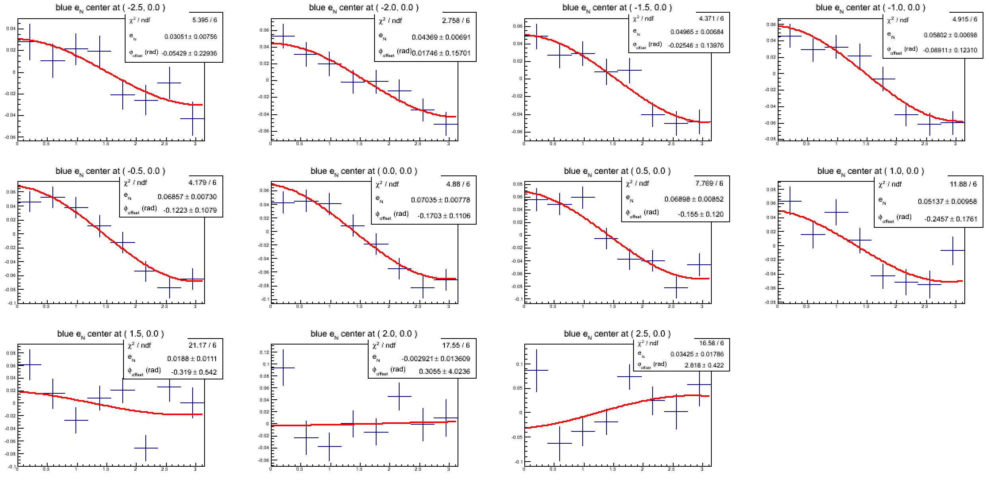
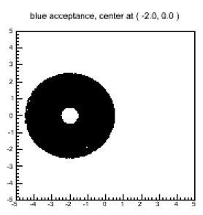
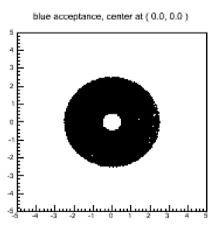
e_N fitting scan across X-axis
e_N maximum when it is calculated around the real beam center.
0.5 cm < r < 2.5 cm
Notes:
This plots shows the e_N fitting scan across X-axis to show how e_N can varies by changing assumed beam center.
I expected that I will get the largest e_N with beam center at -2 cm, but cosine modulation fitting is not
e_N will be maximum when it is calculated around the real beam center,

