Slide 1
Study on Amount of Material

Slide 2
In the electron measurement, amount of the material affects:
Conversion yield (largest background electrons)
Energy loss by Bremsstrahlung in the material
DCA distribution from conversions
The peak of the DCA from conversions are shifted due to the fake bending calculation.
The amount of the material is important
Amount of the material can be studied using Mee.
The comparison of Mee between data and sim.

Slide 3
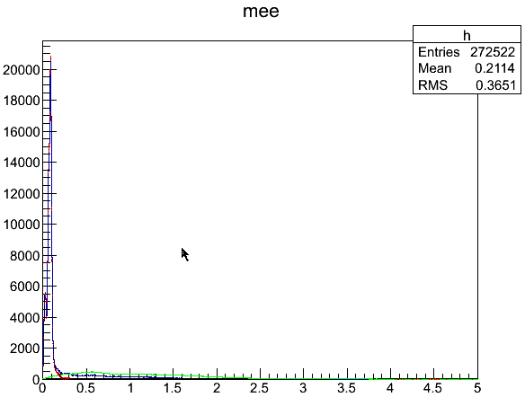
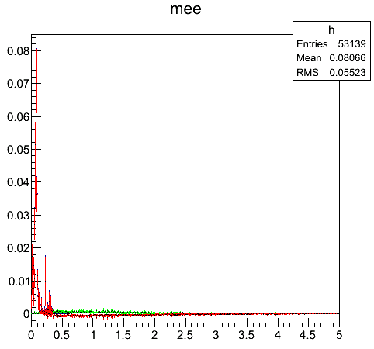
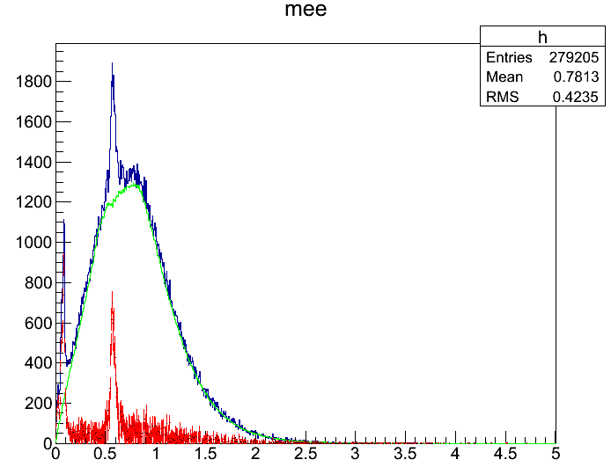
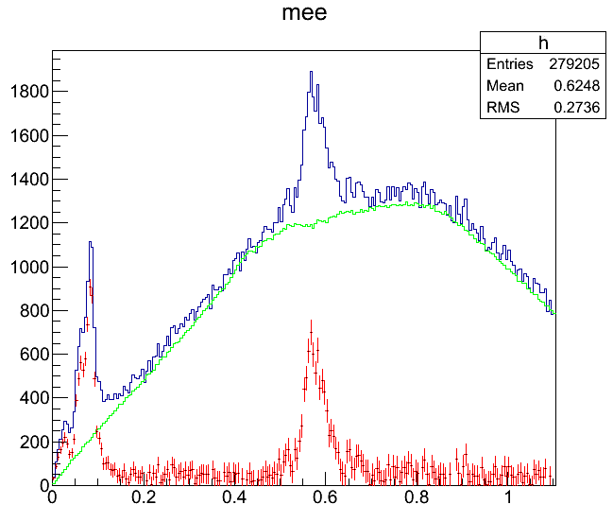
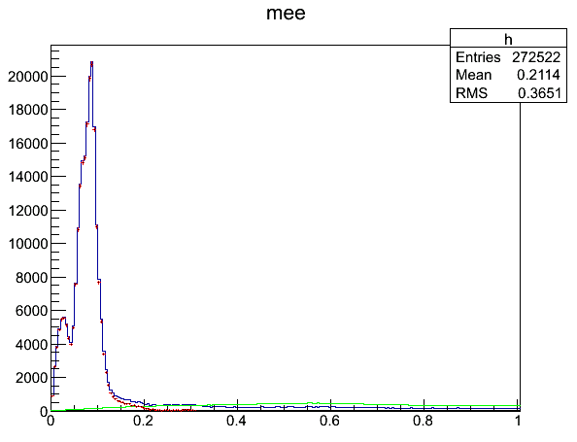
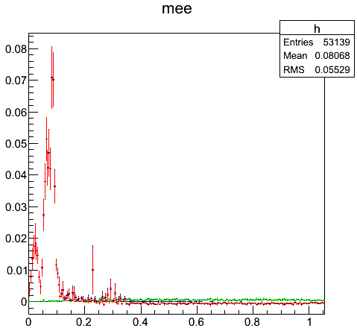
Comparison Mee distribution
Data: Run349206, 349425 (Au+Au), 100files ERT(pp)
Sim : Pi0 simulation with flat pT generated
pT weight : pT*(exp(-0.42172*pT-0.21329*pT*pT)+pT/0.70972)^{-8.34158} with primary pi0 pT
Net signal is extracted subtracting BG
Mee=0.6 is seen (check later)
Pp and sim has no combinatorial BG. These data are compared.
Data (AuAu)
Data (pp)
Sim
FG
BG(event mix)
Net

Slide 4
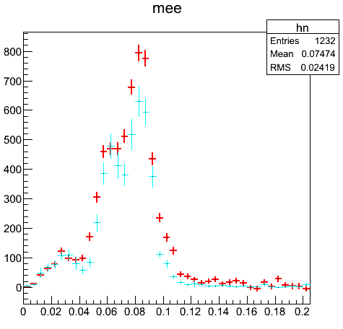
Comparison of Mee between data(pp) and simulation(pi0)
Using tigher eID cut and phiv cut, Mee is much cleaner.
These histograms are normalized so that Mee<0.04 is the same.
From the comparison, Mee yield is similar between data and simulation. But the Mee=0.08-0.1 seems to be different. Data has more material than sim.
I suspect that the cover material after the 4th strip layer is not well implemented in the simulation (Next page)
Data
Sim
Mee
N0>3, E/p>0.8, phiv>2.9, abs(emcdphi)<0.02
Dch mom is used to calculate Mee (not refit mom)
R(Mee(40-100)/Mee(0-40)):
Data(p+p): 8.63+- 0.0462
Sim : 8.44+- 0.0727
R(data)/R(sim) : 1.023 +- 0.0883

Slide 5
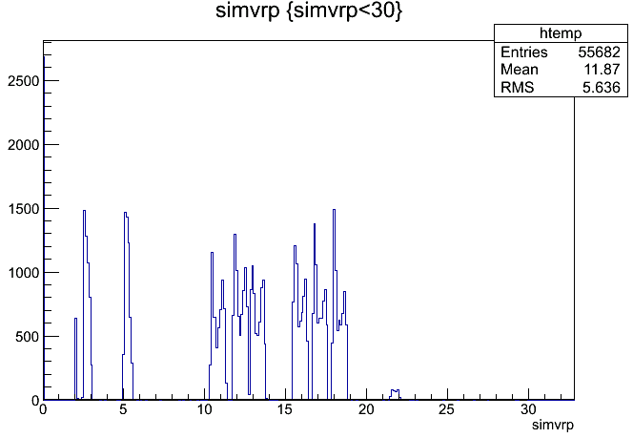
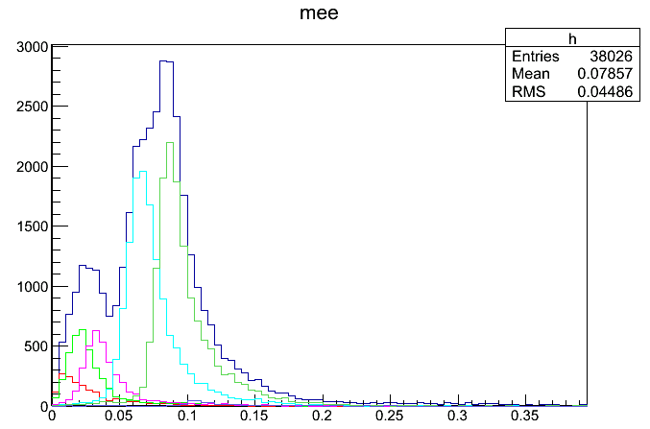
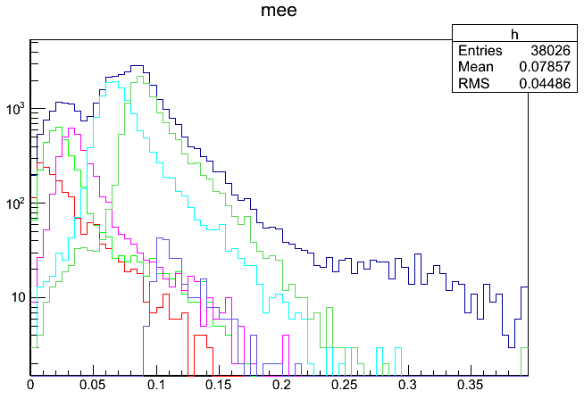
Conversion Position and Mee in Simulation
Conversion position in R (x-y)
Total
Dalitz
BP
B0
B1
B2
B3
B0
B1
B2
B3
Cover
We can trace the conversion position
in the simulation

Slide 6
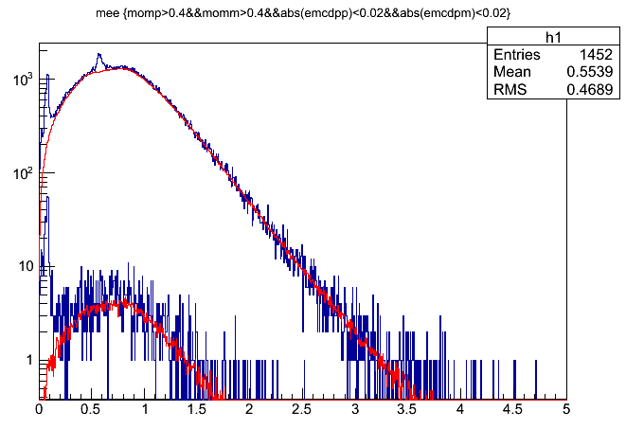
About Mee=0.6 peak
The peak (Mee=0.6) is disappeared in peripheral event.
This should be fake peak, not related to Physics (even conversion).
I thought that the ghost or mis-association due to higher multiplicity make the problem.

Slide 7
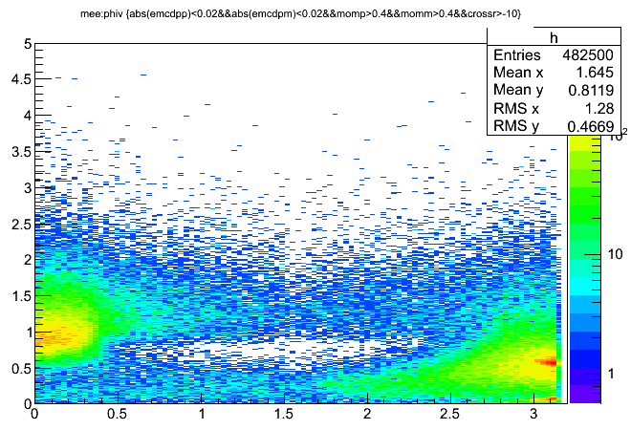
Correlation between phiv and Mee
The peak at Mee=0.6 has large phiv( almost pi) as same as conversion (Mee=0.1)
This suggests that the hadron paralell to the conversion electron makes the fake peak at Mee=0.6
The tracks going in paralell focus to the same ring on the RICH.
To confirm this, I checked Mee with tigher eID cut (next page)
Mee
AuAu MB
phiv

Slide 8
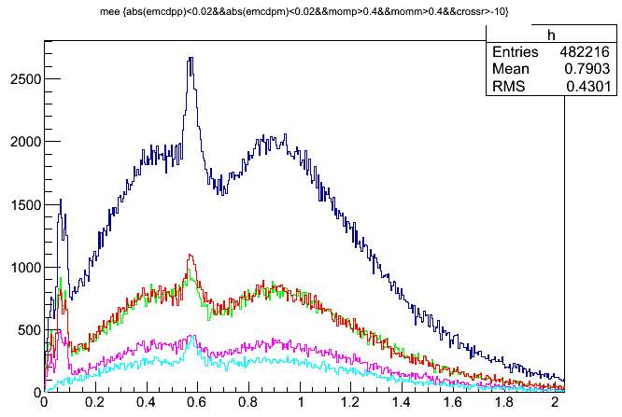
Mee with tigher eID
Compare Mee=0.6, 0.08 peak with tigher elD
If using tigher eID, the peak at Mee=0.6 get small, but Mee=0.08 does not change.
This shows the peak at Mee=0.6 is made from the hadron track with mis-ID
If choosing hadron even associated with RICH:
N0>2 & 0.5<E/p<0.8
The peak at Mee=0.6 was appeared and Mee=0.08(convpeak) was disappeared.
Mee (MB n0>2 E/p>0.5)
Mee (MB n0>3 E/p>0.5)
Mee (MB n0>2 E/p>0.8)
Mee (MB n0>3 E/p>0.8)
Mee (MB n0>2 0.5<E/p<0.8)
Here, DCH-mom is used to calculated Mee.
Refit mom is not used.

