Slide 1
YU, Haiwang (于海旺)
Ph.D. candidate at Peking University, student of Mao, Yajun
working in BESIII collaboration for 2 years
student of Ming and Xiaorong at PHENIX
will focus on Drell-Yan Asymmetry
am now trying to do B to Jpsi

Slide 2
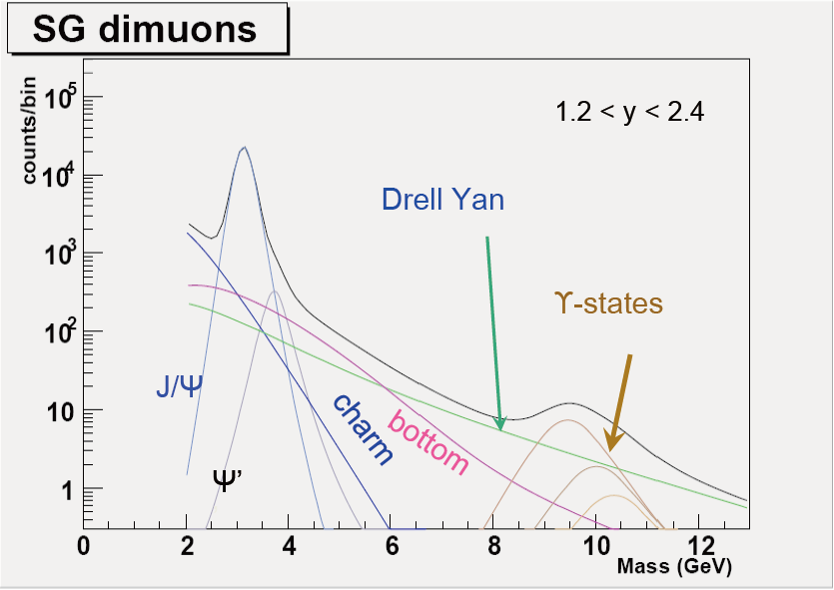
separate prompt and non prompt Jpsi
From Ming’s

Slide 3
outline
MC feasibility study using RooFit
unbinned 2D-fit (ALICE, CDF)
signal model:
mass: 𝐷𝑜𝑢𝑏𝑙𝑒 𝐺𝑎𝑢𝑠𝑠
testVar(squared sum of two trk DCArs): 𝐿𝑎𝑛𝑑𝑎𝑢⨂𝐺𝑎𝑢𝑠𝑠
bkg model:
use the side band to determine bkg shape
preliminary test of testVar distribution in different mass windows

Slide 4
data set for signal
 | b2jpsi | prompt Jpsi
pythia events | 1M | 1M
cross-section (mb) | 5.4D-03 | 9.0D-04
lum_gen(pb-1) | 0.19 | 1.1
lum_run12(pb-1) | 30 | 30
scale factor | 160 | 27
BR factor | ~1.% * 5.93% | 5.93%
Scale factor’ | 9.6D-2 | 1.6
Entries | 393’222 | 89’882

Slide 5
model_2: $Double Gauss ⋅Landau⨂Gauss$
b2Jpsi
$$\frac{χ^{2}}{d.o.f}=1.06653$$
$$\frac{χ^{2}}{d.o.f}=1.01857$$

Slide 6
model_2: $Double Gauss ⋅Landau⨂Gauss$
prompt
$$\frac{χ^{2}}{d.o.f}=0.754807$$
$$\frac{χ^{2}}{d.o.f}=0.740243$$

Slide 7
model_2: 2D-fit $\left(fitResult −input\right) vs. input$

Slide 8
model_2: $ratio=\frac{fitResult −input}{input} vs. input$

Slide 9
model_2: DCAr 1D-fit

Slide 10
data set for bkg
 | bb | dy
pythia events | 100M | 10M
cross-section (mb) | 5.4D-03 | 1.8D-4
lum_gen(pb-1) | 19 | 56
lum_run12(pb-1) | ~30 | ~30
scale factor | 1.6 | 0.54
Entries | 1’200’478 | 1’105’029

Slide 11
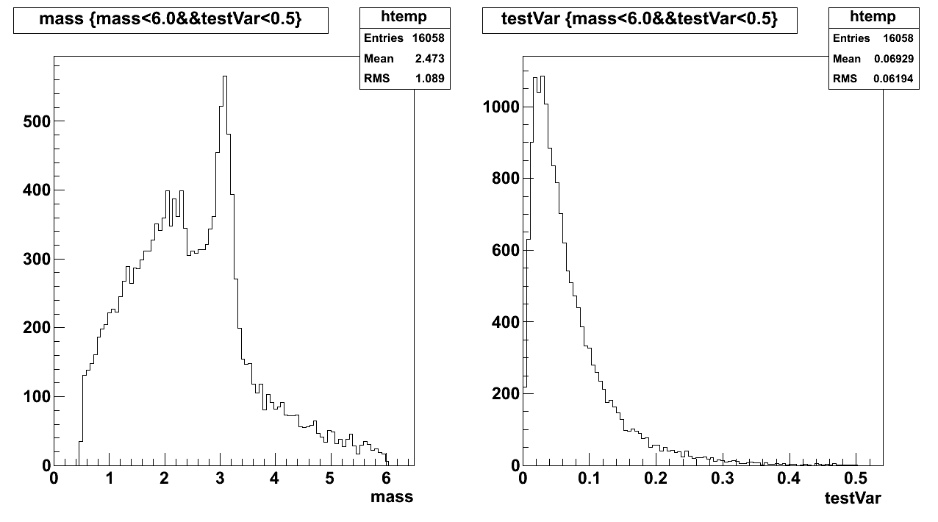
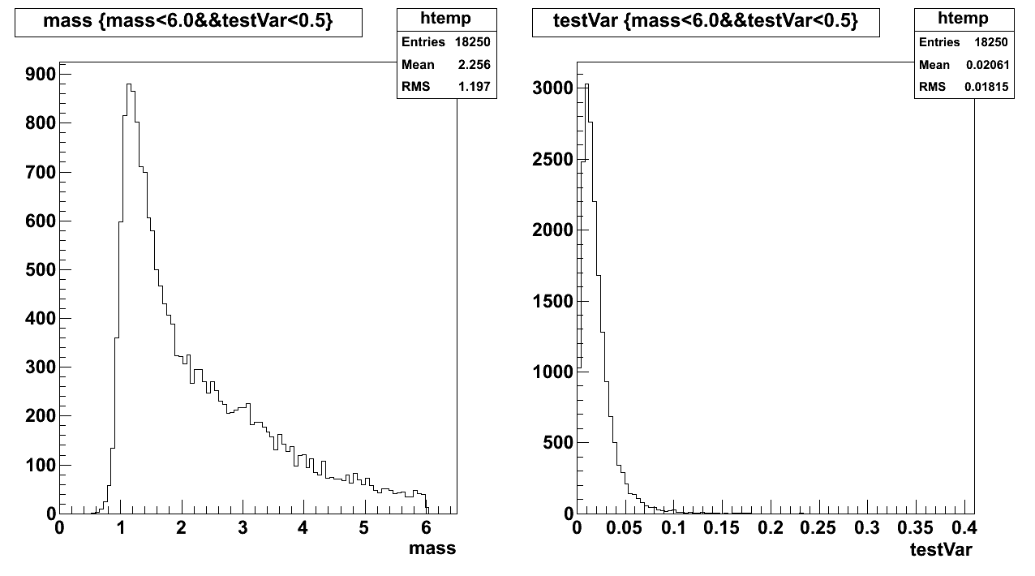
bb
dy

Slide 12
bb
fit result (LD_mean, LD_sigma) with different windows of di-mu mass:
min_win~min_win+1(GeV)

Slide 13
dy

Slide 14
Thank You

Slide 15
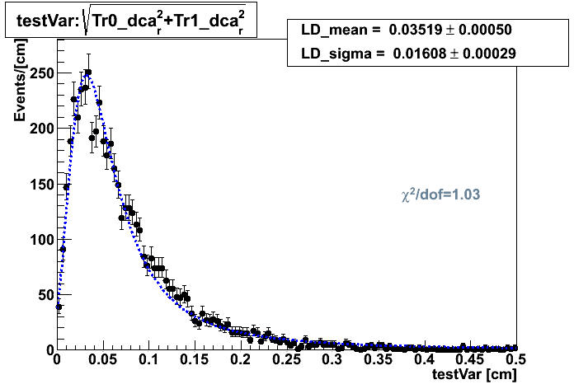
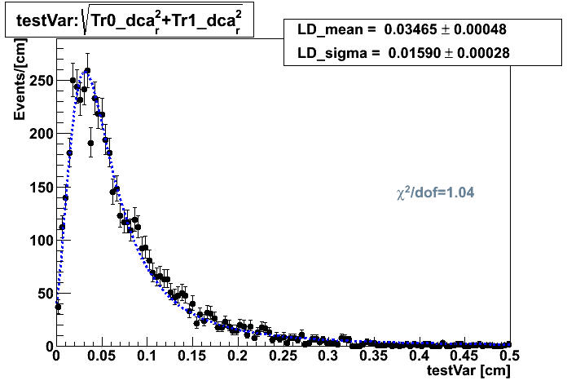
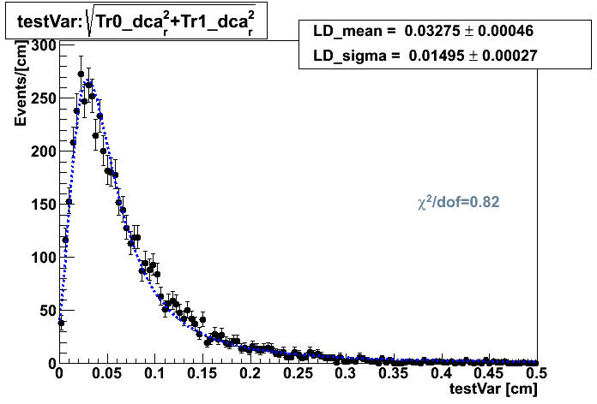
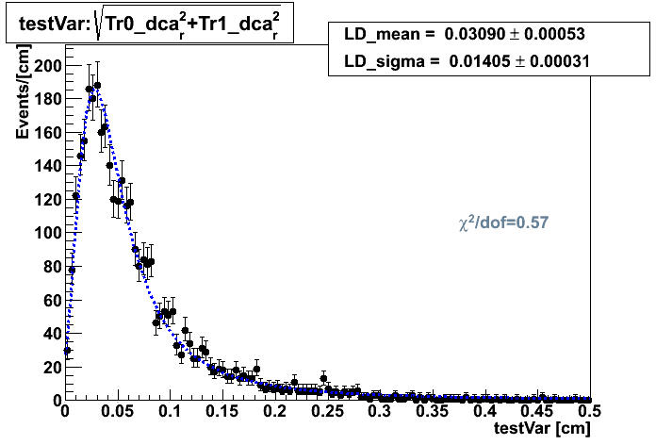
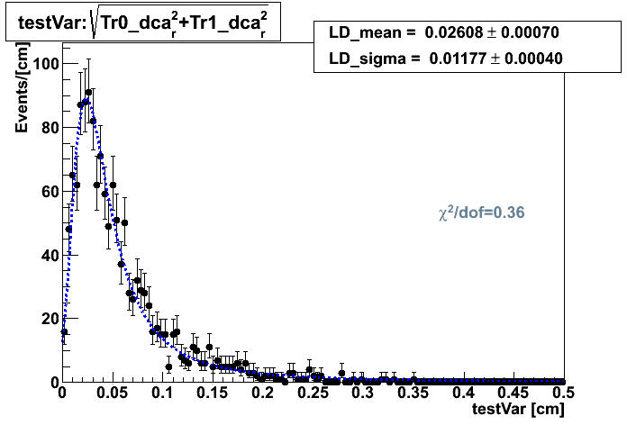
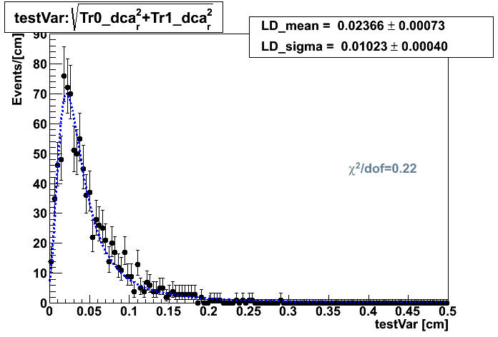
backup
bb

Slide 16
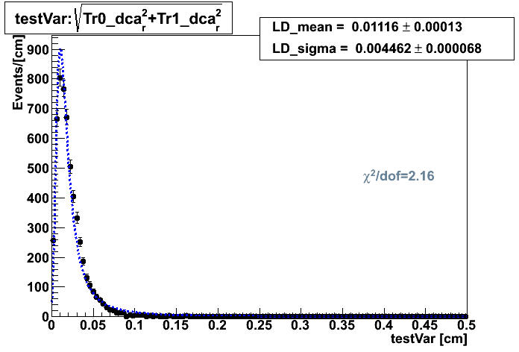
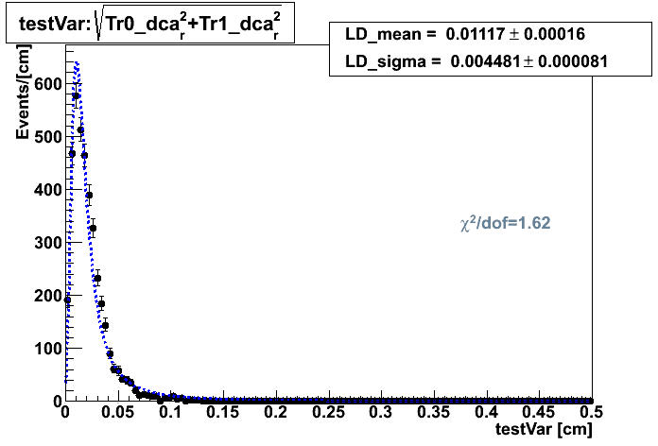
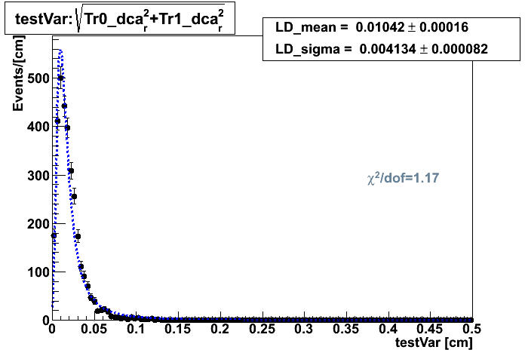
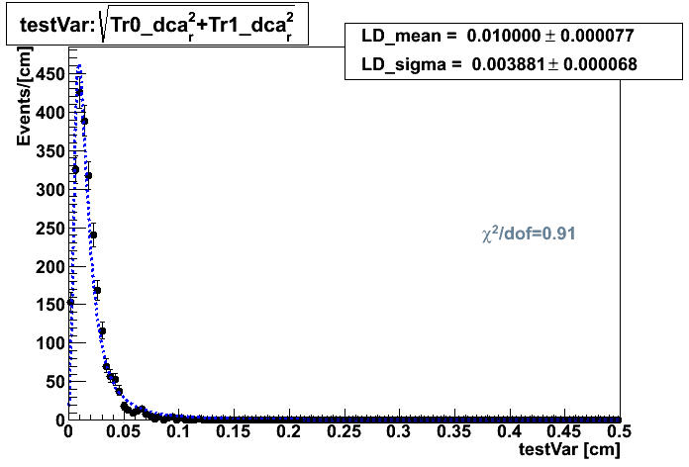
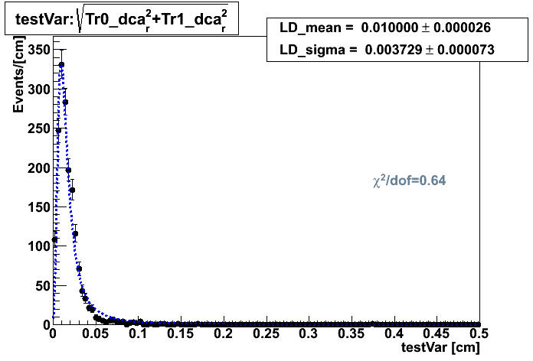
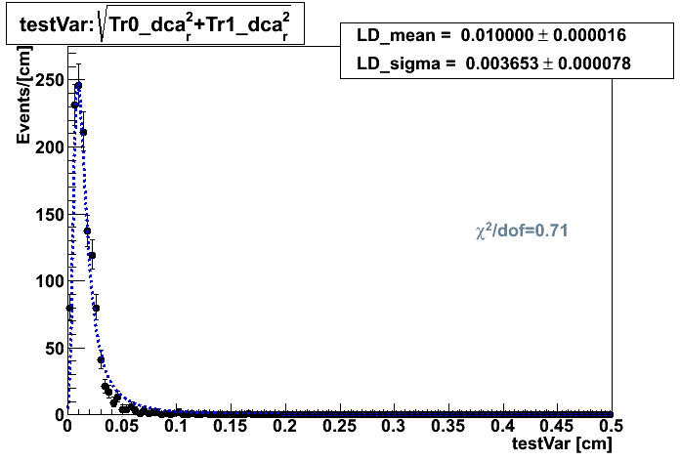
backup
dy

