Slide 1
Rapidity Separated Jet-Hadron Correlations
Josh Perry
Iowa State University
PHENIX Collaboration

Slide 2
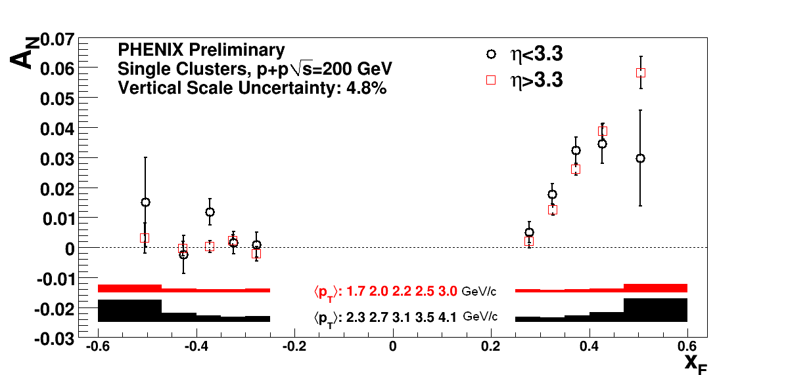
Measurement at PHENIX
Collide transversely polarized protons
Left
= particle yield to the left versus particle yield to the right
Right
Experiment

Slide 3
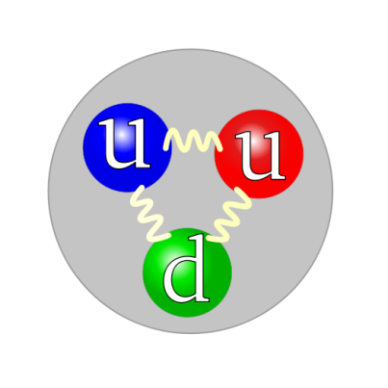
Asymmetry Sources
Sivers Effect
Initial state effect
Proton spin and parton transverse momentum are correlated
Left
Right
kT

Slide 4
Asymmetry Sources
Sivers Effect
Initial state effect
Proton spin and parton transverse momentum are correlated
Final state quark momentum leaves asymmetrically
Results in final state Left/Right asymmetry of fragmentation hadrons
Left
Right

Slide 5
Asymmetry Sources
Collins Effect (coupled with Transversity)
Final state effect
Final state quark leaves WITHOUT asymmetry but inherits proton polarization (through transversity)
Left
Right

Slide 6
Asymmetry Sources
Collins Effect (coupled with Transversity)
Final state effect
Final state quark leaves WITHOUT asymmetry but inherits proton polarization (through transversity)
Quark spin and quark fragmentation shape are correlated
Results in a final state Left/Right asymmetry of fragmentation hadrons
Left
Right

Slide 7
My Research
Measure the Collins Effect independent of Sivers
Find a way to ignore initial state Sivers Effect
Collins and Sivers (possibly more)
Collins alone, no Sivers
?
MPC Single Cluster Asymmetry
We’re going to need a place to collide protons and detect particle showers exiting the collision...

Slide 8
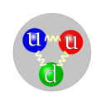
PHENIX crayon drawing
PHENIX Central Arm Detectors
PHENIX Forward EM Calorimeter (MPC)

Slide 9
Hard Scattering
2 -> 2 scattering at leading order
Conservation of momentum
Outgoing partons back-to-back in CM frame
q
q
G
G
q
G

Slide 10
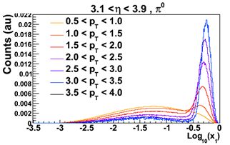
Hard Scattering
2 -> 2 scattering at leading order
Conservation of momentum
Outgoing partons back-to-back in CM frame
q
q
G
G
q
G
Higher x

Slide 11
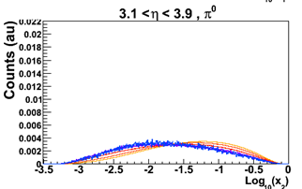
Hard Scattering
2 -> 2 scattering at leading order
Conservation of momentum
Outgoing partons back-to-back in CM frame
q
q
G
G
Lower x
q
G
Higher x

Slide 12
Kinematic Selection
PHENIX Central Arm Detectors
q
G
PHENIX Forward EM Calorimeter (MPC)
Automatic bias of parton species from our detector positions (and kinematic selection)
The goal is Collins: now we just need transversely polarized quarks so we can detect the fragmentation products.

Slide 13
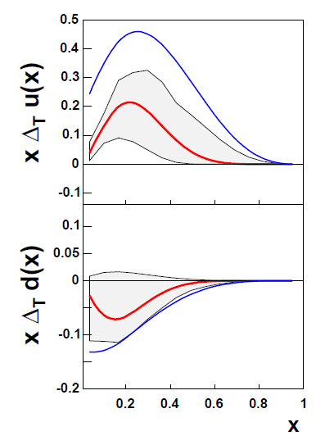
Transversity Distribution
How often is a quark’s spin parallel to the proton’s spin direction?
u-quark
Spin 1/2
d-quark
hep-ph/070100v3

Slide 14
Kinematic Selection
PHENIX Central Arm Detectors
q
G
PHENIX Forward EM Calorimeter (MPC)
We now have set up a bias for mostly transversely polarized quarks to be headed toward our detector!

Slide 15
Kinematic Selection
PHENIX Central Arm Detectors
fragmention hadrons
q
G
fragmention neutral pion
PHENIX Forward EM Calorimeter (MPC)
After the collision, the forward-going quark and central-going gluon fragment into particle showers

Slide 16
Kinematic Selection
PHENIX Central Arm Detectors
Reconstructed central jet direction
q
G
fragmention neutral pion
PHENIX Forward EM Calorimeter (MPC)
Sum up central particle shower constituent momenta to reconstruct central gluon (jet) momentum.
FastJet Anti-K_T algorithm applied
PHENIX does not have hadronic calorimetery, jet energy goes missing…

Slide 17
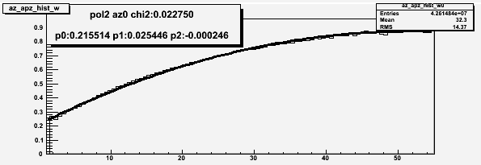
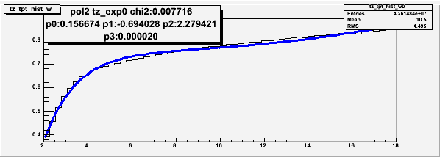
P_reco/P_jet correction
Apply a momentum correction based on the sampled longitudinal momentum fraction during fragmentation
i.e.; momentum of the reconstructed jet divided by the momentum of the jet in monte carlo
<z> = P_hadron/P_parton
<z>
Forward pion
P_reco/P_jet
Central jet
p
p

Slide 18
‘Flip and Swap’
PHENIX Central Arm Detectors
Reconstructed (central jet)/(P_reco/P_jet) direction
q
G
fragmention (neutral pion)/<z>
PHENIX Forward EM Calorimeter (MPC)

Slide 19
‘Flip and Swap’
Perform Lorentz boost to CM frame of central jet and forward neutral pion
Reconstructed (central jet)/(P_reco/P_jet) direction
q
G
forward jet direction (unobserved)
fragmentation (neutral pion)/<z>

Slide 20
‘Flip and Swap’
Flip reconstructed central jet direction around 180 degrees
q
G
forward jet proxy direction
fragmentation neutral pion

Slide 21
‘Flip and Swap’
hadron
quark spin
forward quark
proxy direction
Flip reconstructed central jet direction around 180 degrees
Measure the hadron’s direction relative to the forward jet (proxy) direction (and projected spin axis)
Asymmetry seen in fragmentation?
Too much smearing due to ‘Flip and Swap’?
φ
q
G
forward jet proxy direction
fragmentation neutral pion
Let’s check with simulation.

Slide 22
Simulation
No simulation existed to do what we needed
proton-proton collisions
Transversity to give final state quarks a polarization
Collins fragmentation
ToyMC Monte Carlo (simulation)
Created at Iowa State University
Now available publically as TPPMC (http://code.google.com/p/tppmc/)
PYTHIA simulation package
Performs hard scattering
Using Anselmino et al. global fits from HERMES and COMPASS fixed target data
Initial state transversity weighting
Gives final state quarks polarization
Independent fragmentation model
Applies Collins Effect to fragmentation
Sivers final state event weighting is also available

Slide 23
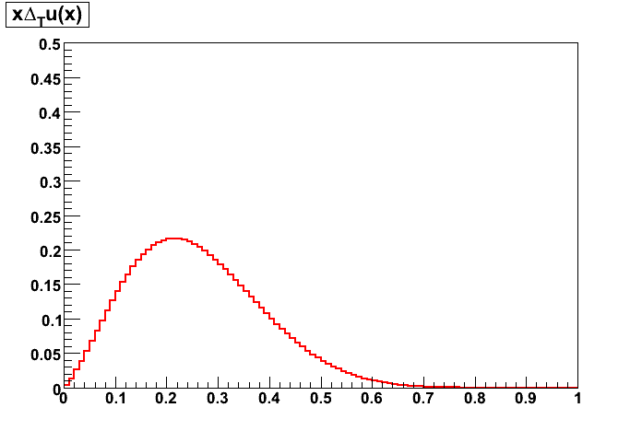
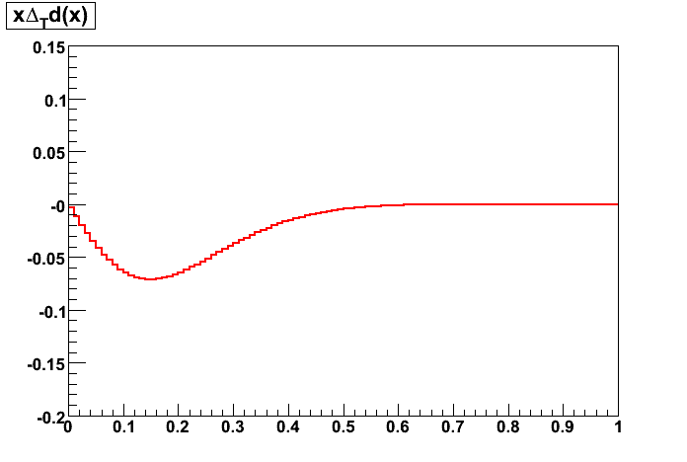
Transversity
hep-ph/070100v3
ToyMC Monte Carlo
x
ToyMC consistent with published distributions; transv. opposite for down quarks.

Slide 24
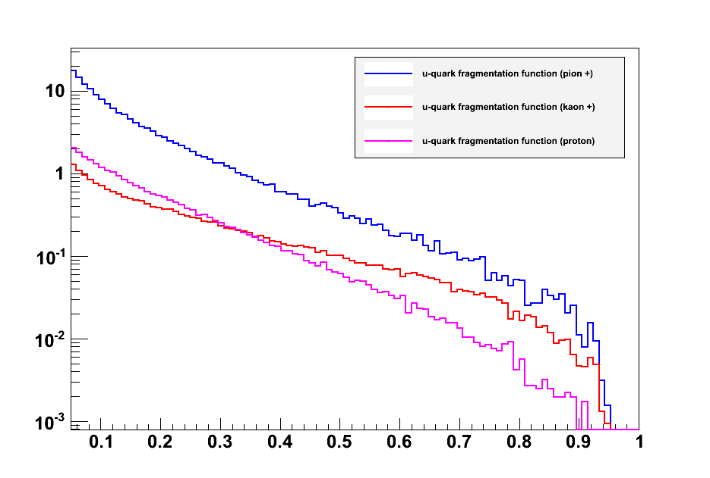
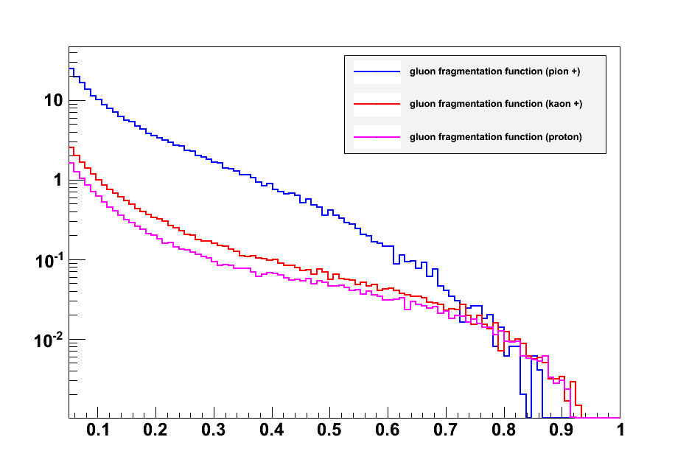
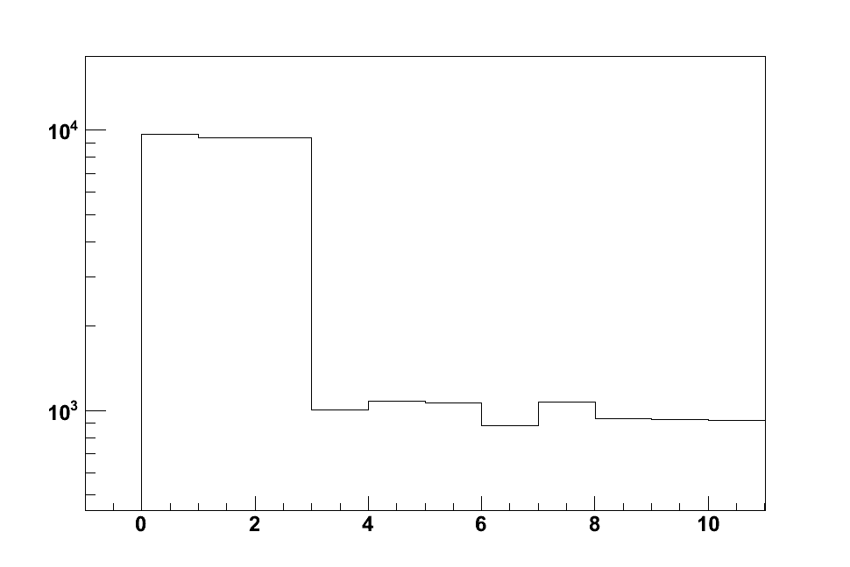
Fragmentation
u-quark fragmentation
gluon fragmentation
Pion+
Kaon+
Proton
(DSS)
(DSS)
z
z
Particle yield
π+
π-
π⁰
Κ⁰
Κ⁰
Κ+
K-
p
p
n
n

Slide 25
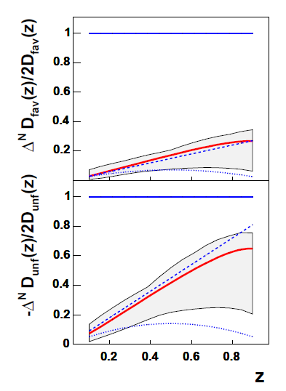
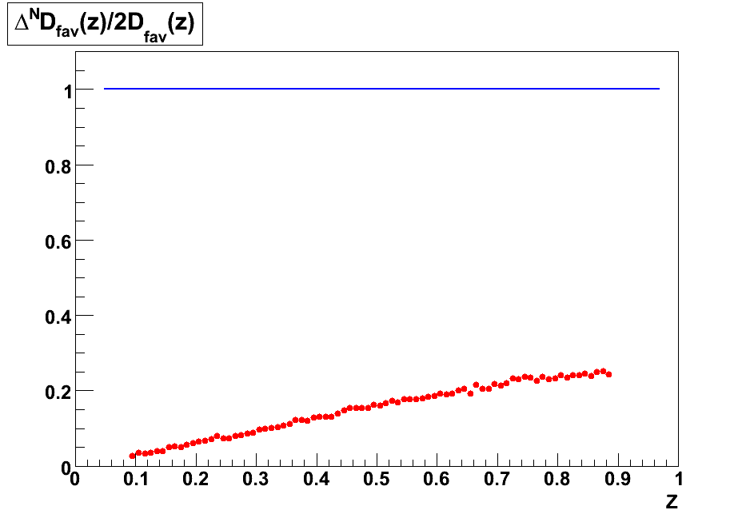
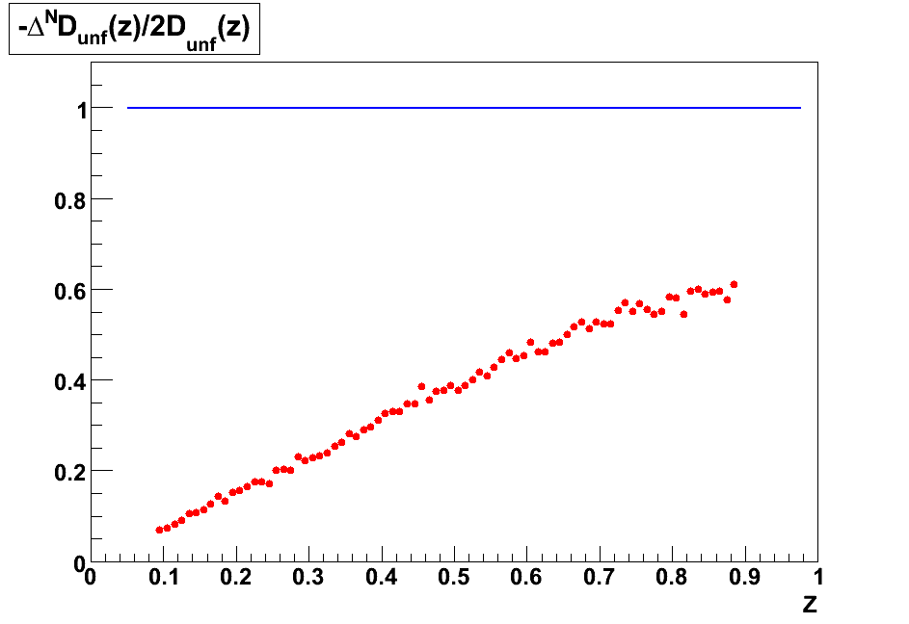
Collins Function
Check implementation by reproducing Anselmino et. al. results:
Phys.Rev.D75:054032,2007
ToyMC Monte Carlo
Large asymmetry at high z

Slide 26
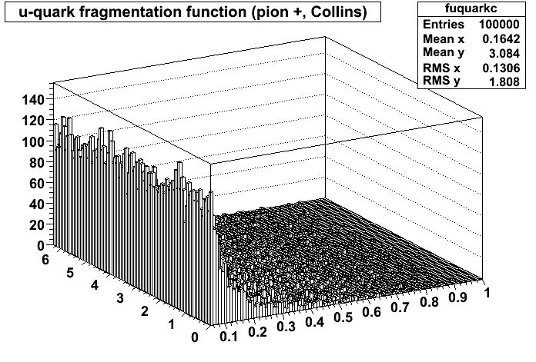
Collins Function
Check implementation by reproducing Anselmino et. al. results:
Phys.Rev.D75:054032,2007
φ
z
Actual fragmentation function sampled is now a 2D function

Slide 27
‘Flip and Swap’ simulation results
Use the ToyMC Monte Carlo
Perform the ‘Flip and Swap’ procedure
Collins effect seen? Sin(phi) distribution of fragmentation hadrons about quark direction?
hadron
Neutral pions
quark spin
forward quark
proxy direction
φ
Phi
Using the Anselmino group’s global fit mean values

Slide 28
‘Flip and Swap’ simulation results
Use the ToyMC Monte Carlo
Perform the ‘Flip and Swap’ procedure
Collins effect seen? Sin(phi) distribution of fragmentation hadrons about quark direction?
Neutral pions
Large smearing
Jet axis reconstruction
‘Flip and Swap’
Large asymmetry at high z
The asymmtery is large enough to be seen through the smearing
Phi
Using the Anselmino group’s global fit mean values

Slide 29
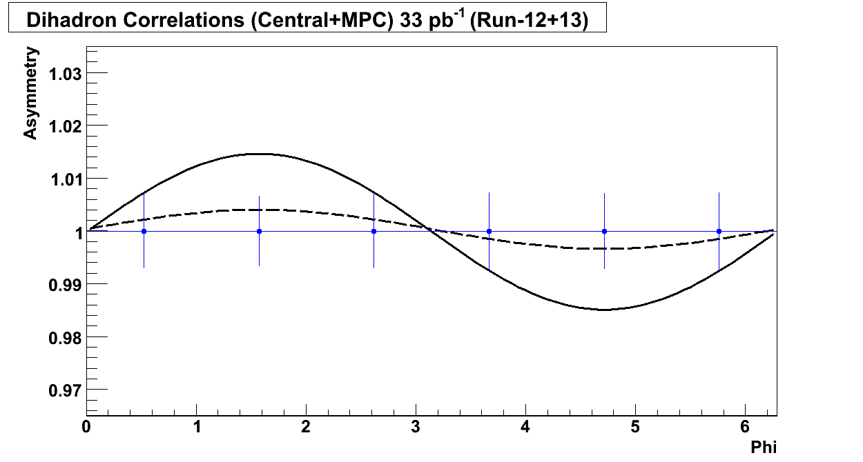
Projected resolution
Simulation parameters
Statistical yield based on Run8 ‘proof of principle’ data analysis
Error bars are statistical errors for 33 pb^-1 (Run12+13)
Taking into account PHENIX uptime, z vertex cut, etc.
Solid and dashed lines: 100% and 25% Collins contributions

Slide 30
Progress
Run12pp200 calibrations
Drift-chamber beam offset calibration
Global momentum scale calibration
MPC gain calibration
PC3 charged track matching sigmalized recalibration
EMC charged track matching sigmalized recalibration
EMC Time of Flight calibration

Slide 31
BACKUP
End

Slide 32
MPC Asymmetry
Run8 (2008) transverse spin MPC data
Instead of a fancy A*sin(phi) this compares left and right halves
Effectively A*sin(phi) with only two phi bins
x_F is similar to x

Slide 33
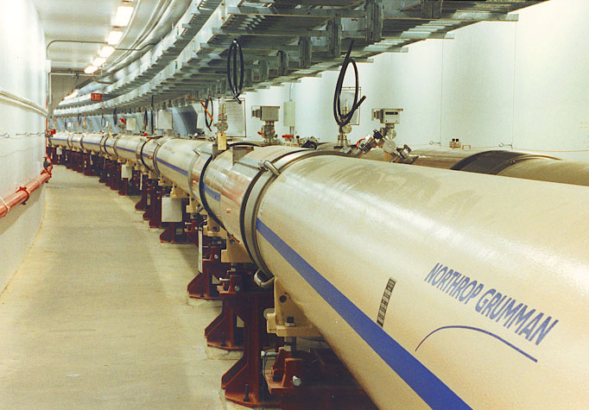
RHIC
The tunnel

Slide 34
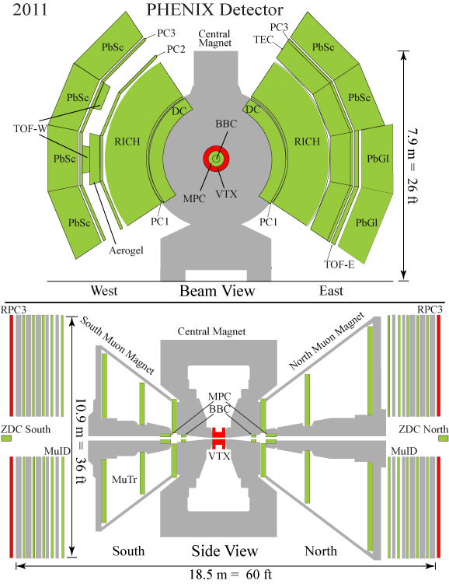

Slide 35
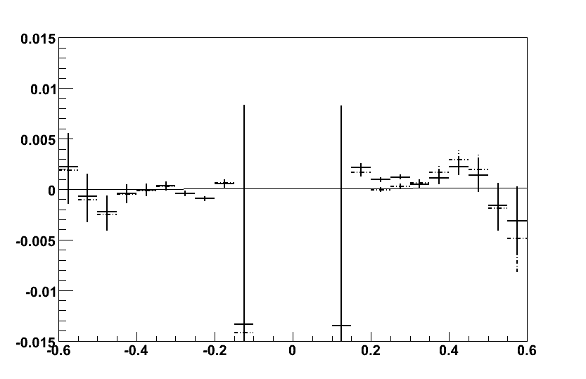
Comparison to Data
SOLID: Collins only
DASHED: Collins+Sivers
Simulation
Simulation
Plot courtesy of John Lajoie

Slide 36
Partile Yield
π+
π-
π⁰
Κ⁰
Κ⁰
Κ+
K-
p
p
n
n
Plot courtesy of John Lajoie

Slide 37
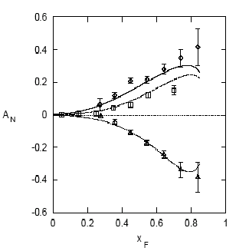
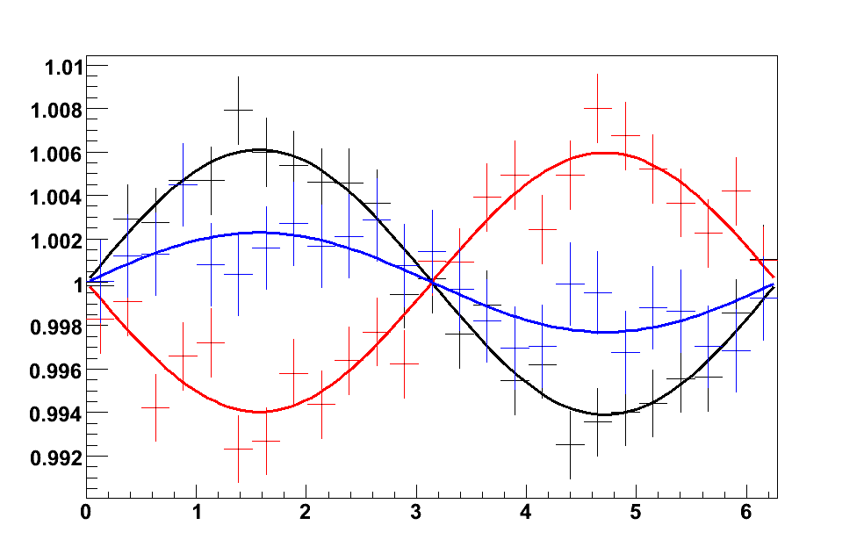
Comparison of pion asymmetries
parton
E704: Left-right
asymmetries
A_{N} for pions:
π⁺
spin
pion
π⁰
A_{N}
Black – pi+
Red – pi-
Blue – pi0
π⁻
x_{F}
pi0 FF is taken as all favored (based on quark content)
shown averaged over all quark flavors
φ (radians)
Plot courtesy of John Lajoie

Slide 38
Ideal case, probing Transversity*Collins
Throw a polarized quark, watch it fragment

Slide 39
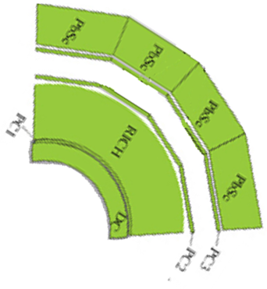
Ideal case, probing Transversity*Collins
Throw a polarized quark, watch it fragment
Put a big particle detector in front of it

Slide 40
Ideal case, probing Transversity*Collins
Throw a polarized quark, watch it fragment
Put a big particle detector in front of it
… but of course we need a quark from a proton
At high x
Polarized quark
No gluons

