Slide 1
Introduction to Perturbative QCD
Hiroyuki Kawamura (KEK)
PHENIX Spinfest at RIKEN, Wako
16-17 July 2013

Slide 2
Outline
Lecture 1: Introduction, Renormalization, Asymptotic Freedom
Lecture 2: α_{s} determination, RG equation, Scale dependence
Lecture 3: IR divergence, NLO calculation, Factorization
Lecture 4: DIS, DGLAP equations, parton distribution functions

Slide 3
References
Textbooks
(1) “QCD and Collider Physics” by Ellis, Stirling, Webber.
practical and useful
(2) “Quantum Chromodynamics” by Dissertori, Knowles, Schmelling.
theory & exp. well-balanced, basic calculations
(3) “Foundation of Perturbative QCD” by Collins.
theoretical foundation, factorization
Reviews
(1) “Handbook of perturbative QCD” from www.cteq.org
(2) “Basics of QCD perturbation theory” by Soper, hep-ph/9702203.
pedagogical
(3) “Hard Interactions of Quaks and Gluons”, Campbell, Huston, Stirling
Rept.Prog.Phys.70 (2007) 89 ; arXive: hep-ph/0611148
practical, for LHC
Lecture slides are available from the CTEQ summer school
and Spinfest (by Stratmann, Qiu, Diehl, …) webpages.

Slide 4
Introduction to Perturbative QCD
Lecture１：Introduction, Renormalization,
Asymptotic Freedom

Slide 5
Introduction
QCD = SU(3)_{c} gauge theory + fermions in fundamental rep.
Gauge transformation
quarks
gluons
Gell-Mann matrices

Slide 6
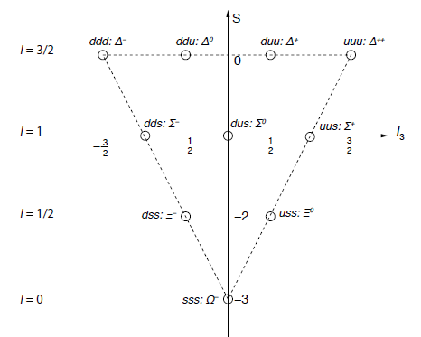
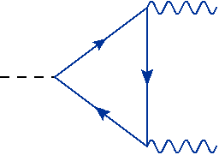
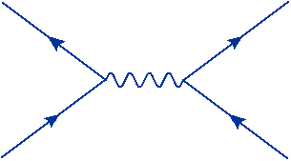
Introduction
Spin 3/2 Baryons
Color degrees of freedom
— Pauli principle for Δ⁺⁺(uuu), Δ⁻ (ddd), Ω⁻(sss).
Hadrons are color neutral (color confinement).
— decay rate
— R-ratio (Drell ratio)

Slide 7
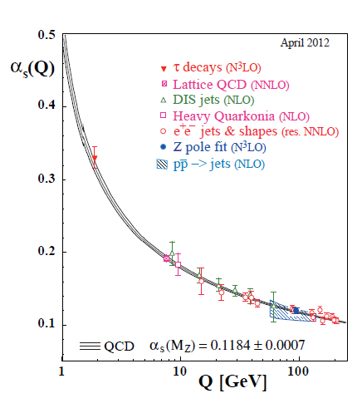
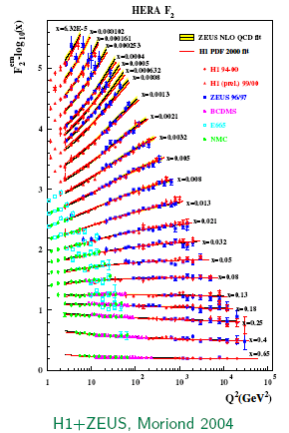
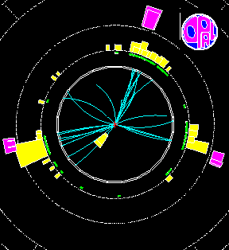
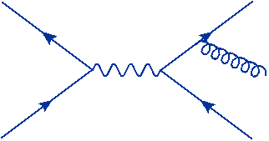
Introduction
Actually, the strong dynamics is well-described by QCD.
— In DIS, the Bjorken scaling (↔ quasi-free quarks inside the nucleon) and
its breaking are understood from the asymptotic freedom of QCD.
Structure function F₂
— 3 jet events, gluon jets.
OPAL

Slide 8
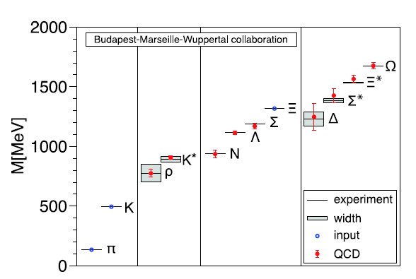
Introduction
QCD is successful also in the non-perturbative regime.
— Hadron spectroscopy from a lattice simulation.
— Chiral Lagrangian.
expansion in

Slide 9
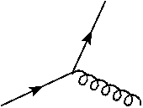
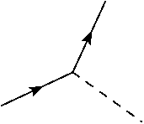
Introduction
QCD in various energy scales.
1TeV
High P_{T} jet at LHC
DOF:
quarks & gluons
90GeV
Asymptotic freedom
2-3GeV
1GeV?
DOF:
hadrons
0.2GeV
Confinement,
Chiral symmetry breaking
0.01GeV

Slide 10
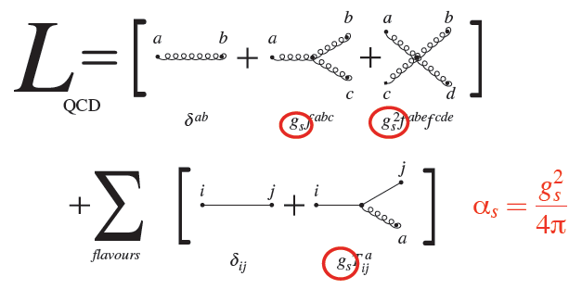
QCD Lagrangian
gluon self coupling
↔ non-abelian gauge theory

Slide 11
QCD Lagrangian
Gauge invariance ↔ unphysical degrees of freedom
↔ constrained system
Gauge fixing
covariant gauge
: gauge parameter
: (anti-)ghost field
The ghost fields are introduced to cancel the negative- (and zero-) norm states.

Slide 12
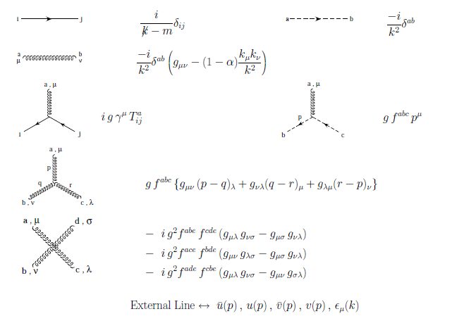
Feynman Rule
quark
ghost
gluon
q-q-g
gh-gh-g
3g
4g

Slide 13
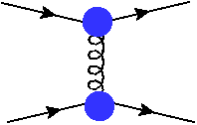
Strong coupling
Is the strong coupling a physical observable?
— No. Its value depends on how to extract it from experiments.
Suppose we can measure qq’ → qq’ cross section. The coupling constant can be
determined by comparing the measured cross section with the theoretical formula.
qqg coupling
As long as the calculation procedure is well-defined, we can take any definition
For the coupling constant to express the cross section (“scheme”).
What is a good choice ? — ↔ rapid convergence.
If this is the case, we can consider that as the strength of the q-q-g interaction.

Slide 14
Renormalization
Regularization & Renormalization
(Forget self energy corr. etc.)
UV divergences in .
Regularization
“bare coupling”
In QCD, we take the dimensional regularization.
space-time dim.: 4 → D = 4-2ε
(It preserves the non-ablian gauge symmetry.)
=
Renormalization
“renormalized coupling”
Determine Zg order by order such that all the coeffs.
are finite after removing the regulator.

Slide 15
Renormalization
MS-bar scheme
coupling renormalization :
wave-function renormalization :
gauge parameter
— The renormalization constants are determined such that contain only
pole terms.
Subtract from divergence.
D-dim. phase-space integral → unphysical
— The renormalization scale μ carries the mass dimension of the coupling
constant in D-dim.

Slide 16
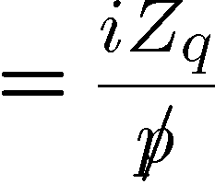
Renormalization in QCD
1-loop results

Slide 17
Asymptotic Freedom
RG equation
QCD beta function
Asymptotic Freedom
(-1) by Fermi statistics
“screening”
“anti-screening”
Bethke (‘12)

Slide 18
Renormalization scale
Typical loop integral (after the angular integral):
MS-bar scheme
→ : “physical” coupling at the scale μ.
= momentum cut-off
Physics at the scales higher than is contained
in when it is adjusted to the measurements.

Slide 19
At 1-loop, the solution can be expressed by
QCD scale (α_{s} blows up)
Up to 4-loop,
depends on scheme (MS or MSbar, N_{f}, LO or NLO or …, )
ex.

Slide 20
Quark mass
Running quark mass
Light quarks
These light quarks can be treated as massless particles.
Heavy quarks (MS-bar mass)
PDG12
We need to change the flavor number by hand as the energy scale grows.

Slide 21
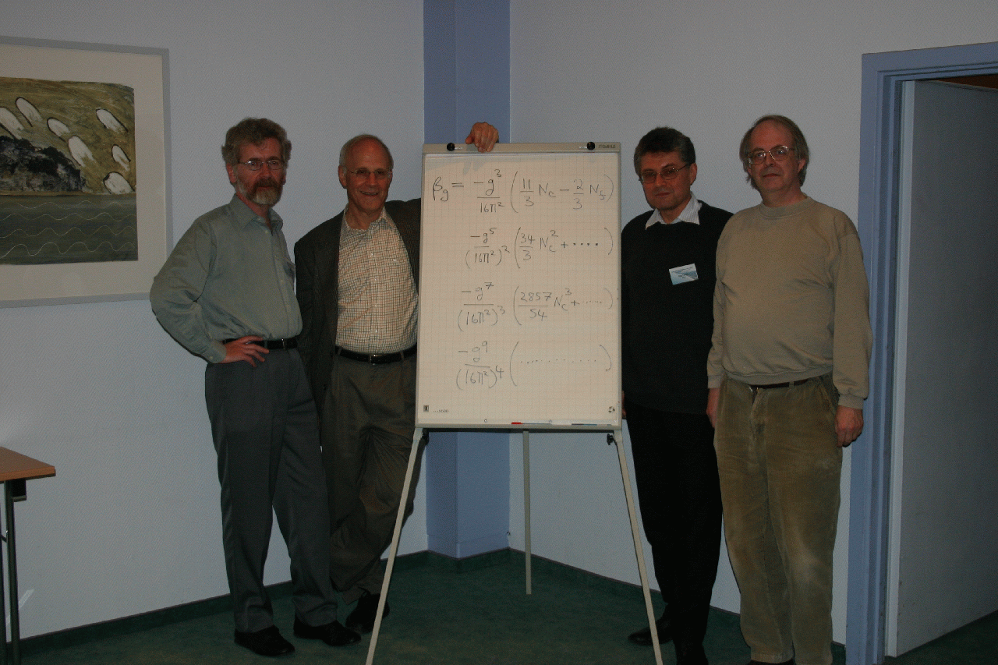
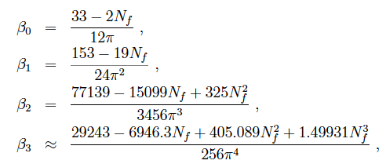
QCD beta function
4-loop beta function
Ritbergen, Vermaseren, Larin (’97)
‘73
‘74
‘80
‘97
Loops & Leggs ‘04
3-loop threshold matching
Chetyrkin,Kniehl,Steinhauser (’97)

Slide 22
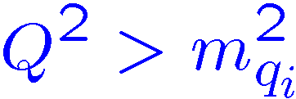
Flavour number
MS-bar scheme gives a mass-independent renormalization.
The beta function also is mass-independent.
(N_{f} in beta function = # active quarks)
“active quark”
Matching between n_{f} flavour QCD and (n_{f} + 1) flavour QCD
discontinuity at only at NNLO.

Slide 23
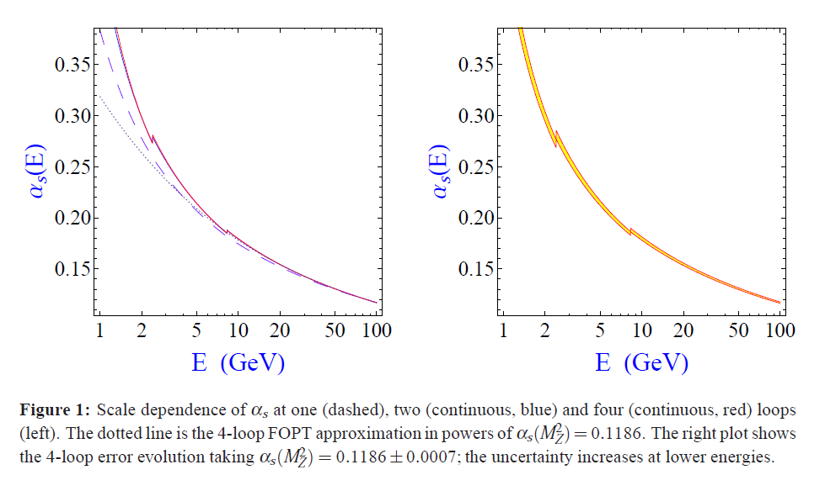
Scale dependence
Pich arXiv:1303.2262
1-loop
4-loop
Note : matching at μ=2m_{h}

Slide 24
Summary of Lecture 1
QCD has been established as the fundamental theory of the Strong Interaction.
QCD has remarkable features: Asymptotic Freedom at the short distance.
Color Confinement at the long distance.
Renormalization enables us to calculate the physical quantities without any
need to know the physics at very short distance.
↔ Factorization of the long-distance physics
Unlike QED, the scale dependence of strong coupling is large, so that
careful treatments of the radiative corrections are needed in QCD.

