Slide 1
Introduction to Perturbative QCD
Lecture 4：DIS, DGLAP equations,
Parton Distribution Functions

Slide 2
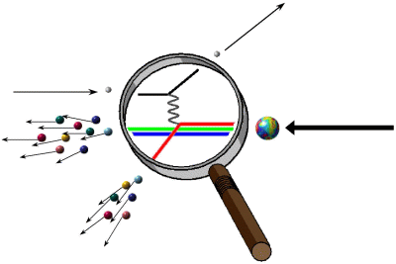
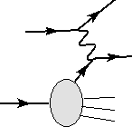
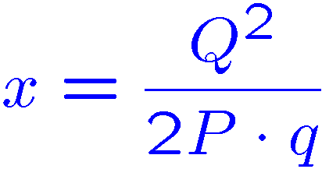
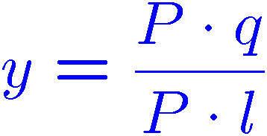
Deep inelastic Scattering
Photon momentum squared
Bjorken x
in proton’s rest frame
Structure Functions
LO

Slide 3
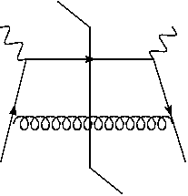
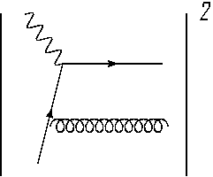
1-loop calculation in axial gauge
Ellis,Stirling,Webber textbook
with
=
Phase space integration

Slide 4
space-like
(in the coll. limit)
Matrix element squared
Projection onto F₂
→

Slide 5
Collinear divergence comes from the region
Hence
IR cut-off (regularization)
partonic structure function
1-loop factorization
collinear div.

Slide 6
Cutoff reguralization
→ Dimensional regularization
1-loop factorization
factorization scale
Hadronic structure function

Slide 7
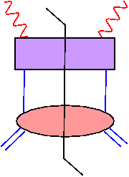
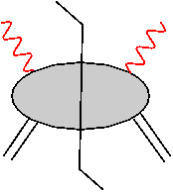
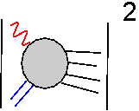
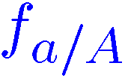
Factorization in DIS
=
Coefficient functions

Slide 8
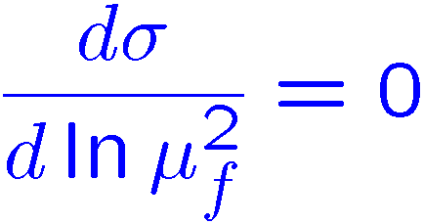
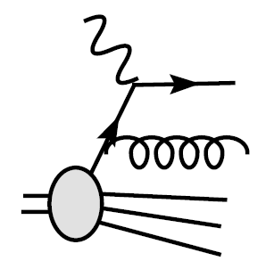
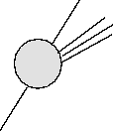
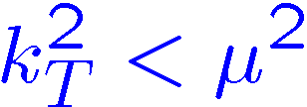
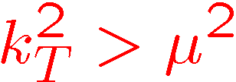
DGLAP equation
Dokshitzer: Gribov,Lipatov:
Altarelli, Parisi
splitting functions
● PDF itself is not calculable perturbatively,
but its scale dependence is calculable.
LO ‘74
NLO ‘80
NNLO ‘04

Slide 9
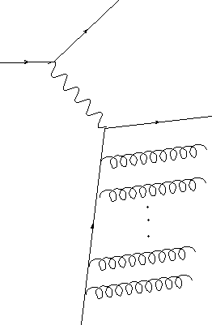
Scale dependence of PDFs
Leading log. approximation ↔ k_{T} ordering
⇔ emission of n gluons
⇓
factorization scale μ_{F} = a cutoff scale which divides the inside and outside of hadron

Slide 10
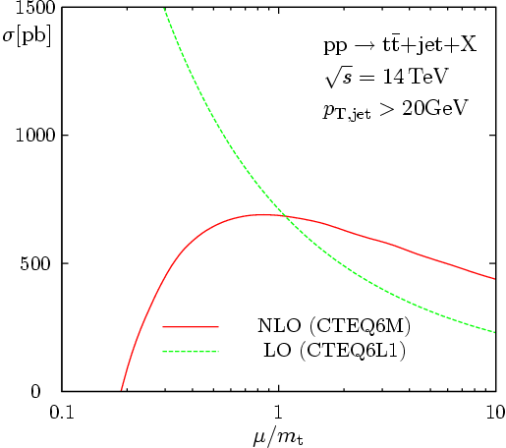
Factorization scale
Scale dependent PDFs “QCD improved parton model”
partons inside partons
⇒
Kogut & Susskind
Analyzing power
>>
The probabilistic interpretation is valid only in the LLA.
Similarly to μ_{R}, this scale is artificial, but the optimal choice is μ_{F} = Q
The residual scale dependence be used for
error estimation.
Dittmaier, Uwer, Weinzierl (’07)

Slide 11
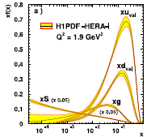
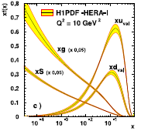
DGLAP evolution
soft pole

Slide 12
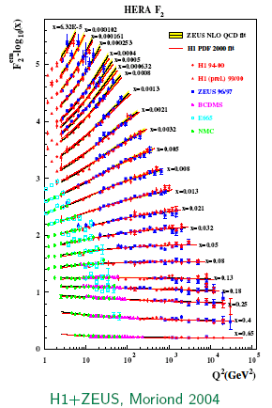
DIS cont’d
HERA F2 data vs. NLO pQCD
NLO (next-to-leading order)
dep. only on x → Bjorken scaling
scaling violation

Slide 13
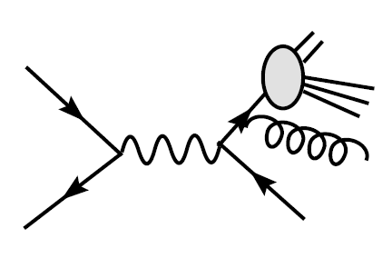
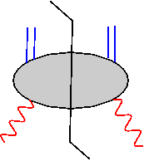
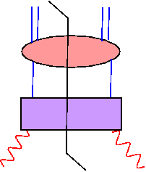
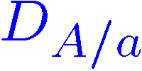
1 particle inclusive process
Not IR safe: collinear divergence associated with the outgoing A.
Factorization
IR safe
fragmentation functions

Slide 14
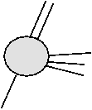
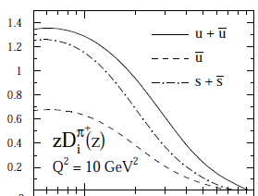
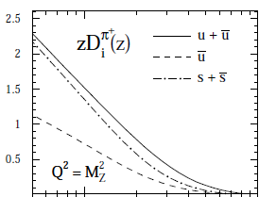
Fragmentation function (FF)
Probability distribution for a parton a
to “fragment” into a hadron A.
A
a
Uematsu ‘77
De Florian, Sassot, Stratmann (‘07)

Slide 15
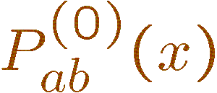
How to solve the DGLAP equations
(1) Flavor decomposition (n_{f}=3 case)
▪ flavor SU(3) non-singlet
valence distributions
▪ flavor SU(3) singlet

Slide 16
(2) Mellin transformation
↔
Right of the rightmost singularity

Slide 17
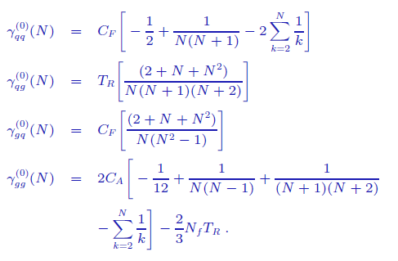
“Anomallous dimensions”

Slide 18
(3) Solve the differential equation
Non-singlet
Singlet (after diagonalization)

Slide 19
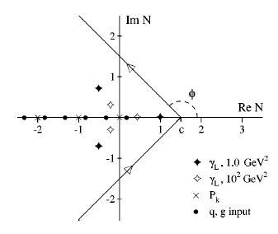
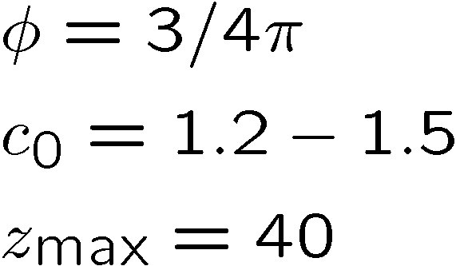
(4) Inverse Mellin transform
Sufficient for x<0.99

Slide 20
Stirling

Slide 21
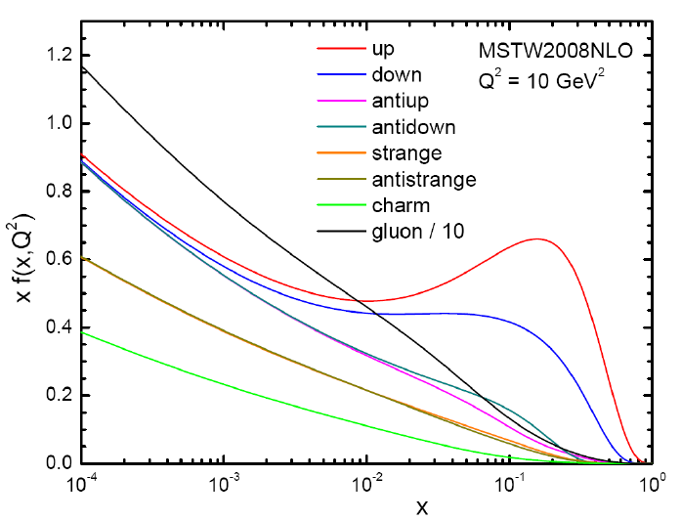
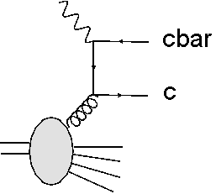
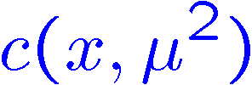
MSTW2008 NLO fit
Charm PDF
Also NNLO fits are available.
ABM, JD, MSTW, NNPDF, HERAPDF, CTEQ

Slide 22
Stirling

Slide 23
Useful webpages
─ cteq meta-page www.cteq.org
Many lecture slides and write-ups.
─ CERN Series
http://cdsweb.cern.ch/collection/CERN%20Series?ln=ja
─ HEPDATA
http://durpdg.dur.ac.uk/
Collection of experimental data & PDFs.
─ hepforge
http://www.hepforge.org/projects
Useful tools for jet calculation, shower MC etc.

