Slide 1
Inseok’s self introduction. - Run13 $π^{0}$ $A_{LL}$ analysis.
2013/07/03
Yoon Inseok.
S.N.U / RIKEN
@SPINFEST 2013 in RIKEN

Slide 2
Self Introduction
2 / 21
Seoul National University/RIKEN, Ph. D student.
I’ve participated in PHENIX since Run12.
I participated in Run12 mutrig commissioning in winter mutr maintenance in summer.
I participated in Run13 as a ERT expert.
Run13 $π^{0} A_{LL}$

Slide 3
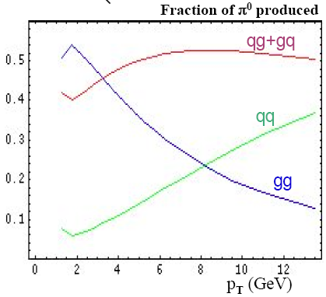
1. Motivation
1. motivation
3 / 21
• Measuring gluon spin component of proton spin.
$$\frac{1}{2}= \int_{0}^{1}{dx [\frac{1}{2}\sum_{q}{\left(Δq+ Δ\overline{q}\right)}\left(x, μ^{2}\right)+Δg(x, μ^{2})]}+L$$
Quark and anti-quark spin component : via $A_{L}$ of W boson production.
Gluon spin component : via $A_{LL}$ of $π^{0}$, $η$, direct photon production and ETC.
• Why $π^{0}$ ?
=> $π^{0}$ is good probe for measuring $∆G (=\int_{0}^{1}{dx∆g}(x) )$, because many of $π^{0}$s are from gluon-gluon or qluon-quark scattering. Especially, gluon-gluon scattering is dominant at low $p_{t}$ region.
PHENIX is very well suited for measuring a large sample of $π^{0}$s. – large statistics.
=>$π^{0}$ is good channel for measuring polarized gluon distribution function.

Slide 4
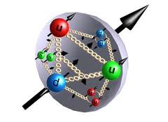
1. motivation
4 / 21
• $A_{LL}$ consist of PDF, partonic reaction and FF.
$$A_{LL}= \frac{{σ^{π^{0}}}_{++}−{σ^{π^{0}}}_{+−}}{{σ^{π^{0}}}_{++}+{σ^{π^{0}}}_{+−}}= \frac{\sum_{f_{1}, f_{2}, f}{∆f_{1}⨂△f_{2}⊗d{\hat{σ}}^{f_{1}f_{2}→fX}⊗{D^{π^{0}}}_{f}}}{\sum_{f_{1}, f_{2}, f}{f_{1}⨂f_{2}⊗{\hat{σ}}^{f_{1}f_{2}→fX}⊗{D^{π^{0}}}_{f}}}$$
$${D^{π^{0}}}_{f}$$
$${D^{π^{0}}}_{f}$$
$$f_{1}f_{2}→fx$$
$$\hat{σ}$$
Parton $f_{1}$
$$f_{1}f_{2}→fx$$
$$\hat{σ}$$
Parton $f_{1}$
X
X
Parton $f_{2}$
Parton $f_{2}$

Slide 5
2. detecting and reconstructing $π^{0}$
2. Detecting and reconstructing $π^{0}$
5 / 21
• $π^{0}$ decays into two photon.
: $π^{0} →2γ$ with probability 0.98798
Mean life time : $8.4 ±0.6 × {10}^{−17}s$
Mass : $134.976 ±0.0006 MeV/c^{2}$
• What we really detect is two gamma by EMCal. EMCal measure energy, hit position and TOF of electromagnetic event.
• By conservation of 4 momentum,
$$P^{μ}\left(π^{0}\right)= P^{μ}\left(γ\right)+P^{μ}(γ)$$
Multiplying $P_{μ}(π^{0})$,
$$P_{μ}\left(π^{0}\right)P^{μ}\left(π^{0}\right)={m_{π_{}^{0}}}^{2}={(135MeV/c^{2})}^{2}$$

Slide 6
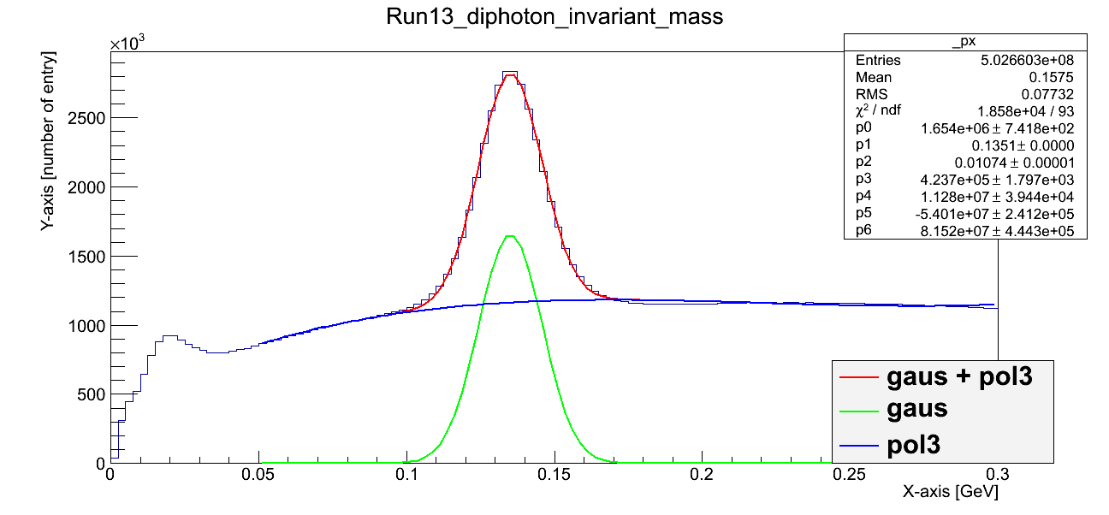
2. Detecting and reconstructing $π^{0}$
6 / 21
• $π^{0}$ reconstrution steps
Make pairs of two gammas and construct the four momentum.
Calculate invariance mass of those.
If the invariance mass corresponds with mass of $π^{0}$, the gamma pair is considered $π^{0}$ decay event.

Slide 7
3. Event selection - ongoing
3. Event selection.
7 / 21
• Trigger requirement.
: ERT4x4c && BBCLL1
• zVertex 30cm requirement.
• Minimum energy cut : to reject noise event.
For PbGl, $E_{min}=200 MeV$
For PbSc $E_{min}=100 MeV$
• Warn map cut : to reject event from noisy or dead towers and tower which is adjacent to the problematic tower or edge of EMCal.
• Shower shape cut
: Because interaction mechanism of hadron is different from photon, shower shape of hadron in EMCal is different with that of photon. By using this, we can distinguish hadron and electromagnetic event.
• Time of flight cut. : to reject slow hadron event and noise event.
• Charge veto cut : to reject charged track event.

Slide 8
Event selection – TOF cut.
3. Event selection – TOF cut.
8 / 21
• EMCal can measure TOF with resolution 200ps.
• If we set small window for TOF of EMCal, we can reject slow hadron events and noise events without losing gamma events.
• Before applying tof cut, EMC tof tower by tower calibration is needed.
• Draw tof histogram tower by tower.
Tight shower shape cut was applied to reject hadron event.
Find the peak time and set this time to correction time of the tower.
• Then, $ToF=EMC TOF −BBC time zero −correction time+distance$/c
Here,
$distance= \sqrt{{(x hit on EMC)}^{2}+{(y hit on EMC)}^{2}+{(z hit on EMC −zVertex)}^{2}}$
.

Slide 9
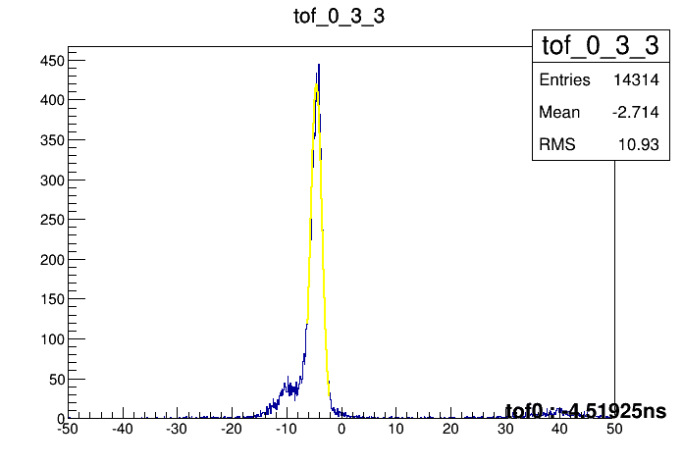
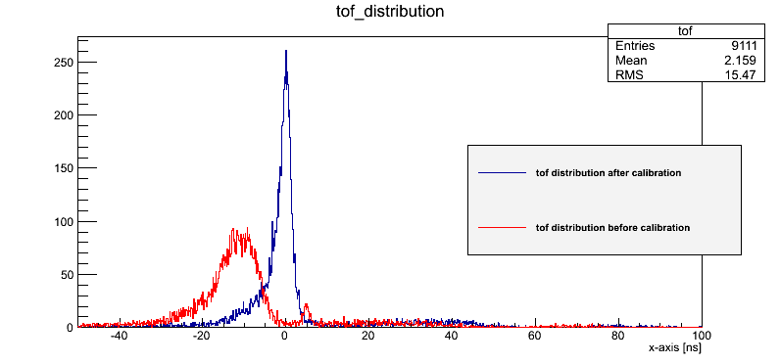
4. Neutral pion analysis
9 / 21
At least one cluster should be in the TOF window. $±10ns$
Width of the TOF window isn’t fixed.

Slide 10
Event selection – charge veto cut.
3. Event selection – charge veto cut.
10 / 21
• To reject charged track
• Charged tracks are bent in central magnet. So charged tracks will have certain $θ_{cv}$.
•Procedure :
Find nearest hit in pc3 and calculate $θ_{cv}$.
If there is no hit in pc3, set $θ_{cv}$=0 .
Nearest Hit in PC3
Hit in EMC
$$θ_{cv}$$
Vertex point

Slide 11
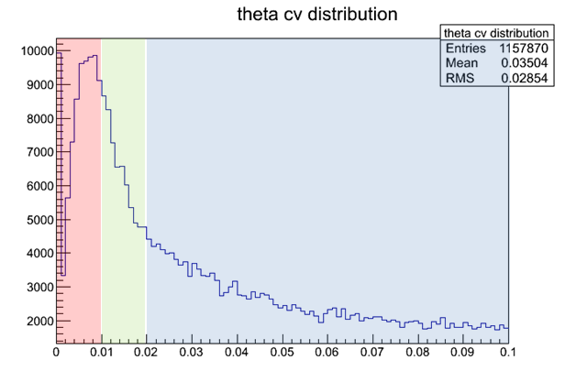
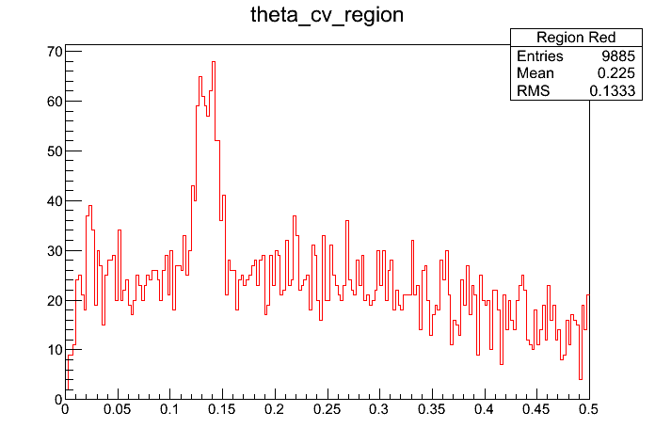
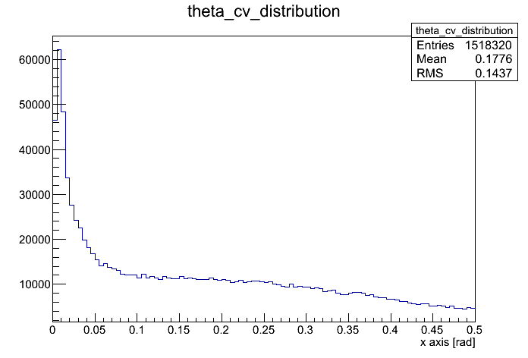
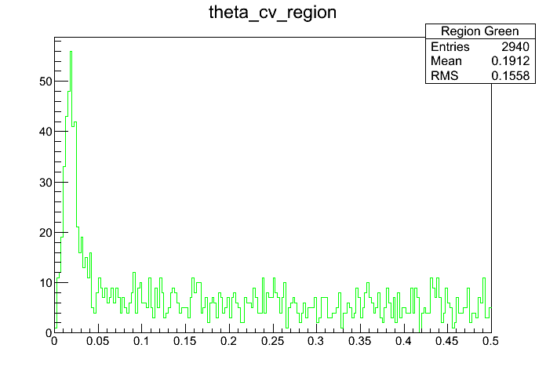
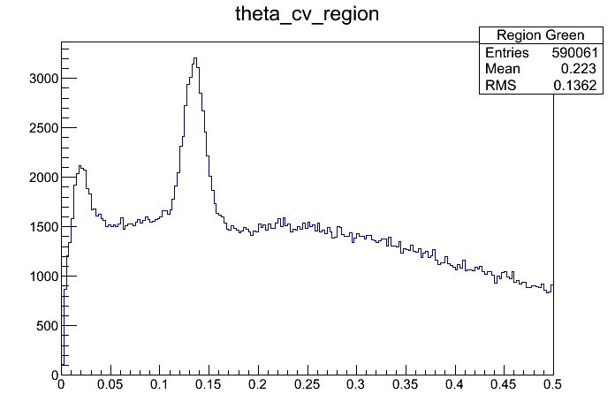

Slide 12
3. Event selection – charge veto cut.
12 / 21
• For red region, photons from $π^{0}$ decay are obviously contained. 2% of photons convert to $e^{+}$- $e^{−}$ pairs and make hit in pc3.
• For green region, photons from $π^{0}$ decay aren’t contained. Clusters in the region are charged.
• For blue region, photons from $π^{0}$ decay are obviously contained. Clusters in the region are not charged and $θ_{cv}$s are calculated with unassociated hit in PC3. Even distribution supports the claim.
• Clusters in green region are rejected.
Note : not optimized value.

Slide 13
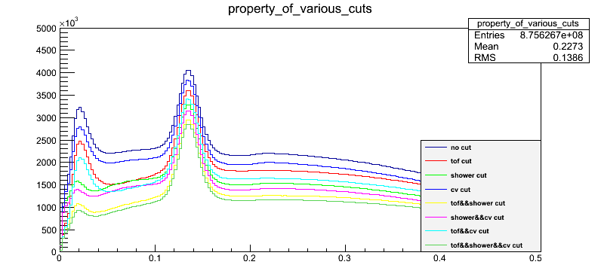
3. Event selection.
13 / 21

Slide 14
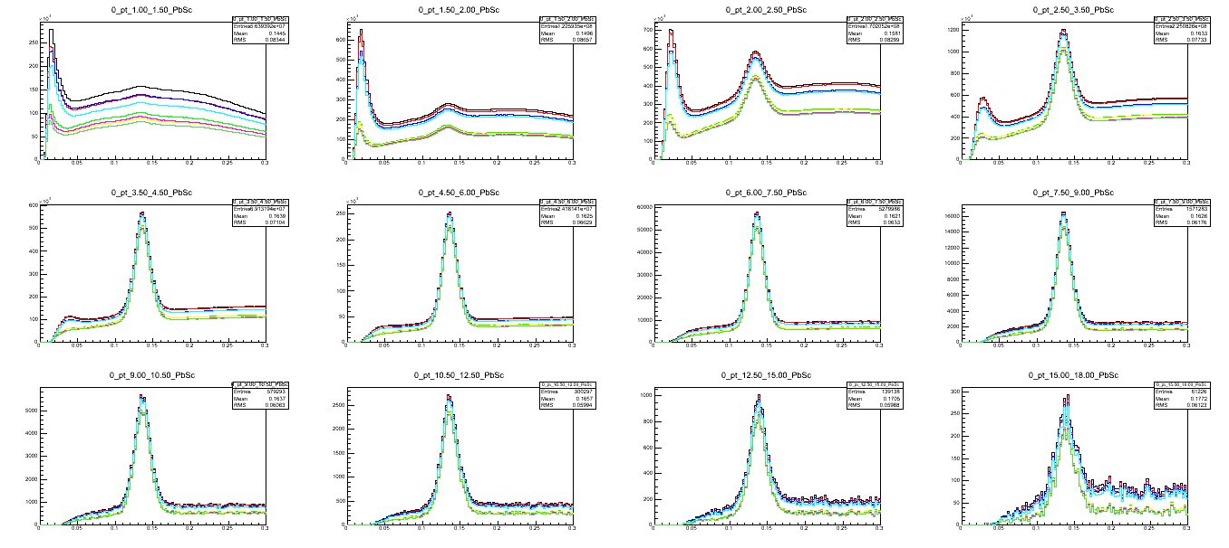
4. Event set - PbSc
14 / 21

Slide 15
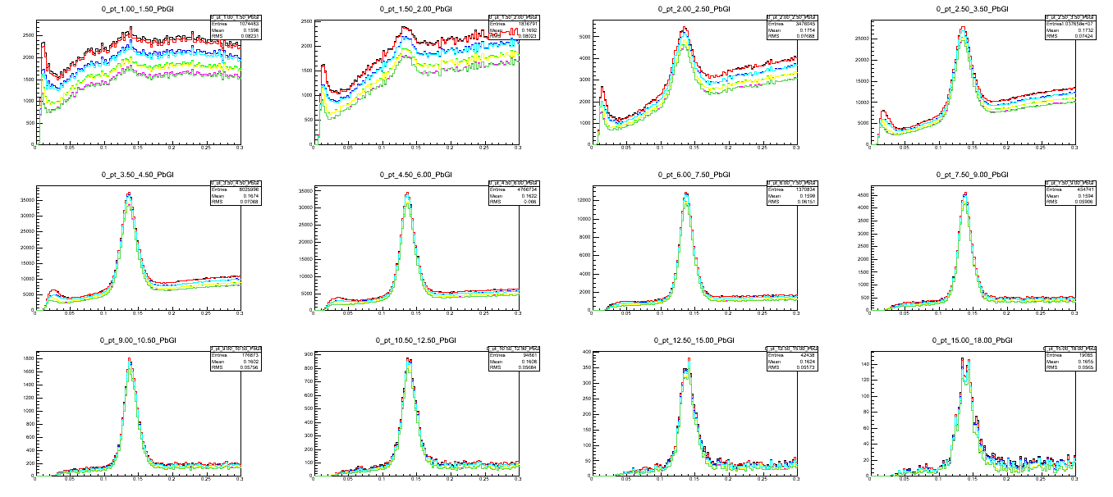
4. Event set - PbGl
15 / 21

Slide 16
16 / 21
Backup

Slide 17
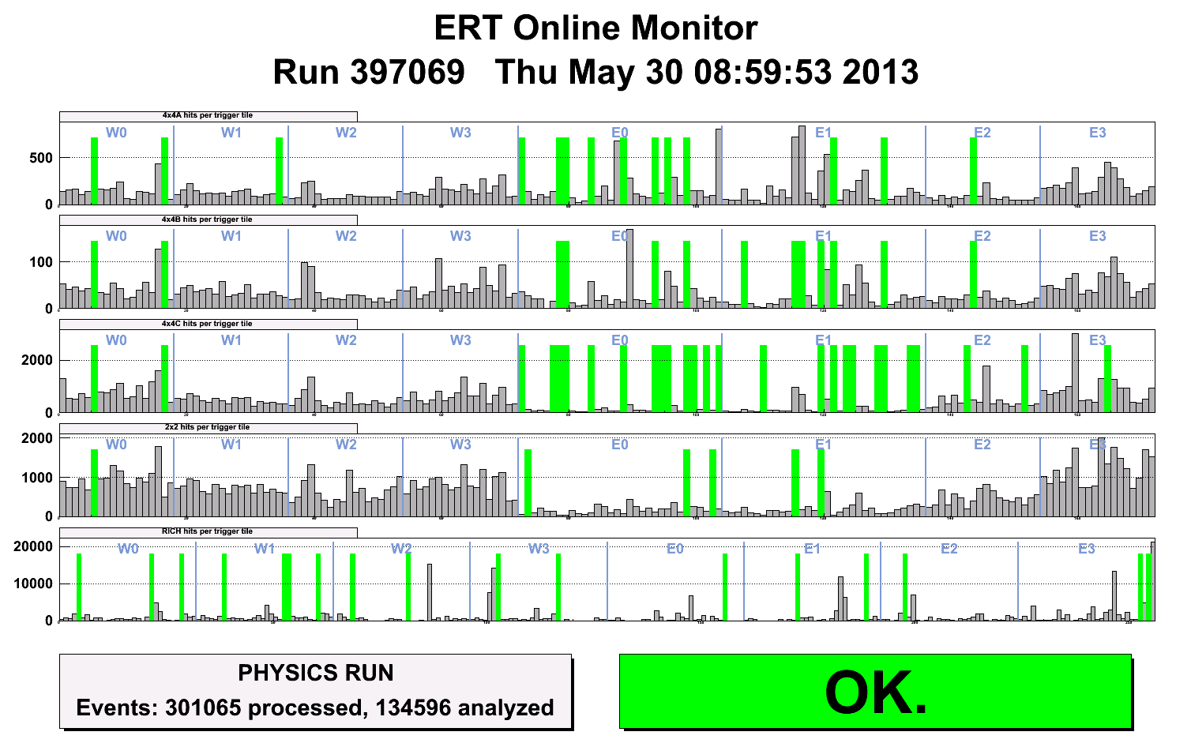
17 / 21
• PbGl is noisy since Run12.
We couldn’t lower Threshold of 4x4c PbGl and should mask a lot of SM of PbGl.
• Percentage of masked SM
W0 : 2/18, W1 : 0/18, W2 : 0/18, W3 : 0/18
E0 : 13/32, E1 : 9/32, E2 : 2/18, E3 : 1/18

Slide 18
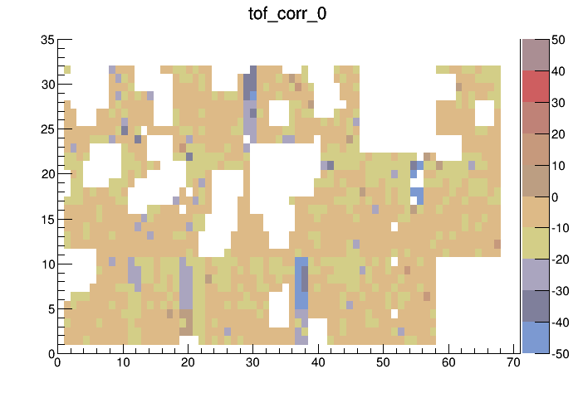
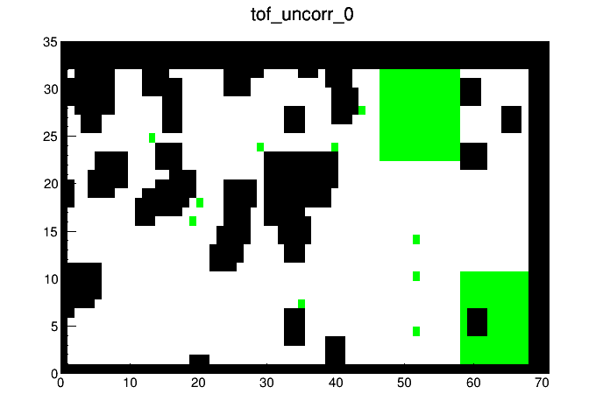
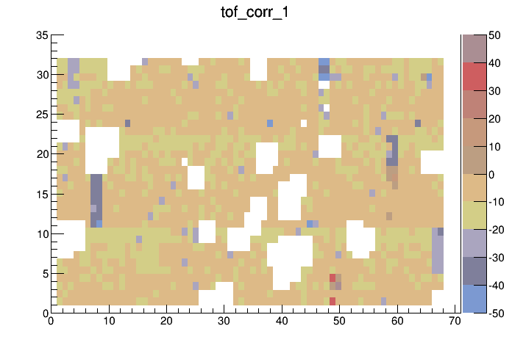
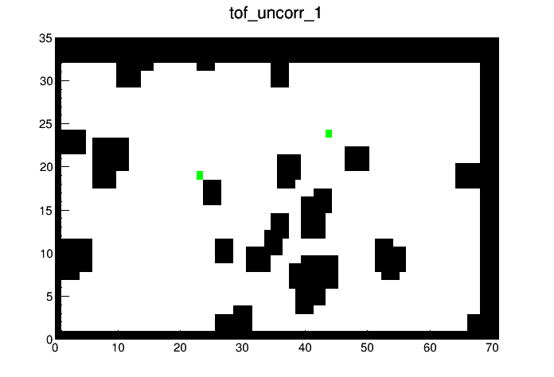
Notes:
Tof_uncorr : black warnmap, green : dead or masked

Slide 19
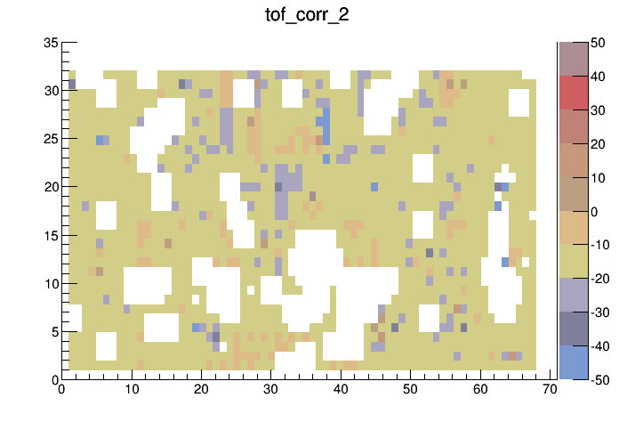
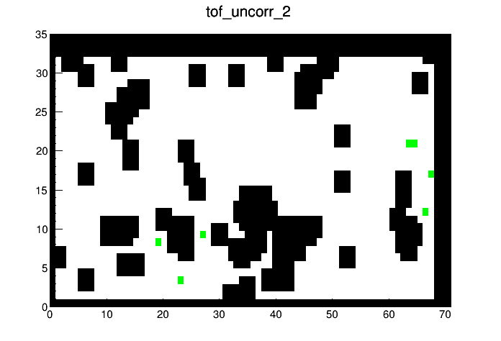
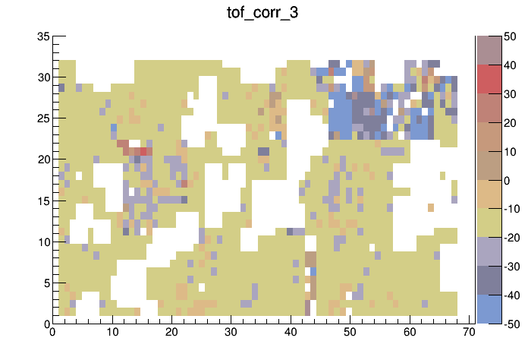
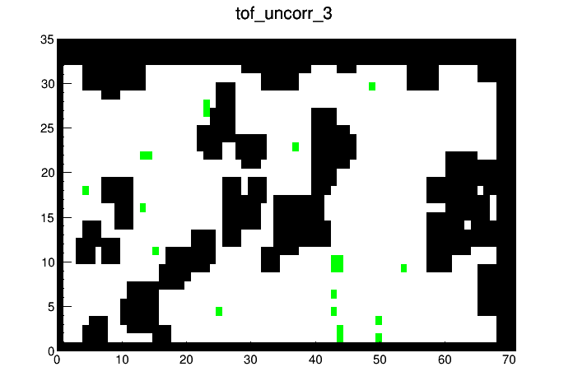

Slide 20
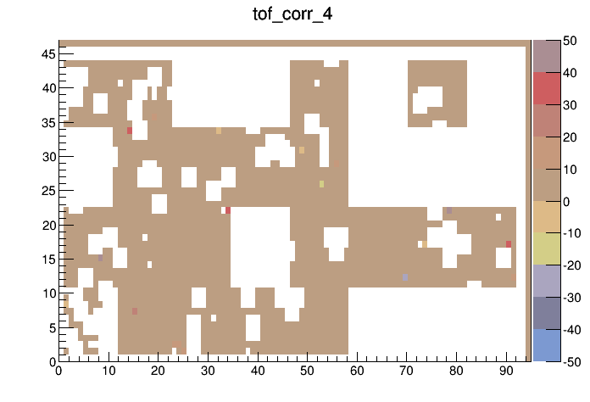
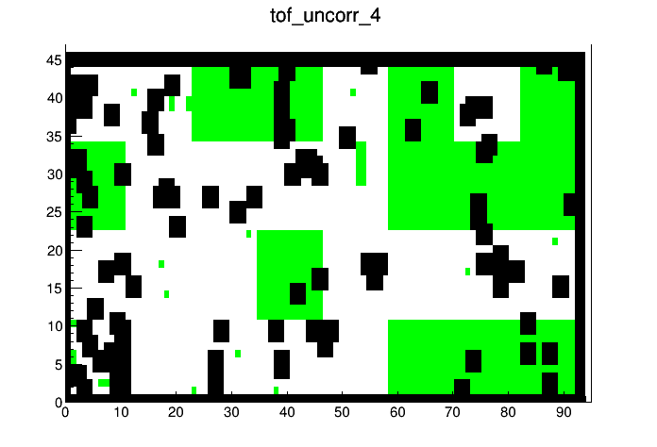
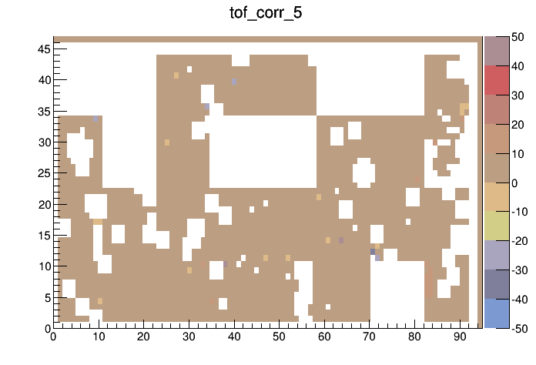
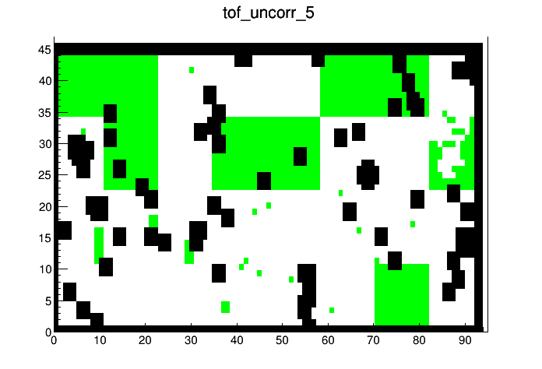

Slide 21
