Slide 1
Development of a liquid ³He target system for experimental studies of antikaon-nucleon interaction at J-PARC
The 27th International Conference of the International Nuclear Target Development Society
Masaharu Sato
RIKEN
in collaboration with
M. Iio(KEK), S. Ishimoto(KEK), S. Shoji (KEK), S. Enomoto(KEK),
T. Hashimoto(RIKEN), M.Iwasaki (RIKEN) and R.S. Hayano(Univ. of Tokyo)

Slide 2
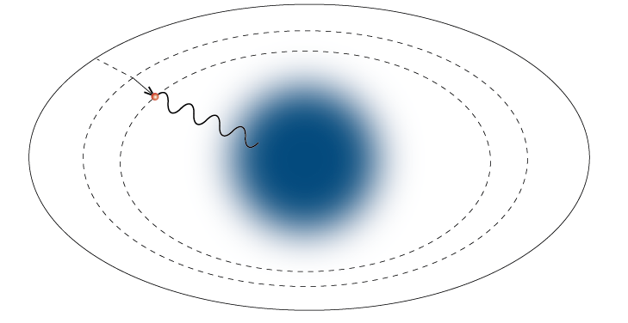
Experiments @ J-PARC K1.8BR
Search for antikaon nuclear bound states in the ³He (K⁻, n) reaction (J-PARC E15)
formation (missing mass) &
decay(invariant mass)
1 GeV/c
Λ
π⁻
one of expected decay modes
p
“1st stage data taking in May 2013”
p
K⁻pp → Λ p→ π⁻ p p
e⁻
Spectroscopy of kaonic He atoms (J-PARC E17)
Kaonic He atom
stopped K- reaction on ³He
K⁻
strong-interaction induced shift & width of atomic level
→ Derive information on K-nucleus interaction
He
X-ray
X-ray detector
Both experiments need liquid ³He target
2

Slide 3
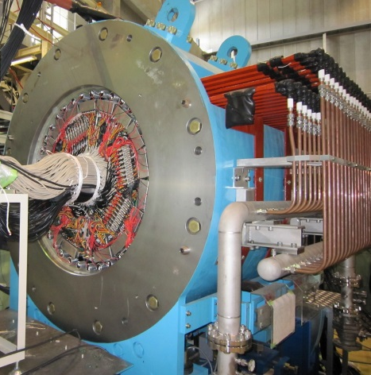
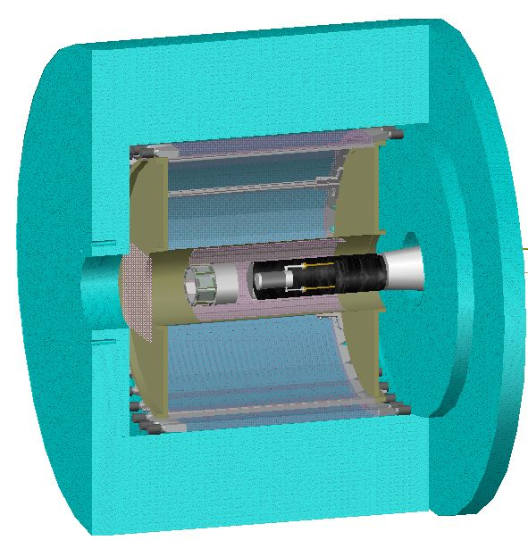
Setup
Setup for ³He(K⁻, n) around the target (E15 setup)
³He target is install at the center of CDS
PTEP02B011(2012)
cylindrical detector hodoscope (CDH)
cylindrical drift chamber (CDC)
Experimental requirements
large size 3He target
(Φ=6.8 cm, L = 12.5 cm)
minimum the amount of the material around the target cell
~ energy loss, multiple scattering
high 6-keV X-ray transmittance of the target cell (for E17).
stability of the temperature
³He density depends on the
temperature
beam tracker
n
K⁻ @1 GeV/c
inner hodoscope (IH)
π,p etc
³He target
access only from the downstream side
solenoid magnet
1.5 m
3

Slide 4
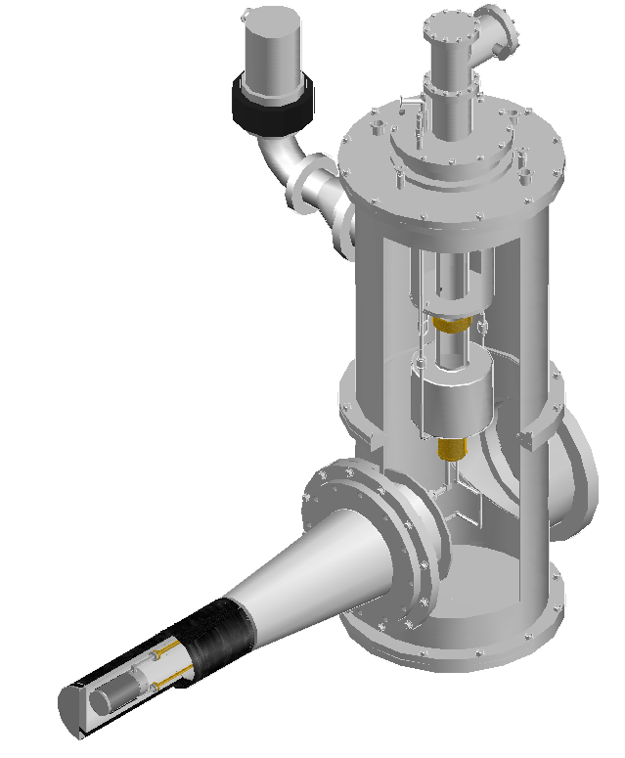
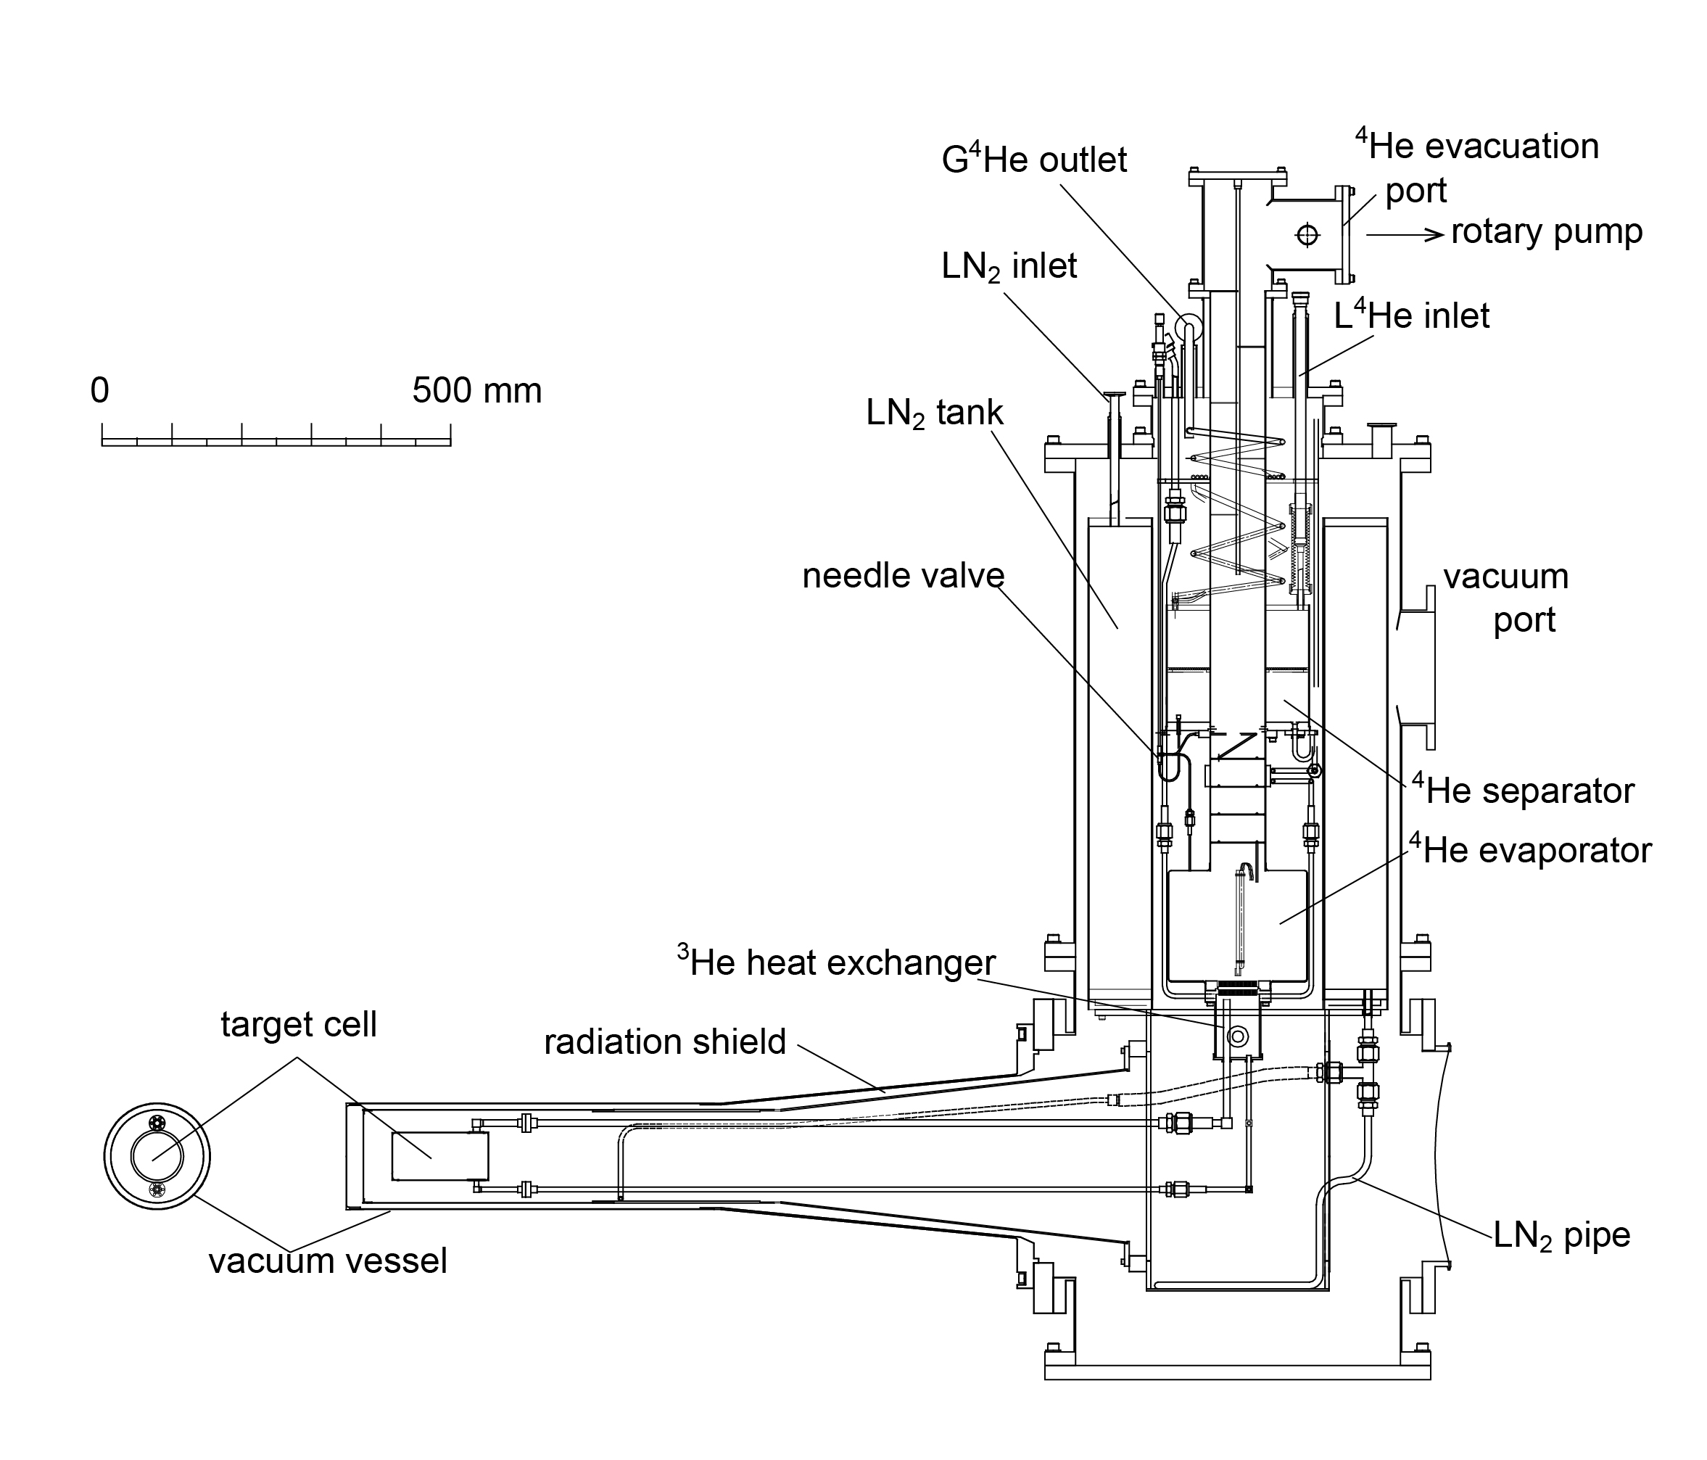
³He cryostat
Evaporator evacuation line
Cover the target with cylindrical detector system
L-shape cryostat.
TMP
only the target cell is isolated from the main component
side view
separator
(⁴He, 4 K)
NIMA687(2012)1
evaporator
(⁴He, 1.3 K)
heat exchanger (³He, 1.3 K)
~1.2 m
cooling principle
the target cell & vacuum chamber
K⁻
Target cell
4

Slide 5
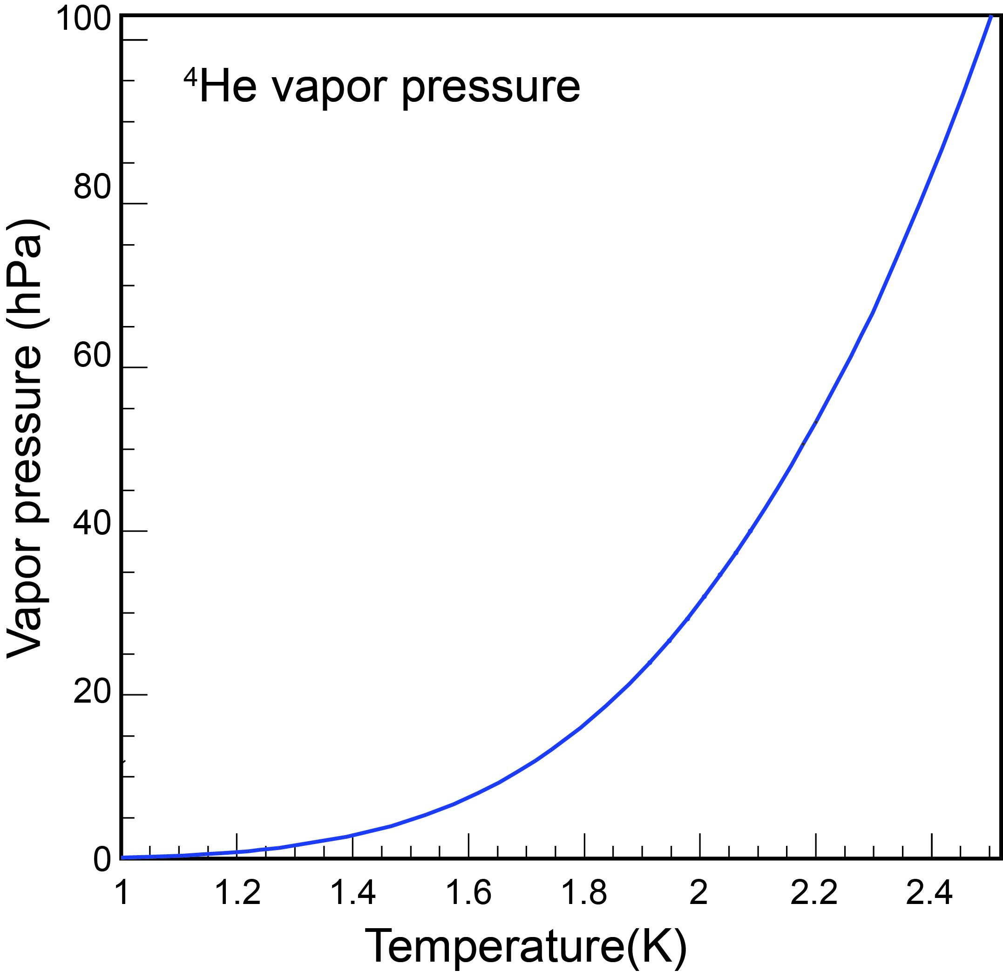
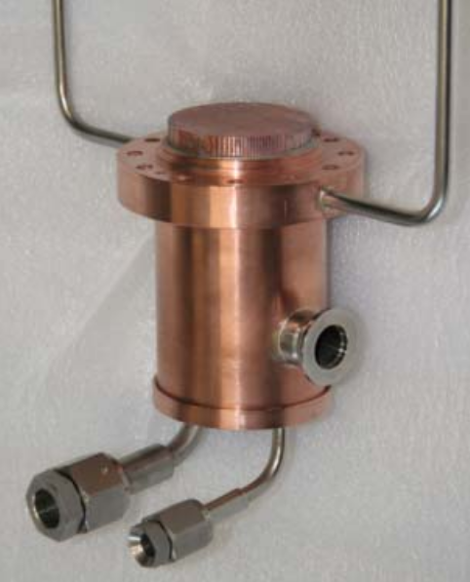
How to condense ³He
Condense gaseous 3He by heat contact with 4He
400 litter of 3He gas (2 x200-litter tanks)
pump (120 m³/h)
⁴He gas out
latent heat of vaporization
separator
(⁴He,4.2 K)
⁴He in
liquid level sensor
(super conducting)
needle valve (NV)
vapor pressure of ⁴He
evaporator
(⁴He, 1.4~2.5 K)
fins
decompression
heat exchanger
(³He,1.4 K
~2.5 K)
³He gas in
³He liq.
5

Slide 6
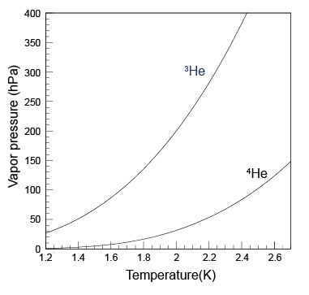
³He vapor pressure
vapor pressure of ³He = pressure inside the tank
achieved temperature ~ amount of the condensed 3He
separator
4.2 K
vapor pressure of ³He (and ⁴He )
only 60 % of 3He gas condense
(initial ~ 1000 hPa)
3He
2.5 K is insufficient
1.4 K:
p_{3He} ~50 hPa
2.5 K:
p_{3He} ~ 400 hPa
due to the limitation of the total 3He gas amount
NV
4He
To lower evaporator
temperature:
2.5 K (NV open)
1.4 K (NV close)
* with NV close, liquid in evaporator decreases
* if evaporator is empty, cooling power is lost
6

Slide 7
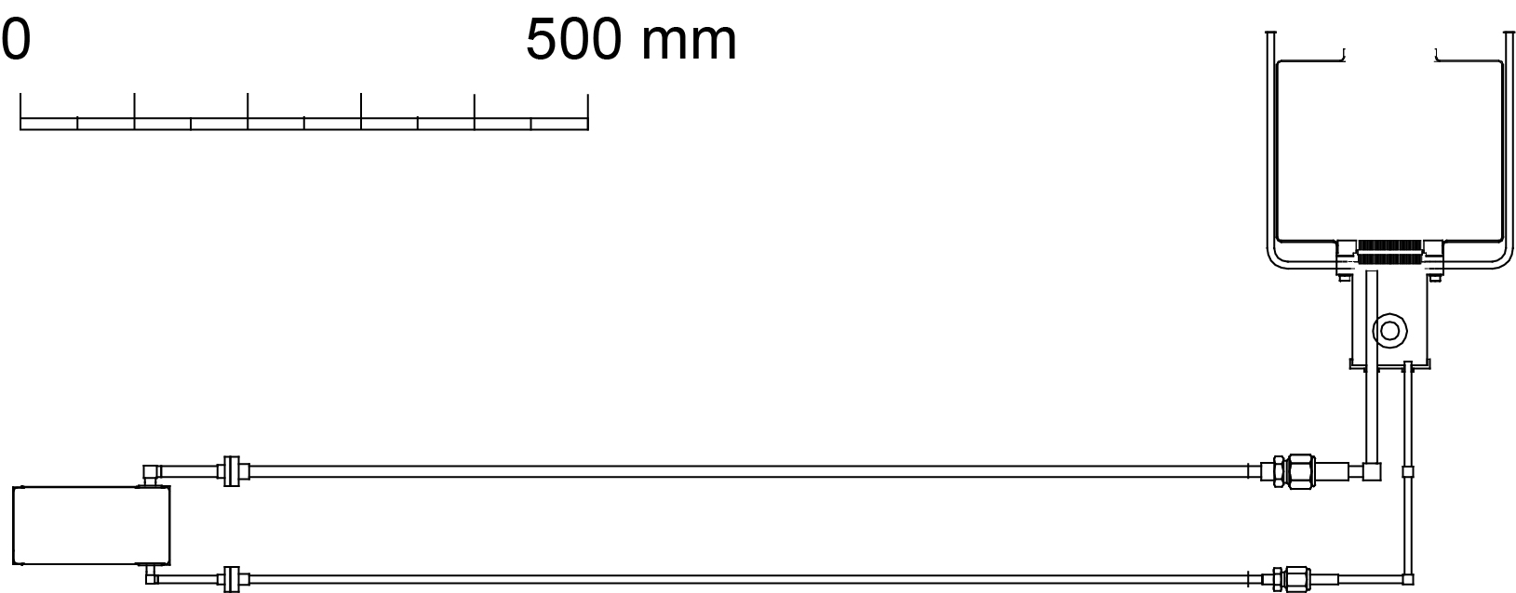
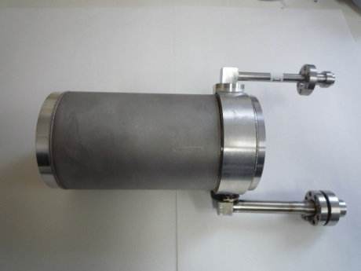
transfer to the cell
liquid transfer between the heat ex. and the target cell
3He in the heat ex. flows into the target cell through lower pipe
~1.2 m
warmed-up 3He returns to the heat exchanger
⁴He
flow
³He
target cell
heat exchanger
flow
effective heat transfer by circulation of the liquid between the heat exchanger and the target cell
7

Slide 8
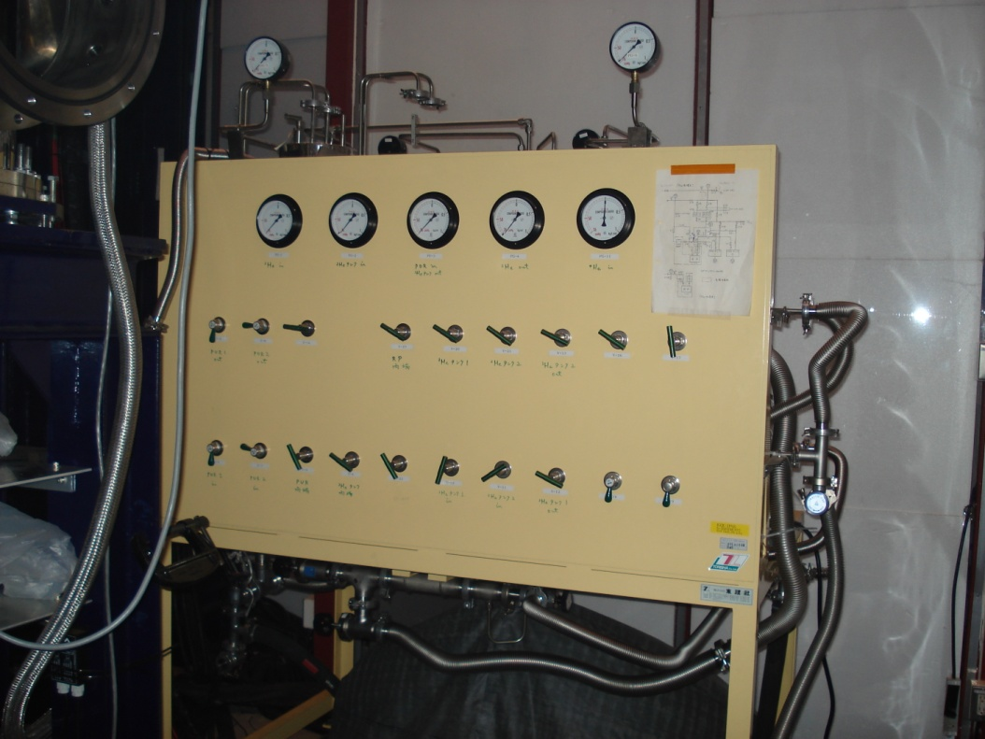
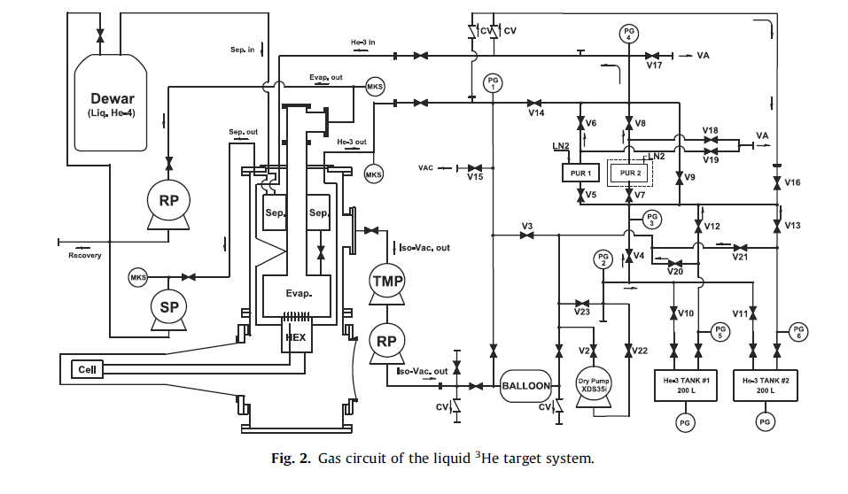
³He Gas handling system
400-litter 3He gas → tank
leak rate : <10⁻¹⁰ Pa m³/s
cooling
recovery
emergency
4He
cell broken!
³He tank
balloon (1000 litter)
dry pump
8

Slide 9
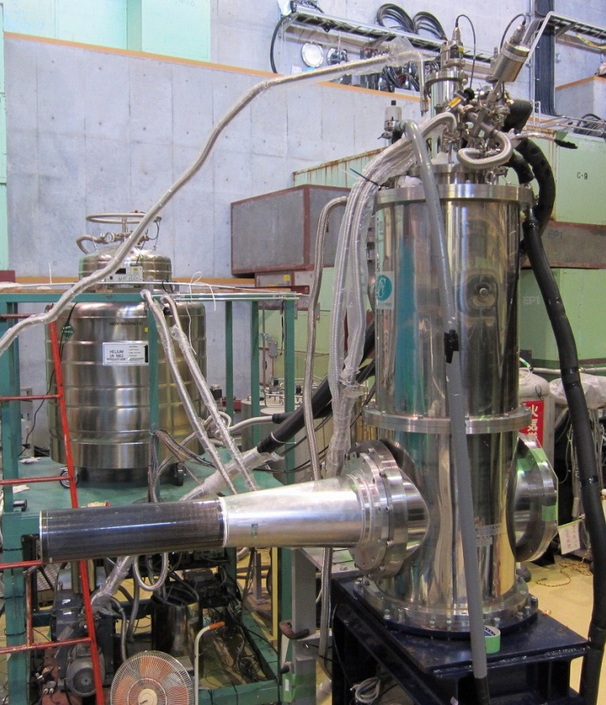
photo @ K1.8 BR beam line
side view @K1.8BR
(uninstalled from CDS)
transfer tube
500 l ⁴He Dewar
³He target
CFRP (t=1 mm)
9

Slide 10
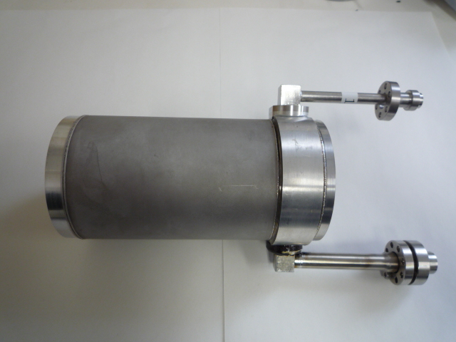
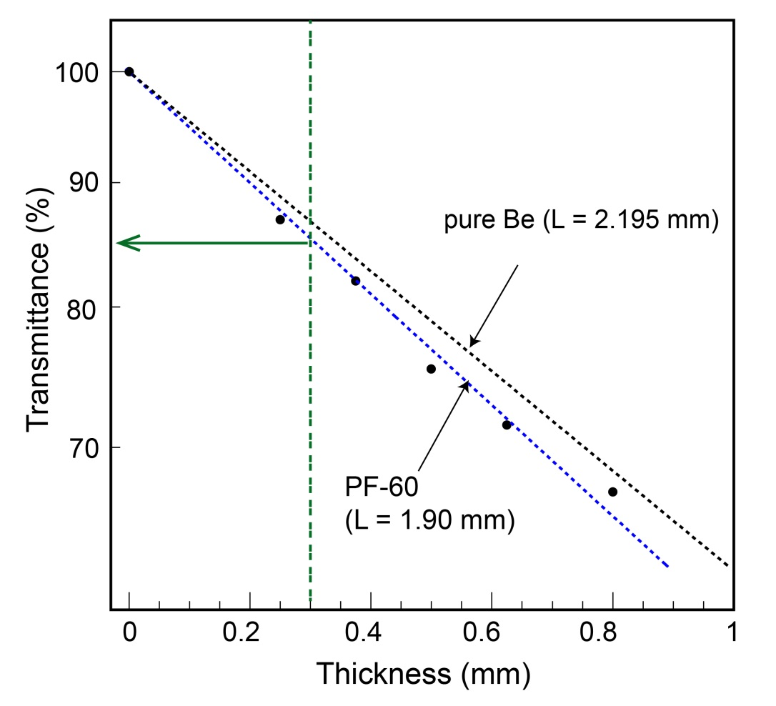
Beryllium target cell
low amount of material
good x-ray transmittance around 6 keV
3He density ~ 0.081 g/cm³
Al ring
(T = 1 mm)
Thickness VS Transmittance
measured with Mn-Kα (5.9 keV)
K⁻
AlBeMet cap
>99.0 % Be (T=0.3 mm, PF-60)
AlBeMet cap
assembled with EBW
AlBeMet (Materion Brash)
lower density (2.0 g/cm3 )than Al
higher Young modulus than Al
easy to handling than Be
transmittance ~ 85 % @ 5.9 keV
c.f. ~50 % with Mylar or Kapton

Slide 11
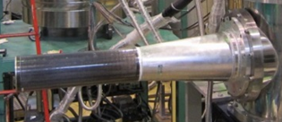
CFRP vacuum chamber
Why CFRP (Carbon Fiber Reinforced Plastic)?
CFRP prepreg sheet T= 0.24 mm
(Sankyo Manufacturing Co Ltd. , 80tonUD)
Strength of cylindrical shell ~ Young modulus
Low density is favored from the experiment
CFRP is the best choice.
(Beryllium is extremely expensive.)
4 layers are laminated with 0 and 90 degrees
T =1 mm
beam window
(t = 0.6 mm)
Al frame
(Out of detector acceptance)
thin vacuum chamber
11

Slide 12
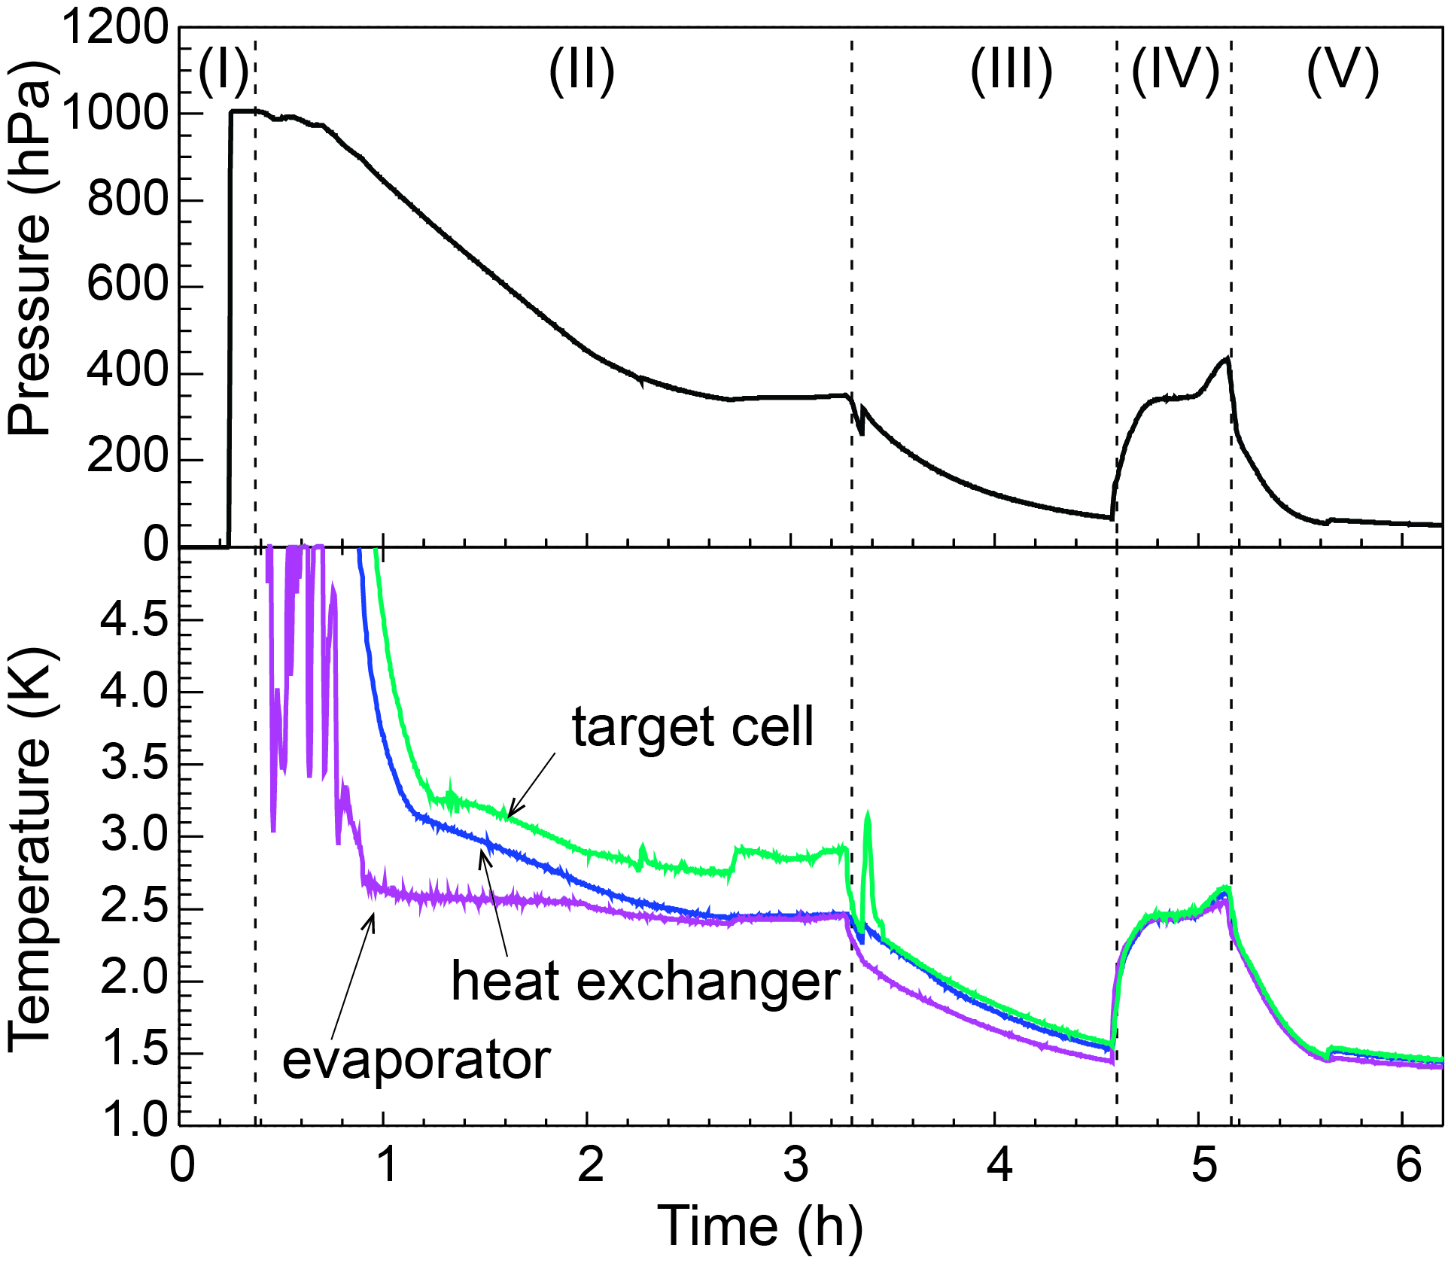
Operational result (1)
time history of a cooling
NV open
close 3He tank valve
refill evaporator
NV close
NV close
condense
..saturate
condense
pressure inside the heat ex.
3He tank open
temperature
no-difference in temperature
liquid 3He target becomes ready within 6 hours.
12

Slide 13
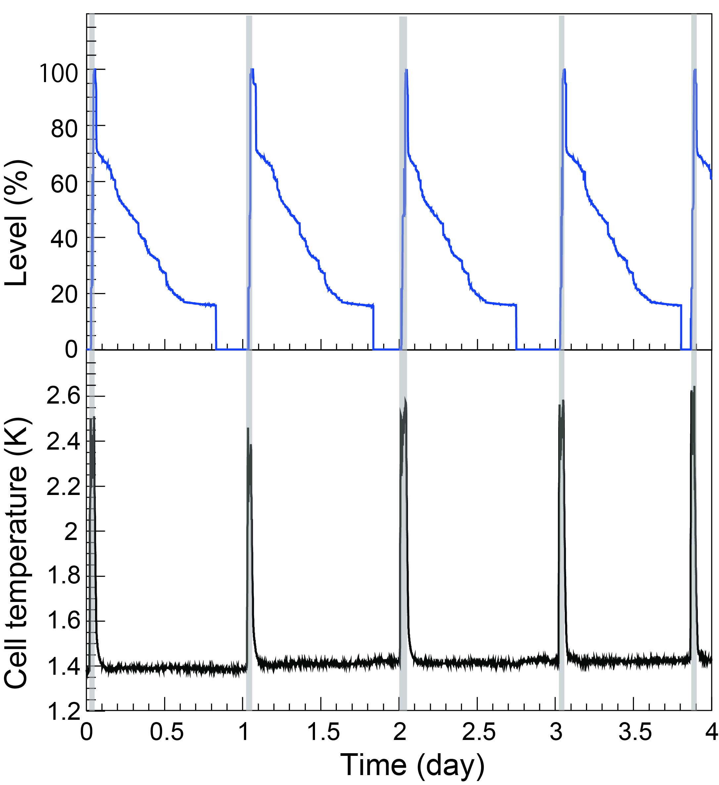
Operational result (2)
time history during the beam time of 3.5 days (May 2013)
cooling power : latent heat evaporation of 4He in the evaporator
→ need to refill ⁴He
evaporator liquid level
refill 4He inside the evaporator
(~ once a day)
heat load is evaluated by the reduction rate of the liquid 4He
cell temperature
Operation parameter
vacuum level <10⁻⁴ Pa
temperature 1.4 K
heat load (1.4 K region) 0.21 W
⁴He consumption 30 l/day
density fluctuation ~ 0.0810(2) g/cm³
Stably operated in the beam time
13

Slide 14
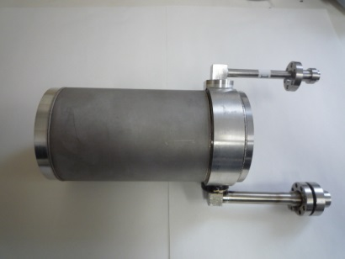
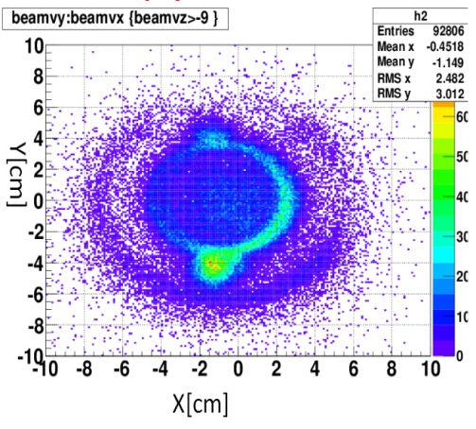
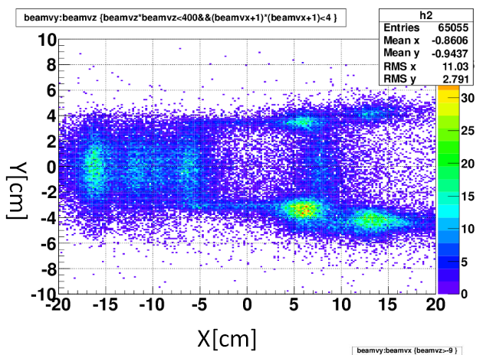
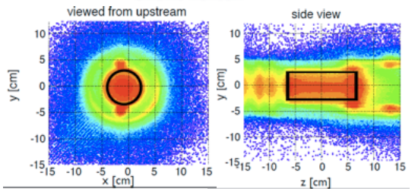
Target image
Target image can be checked with beam data
empty target data
reaction vertex :
beam and secondary particle tracks
Y [cm]
Y [cm]
π,p etc
X [cm]
Z [cm]
³He target data
³He target data
K-
Y [cm]
Y [cm]
Y
X [cm]
Z [cm]
X
confirmed target cell is surely filled up with liquid.
Z

Slide 15
Summary
A liquid ³He target system was newly developed for J-PARC E15 and E17 experiments.
All the experimental requirements were accomplished.
Acceptable operational parameters for a long-term (e.g. ~1 month) experiment.
Successfully operated in the J-PARC E15 experiment in May 2013
1st physics paper was submitted to PLB (arXiv[nucl-ex]1408.5637).

Slide 16
backup

Slide 17
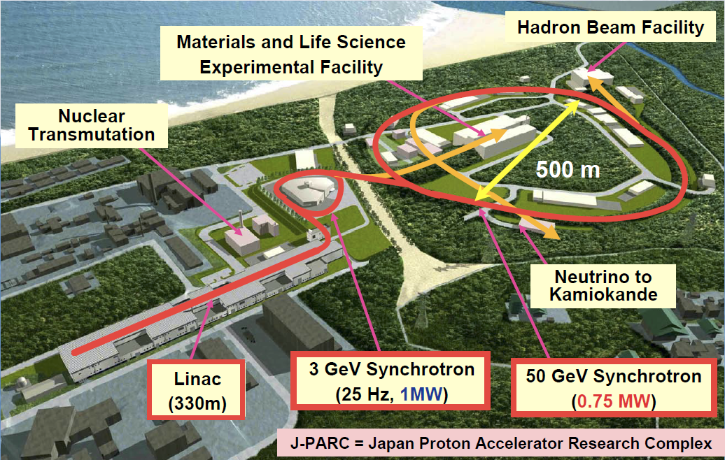
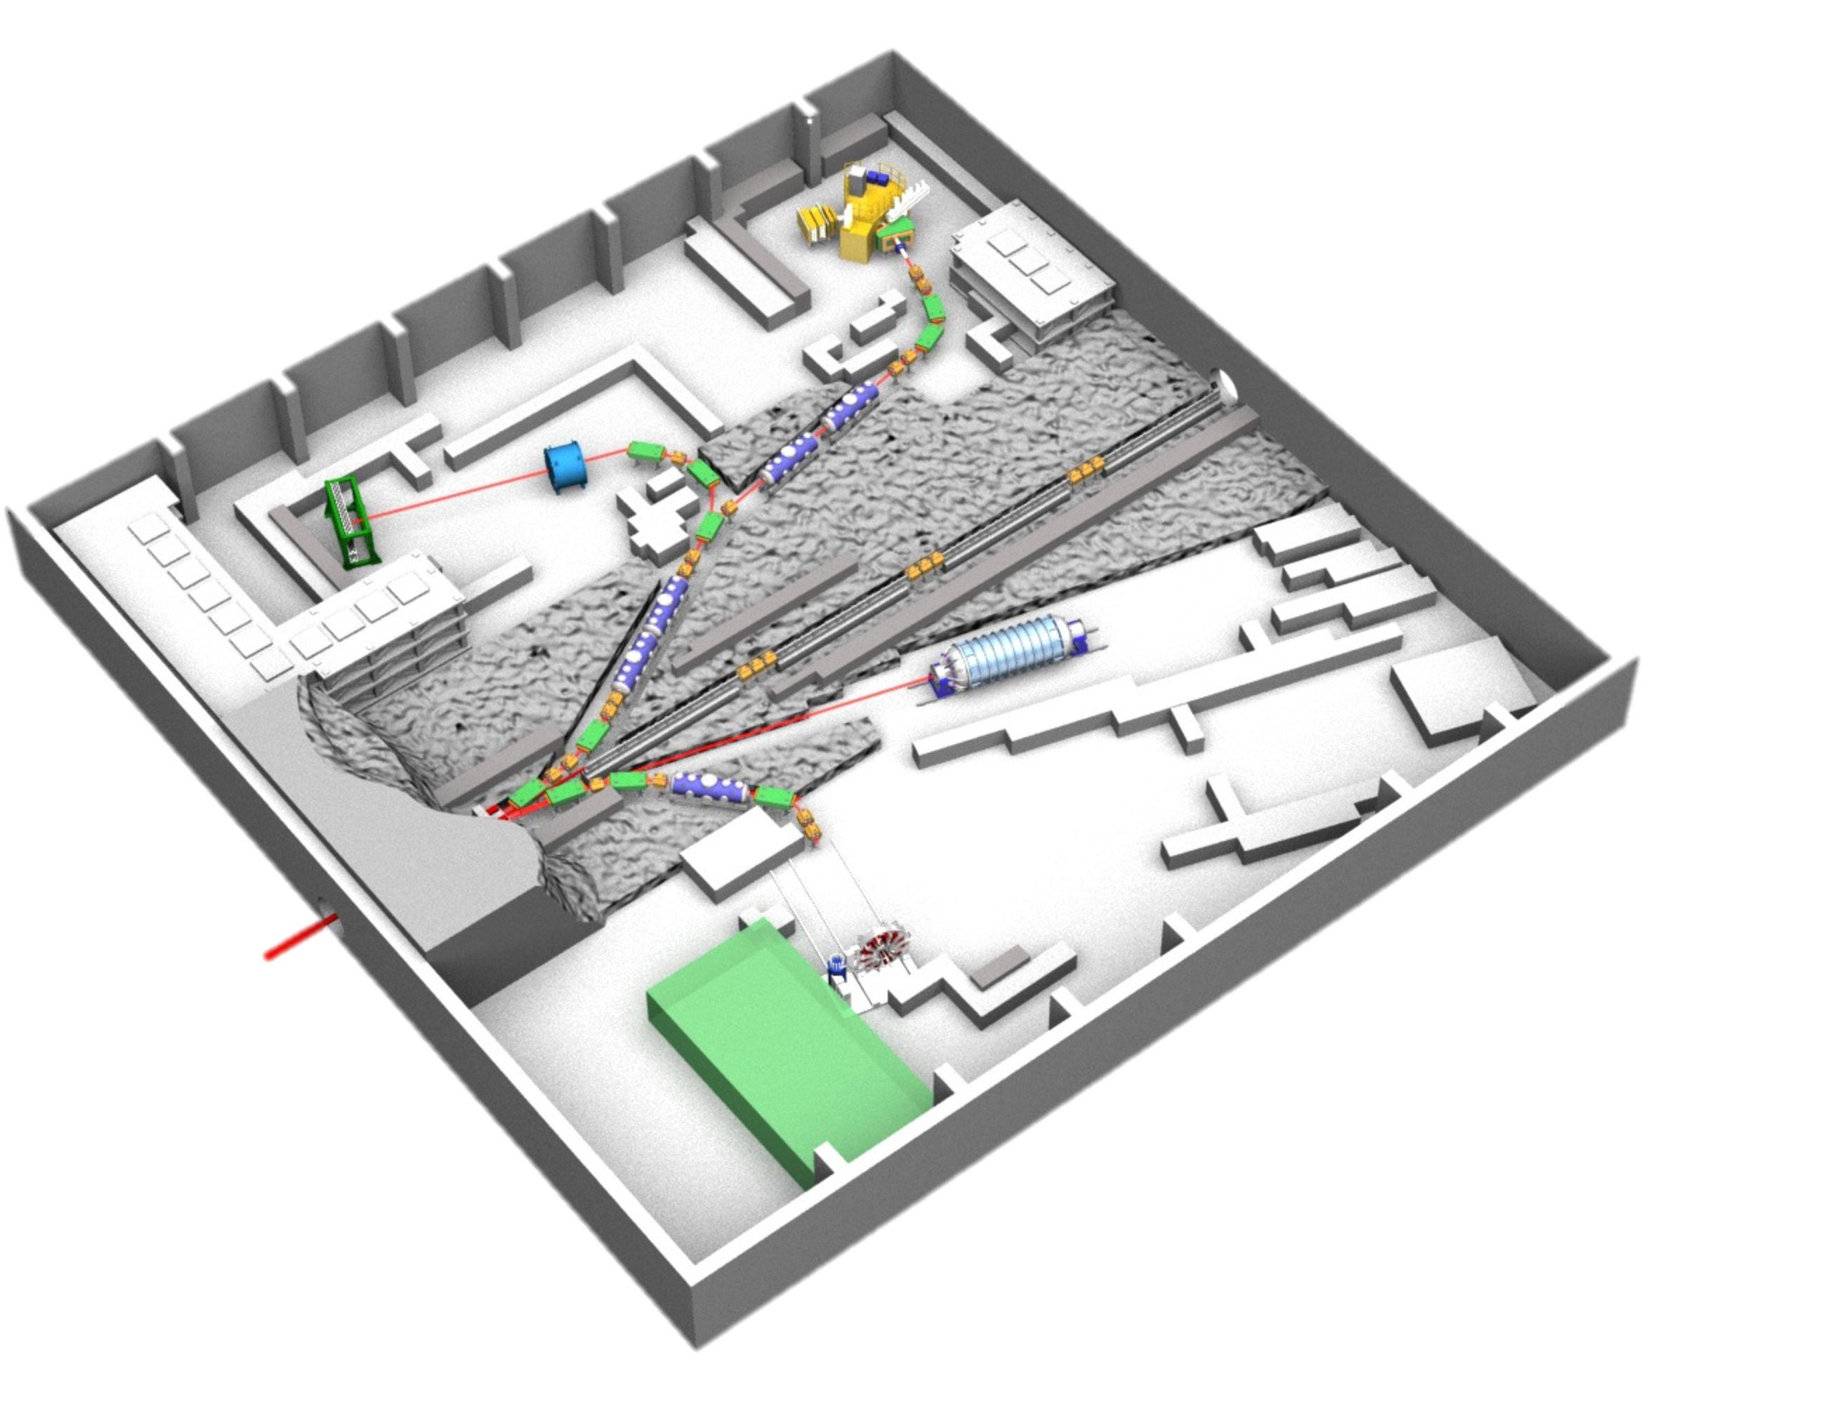
J-PARC hadron facility
Japan Proton Accelerator Research Complex(J-PARC )
Tokai, Ibaraki
layout of hadron hall
K1.8BR
T1 target (Au)
protons
30 GeV, 30 Tppp (~24 kW) as of May 2013
17

Slide 18
Beryllium target cell
good X-yay transmittance @ 6 keV
pure Be
(T=0.3 mm)
Al ring (T=1mm)
Be cell
Indium seal
fabricated with EBW
K⁻
AlBeMet (trade name of Materion Brash )
composite of Be & Al (powder metallurgy)
Lower density (2.0 g/cm³) than Al
Higher Young modulus than Al
Easy to manufacture than Be
AlBeMet

Slide 19
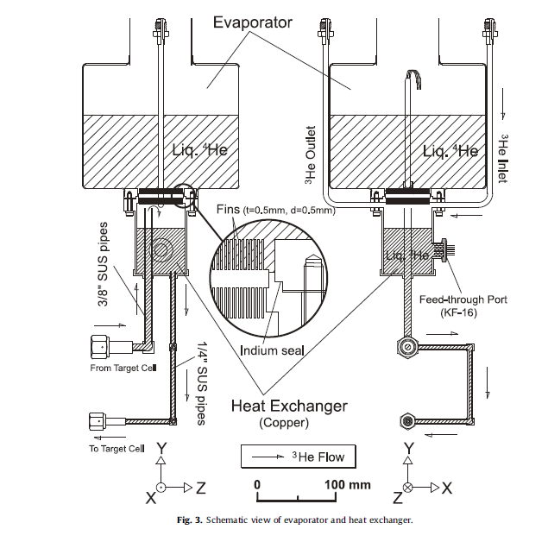
³He - ⁴He heat exchanger
cool down ³He gas with ⁴He by heat contact
Fin structure (5mm pitch)
Side view
19

Slide 20
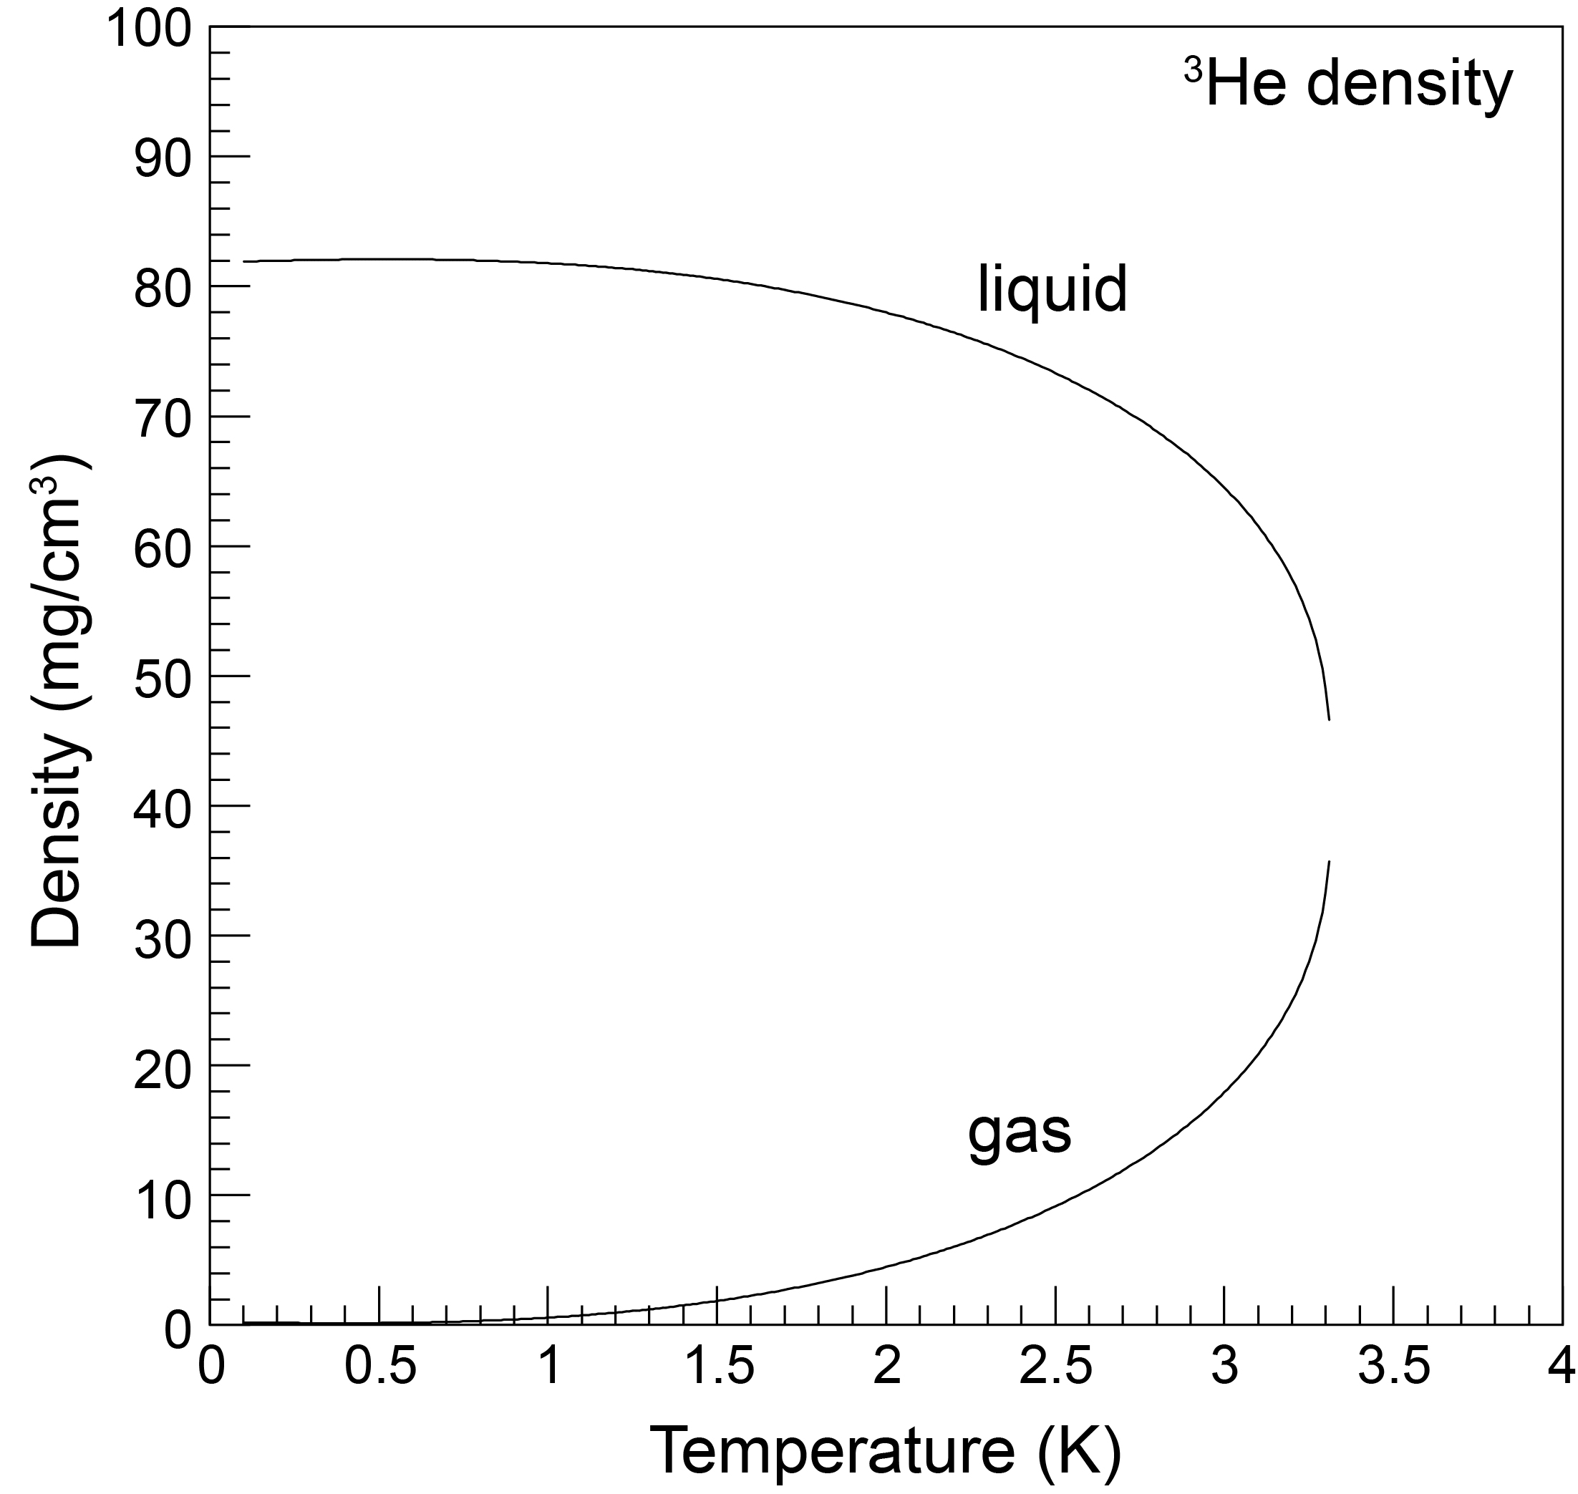
3He density

Slide 21
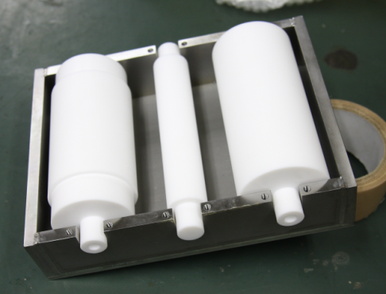
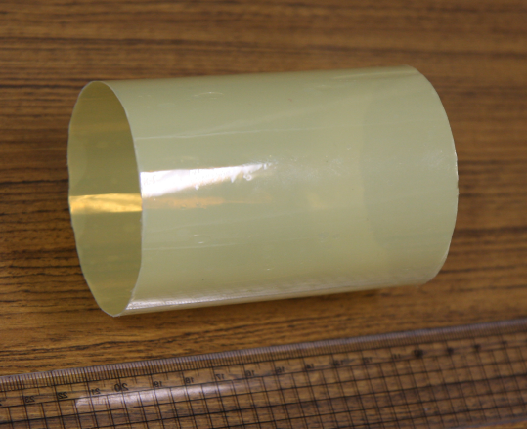
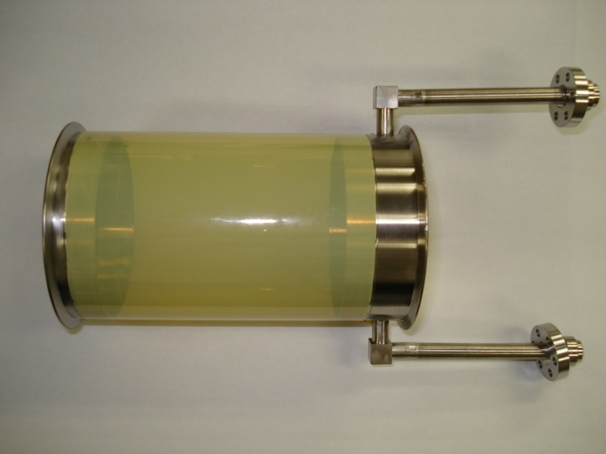
assembly of MICTRON cell
両面コロナ加工 Toray 20GP46
T=25 μm
接着剤（STYCAST1266）に浸した状態で手巻き （４～５周）
巻き取り機
attach frame & pipe
MICTRON成型後 （5巻き、Ｔ＝250～300μm）

Slide 22
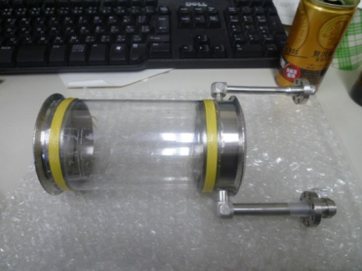
Target cell R&D
Geometry
cylindrical (D=XX), L = 10 cm, V= 500 cc ← limited by ³He gas volume
material
liquid helium 3 density is low (0.081 g/cm³ @1.3 K)
Mylar cell (T =0.3 mm)
critical pressure : > 2 atm (>> normal operation ~ 1 atm)
candidates
 | Mylar | MICTRON | Be
cost | ○ | ○ | ×
X-ray exp | △ | ？ | ◎
In-flight | ○ | ○ | ◎

Slide 23
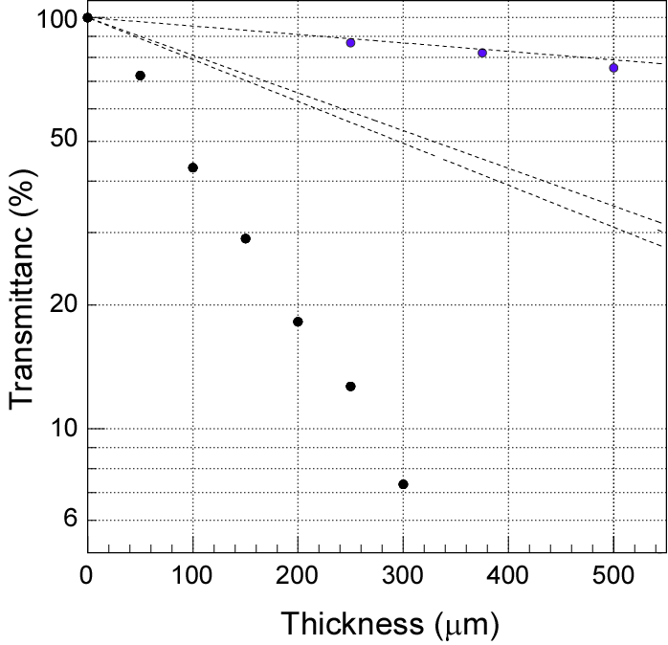
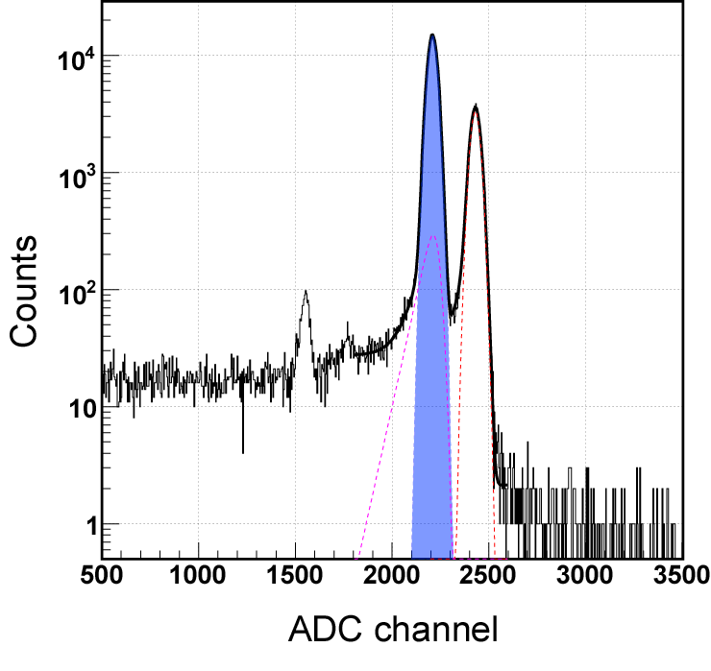
Transmission of X-rays
X-ray transmission test
Thickness VS Transmittance
Be
55Fe
C₁₂H₁₀N₂O₂
X-ray spectrum by SDD w/ ⁵⁵Fe
PET
Mn Kα
MICTRON
very low transmittance with MICTRON

Slide 24
³He cryostat
Evaporator evacuation line
Cover the target with cylindrical detector system
adopt L-shape cryostat.
→ Separate the target cell away (~1m) from the major cooling part
TMP
reduce amount of material around the target
Separator
(⁴He, 4 K)
Density of liquid 3He ~0.08 g/cm³
Evaporator
(⁴He, 1.3 K)
³He cooling with decompressed ⁴He
Boiling point of ³He (3.7 K at 1atm)
pumping ⁴He and cooling by latent heat of ⁴He
Heat exchanger (³He, 1.3 K)
³He leak-tight
³He is extremely expensive!
( > 0.5 M yen / litter ) x (400 litter)
> 2 oku yen
never loss during operation
Target cell
24

Slide 25
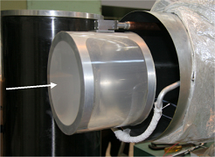
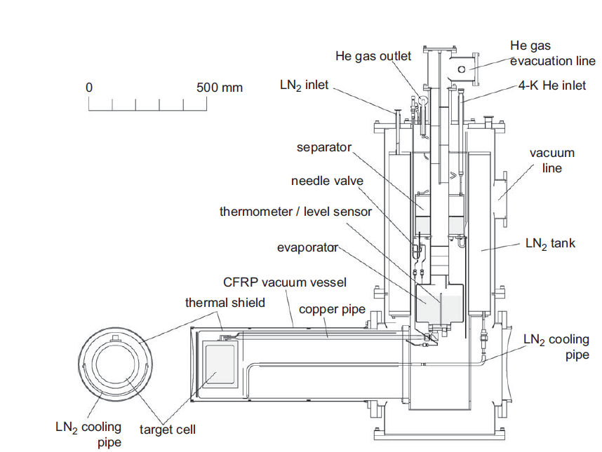
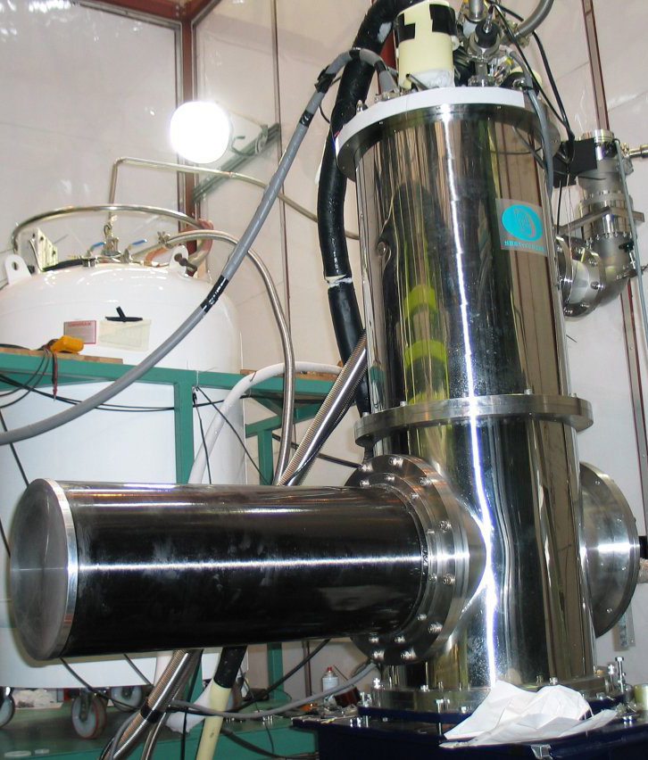
Liquid 4He target
KEK-PS E549/E570 4He target
NIM606(2009)233
cryostat
(side)

Slide 26
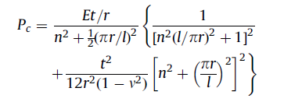
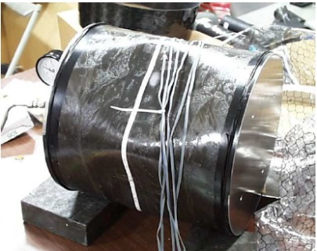
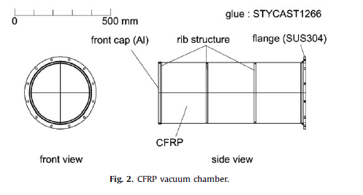
CFRP vacuum chamber (I)
Why CFRP (Carbon Fiber Reinforced Plastic)?
n = 2 n = 4
Buckling theory of cylindrical shell (Sauthwell formula)
P_{c} : critical pressure
E : Young modulus
n : node
High Young’s modulus is favorable
←→ low –Z material is better to suppress multiple scattering
broken CFRP
P
r
l
CFRP is the best choice.
(Beryllium is extremely expensive.)
26

Slide 27
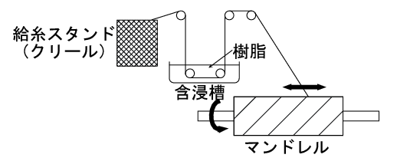
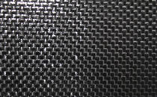
CFRP vacuum chamber (II)
Photo : installed at K1.8BR
forming cylindrical shape
F-W(filament-winding)
← inadequate for thin shell
carbon fiber / plastic ratio is not high
prepreg type (sheet-type CFRP, Sankyo Manufacturing Co Ltd.)
cross
UD
← Use this type
UD: align fibers in one direction
attach on to a mold by changing fiber direction (0, 90 degree , 4 layers = 1 mm)
CFRP
Tapered vacuum chamber : not to interfere neutron acceptance
27

Slide 28
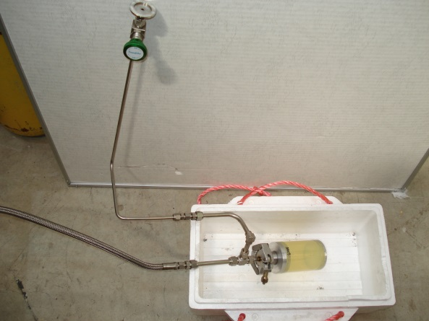
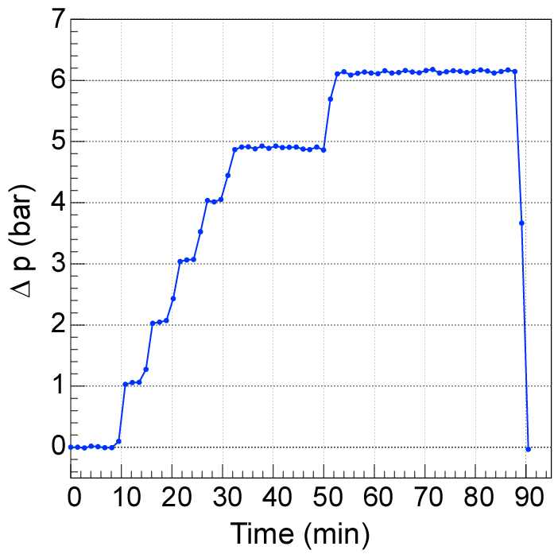
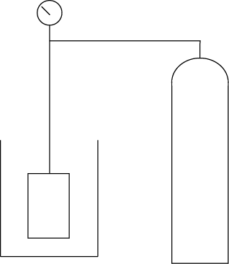
Pressure test of MICTRON cell
Pressurize cell with 4He in LN2
T = 250μm @ 77 K
P
Δp = 6 bar
cell
4He gas
cylinder
LN2
T = 250μm (MICTRON 5 turn) → dP > 6 bar
耐圧性能を確認
cf. T = 100 μm (MICTRON 2turn) d P > 3 bar

