Slide 2


27th International Conference of the International Nuclear Target Development Society (INTDS-2014)
The Stripping Foil Test Stand in the Linac4 Transfer Line
W. Weterings
C. Bracco, R. Noulibos, Y. Sillanoli, P. van Trappen
CERN, European Organization for Nuclear Research, CH-1211 Geneva 23, Switzerland

Slide 3
Talk Overview
Introduction
  LIU Project
  Linac4
  PSB Injection Region Configuration
Stripping Foil Test Stand
Layout & Instrumentation
Foil Handling Mechanism
Stripping Foil Specification
Test possibilities
Conclusion

Slide 4
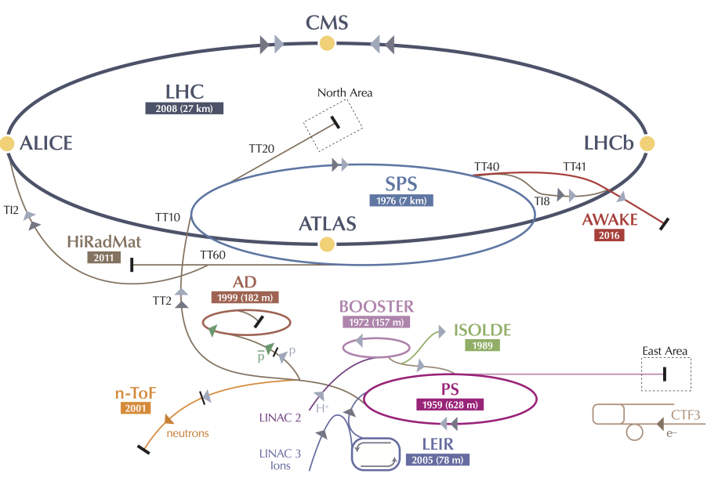
Introduction
Present
LIU Project
Proton flux / Beam power
50 MeV
Linac2
Linac4
160 MeV
1.4 GeV
PSB
2.0 GeV
PSB
26 GeV
Output energy
PS
PS
450 GeV
SPS
LINAC 4
H−
LHC /
HL-LHC
The CERN Accelerator Complex
7 TeV
LHC Injectors Upgrade (LIU) Project comprises a new Linac4, as well as major upgrades and renovations of the Proton Synchrotron Booster (PSB), the Proton Synchrotron (PS) and the Super Proton Synchrotron (SPS).

Slide 5
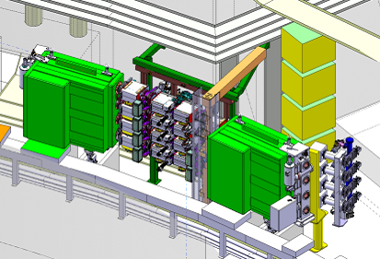
Introduction
The 160 MeV H⁻ beam from the Linac4 will be injected horizontally into the PSB by means of a H⁻ charge exchange injection system, one for each ring.
LINAC 4
H−
The Linac4 project is a new 160 MeV H⁻ linear accelerator replacing Linac2 as injector to the PS Booster (PSB).

Slide 6
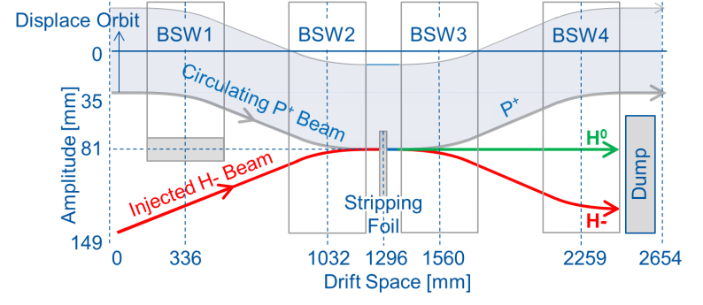
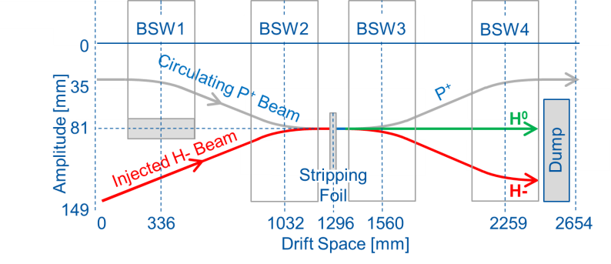
PSB Injection Region Configuration
Configuration of the PSB injection region with 380mm long BSW magnets
The local orbit of the PSB beam is displaced by ~81 mm using two independent closed orbit bump systems:
The Injection Chicane, made by a set of 4 pulsed dipole magnets (BSW).
The Painting Bump, made by 4 horizontal kickers (KSW) outside the injection region, giving a 35 mm closed orbit bump, with falling amplitude.
A stripping foil will convert ~98% of the H⁻ into protons by stripping off the electrons.
Notes:
Horizontal kickers (KSW), outside the injection region, produce 35 mm closed orbit bump.
Injection bump, BSW displaces beam by a constant 46 mm during the injection process.
1560-1032-380 = 148mm. Only ~130mm available for unit, narrow design

Slide 7
Stripping Foil Test Stand
A stripping foil test stand will be installed in the Linac4 transfer line allowing tests with a 160 MeV H⁻ Linac4 commissioning beam:
Testing from 2015, prior to final PSB installation (>2018)
The foil changing mechanism as well as the interlocking functions can be assessed;
Gain experience with these very fragile foils;
Test different foil materials and thicknesses;
Evaluate the lifetime of the foils and foil holders;
Measure the stripping efficiency and emittance growth of the beam through the stripping foil.

Slide 8
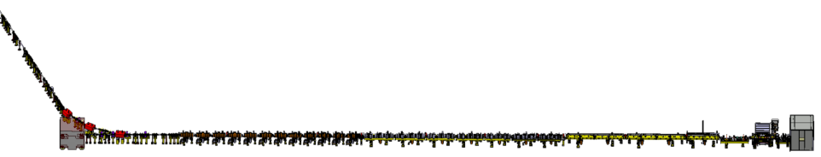
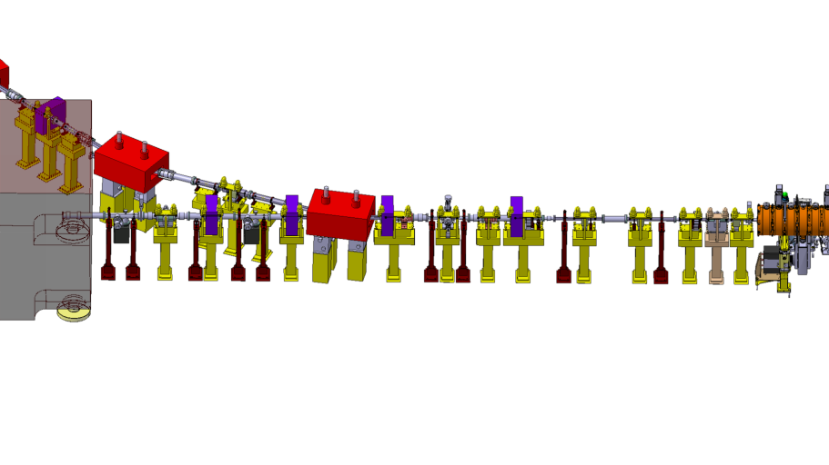
Layout & Instrumentation
Linac4 Layout
160 MeV
100 MeV
50 MeV
3 MeV
Dump
PIMS
CCDTL
DTL
Source
Transfer Line
to PSB
Transfer Line to PSB
Profile Monitors
Stripping Foil
Test Stand Location
QF
QD
BCT + BLM
BCT
Stripping efficiency is measured by current decrease between cross-calibrated Beam Current Transformers (BCT) and by taking the electrical signal from the foil holder.
Emittance growth is estimated using Secondary Electron Monitor (SEM) profile.
The upstream defocusing quadrupole (QD) is used to vary the beam size.
Notes:
QD from 2.5 T/m up to 9 T/m, the horizontal beam size (90%) can be varied from 2.5 mm to 3.7 mm respectively and the vertical beam size from 7.4 mm to 4.2 mm.
Beam can be transported to the main dump without any losses, provided that the downstream QF (L4T. MQF.0210) is switched off

Slide 9
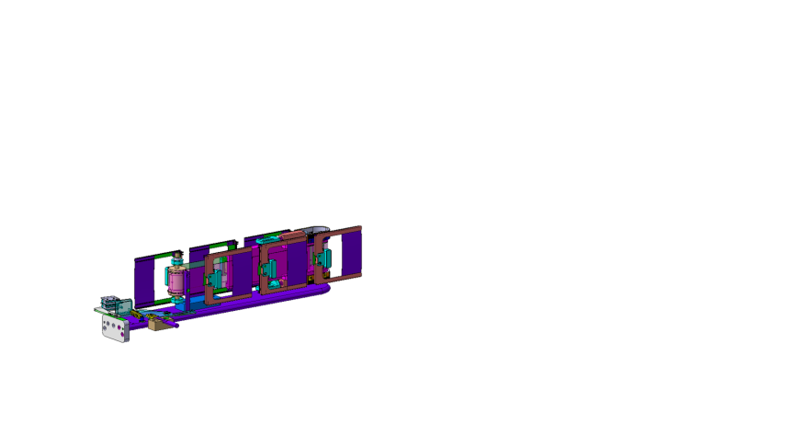
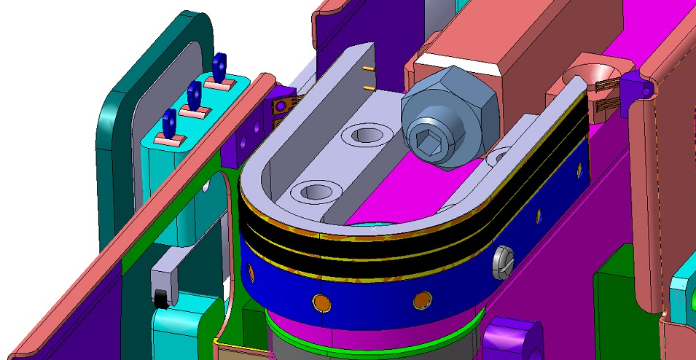
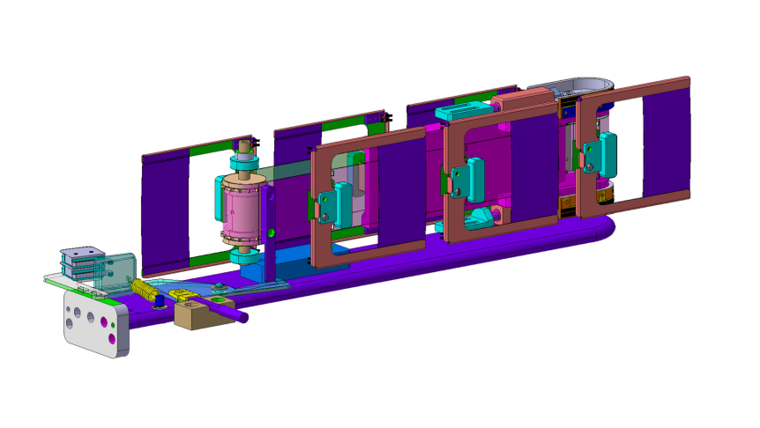
Foil Handling Mechanism
Foil movement of ±2mm, with a precision of ±0.1mm, from the nominal beam position.
Micro
Switch
Wipers
Potentiometer
Conductive Ink
On Kapton®
Foil Holder
Rotating Belt

Slide 10
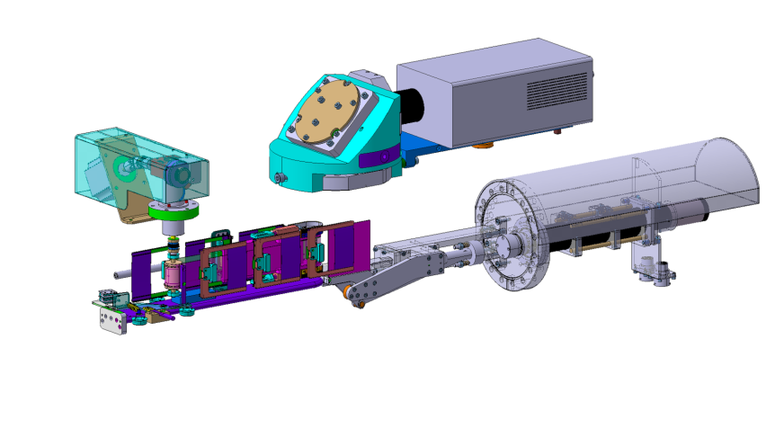
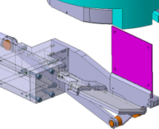
Foil Handling Mechanism
Radiation Hard
Camera
Mirrors and
Optical Filters
Stepping motor
UHV
Magnetic
coupling
Foil Changer
Beam Observation
System (BTV) with
Screen in Beam
Rear View
Showing mirror
Notes:
1 mm thick Chromox (Al₂O₃ doped with CrO₂) scintillating screen, engraved with calibration marks.
The BTV has a position accuracy of ±0.2 mm and for a large range of beam intensities remotely controlled optical filters are included.

Slide 11
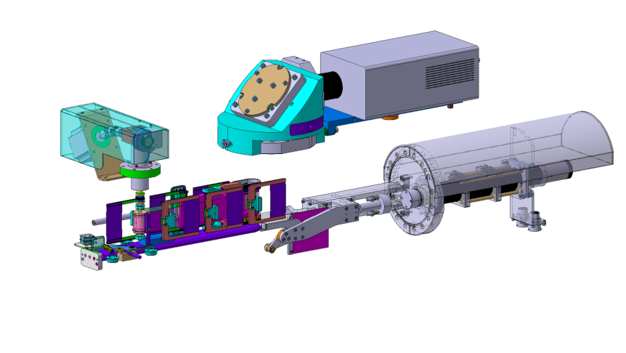
Foil Handling Mechanism
Radiation Hard
Camera
Mirrors and
Optical Filters
Stepping motor
Beam
UHV
Magnetic
coupling
Foil Changer
Beam Observation
System (BTV) with
Screen Retracted
Rear View
Showing mirror
Notes:
A stripping foil current measurement will be made by means of taking the electrical signal from the foil holder

Slide 12
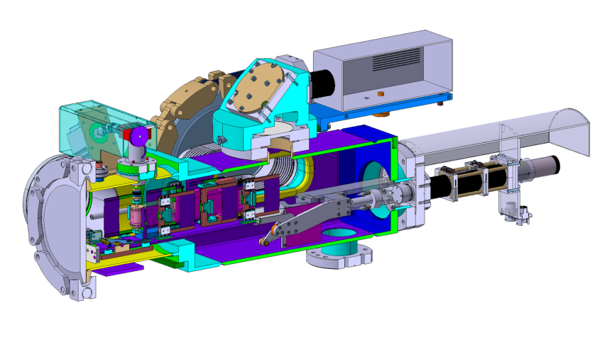
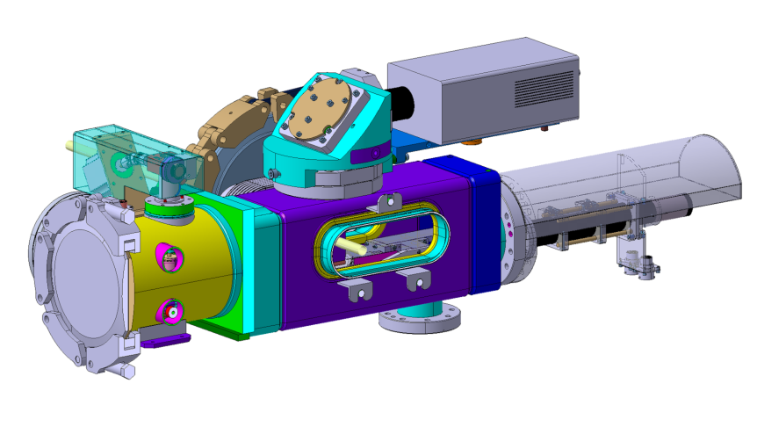
Foil Handling Mechanism
Radiation Hard
Camera
Mirrors and
Optical Filters
Stepping motor
UHV
Magnetic
coupling
Foil Changer
Beam Observation
System (BTV) with
Screen retracted
Vacuum
Chamber

Slide 13
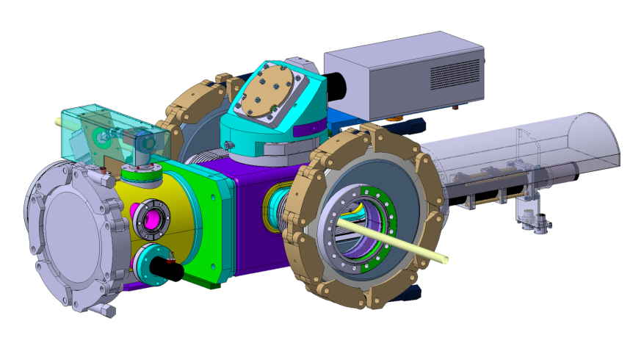
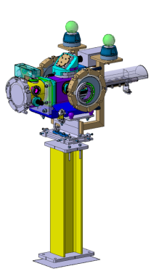
Foil Handling Mechanism
Final configuration to be
installed in Linac4
transfer line (L4T) sector 1.1

Slide 14
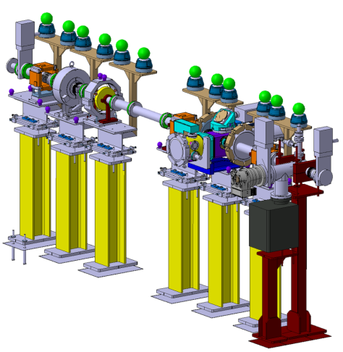


Configuration L4T sector 1.1
Beam Current
Transformer (BCT)
Beam
Vacuum
Valve
Vacuum
Valve
To optimise intervention time and avoid foil damage due to differential pressure, the system is installed in a dedicated vacuum sector.
Stripping Foil
Test Stand

Slide 15
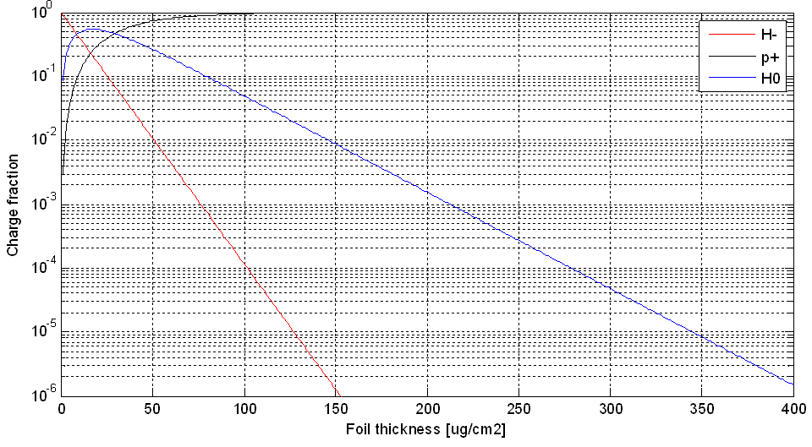
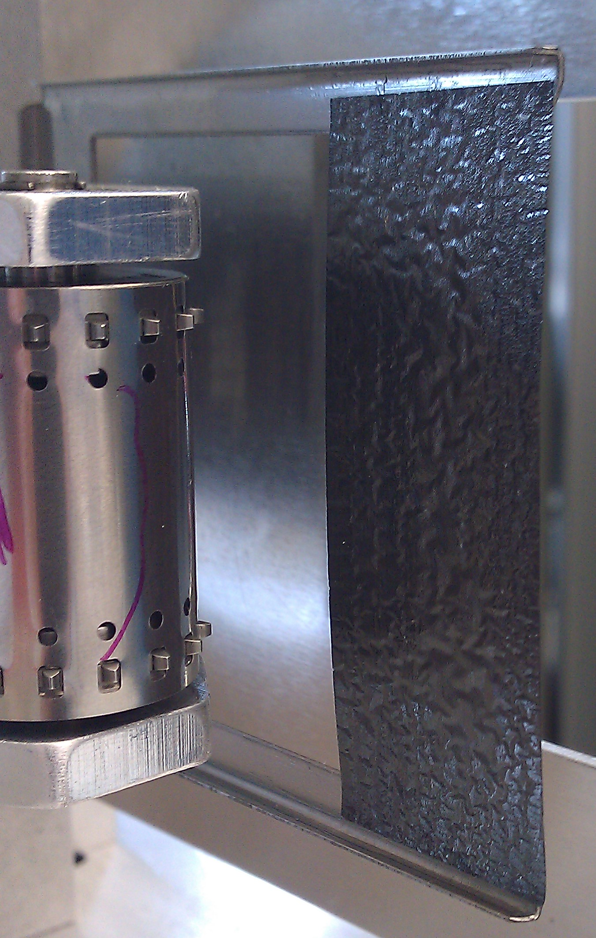
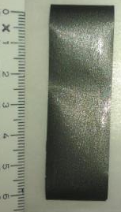
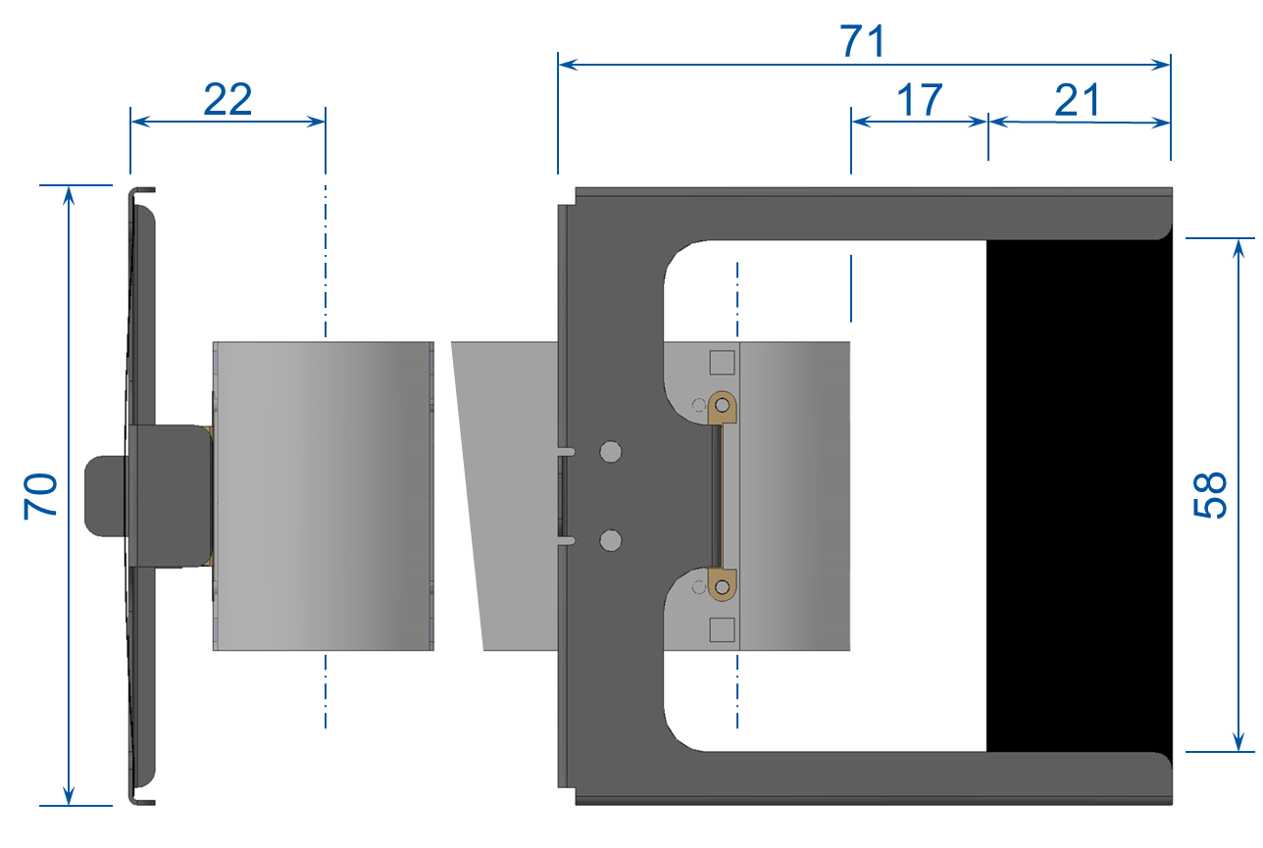
Stripping Foil Dimensions
H⁻, H⁰ and p⁺ yield at 160 MeV as a function of stripping foil thickness.
The foil should be:
< 250 µg/cm² to keep emittance growth below 0.1 π∙µrad, for the ~2 π∙µrad LHC beam.
< 200 µg/cm² to keep uncontrolled beam loss below the 10⁻⁴ level.
> 150 µg/cm² to ensure a theoretical stripping efficiency > 99 %.
Chosen baseline foil thickness 200 μg/cm²
The Stripping Foil Test Stand in the
Linac4 Transfer Line
Notes:
The stripping efficiency as a function of the carbon foil thickness was estimated by scaling the charge exchange cross-sections measured at 200 MeV to160 MeV [8].

Slide 16
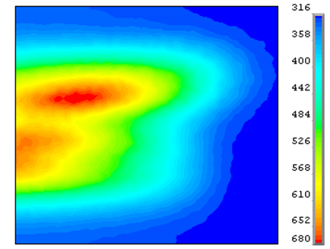
Stripping Foil Heating
Peak temperature on the 20 x 20mm centre area (left) and evolution of maximum temperature (right) in carbon foil for 1.3 x 10¹³ p⁺ beam injected at 1.2 s intervals. The equilibrium peak temperature is about 650 K.
Thermal foil damage is unlikely to be a foil lifetime or performance issue.
The Stripping Foil Test Stand in the
Linac4 Transfer Line
Notes:
emittances around 8 and 6 π∙µrad are assumed in the horizontal and vertical planes
0.833 Hz, assuming only black-body radiation cooling

Slide 17
Test possibilities
Stripping efficiency by measuring the BCT current before and after the foil (resolution of 0.1 mA).
Beam losses at the level of few 10⁹ protons are expected for 10¹⁴ H⁻ nominal intensity from L4.
A rough estimate of the emittance growth through the stripping foil could be obtained by using the SEM profile grids.
The PSB injection worst failure scenario can be simulated by hitting the foil with a 400 µs pulse and minimum beam size.
Many mechanical cycles and movement of the foil, with and without beam to test rigidity of different types of foils.
The BTV system will be tested, including correct filters selection for beam measurements over a large range of beam intensities as well as the Foil – BTV screen interference interlock.

Slide 18
Conclusion
A stripping foil test stand in the Linac4 transfer line will allow testing of the foil exchange mechanism, controls, and instrumentation.
It will also allow measurement, at the % level, of the stripping efficiency for different foils.
A rough estimate of the emittance growth of the beam through the stripping foil can also be obtained.
The operation of the test stand will be in parallel with Linac4 operation and is anticipated to start autumn 2015.

Slide 20
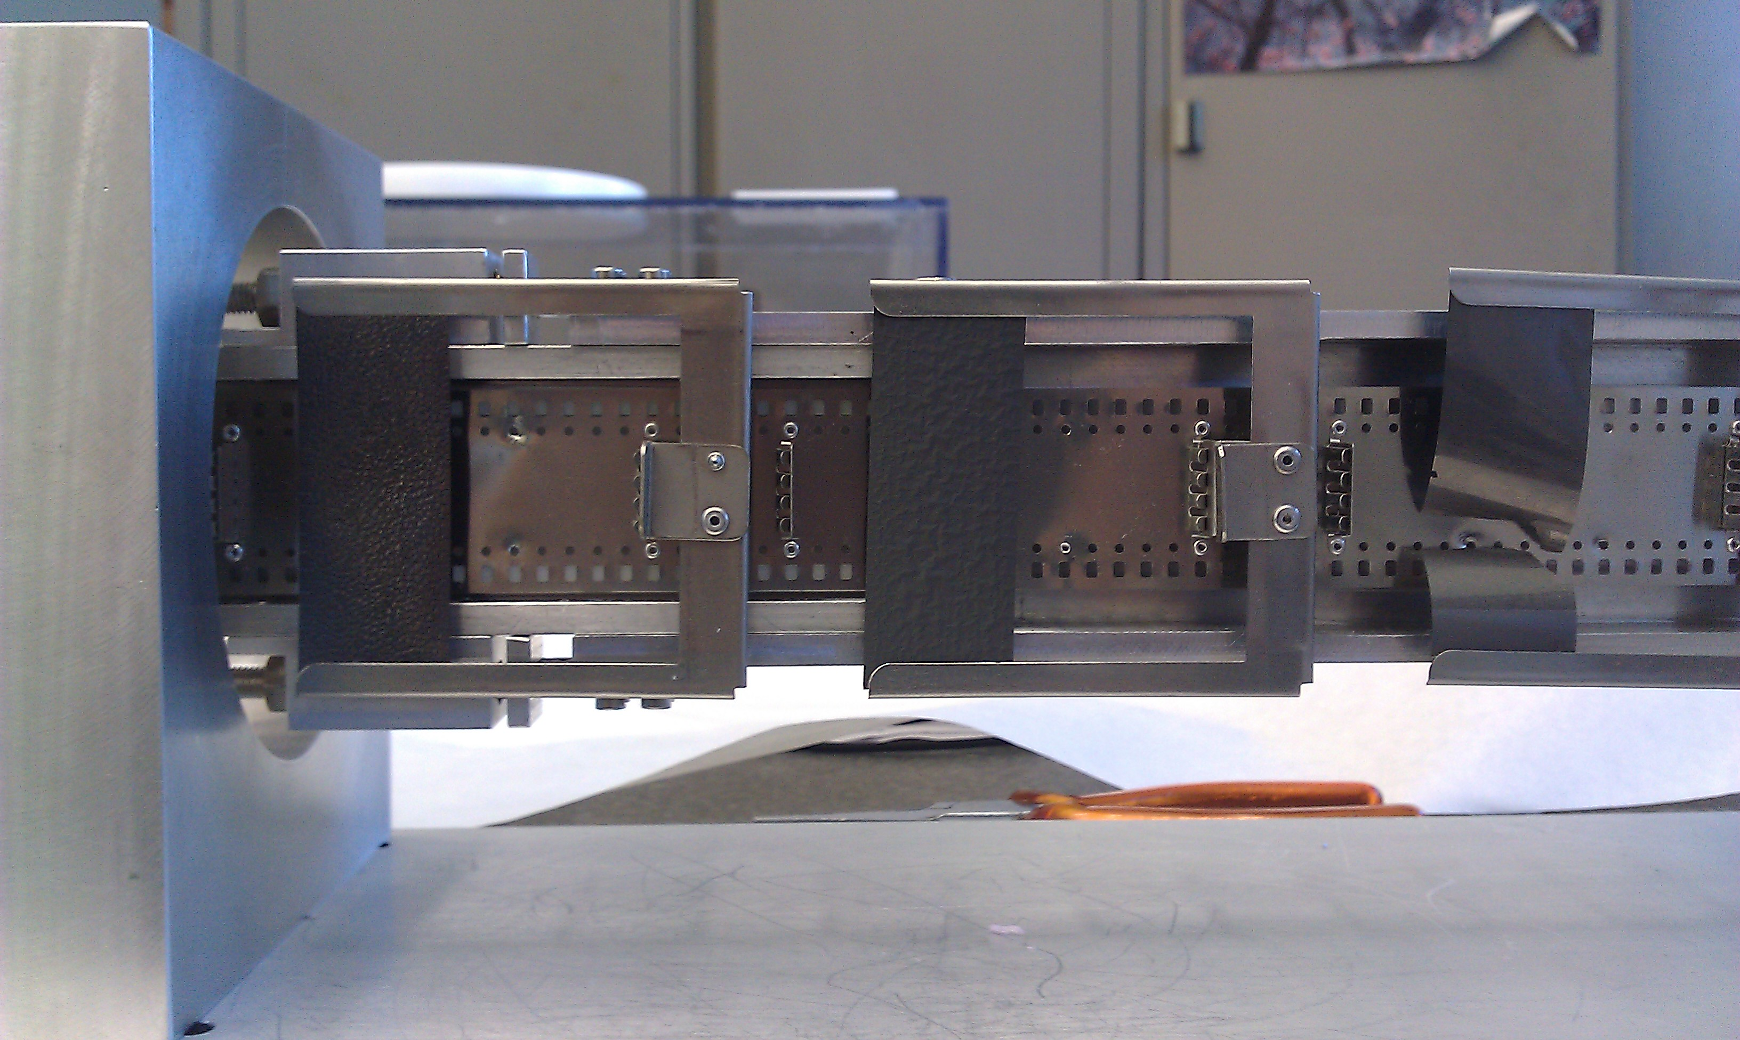
Spare Slides

Slide 21
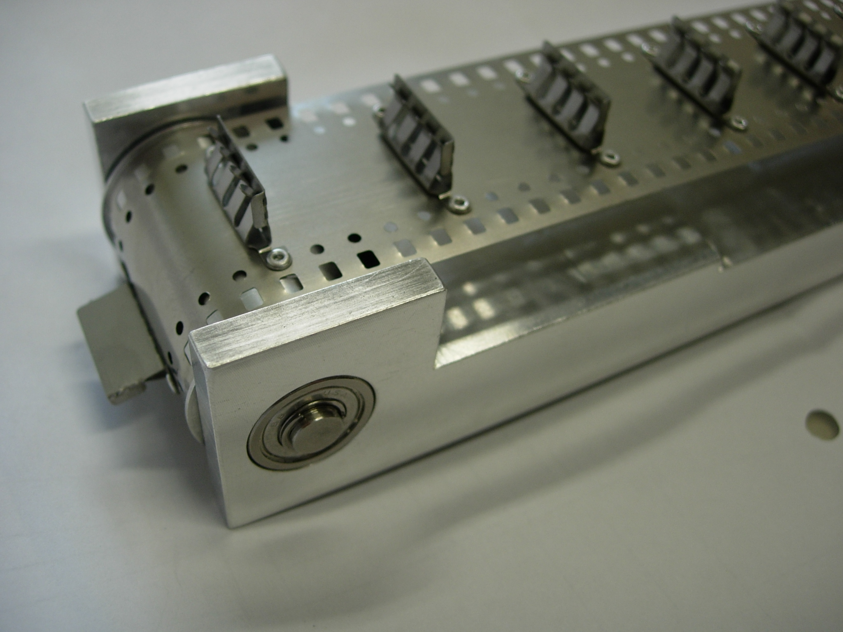
Spare Slides

Slide 22
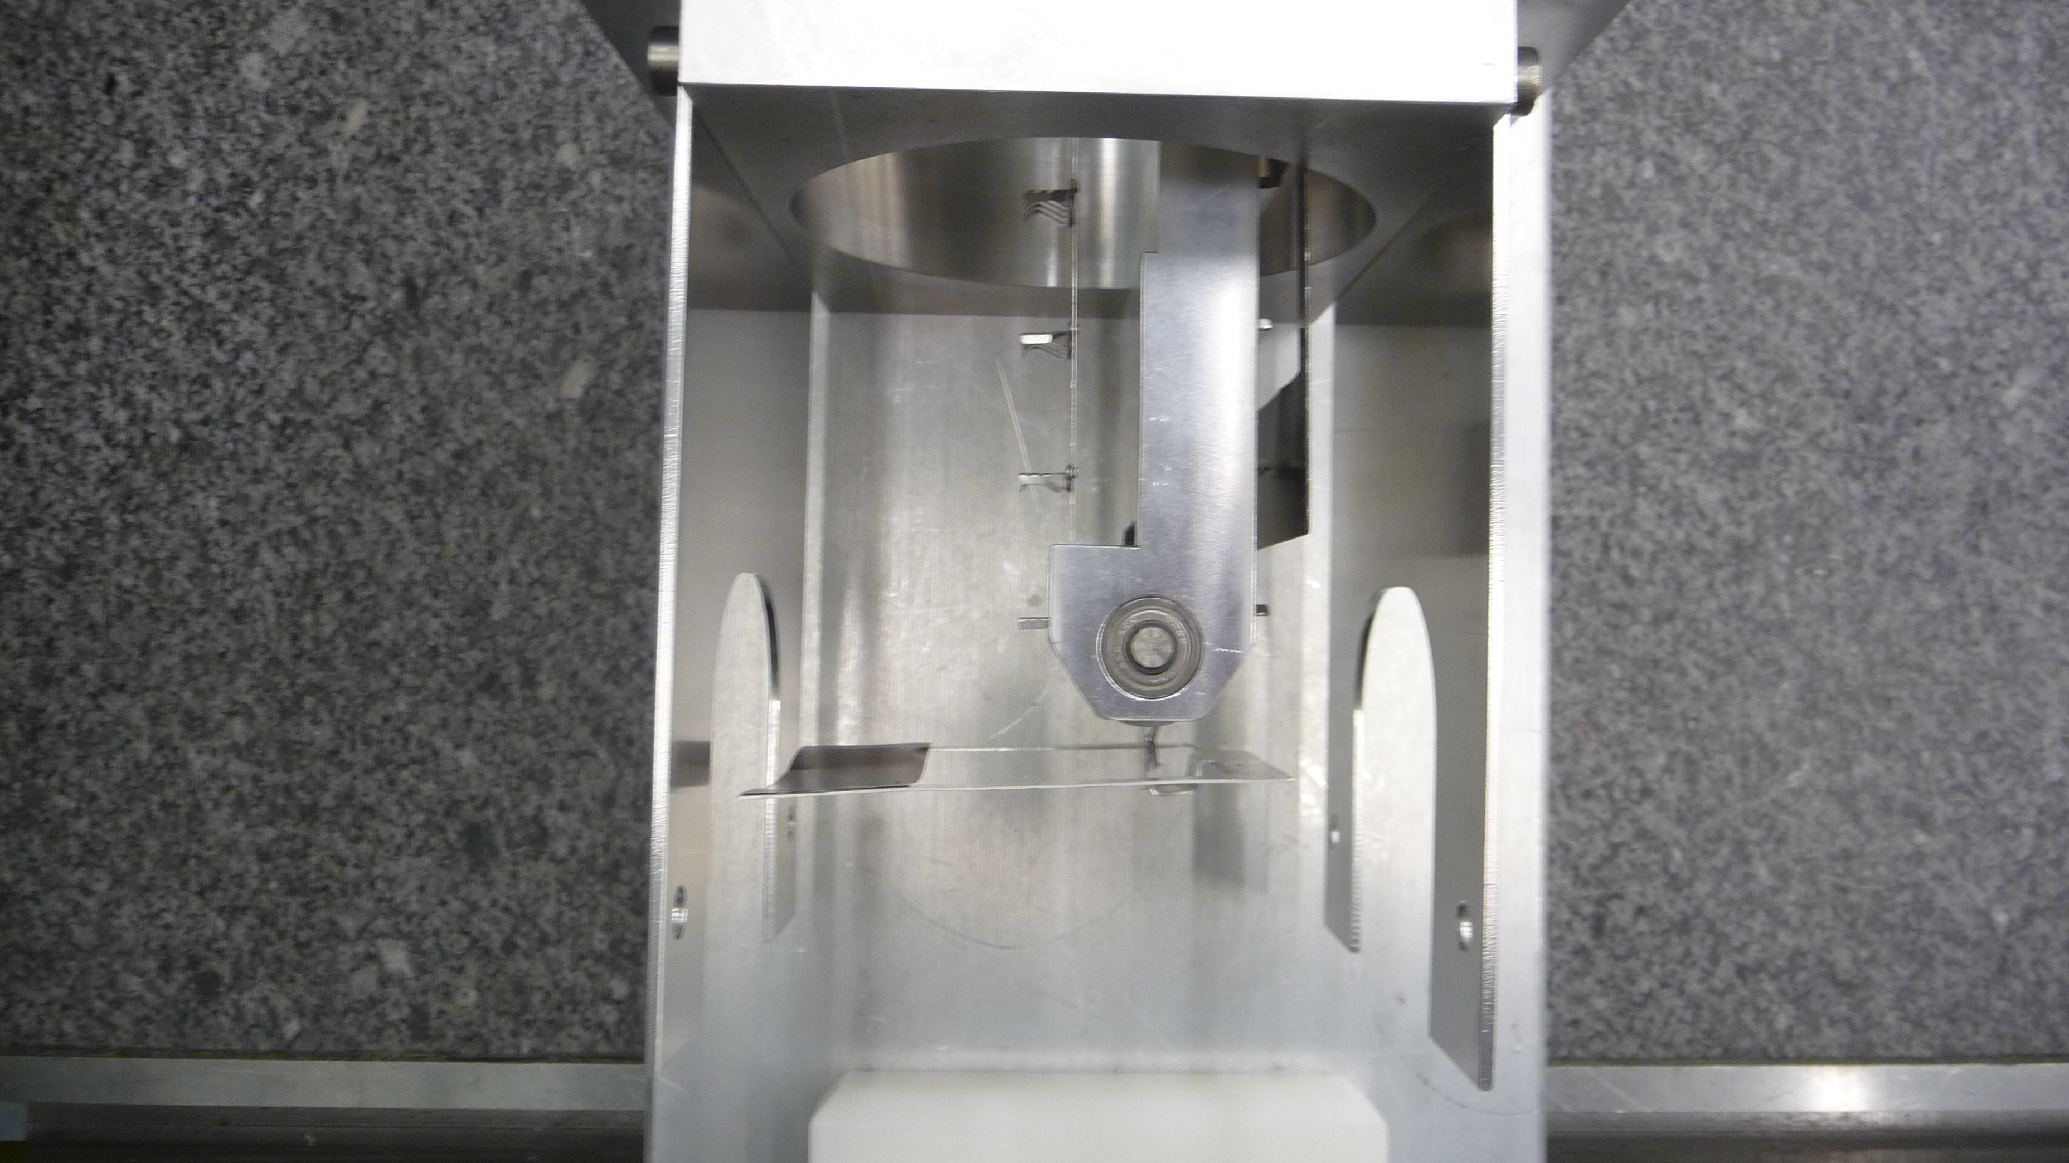
Spare Slides

Slide 23
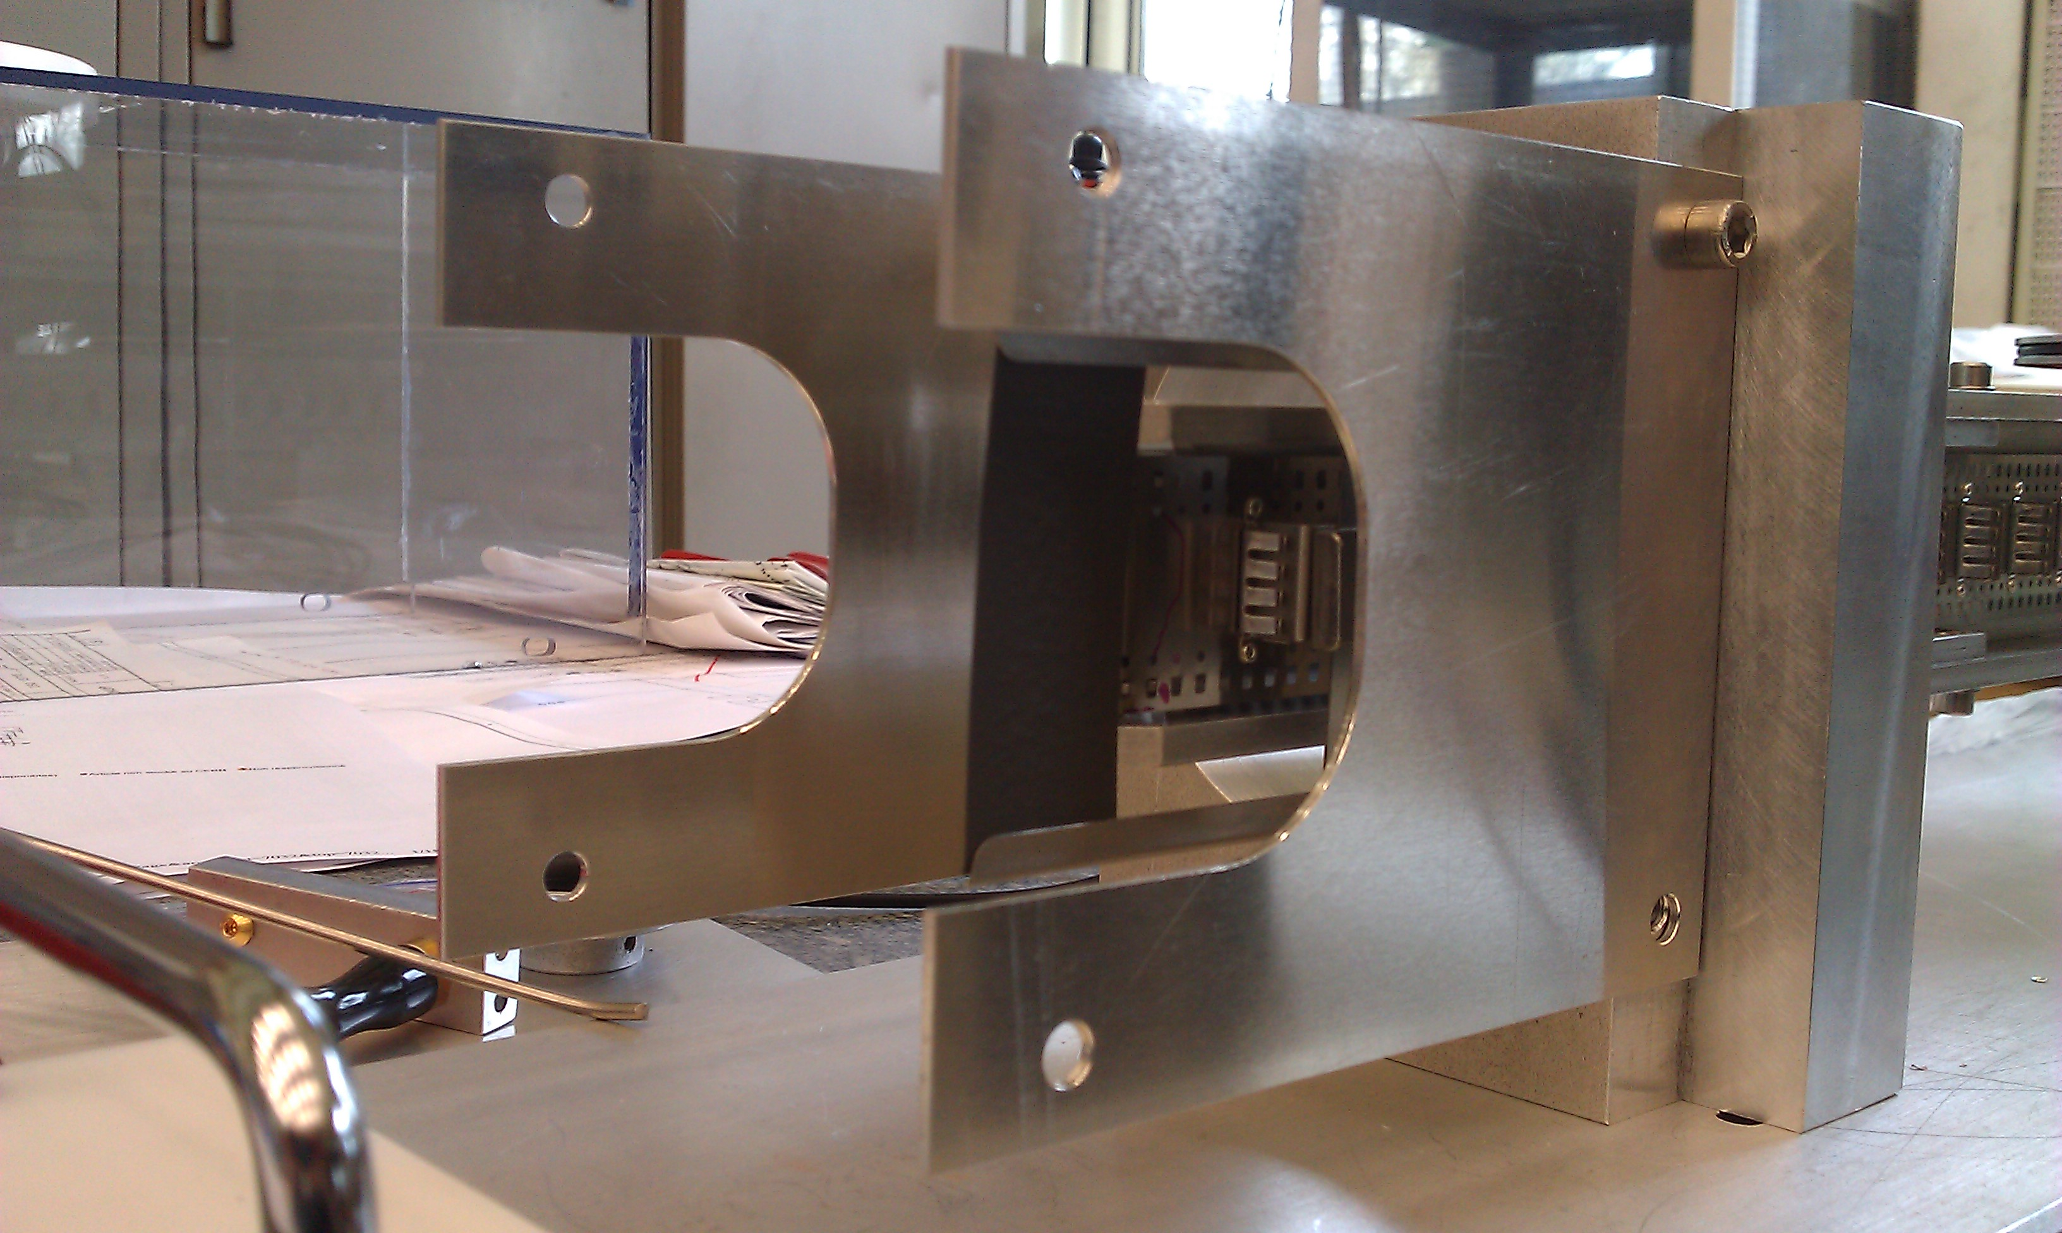
Spare Slides

Slide 24
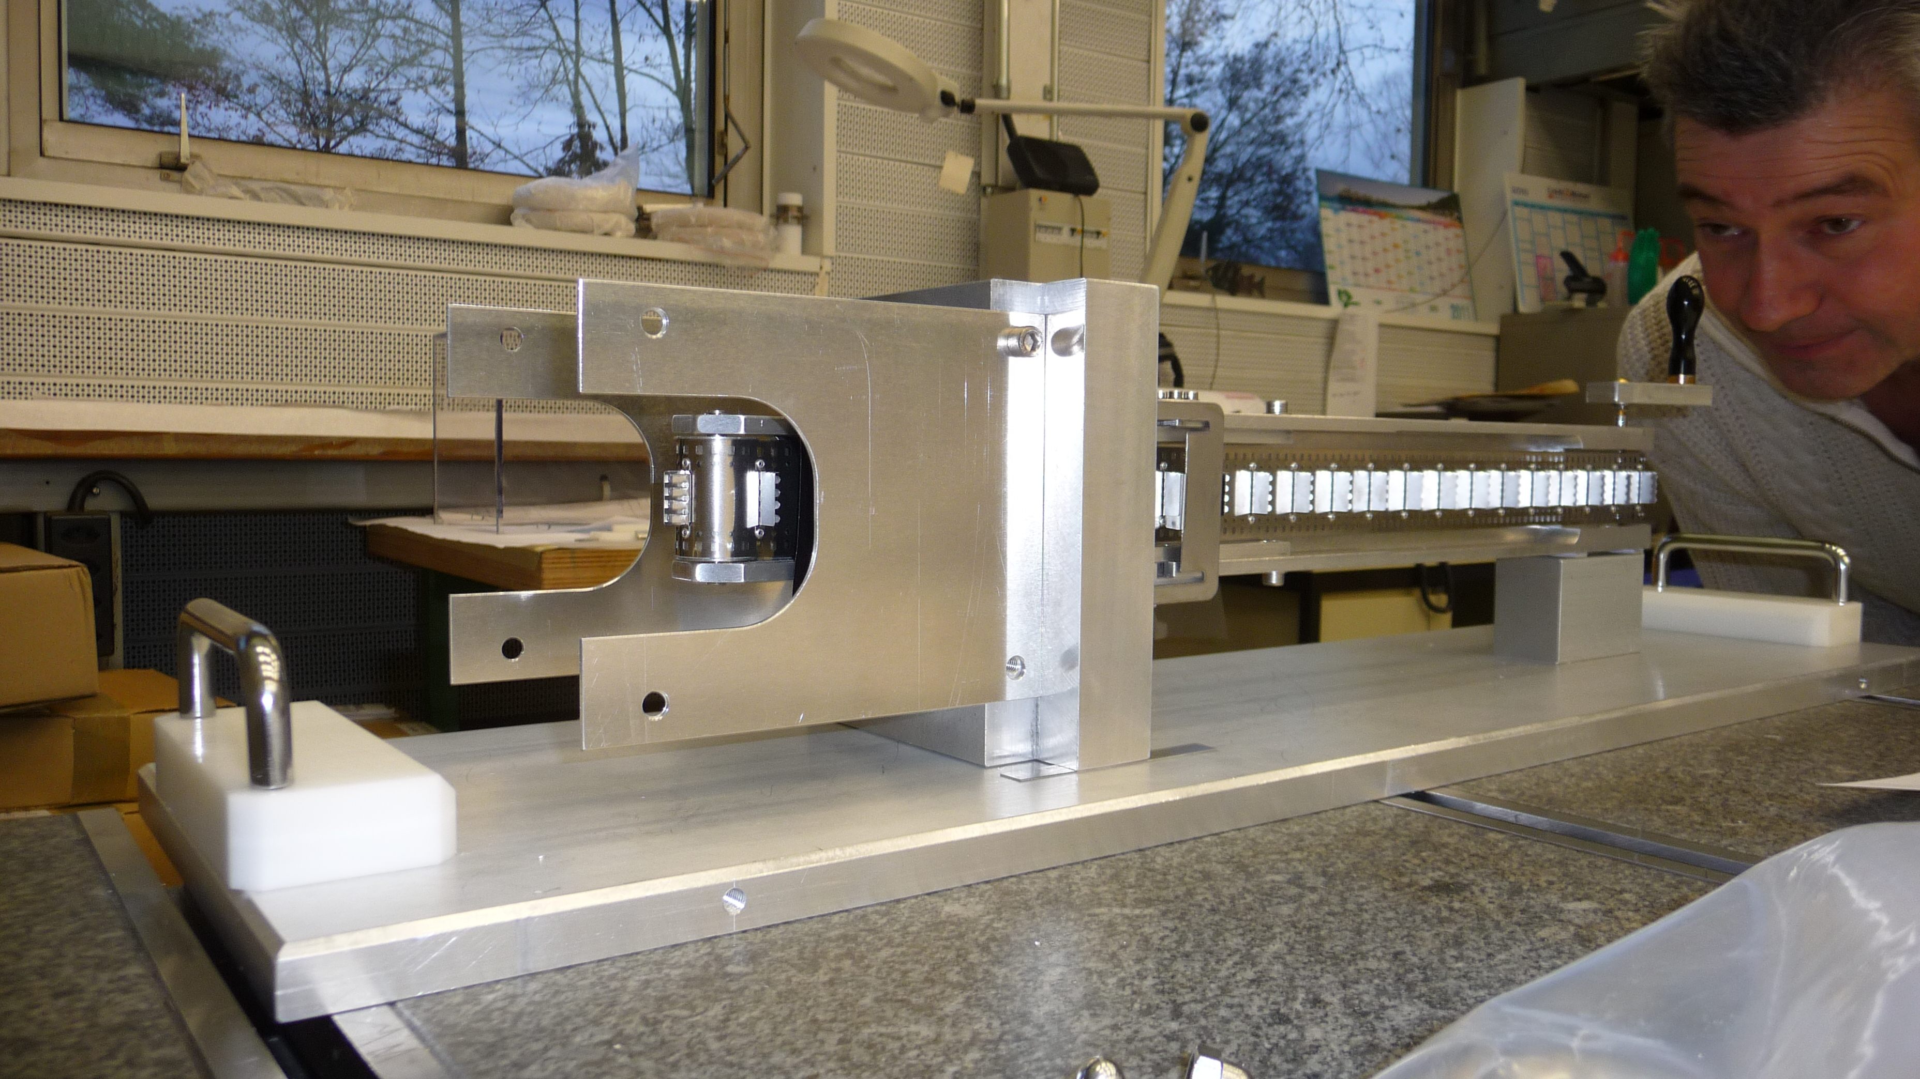
Spare Slides

