Slide 1
Nucleon spin decomposition at twist-three
Yoshitaka Hatta
(Yukawa inst., Kyoto U.)
TexPoint fonts used in EMF.
Read the TexPoint manual before you delete this box.: AAAA

Slide 2
Outline
Ji decomposition
Complete decomposition
Canonical vs. kinetic OAM
Twist analysis
Transversely polarized case
Refs:
1101.5989 (PRD)
1111.3547 (PLB)
1207.5332 (JHEP) with Shinsuke Yoshida
1211.2918 (JHEP) with Shinsuke Yoshida and Kazuhiro Tanaka

Slide 3
Ji decomposition
Based on the Belinfante-improved energy momentum tensor
Operators local and gauge invariant
Related to twist-two GPDs, measurable in DVCS
Further decomposition in the quark part

Slide 4
Frequently Asked Questions
Where is ? Everybody says is important to understand the nucleon spin structure.
Can we interpret the integrand as the `angular momentum density’ of quarks and gluons with momentum fraction ?
Commutation relation must be abandoned?* Would be nice to have it at least at tree level.
Is this valid for the longitudinal polarization, or transverse, or both? In any frame?
Go to twist-3

Slide 5


Early hint at twist-three
Penttinen, Polyakov, Shuvaev, Strikman (2000)
Twist-2 and twist-3 GPDs
In the parton model,
related to OAM (Which OAM?)

Slide 6
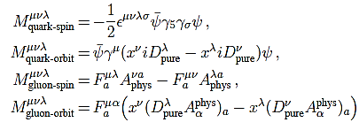
Complete decomposition
Chen, Lu, Sun, Wang, Goldman
Wakamatsu
Y.H.
Define the `physical’ and `pure gauge’ parts of the gauge field
My choice

Slide 7
Remarks
Gauge invariant completion of Jaffe-Manohar
Gluon helicity part coincides with
Each component measurable on the lattice!?
Ji, Zhang, Zhao, 1304.6708

Slide 8
Canonical vs. kinetic OAM
“kinetic” OAM
“canonical” OAM
“potential” OAM
Physical meaning of the potential OAM
Torque acting on a quark
Burkardt (2012)

Slide 9
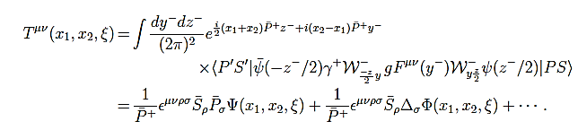
Potential angular momentum
Nonforward generalization of the Qiu-Sterman matrix element
→ single spin asymmetry
→ OAM

Slide 10

OAM from the Wigner distribution
Lorce, Pasquini (2011)
Wigner distribution in QCD
Belitsky, Ji, Yuan (2003)
Phase-space distribution of partons
related to a generalized TMD by Meissner, Metz, Schlegel

Slide 11
Canonical OAM from the Wigner distribution
YH (2011)
Kinetic OAM also follows
Ji, Xiong, Yuan (2012)

Slide 12
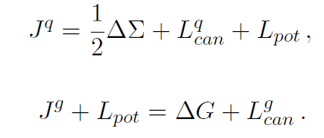

Twist analysis
YH, Yoshida (2012)
see also, Ji, Xiong, Yuan (2012)
Understand these relations at the density level
etc.

Slide 13

Twist three matrix elements
F-type
D-type

Slide 14
Relation between F- and D-type correlators
Eguchi, Koike, Tanaka (2006)
kinetic OAM canonical OAM potential OAM
doubly-unintegrated
The gluon has zero energy → density interpretation

Slide 15
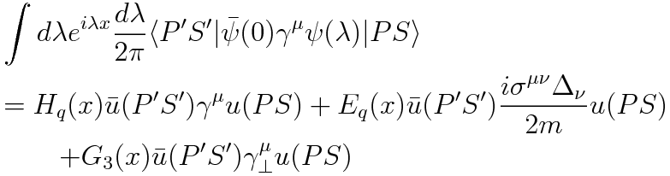


Canonical OAM and twist-3 GPD
From the equation of motion,
integrate

Slide 16
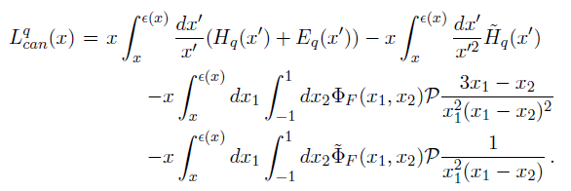

Quark canonical OAM density
Wandzura-Wilczek part
genuine
twist-three
First moment:

Slide 17



Gluon canonical OAM
Relation between F- and D-type three-gluon correlators
Twist-3 gluon GPD

Slide 18
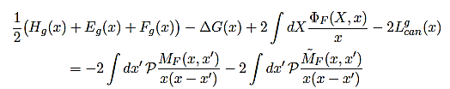
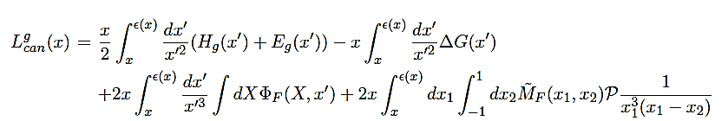


Relation between gluon canonical OAM and twist-3 GPD
WW part
genuine
twist-three
first moment:

Slide 19
Transverse spin decomposition
It’s important to use the Pauli-Lubanski vector
in order to obtain a frame-independent sum rule.
Higher twist?
Equally important!
Ji, Xiong, Yuan (2012)

Slide 20
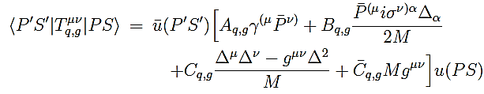



Frame-dependence endures
noncovariant !
Bakker, Leader, Trueman
YH, Tanaka, Yoshida
Leader

Slide 21
Gluon spin in the transversely polarized nucleon
YH, Tanaka, Yoshida
unpol
longitudinal transverse

Slide 22
Complete transverse spin decomposition?
Longitudinal
Transverse
same!
cannot be separated in a
frame-independent way

Slide 23

Frequently Asked Questions : Answers
Where is ?
Can we interpret the integrand as the `angular momentum density’?
Commutation relation must be abandoned?
Is this valid for the longitudinal polarization, or transverse?
We do have in the complete decomposition
Ambiguous for kinetic OAM. Unambiguous for canonical OAM.
Canonical OAMs do satisfy commutation relations.
Only for the longitudinal pol.
Contaminated by a `higher twist’ term in the transverse case.
Complete, gauge invariant decomposition in QCD
= twist-three decomposition

