Slide 1
summary
Y. Akiba

Slide 3
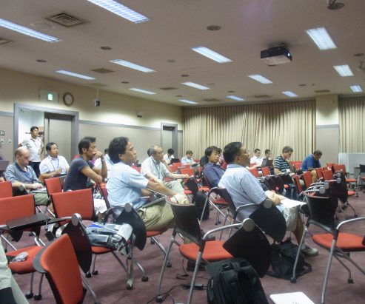
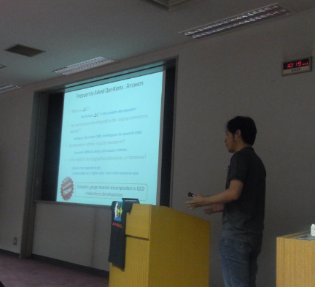

Slide 4
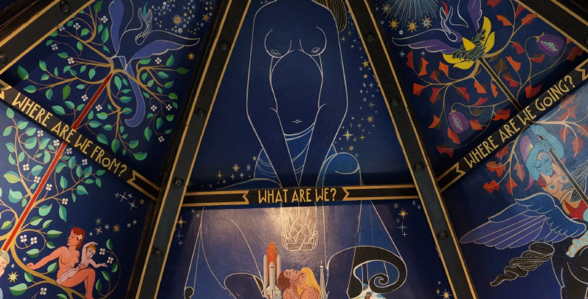

Slide 5
sPHENIX/fsPEHNIX/ePHENIX
sPHENIX/fsPHENIX/ePHENIX
Jamie Nagle sPHENIX physics overview
John Haggerty sPHENIX overivew
Kenta Shigaki hard probes
ShinIchi Esumi Soft probes
Xiaochun He Quarkonia
YA tracker/preshower
John Lajioe MPC-EX
Yuji Goto fs/ePHENIX spin
Joe Seele fsPHENIX detector
eRHIC
Abhay Deshpande
ePHENIX LOI
Kieran Boyle
Jin Huang
Itaru Nakagawa

Slide 6
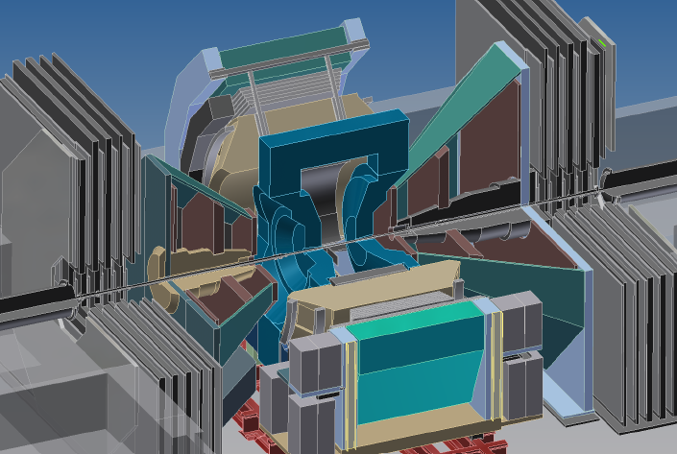
Where we are

Slide 7
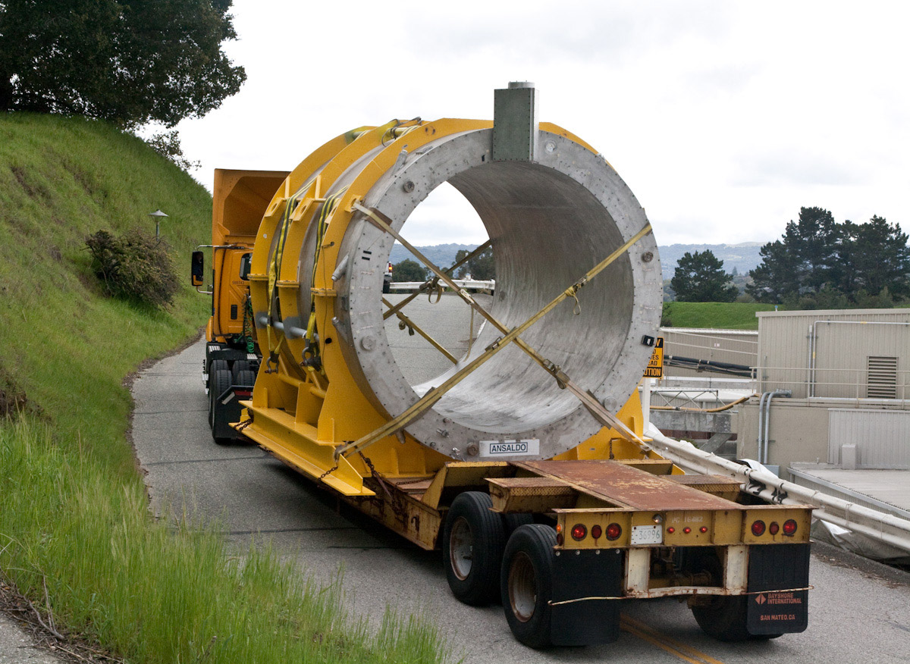
BaBar Solenoid
Excellent foundation for sPHENIX and ePHENIX: inner radius 140 cm, length 385 cm, field 1.5 T
Just moving to SLAC station A
Soon to Brookhaven
Reduces technical risk associated with acquiring new superconducting research magnets

Slide 8
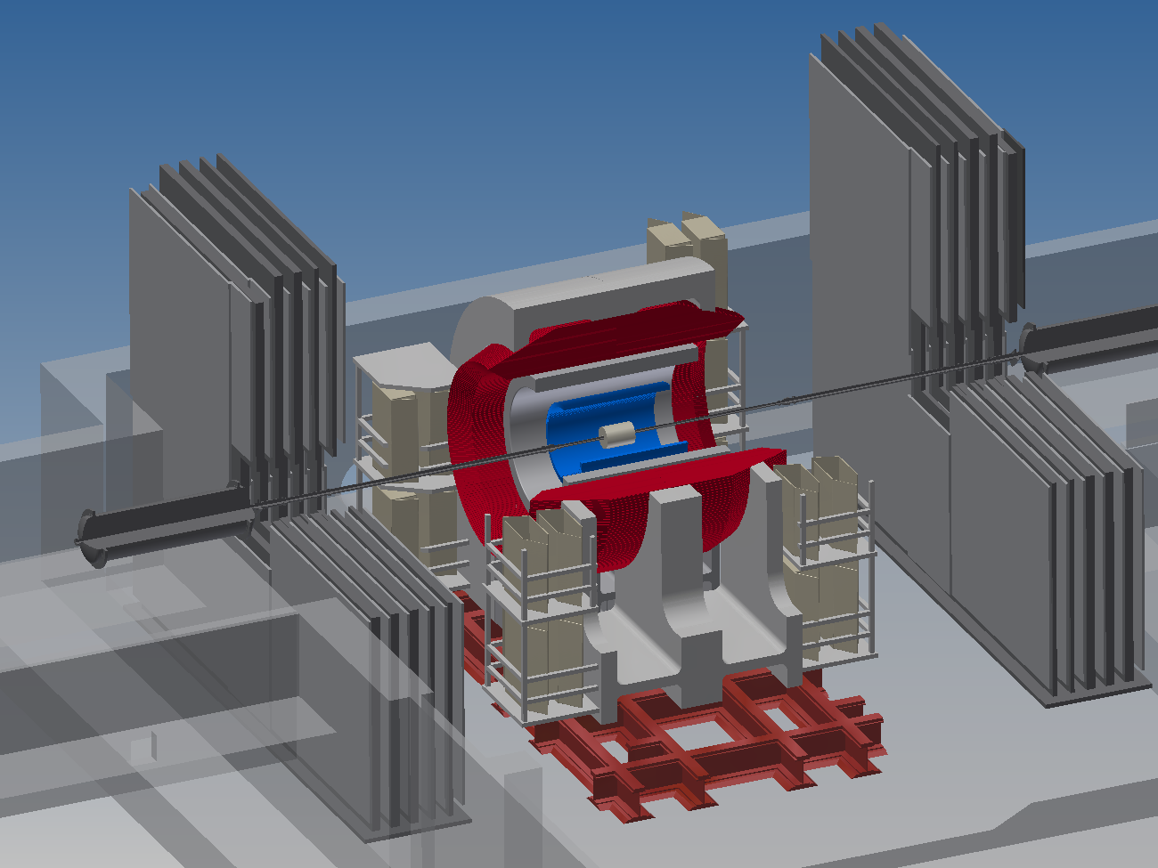
sPHENIX
Notes:
sPHENIX with BaBar magnet

Slide 9
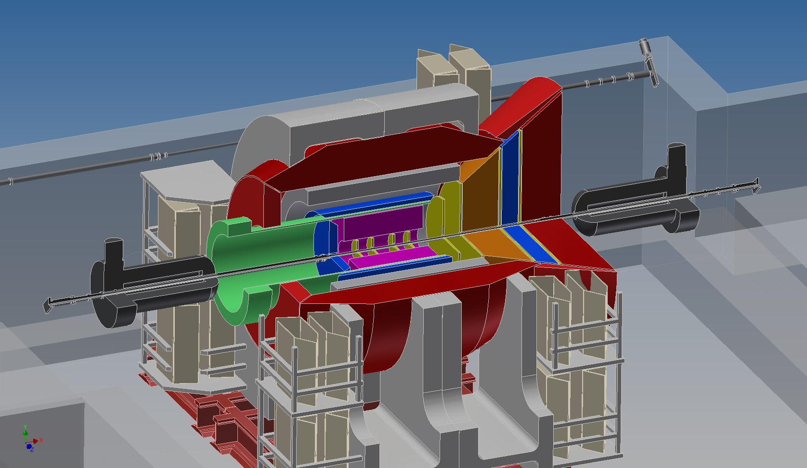
ePHENIX – built on the sPHENIX foundation

Slide 11
Lively discussion on “what is MUST in eRHIC/ePHENIX

Slide 12
Advance in theory
QCD overview
Tetsuo Hatsuda
Lattice QCD
Taku Izubuchi
Spin
Xiangdong Ji Delta G
Yoshitaka Hotta Decomposition
Yuji Koike transverse spin
QGP/CGC Theory
Yukinao Akamatsu Heavy Flavor
Yasushi Nara Jet and flow
Hirotsugu Fujii CGC and pA

Slide 13
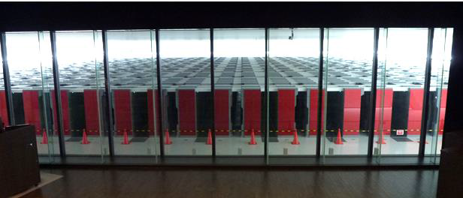
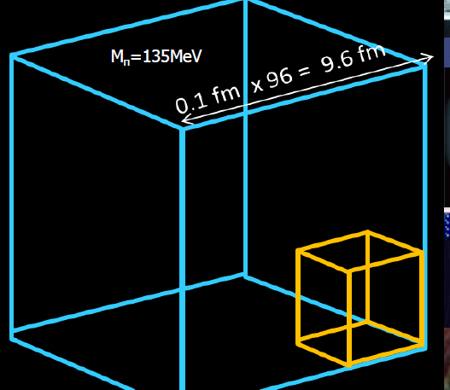
Great advance in Lattice computation
Big computer
Much larger volume
Clever and efficient algorithm
Hatsuda
Izubuchi
Realistic simulation → QGP properties and nucleon structure

Slide 14
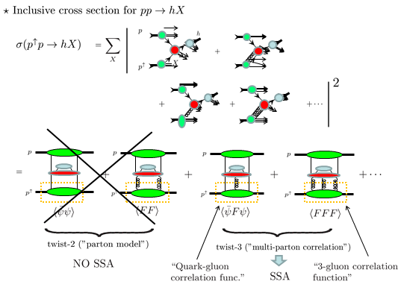
Advance in spin physics theory
Ji
Hatta
Koike
Koike

Slide 15
QGP theory
Akamatsu
Nara
Fujii

Slide 16
detector
sPHENIX Detector/Simulation
Eric Manneal FEE/Test Beam
Edward Kistenev Calorimeter
Nagashima G4 preshower
Xiaochun He G4 calorimeter
Detector technology
Akira Yamamoto superconducting magnet
Yasuo Arai SOI pixel
Youngil Kwon Silicon at Korea
Atsushi Taketani Silicon for sPHENIX tracker

Slide 17
Progress/status of sPHENIX Detector
Ed Kistenev
Eric Mannel

Slide 18
sPHENIX simulation
Preshower
X. He
Nagashima

Slide 19
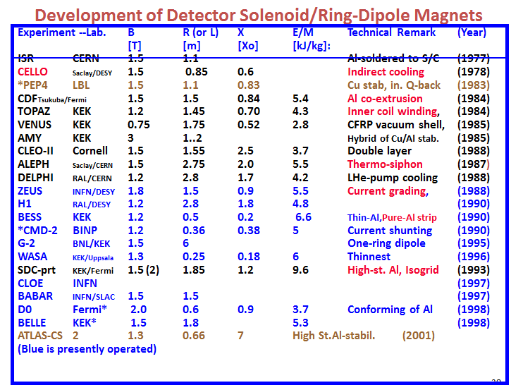
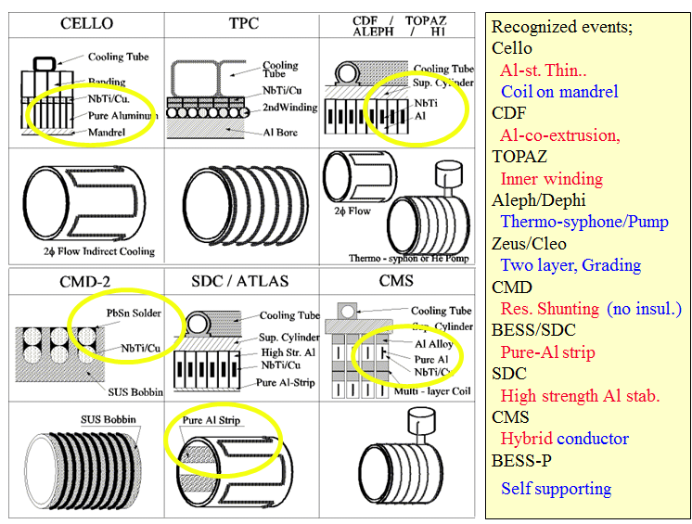
Superconducting detector magenet
J.Haggerty
A. Yamamoto

Slide 20
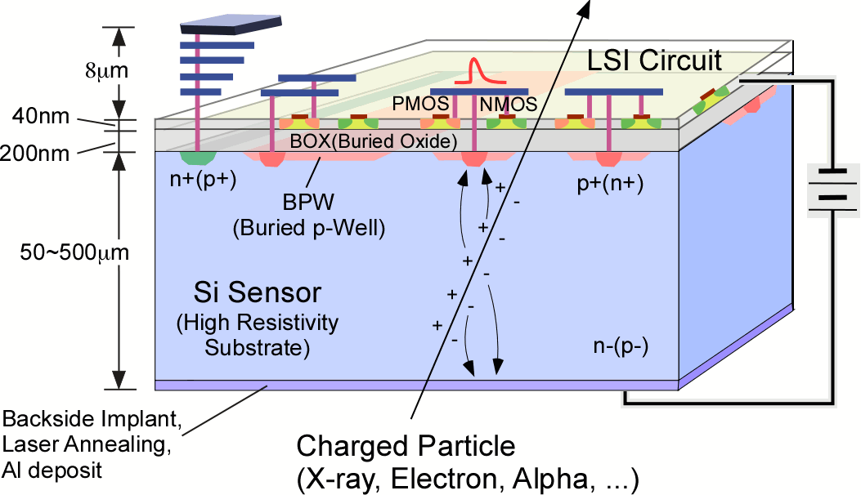
SOI Pixel Detector (SOIPIX)
Monolithic Detector having fine resolution of silicon and data processing power of CMOS LSI by using the FD-SOI Pixel Technology.
Y. Arai
Notes:
＊これが３次元半導体放射線検出器(SOIPIX)の概念図です。
＊半導体放射線センサの高分解能と、集積回路の高機能を併せ持つ、３次元構造のイメージング検出器
＊通常の放射線イメージセンサはセンサー部と読み出し回路の部分は別々になっていますが、SOIPIXでは一体化されています。
＊このため、各画素毎に様々なデータ処理回路を内蔵する事が出来、またセンサーの寄生容量が小さい事から高いゲインを得る事が出来ます。
＊センサー部は様々な放射線検出に対応出来、用途に応じて厚さは調整可能です。
＊この開発は一部JSTの先端計測分析技術・手法開発事業で資金をいただき行いましたが、昨年行われた事後評価に於いて最高評価Sをいただきました

Slide 21
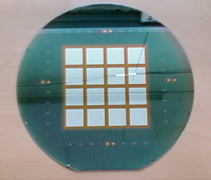
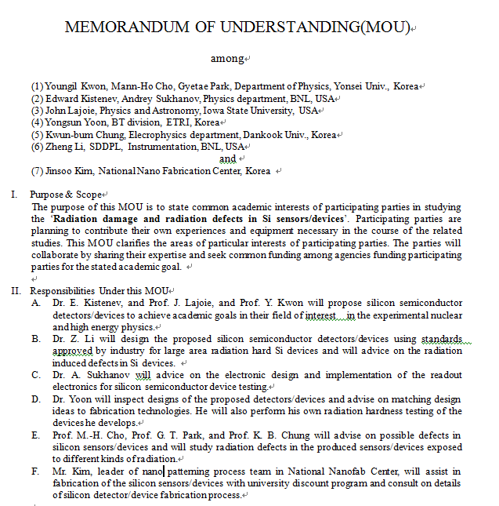
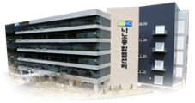
Possibility in Korea
R&D environment
6 inch fabrication line
1 cm² ~ $ 2
8 inch fabrication line
Y. Kwon

Slide 22
Non-PHENIX experiment
Yuji Yamazaki low x physics at HERA/LHC
Katsuo Tokushuku HERA/ZEUS
ToshiAki Shibata Hermes, SeaQuest
Yoshiyuji Miyachi Compass
Hideki Hamagaki Alice
Yajun Mao CMS quarkonium
KiyoshiTanida charm baryon
Nuclear Physics Experiment in Japan
Hirokazu Tamura
Nuclear Theory in Japan
Masayuki Asakawa
The time when PHENIX was born
Shoji Nagamiya

Slide 23
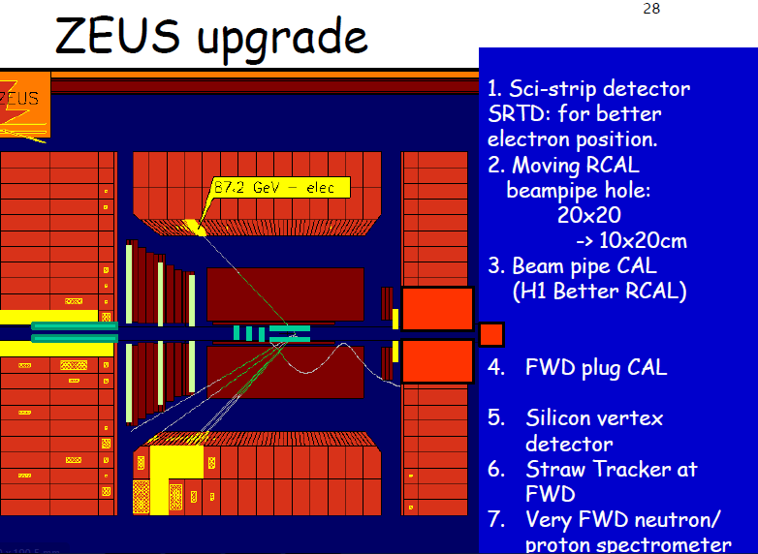
ep collider experiment → ePHENIX
K. Tokushuku
Y. Yamazaki

Slide 24
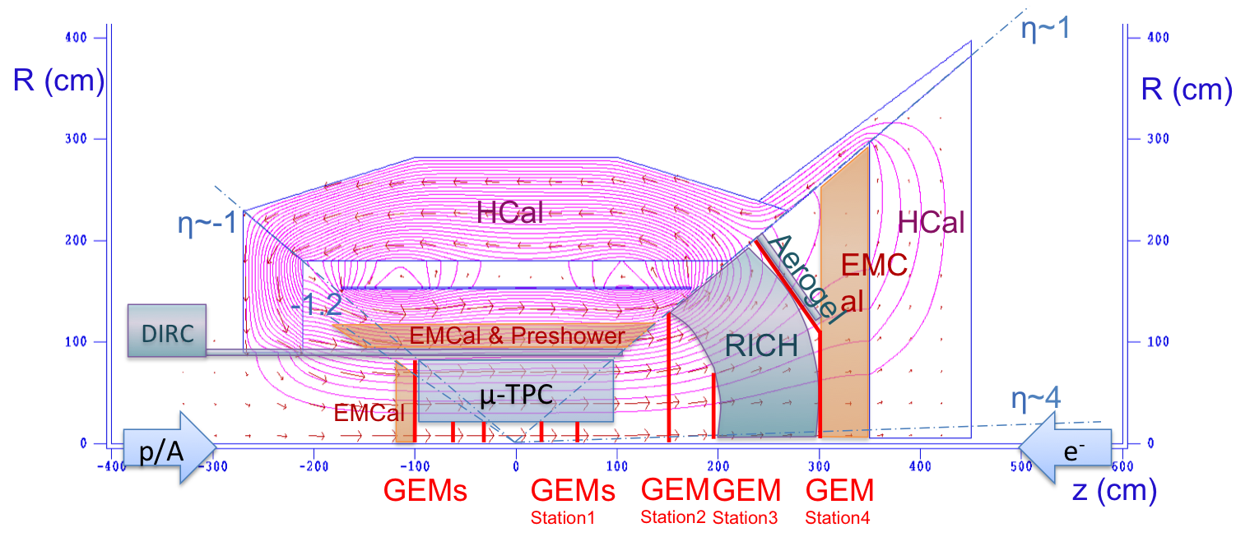
ePHENIX Detector Concept
Next two talks:
Tracking & Magnetic Field: Jin Huang
PID: Itaru Nakagawa
Use BABAR magnet
-1<η<1:
Keep sPHENIX EMCal and HCal
Add μ-TPC and DIRC
-4<η<-1:
Crystal calorimeter with good (2%) Energy resolution
GEM Trackers (+ μ-TPC)
No PID
1<η<4:
HCal (1<η<5)
EMCal
PbSc restack?
GEM Trackers (+ μ-TPC)
PID requires good resolution
Aerogel (1<η<~2)
RICH

Slide 25
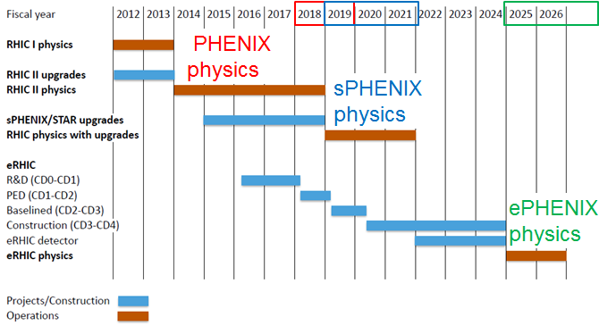

Slide 26
Thank you!

