Slide 1
PID Design for eLOI
RIKEN/RBRC
Itaru Nakagawa

Slide 2
Table of Contents
Requirements
  Kinetic Coverage (p, rapidity)
Technological Choice, Existing Detectors
ePHENIX Design Concerns
  RICH (Forward)
  DIRC (Central)
Photon Detector

Slide 3
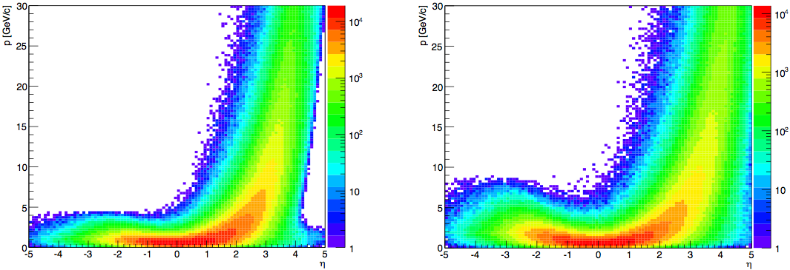
Required Kinetic Coverage and Spatial Constraint
Forward Arm
  B-field
  Path length < 1m
  Shoot for 4 < pi/K/p < 50 GeV
Central Arm
  B-field
  Path length 10 ~ 30 cm
  Shoot for pi/K/p < 5GeV
5x100
10x250
p
η

Slide 4
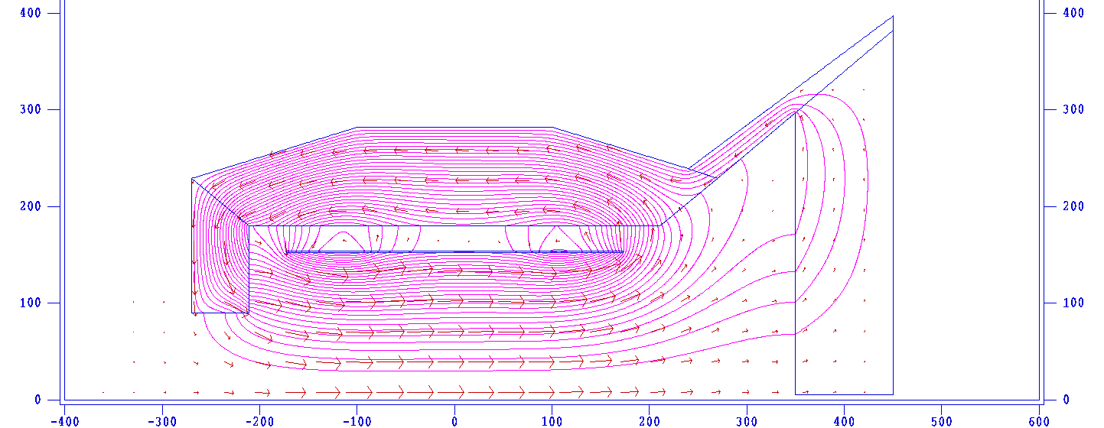
η~1
R (cm)
R (cm)
η~-1
HCal
HCal
AreoGel
EMCal
-1.2
DIRC
EMCal & Preshower
RICH
μ-TPC
η~4
EMCal
p/A
e⁻
GEMs
GEMs
Station1
GEM
Station2
GEM
Station3
GEM
Station4
z (cm)

Slide 5
PID @ LHCb

Slide 6
RICH-1 (modern HERMES RICH) RICH-2
2<p<60 GeV 17<p<100 GeV
25-300 mrad 10-120 mrad
5cm Aerogel (n=1.030) ~200 cm CF₄ (n=1.0005)
85 cm C₄F₁₀ (n=1.0014)

Slide 7
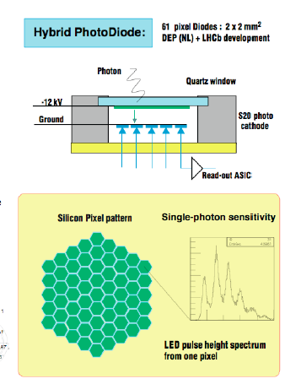
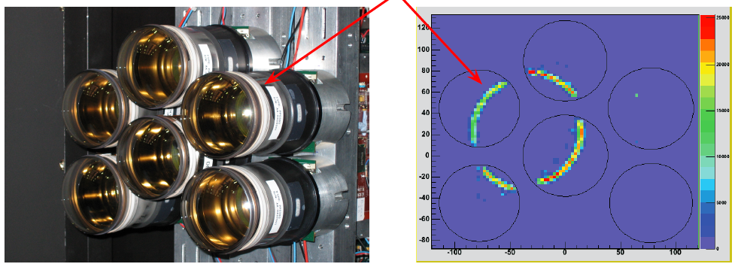
LHC-b HPD based Photondetector
3 m² area have been equipped with photodetectors providing:
Single Photon Sensitivity (200 - 600nm)
2.5 x 2.5 mm2 granularity
Fast readout (40 MHz)
Active-area fraction > 70%
Hybrid Photo Diodes (HPD)
340 k channels

Slide 8
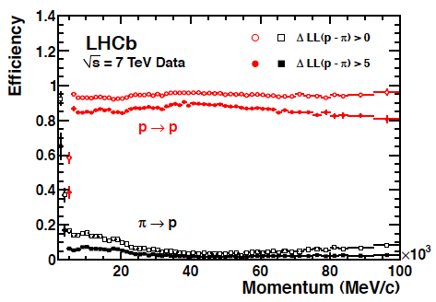
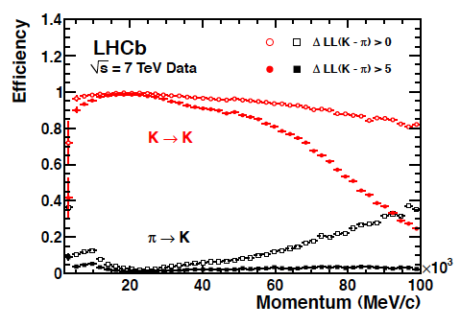
LHCb RHIC Performance
Achieved excellent PID for wide momentum range.

Slide 9
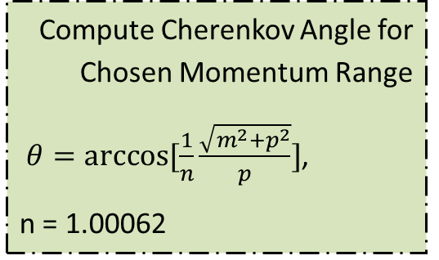
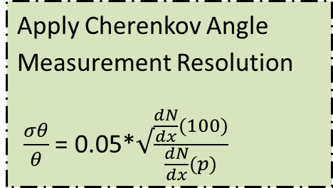
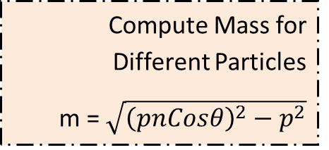
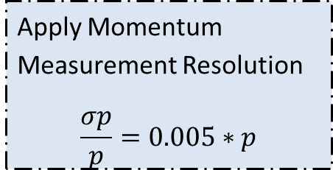
RICH Performance Simulation
PYTHIA Momentum Distribution
Choose Momentum Range
Apply Momentum Measurement Resolution
$$\frac{σp}{p}=0.005∗p$$
Compute Mass for Different Particles
m = $\sqrt{{\left(pnCosθ\right)}^{2}−p^{2}}$
Compute Cherenkov Angle for Chosen Momentum Range
$θ=arccos⁡[\frac{1}{n}\frac{\sqrt{m^{2}+p^{2}}}{p}]$,
n = 1.00062
Apply Cherenkov Angle Measurement Resolution
$\frac{σθ}{θ}$ = 0.05*$√\frac{\frac{dN}{dx}(100)}{\frac{dN}{dx}(p)}$
Study by Tuya Erdenejargal @ Colorado

Slide 10
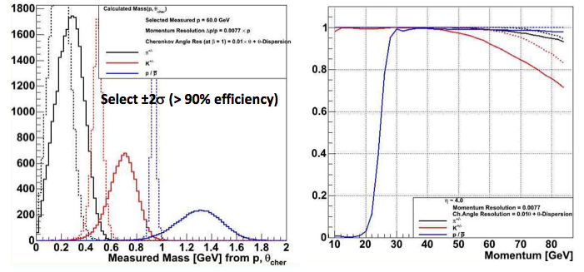
Expected Purity (for Ideal Case)
dp/p = 0.5%, dθ/θ=1% assumed
Study by Tuya Erdenejargal @ Colorado

Slide 11
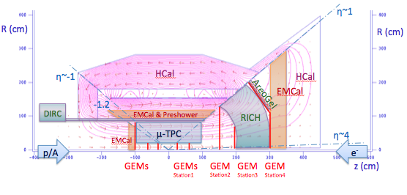
ePHENIX Strategy
1m
Path length
AreoGel
RICH
B-Field
CsI-GEM (RICH)

Slide 12
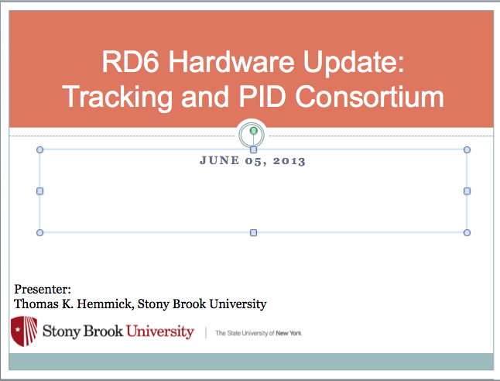
Technological Challenge for eRHIC
Photon Detector
  (Hybrid) PMT doesn’t work in B-field
  -> ePHENIX Choice : R&D fund for CsI-GEM

Slide 13
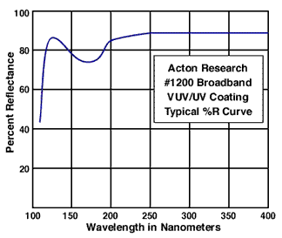
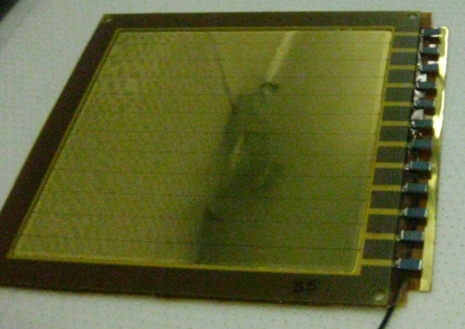
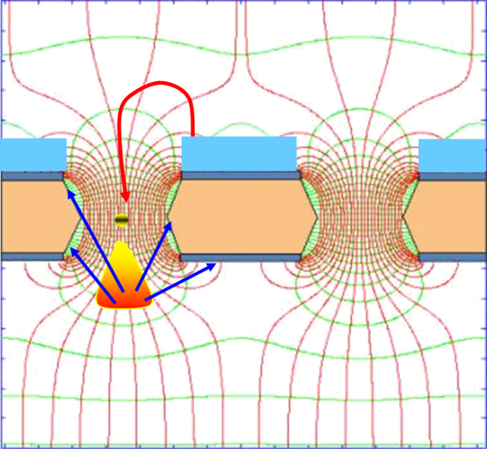
R&D Objectives
Test of Ring-Imaging Cherenkov detector prototype
  Photocathode in field
    CsI-GEM
  Mirror in deep UV
    MgF₂ coating
  Single Photon Capability
    quintuple GEM stack with APV25-SRS
  Radiator choice:
    CF₄

Slide 14
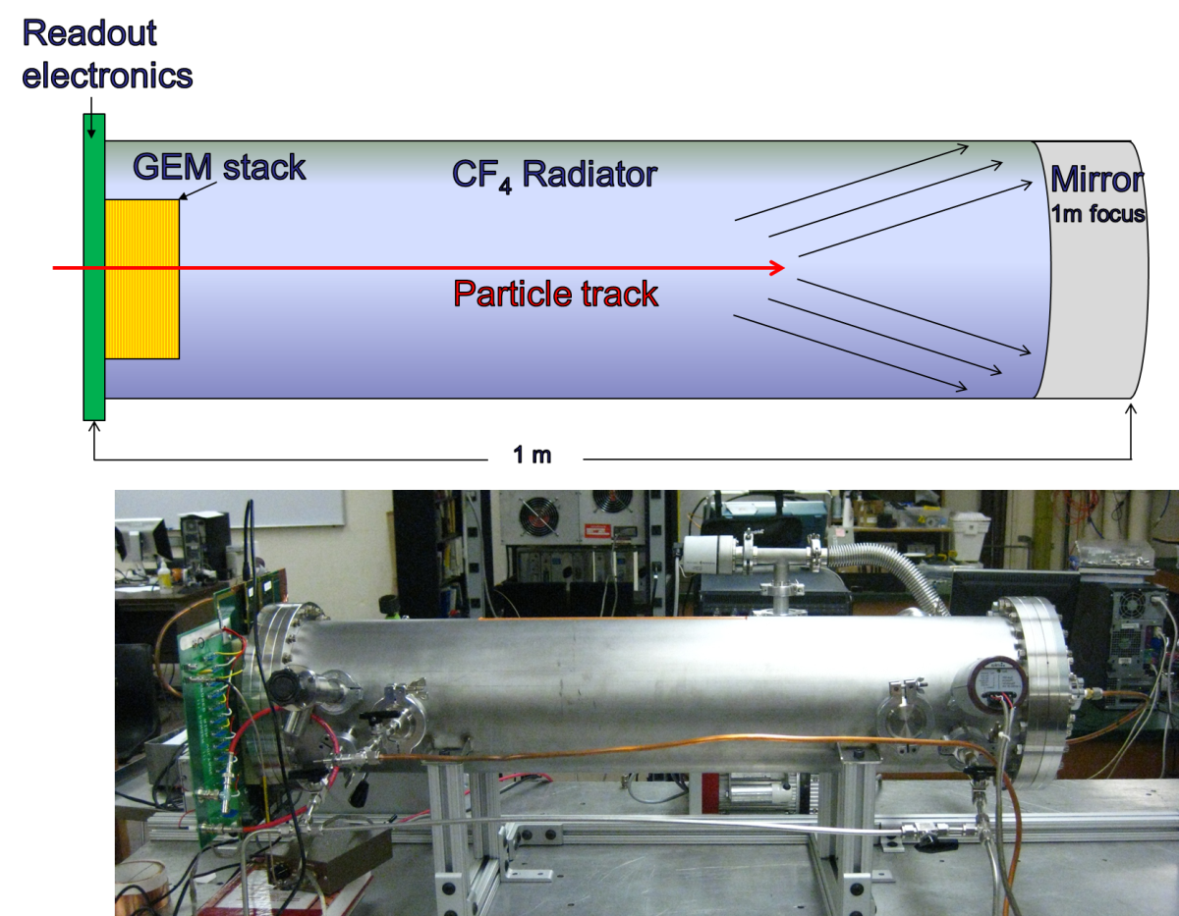
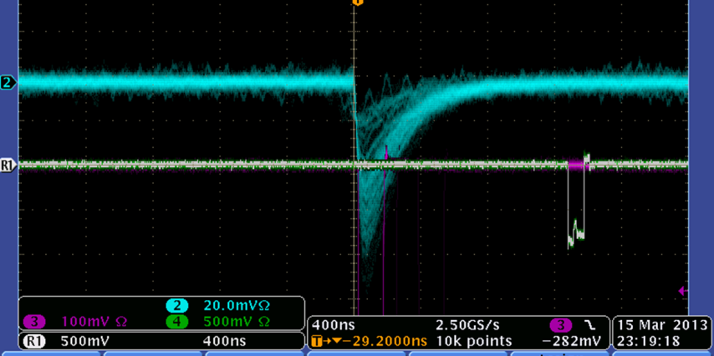
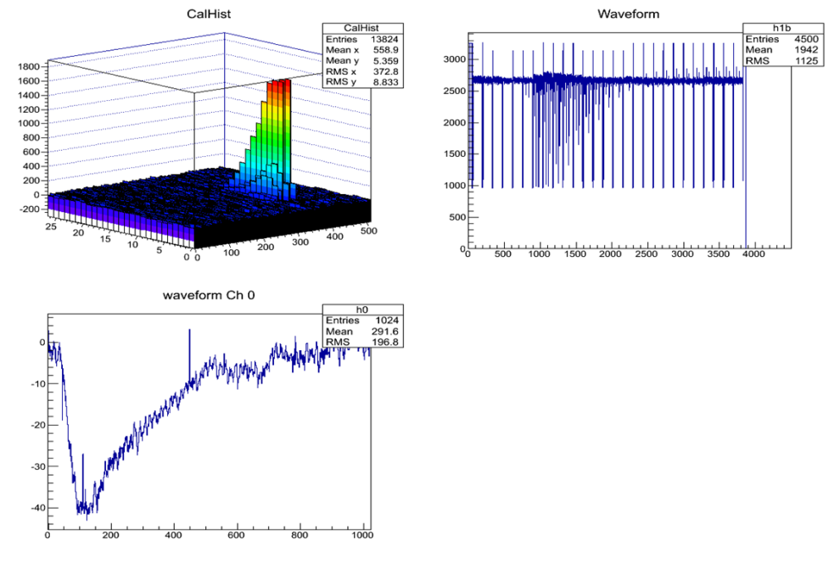
Test Beam May/June @ SLAC
Spherical mirror makes ring:
  Ring → Cherenkov Angle
Here: system running w/ ⁵⁵Fe.
Readout APV25 via SRS.
Ready for Test Beam.

Slide 15
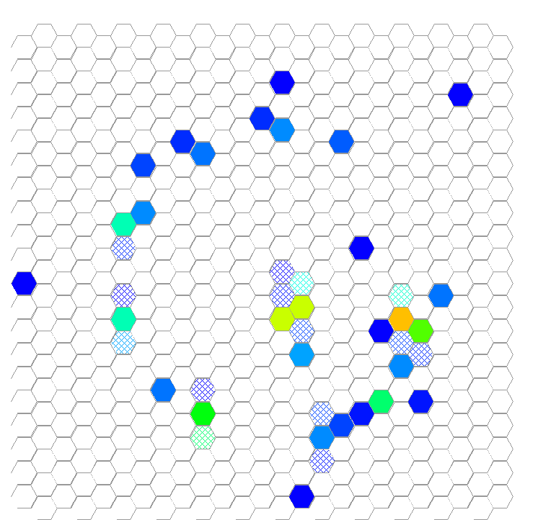
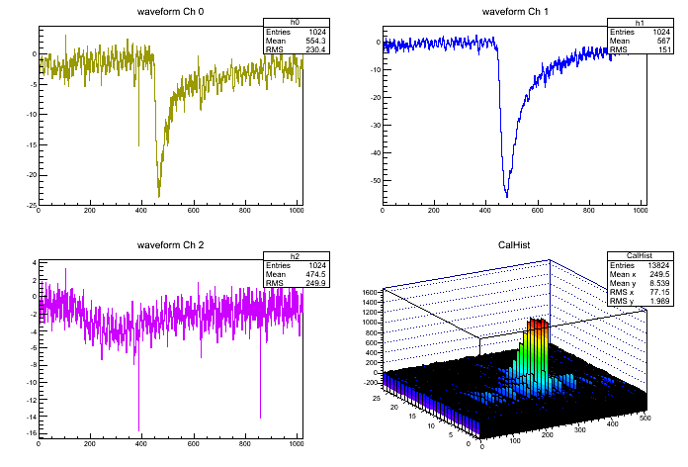
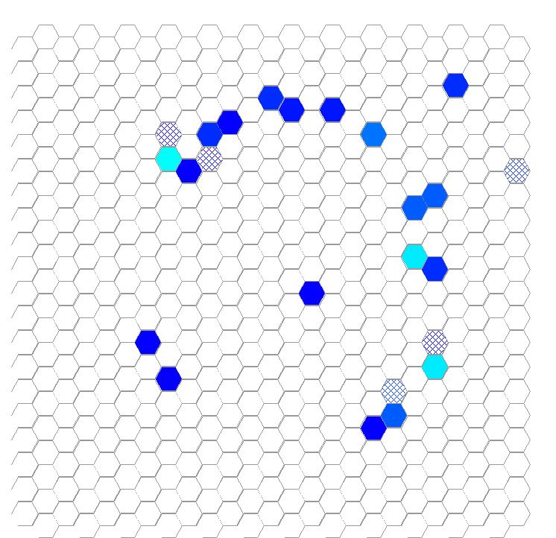
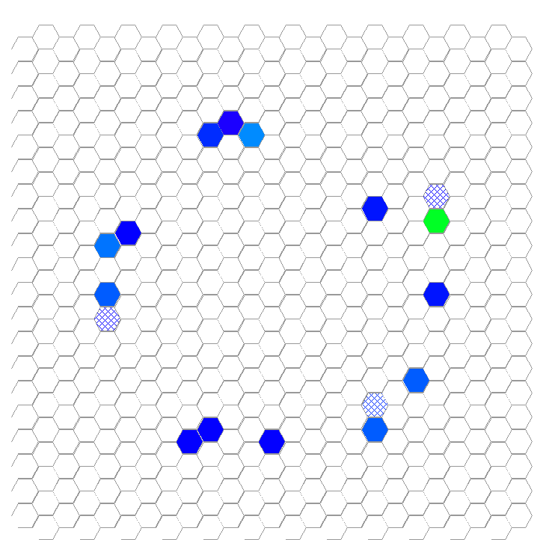
First Results: Rings and more
Home-grown DAQ allows
us to readout SRS and
FADC to get chamber and
beam counters into single
data file.
RINGS!!!!!!!!!!
Data taken:
  FWD & reverse bias.
  Gain Scans
  Relative GEM variation

Slide 16
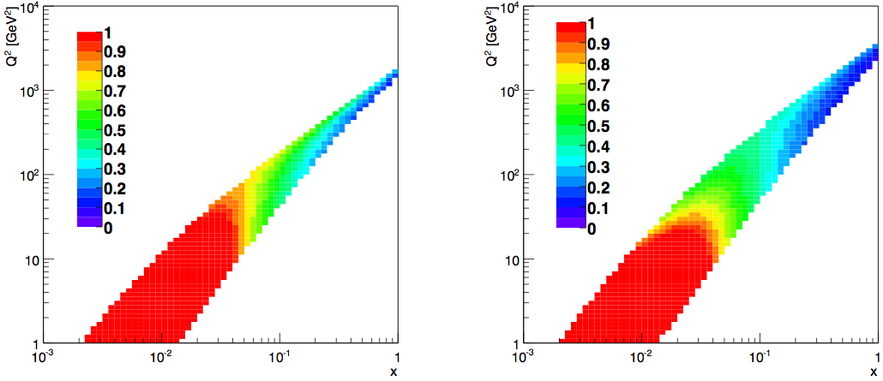
Central PID
Central PID:
Mid rapidity has some high momentum tracks, but most are in hadron direction.
PID detector works in tight spatial constraint 10 ~ 30 cm, technology choice is DIRC. DIRC distinguish π-K up to ~4 GeV.
5x100
10x250
p
η
For SIDIS, cut on z= P•p/P•q
z>0.2 standard cut
Can measure dark blue
region in central arm
Max z in |η|<1
Q²
→η>1
x

Slide 17
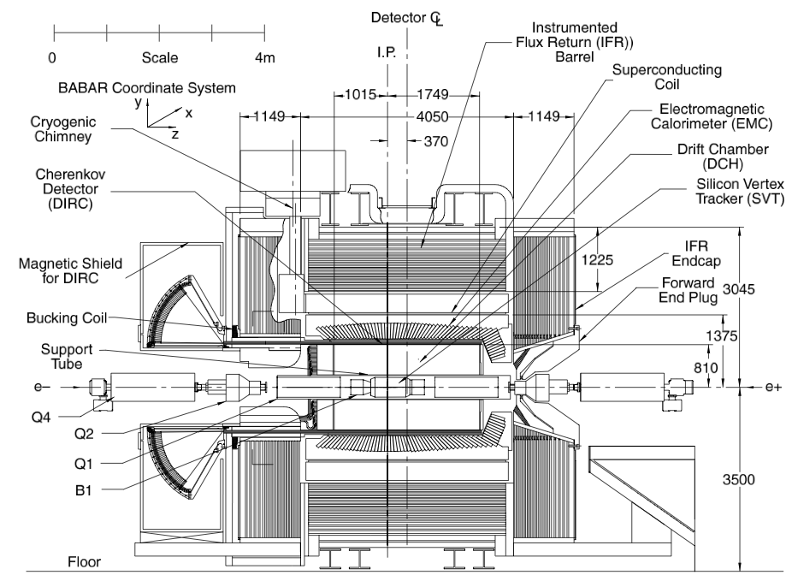
BaBar Detector

Slide 18
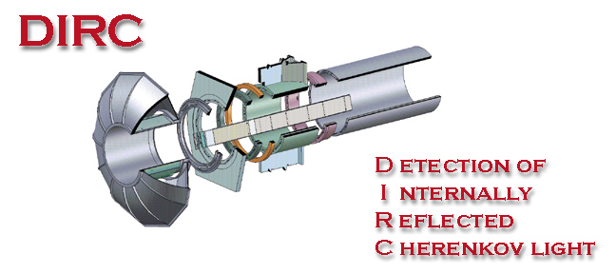
DIRC
DIRC (Detection of Internally Reflected Cherenkov light)
Path length ~ 10cm
Quartz as radiator and as light guide
Effective at low momenta
(p < 4 GeV/c)
The only existing DIRC was in
operation at BABAR
PANDA is planning two

Slide 19
Principle of DIRC
Slide from Thomas Hdig, 3rd Workshop on Higher Luminosity B Factory 2012

Slide 20
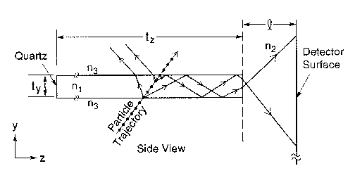
Reflaction Index
<n₁> = 1.473
n₃ (nitrogen) ~ 1

Slide 21
RING Image of DIRC
Slide from Thomas Hdig, 3rd Workshop on Higher Luminosity B Factory 2012

Slide 22
DIRC Performance
SLAC-PUB-10516
Plot from Jochen Schwiening, RHIC2004

Slide 23
Efficiency and Mis-ID

Slide 24
Summary and Ideas
Study in progress to achieve as close as possible to the established performance of other facility COMPASS/LHCb within ePHENIX constraint (B-field, spatial constraint.
Focusing DIRC (intended design for Super-B). Compact enough to employ SiPM for better θ_{c} measurement + fine timing measurement.
Microchannel Plates Detectors instead of Aerogel.
TPC+HBD hybrid to expand PID in higher momentum region. (P20 of Jin’s Talk)

Slide 25
Backup

Slide 26
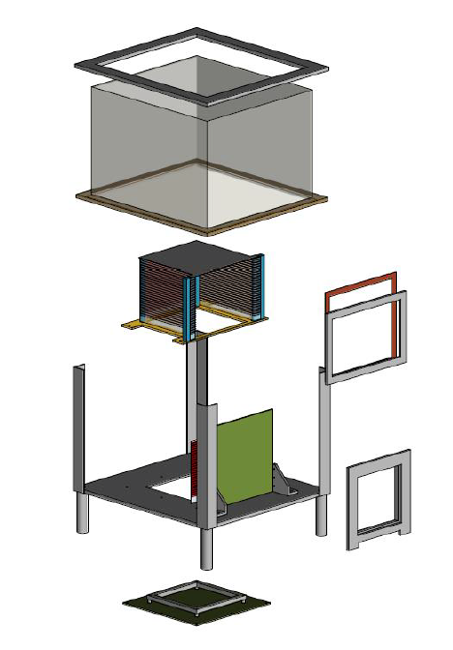
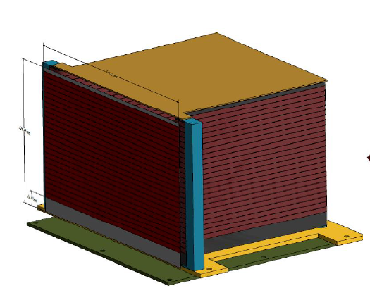
TPC/HBD Design Progress
Central arm tracking via TPC.
Central arm dominantly low p.
  Low Mass Tracking.
  Hadron ID from dE/dx.
  eID from Cherenkov “blob”s.
  Prototype design progressing.

Slide 27
SINGLE PHOTON DETECTORS
the requests:
QE: high QE (above standard PMT photocathodes having peak-values of 20-25 %)
r: rate capabilities (> 100 kHz/ mm²)
t: time resolution below 100 ps
B: insensitivity to high magnetic fields (B=1T and more)
$: reasonable costs to make large systems affordable
L: Large area and wide angular acceptance of each single sensor
the approaches:
Poly- and nano-crystalline diamond-based photocathodes (QE)
Photocathodes based on C nanotubes (QE)
Hybrid avalanche photodiodes HAPD (B)
Si photomultipliers (QE,r,t,B)
Microchannel plate (MCP) PMTs (B,t)
Micro Pattern Gas Detectors (MPGD) + CsI (r, B, $)
Large, wide aperture (hybride) PMTs (L)
promising
for a far
future
astroparticle experiments

Slide 28
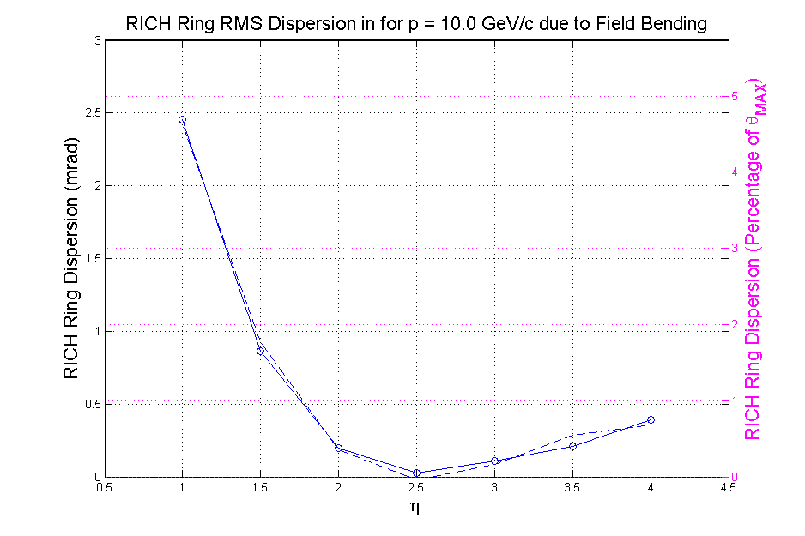
Magnetic Field Effect
dispersion < 5% of θ_{MAX}
The RICH sits in a magnetic field and causes some ring irresolution
A lot for the lower eta tracks (irresolution is 30% of size of max ring).. Still working to reduce (some amount will be correctable through reconstruction)
At high eta it is small compared to irresolution due to momentum measurements

Slide 29
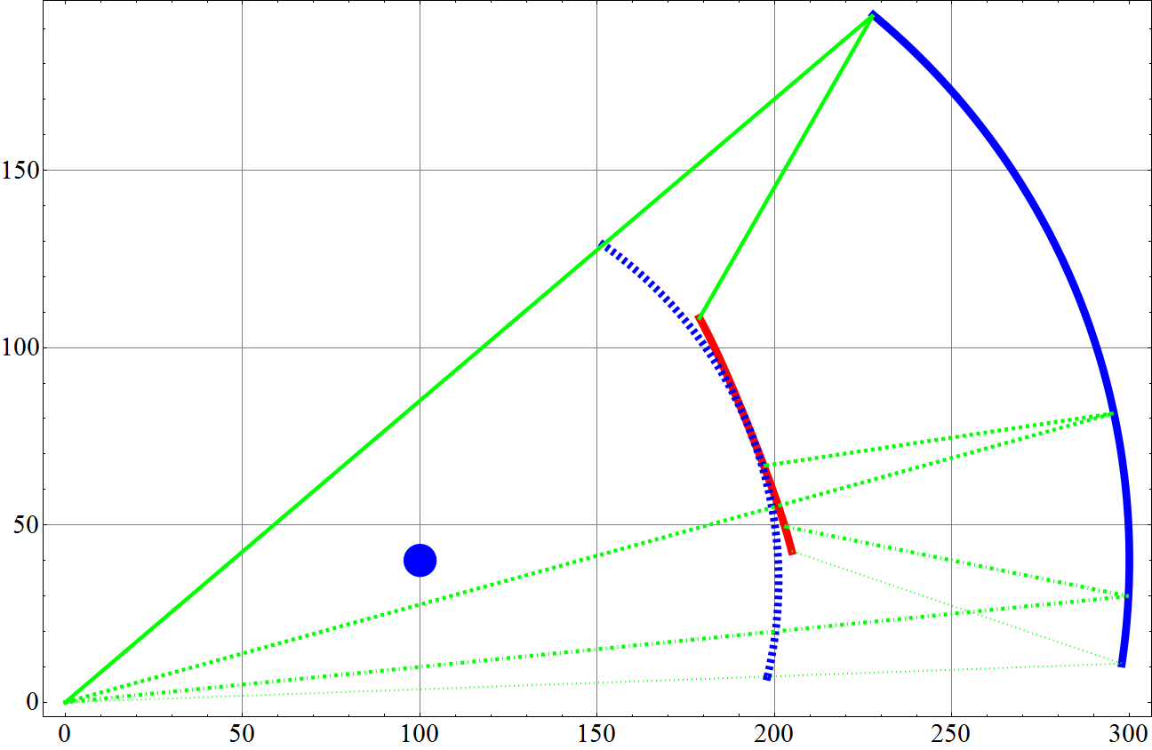
Focusing
R (cm)
Focal plane and photon detector
η=1
Mirror Center:
Z = 100 cm
R = 40 cm
RICH Mirror
RICH Gas
Volume
η=2
η=3
η=4
IP center
GEM
Station2
Z (cm)
Entrance
Window

Slide 30
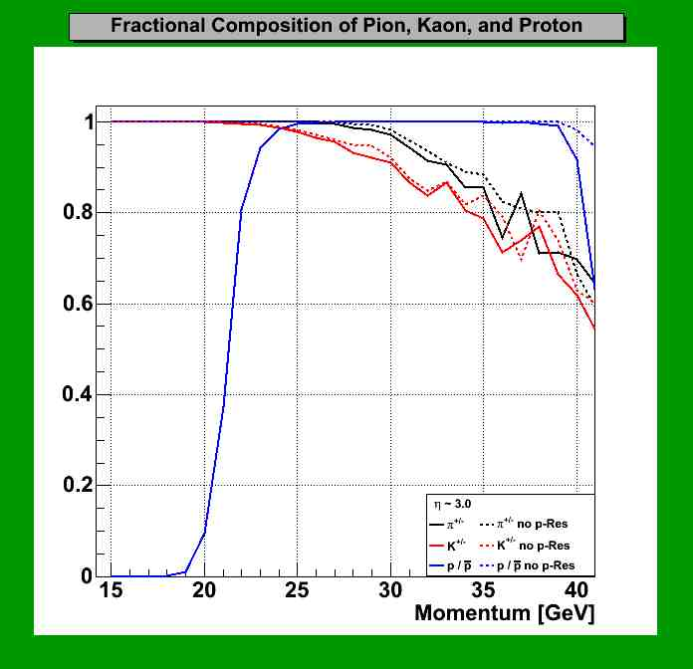
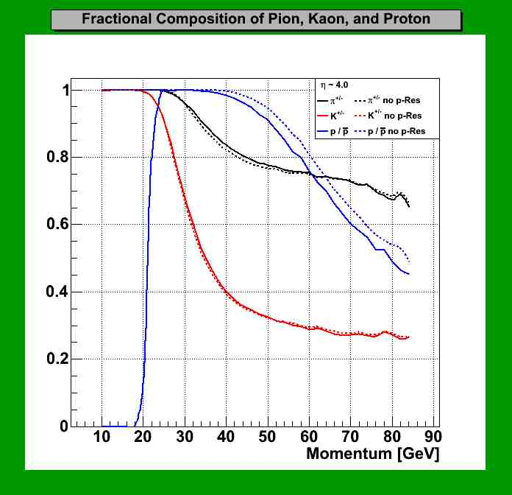
Purity
dp/p = 0.5%, dθ/θ=5% assumed
Study by Tuya Erdenejargal @ Colorado

Slide 31
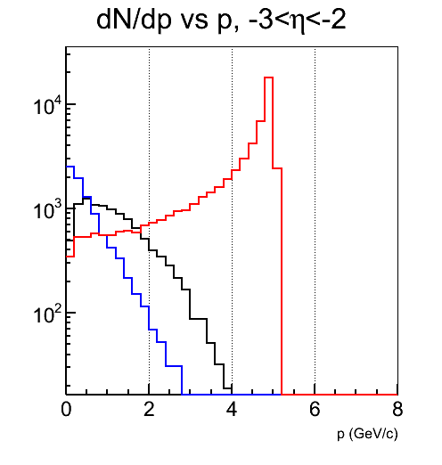
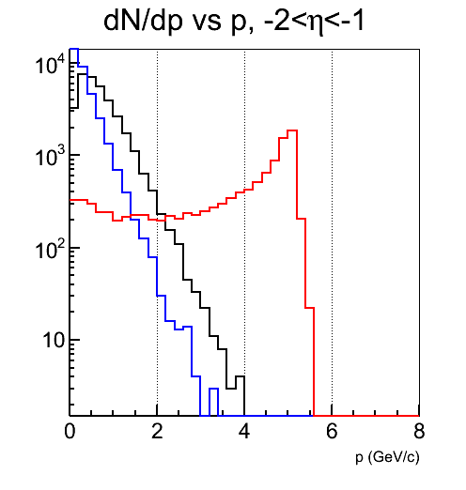
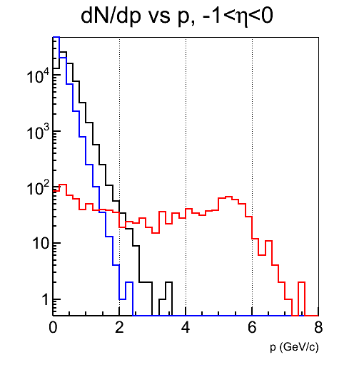
Some fast results already
Sasha reexamining his work for MIE:
  Do we need measure below 2 GeV?
    Would require much better hadron rejection
    Can we use event topology to get better rejection

Slide 32
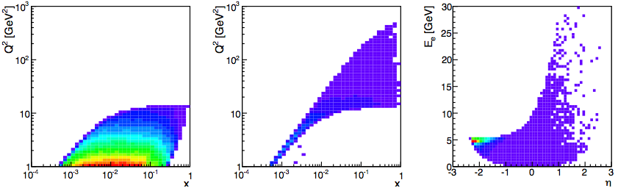
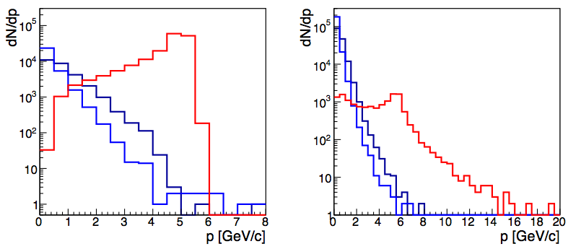
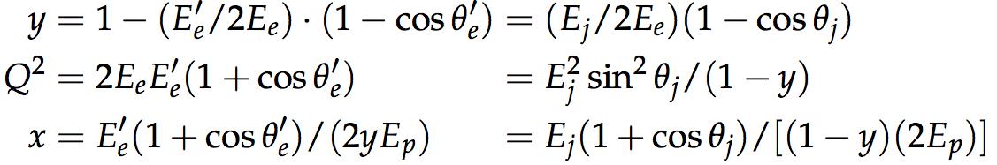
Results from task force
|η|<1
η<-1
In MIE, assumed Q²<1 is uninteresting, but will revisit.
Also argued that hadron rejection fine if E_{e}>2, and below 2 GeV, little phase space, so no loss.
Sasha revisiting these assumptions after feedback from EIC group.
Central EMCal energy resolution (5x100):
|η|<1
η<-1
For MIE studies, looked at 5x100 and 20x250 to see extremes. For LOI, use 5x50 and 10x250.

Slide 33
COMPASS

Slide 34
COMPASS PID
PLB673 (2009)127
NIM577 (2007)455 ->

Slide 35
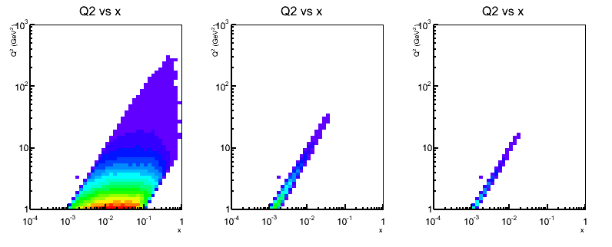
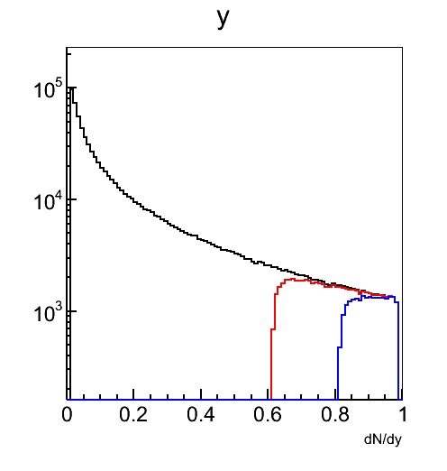
5x50: Minimal energy cut
E_{e}<2GeV
E_{e}<1GeV
Not so much of Q2&x space is lost but it corresponds to quite some range in y (important for F_{L}, DVCS etc).
How crucial is the lost of y>0.6 or y>0.8?
Similar effect at 10x250
Preshower to get better hadron rejection?
E_{e}<2GeV
E_{e}<1GeV

Slide 36
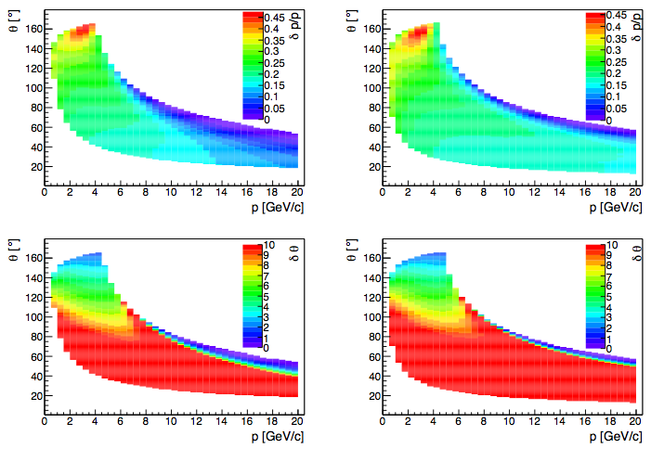
Results from task force
5x100
Momentum resolution requirements:
Requirements for momentum in forward direction not so stringent
Angular resolution requirement at small angle will more important
5x250
δp/p
5x100
5x250
δθ

