Slide 1
sPHENIX Mid-rapidity extensions: Additional Tracking system and pre-shower
Y. Akiba (RIKEN/RBRC)
sPHENIX workfest
July 29, 2013

Slide 2
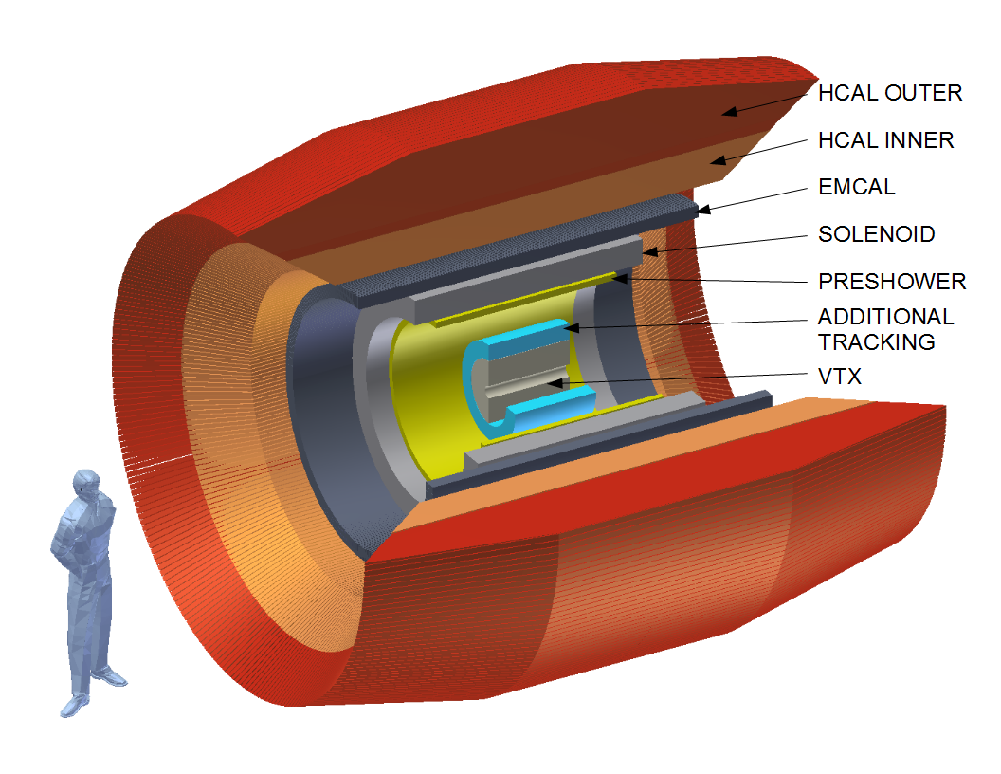
sPHENIX upgrade path
Additional Tracking
high p_{T} hadrons, modification of jets, heavy quark (b, c)
Preshower
Upsilons high p_{T} π⁰ R_{AA}, improve direct γ and γ-jet

Slide 3
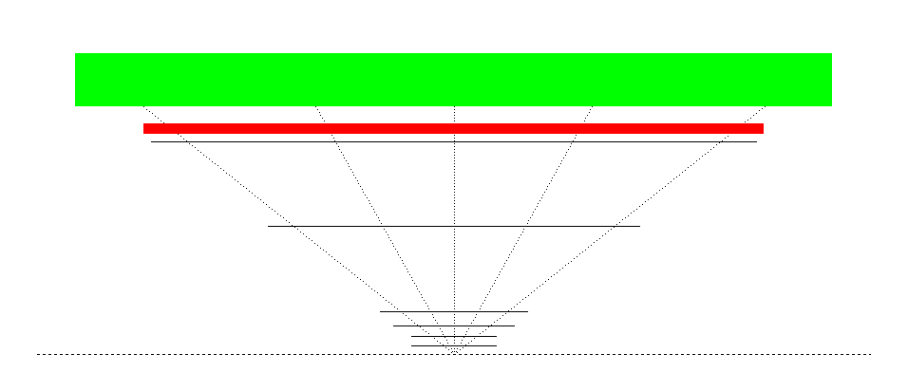
Concept of additional tracking
Magnet Coil IR 70cm → moved out; EMCal IR at 90cm
Preshower
B5
η=0.5
η=1.0
B4
R~60cm
R~40cm
B0 to B3
reconfigured
VTX
Beam Line
(reconfigured) VTX alone in sPHENIX has only limited momentum resolution and high fake rate
Add (at least) 2 layers silicon tracker outside of reconfigured VTX to Improve the momentum resolution of charged tracks
Details of the detector design is to be determined

Slide 4
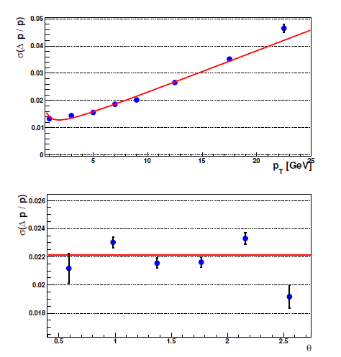
momentum resolution w additional Tracker
Full Geant4 simulation
Strip layer at R=40 cm and 60 cm
Strip width 80 micron (same as PHENIX VTX)
σ_{p}/p ≈ 0.7%+0.15%p (GeV)
Uniform in θ
Sufficient to resolve three states of Upsilon
Note: Details of the external tracker is not optimized yet
η= 1.2
η= 0
η= -1.2

Slide 5
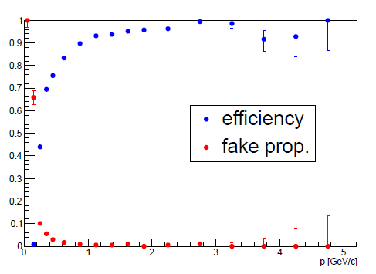
Fake track rate (G4 Simulation)
Geant4 simulation with additional 2 tracking layers at R=40 and 60cm
High tracking efficiency with very little fake tracks

Slide 6
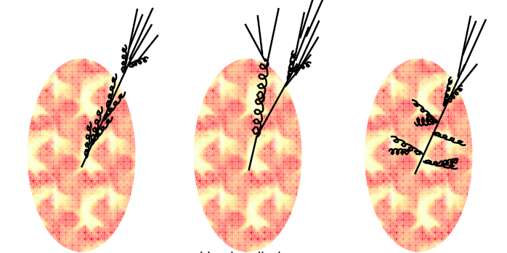
Physics with additional Tracker: Detailed study of jet modification
small angle soft radiation
Hard radiation
large angle soft radiation
Several quite different models of jet quenching in QGP
→ Different modification of jet shapes and track-jet correlations
Detailed study of jet modification as function of pT(jet) can distinguish models
This can also reveal a large difference in jet modification at RHIC and LHC energies

Slide 7
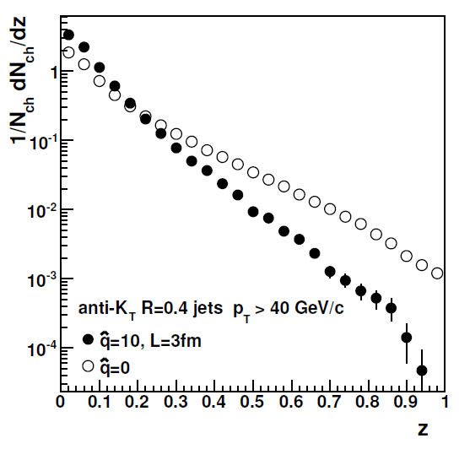
Measurement of fragmentation function
$z$= $\frac{particle pT}{jet pT}$
Q-Pythia simulation at RHIC energy
Measure Jet fragmentation function (FF) from pT of charged tracks within jet and jet pT
Such measurement is sensitive to jet energy loss mechanism
Q-pythia model predict large suppression of high z particle
Other model gives different prediction

Slide 8
Modification of jet fragmentation
ATLAS QM2012
RHIC simulation
Qpythia
40 GeV Jets
Modification of Fragmentation Function (FF) at LHC
Modification of FF expected at RHIC (Qpythia)
$z$= $\frac{particle pT}{jet pT}$
Measure modification of jet Fragmentation Function (FF)
This can reveal a large difference between RHIC and LHC
Modification in Q-PYTHIA at RHIC is larger than LHC data
Modification pattern can be different in RHIC and LHC

Slide 9
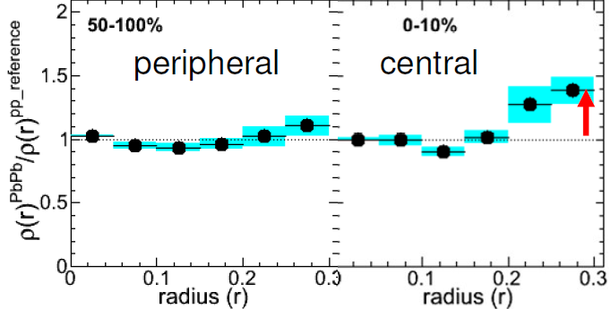
Radial modification of jets (LHC)
CMS Pb+Pb at 2.76TeV
pT(jet)>100 GeV
r
Modification of radial energy distribution in jets
At LHC, modification of radial energy profile of jet is observed
More energy flow at larger radius from the jet axis in central PbPb collisions
Similar measurement is possible with the tracker extension by measuring energy flow carried by charged tracks around the jet axis
The modification can depend on beam energy as well as jet Pt.

Slide 10
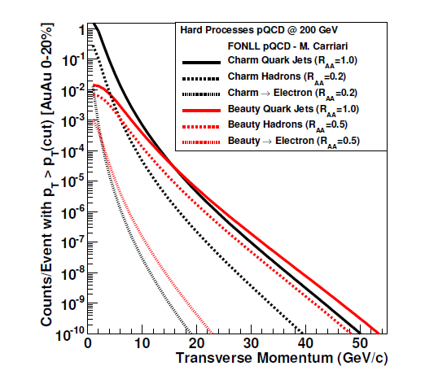
heavy quark measurements
Rate of b, c jets and b, c hadrons
1M / year
10K / year
100 / year
High statistic measurements of b, c tagged jets
Study of modified fragmentation of charm

Slide 11
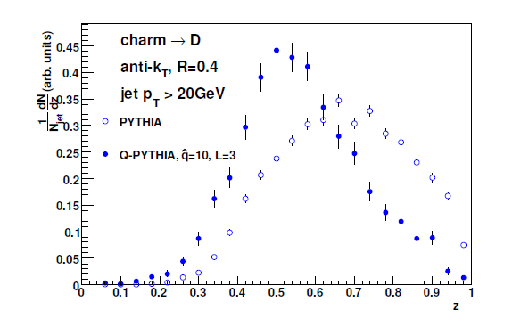
Modified fragmentation of charm
Charm fragmentation in PYTHIA and Q-PYTHIA (energy loss)
Measure FF of D-meson
D-meson FF is harder than light quark/gluons. It can be more sensitive to medium effects

Slide 12
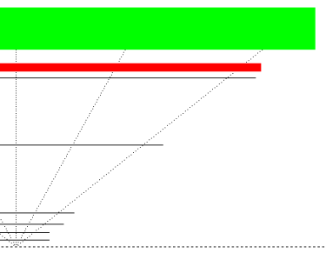
Example of tracker concept
Detail of the extended tracker need to be decided. This is one example of conceptual design
B5
To cover |η|<1.1
R=60 cm zmax = 80cm Area = 6.0m²
R=36 cm zmax = 48cm Area = 2.2m²
Total Area: 8.2m² of silicon (single layer)
The area and channel counts doubled if each layer has X and U
B4
η=1

Slide 13
Example of tracker concept
Silicon modules made of a large silicon sensor
9.6 cm x 9.6 cm (maximum from 6inch wafer)
Read-out by 10 SVX4 chips (128ch/chip)
75um strip width
Two layers of single sided silicon
B4: R=36cm 24 ladders x 10 sensor/ladder =240 SMs
B5: R=58cm 40 ladders x 16 sensor/ladder = 640 SMs
Total: 880 SMs = 8,800 SVX4 = 1,126,400ch
Occupancy: 0.9 % at B4 and 0.35% at B5 in the most central Au+Au collisions (if 2strip/track)

Slide 14
Preshower Detector
Magnet Coil IR 70cm → moved out; EMCal IR at 90cm
Preshower
B5
η=0.5
η=1.0
B4
R~60cm
R~40cm
B0 to B3
reconfigured
VTX
Beam Line
Pre-shower detector just behind the last layer of the tracker
R~65cm
The detector is for
e/h separation
γ/π⁰ separation

Slide 15
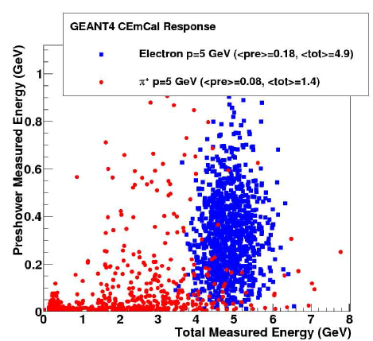
Pre-shower: e/h separation
Preshower can improve e/π separation
High p_{T} electrons → c, b measurement
Upsilon measurements

Slide 16
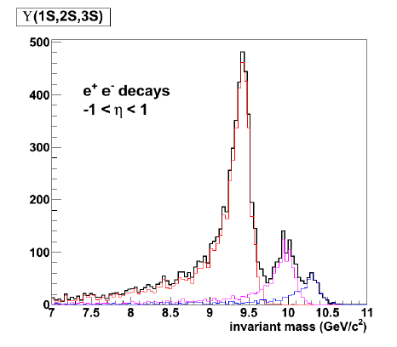
Upsilon measurements
Mass resolution of Upsilon states calculated by Geant4 simulation
Clear separation of the three upsilon state
Study binding energy dependence of suppression
Different temperature at RHIC and LHC can leads to different suppression patterns

Slide 17
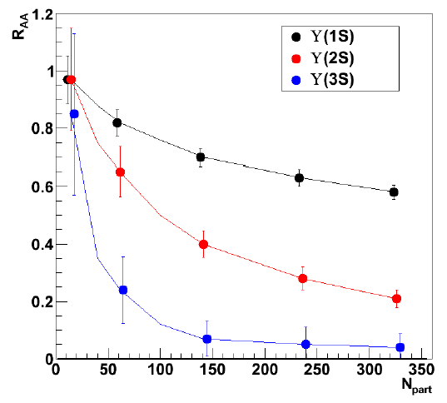
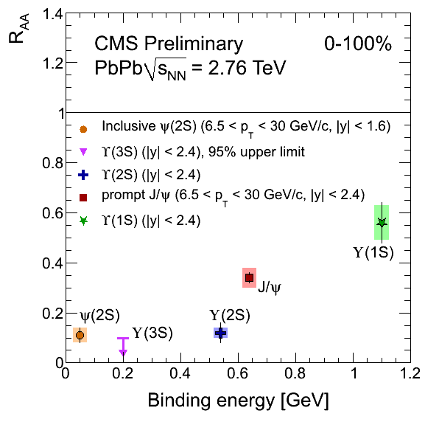
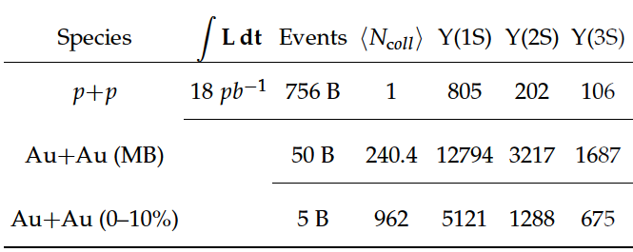
R_{AA} of three Upsilon states
Expected results in 1 year of AuAu run (50B Au+Au collisions)
LHC results of Upsilon measurement
R_{AA} of the three upsilon states can be related to b-b binding energy
It is important to do similar measurement at RHIC

Slide 18
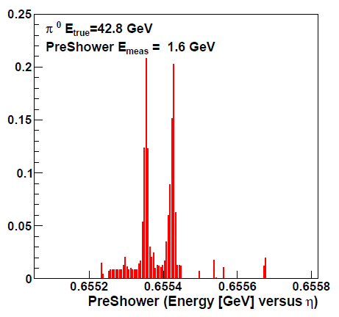
Pre-shower: γ/π⁰ separation
G4 simulation of a 40 GeV pi0 before digitization
More realistic simulation is underway at Hiroshima
γ/π⁰ separation
High p_{T} π⁰ R_{AA} up to 40 GeV/c
Direct photon
γ-jet correlation

Slide 19
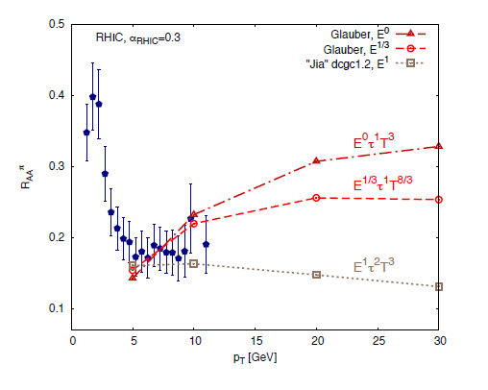
Extend π⁰ R_{AA} to 40 GeV/c
Current data is up to 20 GeV and show difference between LHC and RHIC.
π⁰ R_{AA} at higher pT is sensitive to energy loss model parameters

Slide 20
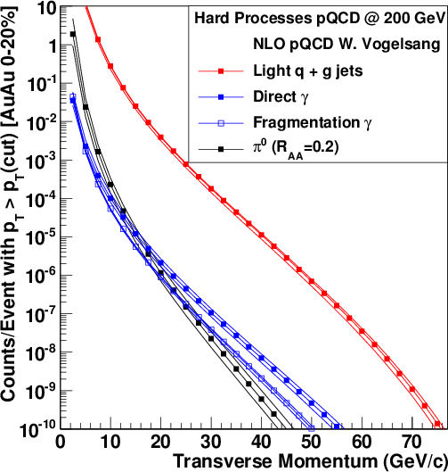
Direct γ and γ-jets measurements
1M / year
10K / year
γ
100 / year
π⁰
Improved measurement of direct γ and γ-jet
Direct γ at lower p_{T} (p_{T}< 15 GeV/c )
direct γ tagged jet with almost pure direct γ

Slide 21
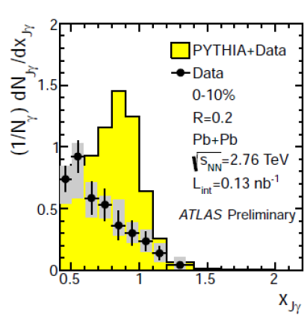
γ-jets
ATLAS QM2012
Jet
direct γ
$x_{jγ}$=$\frac{jet pT}{direct γ pT}$
direct γ tagged jet with almost pure sample of direct γ
Detailed study of jet FF from direct γ tagged jet
Study of jets at low pT (pT<15GeV) from direct γ tagged jet

Slide 22
Summary
Additional Tracker and Pre-shower detector can substantially enhance physics capabilities of sPHENIX
Additional Tracker
Detailed study of jet modification
Bottom and charm measurements
Pre-shower Detector
Upsilon
High p_{T} π⁰ R_{AA}
direct γ, γ-tagged jets

