Slide 1

Heavy Flavor Theory
PHENIX Workshop on Physics Prospects with Detector and Accelerator Upgrades @RIKEN, 2013.07.29-08.02
Yukinao Akamatsu (Nagoya/KMI)

Slide 2
Content
Introduction
Production
Heavy Quarks in Medium
Quarkonia in Medium
Conclusion & Outlook

Slide 3
1. Introduction
QGP Fireball
Heavy quark
Quarkonium
Quark-gluon matter
Equation of state
Collective modes
Color charges in medium
Photon
Dilepton
Chiral symmetry restoration
Collective modes
Jet
Opacity of medium

Slide 4
Factorization
Convolution of each process
Quarkonia
Heavy quarks
production
evolution
observables
Energy loss
Diffusion
D,e,μ,…
Nuclear collision
interaction
Medium evolution
π,K,p,…

Slide 5
2. Production
Parton distribution functions
Matrix elements by pQCD
Formation of bound states
and
Nuclear effects …

Slide 6
HQ production in p+p
FONLL calculation
PHENIX (06)
Cacciari et al (06)

Slide 7
QQbar production in p+p
Color singlet/octet/evaporation models
  Bound state formation = non-perturbative process
=COM
PHENIX (11)
p_{T} (GeV/c)

Slide 8
3. Heavy Quarks in Medium
Energy loss and diffusion
  Many approaches (list strong points)
  Perturbation theory: clear elementary processes
  AdS/CFT: analytical exact result for SYM
  Lattice QCD: exact within error bars
  Resonant scattering model: non-pert. model

Slide 9
Heavy quark energy loss & diffusion
Perturbation theory
Inelastic scattering
production
Horowitz (10)
L
Elastic scattering
In-medium energy loss
Braaten & Thoma (91)
Moore & Teaney (05)
Non-relativistic limit: Brownian motion
HTL
Svetitsky (88)
Moore & Teaney (05)
Caron-Huot et al (08,09)

Slide 10
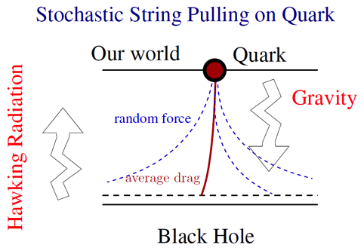
Heavy quark energy loss & diffusion
AdS/CFT correspondence
production
Gubser 06, Herzog et al (06)
L
Non-relativistic limit: Brownian motion
Casalderrey-Solana & Teaney (06)
Son & Teaney (09)

Slide 11
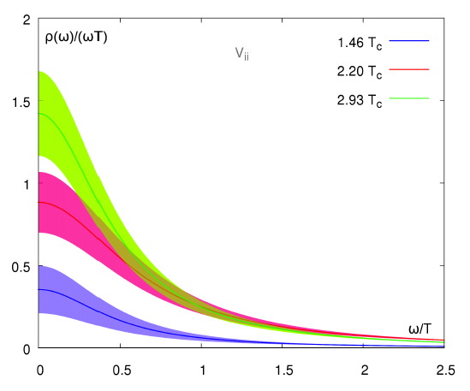
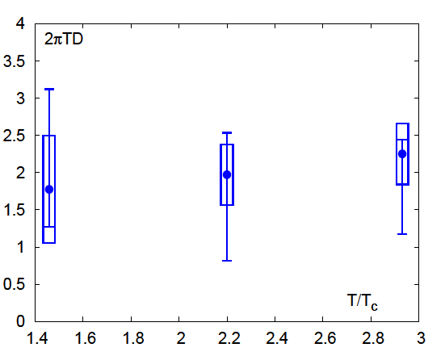
Heavy quark diffusion constant
Lattice QCD simulation
Current correlator
(Kubo formula)
Ding et al (11)
Quench approximation

Slide 12
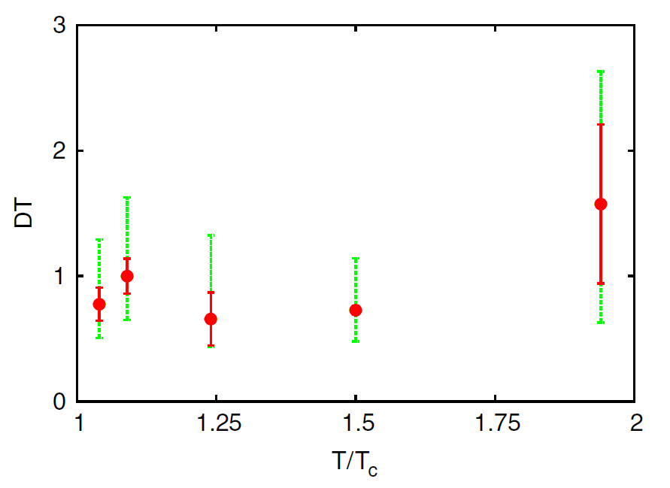
Heavy quark diffusion constant
Lattice QCD simulation
Force correlator
(M→∞)
Renormalization of electric field
Statistical errors (red)
Systematic errors (green)
Banerjee et al (12)
Quench approximation

Slide 13
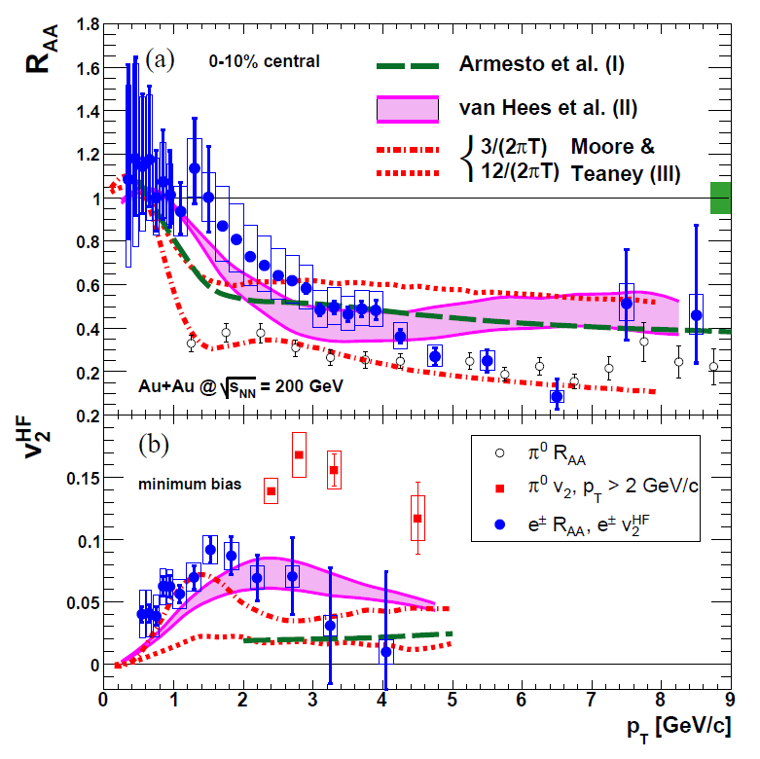
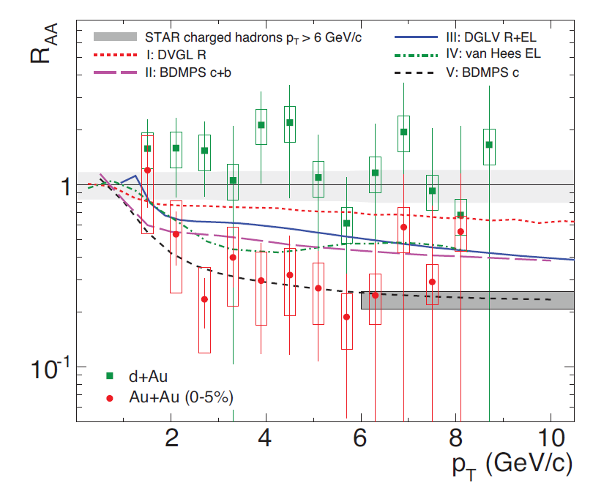
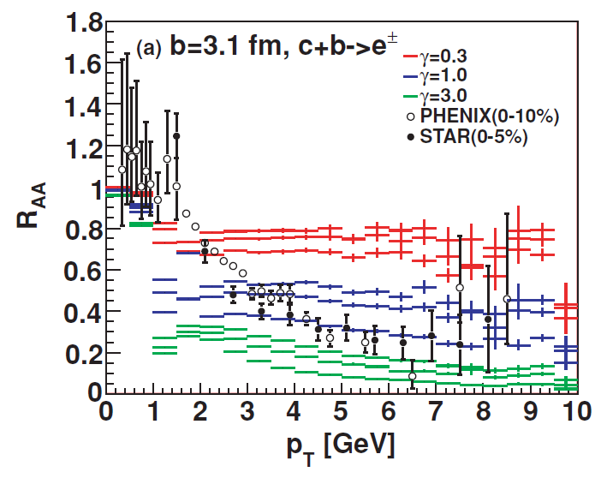
Phenomenology
Diffusion constant
Gubser (07)
 | Pert.（LO,NLO） | AdS/CFT | lattice | RHIC | LHC
DT | 0.4(NLO)-5(LO) | 0.5 | 0.3-1 | ? | ?
 | Pert.（LO,NLO） | AdS/CFT | lattice | RHIC | LHC
DT | 0.4(NLO)-5(LO) | 0.5 | 0.3-1 | 0.3-1 | ?
PHENIX (07)
STAR (07)
Akamatsu et al (09)

Slide 14
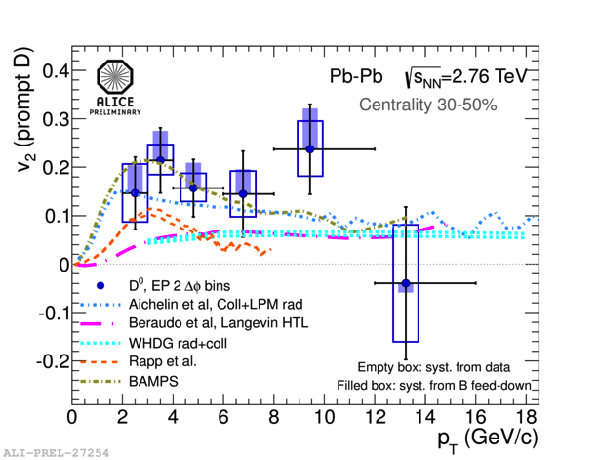
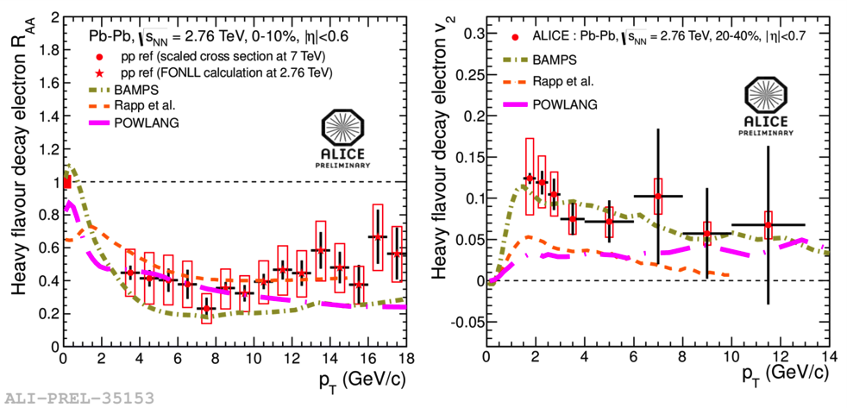
Phenomenology
Diffusion constant
Gubser (07)
 | Pert.（LO,NLO） | AdS/CFT | lattice | RHIC | LHC
DT | 0.4(NLO)-5(LO) | 0.5 | 0.3-1 | 0.3-1 | ?
Single
electrons
D mesons
ALICE (QM12)
ALICE (12)
ALICE (QM12)
Notes:
Check original figure from Alice publication

Slide 15
Azimuthal correlation
Initial back-to-back correlation decrease
Electron-muon correlation
to reduce background
Akamatsu et al (09)

Slide 16
Azimuthal correlation
Initial back-to-back correlation decrease
Adare et al (13)
Nahrgang et al (13)
Radiative vs collision
Sensitivity to coupling at high temperature

Slide 17
4. Quarkonia in Medium
Potential
  Free energy
  Real-time potential → complex by decoherence
Dynamics
  Open quantum system
  Quantum Brownian motion
  Quantum optics

Slide 18
Free energy
Lattice simulation
Nf=2+1, improved Wilson fermion, Tc~190
Maezawa et al (12)

Slide 19
Real-time potential
Potential in Schrödinger equation
Laine et al (07), Beraudo et al (08), Brambilla et al (10), Rothkopf et al (12)
σ(ω;R,T)
Γ(R,T)
Some phenomenological applications using complex potential
V(R,T)
ω

Slide 20
Real-time potential
Potential in Schrödinger equation
σ(ω;R,T)
Γ(R,T)
Some phenomenological applications using complex potential
V(R,T)
ω

Slide 21
Real-time potential
Complex potential as <stochastic potential>
Unitary & stochastic evolution
Imaginary part from averaging the random phase rotations
Akamatsu & Rothkopf (12)
So far M=∞; what about M<∞?

Slide 22
Classical picture of the open system
M=∞ or M<∞ matters
Svetitsky (88)
Young & Shuryak (09)
Quantum counter part:
Akamatsu (13)
Debye screened force
+
Fluctuation
(stochastic/complex)
Potential force
M=∞
→Hamiltonian dynamics
M<∞
Drag force
Non-potential force
→Not Hamiltonian dynamics
Langevin dynamics

Slide 23
Open quantum system
sys = heavy quarks
env = gluons, light quarks
Basics
Hilbert space
von Neumann equation
Trace out the environment
Reduced density matrix
Master equation
(Markovian limit)

Slide 24
Quantum Brownian motion
Langevin dynamics + Debye screening
Q
Leading order processes
g
q
q
Shallow bound states
& unbound states
. . .
. . .
Independent scatterings
. . .
g
. . .
g
Akamatsu (13)
Q

Slide 25
Quantum optics
Level transitions
Deep bound states
Borghini & Gombeaud (11,12)

Slide 26
5. Summary & Outlook
Single HQs: energy loss & diffusion
lots of phenomenological works
R_{AA}, v₂, and azimuthal correlation
Quarkonia: open quantum system
complex potential triggers a paradigm shift
quantum BM & quantum optics

Slide 27
Backup

Slide 28
Factorization
Heavy quarks
production
evolution
observables
Energy loss
Diffusion
D,e,μ,…
Nuclear collision
interaction
流体時空発展
π,K,p,…

Slide 29
Factorization
Quarkonia
production
evolution
observables
D,e,μ,…
Nuclear collision
interaction
流体時空発展
π,K,p,…

Slide 30
Phenomenology
Diffusion constant
Gubser (07)
 | Pert.（LO,NLO） | AdS/CFT | lattice | RHIC | LHC
DT | 0.4(NLO)-5(LO) | 0.5 | 0.3-1 | 0.3-1 | ?
STAR (07)
Akamatsu et al (09)
PHENIX (07)

Slide 31
Phenomenology
Diffusion constant
Gubser (07)
 | Pert.（LO,NLO） | AdS/CFT | lattice | RHIC | LHC
DT | 0.4(NLO)-5(LO) | 0.5 | 0.3-1 | 0.3-1 | ?
Single
electrons
ALICE (QM12)
Notes:
Check original figure from Alice publication

Slide 32
Phenomenology
Diffusion constant
Gubser (07)
 | Pert.（LO,NLO） | AdS/CFT | lattice | RHIC | LHC
DT | 0.4(NLO)-5(LO) | 0.5 | 0.3-1 | 0.3-1 | ?
D mesons
ALICE (QM12)
ALICE (12)
Notes:
Check figure

