Slide 1
Low Cost Silicon Sensor
Y. Kwon
in exploration with
J. Lajoie, E. Kistenev, A. Sukhanov, and Z. Li
as part of MPC-EX R&D

Slide 2
Si sensor in general
Mature technology
Reliable performance
Fine granule
Higher energy and time resolution (than gaseous ionization detectors)
Key burden is cost.

Slide 3
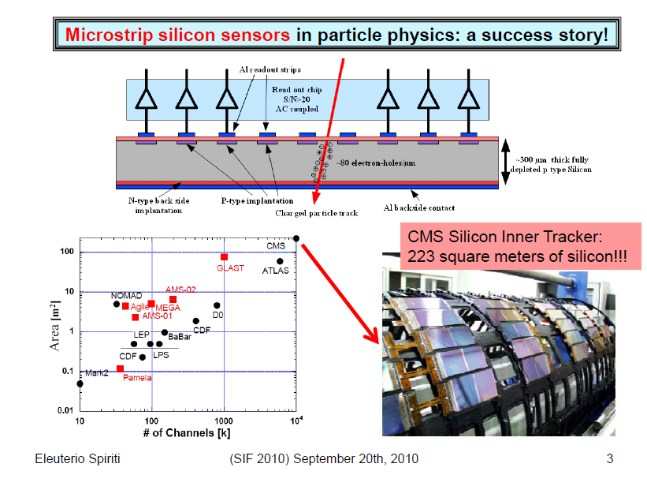

Slide 4
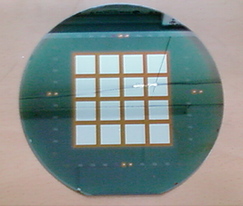
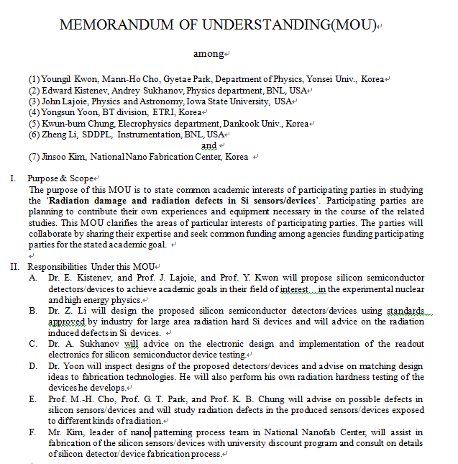

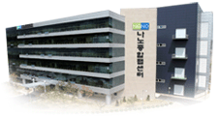
Possibility in Korea
R&D environment
6 inch fabrication line
1 cm² ~ $ 2
8 inch fabrication line

Slide 5
ETRI/NNFC
ETRI
  Established PIN-type silicon sensor.
  Λ = 0.4 μ, 6 inch line.
  Founded by government & self-sustaining for 6 years.
NNFC
  PIN-type sensor fabrication process needs establishment.
  SiPM fabrication.
  Λ = 0.18 μ, 8 inch line (inefficient 4 & 6 inch support).
  Founded by government & government subsidy. terminated last year.

Slide 6
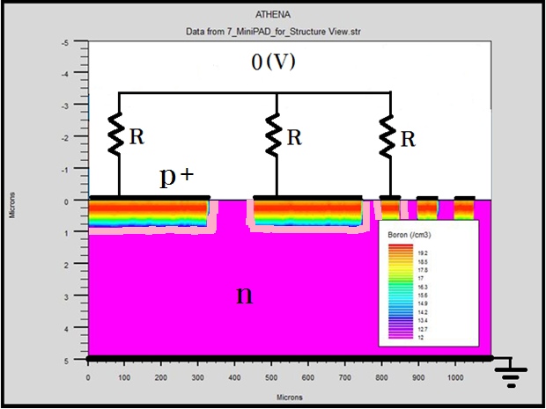
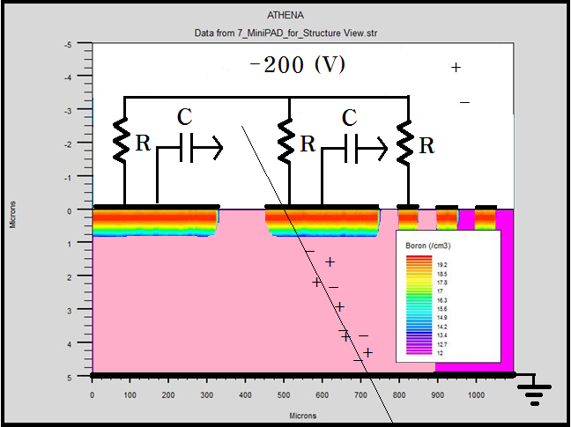
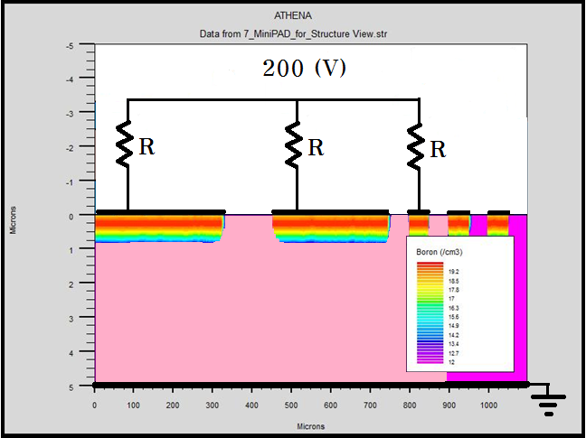
Traditional Si sensor operation
-

Slide 7
DC/AC coupled sensors

Slide 8
Conventional AC-coupled sensor structure

Slide 9
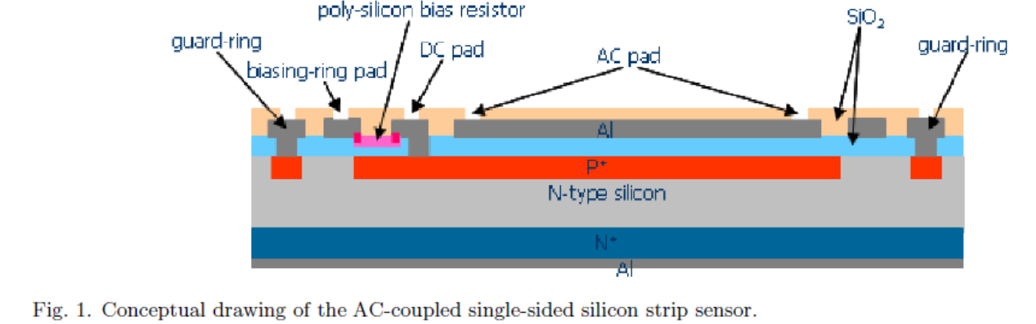
An implementation at ETRI

Slide 10
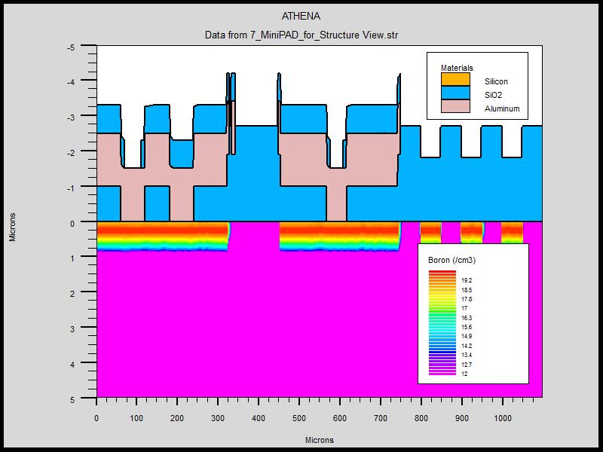
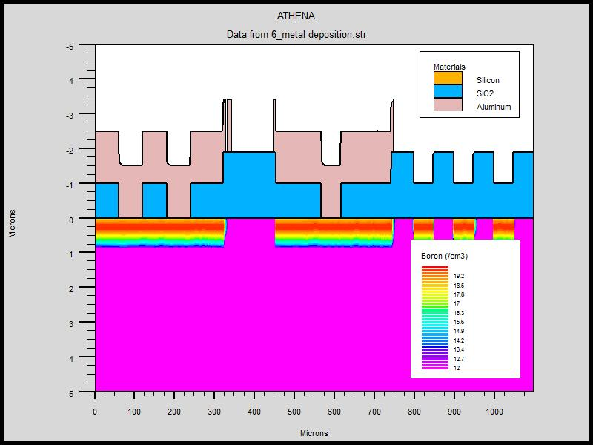
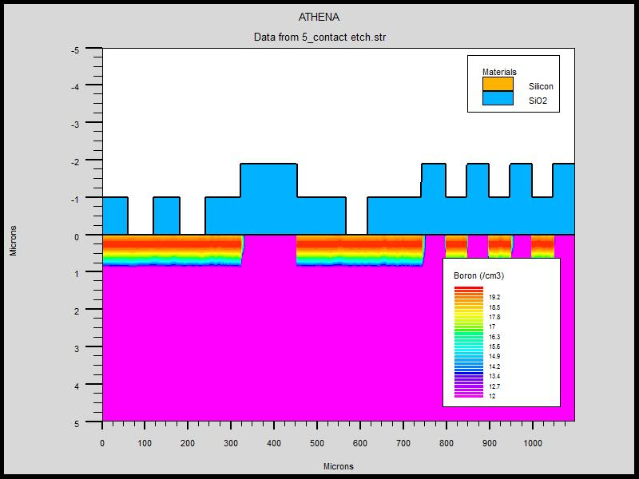
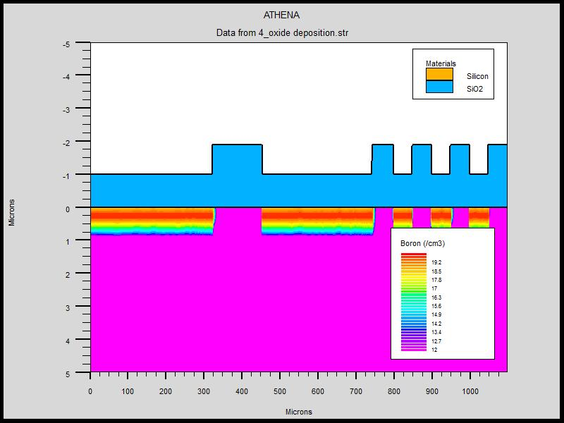
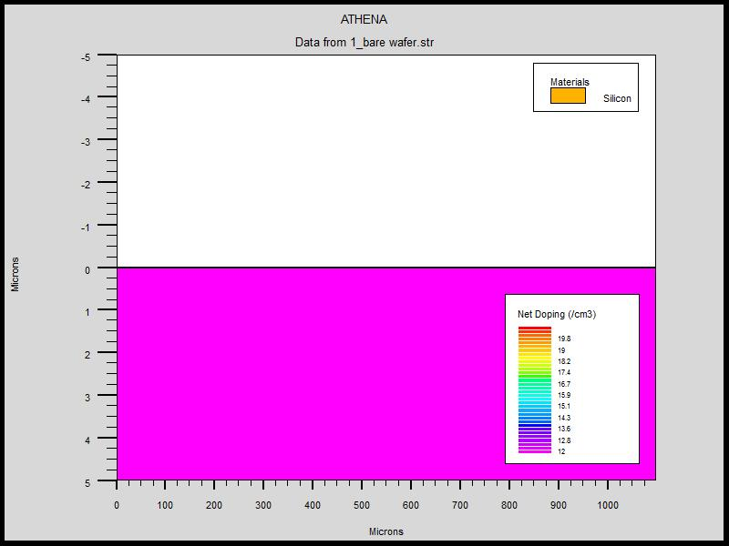
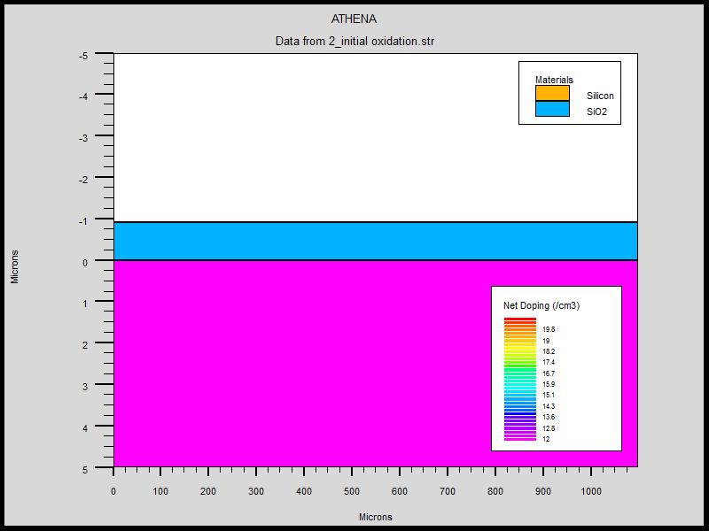
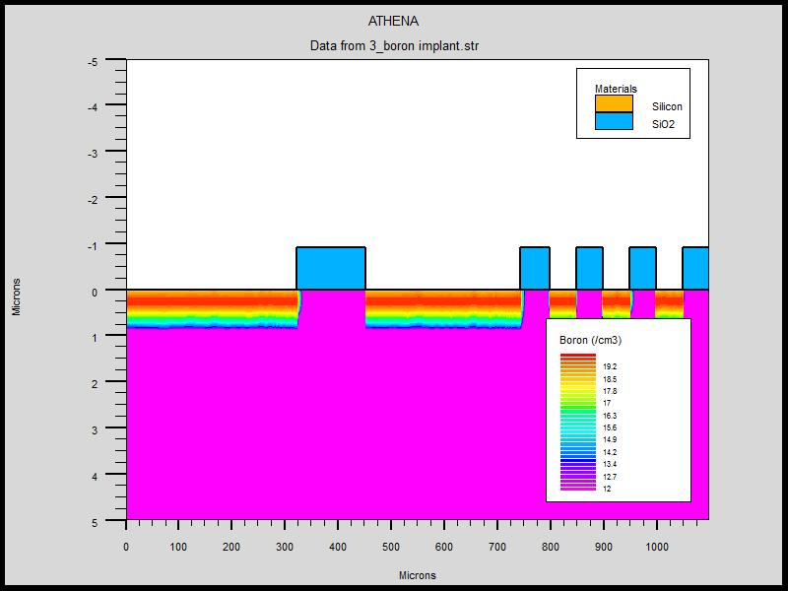
How do we make it?
(CMOS process)
Metal layer deposition
Passivation
Oxide layer deposition
Etch for contact
High purity Si wafer
Oxidation
Ion implant

Slide 11
Actual process sheet

Slide 12
Our collaboration model
Z. Li : Design/Process schematics
ETRI : Suggestion/Fabrication
A. Sukhanov : Coupling to electronics
Y. Kwon, E. Kistenev, J. Lajoie : Implementation, Quality control, follow-up, identification of main issues
Korean MPC-Ex groups : Test

Slide 13
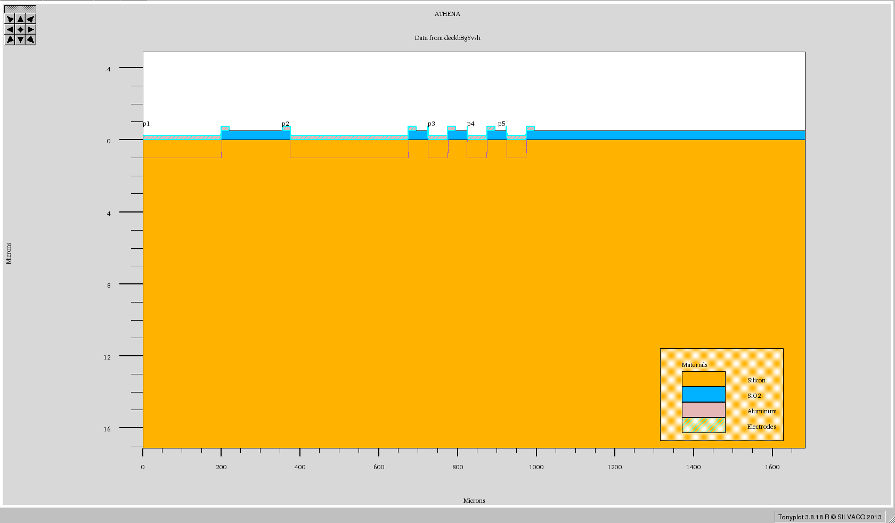
Structure with Al-overhang p⁺- implant, 20keV B, 1x10¹⁵/cm²

Slide 14
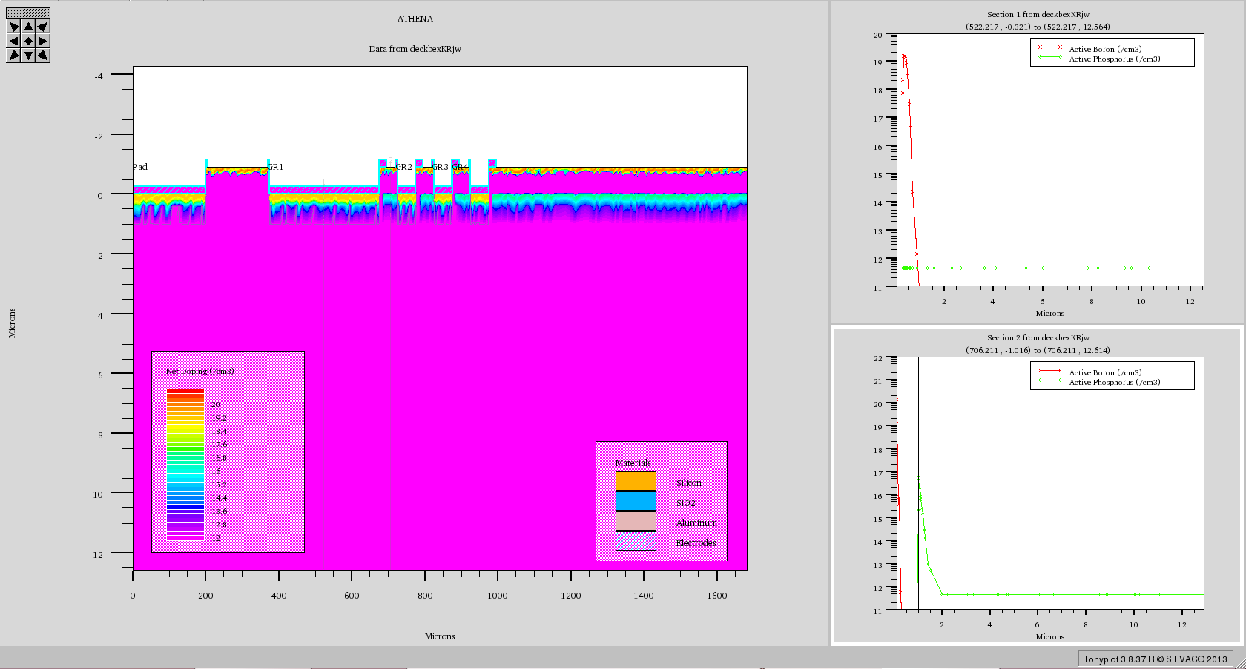
n⁺ Implant (40 keV Ph, 1x10¹²/cm²) channel stopper added
n⁺ Implant (40 keV Ph, 1x10¹⁵/cm²)

Slide 15
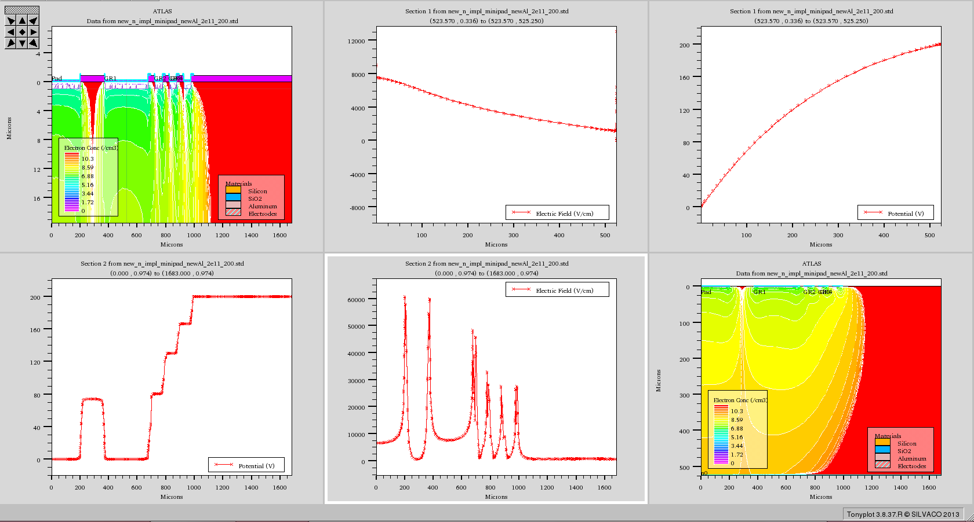
N_{it}=2E11/cm²; Bias: 200 V

Slide 16
Mask layers
(DC coupled sensor)
“p+”
“n+”
“contact”
“metal”
“passivation”

Slide 17
“p+”

Slide 18
“n+”

Slide 19
“contact”

Slide 20
“metal”

Slide 21
“passivation”

Slide 22
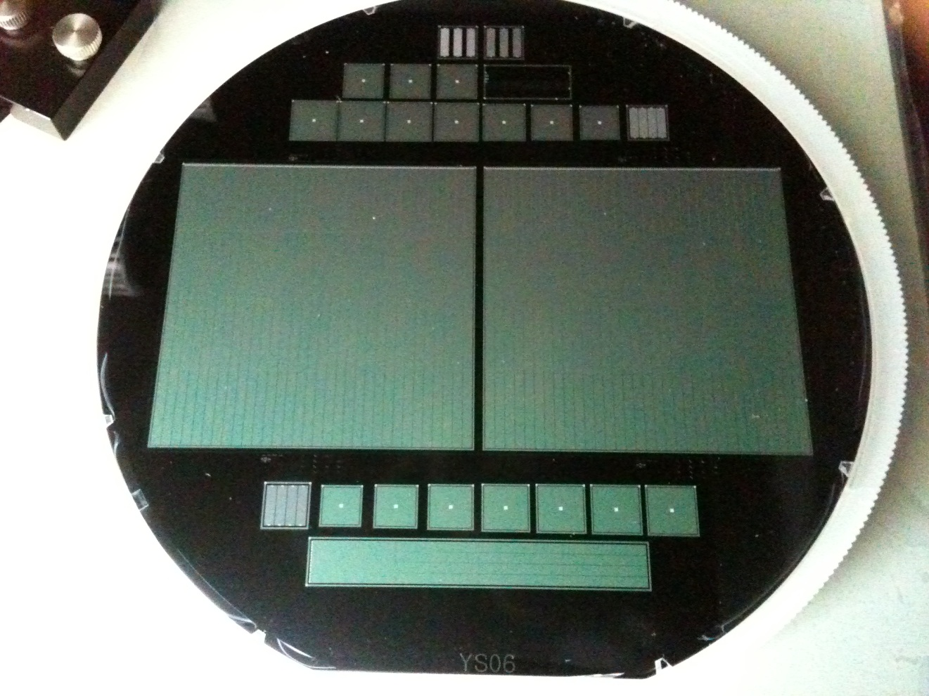
Processed Wafer

Slide 23
Dicing
Key origin of trouble :
  Two sensors on one wafer
  When we use diamond saw (mechanical dicing), we have to use sticky tape to hold pieces still while in dicing. We couldn’t avoid exerting stresses to the sensor edges when we remove those sticky tapes after dicing.
Solution : Expander
  Dicing company suggested expander. No change in leakage current up to the bias of 3 x full depletion voltage.

Slide 24
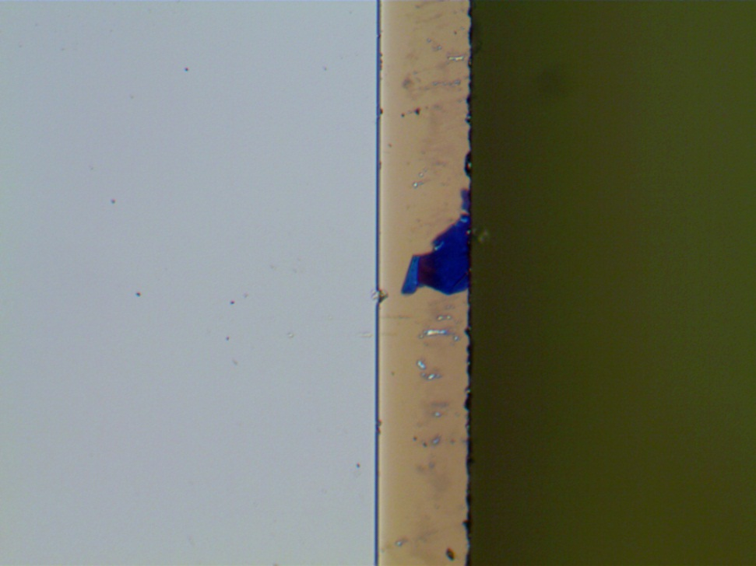
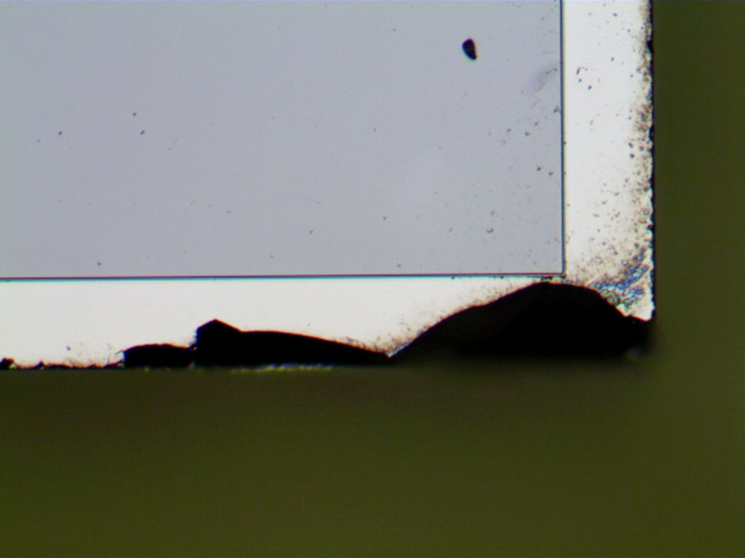
Where problems are …
~70 μ
~70 μ

Slide 25
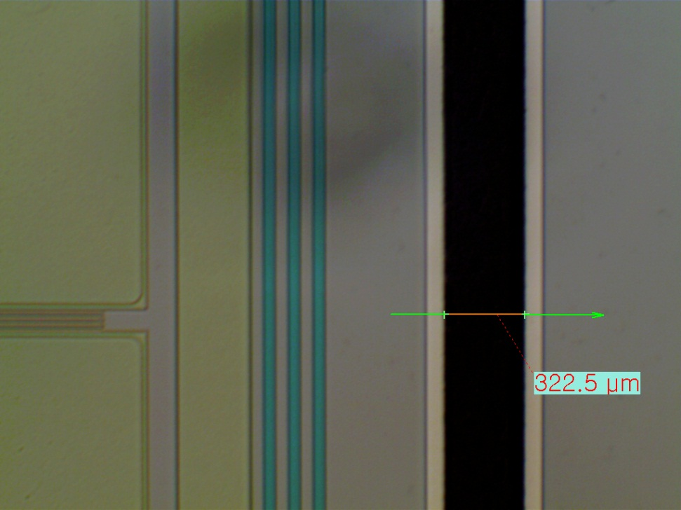
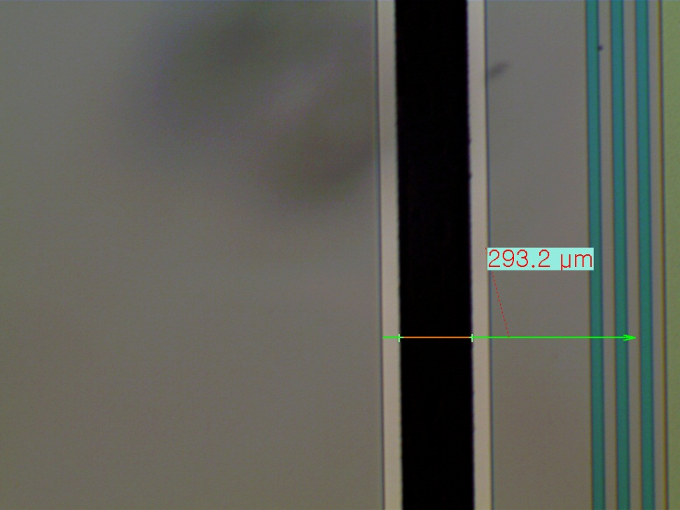
Expander

Slide 26
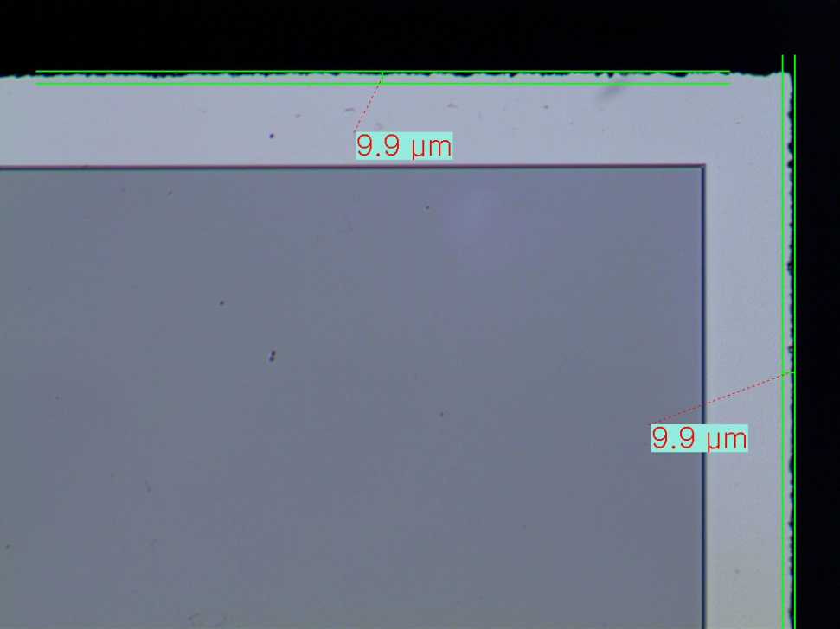
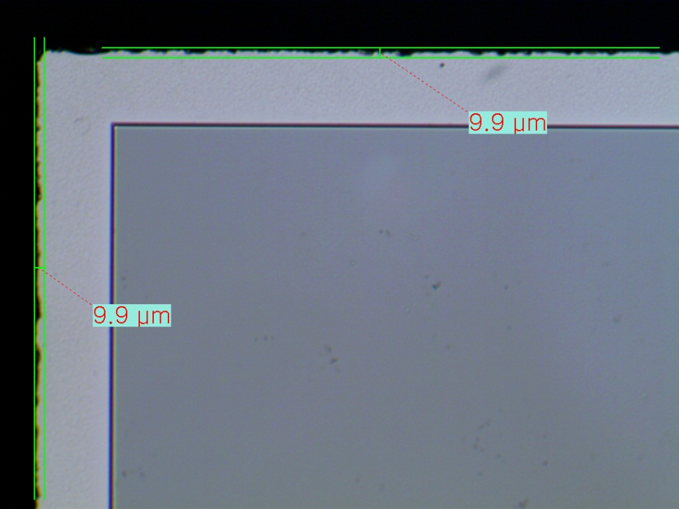
After corrected procedure

Slide 27
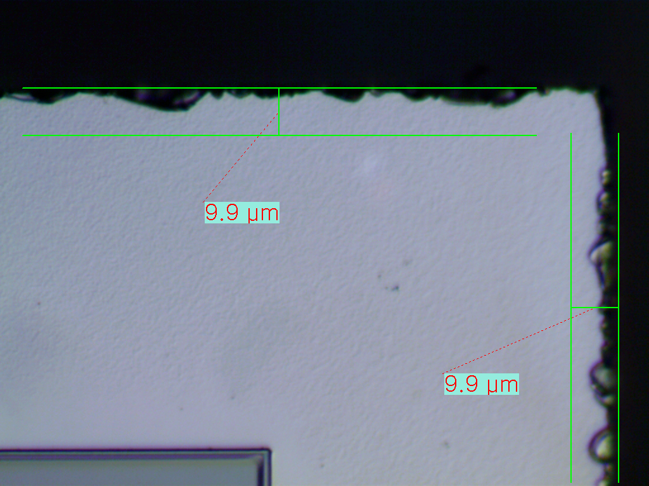

Slide 28

Photocurrent measurement
(LED 1070 nm)

Slide 29
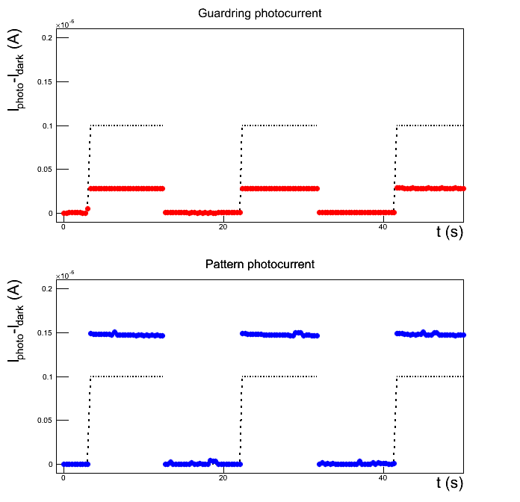
Middle, 2V

Slide 30
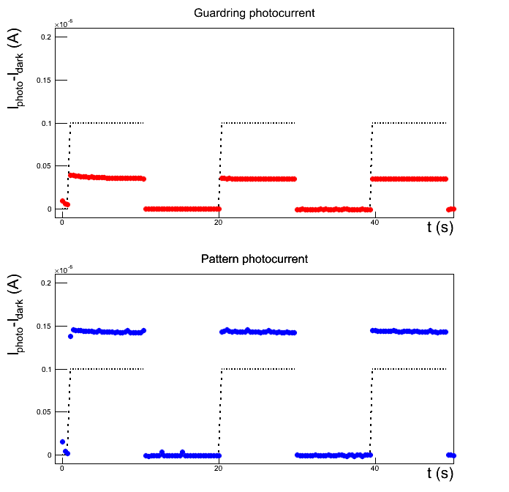
Middle, 8V

Slide 31
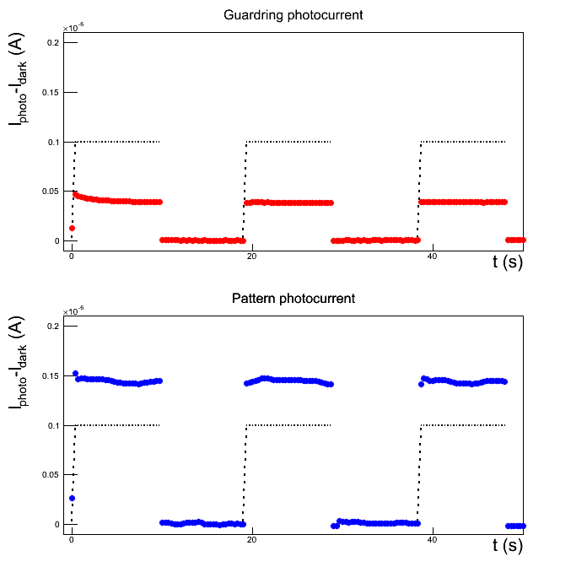
Middle, 16V

Slide 32
In-between, 2V

Slide 33
In-between, 8V

Slide 34
In-between, 16V

Slide 35
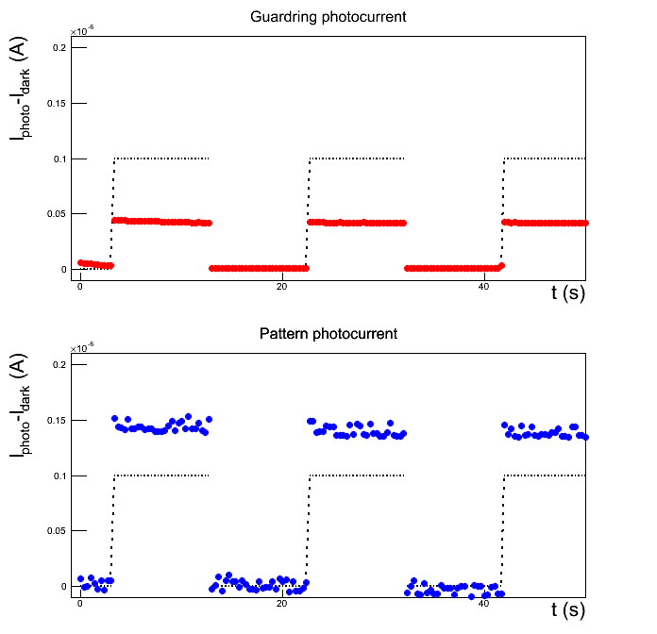
In-between, 32V

Slide 36
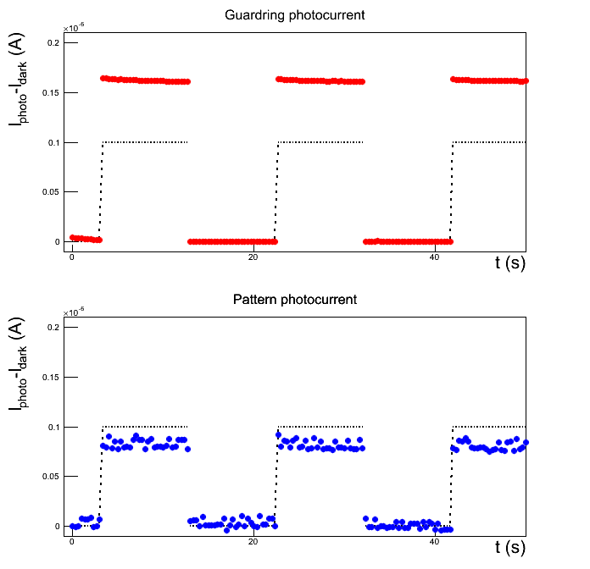
GR, 2V

Slide 37
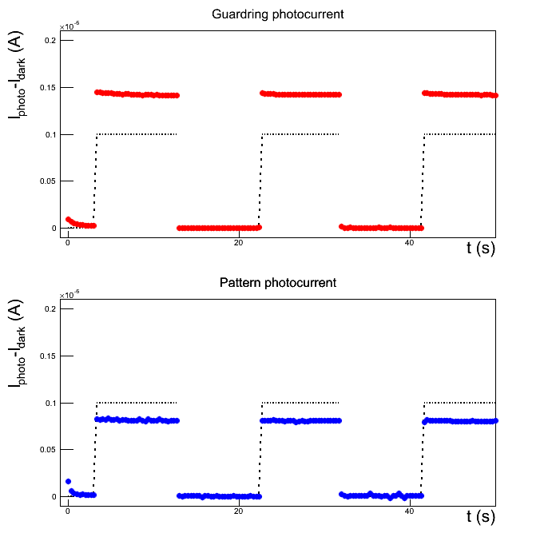
GR, 8V

Slide 38
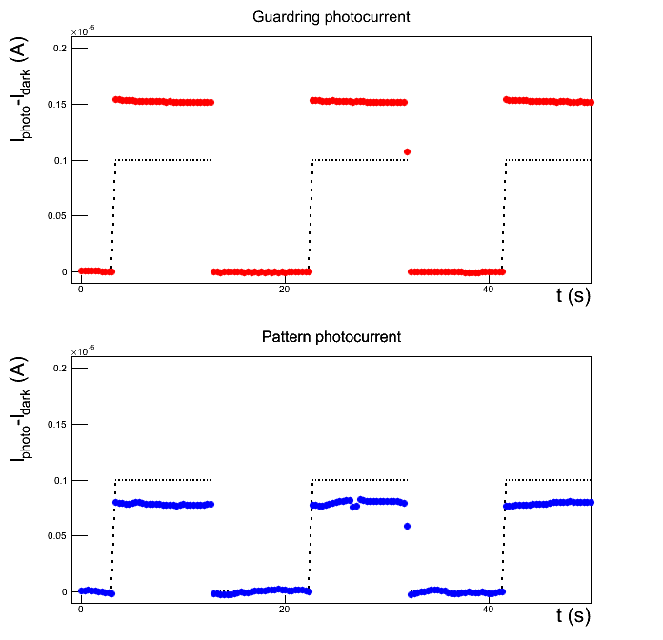
GR, 16V

Slide 39
GR, 32V

Slide 40
What is the issue?
(1070 nm)

Slide 41
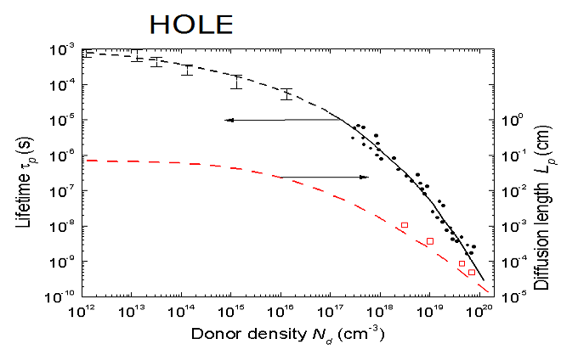
Diffusion vs Drift
Very high resistivity
> 20 kΩ⋅cm
Lifetime
τ > ms
e(h) thermal velocity :
2.3 (1.6) x 10⁵ m/s
Charge collection by diffusion
when not by drift

Slide 42
New efforts?
(ALICE induced)
Readout ASIC
  Preamp + ADC + memory + trigger
  Built contact with CMOS image sensor expert.
  Running local MPW.
  KORIA might make some investment.
  Small scale funds might work… (Local grant application?)

