Slide 1
Introduction of the Progress in
Detector Solenoids
Akira Yamamoto
KEK
Presented at sPHNIX held at RIKEN,
July 31, 2013

Slide 2
Outline
Introduction
Accelerator Magnets
Detector Magnets
  Accelerator Experiments
  Space Experiments
Technical Topics
Summary

Slide 3
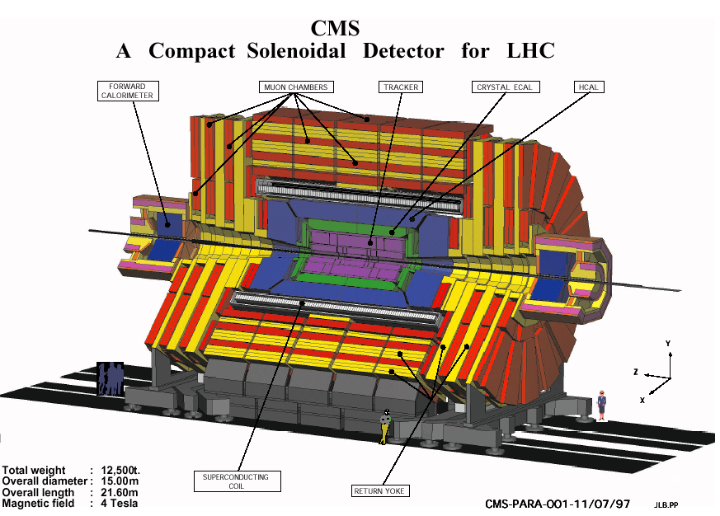
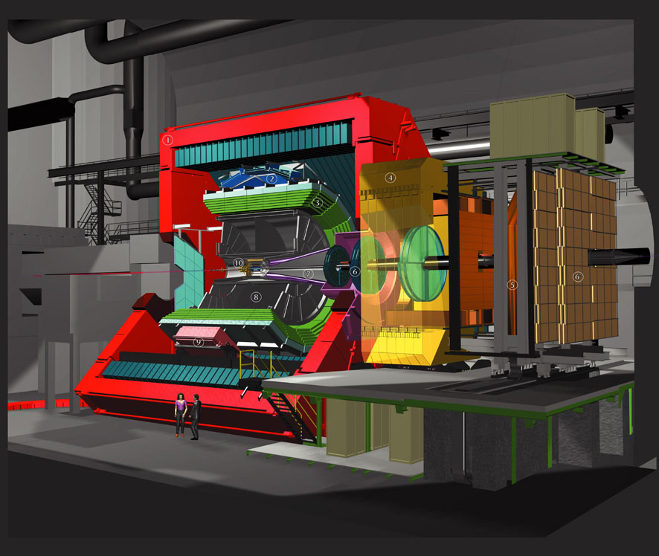
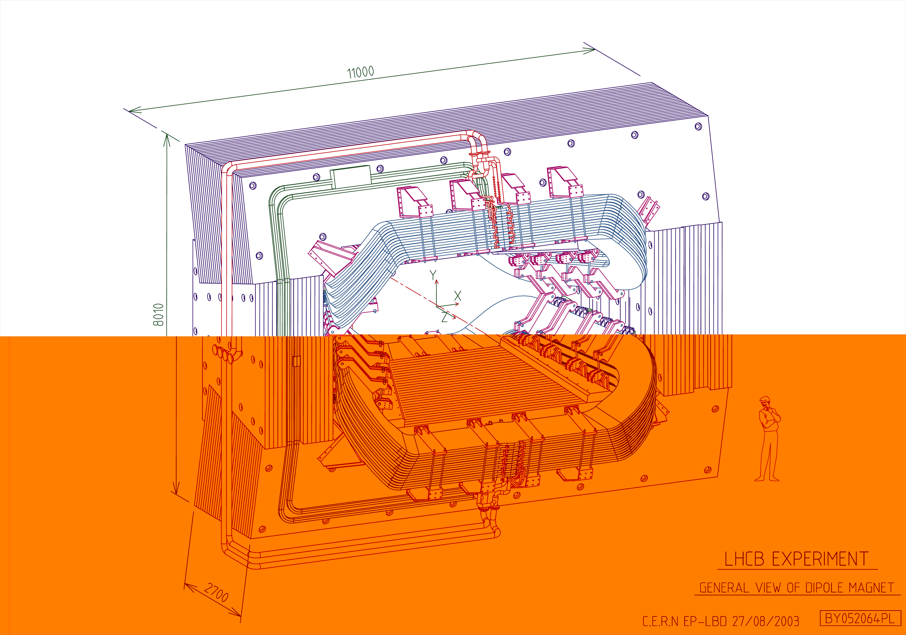
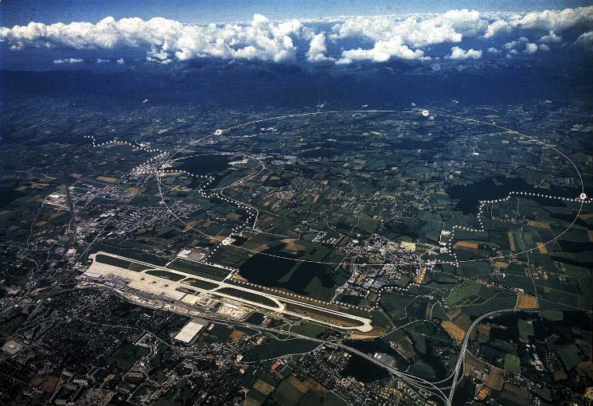
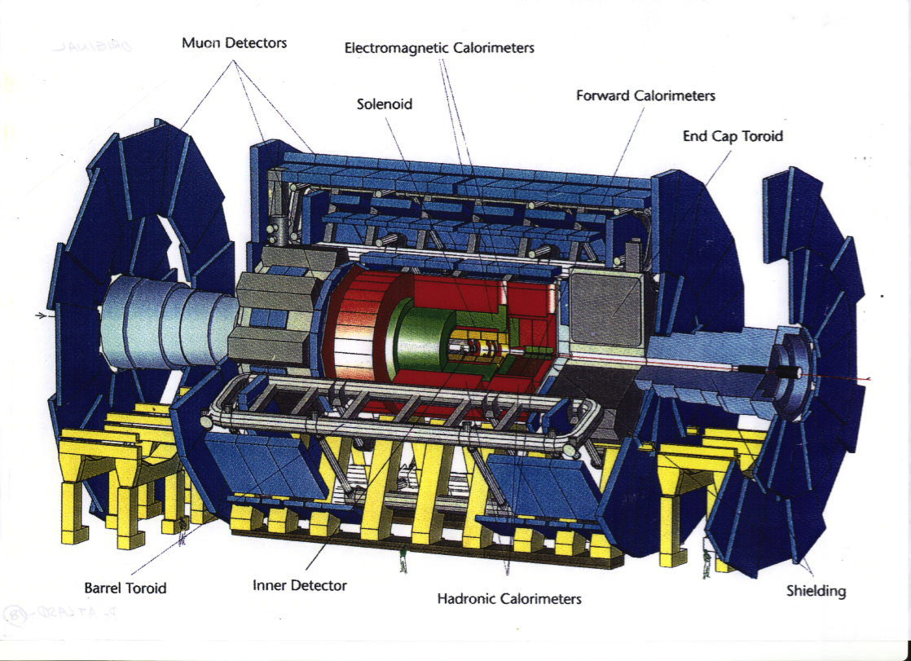
Superconducting Magnets for LHC Experiments in Progress
ATLAS
(H. Ten Kate et al)
CMS
(A. Herve et al)
Alice (Resistive Coil)
D. Swoboda et al.,
LHCb (ResistiveCoil)
J. Andre, W. Flegel et al.,

Slide 4
Superconducting Detector Magnets at LHC
Experiment B R E E/M Remark
[T] [m] [GJ] [kJ/kg]
ATLAS
CS 2.0(2.1) 1.25 0.04 7 (8.1) High-St. Al, no-cryo
Thin solenoid (0.7 Xo)
BT ~1 1.08 3 8 split, Largest
ET ~1 2x0.25 1.6 Single cold mass
CMS 4.0 3.2 2.6 12 Hybrid-conductor

Slide 5
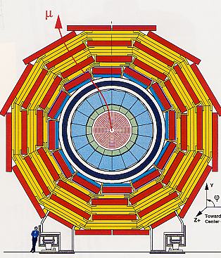
CMS: Solenoidal Field
Axial, Uniform Field
Self Supporting
Iron Return Yoke
Field inside the solenoid
  Sagitta measurement
  dp/p ~ {B • R²}⁻¹
Deflection angle outside the solenoid
  dp/p ~ {B • R} ⁻¹

Slide 6
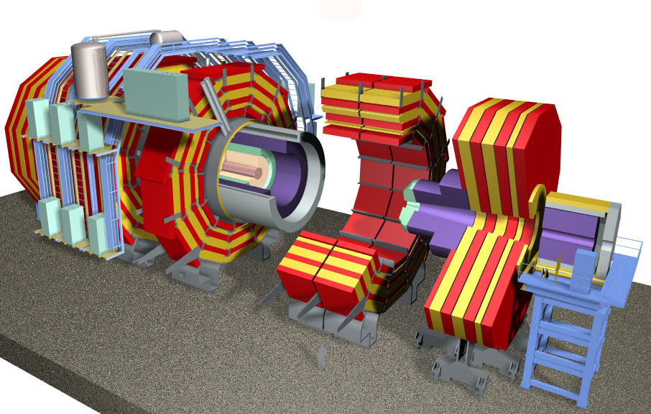
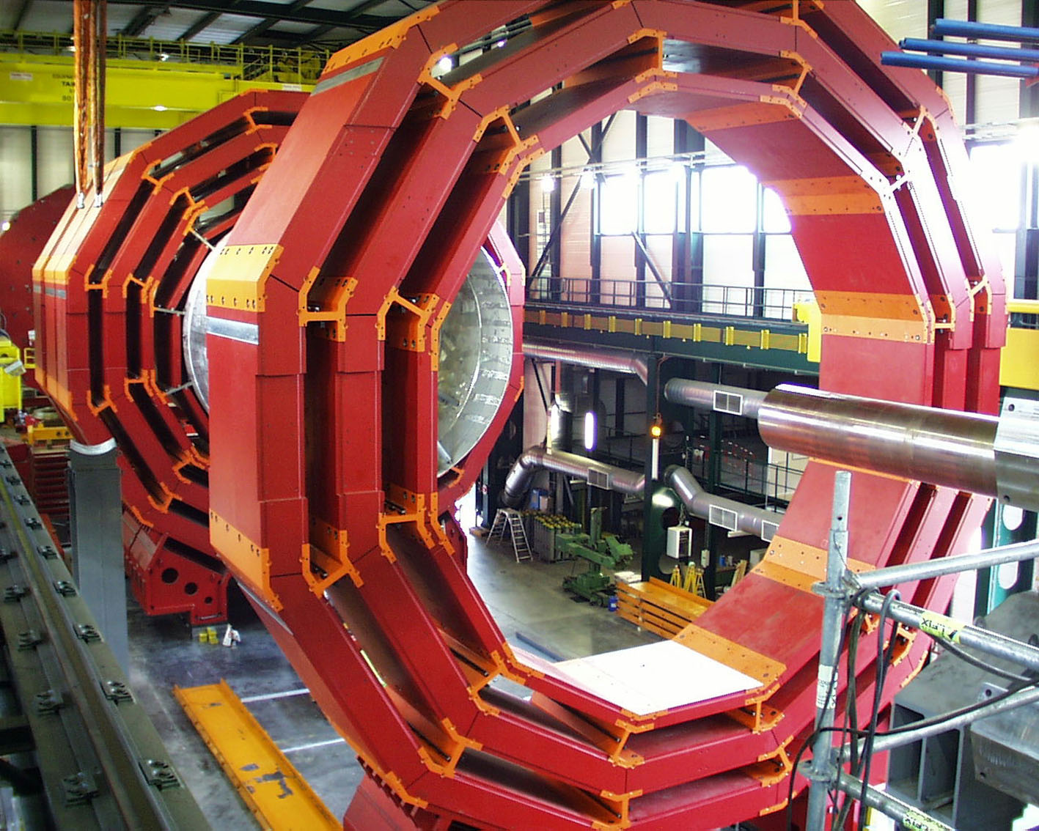
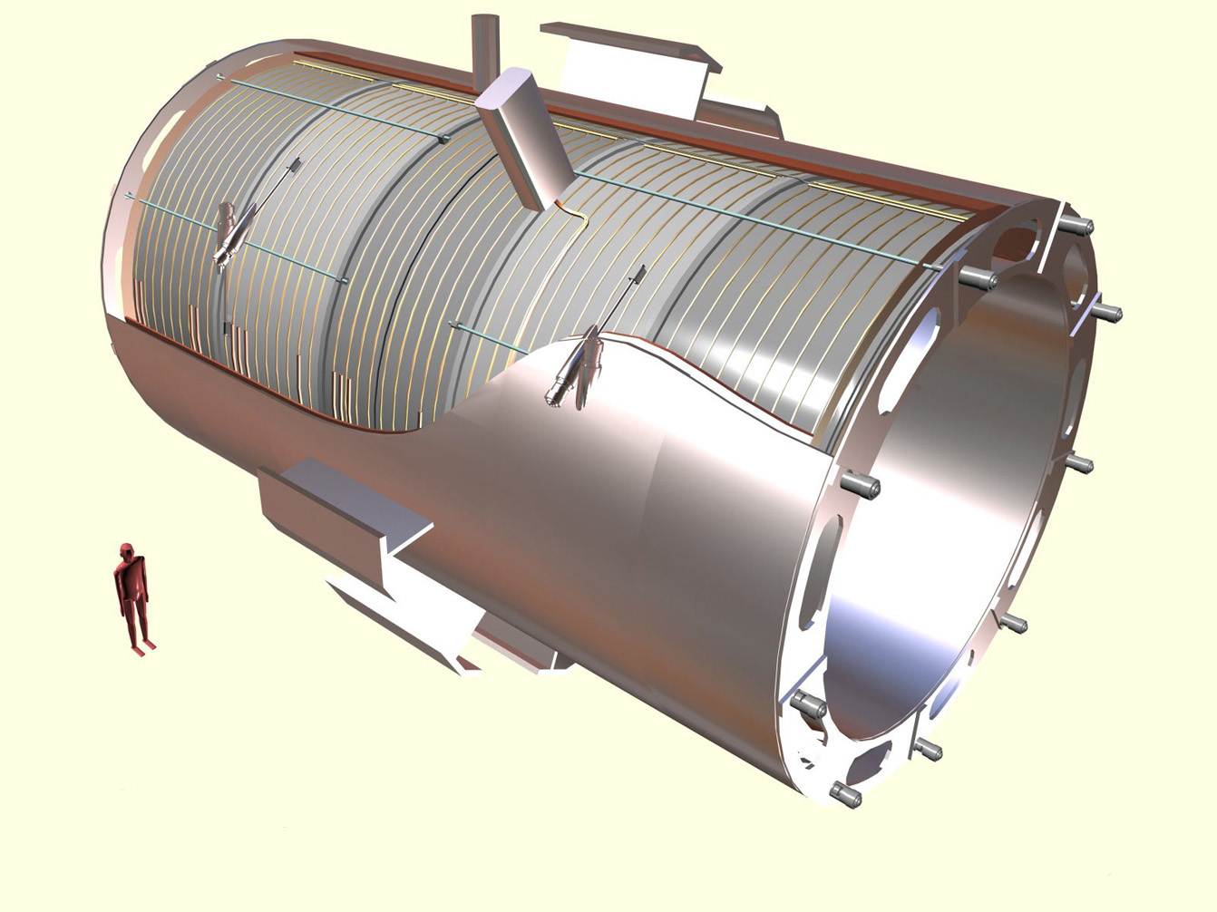
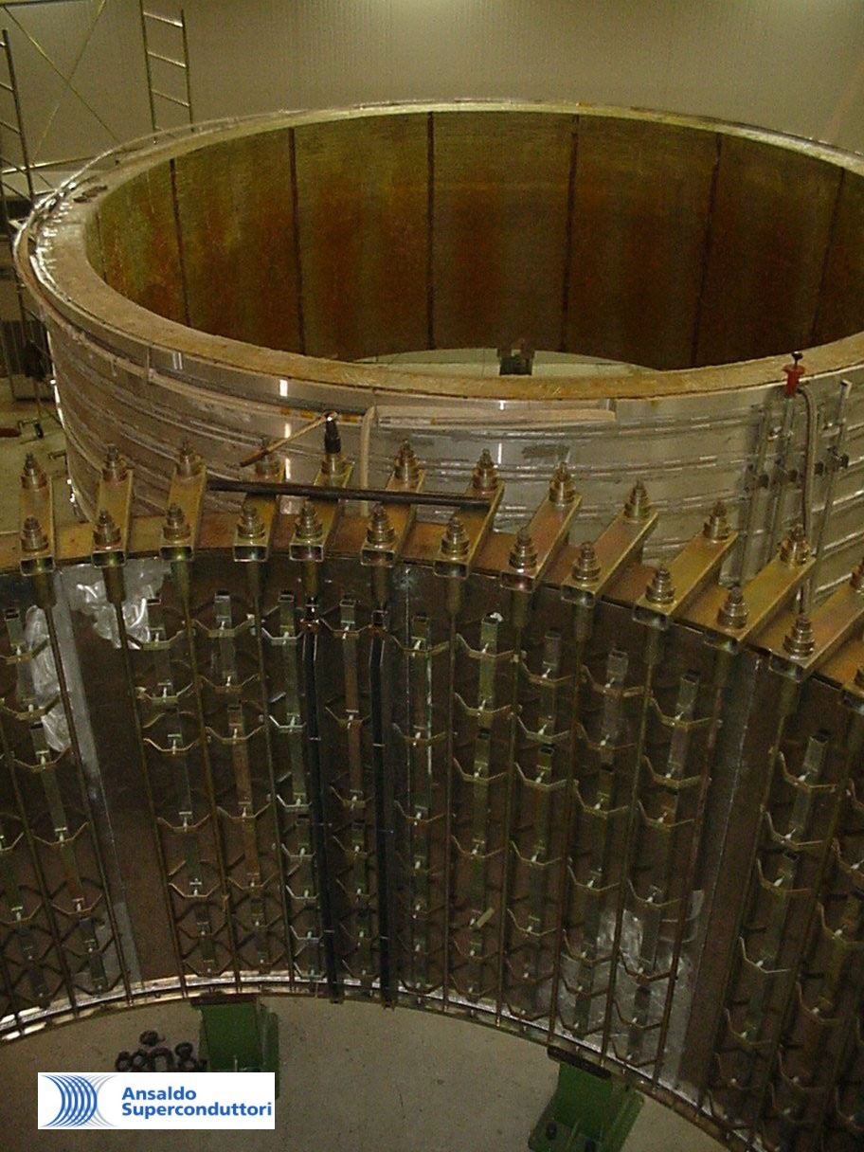
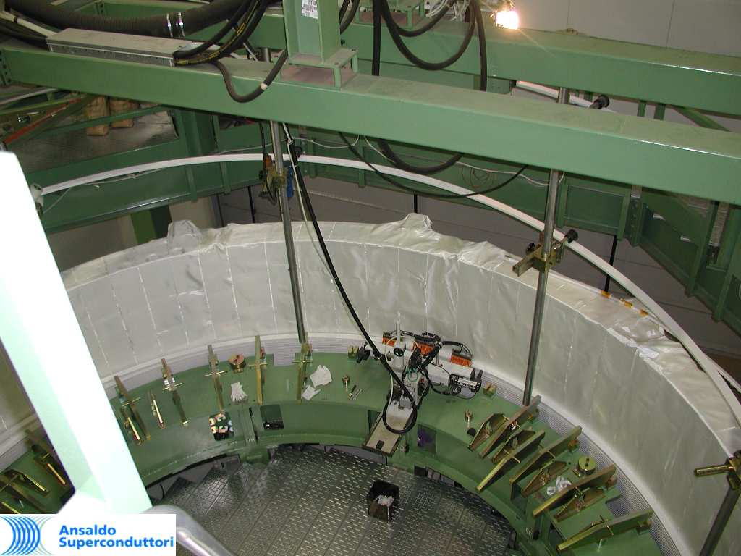
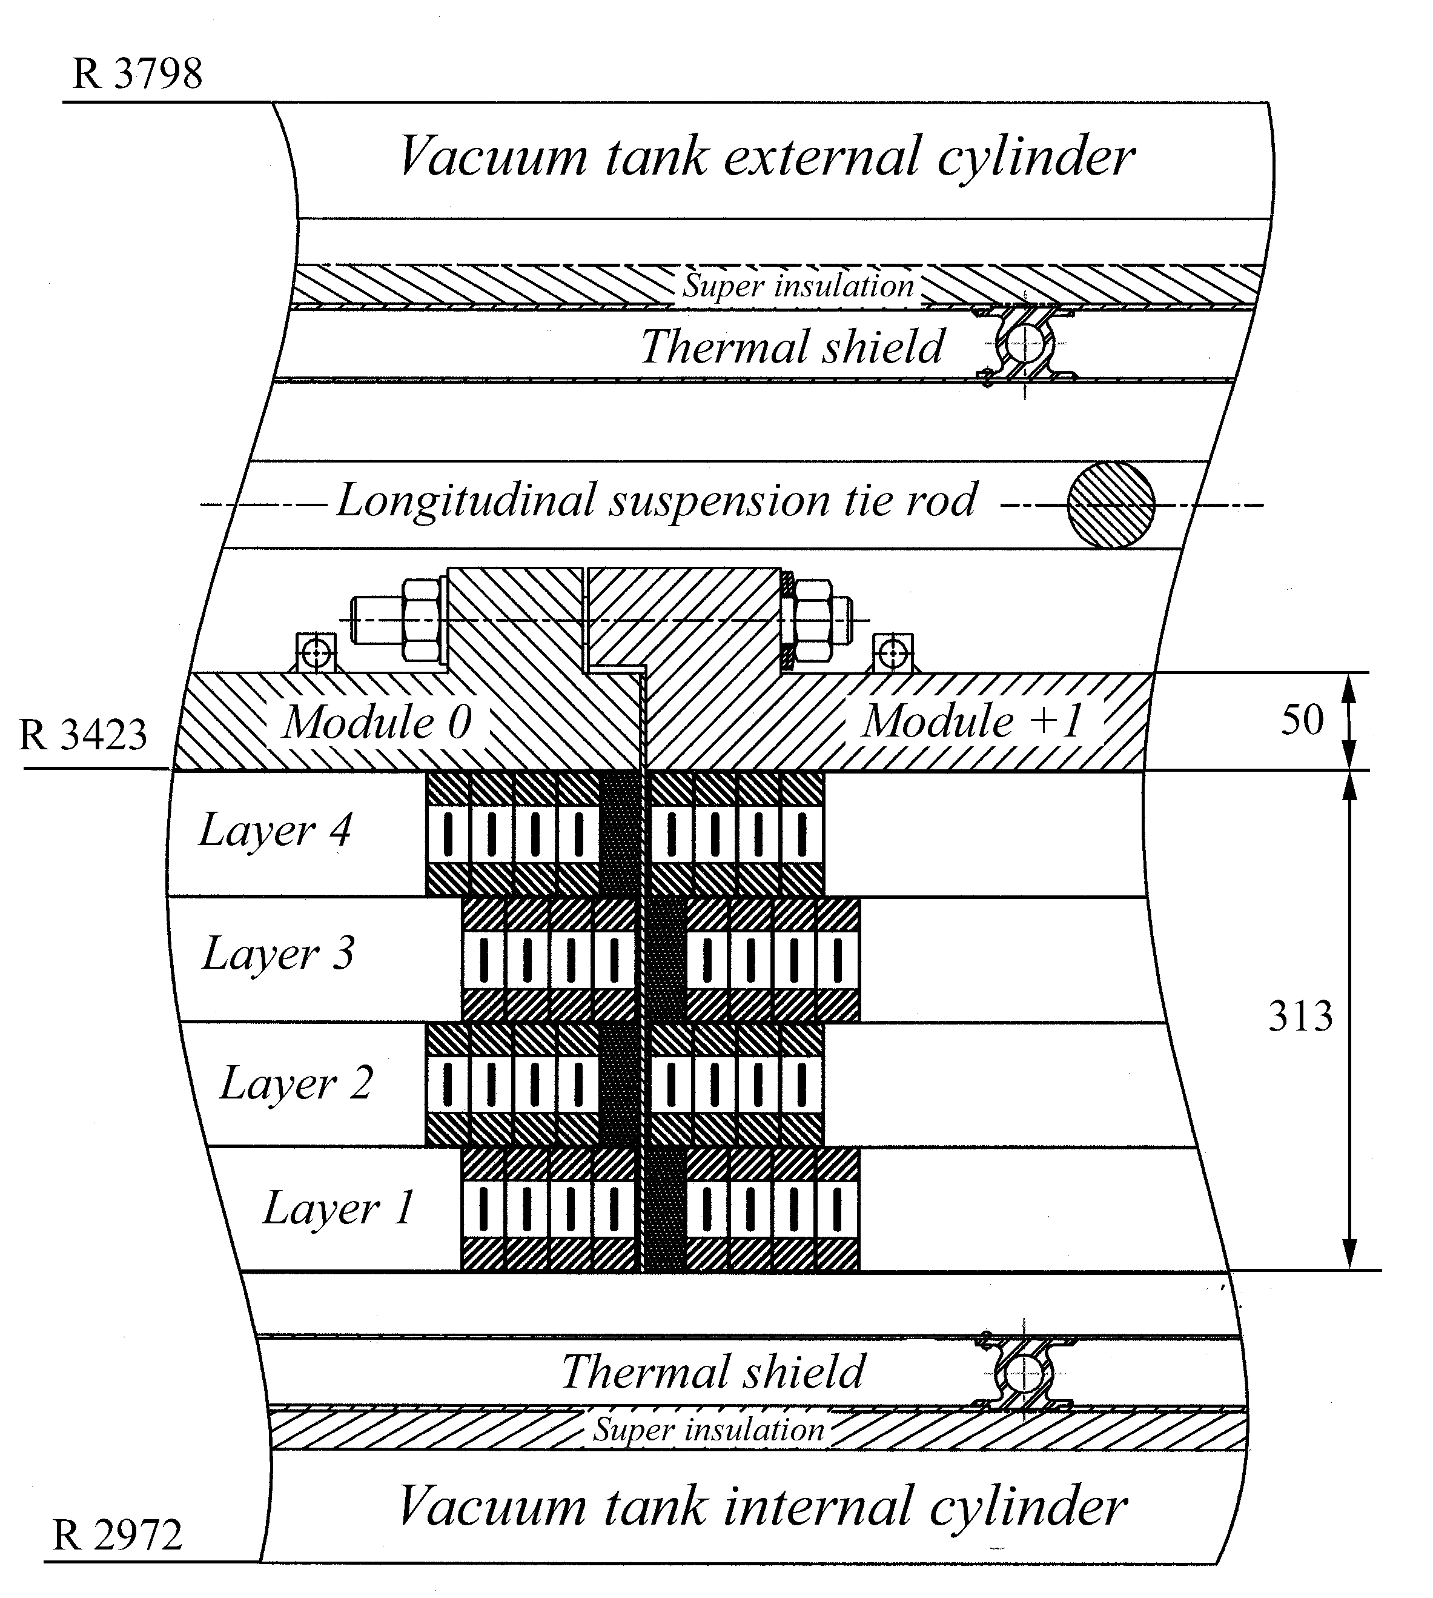
CMS

Slide 7
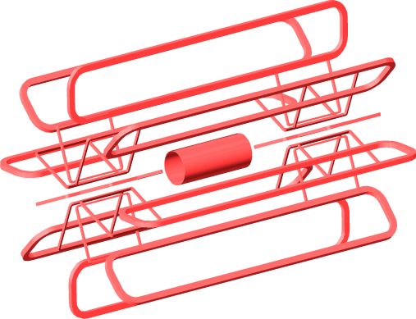
ATLAS: Toroidal Field
Self Closed Field
Field only at Detector Region
Field : proportional to R⁻¹
6~ 8 coils in practical design
Largre field in the coil
Sophisticated support structure
to keep self balance
Saggita and deflection
  dp/p ~ {B_{φ}•R_{i} • ln(R_{i}/R_{o}) / sin θ }⁻¹
θ
Much Powerful Deflection in forward/backward direction

Slide 8
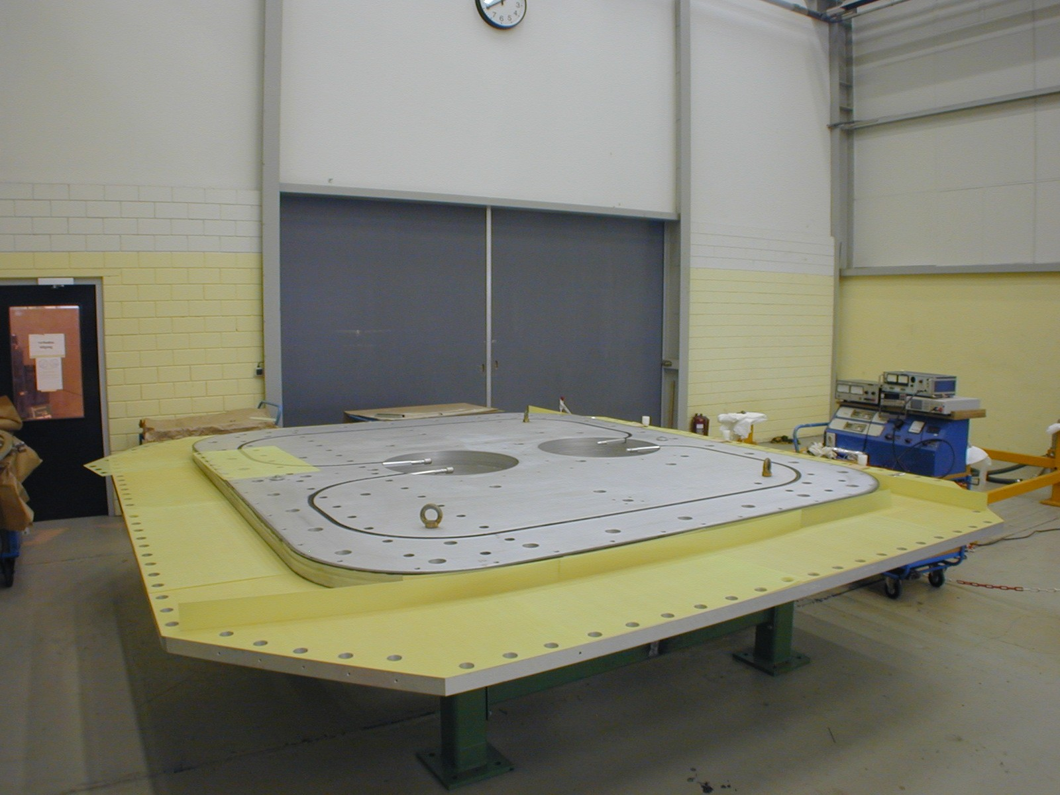
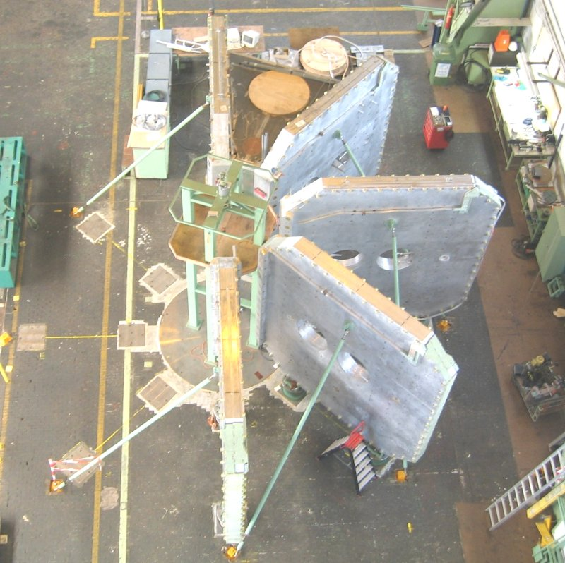
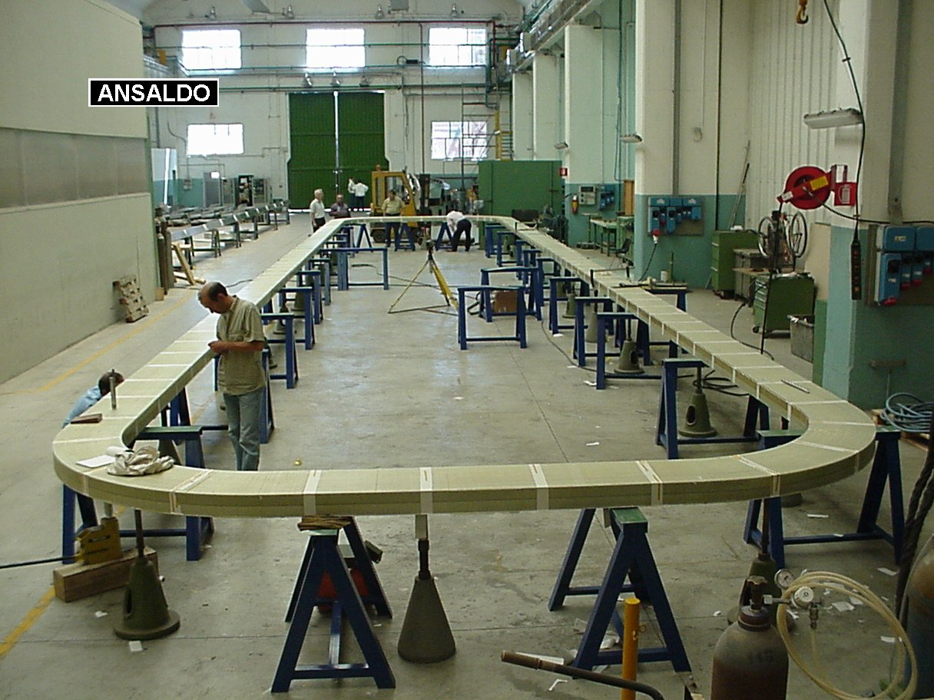
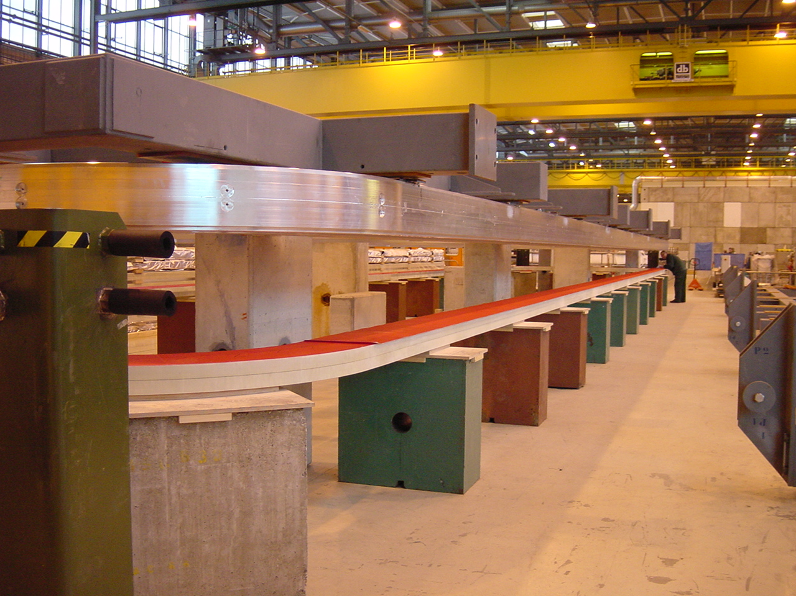
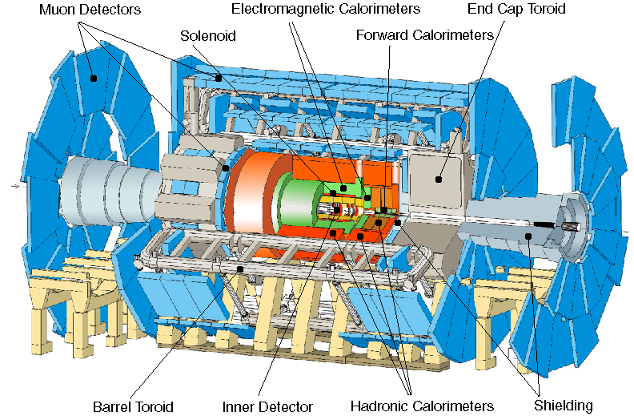
width: 44m
diameter: 22m
weight: 7000t

Slide 9
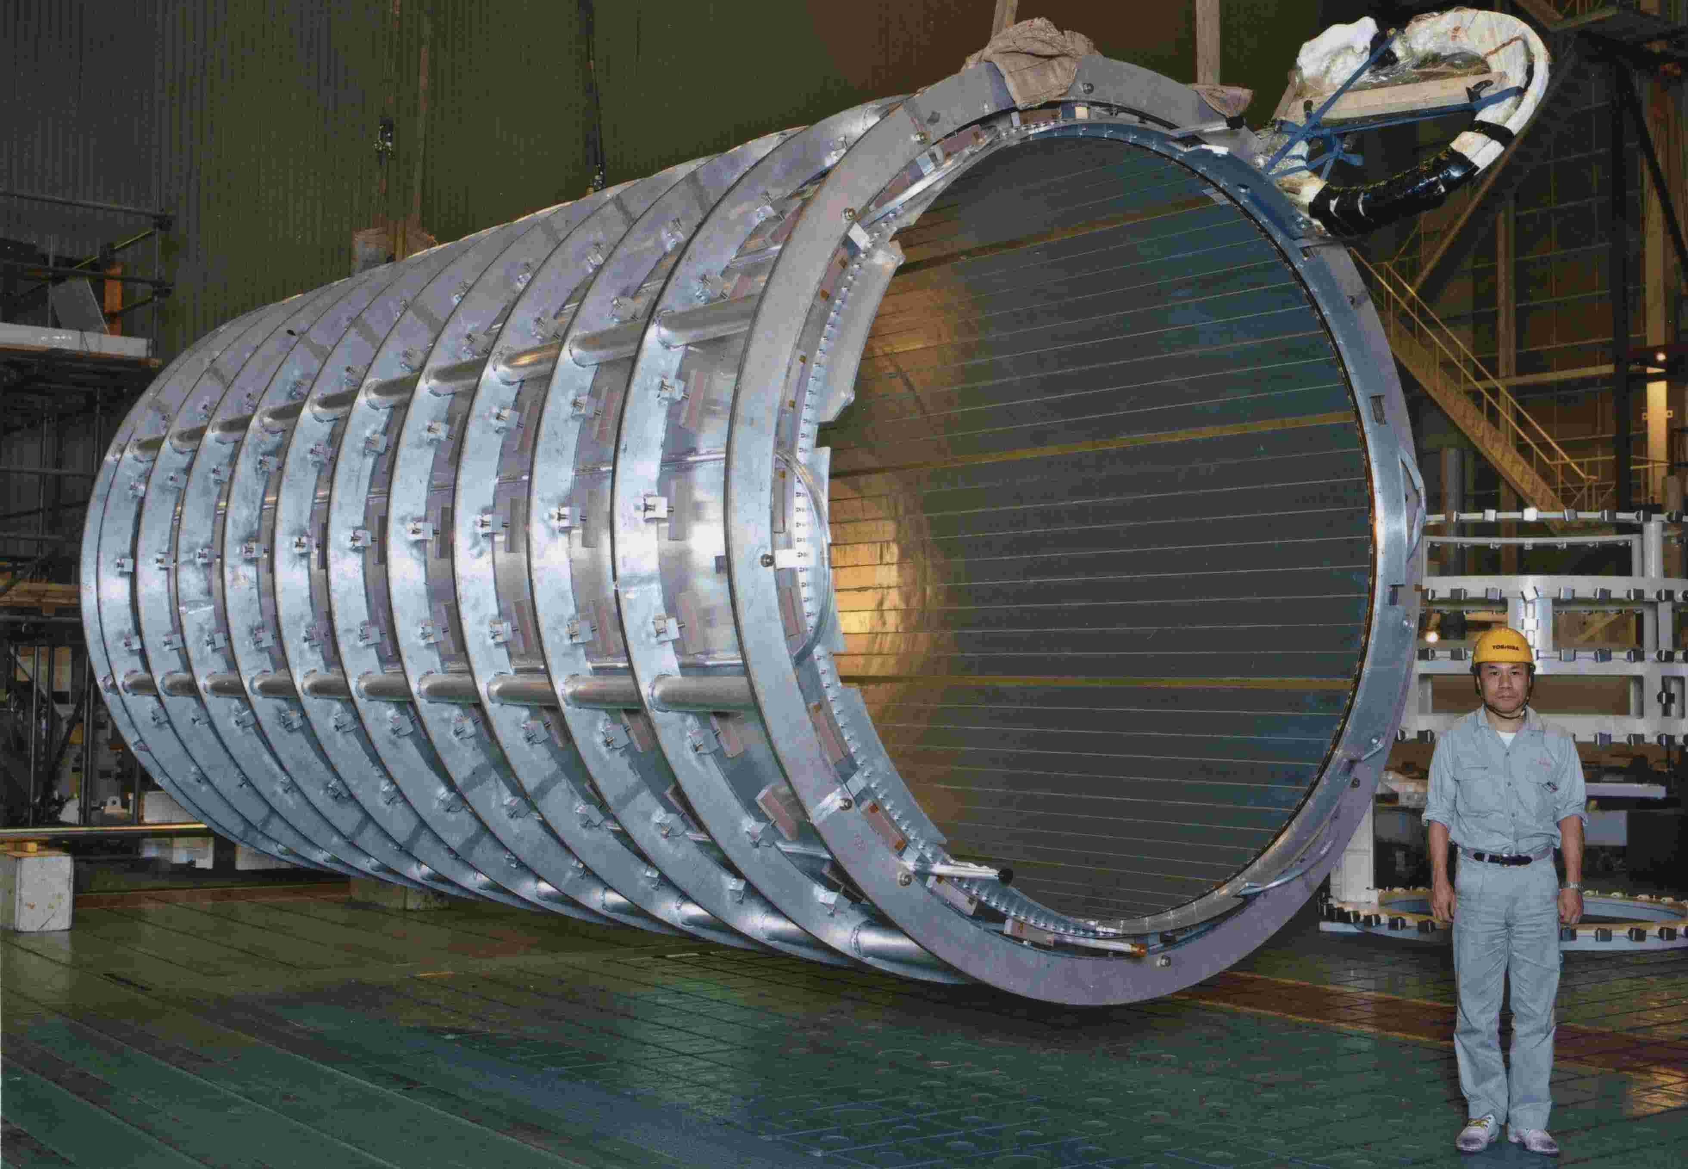
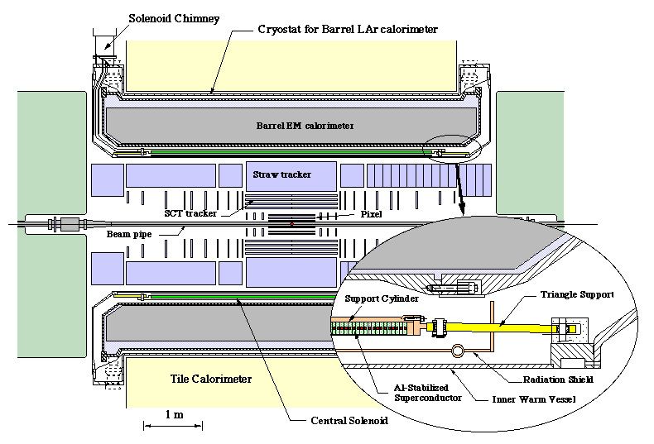
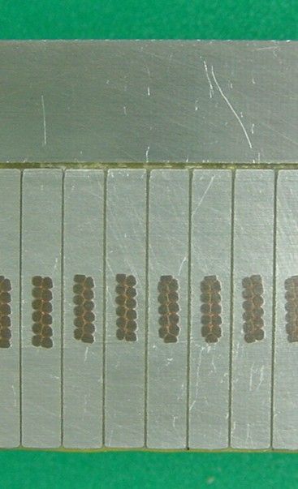
Central Solenoid
Thin coil
High-strength
Al-stabilizer
30 mm

Slide 10
Features of Detector Magnets
Al-stabilized superconducting magnet
Indirectly cooled,
  forced flow 2-phase helium or
  thermo-syphon cooling

Slide 11
Development of Detector Solenoid/Ring-Dipole Magnets
Experiment --Lab. B R (or L) X E/M Technical Remark (Year)
    [T] [m] [Xo] [kJ/kg]:
ISR CERN 1.5 1.1 Al-soldered to S/C (1977)
CELLO Saclay/DESY 1.5 0.85 0.6 Indirect cooling (1978)
*PEP4 LBL 1.5 1.1 0.83 Cu stab, in. Q-back (1983)
CDF Tsukuba/Fermi 1.5 1.5 0.84 5.4 Al co-extrusion (1984)
TOPAZ KEK 1.2 1.45 0.70 4.3 Inner coil winding, (1984)
VENUS KEK 0.75 1.75 0.52 2.8 CFRP vacuum shell, (1985)
AMY KEK 3 1..2 Hybrid of Cu/Al stab. (1985)
CLEO-II Cornell 1.5 1.55 2.5 3.7 Double layer (1988)
ALEPH Saclay/CERN 1.5 2.75 2.0 5.5 Thermo-siphon (1987)
DELPHI RAL/CERN 1.2 2.8 1.7 4.2 LHe-pump cooling (1988)
ZEUS INFN/DESY 1.8 1.5 0.9 5.5 Current grading, (1988)
H1 RAL/DESY 1.2 2.8 1.8 4.8 (1990)
BESS KEK 1.2 0.5 0.2 6.6 Thin-Al,Pure-Al strip (1990)
*CMD-2 BINP 1.2 0.36 0.38 5 Current shunting (1990)
G-2 BNL/KEK 1.5 6 One-ring dipole (1995)
WASA KEK/Uppsala 1.3 0.25 0.18 6 Thinnest (1996)
SDC-prt KEK/Fermi 1.5 (2) 1.85 1.2 9.6 High-st. Al, Isogrid (1993)
CLOE INFN (1997)
BABAR INFN/SLAC 1.5 1.5 (1997)
D0 Fermi* 2.0 0.6 0.9 3.7 Conforming of Al (1998)
BELLE KEK* 1.5 1.8 5.3 (1998)
ATLAS-CS 2 1.3 0.66 7 High St.Al-stabil. (2001)
(Blue is presently operated)

Slide 12
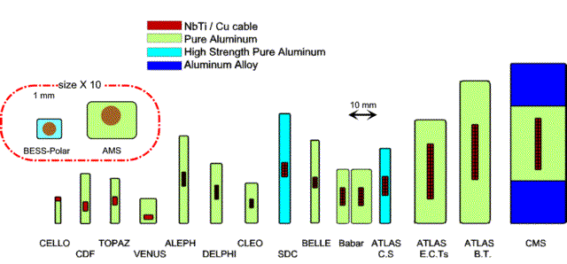
Progress of Al-stabilized SC

Slide 13
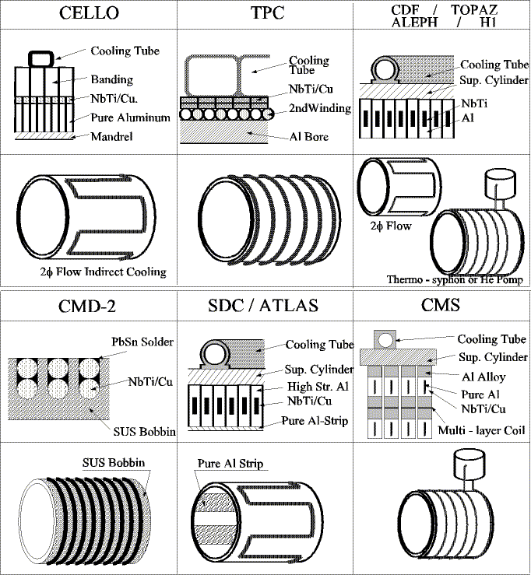
Recognized events;
Cello
Al-st. Thin..
Coil on mandrel
CDF
Al-co-extrusion,
TOPAZ
Inner winding
Aleph/Dephi
Thermo-syphone/Pump
Zeus/Cleo
Two layer, Grading
CMD
Res. Shunting (no insul.)
BESS/SDC
Pure-Al strip
SDC
High strength Al stab.
CMS
Hybrid conductor
BESS-P
Self supporting

Slide 14
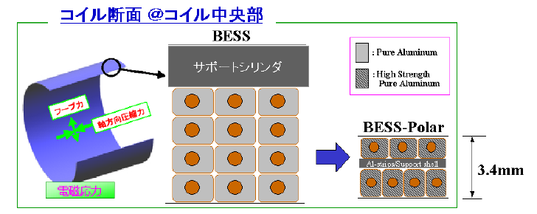
Bess-Polar
Support Cyl.
Self supporting coil
w/o outer sup. Cylinder

Slide 15
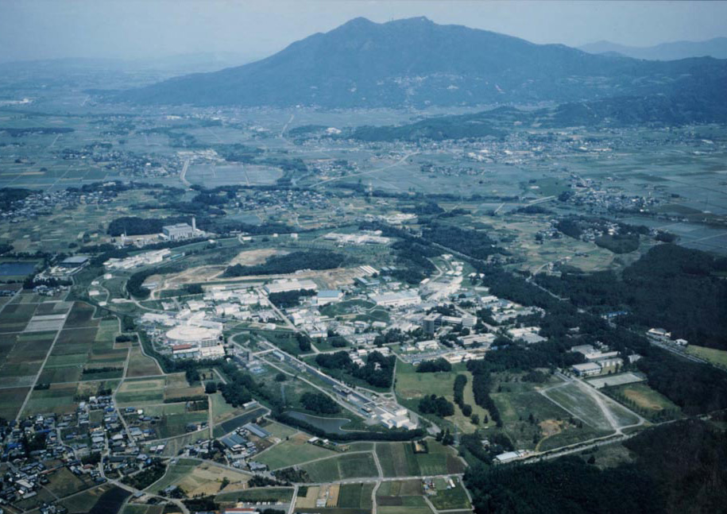
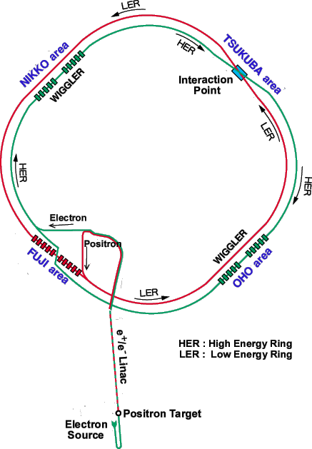
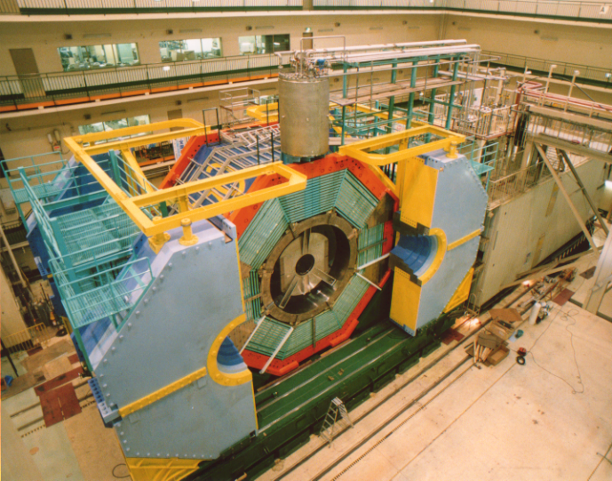
Belle Solenoid for KEK B-Factory
KEK Site

Slide 16
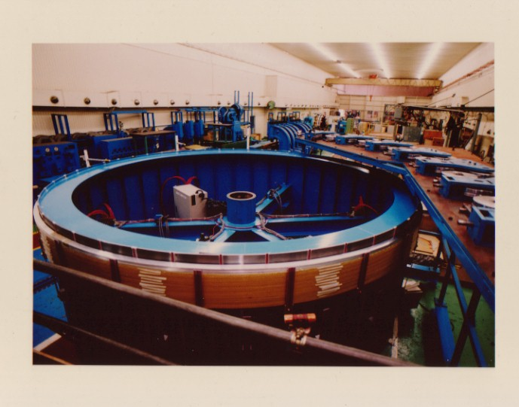
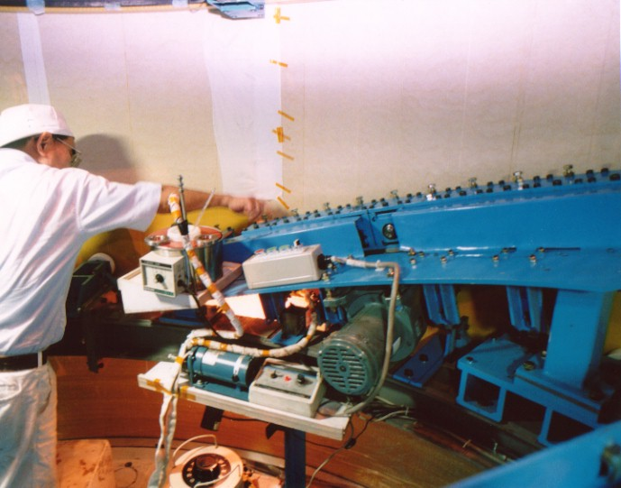
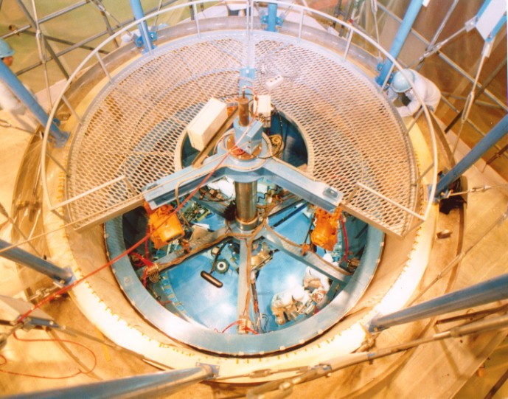
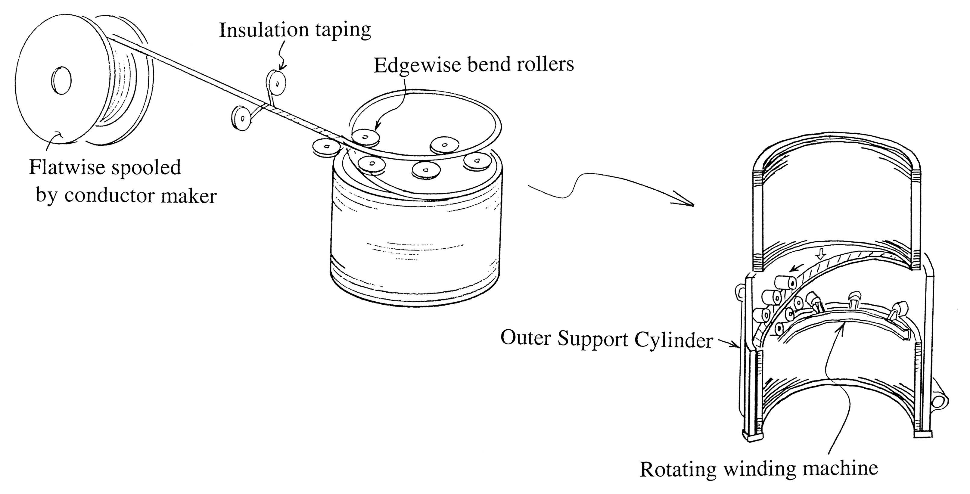
BELLE Coil Winding

Slide 17
Roles of Aluminum Stabilizer
Stabilizer for Superconductor
  Low Resistivity, and high thermal conductance
Energy absorber with Joule Heating in case of quench
  Large heat capacity / mass
Transparency / Light weight
  Low Z, and low density
Mechanical Strength (to be improved)
  High-strength Aluminum Stabilizer

Slide 18
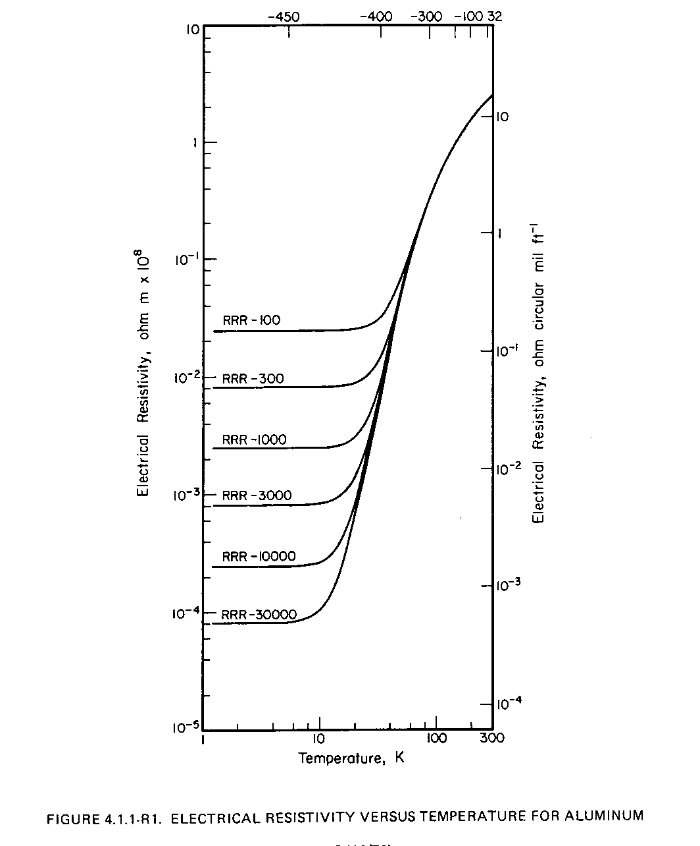
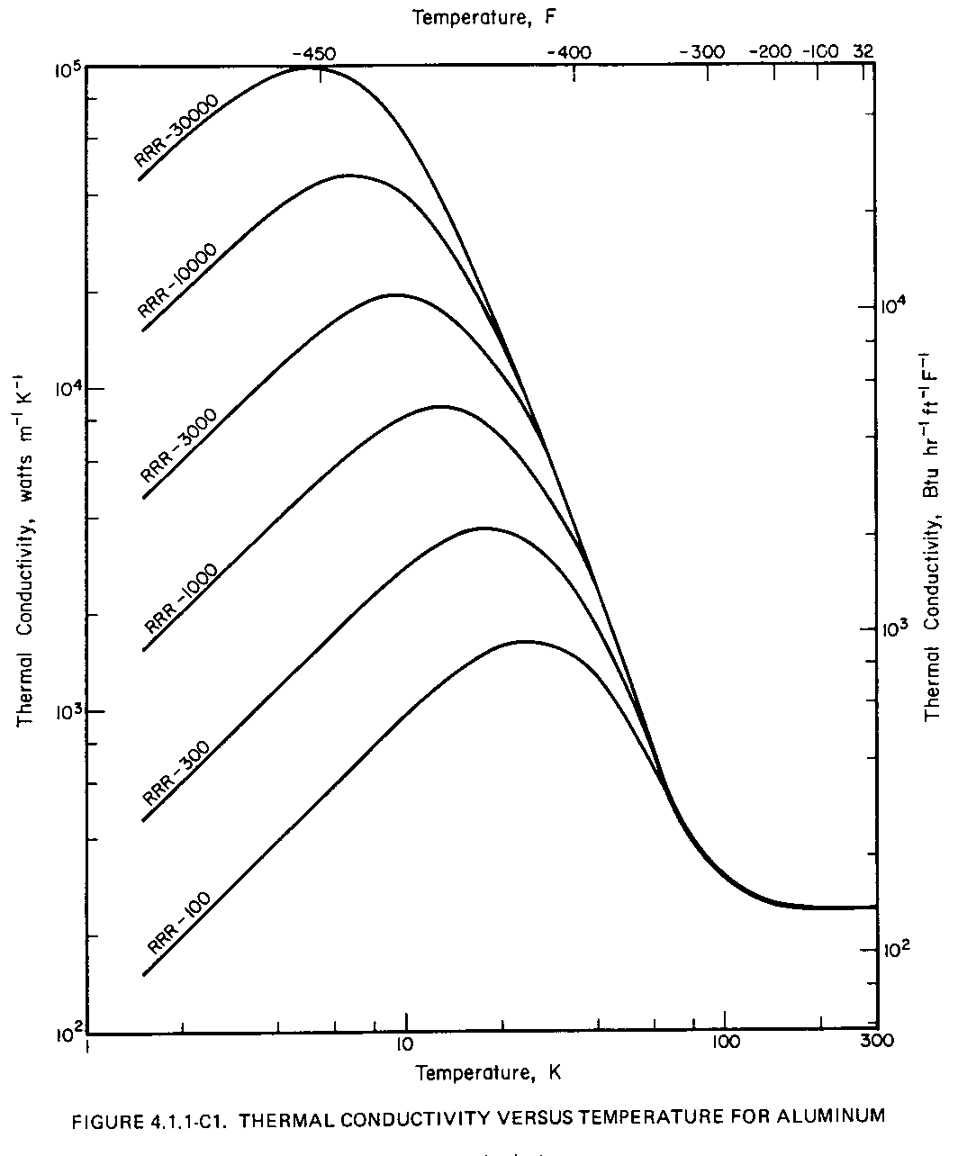
Characteristics of Aluminum
Eletctical
Resistivity
Thermal
Conductivity
Al (RRR=1000)
Cu (RRR= 100)
Aluminum may provide very wide range characteristics
depending on the purity (or RRR)

Slide 19
Two Approaches for
High Strength Al Stabilizer
Reinforcement of Al
  with keeping low resistivity
Uniform reinforcement
  Micro-alloying and cold work
  ATLAS-CS
Hybrid reinforcement
  Welding Al-Alloy with pure-Al
  CMS
NbTi/Cu
Uniform Micro-alloying
Uniform
Alloy / Pure-Al / Alloy
Hybrid

Slide 20
Micro-alloying with pure-Al
Additve metal A Dens. Solubility Resistivity contribution
(in solution / crystal.)
[g/cm³] [w-%] [10⁻¹² Ωm/wppm]
Solid solution:
Si 28 2.6 1.65 0.7 0.088
Zn 65 7.1 83 @ 400C 0.10 0.023
Crystallization / Precipitation:
Ni 59 8.8 0.05 @640C 0.81 0.061
<0.006 @<500C
Ni: Best reinforcement with keeping Low resistivity.

Slide 21
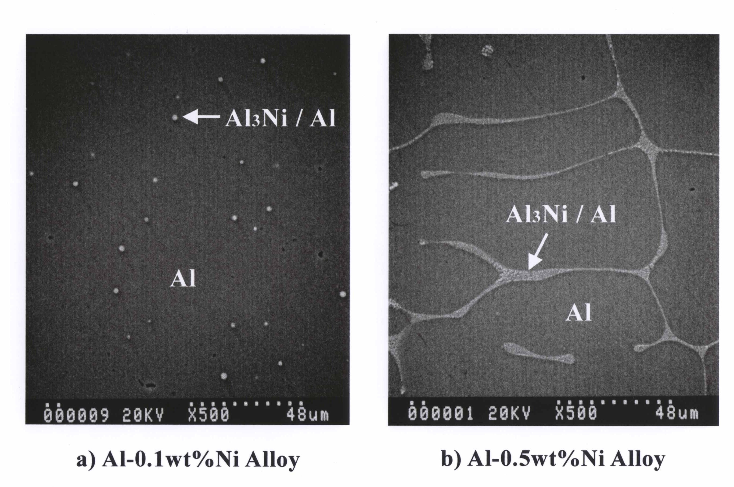
Composite structure formed by
Micro-alloying and precipitation
Ni>> High
Al₃Ni precipitated
Contributes as
structural component
Pure-Al region
Keep low resistivity
0.1%
0.5%

Slide 22
High-strength Al-stabilizer
Micro-alloying + Cold-work (area rediction) hardening
Ni 0.1 ~ 2 % + 15~20 % Cold-work

Slide 23
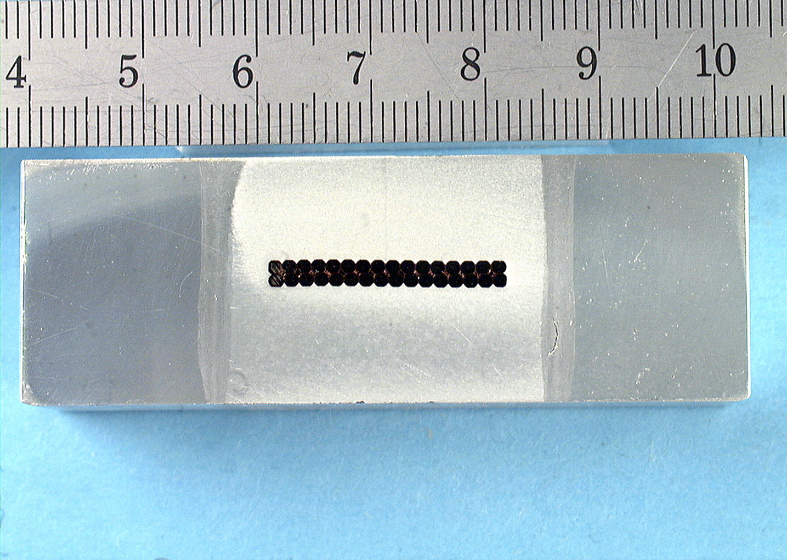
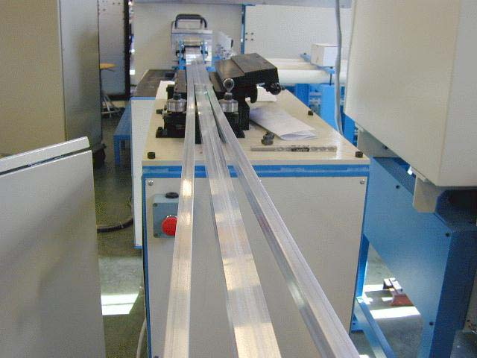
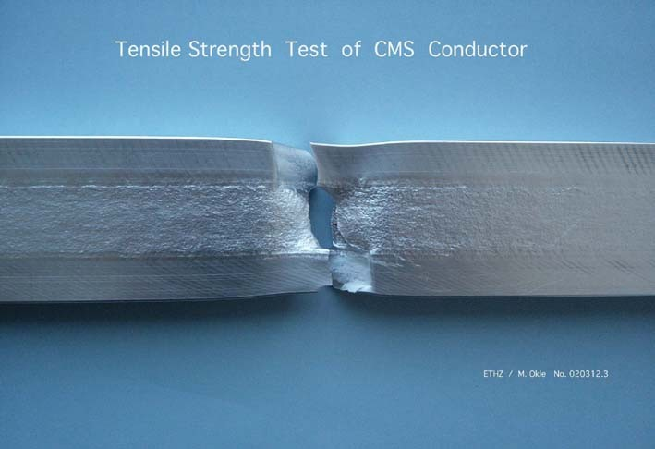
CMS with Hybrid Structure
(5N-Al/AA6082)
Overall mechanical strength
Y.S . :
130 MPa @ 300 K before curing
180 MPa @ 300 K after curing
(258 MPa @ 4.2 K, estimated)
Electrical properties of inserts
RRR :
3020 @ 0 T
1134 @ 1 T
977 @ 5 T
B. Cure, B. Blau. A. Herve, et al, this conference

Slide 24
Comparison with Cu and Al Alloy
effectively
Al-stabilized superconductor becoming equivalent to or
stronger than ordinal Cu stabilized superconductor

Slide 25
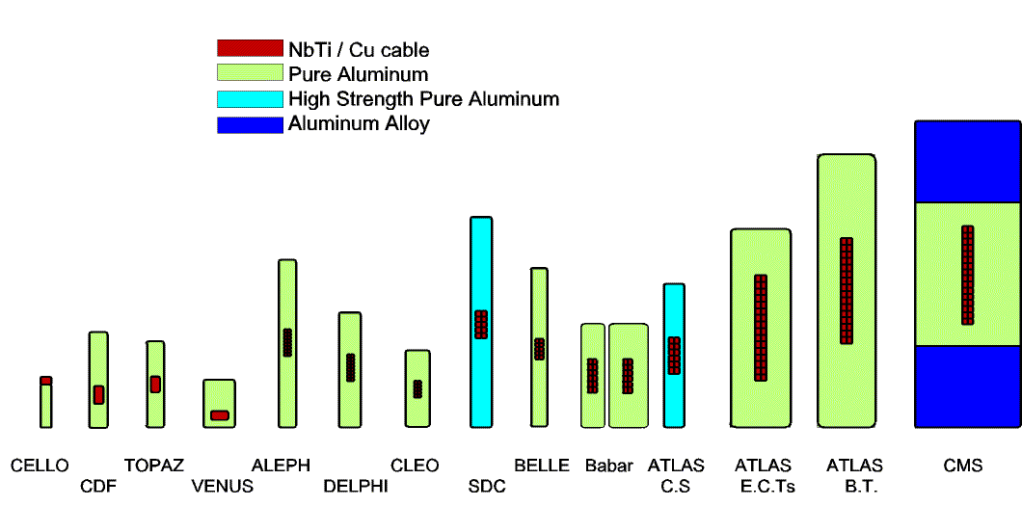
Progress of Al-stabilized SC

Slide 26
Energy / Mass Ratio
Magnetic Field: rot B = µ₀J
Stored Energy: E = 1/2µ₀ ∫ B² dv
Coil Mass: M = V_{coil}  γ
Pressure: p = B²/2µ₀
Hoop Stress: σ_{hoop} = (R/t) • p
Wall thickness: t = (R/σ_{h}) • p
E/M ratio: E/M = (B²/2µ₀) • R/2γ
= σ_{h}/2γ
B: magnetic field
µ₀: permeability
V_{field}: magnetic volume
V_{coil}: coil volume
γ: effective density
σ_{hoop}: hoop stress
R: coil radius
t: coil thickness

Slide 27
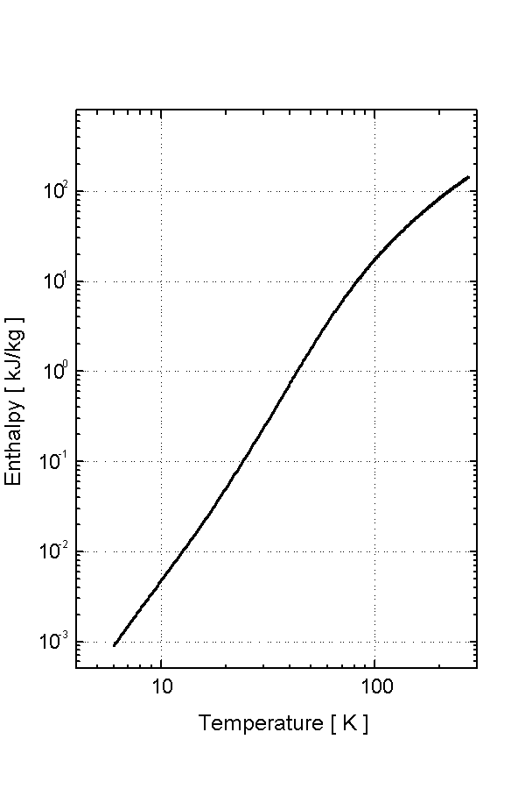
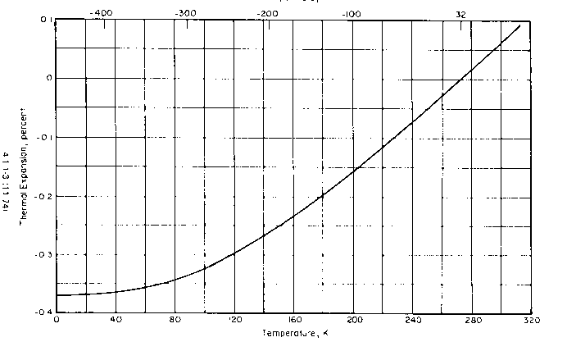
E/M Ratio
Energy Density to Coil Mass
= Temperature Rise after Quench (all energy dump)
Entharpy
Enthalpy
H = E/M = Int. Cp dt
---------------------------------
20 kJ/kg ~100 K
10 kJ/kg ~ 80 K
5 kJ/kg ~ 65 K
---------------------------------
Temp [K]
Correspond to:
Peak Temperature with homogeneous energy dump
Thermal
Expansion
80, 100 K

Slide 28
Safety against Quench
Energy extraction (CMS)
  ~ Half energy to be extructed
    E/M = 12 kJ/kg >> effectively 6 kJ/kg
Full energy absorption (ATLAS)
  Using quench back techniques such as
  Quench Protection Heater (BT, ET, CS)
  Pure-Al strips and QPH (ATLAS-CS)

Slide 29
Progress in
E/M Ratio in Detector Magnets
Reached

Slide 30
Wall Thickness / Material
Magnetic Field: rot B = µ₀J
Stored Energy: E = 1/2µ₀ ∫ B² dv
Coil Mass: M = V_{coil}  γ
Pressure: p = B²/2µ₀
Hoop Stress: σ_{hoop} = (R/t) • p
Wall thickness: t = (R/σ_{h}) • p = (R/σ_{h}) • B²/2µ₀
E/M ratio: E/M = (B²/2µ₀) • R/2γ
= σ_{h}/2γ
B: magnetic field
µ₀: permeability
V_{field}: magnetic volume
V_{coil}: coil volume
γ: effective density
σ_{hoop}: hoop stress
R: coil radius
t: coil thickness

