Slide 1
A02班 活動報告
Σp散乱実験(E40)
Koji Miwa (Tohoku university)
for the E40 Collaboration

Slide 2
Contents
Σp scattering experiment (J-PARC E40)
  Physics motivation
  Expected results
E40 preparation status
  Beamline Fiber Tracker for high rate beam
  Preparation of Scattered Proton Detector
    Construction of prototype detector
    Performance evaluation by test experiments
  MPPC readout electronics
Summary and Outlook

Slide 3
J-PARC E40 :
Measurement of dσ/dΩ of Σp scatterings
Physics motivations
  Verification of Quark Pauli repulsive force in the Σ⁺p channel
  Systematic study of the ΣN interaction by separating isospin channel
Measurement of dσ/dΩ
  Aim to detect 10,000 events
  Σ⁺p elastic scattering
  Σ⁻p elastic scattering
  Σ⁻p → Λn inelastic scattering
Kinematical identification of Σp scattering
Using LH2 target and surrounding detector
High intensity π beam to get a large Σ beam
  Beamline tracker under 10⁷ Hz
Large acceptance Scattered proton detector
  Cylindrical fiber tracker + BGO Calorimeter
Notes:
This is the summary of our J-PARC E40 experiment.
Our physics motivation is to verify the quark Pauli repulsive force in S+p channel.
And we will do systematic study of SN interaction by separate isospin channel.
For these purpose, we will measure differential cross section of following Sp channel from the 10,000 events.
S+p elastic scattering, S-p elastic scattering and S-p->Ln inelastic scattering.
We proposed a new experimental technique.
We use LH2 target as hyperon production and hyperon-proton scattering target.
By detecting scattered proton, we kinematically identify the Sp scattering.
We are considering to perform at K1.8 beam line with SKS spectrometer.
We also handle high intensity p beam to produce intense S beam.

Slide 4
Experimental goal of Σ⁺p (=Σ⁻n) channel
dσ/dΩ Σ⁺p scattering
0.6<p(GeV/c)<0.7
Measurement of differential cross section
Derivation of phase shift of quark Pauli forbidden channel
Simulation
0.5<p(GeV/c)<0.6
Phase shift δ_{3S1} (degree)
0.4<p(GeV/c)<0.5
Σ⁺ beam momentum (MeV/c)
Notes:
We determine the phase shift in quark Pauli channel from ds/dO measurement
in wide momentum range.
This is the expected spectra for 3 different momentum range.
This is the expected precision of phase shift.
Here we took into account the statistical error of DC, beam momentum spread and error of estimation of contribution of higher waves.
This is the most direct measurement to determine the strength of quark Pauli repulsive force.
我々は、このS+pの断面積の測定から、まず90度の微分断面積に着目し、
位相差のエネルギー依存性を調べる。
我々は、微分断面積のエラー、ビーム運動量の広がり、および高次の寄与の理論的見積りのエラーを考慮し、
予想される位相差の精度を見積もった。
この位相差を求めることが、もっともダイレクトにquark Pauli stateの斥力の強さを決定することになる。
我々は統計が十分あるこの運動量領域で5度の精度で決定したいと考えている。

Slide 5
Principal of Σp scattering
π+
Κ+
Momentum analysis by
spectrometers
ΔE=TotalE − E(θ)
p
Momentum of Σ
is determined
n
Σ+
production
LH2 target
decay
scattering
π+
θ
Cylindrical Fiber Tracker
(particle trajectory)
Total E
Consistency check
between θ and E
BGO Calorimeter
(Kinetic energy)
Notes:
I will illustrate the experimental method for Sp scattering experiment.
We will use a LH2 target .
The sigma is produced by (p+, K+) reaction.
The momentum of p and K are analyzed by beamline spectrometer and forward spectrometer.
Then the momentum of S beam can be determined.
There is a scattering with proton and sigma will decay.
The scattered proton and decay product are detected by surrounding detectors .
The cylindrical fiber tracker measure the trajectory of scattered proton and determine the scattering angle.
The outer BGO calorimeter measure the total energy of the scattered proton.
By checking the consistency of the scattering angle and total energy, the elastic scattering event can be identified.
This shows the simulation result of scattering event identification.
This is the difference between measured total energy and the expected energy from scattering angle.
The Sp scattering events make a peak around 0.

Slide 6
Experimental setup
J-PARC K1.8 beamline
Momentum analysis
of Κ beam
Σ beam momentum
Momentum analysis
of π beam
Notes:
This shows the experimental setup.
The pi beam and scattered K are momentum analyzed by these spectrometers.
The momentum of S beam is determined.
Around the target, we place scattered proton detector which consists of
cylindrical fiber tracker and BGO calorimeter.
Scattered proton and decay products from S are detected by this detectors.

Slide 7
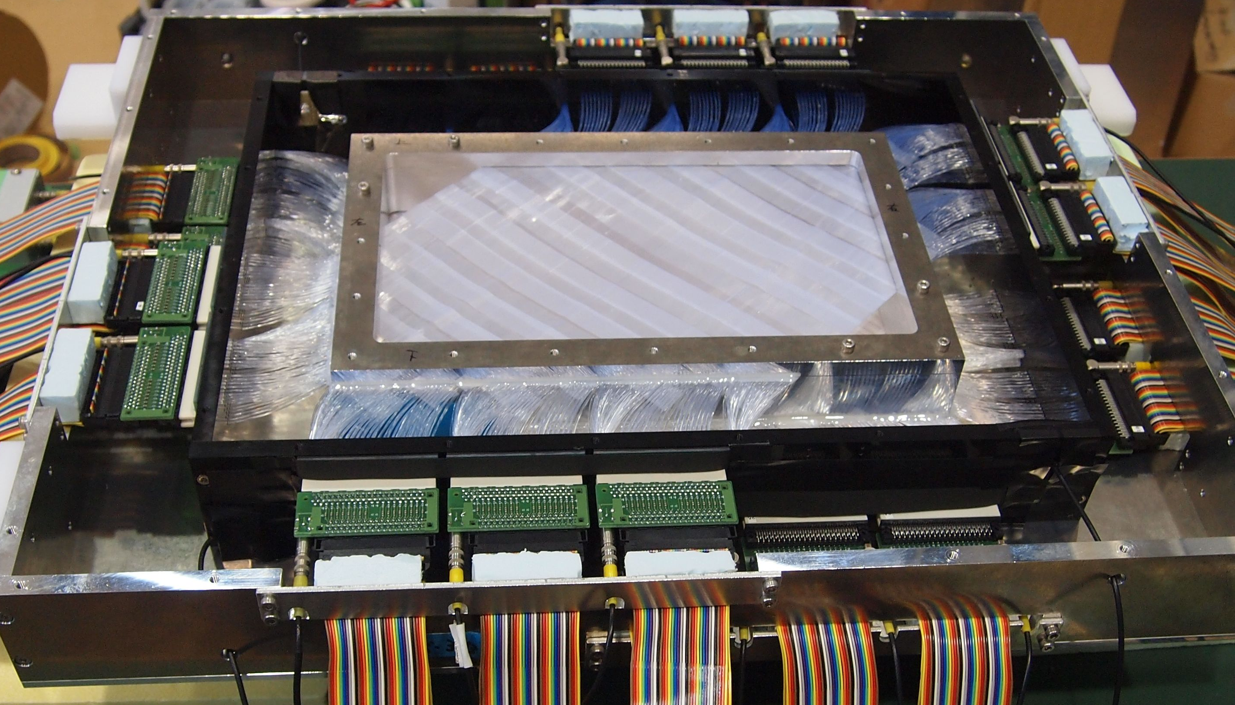
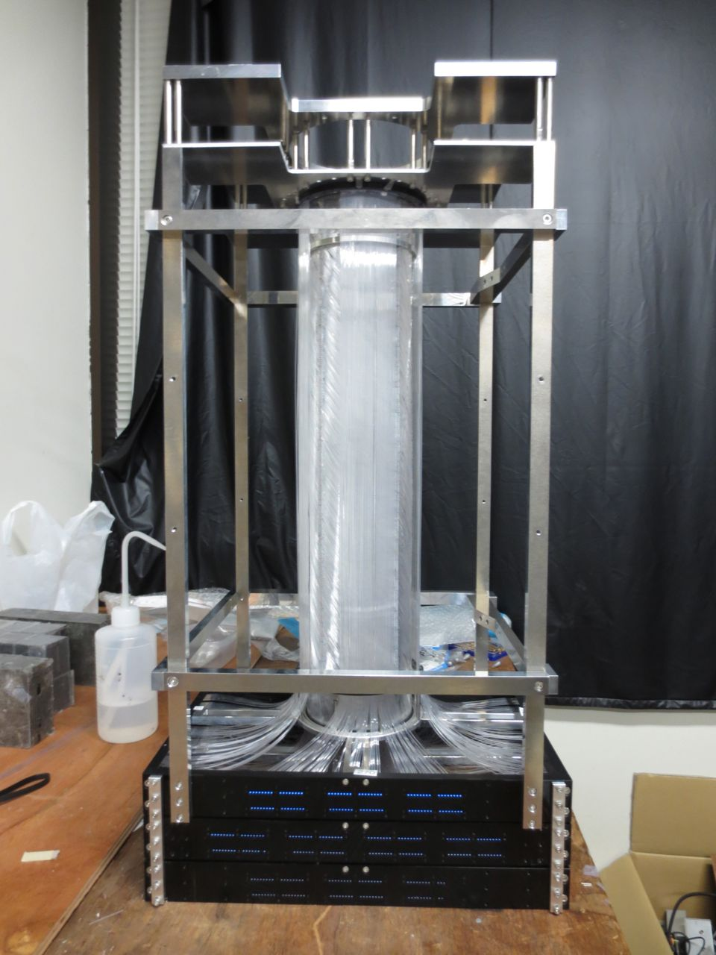
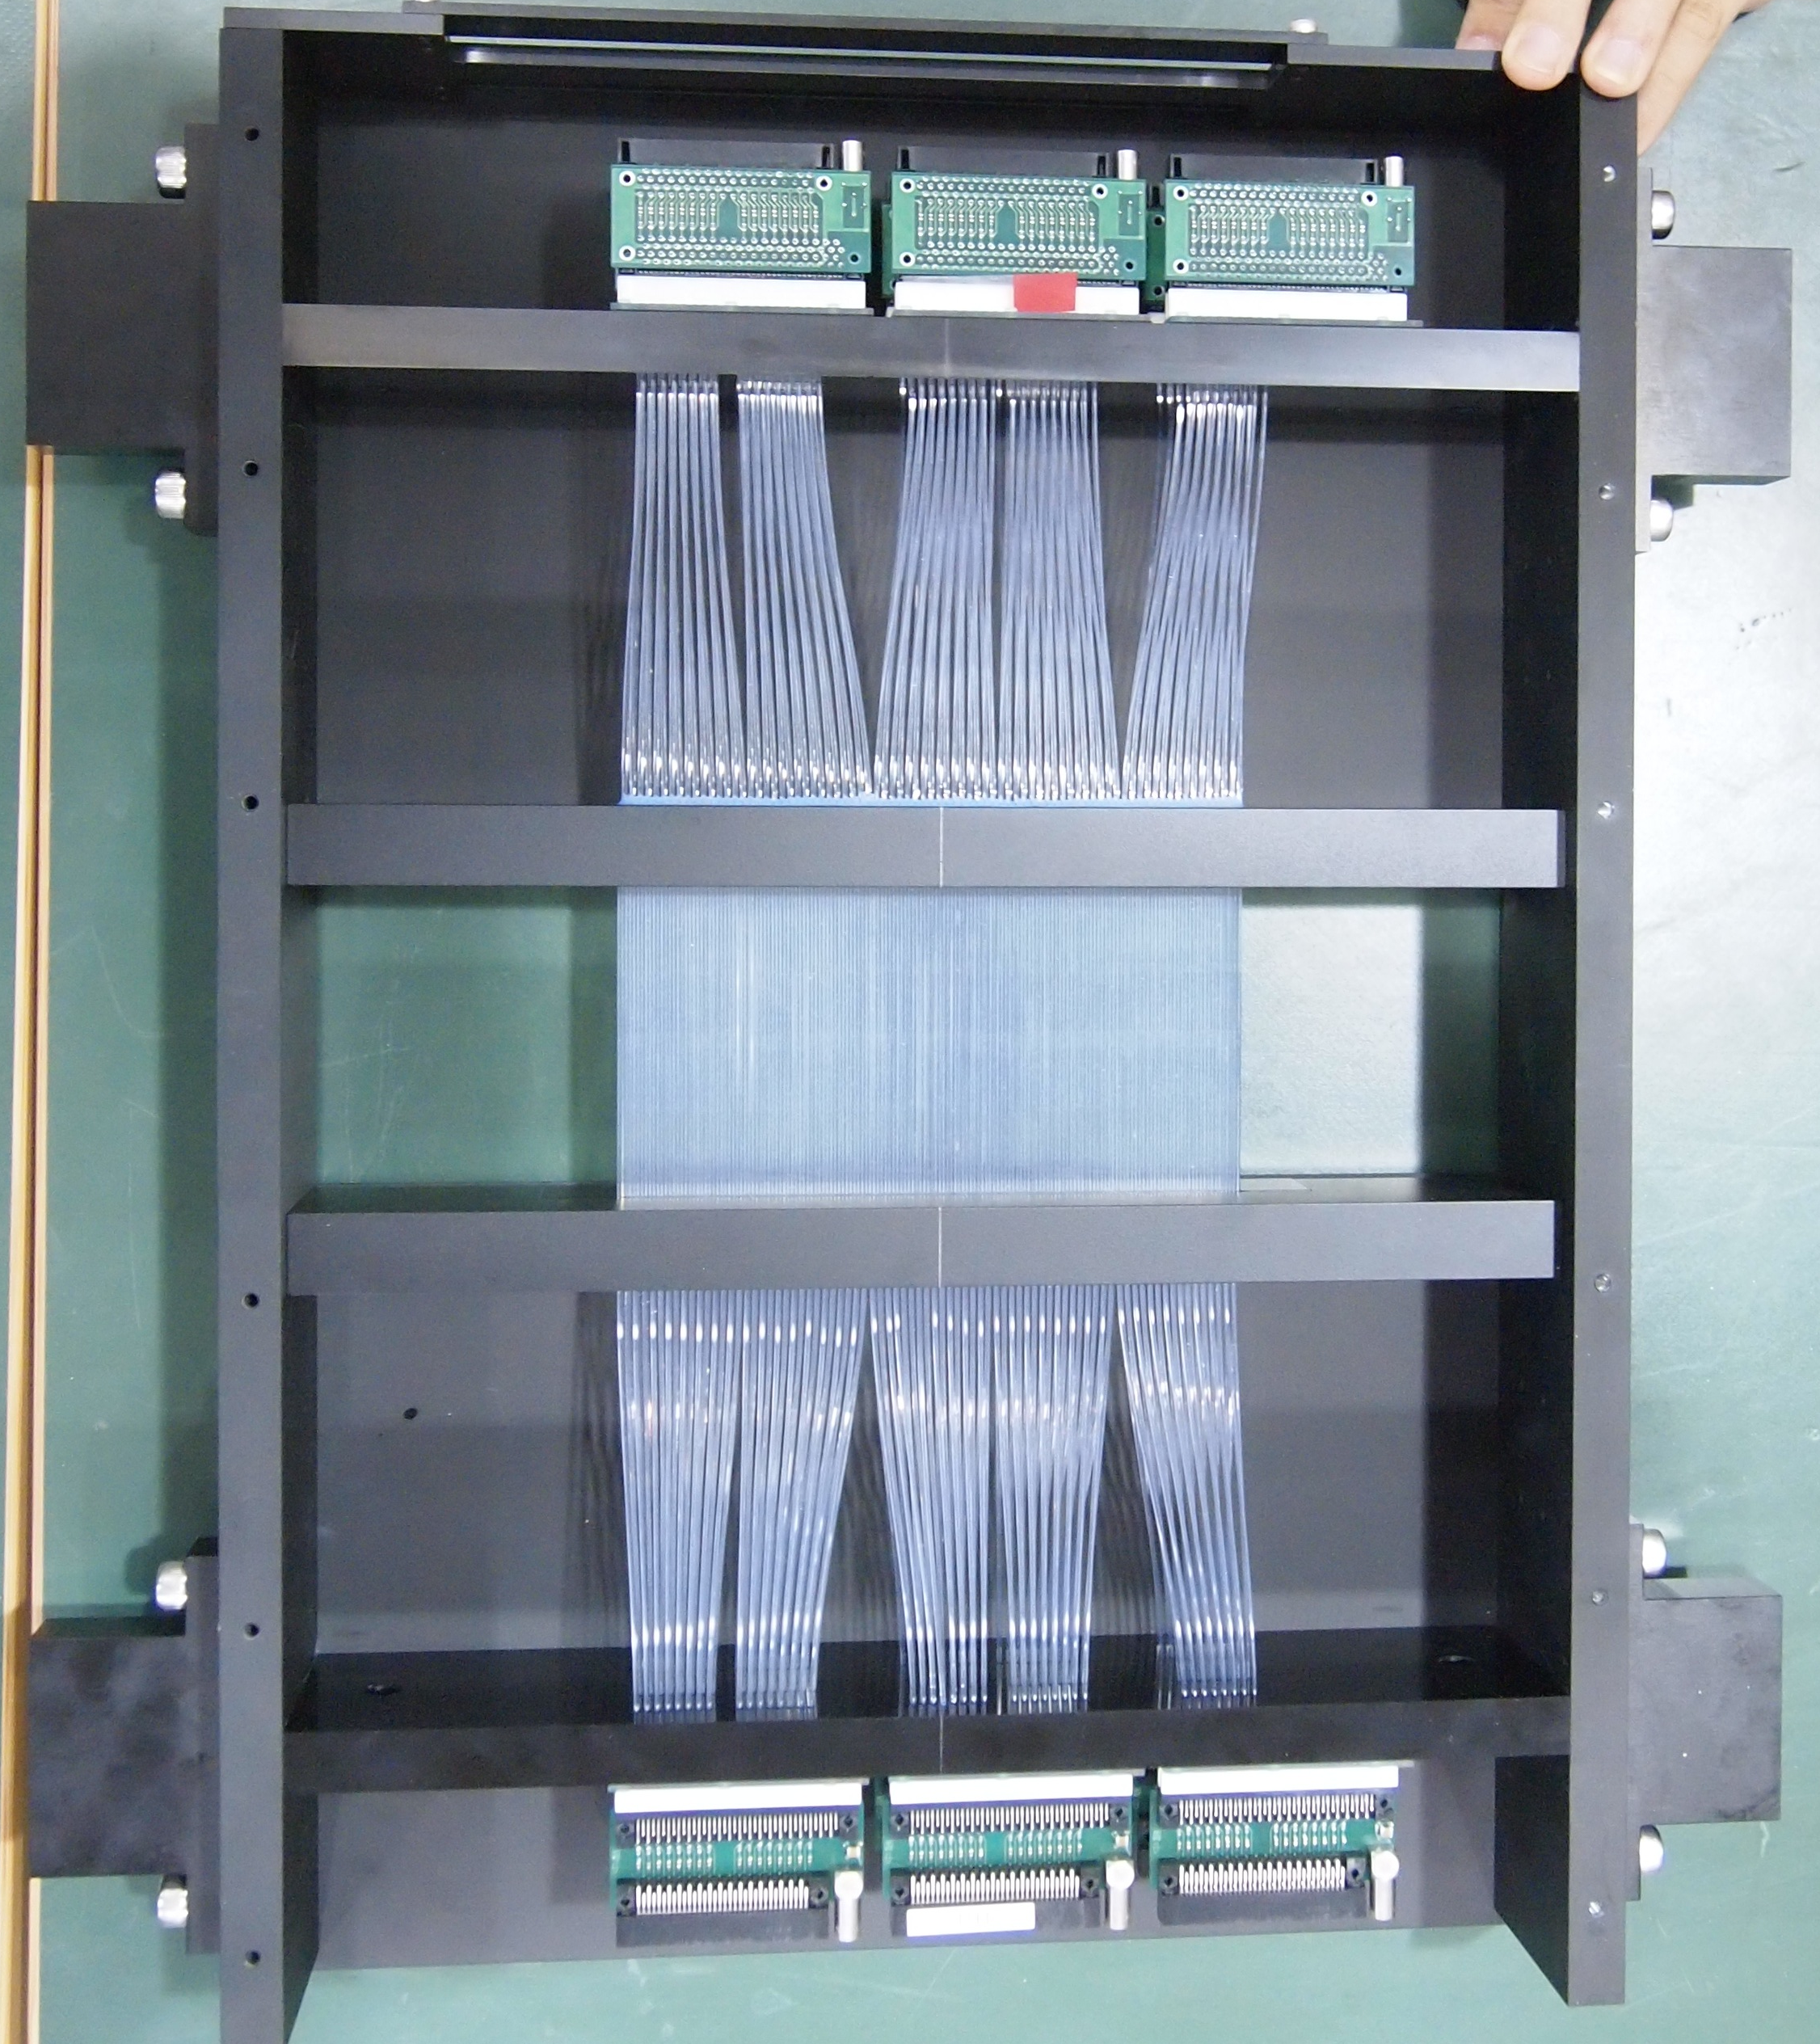
Experimental challenge
High intensity π beam (10⁷Hz) handling
Large acceptance detector for scattered proton
Beamline Fiber Trackers
High efficiency
for intense beam
Good timing resolution
Development of proton detector
Cylindrical Fiber Tracker
BGO calorimeter
Notes:
Our experimental challenges are these two points.
High intensity pi beam handling for spectrometer parts.
Large acceptance detector for scattered proton.
For the beam handling, we developed beamline fiber trackers.
These detector has high efficiency even under high beam intensity
and good timing resolution to separate real triggered event from accidental background.
For the scattered proton detector we constructed a prototype detector of
cylindrical fiber detector and BGO calorimeter
By using this prototype detector, we check the feasibility of the Sp scattering experiment by performing pp scattering experiment.

Slide 8
K1.8 beam intensity history
7
E10
6
5
4
BFT Install
( 320 ch )
3
SFT Install
( 1152 ch )
Beam Intensity (MHz)
2
E27
1
E19-1st
E19-2nd
0
We become to use 10 times larger beam intensity.
We believe we can handle 10M Hz beam.
Notes:
This is a K1.8 beamline intensity history.
At first, we can use only 0.5 MHz beam intensity due to the beam structure.
However by installing our fiber tracker, now we can use more than 10 times larger beam intensity.
we believe we can access to the 10 MHz beam.

Slide 9
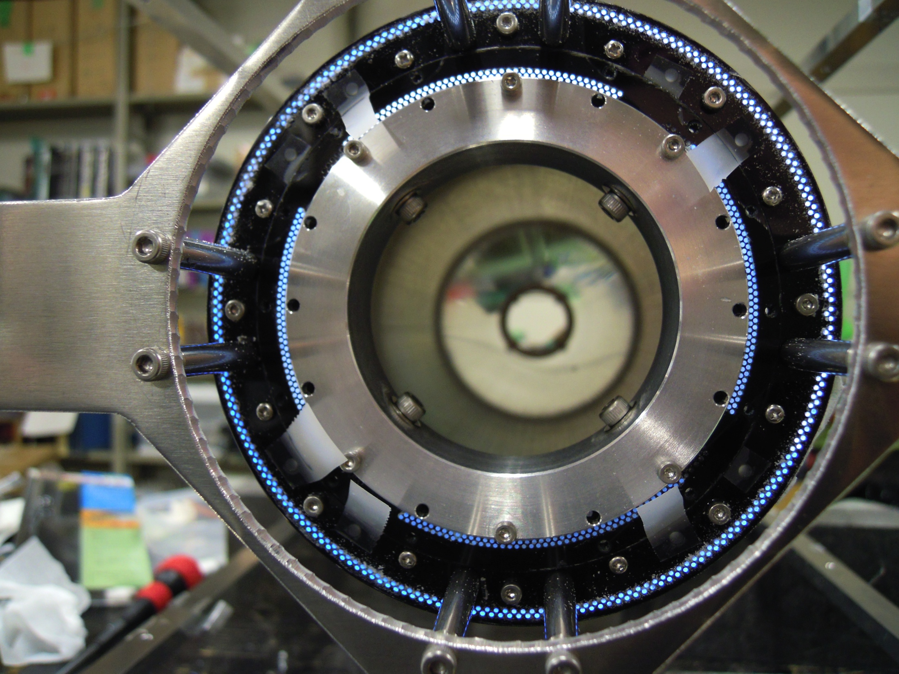
E40 Preparation status
Scattered Proton Detector

Slide 10
Requirements for Scattered Proton Detector
Cylindrical Fiber Tracker (CFT)
  Large acceptance for scattered proton
  Measurement of scattering angle
  Particle Identification by ΔE information
    σ/E < 20 % for 1 MeV energy deposit
BGO Calorimeter
  Measurement of kinetic energy of proton up to 150 MeV
  Energy resolution σ/E < 3 % at 80 MeV
CFT+ BGO
  Particle Identification (proton - π) by ΔE-E information
  Reconstruction of elastic scattering kinematics
Notes:
These are

Slide 11
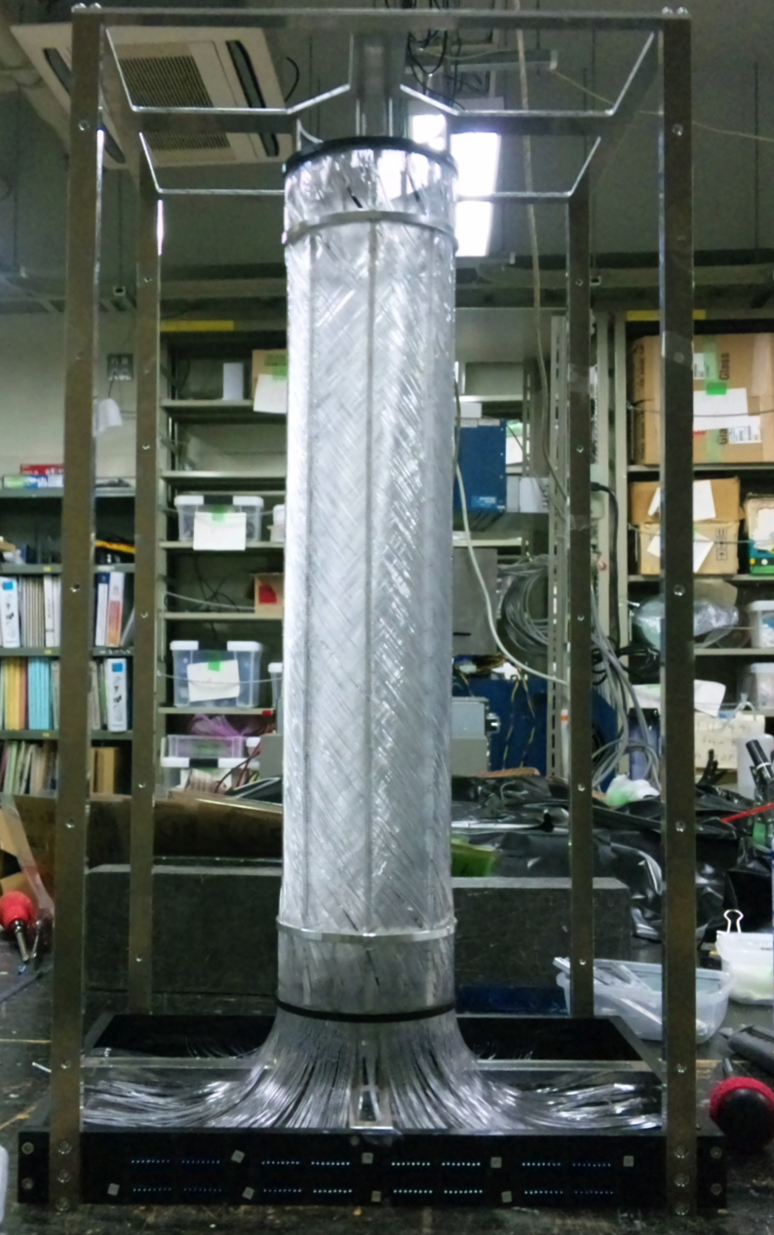
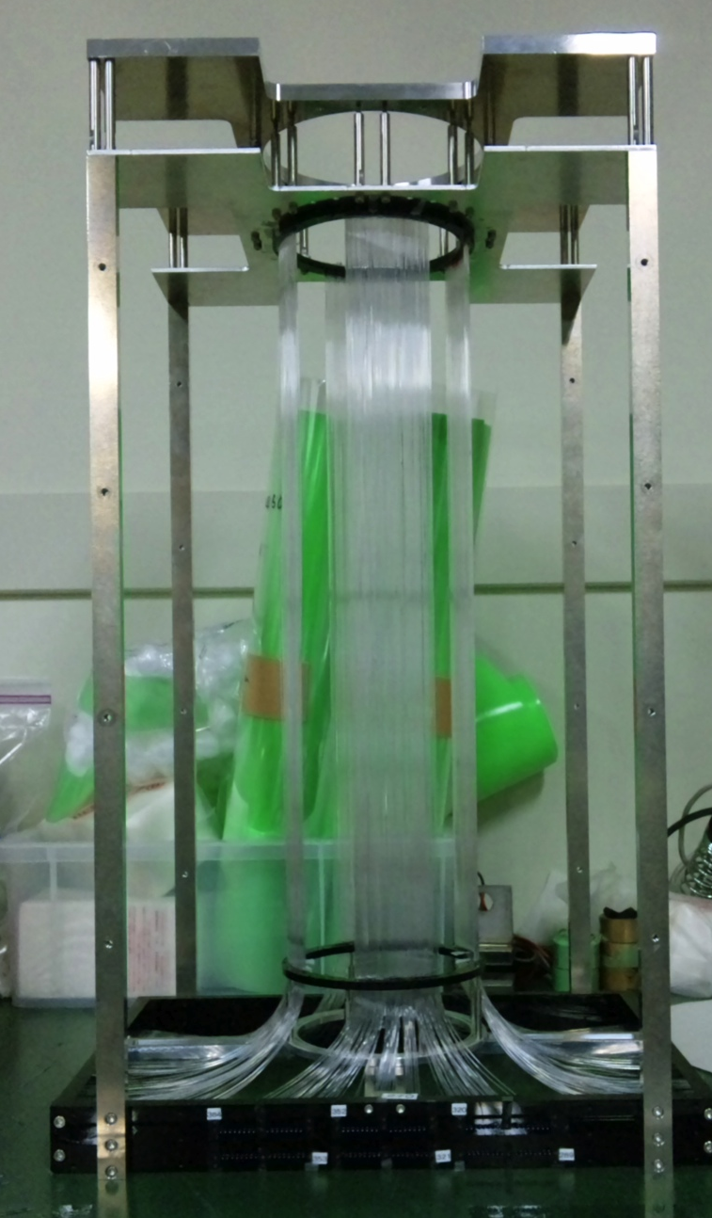
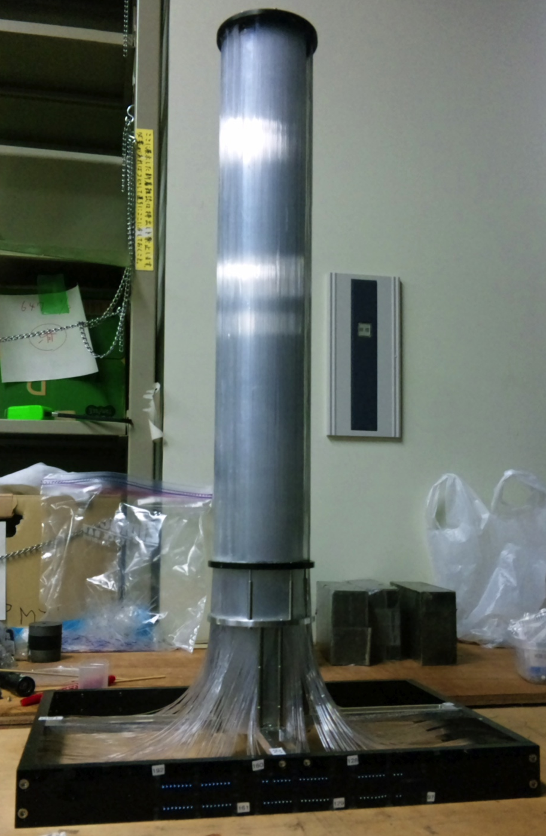
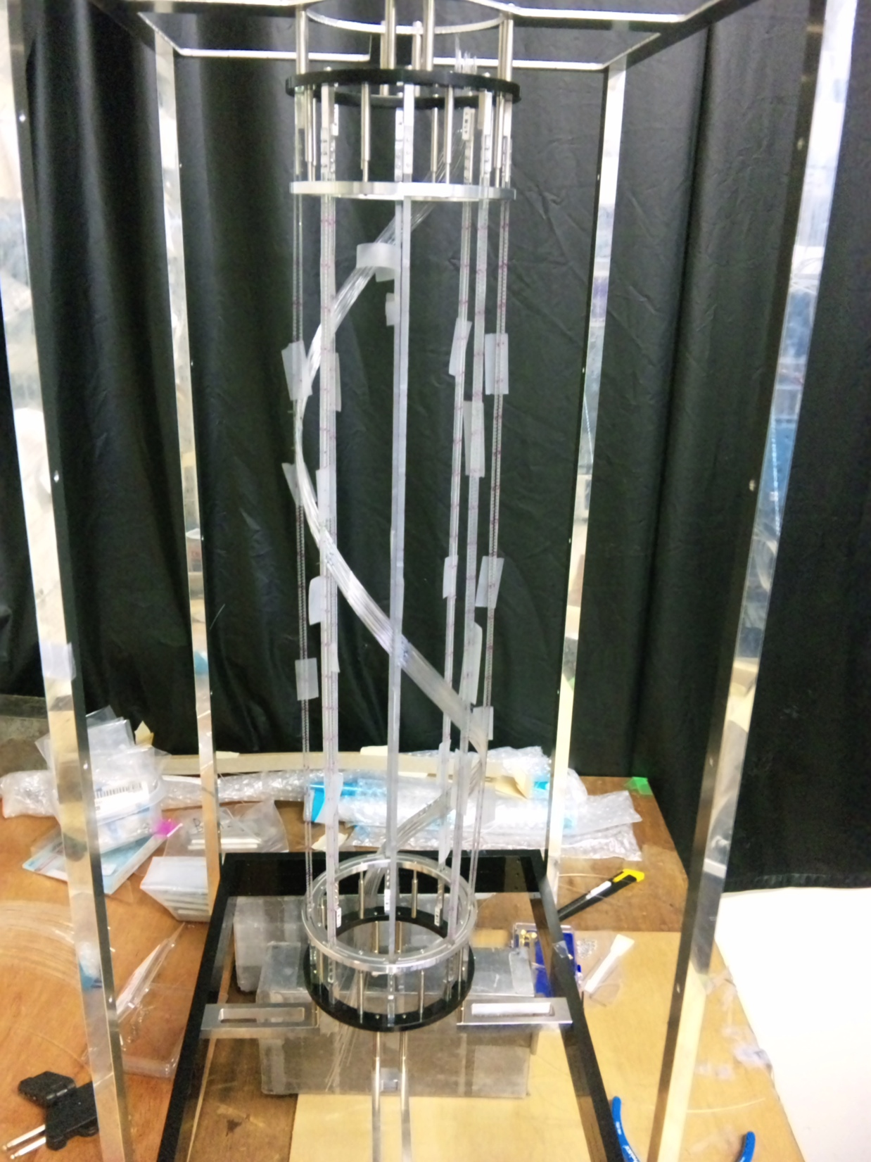
Prototype of CFT
Purpose
  Establish the construction method
  Performance check
Three layers
  φ1, U (spiral), φ2
φ2
U(spiral)
φ1
400 mm
R=40mm
R=50mm
R=60mm
Notes:
At first, we constucted a protype of CFT.
The purpose is to establish the construction method of this cylindrical fiber tracker
and also to do a performance check.
This prototype consists of 3 layers of phi1, U, this is a spiral configuration and phi2.

Slide 12
Prototype of Proton Detector
400 mm
Energy resolution
σ/E = 1.2 % @ 80 MeV
400 mm
Prototype of CFT & BGO
CFT
  Enough photon number for MIP
  Efficiency is rather low (R&D)
BGO
  Enough energy resolution (σ/E = 1.2% for 80 MeV proton)
Photon number
~20 for MIP
Notes:
By combining the 3 layers, the prototype CFT detector was completed.
We also tested a real size BGO calorimeter.
This is a very big BGO and its length is 400 mm, this is the same with the CFT length.
The photon number of CFT for MIP was obtained to be 20 and its enough photon number.
For BGO calorimeter, we checked the energy resolution for 80 MeV proton by irradiating 80 MeV proton beam.
This is ADC spectrum for 80 MeV proton.
The resolution for 80 MeV was obtained to be 1.2 %.
This is enough resolution to identify scattering event.

Slide 13
Experimental proof
pp, pC scattering experiment using prototype detector
  80 MeV proton beam @ Cyclotron Facility at Tohoku university
Reconstruction of pp, pC scattering kinematics
Particle identification by ΔE(CFT)-E(BGO) information
Notes:
In order to confirm the experimental feasibility to this new experimental method,
we performed a pp scattering scattering experiment by using this prototype detector.
This shows the experimental setup.
80 MeV proton beam was irradiated to the polyethylen target.
The scattered proton was detected by the prototype detector .
This is the picture of the prototype detector.
The BGO detector was mounted around the CFT detector.
This is the typical event display,
The track can be reconstructed.
In this test experiment, we check that the pp, pC scattering event can be reconstructed by using scattering angle and Total energy.
We also check the particle identification performance by DE-E information.

Slide 14
Reconstruction of pp, pC scatterings
Relation between θ and Total E
pC scattering
Total energy (MeV)
θ
pp scattering
Total energy
(CFT+BGO)
Scattering angle (degree)
Notes:
This shows the relation between the scattering angle and total energy.
The scattering angle is defined by the crossing angle between reconstructed track and beam axis.
The total energy is the sum of BGO and CFT.
We can see the loci correspoinging to the pp scattering and pC scattering.
We overwrite the kinematical line for pp and pC scattering.

Slide 15
Reconstruction of pp, pC scatterings
Relation between θ and Total E
We confirm that reconstruction of scattering events is possible by this configuration
pC scattering
Total energy (MeV)
θ
pp scattering
Total energy
(CFT+BGO)
Scattering angle (degree)
Notes:
We overwrite the kinematical line for pp and pC scattering.
The obtained relation is almost consistent with this kinematical line.
This means that the reconstruction of the scattering event is possible by this experimental method.

Slide 16
Particle Identification by ΔE-E
ΔE-E relation
deuteron
ΔE (CFT) [MeV]
ΔE (CFT)
proton
E(BGO)
E (BGO) [MeV]
Notes:
Next we checked the relation between dE for CFT and Energy at BGO.
We can see the loci corresponding to proton and deuteron.
In the E40 experiment, we have to separate proton and pi by this dE-E relation.
In order to estimate the PID performance, we also take data for cosmic ray.

Slide 17
Particle Identification by ΔE-E
ΔE-E relation
deuteron
ΔE (CFT) [MeV]
ΔE (CFT)
proton
E(BGO)
Cosmic ray (π like)
E (BGO) [MeV]
Proton / π separation requirement
  20 % for 1 MeV
16 % for 1 MeV
PID is possible
Notes:
We overwrite the cosmic ray data.
We can clearly separate proton and cosmic ray data.
For the proton / pion separation at more higher energy,
the required energy resolution of CFT is 20 % for 1 MeV energy deposit.
The obtained resolution from the CFT prototype was 16 % and this is enough performance.

Slide 18
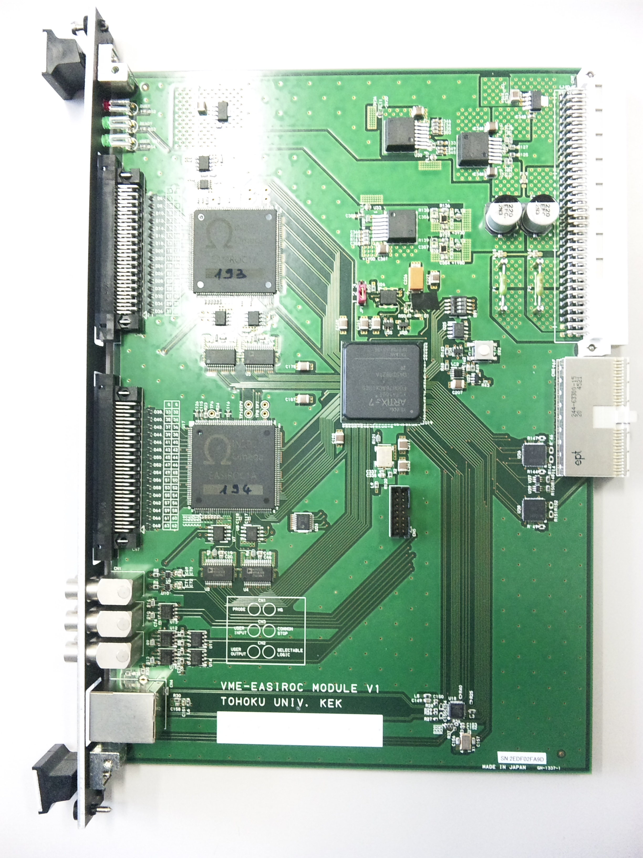
MPPC readout electronics

Slide 19
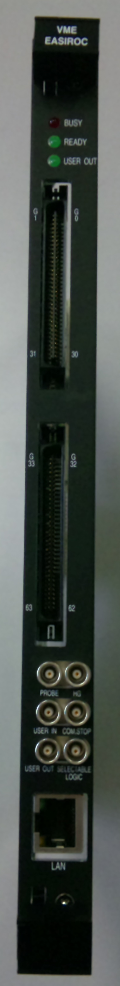
VME-EASIROCの開発
VME-EASIROC
EASIROC v1
EASIROC ASIC
32ch input x 2
FPGA(Artix-7)
トリガーなどを
J0バスから受ける
データはTCPで送信
テスト用に開発
32ch MPPC
SiTCP外付け
電源を外部から供給
実機として使用する
64ch MPPC (EASIROC ASIC x 2)
SiTCP内蔵 (FPGA内に搭載)
VMEバスから電源供給
J-PARCのネットワーク分散型の
DAQに対応
64 chのADC
Multihit TDC (1ns resolution)

Slide 20
性能評価
Slow control
  各チャンネルのオペレーション電圧の調整
  各チャンネルのゲイン、shaping time等の調節
  Discriminatorの閾値の設定
ADCの収集
  Photon counting
100 pixel
400 pixel
pedestal
1 p.e.
pedestal
1 p.e.

Slide 21
性能評価
Slow control
  各チャンネルのオペレーション電圧の調整
  各チャンネルのゲイン、shaping time等の調節
  Discriminatorの閾値の設定
ADCの収集
  Photon counting
  Pedestal suppression
TDCの構築
  1 ns/ch
  Multihit TDC
Dead time
  20 μsを目指す

Slide 22
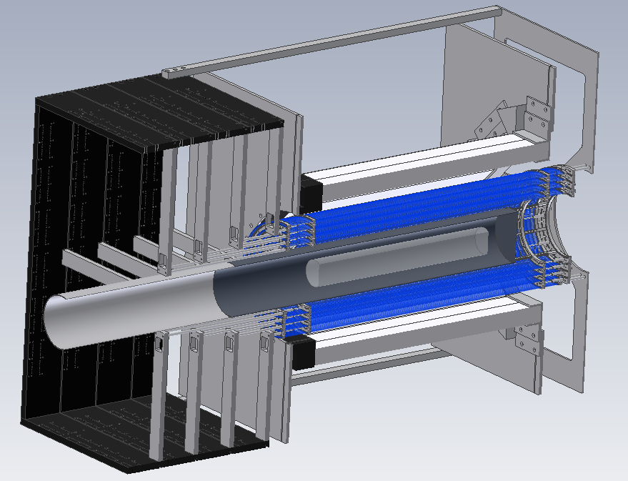
Summary
High rate beam handling
  We developed fiber tracker which can operate stably under high intensity beam.
  We achieved 12 M/spill beam intensity
Scattered proton detector
  CFT
    We established construction method
    We need R&D to improve efficiency
  BGO
    Energy resolution is sufficient
  Combined performance
    Identification of scattering kinematics
    PID by ΔE-E relation
MPPC readout electronics
  We developed VME-EASIROC
    64ch MPPC operation
    ADC, Multihit TDC
Many R&D items are
checked by
several test experiments
Development of
actual detector

Slide 23
Summary
We are planning to perform a Σp scattering experiment (J-PARC E40).
  Measurement of dσ/dΩ for Σ⁺p, Σ⁻p, Σ⁻p→Λn channels
  Verification of Quark Pauli repulsive force in the Σ⁺p channel
    Derivation of phase shift value in Quark Pauli channel
  Systematic study of the ΣN interaction by separating isospin channel
R & D are on going
  Beamline fiber trackers for high rate beam had been developed and installed in the beamline.
  Prototype detector for scattered proton was developed. This prototype detector satisfies requirements to identify Σp scattering events
  We developed VME-EASIROC.
Outlook
  We start the design of actual equipment of scattered proton detector.
  We want to construct until middle of the next fiscal year.

