Slide 1













Status Report of B01: Equation of States of the Neutron-Rich Nuclear Matter at Supra-Density
Tetsuya MURAKAMI
Department of Physics
Kyoto University
For

Slide 2
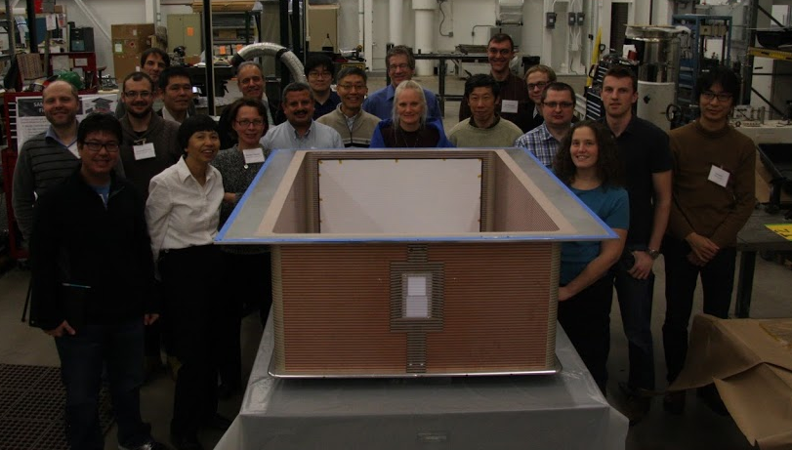
SπRIT Collaboration
MSU: W. Lynch, M.B. Tsang, S. Tangwancharoen, Z. Chajecki, J. Estee, R. Shane, Jon Barney
TAMU: A. Mchintosh, S. Yennello
RIKEN : T. Isobe, H. Baba, H. Otsu, K-I Yoneda, H. Sato, Y. Nakai, S. Nishimura, A-K. Perrevoort, J. Lee, H. Sakurai, A. Taketani, He Wang, N. Fukuda, H. Takeda, D. Kameda, H. Suzuki, N. Inabe, T. Kubo
Kyoto Univ.: T. Murakami, N. Nakatsuka
Rikkyo Univ.: K. Ieki, T. Usukura, T. Yoshida
Liverpool/ Darsbury: M. Chartier, W. Powell, J. Sampson, R.Lemmon
Korea Univ.: B. Hong, G. Jhang
WMU: M. Famiano
INFN: G. Verde
SIAP CAS: Fei Lu, W.G. Ma
CEA: E. Pollacco
INP: J. Lukasik
ORNL: A. Galindo-Uribarri
Tohoku Univ.: T. Kobayashi
TITech: T. Nakamura, Y. Kondo

Slide 3
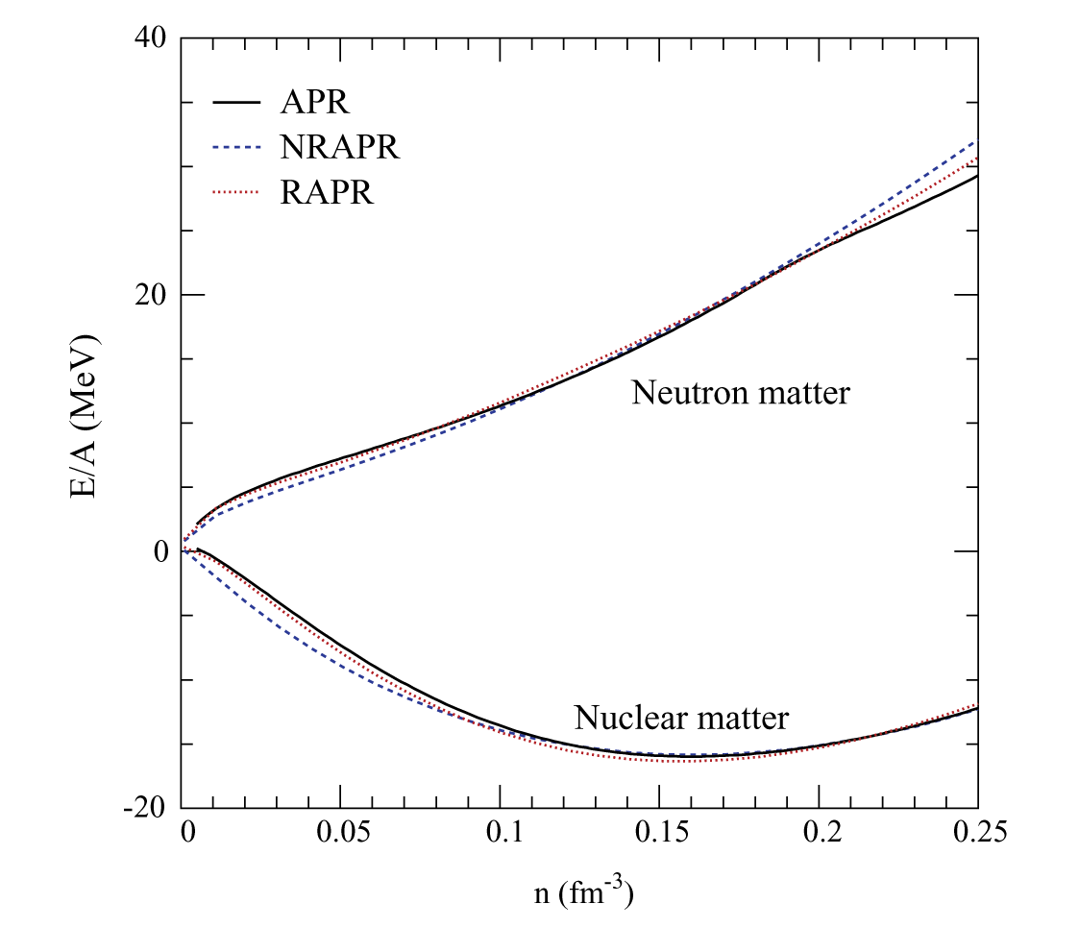
Nuclear Equation of State
Symmetry Energy
A.W. Steiner et al.,
Phys. Reports 411 （2005） 325

Slide 4
Present Constraints on Symmetry Energy from different experiments
Isobaric Analogue States
NPA 818, 36 (2009)
heavy ion collisions
PRL 102,122701(2009)
Finite Droplet Range Model
PRL108,052501(2012)
p elastic scattering
PRC82,044611(2010)
neutron-star radius
PRL108,01102(2012)
Pygmy Dipole Resonances
PRC 81, 041304 (2010)
Tsang et al. Phys. Rev. C 86, 015803 (2012)

Slide 5
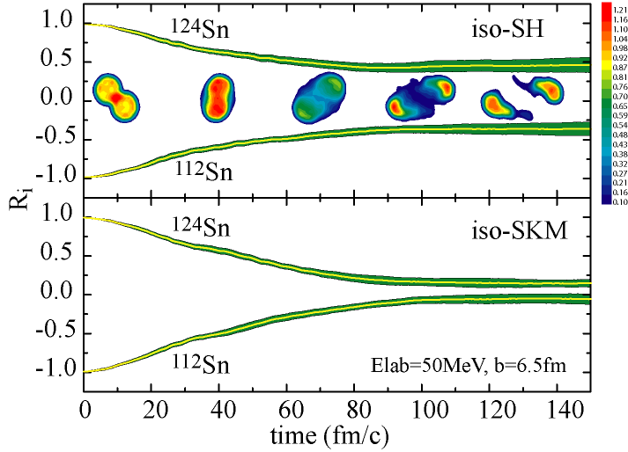
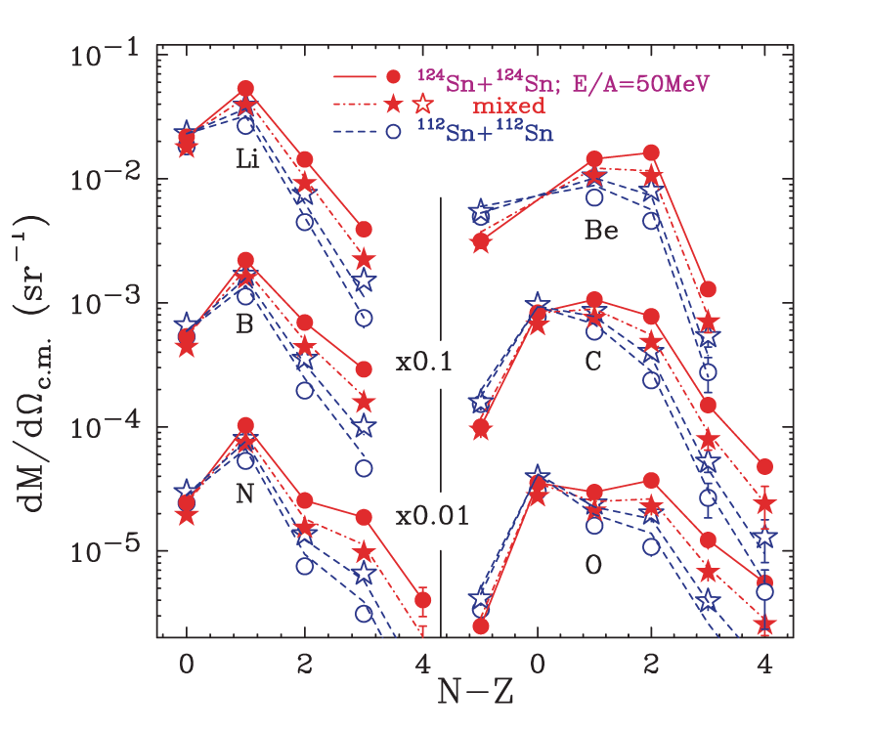
Heavy Ion Collisions compared to transport theory calculation
NSCL/MSU group
Isospin diffusion in peripheral collisions
Yield ratio of neutron and proton
Tsang et al., PRL 92 (2004) 062701
Zhang et.al.,Phys. Lett. B 664 (2008) 145

Slide 6
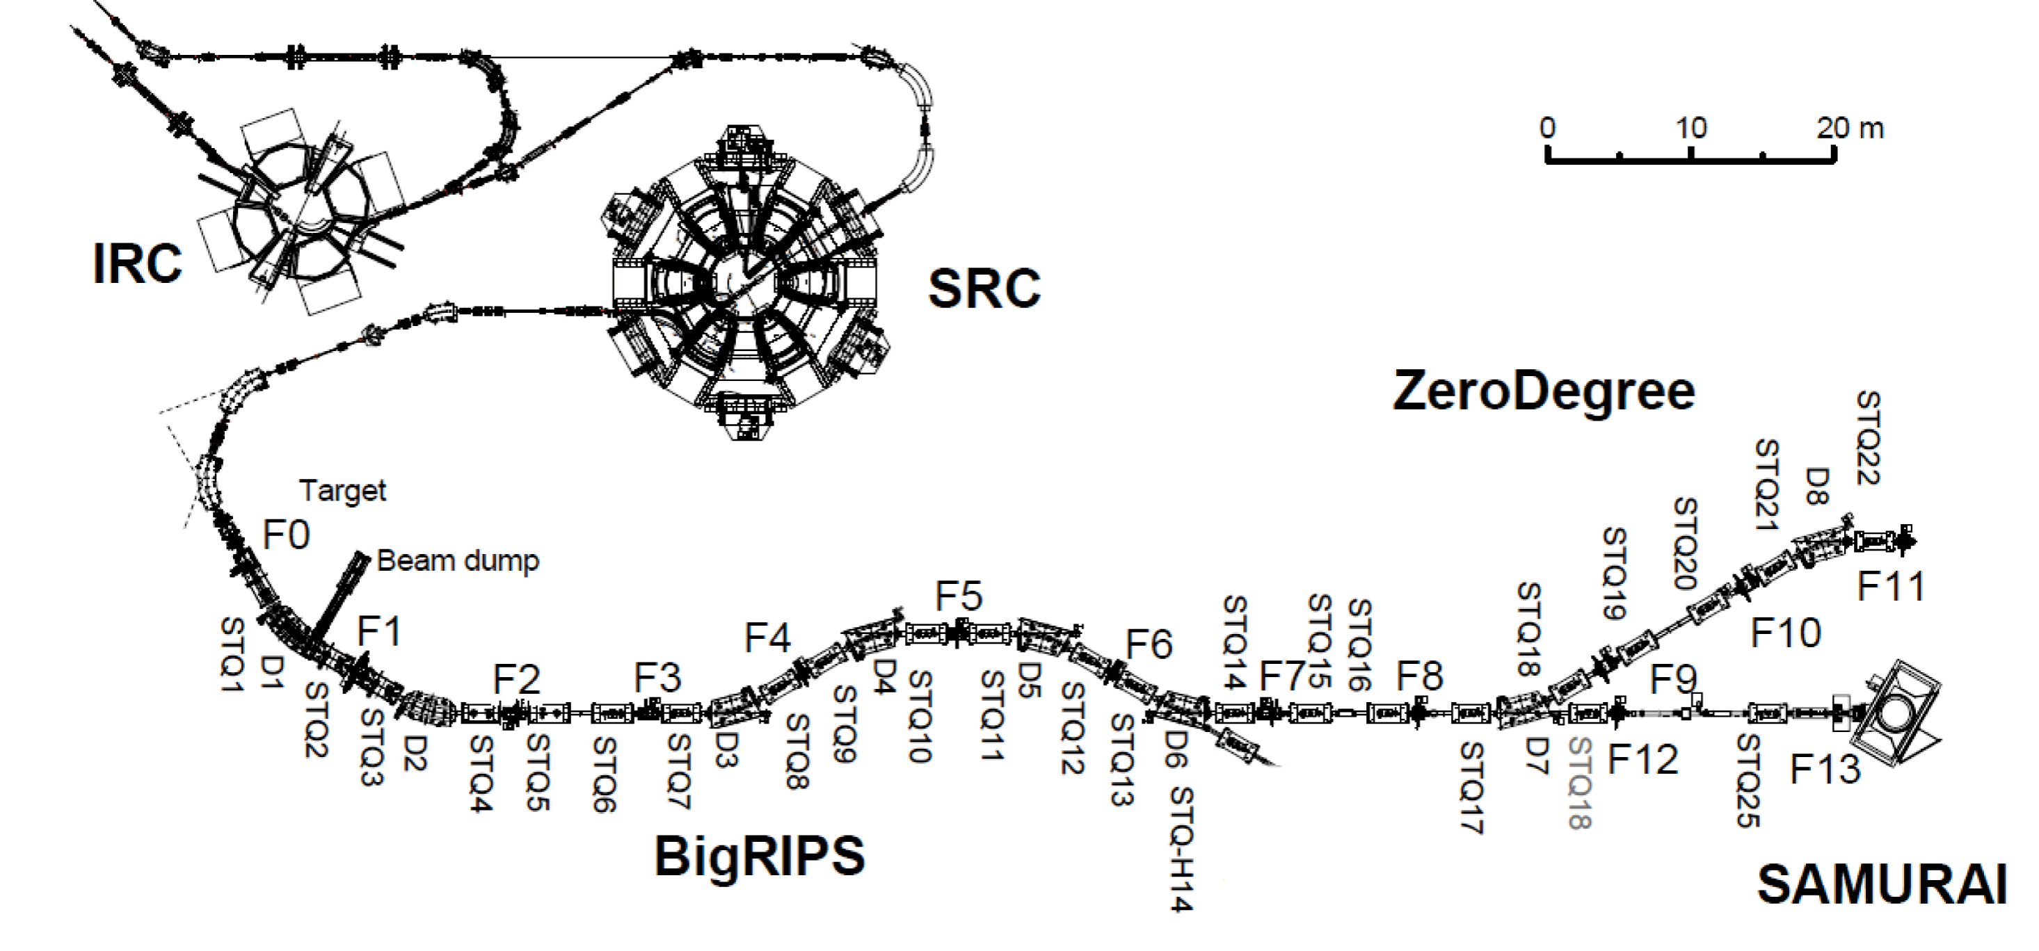
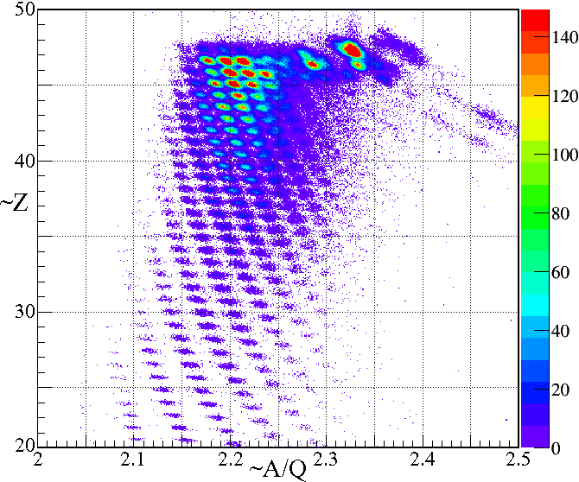
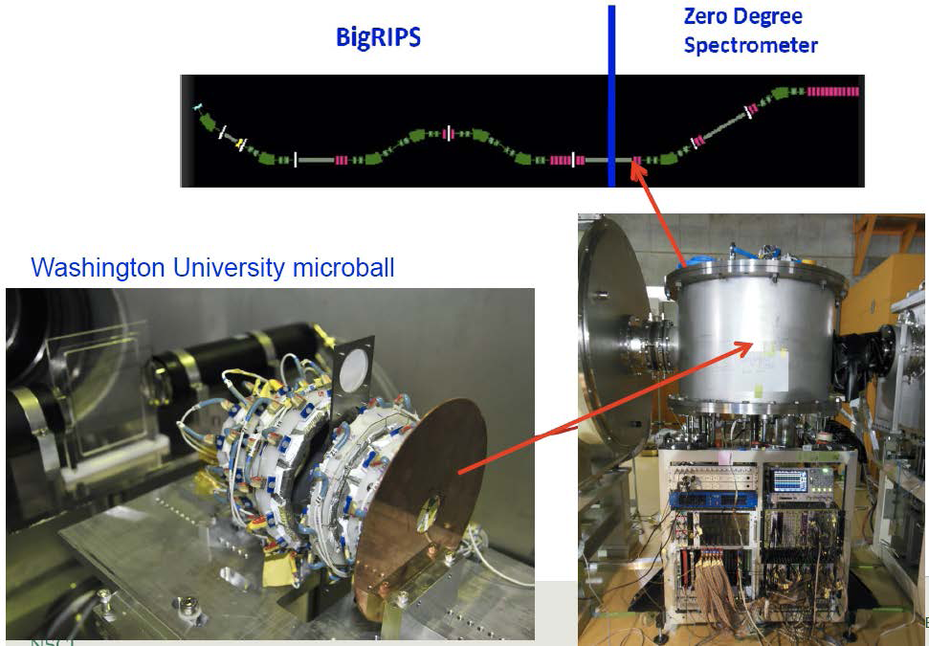
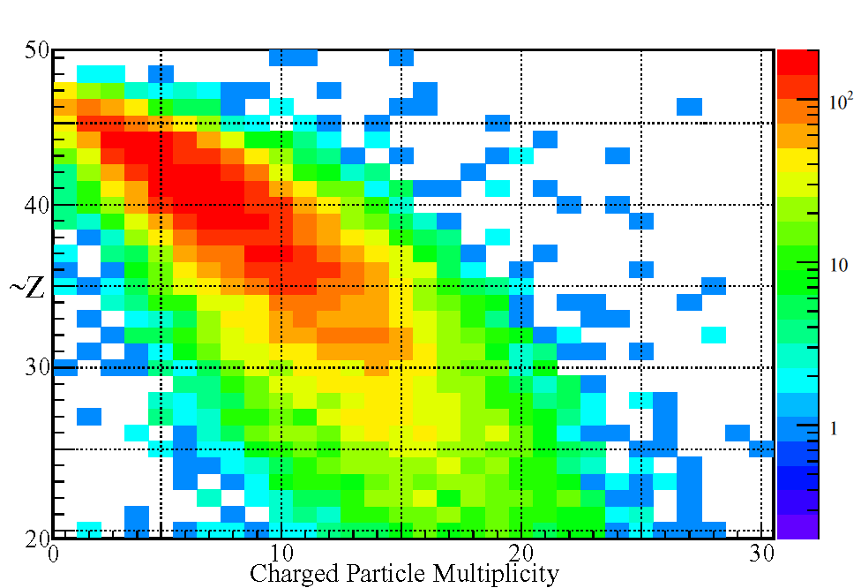
Extention at RIBF
MSU/TAMU/RIKEN/Kyoto Group in June 2013
¹³²Xe 345 MeV/u
¹⁰⁷In ~73 MeV/u
¹⁰⁷In(beam, ~73MeV/u) +¹²⁴Sn (Target)
¹¹²Sn(beam, ~73MeV/u) +¹¹²Sn (Target)

Slide 7
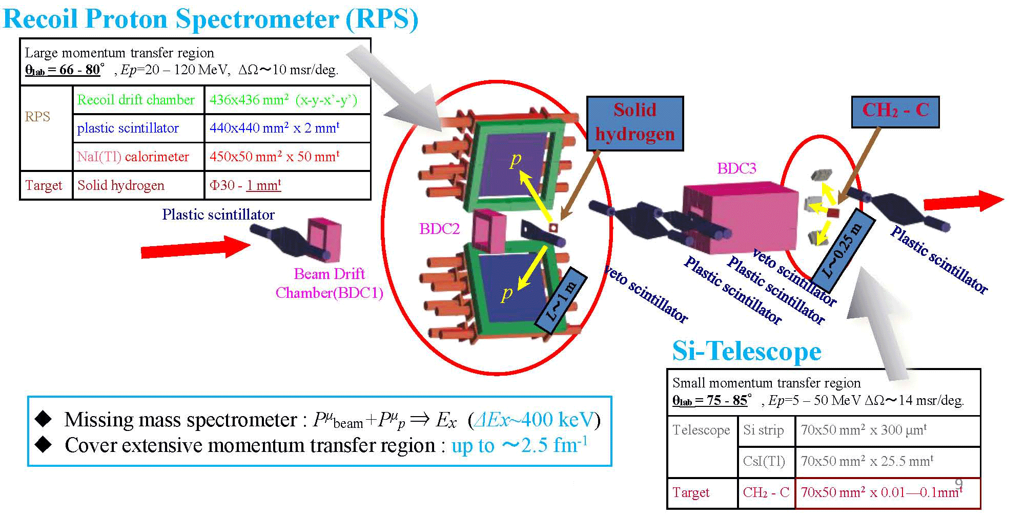
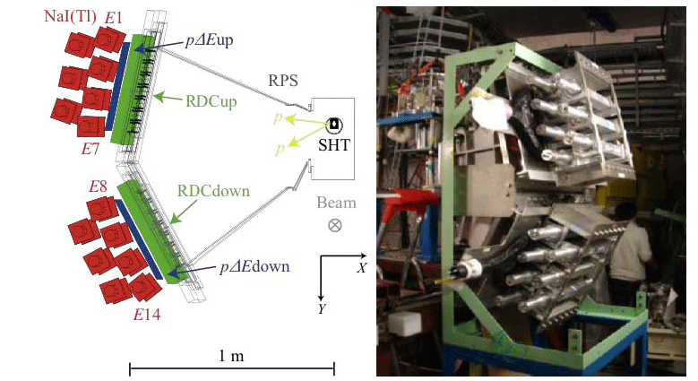
Future Direction of p elastic scattring
ESPRI Group (J. Zenihiro et al.)
Elastic Scattering of Protons with RI beam
¹³²Sn : flag-ship nuclei as a next
step from ²⁰⁸Pb (NP1112-RIBF79)

Slide 8
Surprising observations of Neutron Stars
M_{NS} ~ 2M_{sun}→
Large E_{sym} or
stiff EoS at high ρ
→ large radius
Neutron Star observations
R_{NS} ~ 9 km→
Small E_{sym} or
Soft EoS at ~2ρ₀
→ Small mass

Slide 9
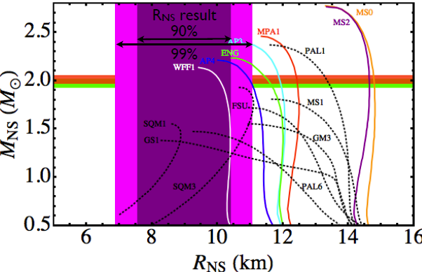
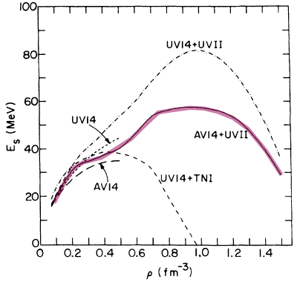
Closer Look
AV14+UVII ;
Wiringa, Fiks, & Fabrocini ,
Phys. Rev. C 38, 1010 (1988)
Neutron star (Gulliot et al.)
APJ 772, 7 (2013)
qLMXB
Observation:
M_{NS} ~ 2M_{sun}
R_{NS} ~ 9 km
Equation of State
softening EoS at ρ∼ 2ρ₀
stiff EoS at high ρ
Goal is to reduce the uncertainty
in symmetry pressure at ρ≈2ρ₀.

Slide 10
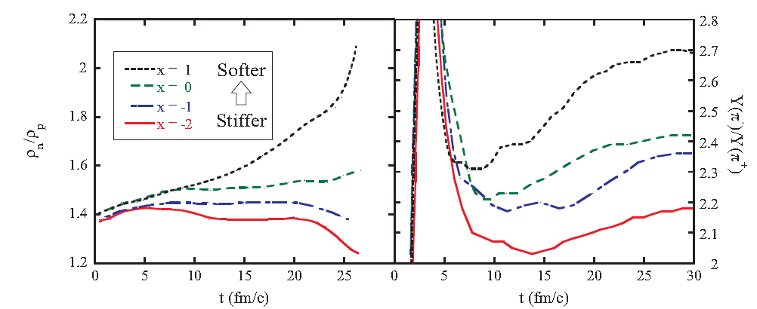
Influence of symmetry pressure;
Possible Probe
The symmetry pressure expels neutrons from and attracts
protons to high density region of neutron-rich system. This
suppresses Y(n)/Y(p), Y(π⁻)/Y(π⁺), etc.
π⁺−π⁻ ratio
Proton-neutron ratio
Light ion ratio (t-³He)
Particle flow of pions, protons, neutrons and light ions

Slide 11
Pilot Experiments at HIMAC
Investigate general trend of pion production in nucleus-nucleus collisions around RIBF energies.
Test response of large TPC to heavy (Z>50) nuclear beams.
Test electronics for Gating Grid
Test Sampling rate

Slide 12
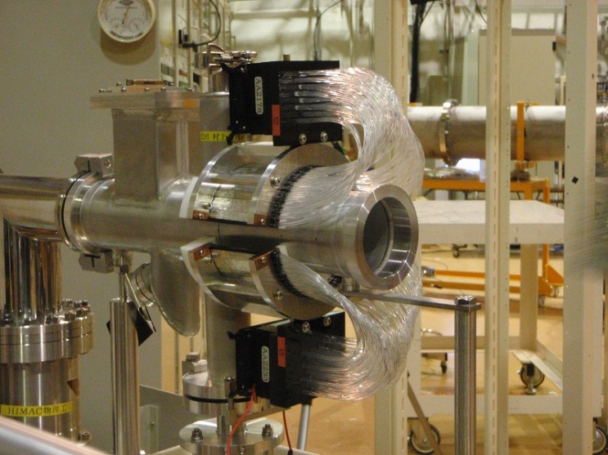
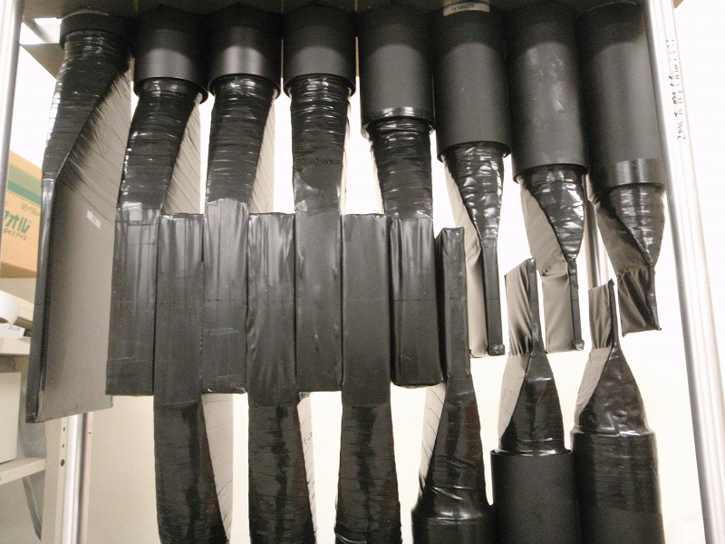
Experimental Setup
Multiplicity Array
Multiplicity Array
Ion Chamber
Target
Beam
Vacuum
θ_{lab}
Air
Target
50cm
Beam | ²⁸Si | ¹³²Xe
Energy(AMeV) | 400, 600, 800 | 400
Target : In ~ 390 mg/cm²
Typical Intensity : ~ 10⁷ ppp
Range Counter : 14 layers (+2) of Sci.
measured angle (θlab)
: 30, 45, 60, 75, 90, 120 degree
solid angle : 10 msr
Range Counter

Slide 13
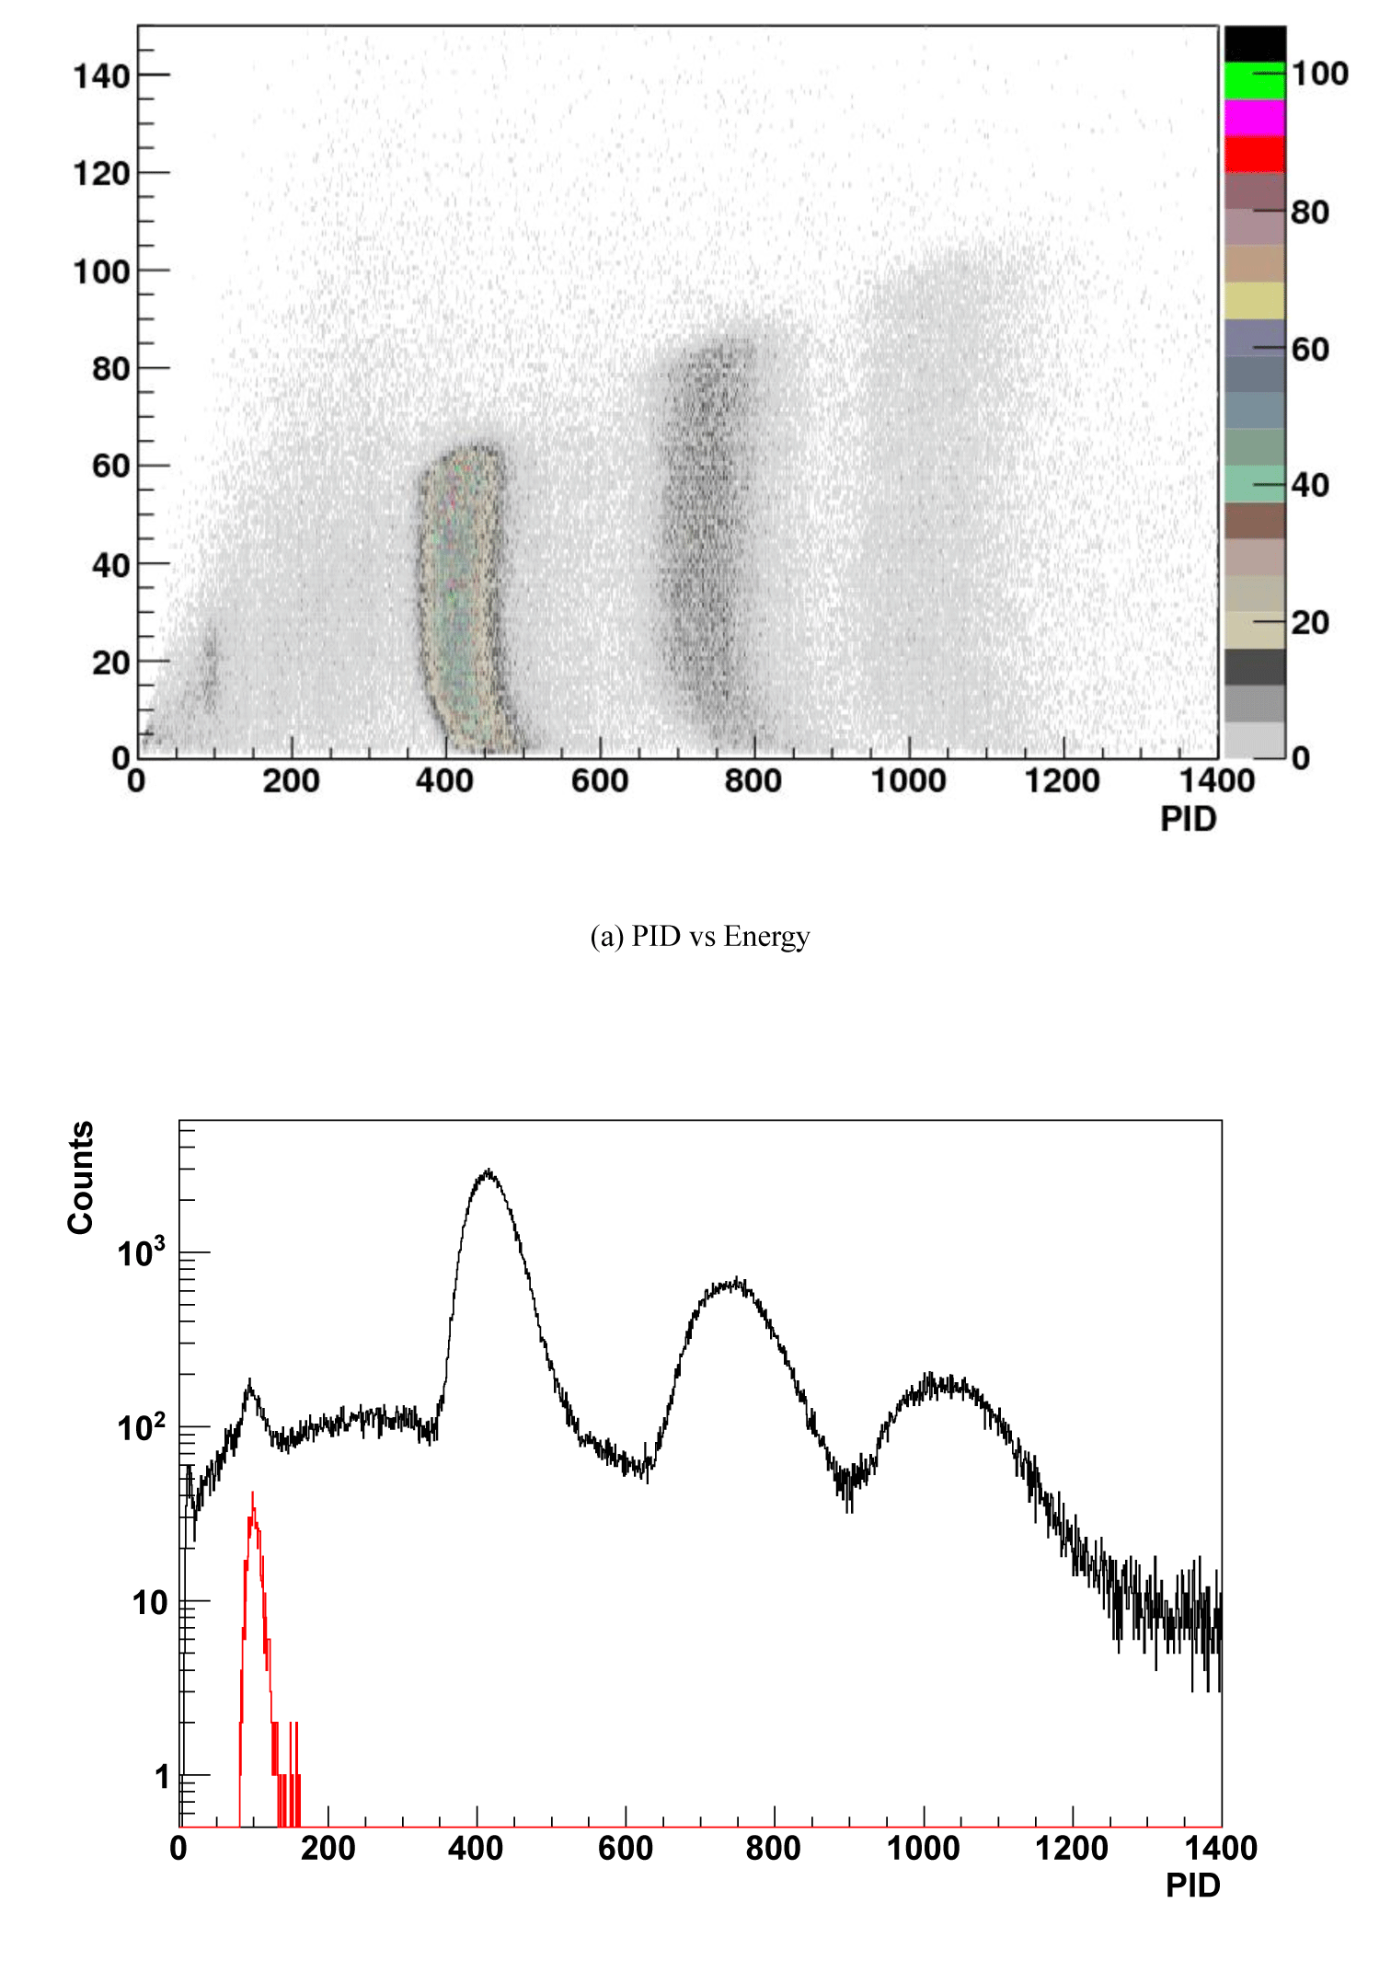
～400MeV/u
Pion’s are rare
less than 1/100 of protons

Slide 14
New Sets of Data to scan N/Z dependence
  ^{129, 132, 136}Xe+CsI 400 MeV/u
  Minimize Coulomb effect
  Mainly at 45º and 90º for high statistics
Beam Time 2011/9/14-28 ＠ HIMAC
  typical beam rate : 1*10⁷ ppp
  CsI (~¹³⁰Xe) target 350 mg/cm²
  Event rate : 200~1200 event/s
  Trigger rate : 200~600 events/s

Slide 15
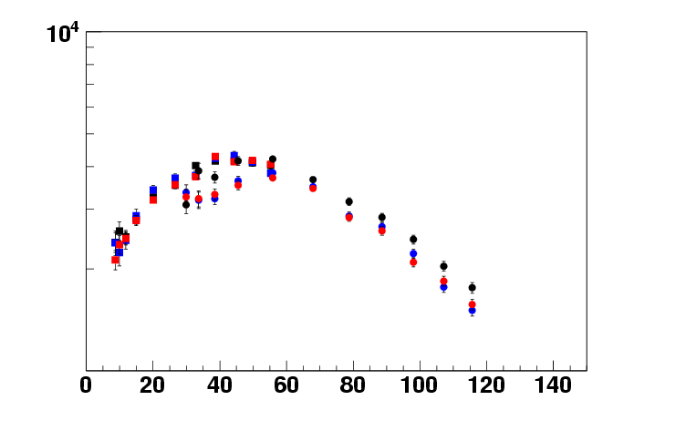
π⁺ from Xe+CsI Reactions
preliminary
■ ¹²⁹Xe 45deg
■ ¹³²Xe 45deg
■ ¹³⁶Xe 45deg
● ¹²⁹Xe 90deg
● ¹³²Xe 90deg
● ¹³⁶Xe 90deg
(mb/sr/GeV²)
90º
1 d²σ
P dEdΩ
45º
10³
Emid π [MeV]

Slide 16
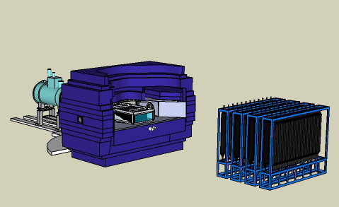
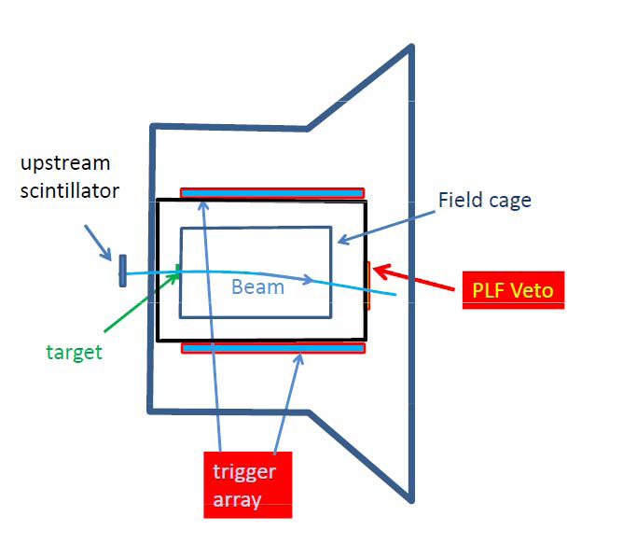
Experimental Setup at RIBF
Equipment
TPC - measures:
  π⁺ , π⁻ , p, d, t, ³He, ⁴He, IMF’s
  The SAMURAI chamber is at air
Trigger scint. array:
  selects central collisions and suppresses peripheral collisions.
NEBULA:
  provides neutron information
NEBULA

Slide 17
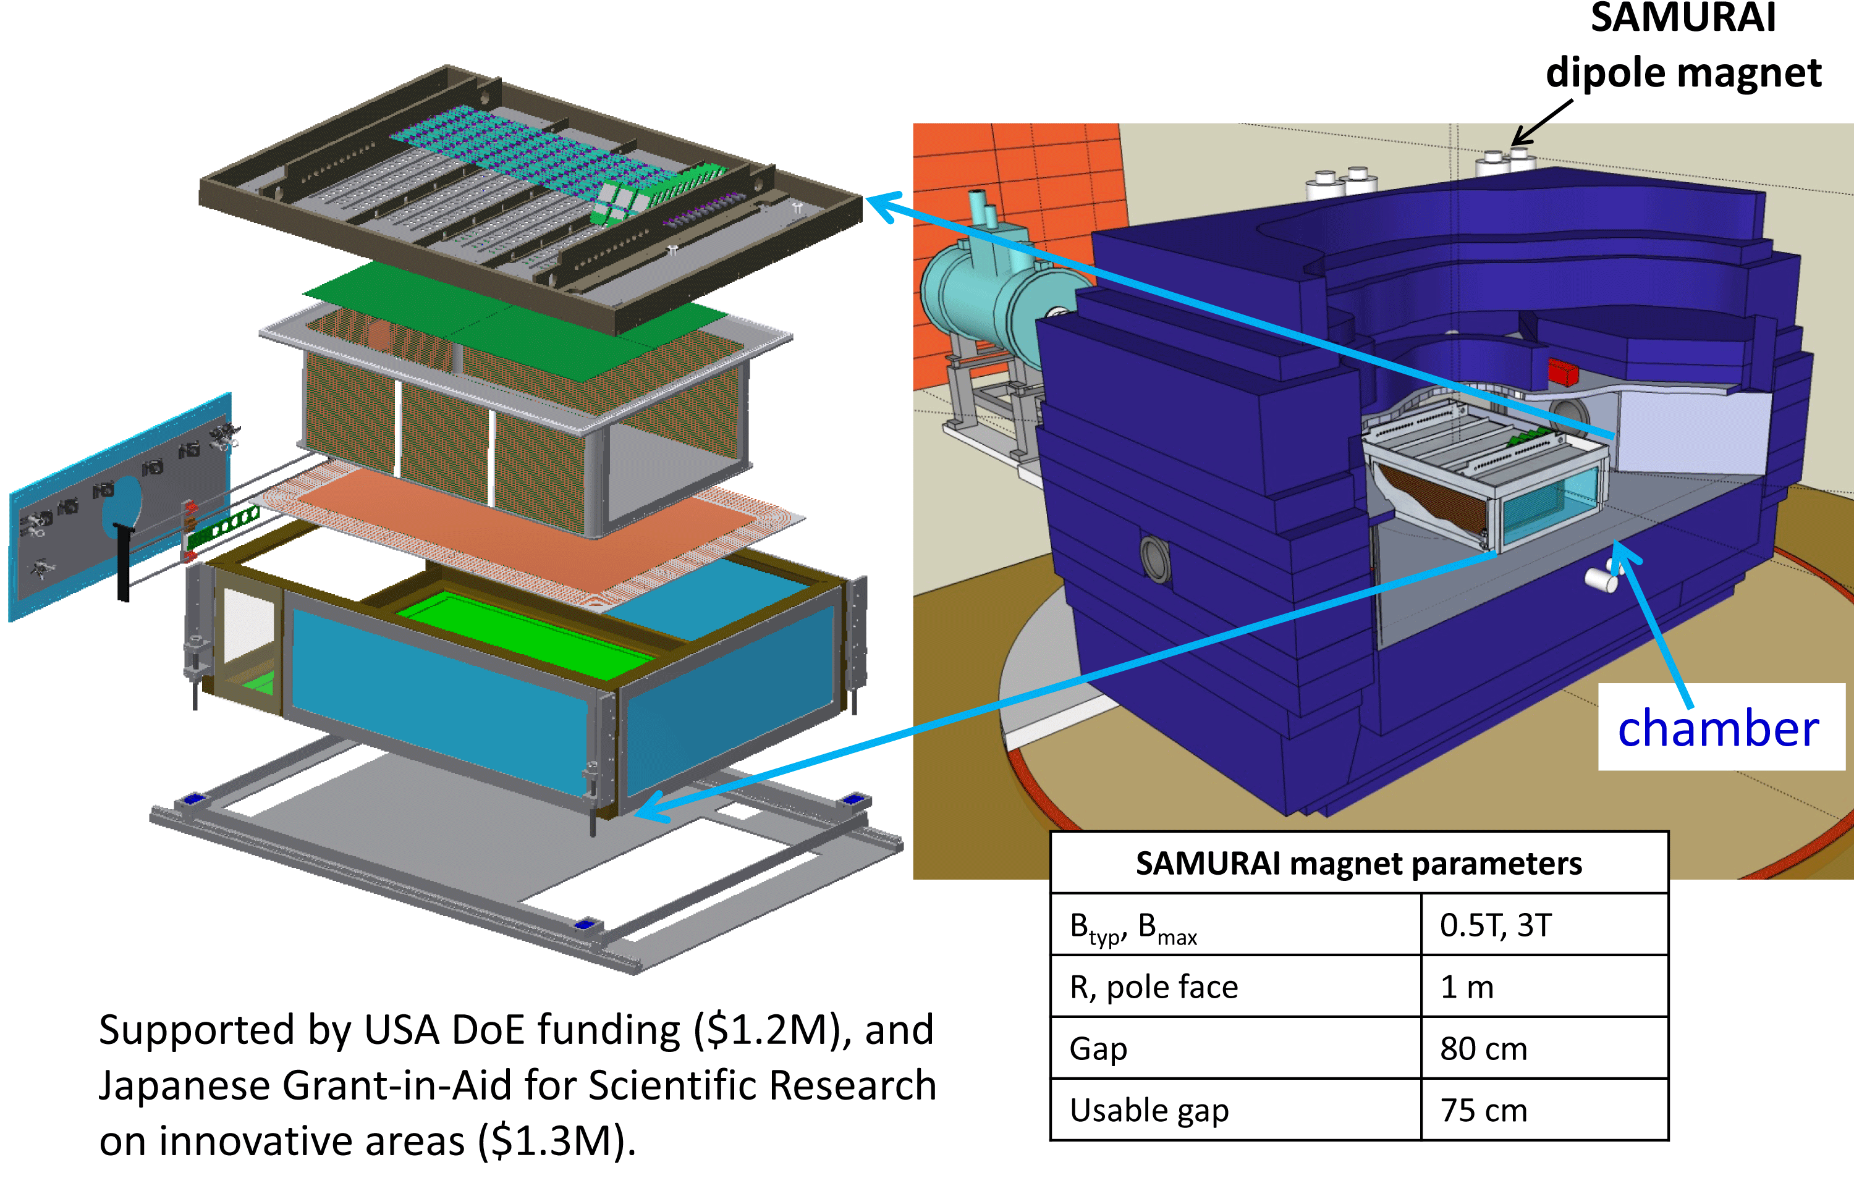
TPC Structure

Slide 18
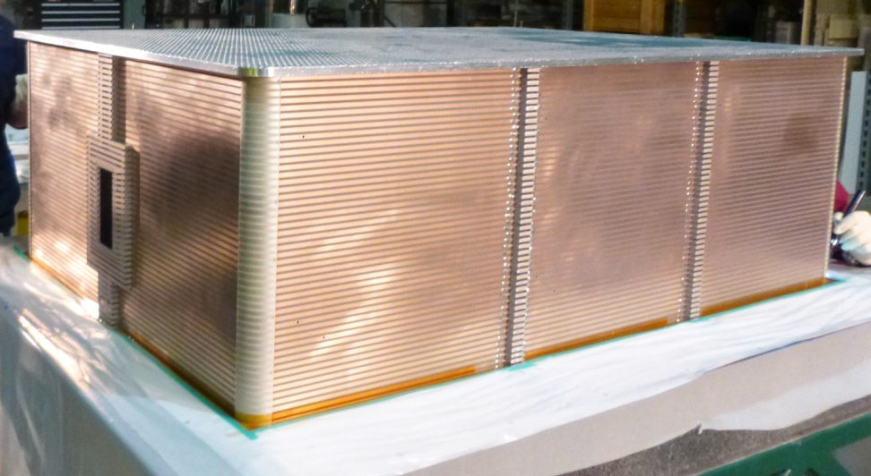
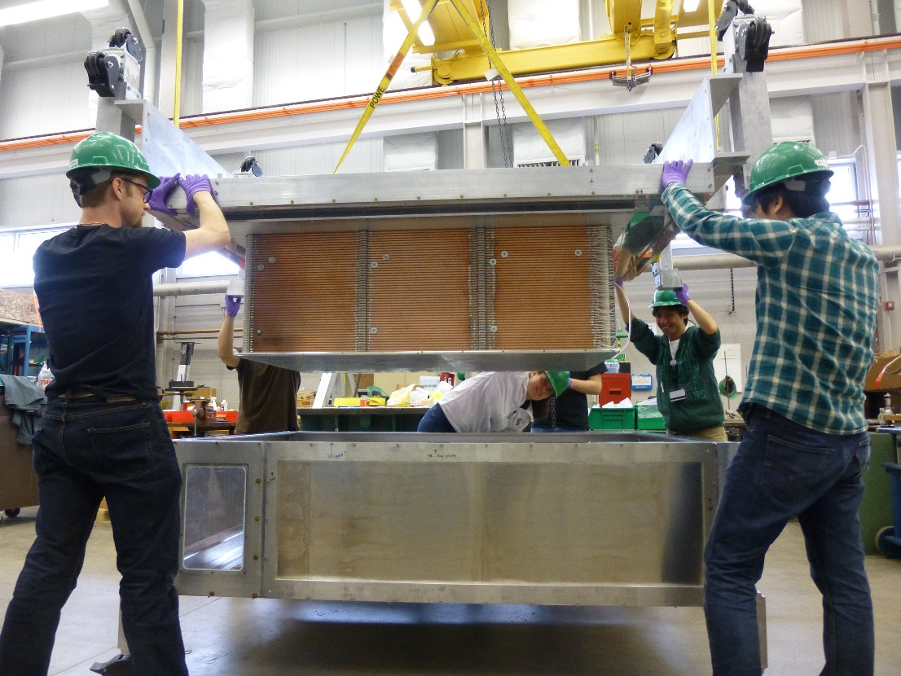
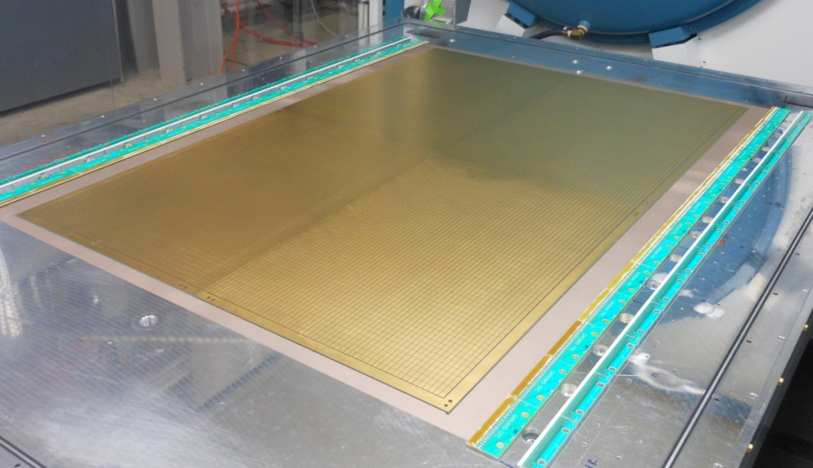
Construction status
Gluing field cage together, Feb 2013
Assembled for initial testing, May 2013
glued circuit boards
0.5m
1m
1.5m
February 2014 | Shipment of TPC to RIKEN
Pad and wire planes, March 2013
12000 pads (8mm x12mm)
3500 wires
Samurai Pion-Reconstruction and Ion-tracker TPC

Slide 19
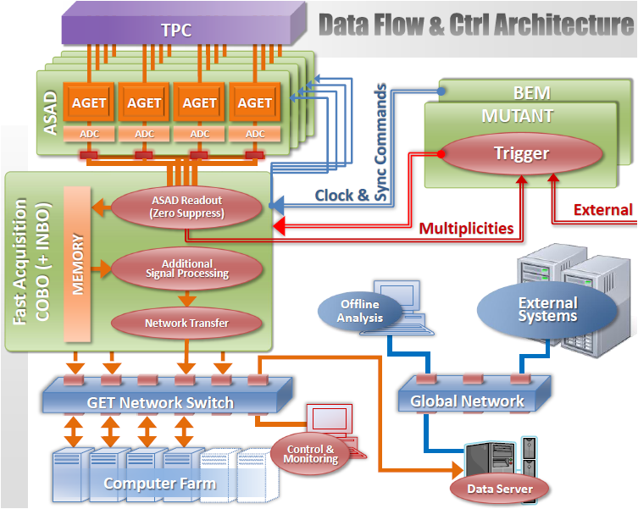
TPC electronics (read-out; GET)
Basic feature:
State of Arts technology
Capable to handle
1KHz – 10Gb/s
Wide dynamic range
10.5 bits
Capacitive Array 1-512
Sampling 1-100MHz
Ideal for SAMURAI-TPC
Read-out

Slide 20
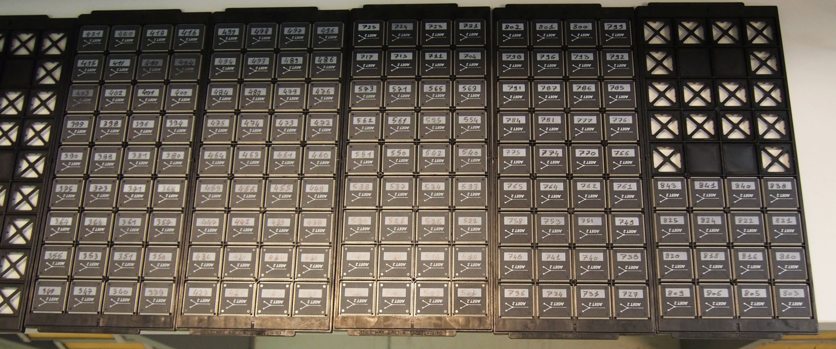
Received 160 AGETs in Nov. 14th in France

Slide 21
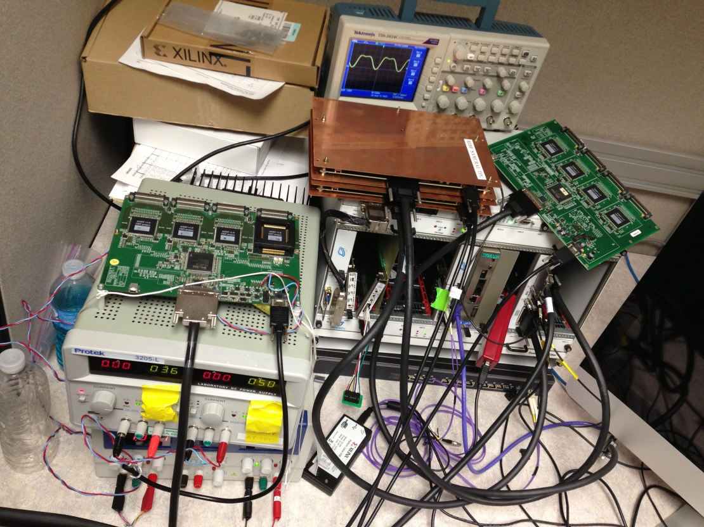
Status of electronics
Purchased 160 AGET (ASIC-chip)s and ordered 40 AsAd boards.
Reduced system with Xilinx evaluation board (ML507, Vertex5) has been finished with RHIC-BRAHMS TPC.
Test of μ-TCA CoBo with 4 AsAd board has been finished in October. We made order of 10 CoBos.
Minimal test of SPiRIT with GET electronics was finished.
4AsAd + CoBo testi as in Sep. 1st

Slide 22
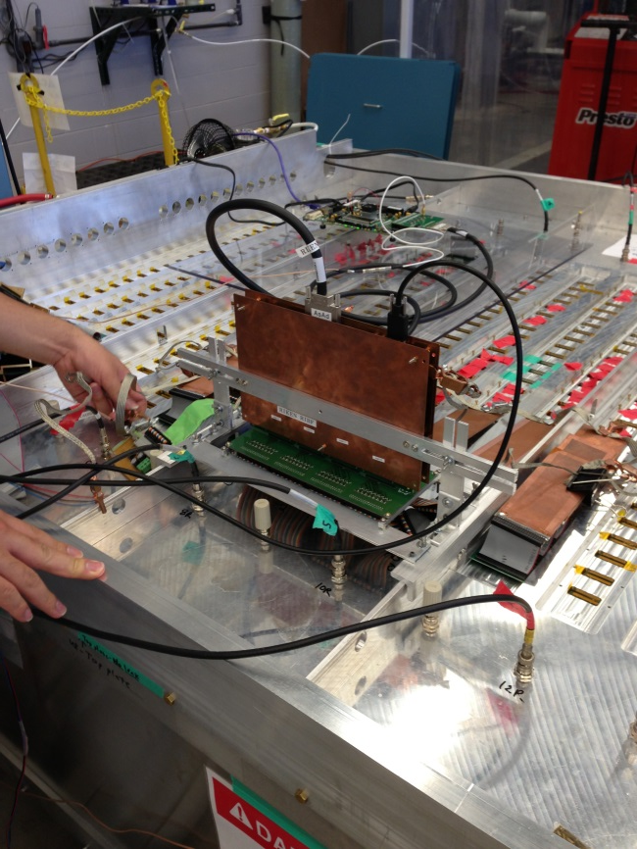
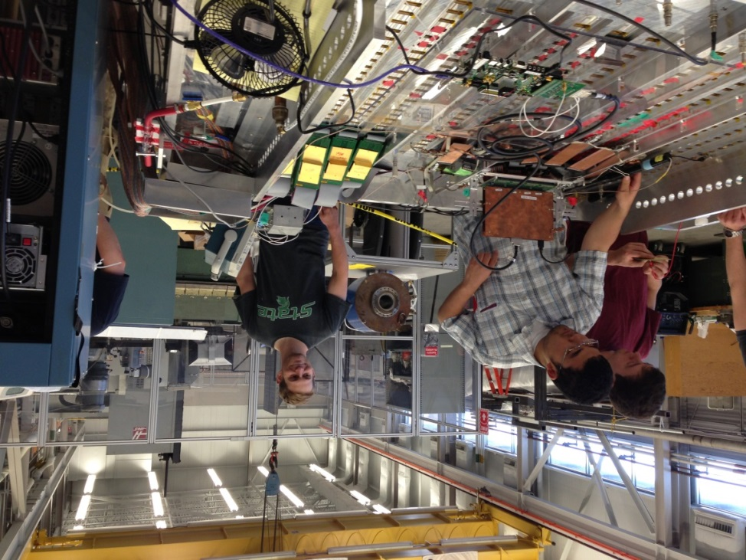
GET on SPiRIT

Slide 23
Proposed set of measurements
Beam | Target | E_{beam}/A | δ_{sys} | Goal | Days
¹³²Sn | ¹²⁴Sn | 300 | 0.22 | Probe maximum δ | 3
¹²⁴Sn | ¹¹²Sn | 300 | 0.15 | Probe intermed. δ, | 3
¹³²Sn | ¹²⁴Sn | 200 | 0.22 | Probe maximum δ | 3
¹²⁴Sn | ¹¹²Sn | 200 | 0.15 | Probe intermed. δ, | 3
¹⁰⁸Sn | ¹¹²Sn | 300 | 0.09 | Probe minimum δ | 3
¹⁰⁸Sn | ¹²⁴Sn | 300 | 0.15 | Probe intermed. δ, | 3
¹⁰⁸Sn | ¹¹²Sn | 200 | 0.09 | Probe maximum δ | 3
¹⁰⁸Sn | ¹²⁴Sn | 200 | 0.15 | Probe intermed. δ, | 3
{
²³⁸U
^{primary}
^{beam}
{
¹²⁴Xe
^{primary}
^{beam}
Approved 6.5+7 days for 300 MeV/u combinations

Slide 24
Summary
Consistent constraints on the symmetry energy at sub-saturation densities with different experiments have been obtained.>> Heavy ion collisions should provide a good probe at high density..
Astronomical observations suggest the importance of probing ~2ρ₀ region.
At high & low densities: Workshop concerning transport model is currently planed to examine the transport codes.
We will be ready to measure pion and light fragment flow from ¹³²Sn+¹²⁴Sn, ¹²⁴Sn+¹¹²Sn, ¹¹²Sn+¹²⁴Sn, and ¹⁰⁸Sn+¹¹²Sn collisions at 300 MeV/u using the TPCs at RIKEN RIBF to constraint the symmetry energy above saturation densities by spring of 2015.

