Slide 1
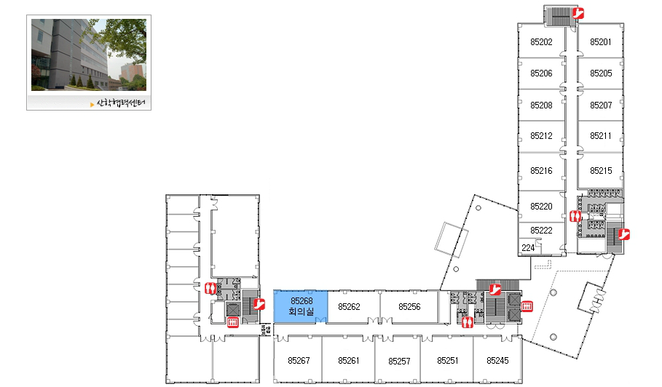
Corporate Collaboration Center
2nd Floor
Meeting room (4 Nov 2013)
Entrance for 2nd floor

Slide 2
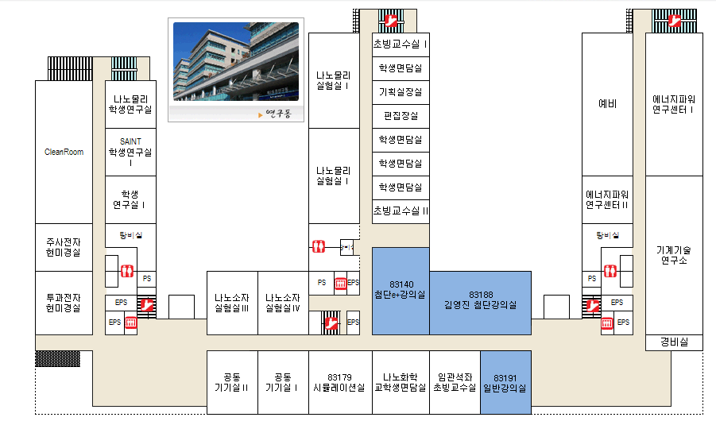
Research Complex Building #2
1st Floor
Entrance for 1st floor
Meeting room (4 Nov. 2013)
Entrance for 1st floor

