Slide 1
2014/3/4 RIBF討論会
中性子星物質EOSにおける3体斥力
およびハイペロン混合の効果
Y. Yamamoto
Collaborators:
T. Furumoto
N. Yasutake
Th.A. Rijken
核–核弾性散乱で（高密度）EOSを視る???
新しいパラダイム???

Slide 2
Our strategy for neutron stars
Neutron-star EOS derived from
Baryon-Baryon interaction model
in relation to Earth-based experiments
without ad hoc parameter for stiffness of EOS
on the basis of G-matrix theory

Slide 3
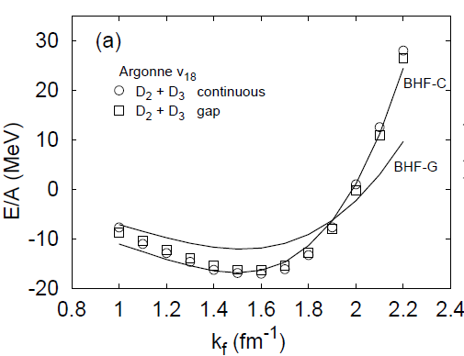
nuclear saturation based on G-matrix theory
LOBT with continuous choice
is reliable up to high density
4ρ₀
Role of Three-Body Interaction
(TBA+TBR) is essential for
saturation problem
● Attraction at low densities
● Repulsion at high densities neutron-star matter

Slide 4
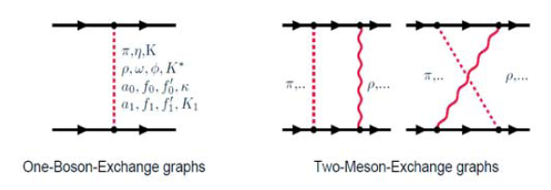
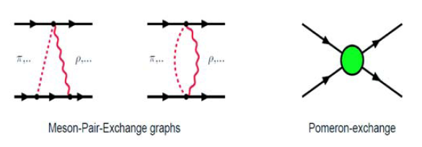
Extended Soft-Core Model (ESC)
●Two-meson exchange processes are treated explicitly
● Meson-Baryon coupling constants are taken consistently
with Quark-Pair Creation model
repulsive cores

Slide 5
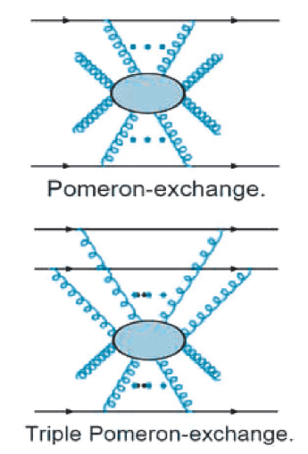
ポメロンって何？
何故ポメロン？
SU3 スカラー

Slide 6
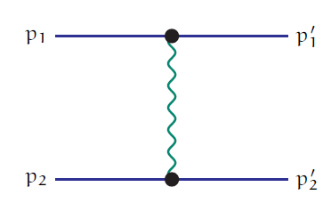
Lagrangian & Propagator
Two-body repulsive core

Slide 7
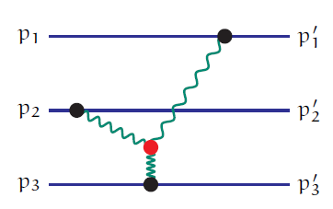
Three(Four)-body Potential from the Triple(Quadruple)-pomeron vertex
Three- and Four-body repulsions with parameters g_{3P} & g_{4P}

Slide 8
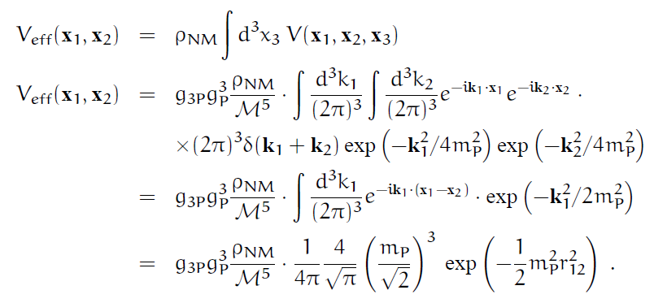
密度依存2体力

Slide 9
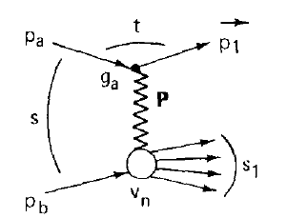
Estimation of g_{3P} and g_{4P}
For pair- & triple-pomeron residues γ₀(t) & r₀(t)
g_{P}=γ₀(0) (s/Μ²)^{αP(0) /2} g_{3P}=r₀(0) (s/Μ²)^{3αP(0)/2}
For s ≈ (6 - 8) Μ2, αP(0) ≈ 1
g_{3P}/g_{P} ≈ (6 - 8) r₀(0)/γ₀(0)
From r₀(0)/γ₀(0) = 1/40 (Kaidalov et al.)
g_{3P}/g_{P} ≈ 0.15 – 0.20
For g_{P}/sqr(4π) = 3.67, g_{3P} ≈ 1.95 – 2.6
In Reggeon field theory
g_{4P}= -4g_{3P}²/Δ ≈ (8.8 – 60) g_{3P}²
g_{4P}/g_{3P} ≈ 20 – 160 for g_{3P}=2.64
Kaidalov et al., N.P. B75(1974) 471

Slide 10
How to determine coupling constants g_{3P} and g_{4P} ?
Nucleus-Nucleus scattering data

Slide 11
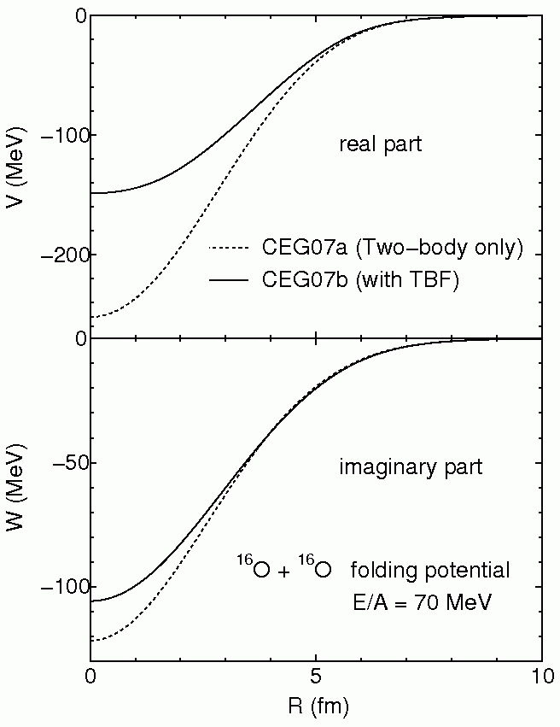
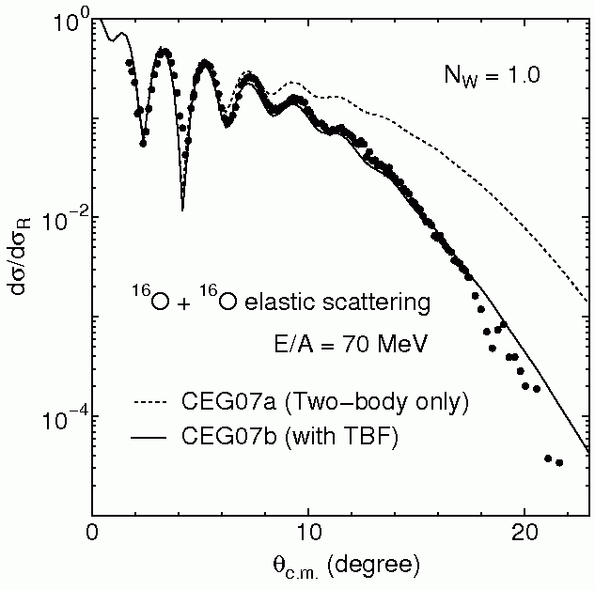
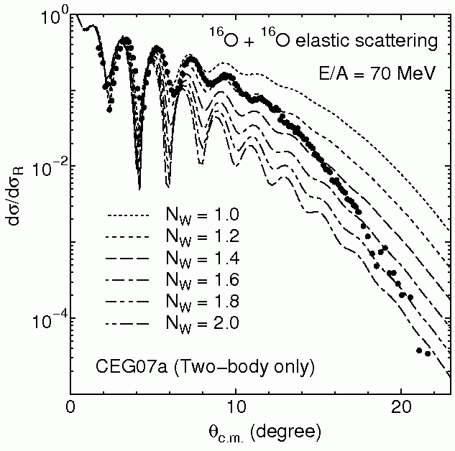
with G-matrix
folding model
¹⁶O + ¹⁶O elastic scattering E/A = 70 MeV
Effect of three-body force
T.Furumoto, Y. Sakuragi and Y. Yamamoto, Phys.Rev.C79, (2009) 011601

Slide 12
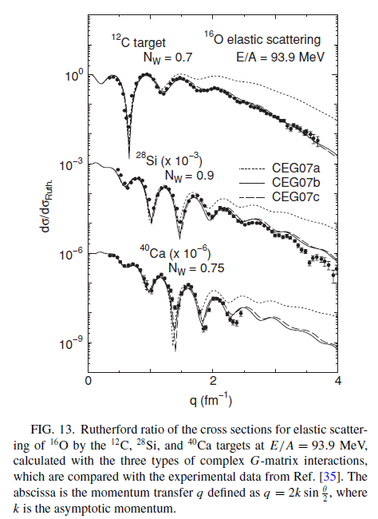
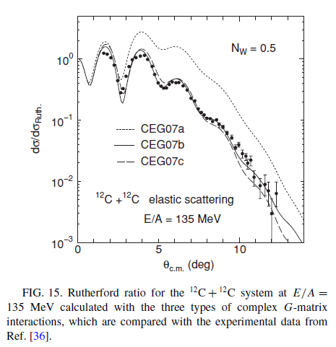

Slide 13
ESC08c + MPP + TNA
repulsive attractive
MPP and TNA parts are determined to reproduce
* ¹⁶O+¹⁶O scattering data (E/A=70 MeV)
* nuclear saturation property
phenomenological
V₀ and η are determined so as to
reproduce saturation density/energy
MPP TNA
Ratio g_{4P}/g_{3P} is not determined in our analysis ---→ three versions MPa/b/c

Slide 14
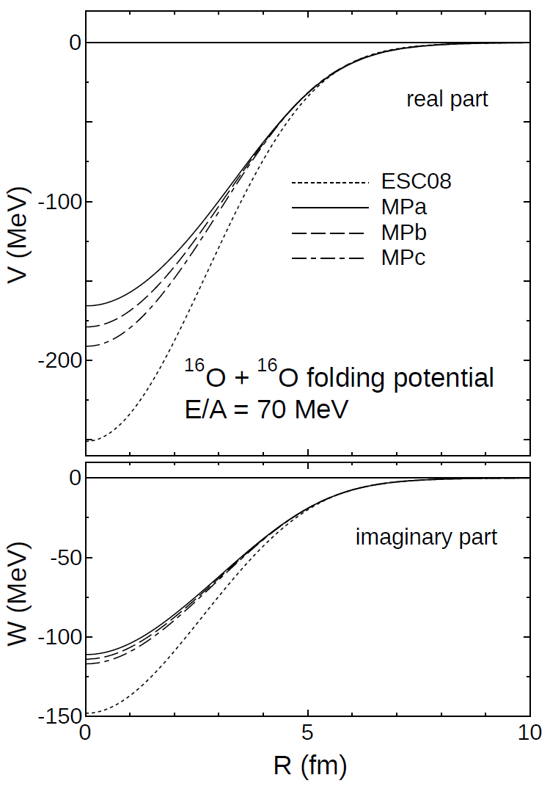
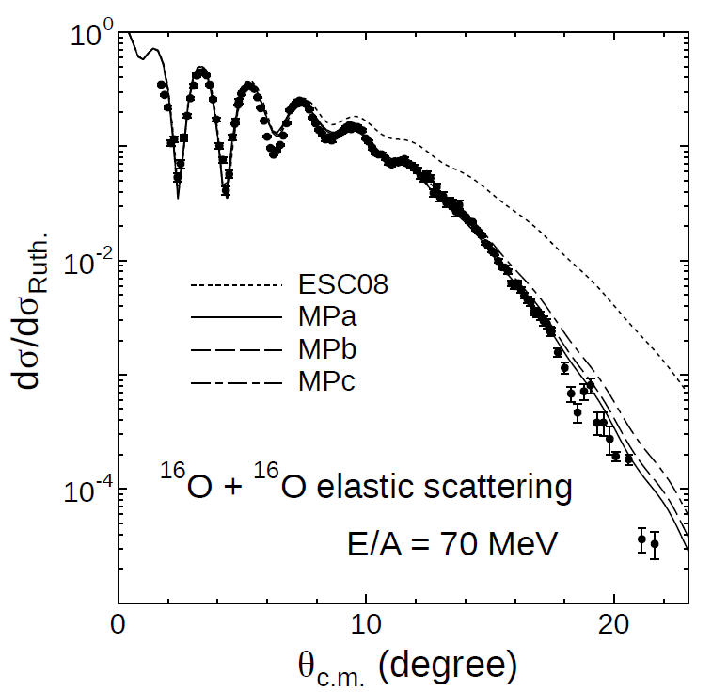
Frozen-Density Approximation
Two Fermi-spheres separated in momentum space
can overlap in coordinate space without
disturbance of Pauli principle

Slide 15
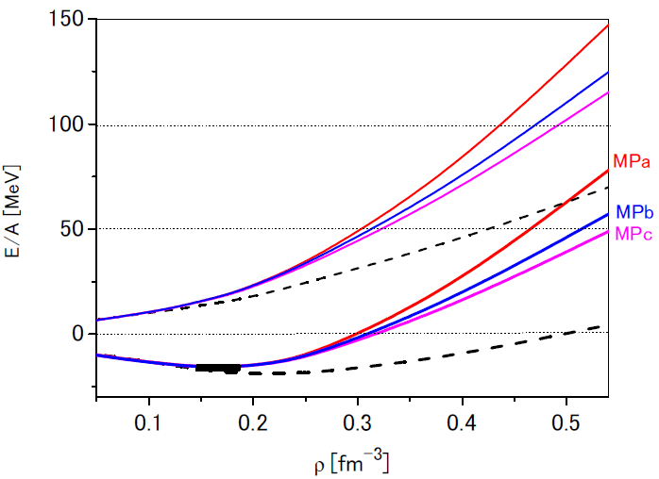
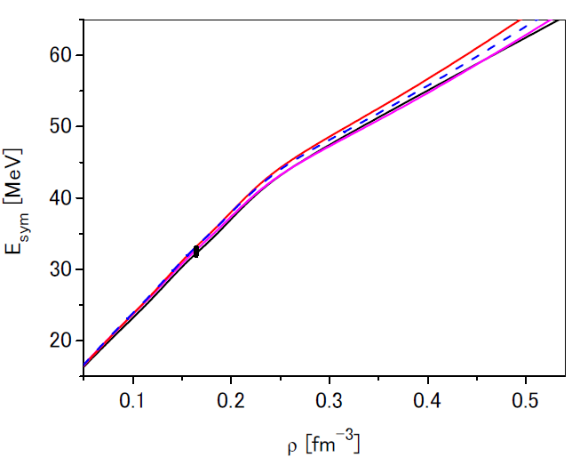
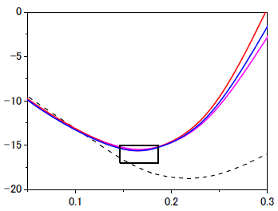
E/A curve
Symmetry energy

Slide 16
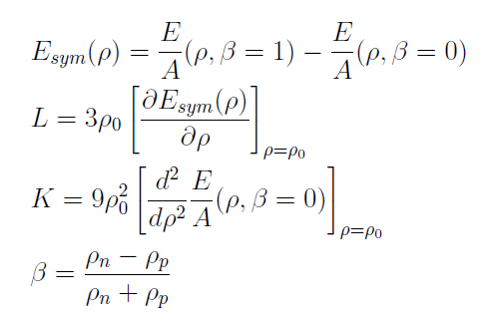
AV8’+UIX : E_{sym}=35.1 MeV L=63.6 MeV (Gandolfi et al.)

Slide 17
核力（今はESC08c)に基づく多体計算で
E_{sym} & Lの適切な値が自然に導かれる
用いているアイソスカラー三体力(MPP+TNA)は
E_{sym} & L にあまり影響しない
結果的にMPPの強さはほぼ非圧縮率Kにのみリンクする
Kで高密度EOSが分かるか???

Slide 18
Tolman-Oppenheimer-Volkoff equation

Slide 19
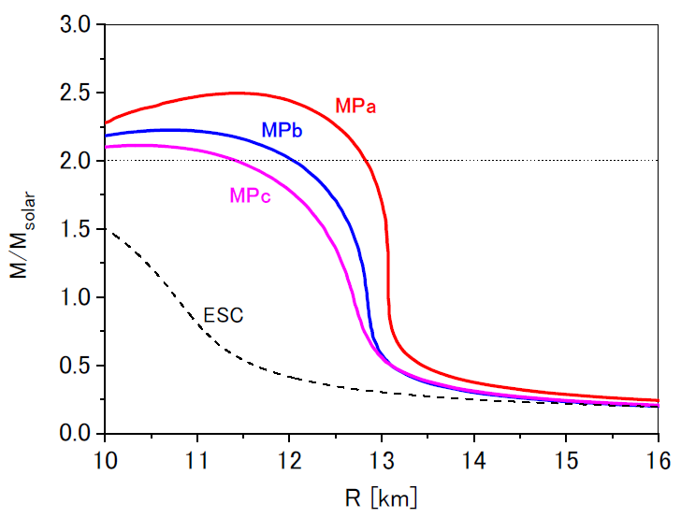
with neutron-matter EOS
MPa : K=310 MeV
MPb : K=280 MeV
MPc : K=260 MeV

Slide 20
Summarizing
ESC08c + MPP + TNA
nuclear part
MPP strength determined by
analysis for ¹⁶O+¹⁶O scattering
TNA adjusted phenomenologically
to reproduce E/A(ρ₀) at saturation density
No ad hoc parameter for massive neutron star (stiff EOS)
on the basis of terrestrial experiments

Slide 21
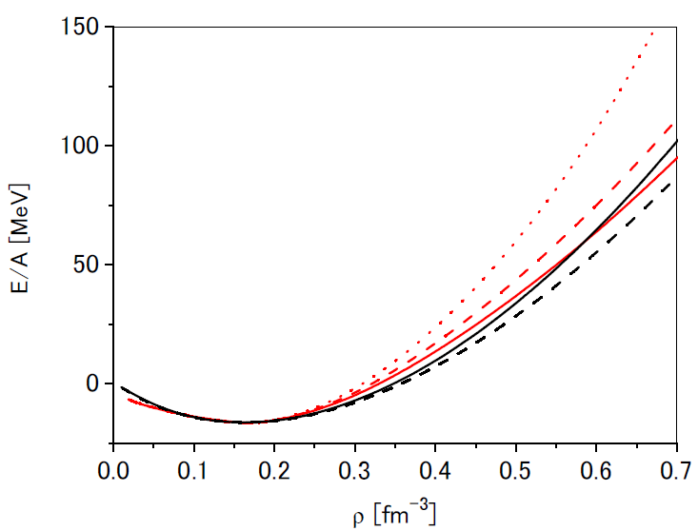
MPa, MPb, MPcをterrestrial dataで 絞り込めるか？
非圧縮率K
MPa : 310 MeV
MPb : 280 MeV
MPc : 260 MeV
M3Y-P7 : 255 MeV
M3Y-P6 : 240 MeV
by 中田
一見よさそうである
が、しかし・・・・・

Slide 22
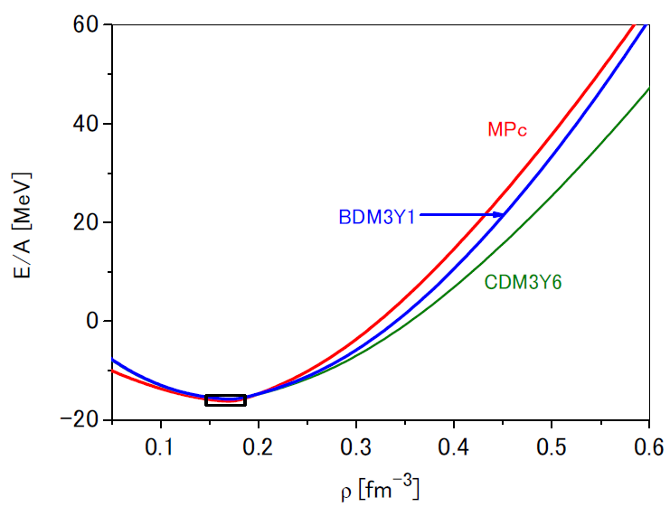
DDM3Y(Khoa)との比較
260
270
250
相互作用の特徴はKで汲みつくされるか？

Slide 23
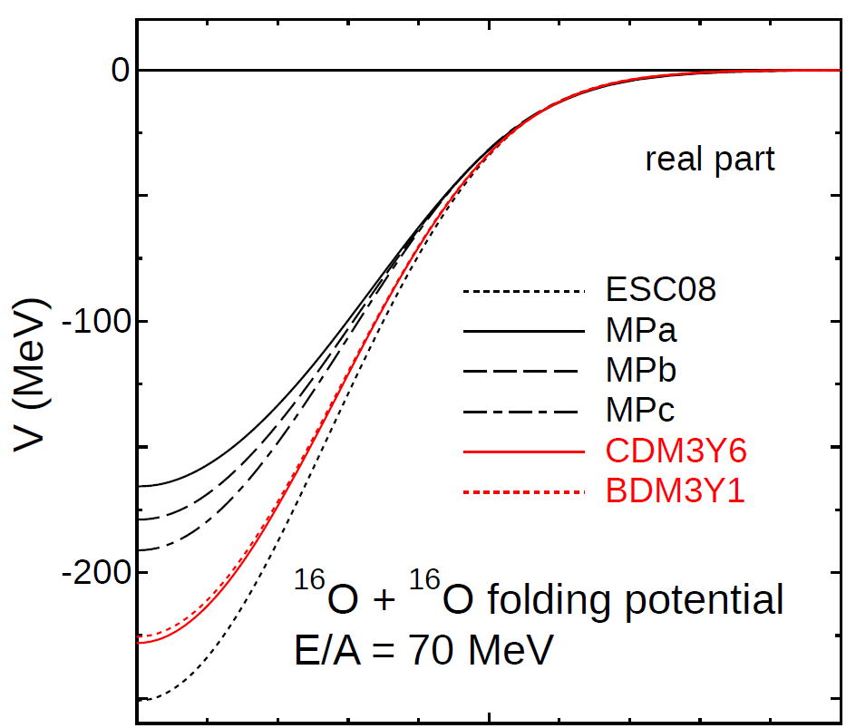
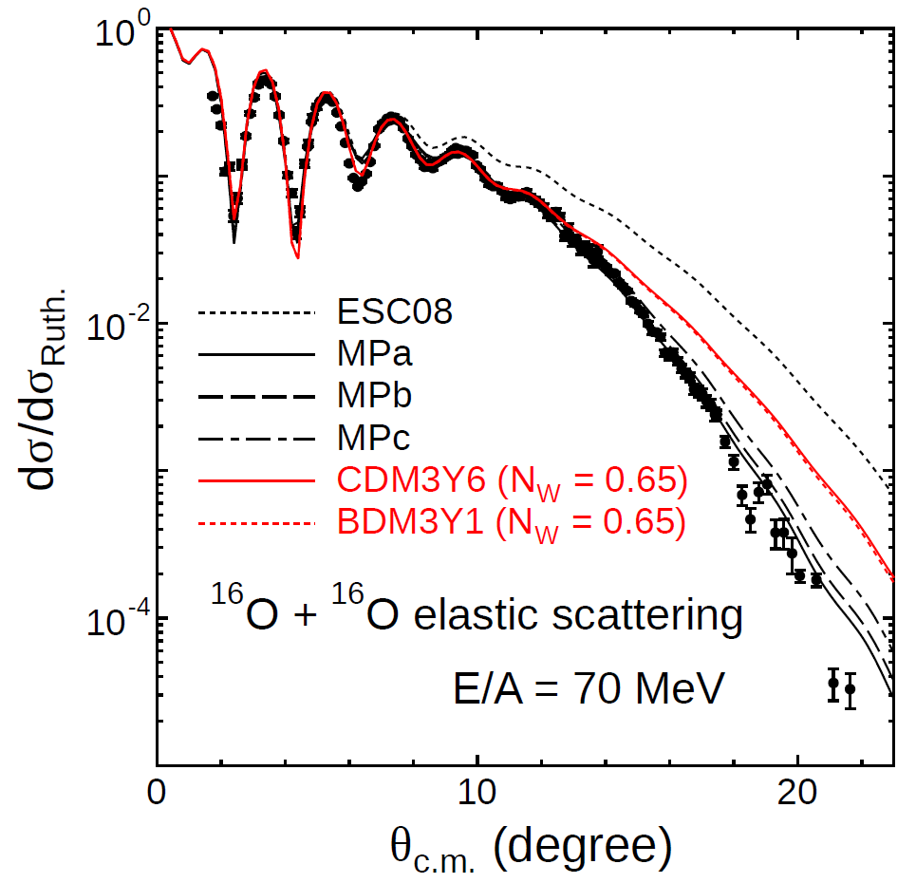
MPc(K=260)に比べてCDM3Y6(K=250)とBDM3Y1(K=270)は共に深すぎる
ほとんど同じ結果
Kは相互作用を特徴づける指標になっていない

Slide 24
非圧縮率Kの値はmodel dependentであり、
異なるモデル（密度依存性の強さ・形）で得られる
K値の比較にはあまり意味がない
K値は相互作用の違いを特徴づける良い指標ではない
標準密度でのK値は高密度EOSを特徴づけるには十分でない
高密度EOS
中性子星
?
有限原子核のEDF解析

Slide 25
Hyperon-Mixed Neutron-Star Matter
ESC08c defined in S=0,-1,-2 channels
MPP universal in all BB channels
TNA TBA ???
(ESC08c+MPP+TBA) model should be tested in hypernuclei
hyperonic sector

Slide 26
Softening by hyperon mixing to neutron-star matter

Slide 27
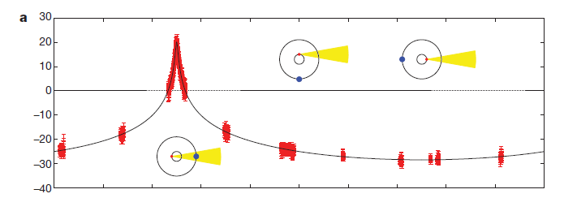
2010 PSR J1614-2230 (1.97±0.04)M☉
Shapiro delay measurement
2013 PSR J0348-0432 (2.01±0.04)M☉

Slide 28
Massive (2M☉) neutron stars
Softening of EOS by hyperon mixing
Compatible ?
An idea is Universal Three-Baryon Repulsion (TBR)
by Takatsuka
Modeling of TBR in ESC = Multi-Pomeron exchange Potential

Slide 29
?
ハイパー核 中性子星
ハイパー核の研究で検証された相互作用を用いて
中性子星核物質におけるハイペロン混合を調べる
Λ & Σ states based on
ESC08c + MPP + TBA
TNA

Slide 30
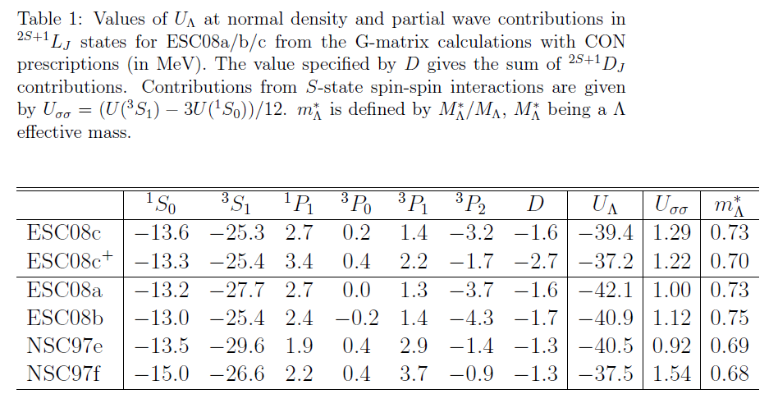
ESC08c⁺ = ESC08c + MPa + TBA
U_{Λ}(ρ₀) is conceptually different from U_{WS} (-28 MeV) !!
use G-matrix folding model

Slide 31
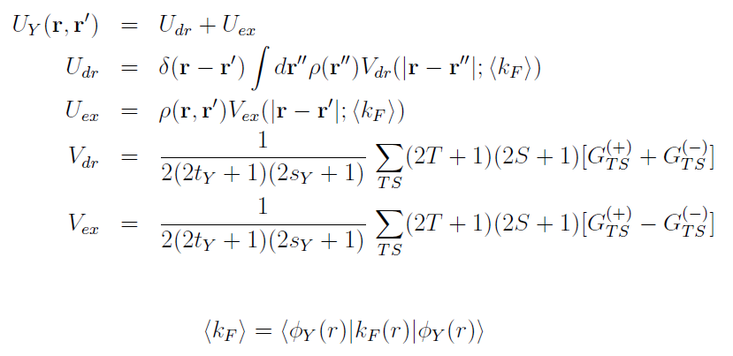
Y-nucleus folding potential derived from YN G-matrix interaction G(r; k_{F})
G-matrix interactions
Averaged-k_{F} Approximation
calculated
self-consistently
+ Δk_{F}
Mixed density
obtained from SkHF w.f.

Slide 32
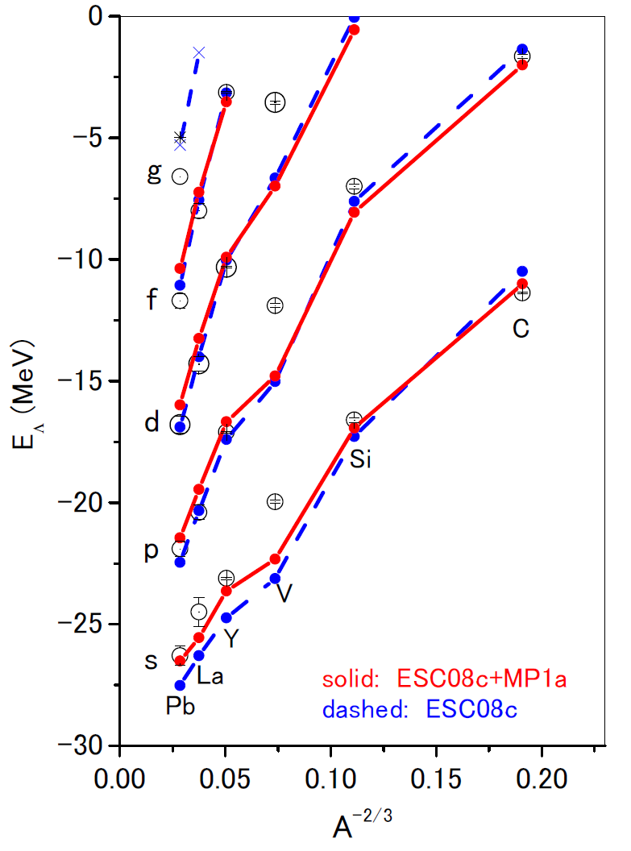
Solid: ESC+MPa
Dashed: ESC
ΔkF=-0.05
ΔkF= 0.02

Slide 33
Quark-Pauli effect in ESC08 models
ESC core = pomeron + ω
Repulsive cores are similar
to each other in all channels
Assuming
“equal parts” of ESC and QM are similar to each other
Almost Pauli-forbidden states in [51] are taken
into account by changing the pomeron strengths
for the corresponding channels phenomenologically
g_{P} factor * g_{P}

Slide 34
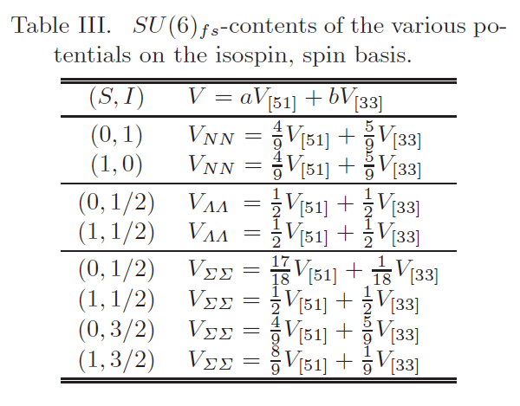
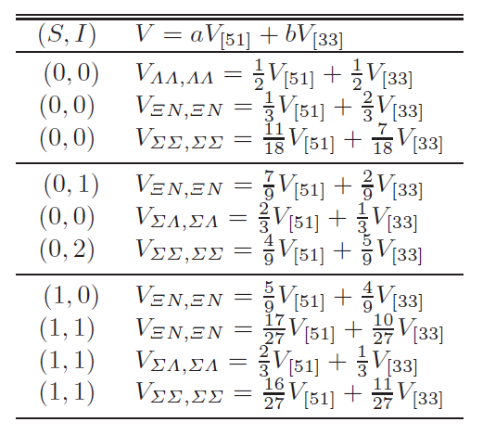
by Oka-Shimizu-Yazaki
Pauli-forbidden state in V_{[51]} strengthen pomeron coupling
V_{BB}=V(pom) + w_{BB}[51]*V(PB)

Slide 35
Pauli-forbidden state in QCM ➔ strong repulsion in T=3/2 ³S₁ state
Σ⁻ in neutron matter

Slide 36
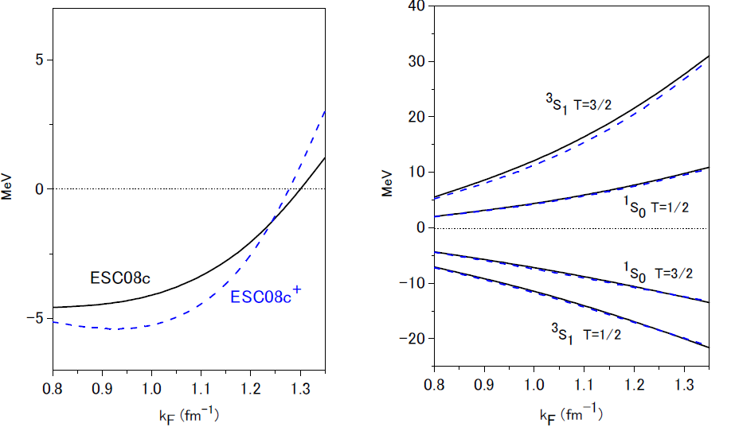
U_{Σ}(k_{F})
Solid Dashed : Contributions from MPP+TBA

Slide 37
Hyperon-mixed Neutron-Star matter
with universal TBR (MPP)
EoS of n+p+Λ+Σ+e+μ system
ESC08c(YN) + MPP(YNN) +TBA(YNN)

Slide 38
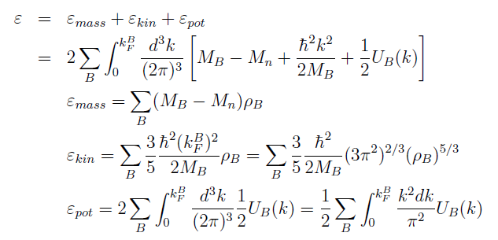

Slide 39
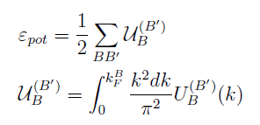

Slide 40
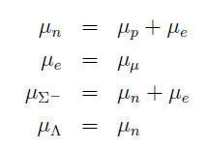

Slide 41
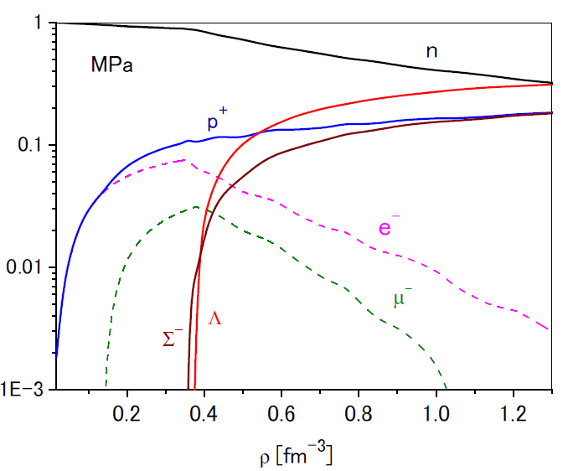
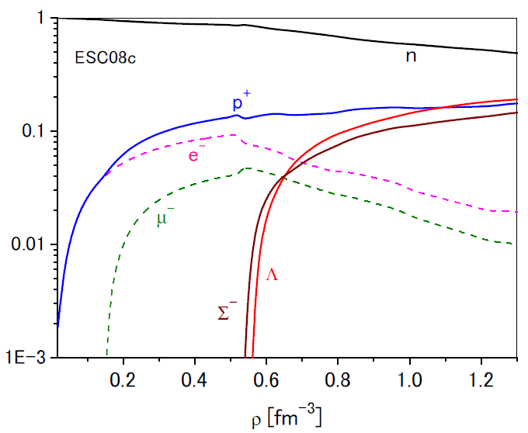
β-stable n+p+Λ+Σ⁻ matter

Slide 42
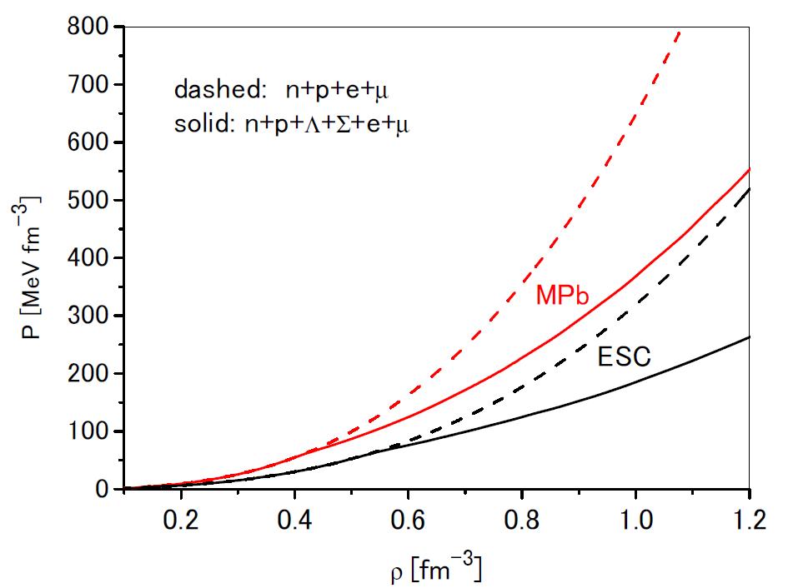
EOS

Slide 43
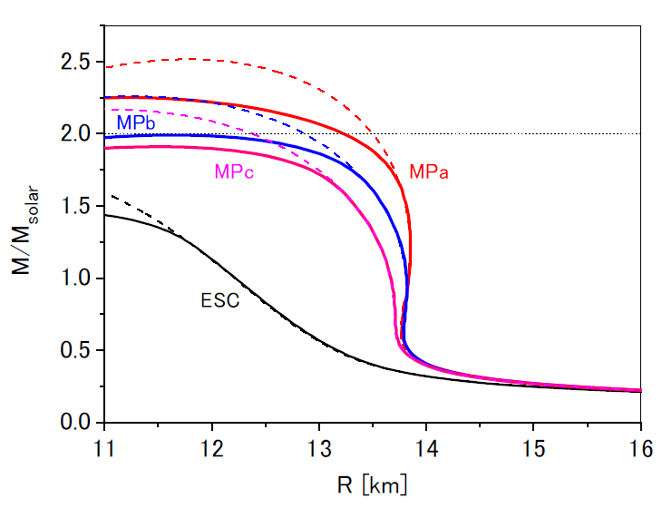
with EOS of n+p+Λ+Σ⁻ matter

Slide 44
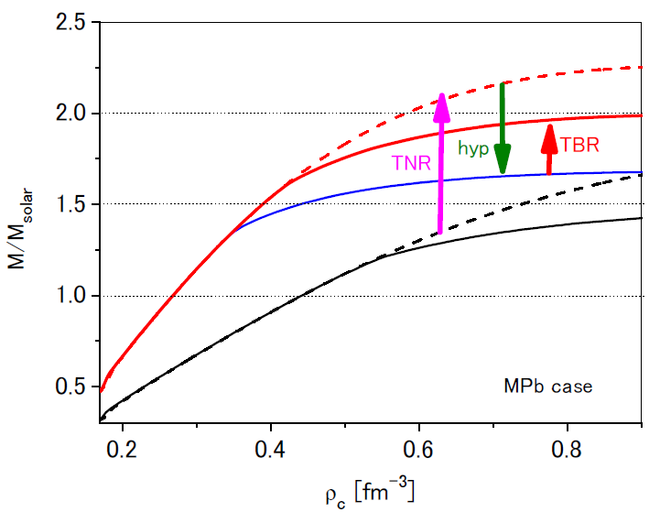

Slide 45
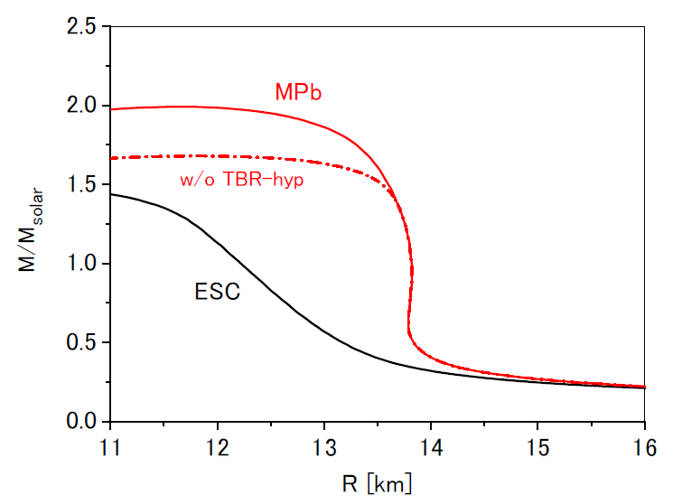

Slide 46
Conclusion
ESC08c+MPP+TBA model
* MPP strength determined by analysis for ¹⁶O+¹⁶O scattering
* TNA adjusted phenomenologically to reproduce
E/A(ρ₀)= -15.8 MeV with ρ₀ = 0.16 fm⁻³
* Consistent with hypernuclear data
* No ad hoc parameter to stiffen EOS
BB interactions based on on-Earth experiments
MPa set including 3- and 4-body repulsions leads to
massive neutron stars with 2M☉ in spite of significant
softening of EOS by hyperon mixing
MPb/c including 3-body repulsion leads to
Comparable to or slightly smaller values than 2M☉

