Slide 1
Shell-model calculations for the IoI —a review from a personal point of view
Yutaka Utsuno
Advanced Science Research Center, Japan Atomic Energy Agency
Center for Nuclear Study, University of Tokyo

Slide 2
Contents
Brief history of shell-model studies for IoI
Current understanding of shell evolution

Slide 3
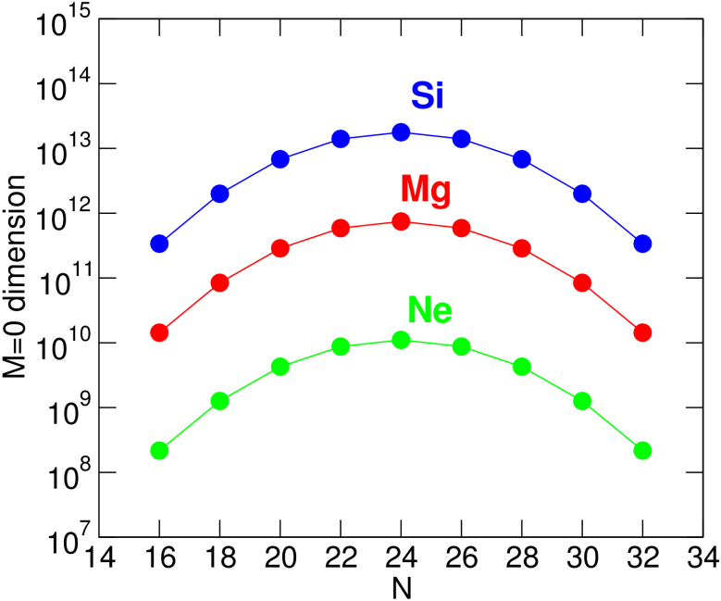
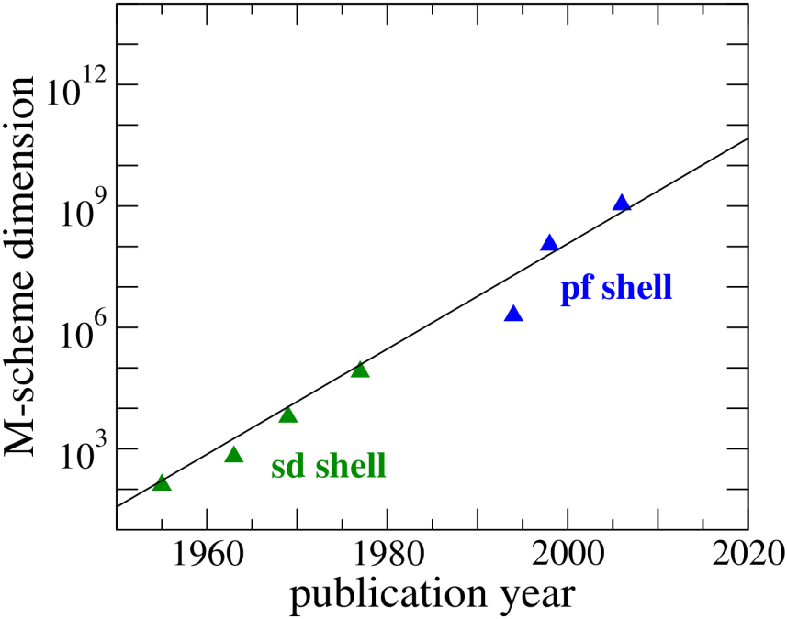
Challenges of the shell model
Diagonalizing a huge matrix
Effective interaction
The result is very sensitive to the interaction used, especially its monopole interaction, which characterizes the effective single-particle energy.
full sd-pf-shell calculation
current frontier

Slide 4
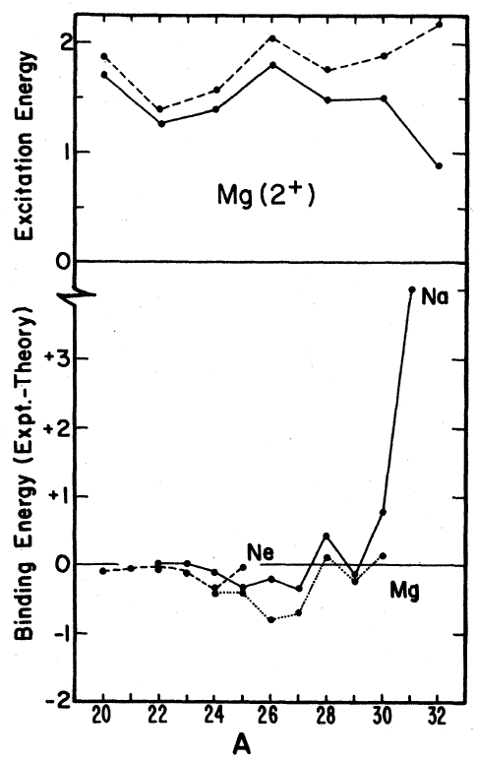
Breakdown of the sd-shell calculation
Comparison with sd-shell calc.
Full sd-shell calc. was possible around the early 1980s.
B.H. Wildenthal and W. Chung, Phys. Rev. C 22, 2260 (1980).

Slide 5
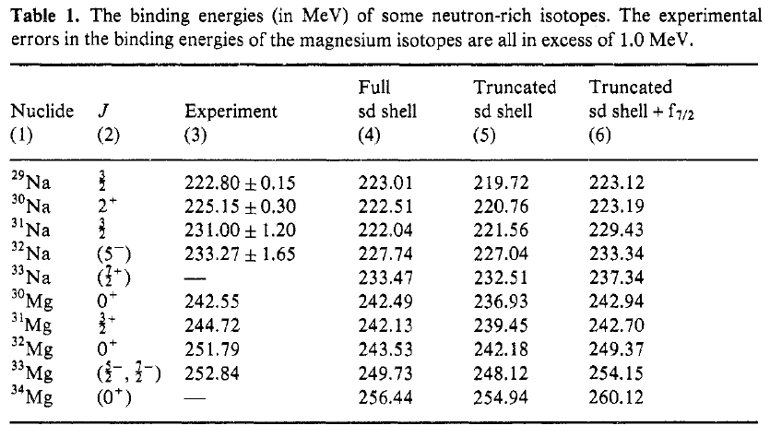
sd + f_{7/2} calc.
The first attempt to include f_{7/2}
A. Watt et al., J. Phys. G 7, L145 (1983).

Slide 6
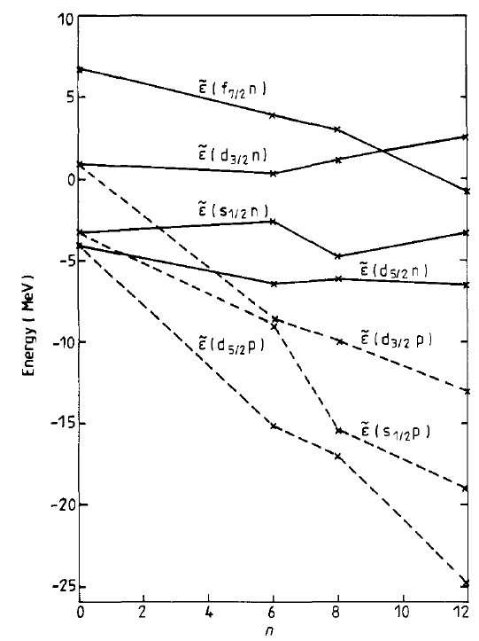
Effective single-particle energy
As far as I know, the paper of Storm et al. is the first paper that pointed out the importance of ESPE in the context of the island of inversion.
Inversion of single-particle energy?
Probably due to limit of a narrow model space
M.H. Storm et al., J. Phys. G 9, L165 (1983).

Slide 7
Shell-model calculations including p_{3/2}
f_{7/2}-p_{3/2}: Δj=2, a crucial role in quadrupole collectivity
Several studies from the late 1980s
Poves and Retamosa (1987, 1994)
sd + f_{7/2} + p_{3/2} with sub-shell and major-shell truncations
Warburton, Becker, Brown (1990)
Famous for the name of “island of inversion”
sd + pf, comparing between energies of 0ħω and 2ħω states (for some nuclei)
Fukunishi, Otsuka, Sebe (1992)
sd + f_{7/2} + p_{3/2} with major-shell truncations
Caurier, Nowacki, Poves, Retamosa (1998)
Similar to “island of inversion” calculations, but for many nuclei

Slide 8
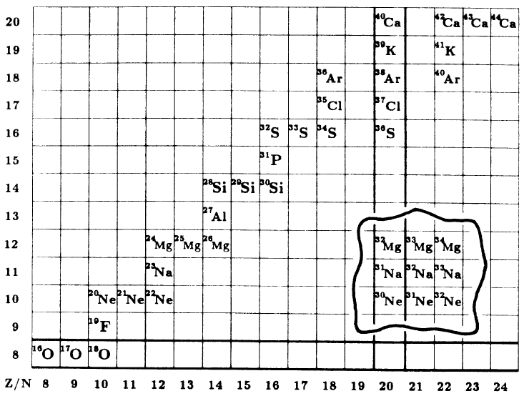
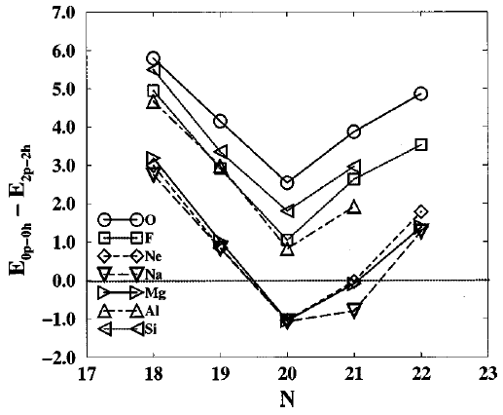
Island of inversion
Based on comparison between energies of 0ħω and 2ħω states without mixing between different ħω states
No need to change the sd-shell interaction
To avoid “nħω catastrophy”
Somewhat unrealistic but comprehensive
E.K. Warburton et al., Phys. Rev. C 41, 1147 (1990).
E. Caurier et al., Phys. Rev. C 58, 2033 (1998).

Slide 9
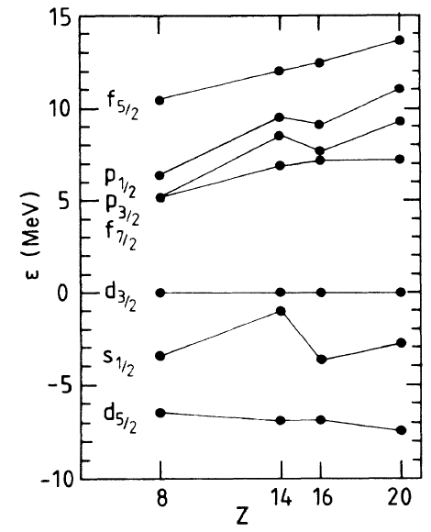
ESPE for “island of inversion” calculation
No sharp reduction of the N=20 gap is required.

Slide 10
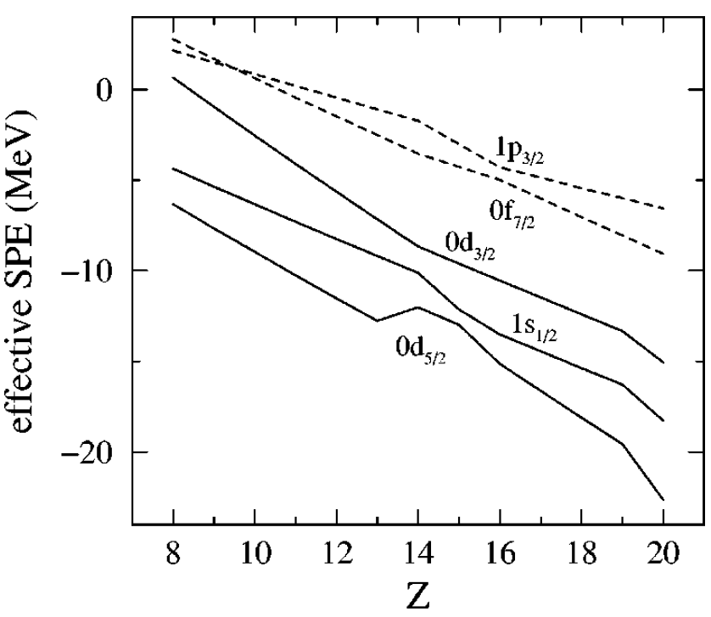
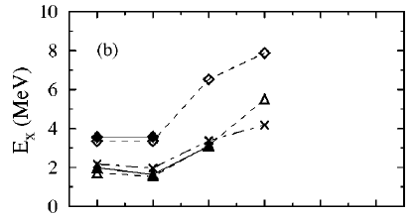
Revival of varying shell gap
Motivated by no bound oxygen isotopes with N>16
Dubbed a new N=16 magic number later (Ozawa et al., 2000)
Sharp change of the d_{3/2} orbit
Oxygen isotopes
2+
16
The high 2+ has been confirmed later.
Y. Utsuno et al., Phys. Rev. C 60, 054315 (1999).

Slide 11
Impact on the island of inversion
Monte Carlo shell-model calculations with the SDPF-M in the full sd + f_{7/2} + p_{3/2} space (without p-h truncation)
First satisfactorily large-scale shell-model calculations
Tested by many (more than 50?) experimental papers
The quality of the MCSM calculation is recently confirmed with the exact diagonalization (Up to ~10⁹ dimension).
accuracy of relative energy: ~0.1 MeV for band members, ~0.3 MeV for others
Upward shift of d_{3/2} = reduction of the N=20 gap for lower Z → Enlarges the island
Southern boundary (lower Z): gain of binding energy in fluorine isotopes
Western boundary (lower N): Onset of intruder for N<20
Northern and eastern boundary: under investigation

Slide 12
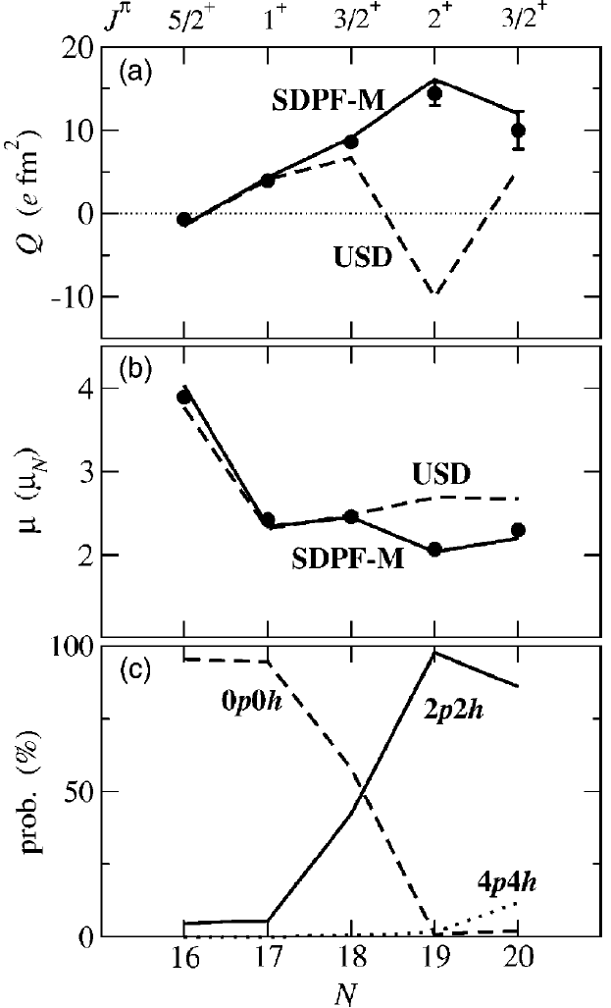
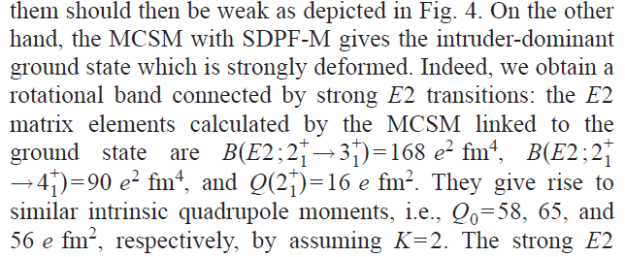
Onset of intruder state probed from moments
Na isotopes
Clear evidence for the intruder dominance in ³⁰Na
With MCSM calculations, many nuclei in the island (Ne, Na, Mg) are well deformed.
Y. Utsuno et al., Phys. Rev. C 70, 044307 (2004).

Slide 13
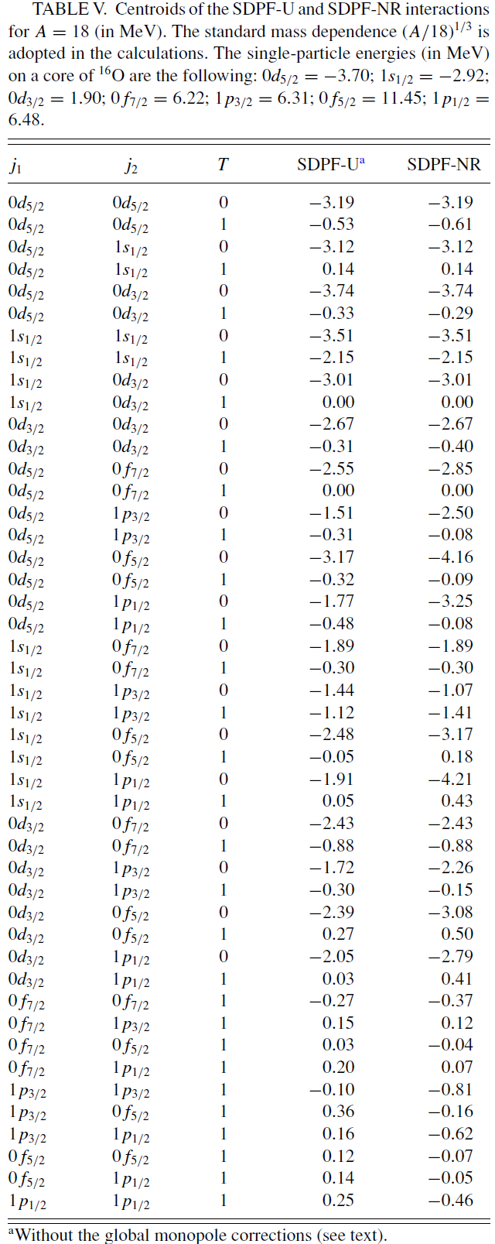
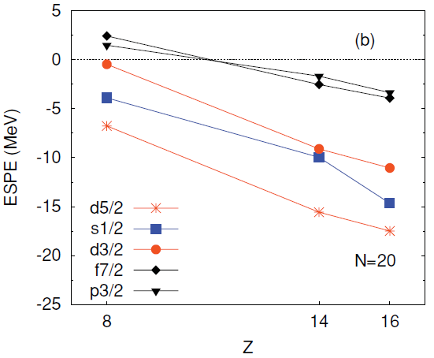
sd + pf calculation
Caurier, Nowacki, Poves (2013)
Called SDPF-U-MIX, based on SDPF-U for 0ħω calc.
SDPF-U: many free parameters (see right)
Dimensions of O(10¹⁰); truncation must be included.
Details are unclear, but its ESPE seems similar to that of SDPF-M

Slide 14
What causes the “inversion”?
Based on shell-model results:
Z=10-12 favors prolate deformation.
Shell structure
Reduction of the N=20 gap
Direct impact on 0ħω vs. 2ħω
Near degeneracy of f_{7/2} and p_{3/2}
Enhances quadrupole collectivity
p_{3/2}
f_{7/2}
20
d_{3/2}
16
s_{1/2}
intensive and extensive studies
to determine local behavior
to determine global behavior

Slide 15
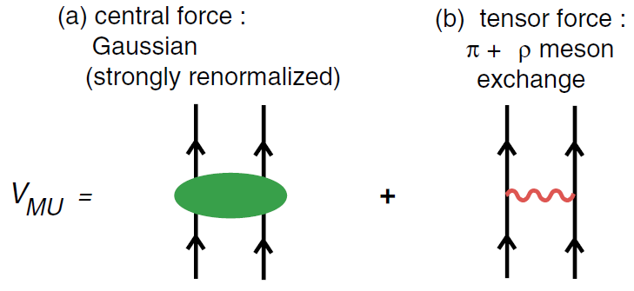
Shell evolution: a global property
After some studies, we have reached a comprehensive picture named the monopole-based universal interaction (V_{MU}) for describing the evolution of shell structure due to the effective interaction.
T. Otsuka et al., Phys. Rev. Lett. 104, 012501 (2010)

Slide 16
Basic properties
tensor force
central force
0f_{7/2}
0f_{7/2}
0d_{3/2}
0d_{3/2}
16
1s_{1/2}
16
1s_{1/2}
narrowing
nearly
constant
14
14
0d_{5/2}
0d_{5/2}
spin dependence → responsible for l∙s term
node dependence → responsible for l² term

Slide 17
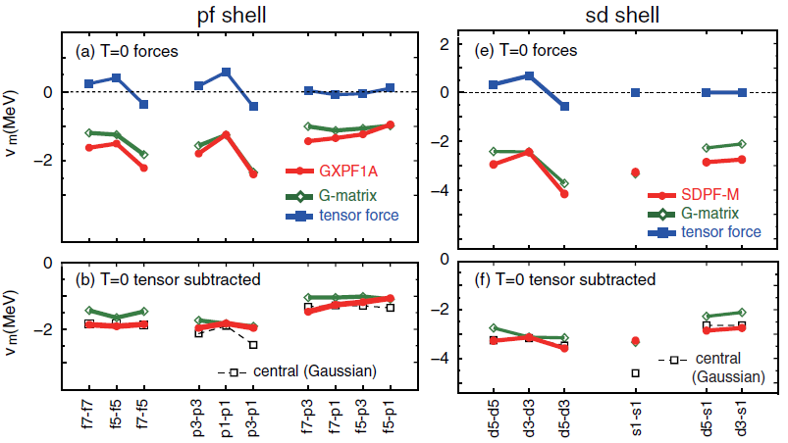
Foundation of V_{MU}: empirical
Tensor-subtracted monopole interaction
Strong and almost constant for the same node
Weaker and almost constant for different nodes

Slide 18
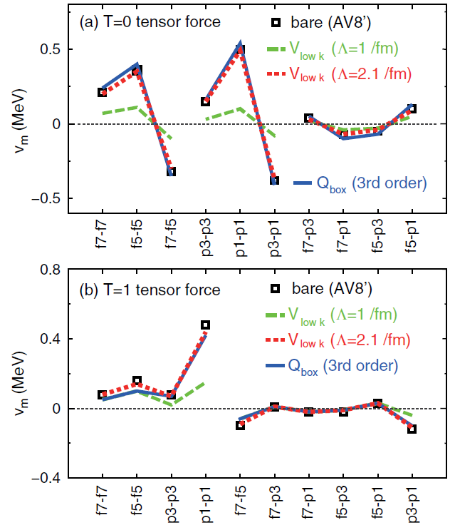
Foundation of V_{MU}: microscopic
“Renormalization persistency”: strength of the bare tensor force ≈ strength of the effective tensor force
Central force: strongly renormalized, phenomenological
Its strength can be determined by using a reference interaction (c.f., GXPF1 → sd-pf shell interaction)

Slide 19
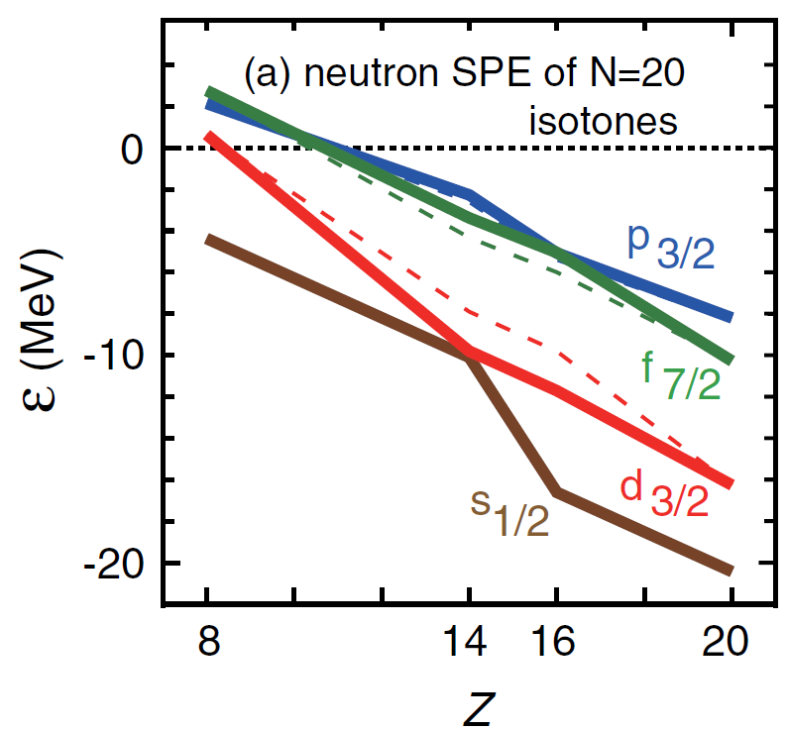
Shell evolution in the N=20 region with V_{MU}
Narrowing N=20 gap
Near degeneracy of f_{7/2} and p_{3/2}
Occurs even in ³⁶S with a modest S_{n}
 | π0d5/2 |  | π1s1/2 |  | π0d3/2
 | central | tensor | central | tensor | central | tensor
ν0d3/2 | ↓↓ | ↓ | ↓ | 0 | ↓↓ | ↑
ν0f7/2 | ↓↓ | ↑ | ↓ | 0 | ↓↓ | ↓
ν1p3/2 | ↓ | ↑ | ↓↓ | 0 | ↓ | ↓

Slide 20
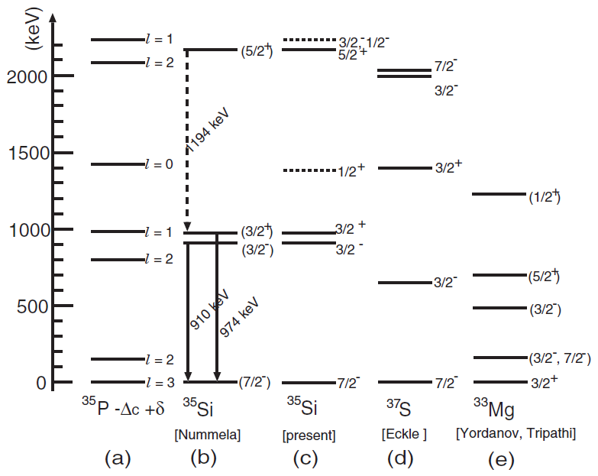
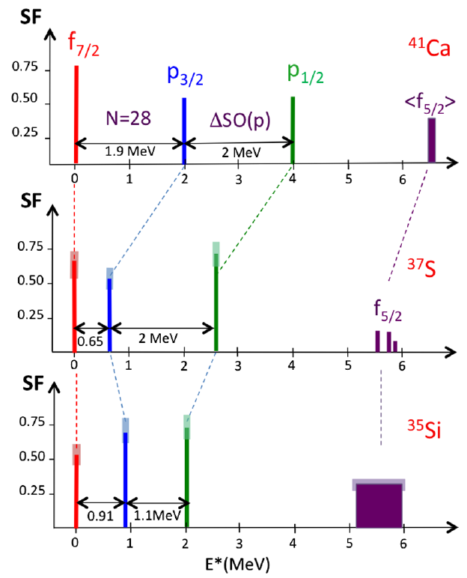
Single-particle properties
N. Imai et al., Phys. Rev. C 85, 034313 (2012).
G. Burgunder et al., Phys. Rev. Lett. 112, 042502 (2014).

Slide 21
Another example
Proton-hole states in K isotopes
Nothing to do with loosely binding
Re-inversion of the ordering is predicted.
 | 0f7/2 |  | 1p3/2
 | central | tensor | central | tensor
π0d3/2 | ↓↓ | ↓ | ↓ | ↓
π1s1/2 | ↓ | 0 | ↓↓ | 0
π0d5/2 | ↓↓ | ↑ | ↓ | ↑
3/2+ ground state in ⁵¹K (N=32) has
been observed recently.
J. Papuga et al., Phys. Rev. Lett. 110, 172503 (2013).

Slide 22
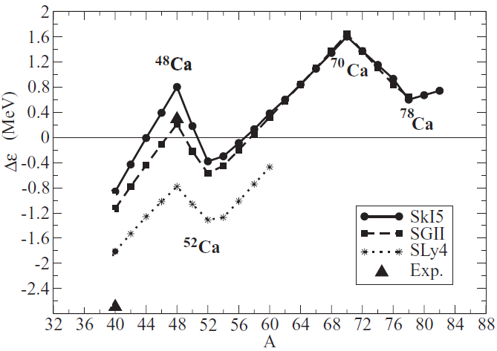
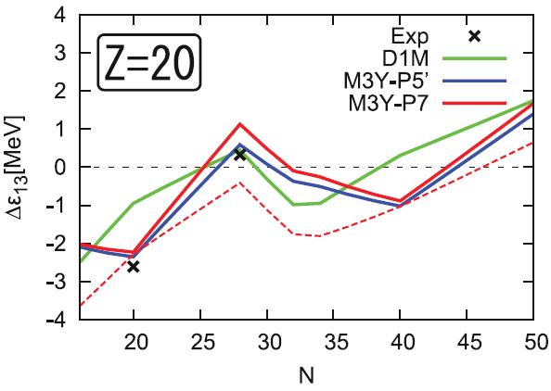
Central-force driven shell evolution
The central force is a common component among any interactions, with which this effect must be seen.
M. Grasso et al., Phys. Rev. C 76, 044319 (2007).
H. Nakada et al., Phys. Rev. C 87, 067305 (2013).

