Slide 1
Spatial measure of reaction size in proton scattering
－ Introduction of the scattering radius and its application－
M. Tomita, M. Iwasaki, R. Ohtani, and M. Ito
Department of Pure and Applied Physics, Kansai univ.

Slide 2
Introduction
Radius
2.40[fm]
Radius
3.47[fm]
1. Cluster structures in ¹²C
0₁⁺ state
0₂⁺ state at E_{x}=7.65 MeV
Radius of the 3α state is expected to be enhanced in a comparison to the ground state
( But direct measurement is difficult… )
2. Recent studies of 3α radius by nuclear reactions
A. Diffraction model （p+¹²C） K. Iida et al., MPLA27 (2012)
An enhanced diffraction radius is obtained in the transition of ¹²C_{g.s.}→¹²C(0₂⁺)
⇒ Diffraction radii are evaluated, but a relation between radius and 3α w.f. is NOT clear.
B. Microscopic coupled-channels （³He+¹²C） Sh. Hamada et al., PRC87 (2013)
Evolution of Airy structures are confirmed in the inelastic scattering of ¹²C_{g.s.}→ ¹²C(0₂⁺)
⇒ Nuclear interactions are constructed from 3α w.f., but radius is NOT evaluated.
3. Present approach
We combine the advantages in A and B M. Tomita et al., PRC89 (2014)
p+¹²C Microscopic coupled-channel
We define radii of the scattering area
Interactions are constructed from 3α w.f.
¹²C(0₁⁺)→¹²C(0₁⁺, 0₂⁺, 2₁⁺, 2₂⁺, 3₁⁻)

Slide 3
Scattering radius
total spin
orbital spin
We characterize the spatial size of scattering area.
0⁺
（1）General scattering theory
nucleon spin
⇒partial cross section
⇒We calculate the radius of the scattering area from .
（2）Definition of the scattering radius
cf. mean matter radius
Effective orbital spin of an incident wave
:matter density
k, incident wave number
⇒ scattering radius:
⇒We can always define the scattering radius in the standard scattering calculation.

Slide 4
Black sphere limit of the scattering radius
We consider the high energy scattering by a black sphere potential
Black sphere potential
Partial cross section of the BS scattering
W(r)
r
for
r.m.s of Black sphere
for
Effective orbital spin and the scattering radius
A. Kohama et al.
PRC69 (2009)
( high BS scattering limit )

Slide 5
Framework
¹²C
2₂⁺
3₁⁻
0₂⁺
2₁⁺
3α
（１）Coupled-channel equation
0₁⁺
¹²C
⇒diff. cross sec.
partial cross sec.
（２）Coupling Potential
phenomenological WS pot. of vol. + surf. type
central potential
:DDM3Y effective NN interaction
:the TO part of the M3Y LS interaction
spin-orbit potential
G. Bertsch et al., Nucl.Phys. A284(1977).
:transition density of 3αRGM
M. Kamimura, Nucl. Phys. A351 (1981).

Slide 6
Results of the differential cross section
＊：experimental data
red line：DDM3Y+multi channel
(incident energy E_{lab}=65MeV)
ground channel (0₁⁺)
3α channel (0₂⁺)
(incident energy E_{lab}=35.2MeV)
ground channel (0₁⁺)
3α channel (0₂⁺)

Slide 7
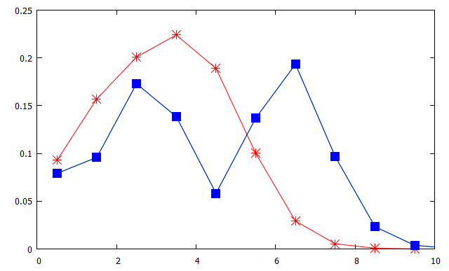
Results of the partial cross section
incident energy E_{lab} = 65MeV
ground channel(0₁⁺)
0.2
3α channel(0₂⁺)
0.1
Partial cross section
0
0 2 4 6 8 10
Total spin J
3α channel has the extended distribution
⇒Scattering occurs in the wide spatial region in the 3α channel

Slide 8
Results of the scattering radius
incident energy E_{lab}=65MeV
 | ground channel(0₁⁺) | 3α channel(0₂⁺)
effective orbital spin | 4.83 | 6.55
scattering radius Rsc [fm] | 2.73 | 3.70
matter radius [fm]※ | 2.40 | 3.47
※M. Kamimura, NPA351 (1981).
Rsc is enhanced in the 3α channel
⇒Inelastic scattering to 3α channel occurs at a large distance region

Slide 9
Results of the differential cross section
(incident energy E_{lab}=65MeV)
＊：experimental data red line：DDM3Y+multi channel
2₁⁺
3₁⁻
(incident energy E_{lab}=35.2MeV)
2₁⁺
3₁⁻

Slide 10
Scattering radius for channels with a finite spin
We should extend the definition of in the finite spin channel
If the final channel has a finite spin S, the partial cross sections are modified like
spinless transition
transition with a finite spin
Initial
0₁⁺ ⇒
Final 0₂⁺
Initial
0₁⁺ ⇒
Final 2₁⁺, 2₂⁺, 3₁⁻
initial and final channels
initial ch.
final ch.
S : final spin
L is common in both the
initial and final channels
is calculated from the
average of the initial orbital spin L

Slide 11
Scattering radius with the finite spin
2₂⁺
3₁⁻
0₂⁺
2₁⁺
3α
0₁⁺
¹²C
incident energy E_{lab} = 65MeV
 | 0₁⁺ | 2₁⁺ | 0₂⁺ | 2₂⁺ | 3₁⁻
effective orbital spin | 4.83 | 5.67 | 6.55 | 7.16 | 6.47
scattering radius Rsc [fm] | 2.73 | 3.21 | 3.70 | 4.04 | 3.65
matter radius [fm]※ | 2.40 | 2.38 | 3.47 | 4.00 | 2.76
※M. Kamimura, NPA351 (1981).
Rsc is enhanced in the 0₂⁺, 2₂⁺ and 3₁⁻ channels.
The scattering radius of 2₂⁺ is strongly enhanced
※Y. Funaki et al., EPJA24 (2005)

Slide 12
Incident energy dependence of Rsc
2₂⁺
K. Iida et al.
MPLA27
E_{p} = 1040MeV
0₂⁺
3₁⁻
2₁⁺
3.20 fm
（0₂⁺）
0₁⁺
2.75 fm
（0₁⁺）
The scattering radius doesn’t depend so much on the incident energy.

Slide 13
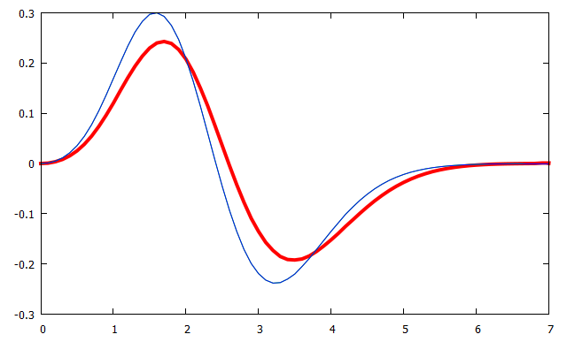
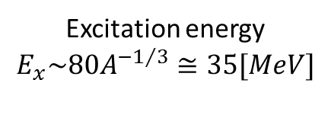
Comparison of cluster with mono. Vib.
Bohr-Mottelson model for the tr. density
Excitation energy
$$E_{x}^{}\sim 80A^{{−1}/3}≅35[MeV]$$
$${ ρ}_{0_{1}^{+}→0_{2}^{+}}^{BM}\left(R\right)=−β\left[3ρ_{0_{1}^{+}}\left(R\right)+\frac{dρ_{0_{1}^{+}}\left(R\right)}{dR}\right]$$
$$β is taken to be the same strength as the 3α excitation$$
$ρ_{0_{1}^{+}}$：density of the ground state
$$0_{2}^{+}$$
0.3
(35MeV)
0.2
3α model
0.1
R²ρ(R) (fm⁻¹)
0
$$ρ_{0_{1}^{+}→0_{2}^{+}}(R){・R}^{2}[{fm}^{−1}]$$
-0.1
$$0_{2}^{+}$$
-0.2
(7.65MeV)
Mono. Vib.
$$0_{1}^{+}$$
$$0_{1}^{+}$$
-0.3
0 1 2 3 4 5 6 7
3α excitation
Mono. Vib.
excitation
distance$R[fm]$
⇒Distributions of the transition density are similar, but the excitation energies are
very different between 3α and monopole vibrational state

Slide 14
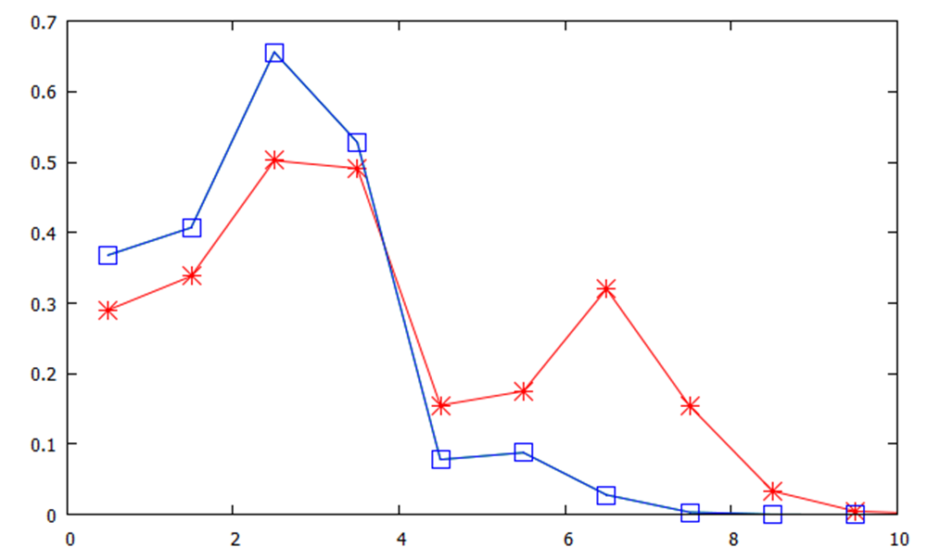
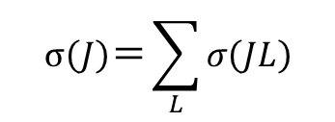
Comparison of 3α with vibration
$$σ\left(J\right)＝\sum_{L}{σ\left(JL\right)}$$
（Ep = 65MeV）
0.7
0.6
Mono. Vib. $\left(0_{2}^{+}\right)$
0.5
0.4
3α channel$\left(0_{2}^{+}\right)$
Partial Cross sections (a.u.)
0.3
0.2
0.1
0
0 2 4 6 8 10
Total spin $J$
Extended distribution in the 3α channel
⇒Scattering area of 3α is larger than that of mono. Vib. state

Slide 15
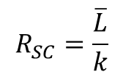
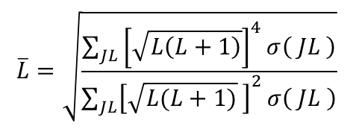
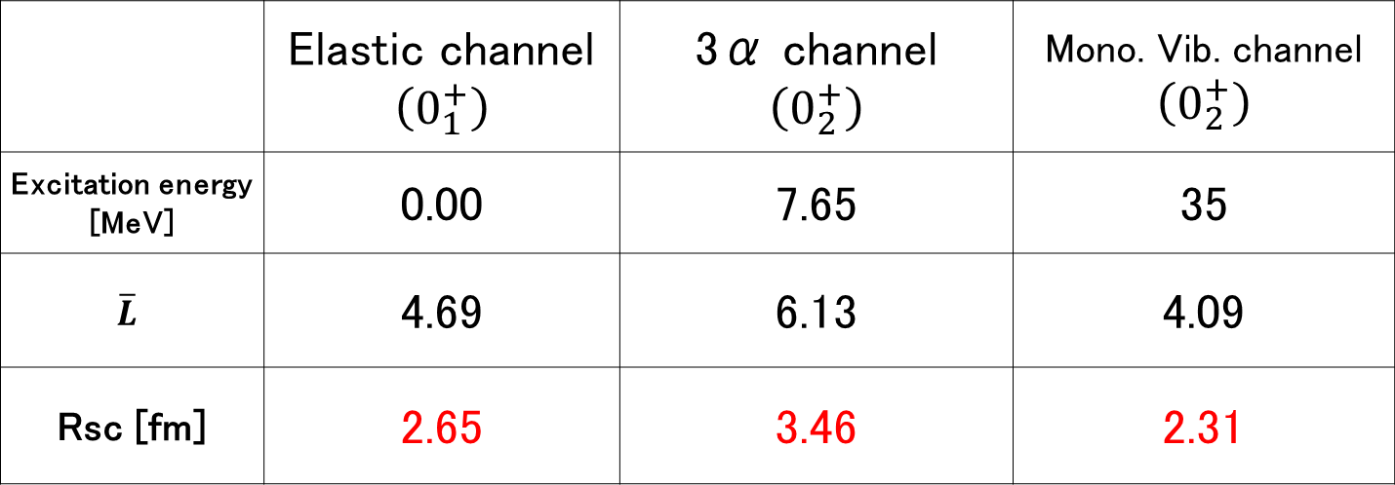
Comparison of the scattering radius
$$\overline{L}=\sqrt{\frac{\sum_{JL}{{\left[\sqrt{L\left(L+1\right)}\right]}^{4}}σ\left( JL \right)}{\sum_{JL}{{\left[\sqrt{L(L+1)} \right]}^{2}}σ\left( JL \right)}}$$
$$R_{SC}=\frac{\overline{L}}{k}$$
（Ep = 65MeV）
 | Elastic channel $$\left(0_{1}^{+}\right)$$ | 3α channel $$\left(0_{2}^{+}\right)$$ | Mono. Vib. channel $$\left(0_{2}^{+}\right)$$
Excitation energy [MeV] | 0.00 | 7.65 | 35
$$\overline{L}$$ | 4.69 | 6.13 | 4.09
Rsc [fm] | 2.65 | 3.46 | 2.31
Scattering radius of the 3α channel is extended in comparison to the mono. Vib. channel
⇒There is a possibility that the scatt. radius is sensitive to the structure of the final channel

Slide 16
Summary
M. Tomita, M. Iwasaki, R. Otani, M. Ito, PRC89, 034619 (2014)
We have performed the microscopic coupled-channel calculation of the p+¹²C
inelastic scattering going to the 0₁⁺, 0₂⁺, 2₁⁺, 2₂⁺ and 3₁⁻ states (DDM3Y+3αRGM w.f.).
We have derived the scattering radii of the individual channels.
The incident energy dependence of the scattering radius has been checked.
Results
The scattering radius is considered to characterize a reaction radius.
A prominent enhancement of the scattering radius is found in cluster channels(0₂⁺, 2₂⁺).
The scattering radius doesn’t depend so much on the incident energy.
Future studies
We should optimize the Potential parameters.
Possible variety of the effective orbital spin should be considered.
Systematic studies of other systems ( ¹⁶O=α+¹²C, ²⁰Ne = α+¹⁶O )

