Slide 1
fsPHENIX and
Hadron Calorimeters
3rd Korea-Japan PHENIX Collaboration Meeting
November 28, 2014 at RIKEN
Yuji Goto (RIKEN)

Slide 2
What is fsPHENIX?
fsPHENIX = forward sPHENIX
  pp/pA whitepaper of PHENIX
  Submitted to and presented at PAC in June 2014
    https://indico.bnl.gov/materialDisplay.py?materialId=5&confId=764
    BNL-wide discussion
  To be updated for wider discussion
sPHENIX under DOE review process
  DOE science review in July 2014
    Barrel detector only
  Updated proposal submitted to ALD in November 2014
    http://www.phenix.bnl.gov/phenix/WWW/publish/documents/sPHENIX_proposal_19112014.pdf
    including forward Hadron Calorimeter in Appendix A
  To be submitted to DOE

Slide 3
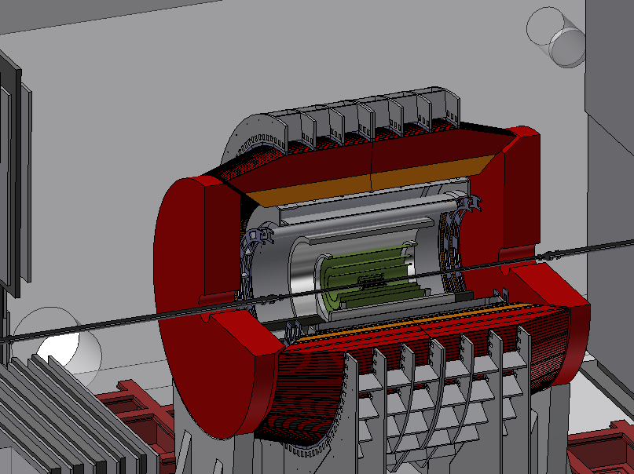
Physics at fsPHENIX
sPHENIX baseline (barrel only)
sPHENIX + fsPHENIX
Transverse spin physics
  Transverse spin “puzzle”
  Large single spin asymmetry (SSA) in the forward region
  Understanding of the orbital motion
  Contribution of the anguler orbital momentum to the proton spin 1/2
p+A and p↑+A physics
  Cold Nuclear Matter (CNM) effects
  Polarization for probe to the gluon saturation

Slide 4
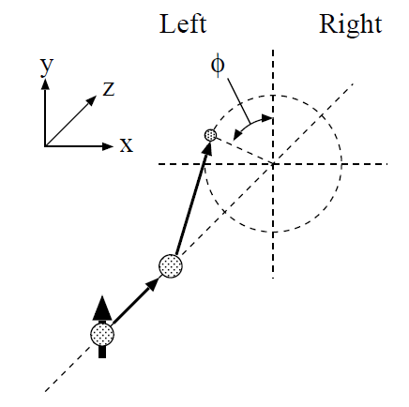
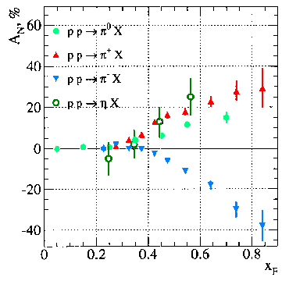
Transverse-spin physics
Single transverse-spin asymmetry
  Expected to be small in hard scattering at high energies
FNAL-E704
  Unexpected large asymmetry found in the forward-rapidity region
  Development of many models based on perturbative QCD

Slide 5



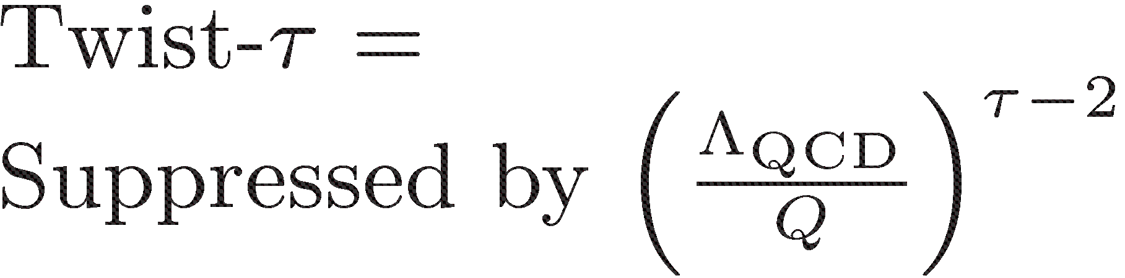

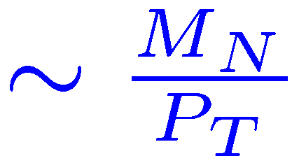



TMD and higher-twist
Described by TMD (Transverse Momentum Dependent) functions at low p_{T} and high Q²
  Sivers effect
    Sivers function (initial-state)
  Collins effect
    Transversity (initial-state) + Collins function (final-state)
Described by higher-twist effect at high p_{T}
  Quark-gluon and multi-gluon correlations
Common description at medium p_{T}
Inclusive π⁰

Slide 6
TMD and higher-twist
Common description by TMD distribution and higher-twist effect at medium p_{T}
Sign mismatch of experimental data
  Large contribution from Collins effect in polarized p+p collisions?
  Polarized SIDIS experiment at high x region necessary?
Joint fit to SIDIS and pp data
from pp data
SIDIS
pp
Kang, Qiu, Vogelsang, Yuan:
PRD83, 094001 (2011)
Kang, Prokudin:
PRD85, 074008 (2012)

Slide 7
Description at high p_{T}
SSA (A_{N}) expected to be decreasing at high p_{T} in polarized p+p collisions, but no decrease in the experimental data
  Large contribution from Collins effect?
PHENIX √s = 200 GeV arXiv:1312.1995
STAR √s = 200 GeV
PRL101, 222001 (2008)
PHENIX √s = 62.4 GeV arXiv:1312.1995
STAR √s = 500 GeV preliminary

Slide 8
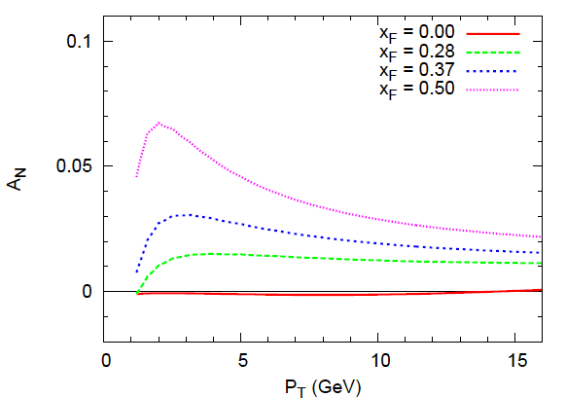
Description at high p_{T}
STAR √s = 500 GeV preliminary
Anselmino, et al.: PRD88, 054023 (2013)
Sivers effect
Collins effect
Koike, Kanazawa: Twist-3 effect
Described by sum of Sivers effect and Collins effect?
TMD evolution need to be evaluated, too

Slide 9
Jet measurement in polarized p+p
Separation of initial-state effect and final-state effect
  Initial-state effect: jet-asymmetry measurement
  Final-state effect: asymmetry measurement inside of jets
Jet-asymmetry measurement at AnDY
Gamberg, et al.:
PRL110, 232301 (2013)
Anselmino, et al.:
PRD88, 054023 (2013)
D’Alesio, et al.:
arXiv:1307.4880.

Slide 10
Drell-Yan measurement in polarized p+p
Establishment of non-universality of TMD distribution function
  Opposite-sign contribution of TMD distribution function to SSA in SIDIS process and Drell-Yan process
  Fundamental property based on gauge invariance of QCD
  Experimental verification required
SIDIS
Drell-Yan

Slide 11
p+A physics
Cold Nuclear Matter (CNM) effects
Nuclear PDFs
  Measurement of the nuclear gluon distribution G_{A}(x)
  Important to understand multiple scattering / higher-twist effect over a broad range of η for transition from dilute region to saturation region
  Jet+jet and hadron+hadron correlations to take advantage of fsPHENIX + sPHENIX jet coverage
Ridge & flow (collective behavior)
  Wide rapidity coverage required
Energy loss of partons and p_{T} broadening

Slide 12
Gluon saturation
Suppression of G_{A}(x) at small-x
  Forward physics
Gluon density is higher in the smaller-x region
The gluon density must be saturated due to size of the nuclei
Color glass condensation (CGC) framework provides precision prediction
  Effective field theory based on classical gluon description

Slide 13
Jet measurement in p+A
Comparison of RHIC and LHC
  To cover transition from dilute region to saturation region
  Global analysis for precision study
R_{pA} comparison to LHC data
  Suppression of jets in central collisions and enhancement in peripheral collisions

Slide 14
p+A physics with fsPHENIX
p↑+A collisions: unique capability of RHIC
SSA suppressed in p↑+A?
  First answer to be given by MPC-EX measurement in 2015 run
Z.-B.Kan and F.Yuan
PRD84, 034019 (2011).
p_{T} (GeV/c)

Slide 15
fsPHENIX detector
A detector for a comprehensive program of spin structure and CNM investigations
Forward VTX (FVTX)
  3 planes covering 1.1 < η < 3
  3 planes covering 3 < η < 4
3 GEM trackers
Field shaper piston
  Made of 50% Co + 50% Fe
Forward HCAL (fHCAL)
MuID + miniMuID

Slide 16
Jet measurement at fsPHENIX
Jet acceptance 1.7 < η < 3.3 with anti-k_{T} R=0.7
Small asymmetry measured by AnDY
  Cancellation between u- and d-quarks
A cut on the charge of the leading hadron changes the composition of the jet sample

Slide 17
Jet measurement at fsPHENIX
Projected fsPHENIX data points (97 pb⁻¹) compared to theoretical models
Projected statistical
precision for jet A_{N}
(w/ z>0.5 leading h±)
Expected
theory constraints

Slide 18
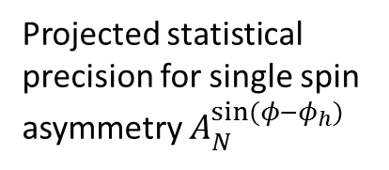
Jet measurement at fsPHENIX
Asymmetry measurement inside of jets
  Issue is z-resolution as a function of jet energy
Projected statistical
precision for single spin
asymmetry $A_{N}^{sin⁡(φ−φ_{h})}$

Slide 19
Drell-Yan measurement at fsPHENIX
To test the “non-universality”
Comparison with COMPASS-II
  Figure of Merit (FoM)
  Kinematic region

Slide 20
Drell-Yan measurement at fsPHENIX
Statistical sensitivities
  With and without Sivers function evolution
Better S/B (lower heavy-flavor cross section) but reduced luminosity at √s = 200 GeV
Higher luminosity (higher statistics) but higher background at √s = 510 GeV

Slide 21
Forward HCAL simulation
Geant4 simulation
  30 layers of Fe:scintillator(= 4:1) in 1 meter
Event display
  PYTHIA p+p 510 GeV
  Forward jet event of η=1.9
Forward HCAL on both ends of sPHENIX
  No gap between barrel HCAL and forward HCAL at η = 1.1
  Study what an ultimate large η acceptance can provide for sPHENIX
  Mimic back scattering from flux return yoke

Slide 22
Forward HCAL simulation
Geant4 simulation

Slide 23
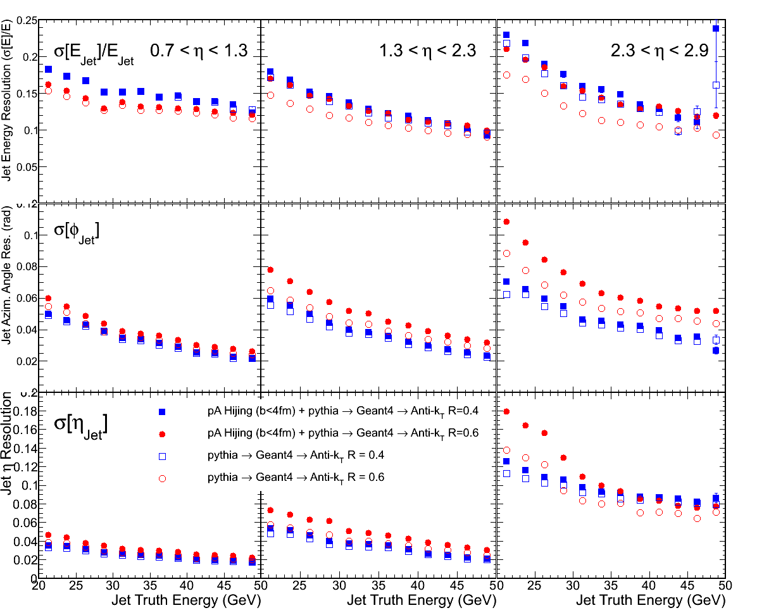
Forward HCAL simulation
Jet simulation for p+p and p+A with FastJet anti-k_{T} algorithm with R=0.4 and R=0.6
Sampling ratio of ∼4.3% (not corrected)
Energy
resolution
φ resolution
η resolution

Slide 24
Summary
Physics at fsPHENIX
  Transverse-spin physics
    Jet for separated initial-state and final-state effects
    Drell-Yan to test non-universality
  p+A and p↑+A physics
    Gluon saturation
    Nuclear PDF
fsPHENIX detector design/simulation underway
  To be included in sPHENIX
To be used (partially) in the eRHIC detector
Towards more forward physics
  Diffraction physics with the most forward detectors discussed by next speakers (RHICf and Roman Pot)

Slide 25
Backup Slides

Slide 26
Direct photon in polarized p+p
Gamberg, et al.:
PRL110, 232301 (2013)
Anselmino, et al.:
PRD88, 054023 (2013)
Kanazawa, Koike:
PLB720 (2013) 161
√s=200GeV
η=3.5

Slide 27
p+A physics
p+A physics is a new window to study novel QCD dynamics
Gluon saturation
  Parton distribution in small x → forward physics
Nuclear PDFs
  Important to understand multiple scattering / higher twist effect in forward rapidity for transition from dilute region to saturation region
Ridge & flow (collective behavior)
  Wide rapidity coverage required

Slide 28
Field shaper piston
Hiperco-50
  Passive piston helping flux return at small angle
  49% Co + 49% Fe alloy providing high field saturation (<2.25 T)

Slide 29
Jet measurement at fsPHENIX
Jets from standard PYTHIA Tune-A
Beam remnants from Tune-A with kT = 0.36 GeV/c
A cut on the charge of the leading hadron changes the composition of the jet sample

Slide 30
Drell-Yan measurement at fsPHENIX
Background simulations

