Slide 1
Alignment of the PHENIX Silicon Vertex Tracker (VTX) in 2014
Yasuyuki Akiba
Takashi Hachiya
Hidemitsu Asano
Taebong Moon
Yonsei Univ./RIKEN
Nov. 27th 2014

Slide 2
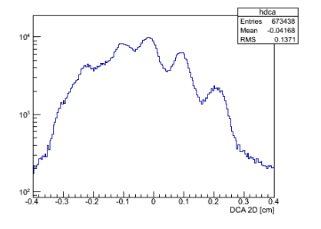
Motivation of the alignment
Alignment:
  Equalizing the expected detector position to the installed position.
Mis-alignment:
  will degrade quality of measurement.
    ex) DCA, pT, invariant mass, primary vertex and etc..
  can lead to ineffective/wrong physical conclusion.
y
Reconstructed track
Real particle track
x
Distance of Closest Approach
(DCA2D)
Primary vertex

Slide 3
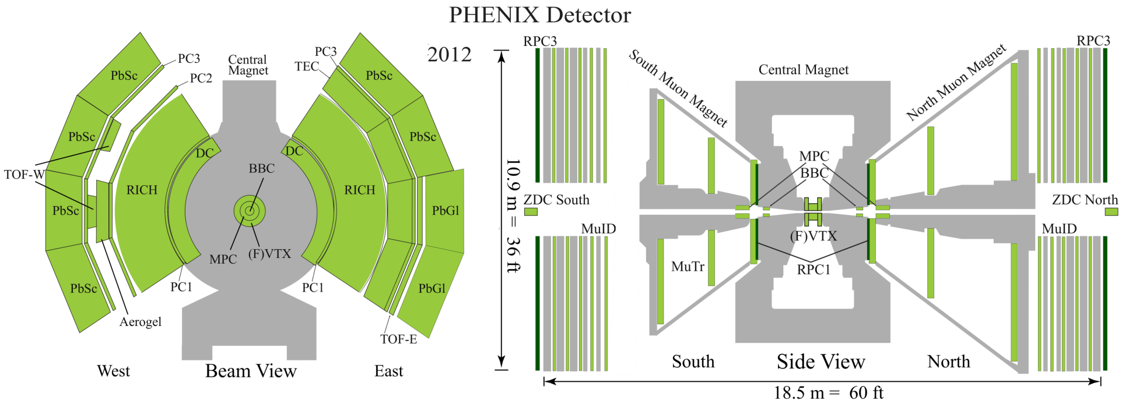
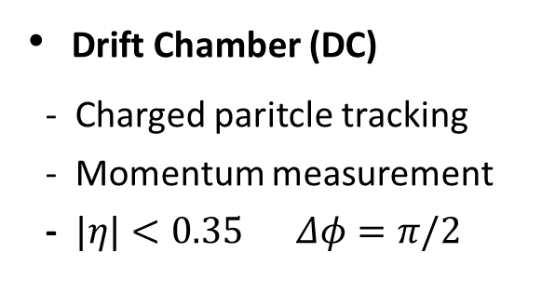
PHENIX detector
Silicon Vertex Tracker (VTX)
- Primary/secondary vertex
- Global/standalone tracking
- DCA measurement
Drift Chamber (DC)
- Charged paritcle tracking
- Momentum measurement
- $|η|<0.35$ $Δφ=π/2$

Slide 4
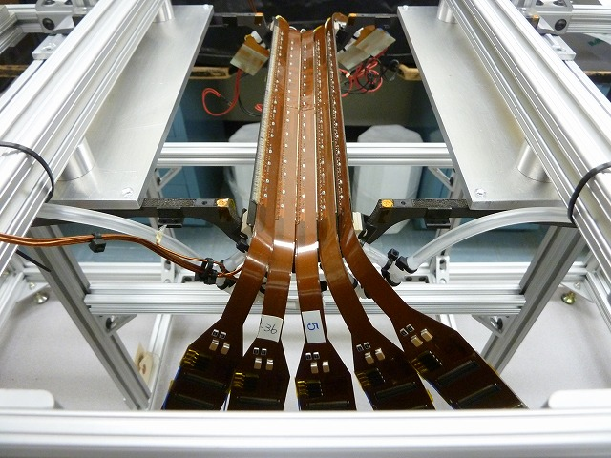
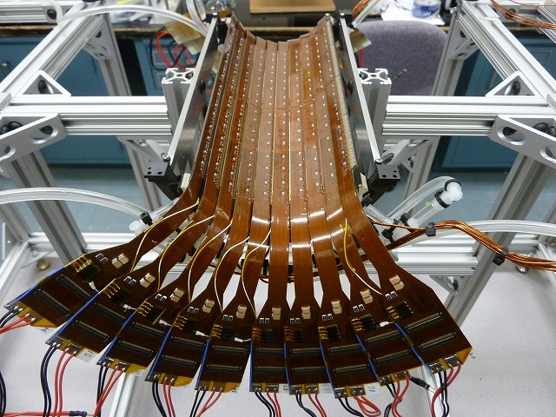
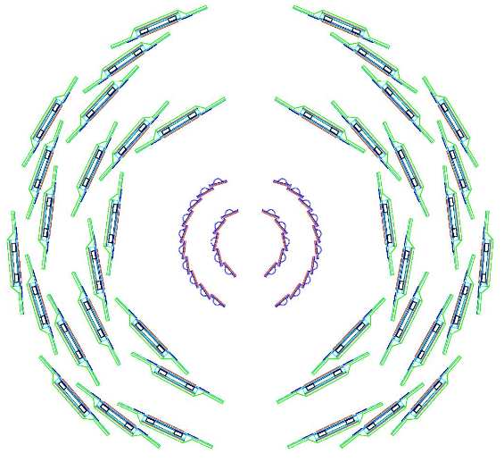
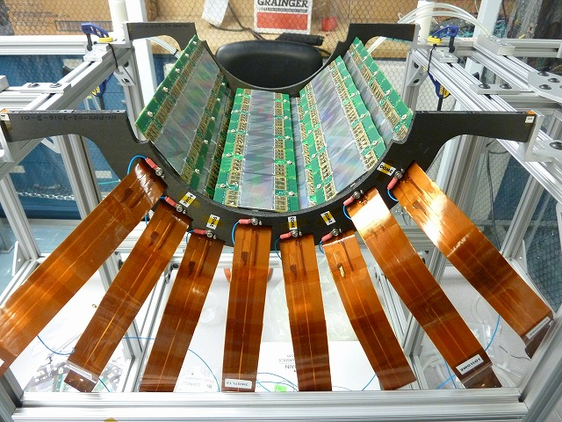
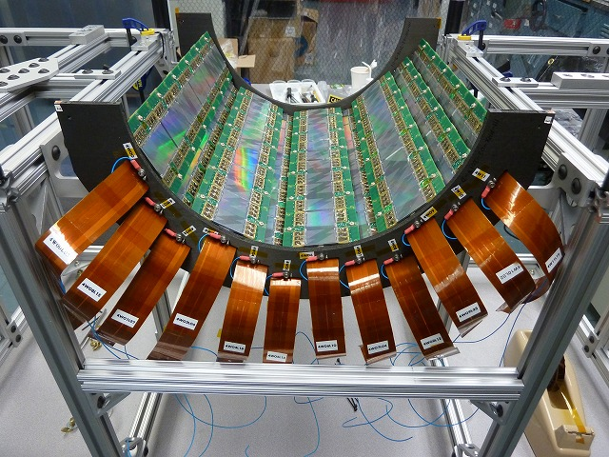


Silicon Vertex Tracker (VTX)
B0
B1
EAST
Y
WEST
B2
B3
X
$$|η|<1.2$$
$$Δφ\sim 2π$$
Layer | Kind | R (cm) | Z (cm) | RO Channel | # Ladders
0 | Pixel | 2.5 | ±10 | 1,310,720 | 10
1 | Pixel | 5 | ±10 | 2,671,440 | 20
2 | Strip-pixel | 11.7 | ±16 | 122,880 | 16
3 | Strip-pixel | 16.6 | ±19 | 221,184 | 24

Slide 5
Alignment procedure
Offset calibration
  VTX and DCH of both west and east have their own coordiante systems.
  The origins of the detector don’t coinside with each other.
  Should take account of the relative positions first.
VTX ladder by ladder alignment
  The expected location of the ladders is different from the installed location.
  Should equalize them.

Slide 6
Offset calibration using field-off run
Beam Center
(reference point)
Relative positions can be calculated if we know BCs in their own internal coordinates.
BC by VTXE in VTXE coordinate
BC by VTXW in VTXW coordinate
O(VTXE)
EastToWest offset
O(VTXW)
BC by DCHW in DCHW coordinate
VTXToCNT offset
O(DCHW)

Slide 7
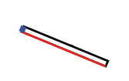
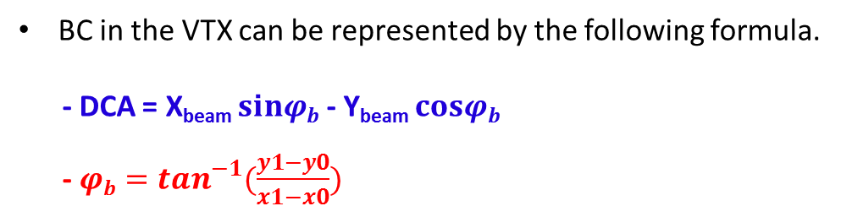

Beam center in the VTX
BC in the VTX can be represented by the following formula.
  - DCA = X_{beam} $sinφb$ - Y_{beam} $cosφb$
- ${φb=tan}^{−1}{(\frac{y1−y0}{x1−x0}})$
(x1, y1)
Y
Beam center
(X_{BEAM}, Y_{BEAM})
(x0, y0)
DCA from O
$$φb$$
O (VTX)
X

Slide 8
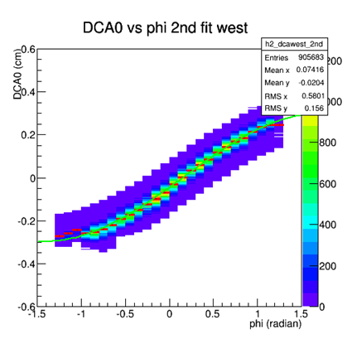
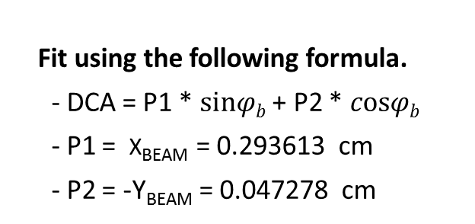

Beam center in the VTX
DCA [cm]
Beam Center
(reference point)
BC by VTXE in VTXE
BC by VTXW in VTXW
$φb$ [rad]
O(VTXE)
  Fit using the following formula.
  - DCA = P1 * $sinφb$ + P2 * $cosφb$
  - P1 = X_{BEAM} = 0.293613 cm
  - P2 = -Y_{BEAM} = 0.047278 cm
EastToWest offset
O(VTXW)

Slide 9
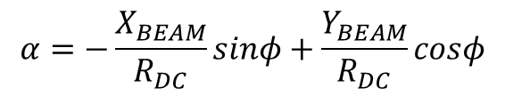
Beam center by DCH
Due to offset btw beam center and the origin of DC, α is not 0 and represented by following formula.
$$α=−\frac{X_{BEAM}}{R_{DC}}sinφ+\frac{Y_{BEAM}}{R_{DC}}cosφ$$
α
Track by DC from BC
Beam center
(X_{BEAM}, Y_{BEAM})
DCH West Arm
Ф
O (DCH)

Slide 10
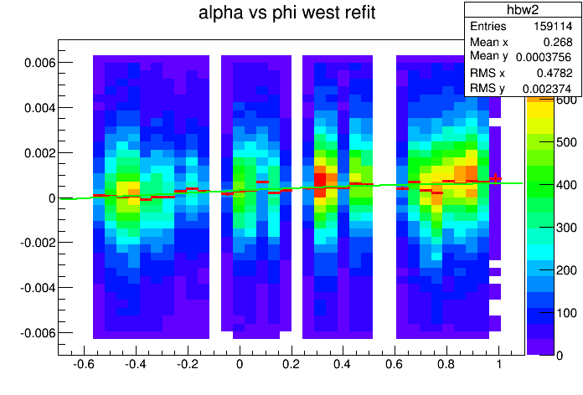


Beam center in the DCH
Beam Center
(reference point)
BC by DCH in DCH
$$X_{BEAM}=−0.115619cm$$
O(DCH)
$$Y_{BEAM}=0.0641195cm$$

Slide 11
Offset calibration using field-off run
Beam Center
(reference point)
Relative positions can be calculated if we know BCs in their own internal coordinates.
BC by VTXE in VTXE coordinate
BC by VTXW in VTXW coordinate
O(VTXE)
EastToWest offset
O(VTXW)
BC by DCHW in DCHW coordinate
VTXToCNT offset
O(DCHW)

Slide 12
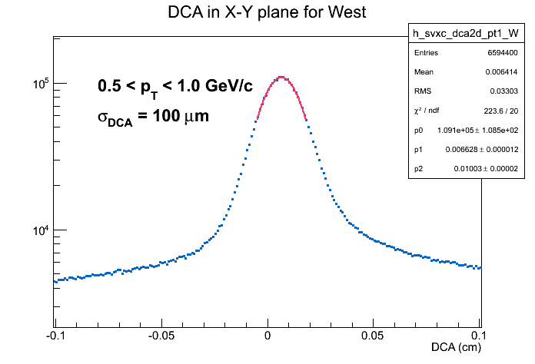
After offset calibration using field-off and -on run
Before offset calib
After offset calib
DCA in X-Y plane (cm)
DCA in X-Y plane (cm)
DCA in X-Y plane became a Gaussian distributin after offset calib.
The problem still exists.
  The mean of Gaussian is shifted to the right.
  A poor DCA resolution.
VTX ladder by ladder alignment is requred.

Slide 13




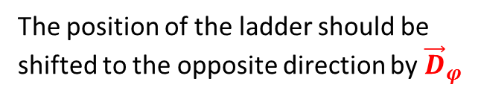




Alignment in $φ$ (ladder by ladder)
Trajectory estimated by initial vector by DC
$$y$$
Real hit in VTX
$$x$$
$${\vec{D}}_{φ}$$
Expected hit in VTX
$${\vec{D}}_{1}$$
$${\vec{D}}_{2}$$
${\vec{D}}_{φ}={\vec{D}}_{1}−{\vec{D}}_{2}$: Residue in φ.
$$\vec{u}$$
The position of the ladder should be shifted to the opposite direction by ${\vec{D}}_{φ}$
Primary vertex by VTX

Slide 14
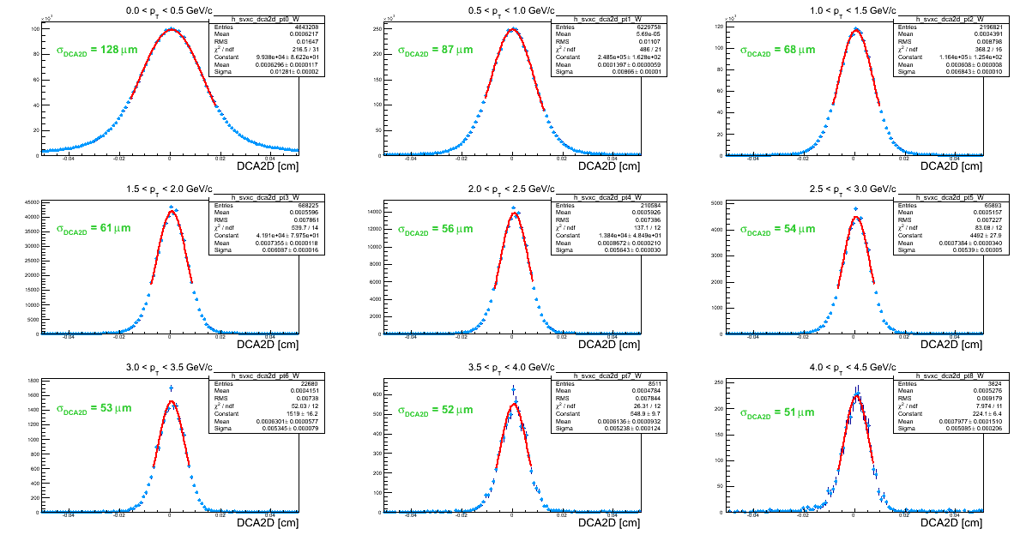
DCA in X-Y plane

Slide 15
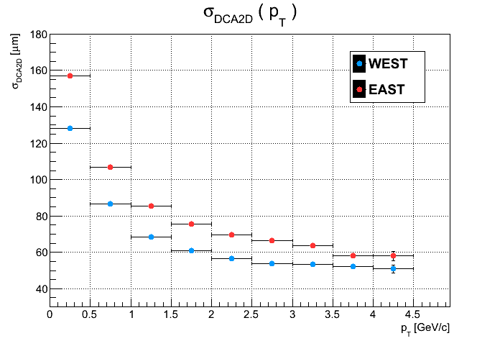
DCA resolution in X-Y plane
DCA resolution becomes better as pT increased.

Slide 16
DCH moving
VTX moving

Slide 17
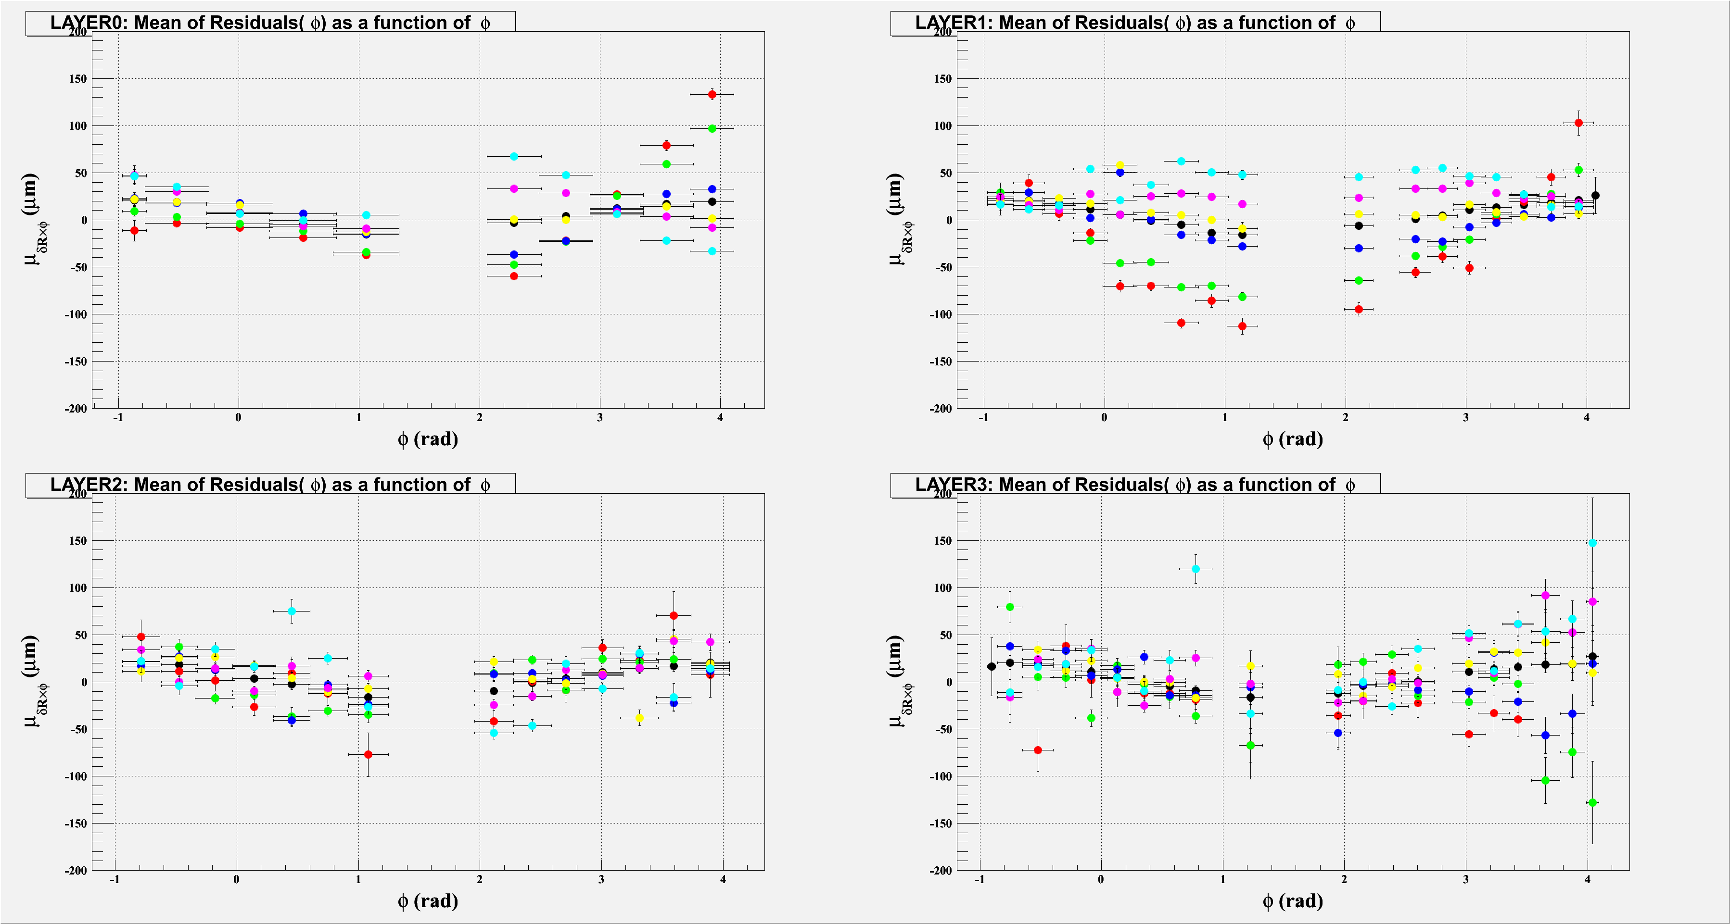
Further study
Black: no primz cut Red: primz < -8 Green: -8 < primz < -4 Blue: -4 < primz < 0
Yellow: 0 < primz < 4 Pink: 4< primz < 8 Bright blue: primz > 8
  /direct/phenix+user06/phnxreco/Takashi_VTX_LbyL/tmoon/dsts/5.Akiba/2.p2Out/macros
Notes:
This is residue as a fuction of phi angle. I sliced residuals though z-vertex.

Slide 18
Summary
Alignment finished and we chieved a good DCA resolution less than 70 micron when pT is 1GeV/c.
There is room for improvement of DCA.
  Rotation of the coordinate and/or the ladder in VTX
  Cosideration of the DCHE coordinate system.

Slide 19
Thanks!

Slide 20
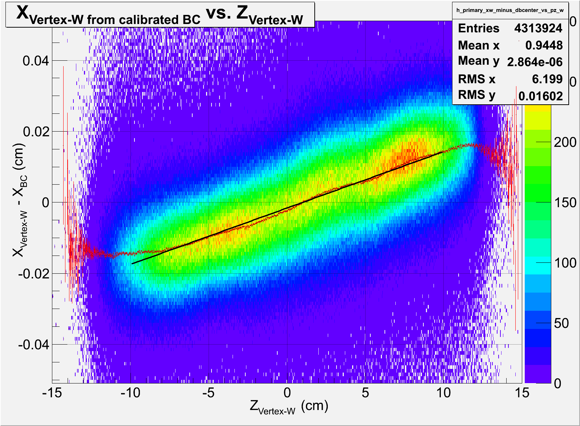
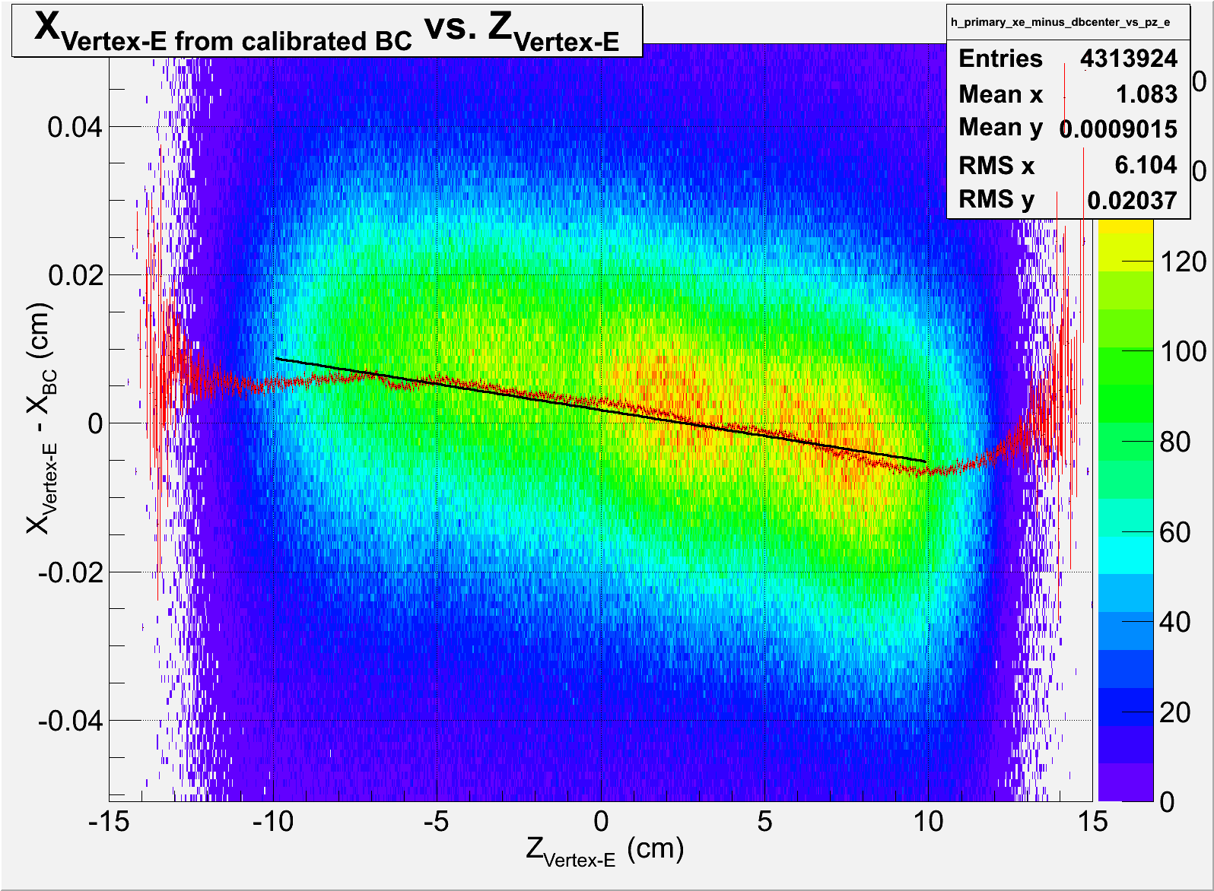
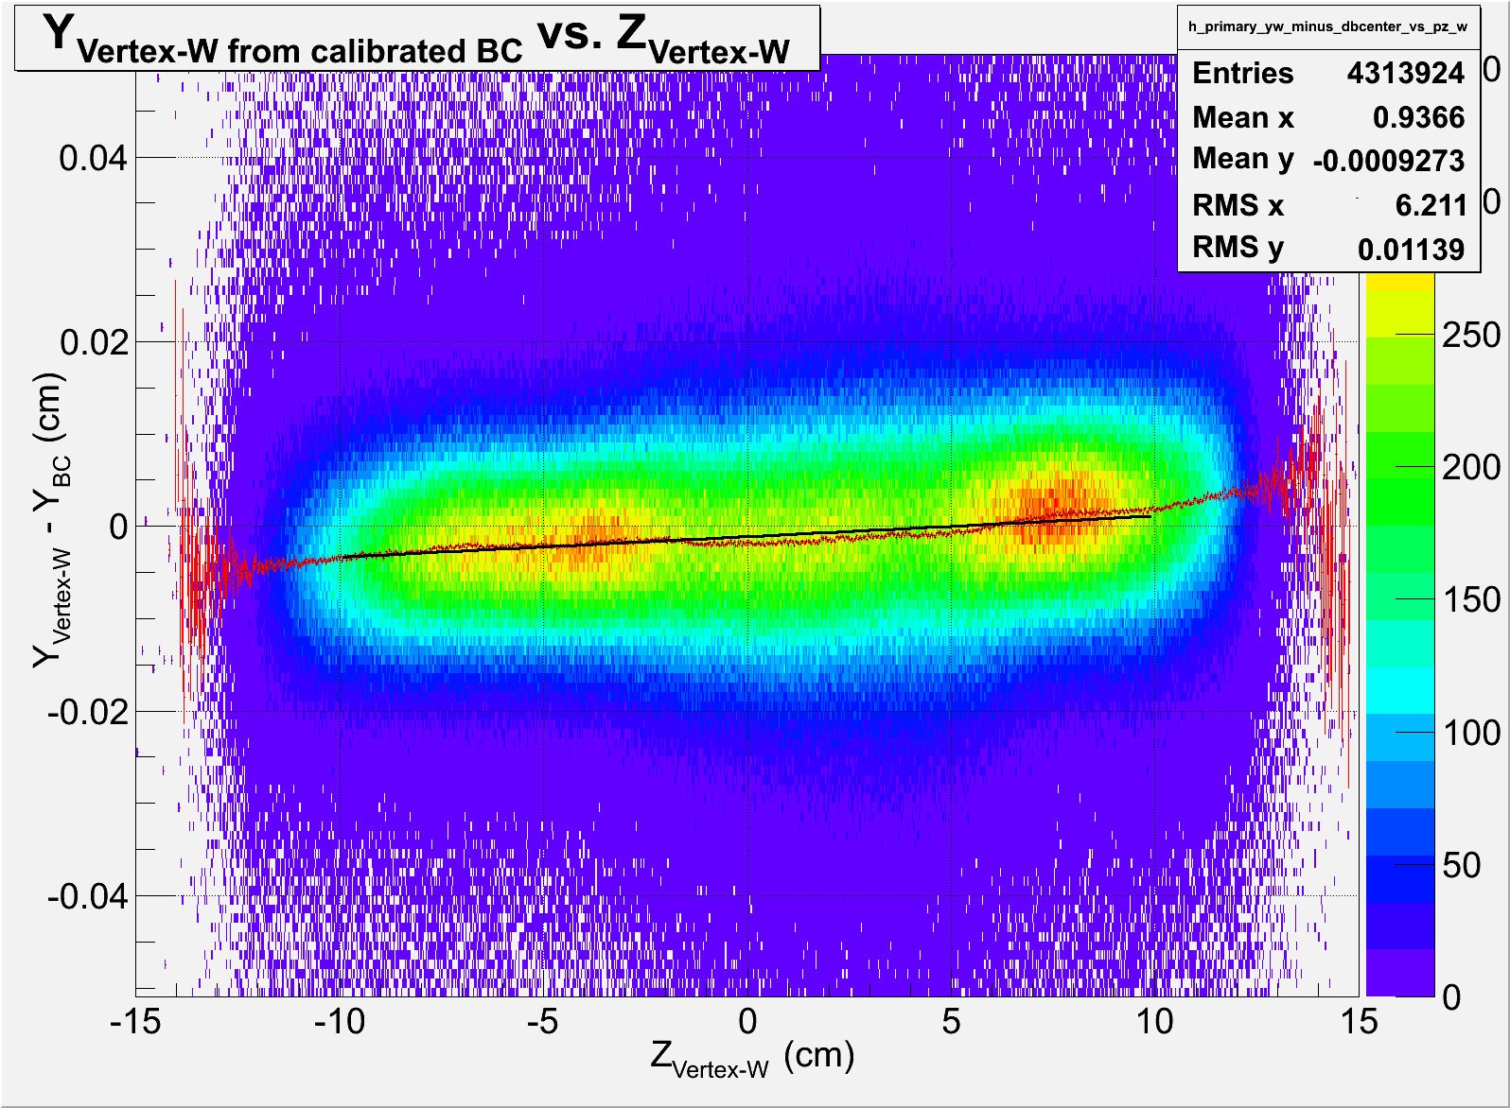
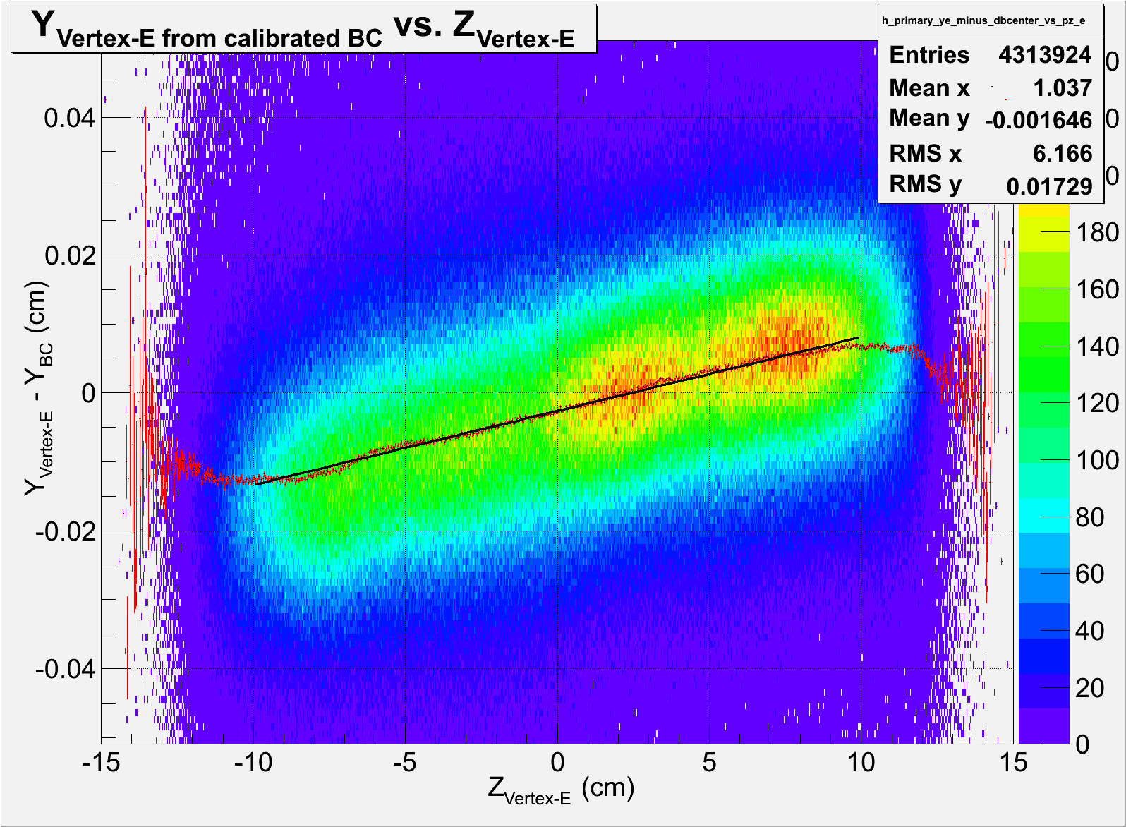
Get paramenters from linear fit.
*523 PRDFs used.
X-vertex for E is wider than others
Y-intercept : -0.00159907 (cm)
Slope : 0.00158915 (cm)
Y-intercept : 0.00177275 (cm)
Slope : -0.000699638 (cm)
Y-intercept : -0.00112291 (cm)
Slope : 0.000222804 (cm)
Y-intercept : -0.00263372 (cm)
Slope : 0.00107324 (cm)
/direct/phenix+user06/phnxreco/Takashi_VTX_LbyL/tmoon/dsts/3.Akiba/4.p2Out/rootfiles/ana.C

Slide 21
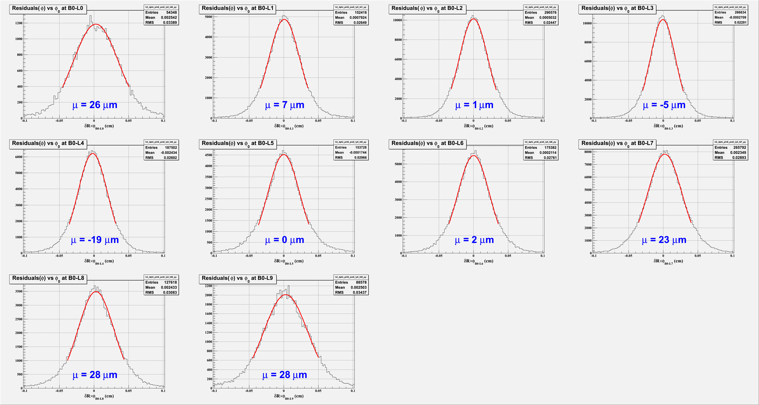
Residue in phi for B0

Slide 22
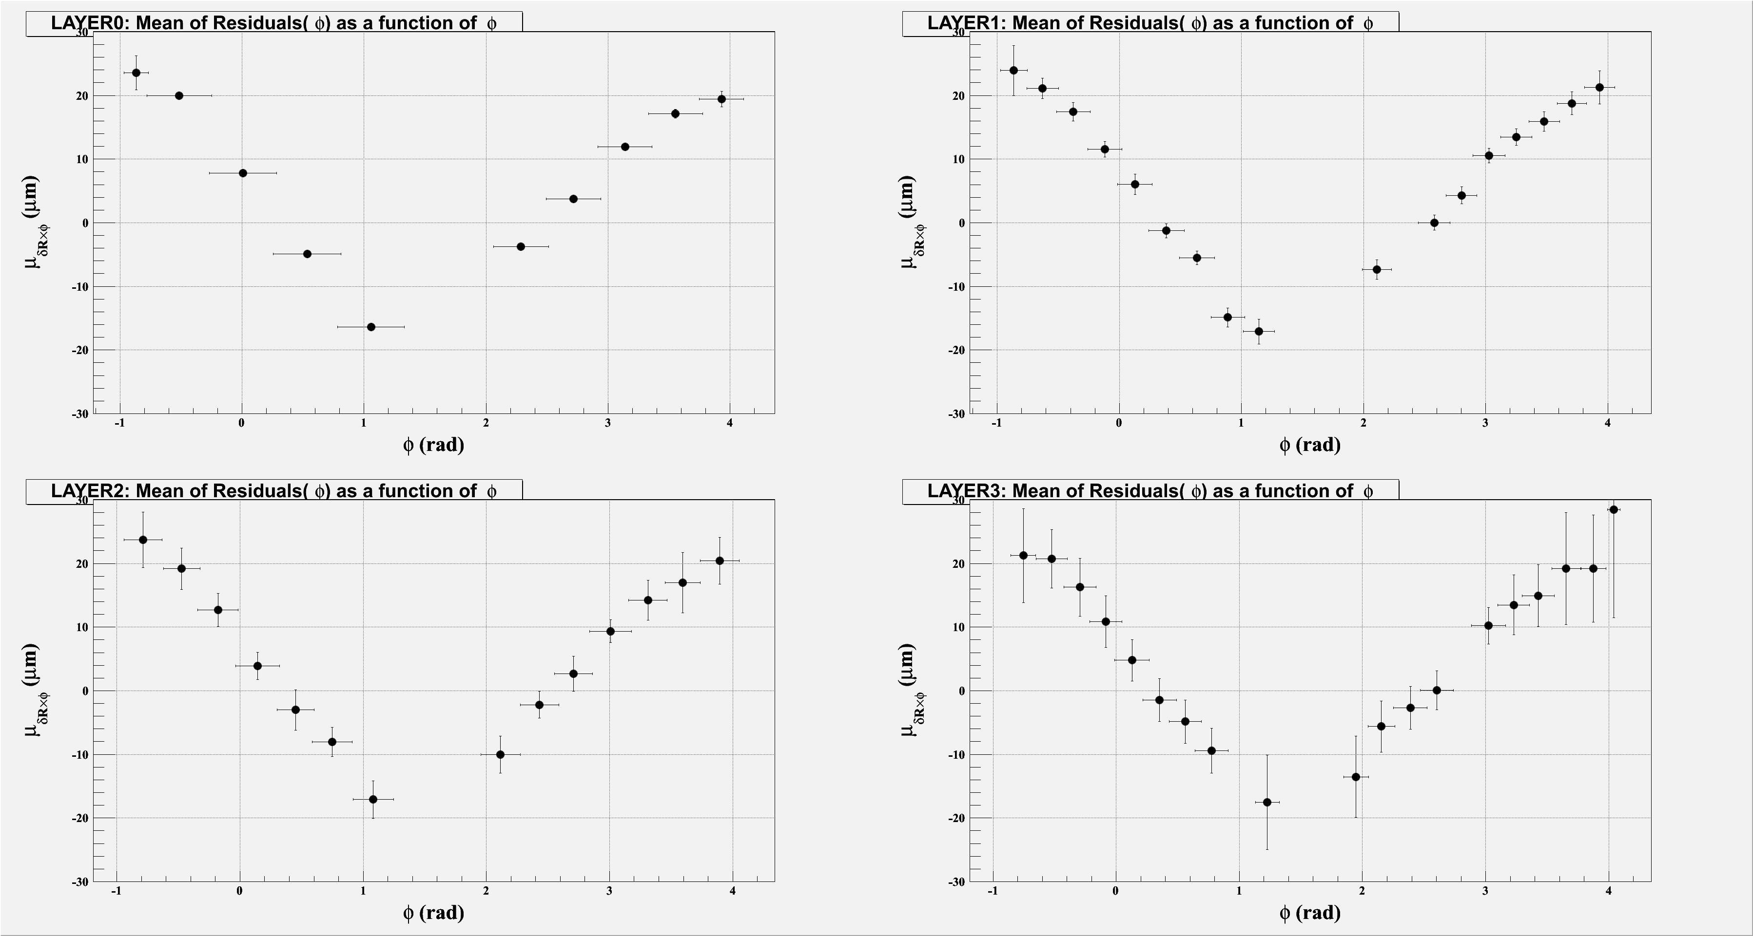
Mean of residue in phi

Slide 23

DCA0 formula for fitting
DCA0 can be represented by beamcenter.
  For fitting,
  DCA0 = X_{beam} sin φ_{b} - Y_{beam} cos φ _{b}
${φb=tan}^{−1}{(\frac{y1−y0}{x1−x0}})$
Before fitting, DCA0 as a function
of $φb$ should be known.
(x1, y1)
Y
Beam center
(xbeam, ybeam)
(x0, y0)
DCA0 from O (VTXW/E)
$$φb$$
O (VTXW/E)
X
This is calculated in VTX internal coordinate

Slide 24


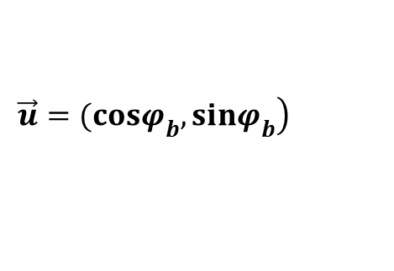

DCA0 formula for data point
By using position of hits in B0 , we can know DCA0 for data point.
  $|DCA0|=\sqrt{d\vec{x}•d\vec{x}−|\vec{u}•d\vec{x}||\vec{u}•d\vec{x}|}$
  $\left.d\vec{x}=(x0,y0\right)$
  $\left.\vec{u}=(cosφ_{b},sinφ_{b}\right)$
${φb=tan}^{−1}{(\frac{y1−y0}{x1−x0}})$
(x1, y1)
Y
Beam center
(xbeam, ybeam)
(x0, y0)
$$\vec{u}•d\vec{x}$$
$$d\vec{x}$$
$$\left.\vec{u}=(cosφ_{b},sinφ_{b}\right)$$
DCA0 from O (VTXW/E)
$$φb$$
O (VTXW/E)
X
This is calculated in VTX internal coordinate

Slide 25
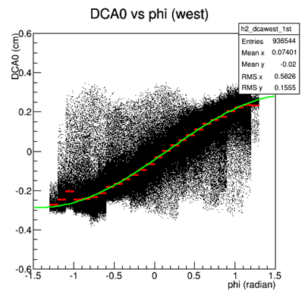
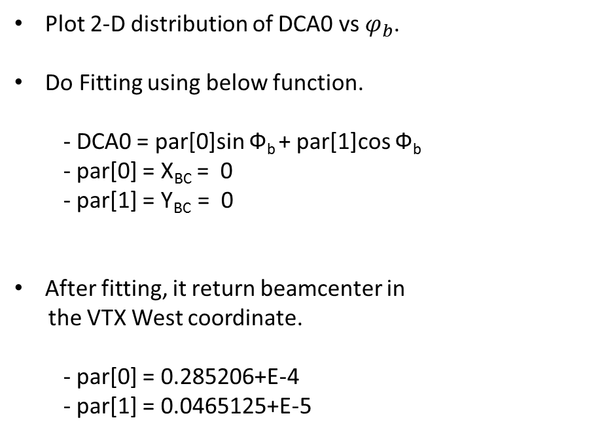
Beam center by VTX : fit DCA0 vs Ф_{b}
Plot 2-D distribution of DCA0 vs $φ_{b}$.
Do Fitting using below function.
    - DCA0 = par[0]sin Ф_{b} + par[1]cos Ф_{b}
  - par[0] = X_{BC} = 0
  - par[1] = Y_{BC} = 0
After fitting, it return beamcenter in
the VTX West coordinate.
  - par[0] = 0.285206+E-4
  - par[1] = 0.0465125+E-5
Parameters should not be fixed
Those will be used as initial parameters for next fitting.
ZEROFDATA_P00_0000405836_000(0~19).PRDFF
Run Number : 406541
Energy : 200 GeV
Number of events : 1.315M

Slide 26
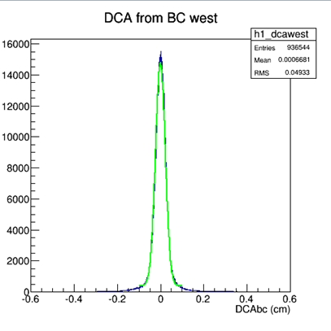
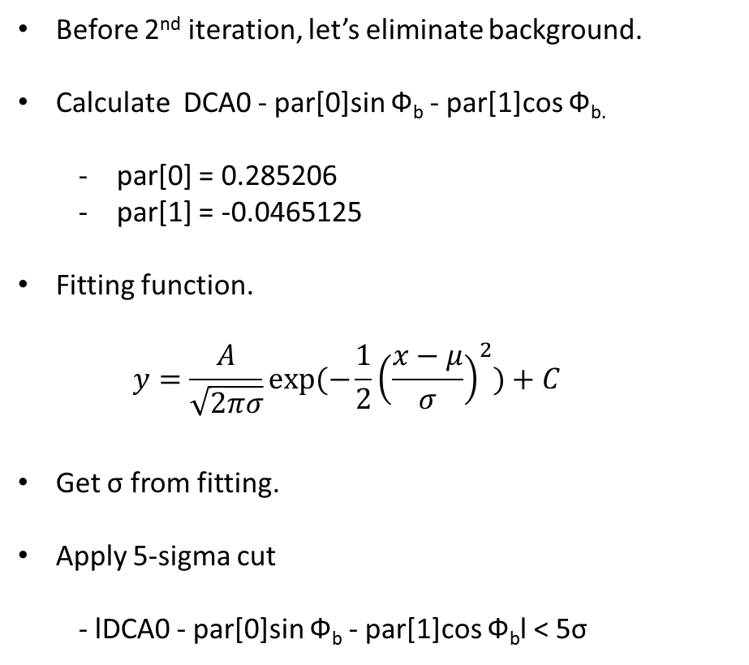
Beam center by VTX : background reduction
Before 2nd iteration, let’s eliminate background.
Calculate DCA0 - par[0]sin Ф_{b} - par[1]cos Ф_{b.}
  par[0] = 0.285206
  par[1] = -0.0465125
Fitting function.
  $$y=\frac{A}{\sqrt{2πσ}}exp(−\frac{1}{2}{\left(\frac{x−μ}{σ}\right)}^{2})+C$$
Get σ from fitting.
Apply 5-sigma cut
  - lDCA0 - par[0]sin Ф_{b} - par[1]cos Ф_{b}l < 5σ
DCA0 - par[0]sin Ф_{b} - par[1]cos Ф_{b}

Slide 27
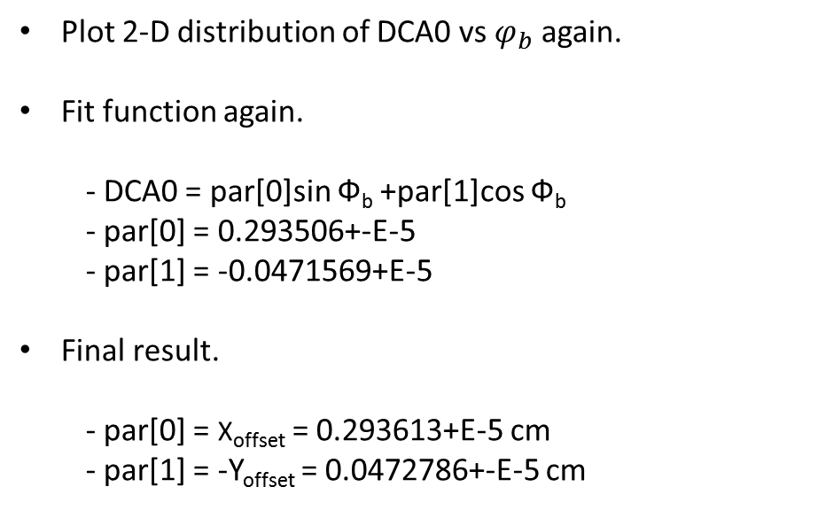
Beam center by VTX : refit DCA0 vs Ф_{b}
Plot 2-D distribution of DCA0 vs $φ_{b}$ again.
  Fit function again.
    - DCA0 = par[0]sin Ф_{b} +par[1]cos Ф_{b}
  - par[0] = 0.293506+-E-5
  - par[1] = -0.0471569+E-5
Final result.
  - par[0] = X_{offset} = 0.293613+E-5 cm
  - par[1] = -Y_{offset} = 0.0472786+-E-5 cm

Slide 28





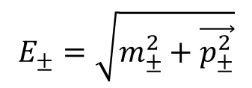

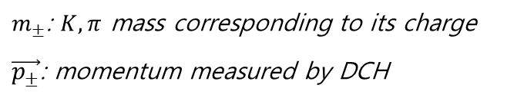

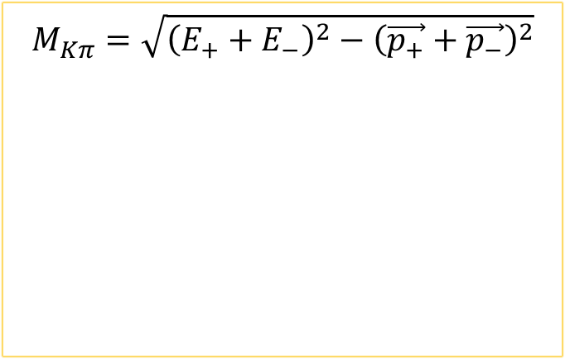
What is zed ?
$$R_{DC_{out}}=2.47m$$
$$zed$$
$$R_{DC_{ref}}=2.20m$$
$$R_{DC_{in}} =2.03m$$
$$α$$
$$y$$
$$y$$
$$x$$
$$z$$
$$L_{DC}=2.4m$$
Beam View
Side View

Slide 29


Alignment in $uN$ (ladder by ladder)
Trajectory estimated by initial vector by DC
$$y$$
Real hit in VTX
$$x$$
Projected hit in VTX
$${\vec{D}}_{1}$$
Expected hit in VTX
$${\vec{D}}_{2}$$
$$\vec{u}$$
Primary vertex by VTX

Slide 30

Alignment in $uT$ (ladder by ladder)
Trajectory estimated by initial vector by DC
$$y$$
Projected hit in VTX
$$x$$
Real hit in VTX
$${\vec{D}}_{1}$$
Expected hit in VTX
$${\vec{D}}_{2}$$
$$\vec{u}$$
Primary vertex by VTX

Slide 31


Alignment in φ (Ladder by Ladder(
Trajectory estimated by initial vector by DC
$$y$$
Real hit in VTX
residue
$$x$$
Projected hit in VTX
$${\vec{D}}_{1}$$
$${\vec{D}}_{2}$$
$$\vec{u}$$
Primary vertex by VTX

Slide 32
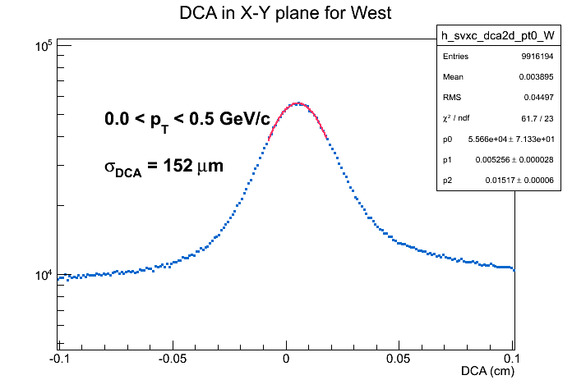
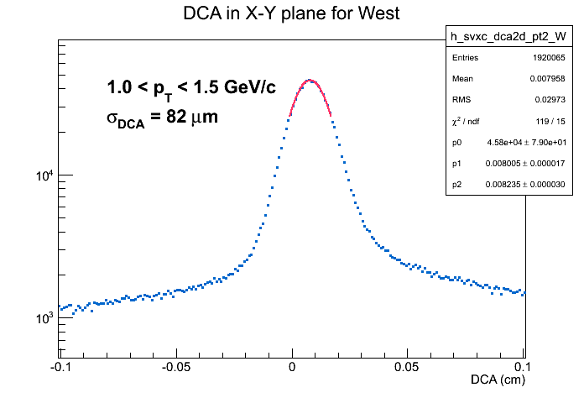
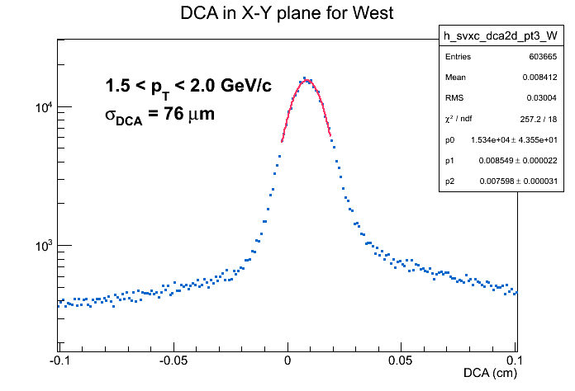
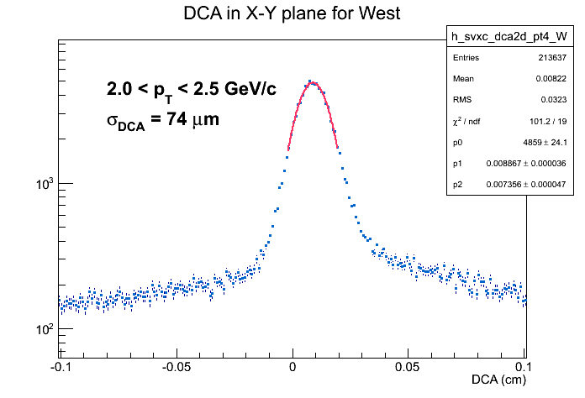
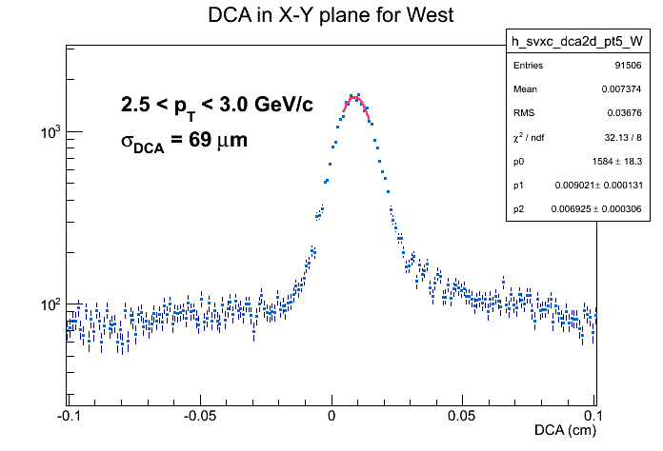
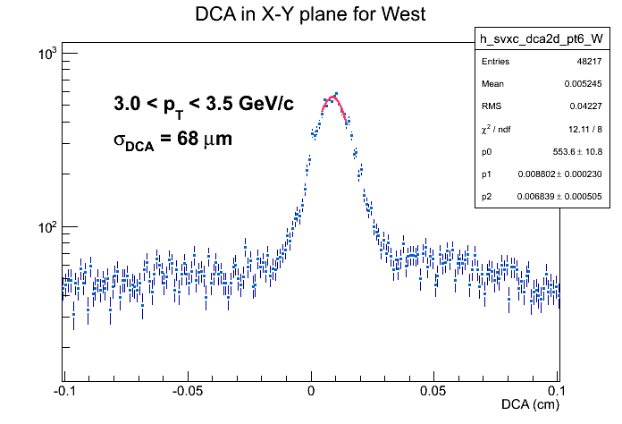
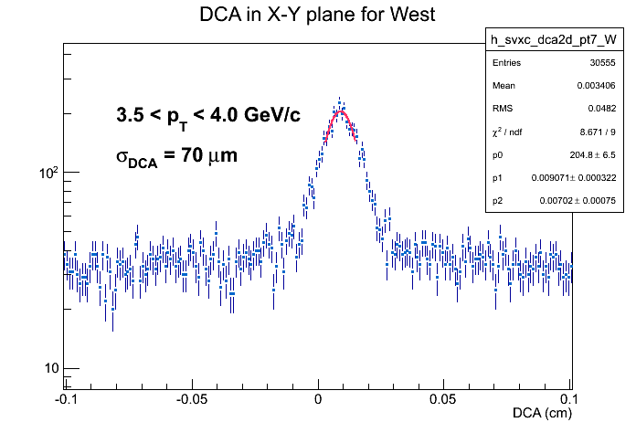

Slide 33
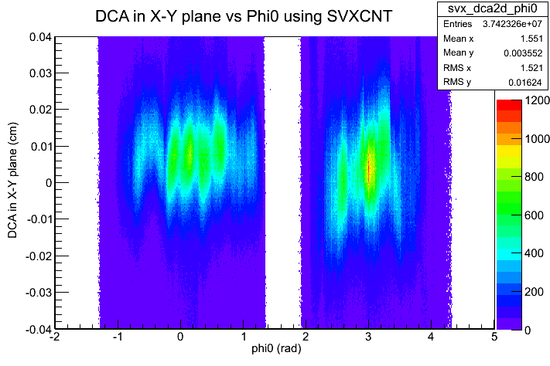

Slide 34
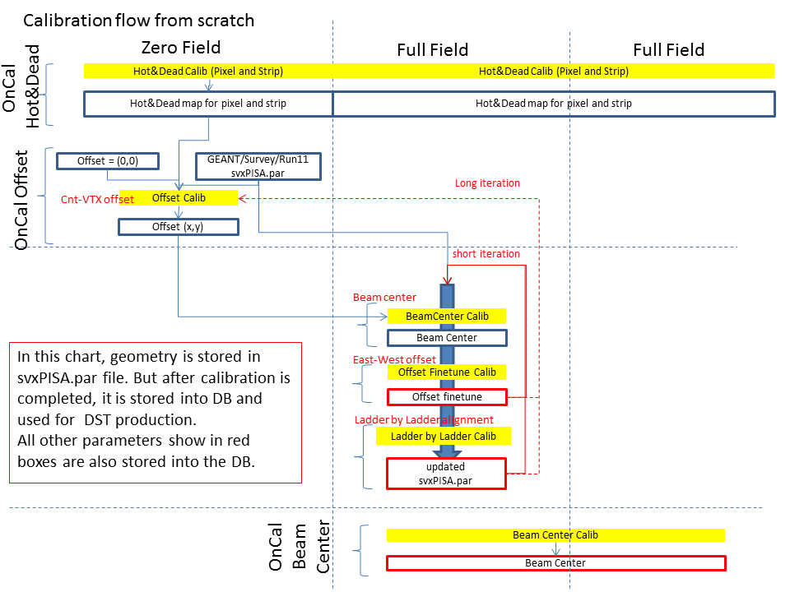
Introduction to calibration
Alignment
1st STEP
Alignment
2nd STEP
BeamCenter
STEP

Slide 35
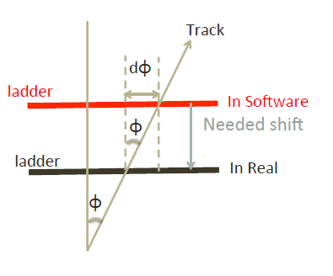
2) Alignment Ladder by Ladder in φ and z

Slide 36


Alignment in $uNormal$ (ladder by ladder)
Trajectory estimated by initial vector by DC
$$y$$
Real hit in VTX
$$x$$
Projected hit in VTX
$${\vec{D}}_{N}$$
Expected hit in VTX
$${\vec{D}}_{1}$$
$${\vec{D}}_{2}$$
${\vec{D}}_{N}={\vec{D}}_{1}−{\vec{D}}_{2}$: residual normal to u.
( = residual in phi in our notation)
$$\vec{u}$$
This is what we did during alignment in phi so far.
Primary vertex by VTX

Slide 37

Alignment in $uTangent$ (ladder by ladder)
Trajectory estimated by initial vector by DC
$$y$$
Projected hit in VTX
$$x$$
Real hit in VTX
$${\vec{D}}_{T}$$
Expected hit in VTX
${\vec{D}}_{T}$: residual tangent to u.
( it doesn’t take account yet in present alignment step)
$$\vec{u}$$
We didn’t take account of all translation.
Primary vertex by VTX

Slide 38
Feb. 14: East carriage moved into run position, ready for physics.
Feb. 18: Zero-field runs 402340 and 402338 with a total of ~780k events.
Feb. 19: Access, East carriage moved out and in.
Feb. 20: Zero-field run 402765 with a total of ~590k events.
Feb. 24: Access and move of East carriage out and in.
Feb. 24: Zero-field run 403312, 403318, 403319, 403322, 403324, 403329 with a total of ~3M events. Note: extended runs because of possible timing shift.
Mar. 05: Access (maintenance day) and move of East and West Carriage.
Mar. 08: Zero-field runs 404895, 404891, 404892, 404893, 404894 with a total of ~1.4M events.
Mar. 11: End of LE run, maintenance day, East carriage moved.
-----
Mar. 15: 200 GeV Au+Au, Zero-field runs 405836, 405837, 405838 with a total of ~13M events.
Mar. 19: West carriage moved, Zero-field run 406541 with ~1.5M events
Apr. 02: East/West carriage moved, Zero-field run 408185 with a total of ~ 2M events.
Apr. 04: East carriage moved, Zero-field run 408327 with about 2M events.
Apr. 16: West carriage moved, Zero-field run 409446 with about 9M events.
Apr. 25: West carriage moved, Zero-field run 410113 with about 11M events.
Apr. 30: West carriage moved, Zero-field runs 410660, 410661 with about 2.5M events.
May 05: West carriage moved, Zero-field run 410925 with about 8.8M events.
May 12: East carriage moved, Zero-field runs 411562, 411653, 411654, and 411655 with about 7.5M events.
May 14: East carriage moved, Zero-field run 411768 with about 3.8M events.
May 28: East and West carriage moved, Zero-field run to be performed.

Slide 39
VTX W/E Beamcenter

Slide 40
DCH W/E Beamcenter

Slide 41
CNT East To West

Slide 42
VTX To CNT Offset

Slide 43
VTX East To West

