Slide 1
Heavy Ion Physics in RUN14-16
Japan Korea PHENIX meeting
Nov. 27, 2014
Y. Akiba

Slide 2
RHIC Runs (2014-2016)
RUN14 (completed)
  Au+Au at 14.6 GeV (complete Beam Energy Scan)
  Au+Au at 200 GeV (Main part of the run)
  He³+Au at 200 GeV (QGP in small system)
RUN15 (Jan – June 2015)
  p+p at 200 GeV (transverse spin)
  p+Au at 200 GeV
  p+Al at 200 GeV
RUN16
  Au+Au at 200GeV 10 weeks
  To Be Determined 510GeV pp or 62 GeV AuAu

Slide 3
Heavy Quark Campaign in RUN14-16
Main purpose of RHIC run in 2014-16 is to measure heavy quarks (charm and bottom)
PHENIX has silicon vertex tracker VTX and FVTX. Charm and botton decays are identified by precision vertex measurement by these detectors.
  STAR also has HFT (Heavy Flavor tracker) from RUN14
RHIC runs with VTX
RUN11 Au+Au @200 GeV (1st run with VTX)
RUN12 p+p @200/510 GeV (1st run with FVTX)
Cu+Au @ 200 GeV
RUN14 1st Main Heavy Flavor run.
Au+Au@200 GeV; ~20 times of RUN11 data
RUN15 p+p: baseline
  p+A: Cold nuclear Matter effects
RUN16 2nd Main Heavy Flavor run

Slide 4
Heavy Quark (charm, bottom)
Quarks
u
c
t
up
~2MeV
charm
~1.3GeV
top
~170 GeV
d
s
b
down
~5MeV
strange
~0.1GeV
bottom
約4.2GeV
(mass of proton ~ 0.94 GeV)
Protons and neutrons are made of u and d quarks (+gluons, etc)
u, d, s quarks are light and can be made in later stage of nuclear reaction
c, b quarks are heavy (m_{c}, m_{b} > Λ_{QCD})
They can only be produced at hard collisions at the initial stage
Their production rate can be calculated by pQCD
➔ Very useful probe for both of Quark Gluon Plasma and nucleon structure

Slide 5
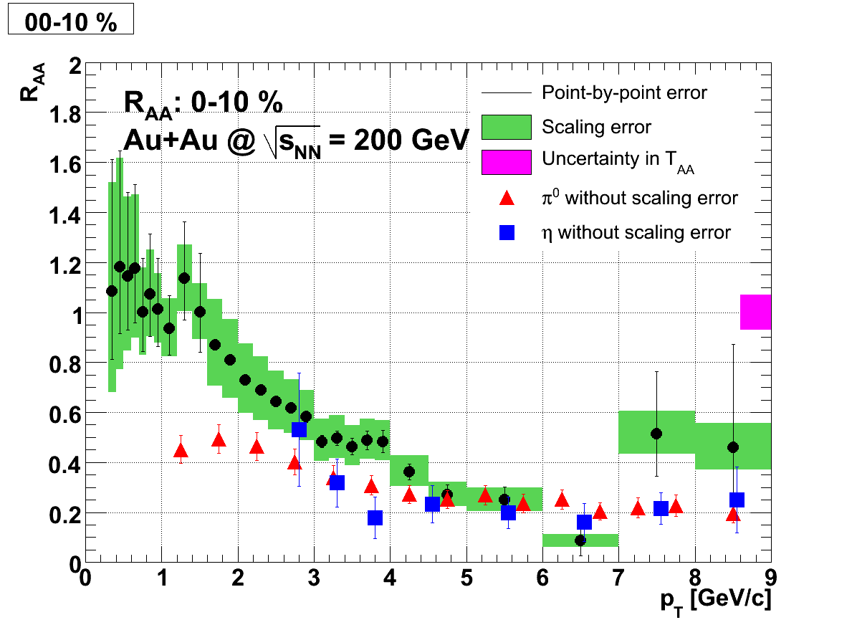
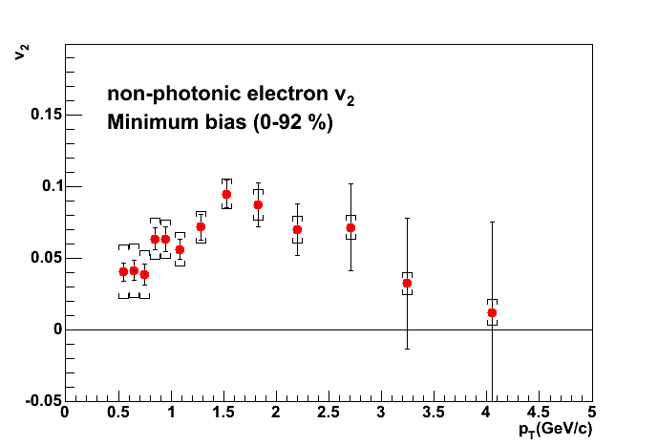
Probing Quark Gluon Plasma with heavy quarks
PHENIX measured heavy quark production in Au+Au collisions via single electrons from heavy flavor decays
PRL98, 172301
R_{AA} of b,c →e
v₂ of b,c →e
Strong suppression of electron from heavy flavor decay is observed
→ Large energy loss of heavy quark in QGP
Large elliptic flow strength v2 of single electrons from heavy flavor decay is observed
→ Heavy quark flows in QGP medium
In these previous measurements, b→e and c→e were not separated
Measure b→ e and c→e separately

Slide 6
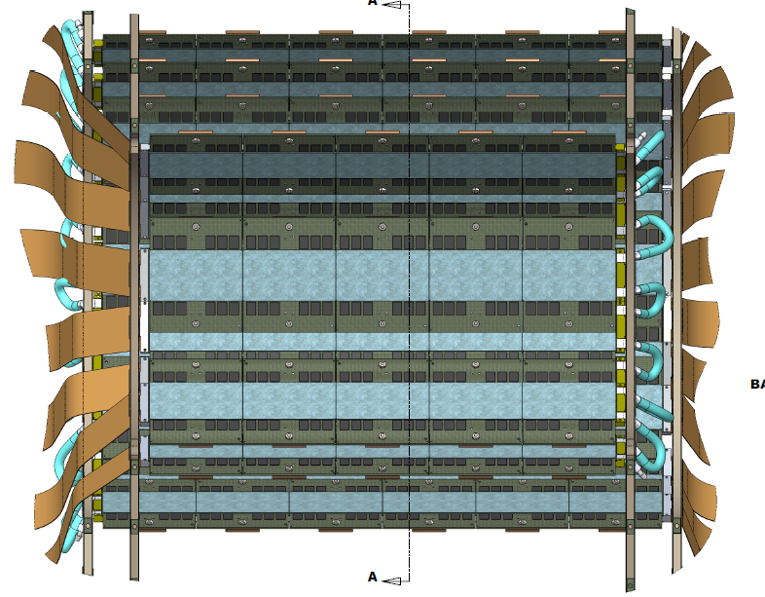
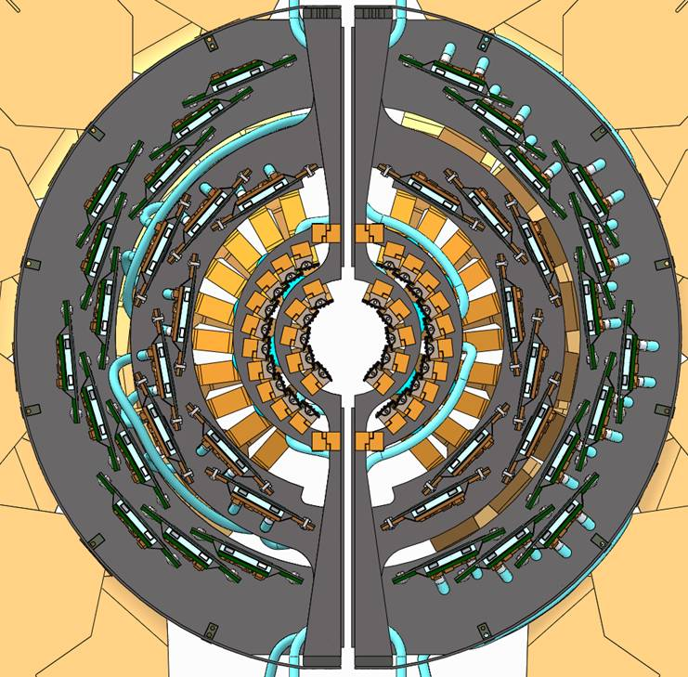
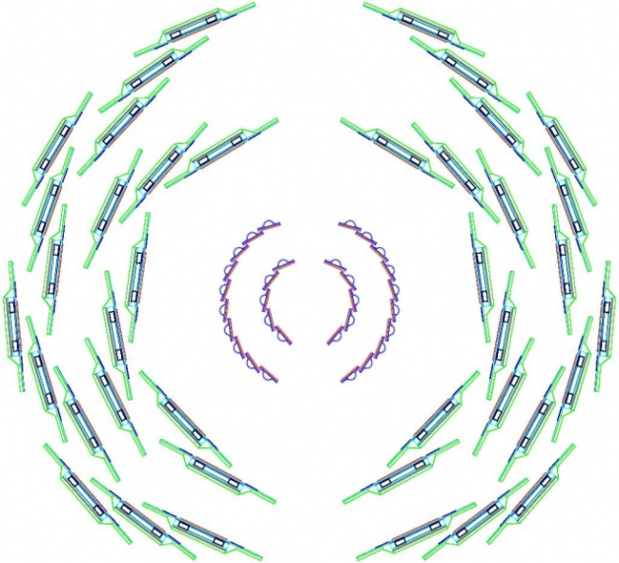
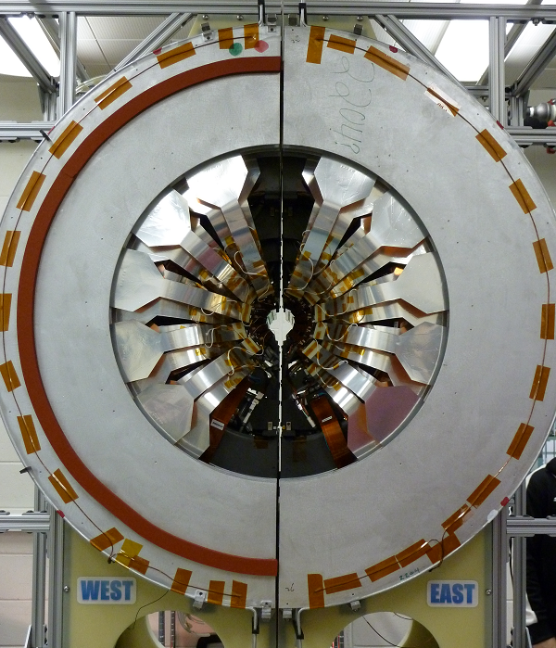
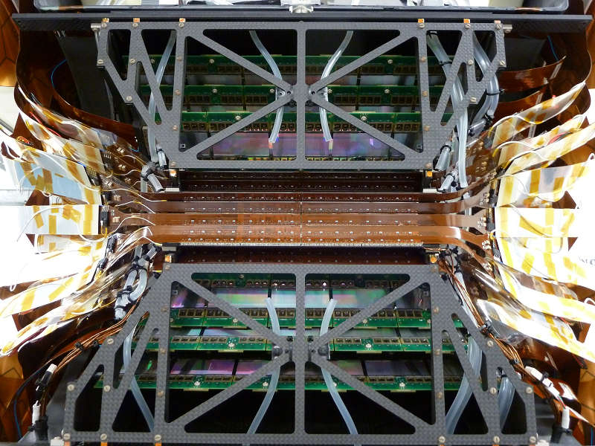
VTX Barrel
BEAM VIEW
SIDE VIEW
beam

Slide 7
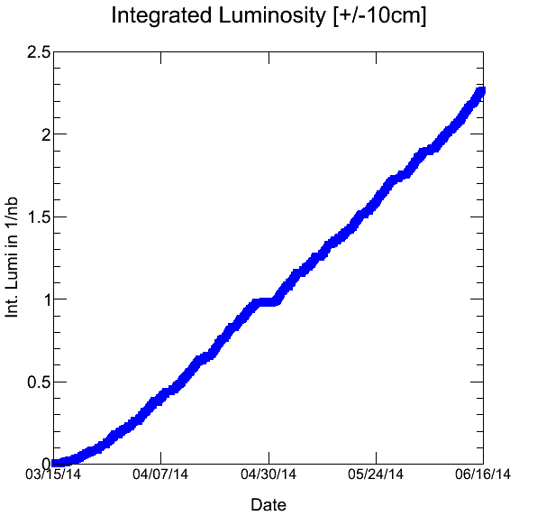
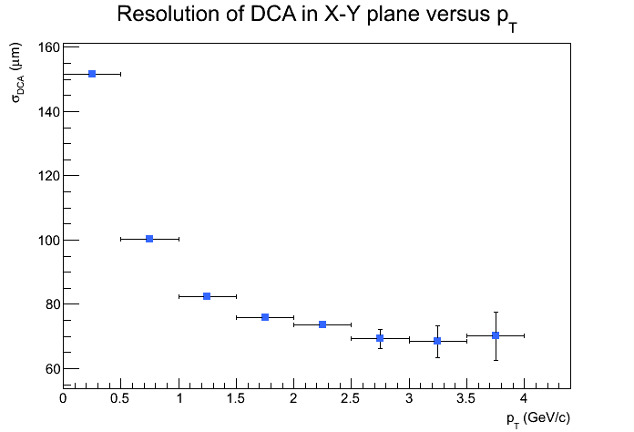
RUN14: heavy Quark run
DCA resolution in RUN14 data
recorded luminosity in VTX acceptance
2.3/nb or 14.3 Billion Au+Au events recorded within |z|<10cm (good VTX acceptance)
Total # of events recorded > 17 Billon
DCA resolution 80μm for pT>1 GeV achieved in RUN14. Will be improved by further refinement of alignment/calibraiton

Slide 8
VTX analysis status
We are finalizing the data analysis of RUN11 Au+Au, the first run of VTX
  About 2B Au+Au events within VTX acceptance
All tools for event analysis have been developed
  Calibration
  Alignment
  DC-VTX track reconstruction
  Decomposition of DCA (Distance to Closest Approach) distribution to separate b→e and c→e
Paper of the final result early in the next year
All analysis tools are available for RUN12 and RUN14 data analysis
RUN12: Cu+Au@200 GeV 2.9/nb (36/pb N+N)
RUN14: > 17 B events with ~2 times of effective acceptance
  → Effectivey, ~20 times of RUN11 data

Slide 9
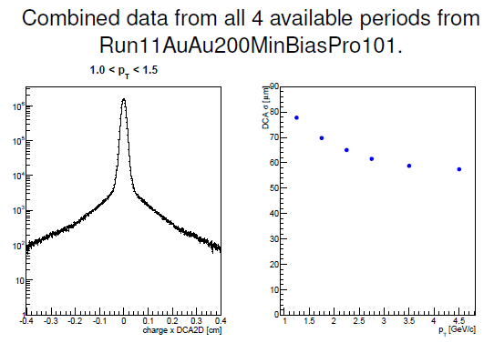
RUN11 DCA resolution
DCA resolution better than
  80 micron for pT> 1GeV/c
  60 micron for pT > 3GeV/c
D⁰ cτ = 123 micron
B⁰ cτ = 455 micron

Slide 10
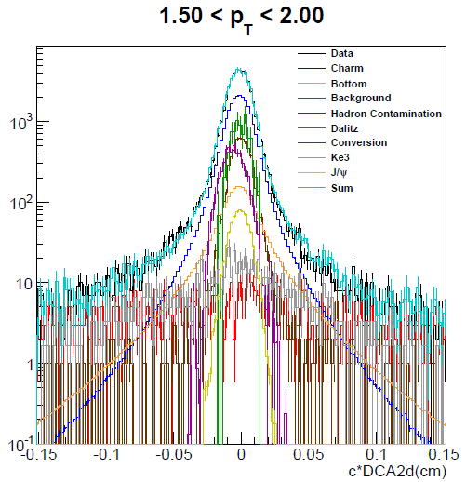
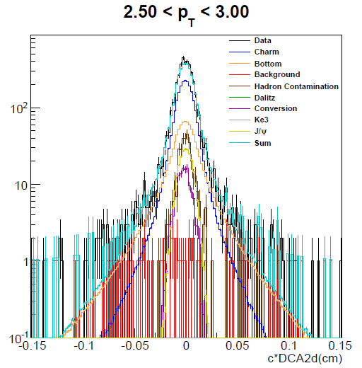
RUN11 DCA distributions
DCA distributions are well reproduced by sum of b->e, c→e and background componets
→ We can measure b→e and c→e separately

Slide 11
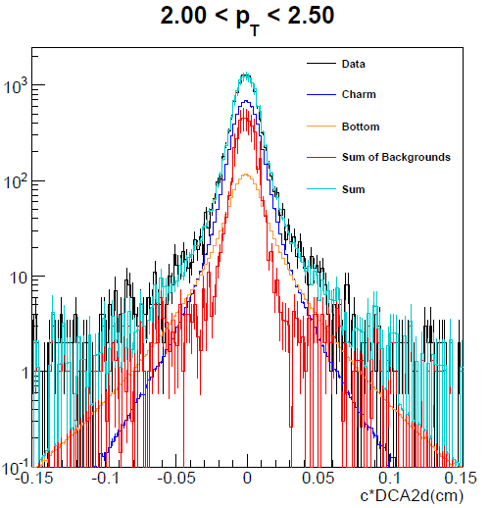
Run11 DCA distribution
0.015<|DCA|<0.06 is dominantly c→e and b→e with small background
c→e and b→e yield can be extracted from the DCA distribution
Very sophisticated fitting/decomposition code of DCA & pT distribution has been developed

Slide 12
Analysis Topics from RUN14 data
R_{AA} of b→e and c→e
v₂ and v₃ of b→e and c→e
Direct reconstruction of charmed hadrons
  D⁰ → Kπ and other modes
  D⁺ → Kππ and other modes
  D_{s} → KKπ, KK⁰ and other modes
  D* -> Dπ
  Λ_{c} -> pK⁰, pKπ and other modes
B→ J/Psi + X

Slide 13
Analysis topics in RUN14 (cont.)
v₂ and v₃ of charged hadrons in wide pT and eta range
High pt charged hadron pT distribution
Correlation of central arm track and VTX standalone tracks
  Hadron – hadron correlation
  e (HF) – hadron correlation
  photon/pi0 – hadorn correlation
Dark Photon search
Thermal direct photon (pT<3 GeV/c) measurement via internal and external conversion
Thermal di-electron pair (1<Mee<3 GeV) from QGP

Slide 14
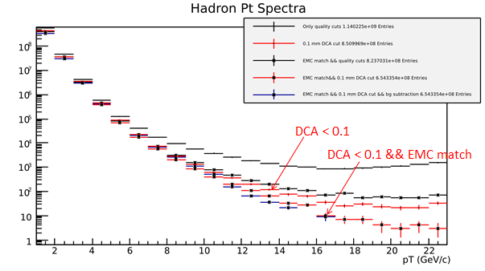
B→ J/Psi measurement
High pT hadrons and correlations
(J/ψ)
Secondary
vertex
e
RUN11 data
e
B
L
X
Lxy
Prim
Vtx
dca
B can be measured as displaced J/Psi (B→J/Psi)
Expected yield: ~500 displaced J/Psi in RUN14 data
With VTX, high pT background is strongly suppressed; pT range extended beyond 20 GeV/c
Various correlation between high pT tracks in DC and VTX standalone tracks

Slide 15
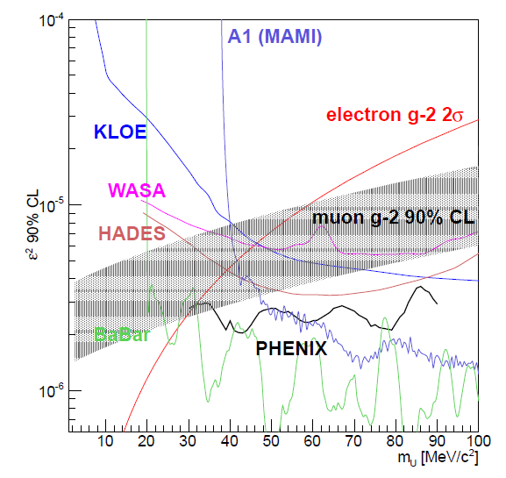
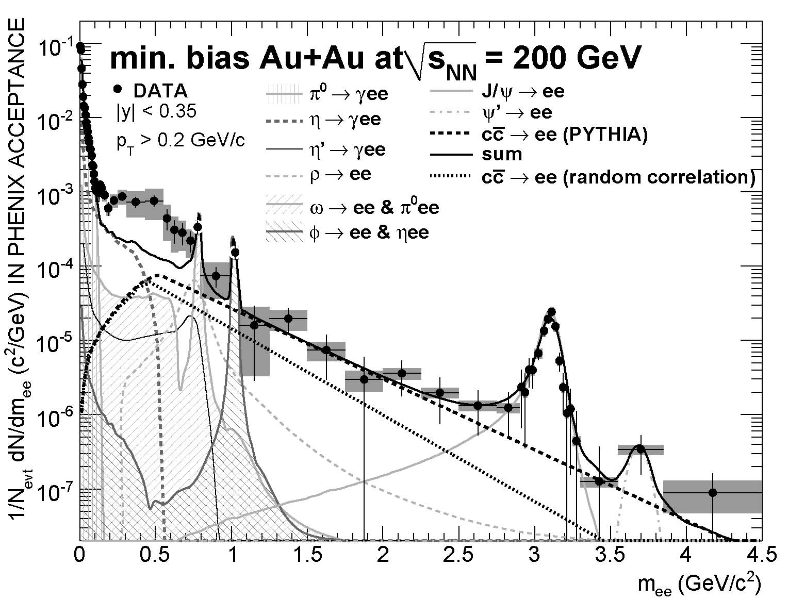
1<mee<3 GeV is the window to detect thermal di-electrons from QGP
Charm background is suppressed by DCA measurement
This measurement is possible in high statistics data of RUN14
G-2 band is basically excluded by the present data
Long lived dark photon with small mixing and small mass can be searched in RUN14 data

Slide 16
RUN15
RHIC plan for RUN15
9 weeks of polarized p+p at 200 GeV
  Transverse spin measurement
  Baseline of charm/bottom production
  Photon/pi0 vias new MPC-EX at forward rapidity
5 weeks of p+Au at 200 GeV
  Flow (v2, v3) in p+Au QGP in small system
  Cold Nuclear Matter effects in c/b production
2 weeks of p+Al at 200 GeV

Slide 17
Analysis Topics in RUN15
A_{N} of charm production
c→e and b→e in p+p (baseline for Au+Au)
c→e and b→e in p+A (CNM effects)
D-meson measurements in p+p
D meason measurements in p+Au, p+Al
Flow in p+Au/p+Al
Photon/pi0 measurement at forward rapidity with MPC-EX
Transverse spin with MPC-EX

Slide 18
Summary
RUN14-RUN16 is “heavy flavor campaign” of RHIC
  Au+Au in RUN14 and RUN16
  p+p/p+A in RUN15
Good progress in VTX analysis
  RUN11 results will be finalized soon
  Ready to analyze large dataset in RUN14
RUN14 is a big success. Large (>17B) Au+Au events are recorded
  DST production will start soon
  Many analysis topics

