Slide 1
CNS CVD Diamond
S. Michimasa

Slide 2
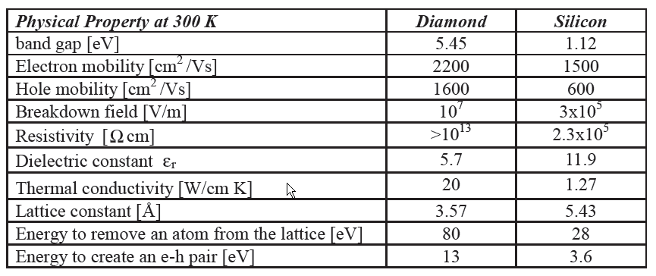
Properties of diamond
Extreme mechanical hardness and extreme high thermal conductivity
  Broad optical transparency in region from IR to UV
    Insensitive for visible light
  Diamond is a semiconductor (band gap = 5.47eV)
  and very high resistivity at room temperature (10¹⁶Ωcm)
    No cooling and No p-n junction ⇒ Easy operation
  High charge carrier mobility (e: 2200/h: 1600 cm²/Vs)
    Fast rise time of detector signal
  High energy needed to remove carbon atom from the lattice (80 eV)
    Radiation hardness

Slide 3
Accessibility for diamond detector
Diamonds materials (commercially)
  Single-crystal CVD diamond plate
    Maximum size: 5×5 mm², d=50,100,200,300μm (commercially)
  Polycrystalline CVD diamond plate
    Maximum size: 50×50 mm², d=50,100,200,300μm (commercially)
Development of large size of Polycrystalline CVD DD
  Beam spot size : typically 20×20 mm² at the BigrRIPS-F3 achromatic focus
  ⇒ pCVD diamond can cover achromatic beam spots of BigRIPS.
  Signal size is determined by energy loss in the detector:
  ⇒ dE/dx ～ 100 keV/μm ～ 10⁵ e-h/μm (¹²N 250A MeV)
  Sufficient number of e-h pair can generate a clear pulse signal.
  ⇒ Heavier ions are more promising.

Slide 4
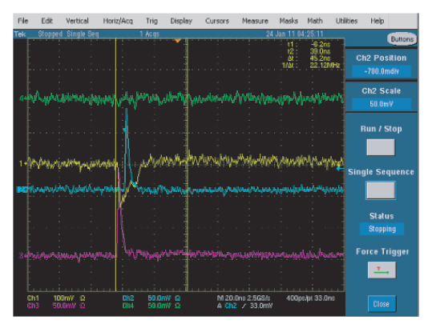
CNS diamond detectors
Side A
Side B
Side B (another side of blue)
Specification
Effective Area: 28 mm□
Thickness: 200um
Number 3 pieces
Time resolution 30 ps (σ)
Signals for 32-MeV ⁴He beam
= Energy loss equivalent for 250-MeV/u ¹⁴N
Ref: S.Michimasa NIM B 317 (2013) 710.

Slide 5
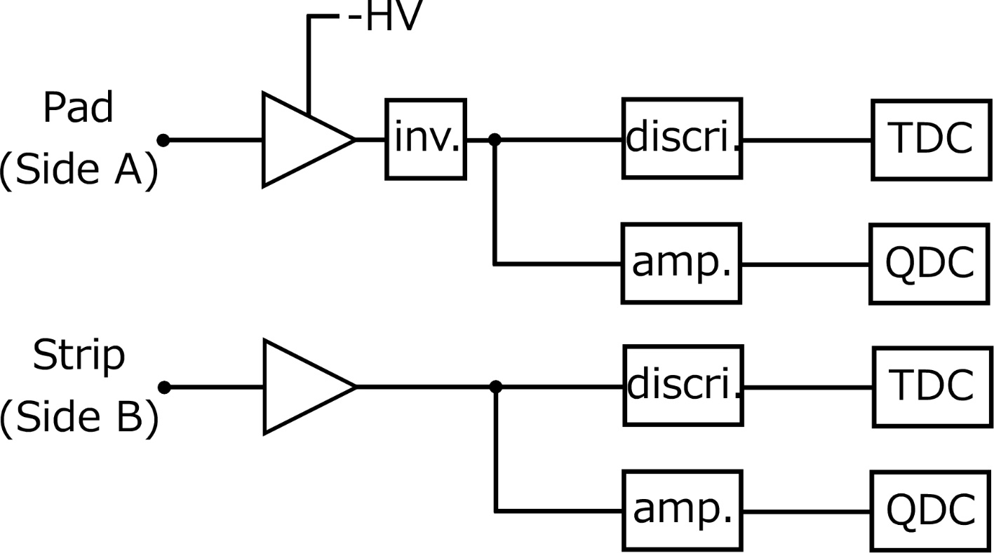
Typical electric circuit
inverter
Circuit is very simple.
Care about high-frequency cables and circuits
For High-rate capability, following changes will be efficient.
TDC → Multi-hit TDC.
QDC → Time-over-Threshold + Multi-hit TDC.

Slide 6
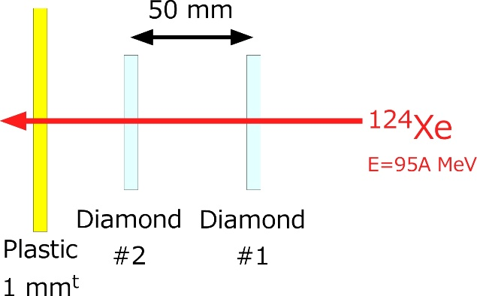
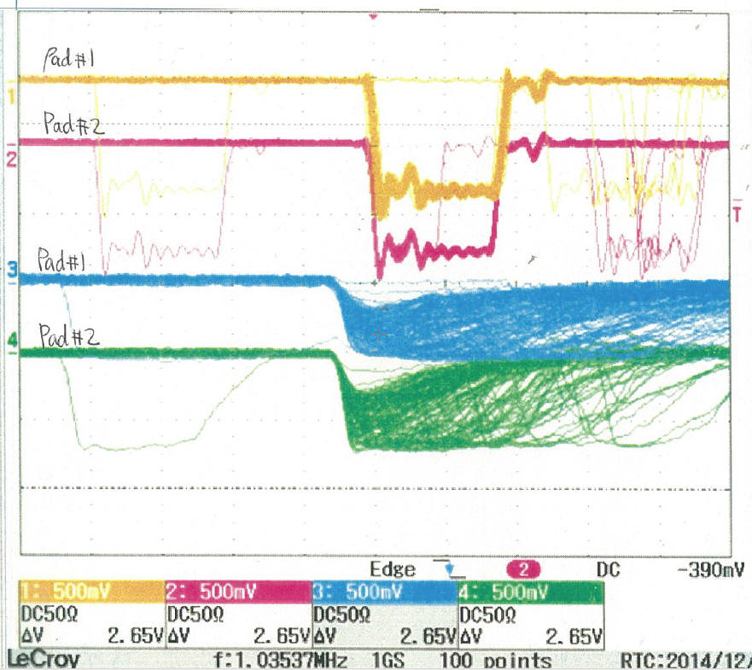
Preliminary result for Xe beam (1)
Detector Setup (at HIMAC)
Outputs (by Oscilloscope)
20ns
Beam Condition: ¹²⁴Xe at 95A MeV, 1M-3M ppp
※ Preamplifier is the same for light ions (¹⁴N)
E loss in Dia.: ¹²⁴Xe/¹⁴N = 2091.4/18.5 = 113
Dias #1 and #2 are almost completely coincidence.
⇒ Efficiency for Xe beam are almost 100% .
Preamp output is frequently saturated but logic signals are correctly generated.
⇒ Beam intensity up to a few MHz will be countable.

Slide 7
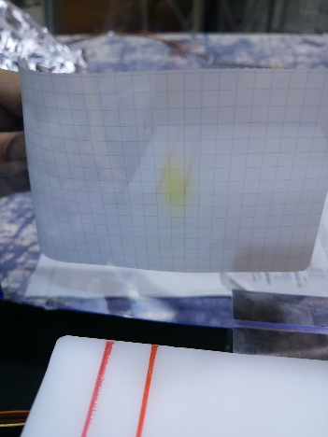
Preliminary result for Xe beam (2)
Detector Setup (at HIMAC)
Plastic scintillator:
Pulse height is reduced 1/2 - 1/3 from the initial status.
Surely underestimate left-shown beam intensity.
Burnt spot by beam.
Irradiation test of 1 Mppp
Period : 5 hours
Beam intensity: 1M-3M ppp
(count by Plastic)
Diamond Detectors:
Pulse height is not changed from the initial status.
Leak current was increasing with irradiation (up to 15 uA).
(Leak current without beam was 15nA.
We do not know how much is limit for operation…)

Slide 8
Next step and target experiment
Longer-time irradiation (at least 1 day)
  Simulation of BigRIPS condition.
    Atomic number, Beam size, Beam energy, Intensity
CNS develops diamond detector
for the ¹³²Sn(d,d’) experiment
(Spokes person: S.Ota).

Slide 9
If You hope further information on a CNS diamond detector.
Contact to
S. Michimasa (mitimasa@cns.s.u-tokyo.ac.jp)

