Slide 1
High rate capability of gas ionization chamber with flash ADC
Masaki Sasano
Spin-Isospin Laboratory
RIKEN Nishina Center

Slide 2
Collaborators…
M. Sasano, D. Nishimura,H. Baba,T. Isobe, S. Kinno, Y. Kanke,
J. Nagumo, S. Nishimura, A. Obertelli, S. Ota, H. Otsu,1 E. Takada,4 Y. Taguchi,2 D. Watanabe, Z. Yifan, T. Yoshinobu,
and H307 and H314 collaborations

Slide 3
Introduction
Goal
Removing contributions from pile up noises from the signals for ionization chamber irradiated a high rate RI beam with an intensity of around a few 10^5 cps
(←→ a conventional way: preamp + shaper → high rejection rate (33% survival rate @ the above intensity)
Establish the method and apply it to other detectors in the beam line

Slide 4
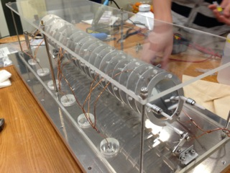
Ion chamber (D. Nishimura, Tokyo University of Science)
Atomospheric pressure
Voltage +400V
Gas : try two kinds P10 and CF4
Length : 440 mm
Drift length : 2 cm (→ drift time : 360 – 400 ns at this voltage)
Active area : 200 mm phi
Resolution achieved with a low rate and without digitizer
5 sigma separation for Z~50 @ ~ 200 MeV/u

Slide 5
Electronics & DAQ
Preamplifier
(Mesytec MPR-16L)
1 micro seconds
TFA
ORTEC863 / ORTEC579
(gain adjustment)
Shaping amp.
Mesytec MSCF-16
0.5 micro seconds
Gain : 6
MADC
Mesytec
MADC-32
Flash ADC
CAEN V1740
62.5 MHz / 16 ns sampling
12 bit
Wave form recorded

Slide 6
Beams
Ne beam @ 180 A MeV ~50k, ~150k, 600k, 1.5M ppp
Xe beam @ 200 AMeV ~10k, ~50k, ~500k ppp
Spill interval and width : 3 and 1 s

Slide 7
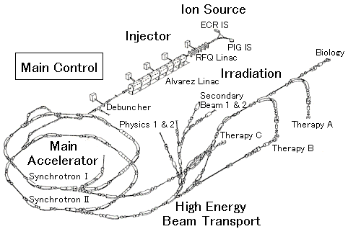
Beam line
7.7 m

Slide 8
Setup
Beam dump
Collimator
Plastic
IC
Collimator
NaI
H307 and H314 setups

Slide 9
Typical recorded waveforms and “local” beam rate definition
Ti
Time window width : 188 micro seconds
“local” rate :
number of hits in the scintillator
in the time window
/ 188 micro seconds

Slide 10
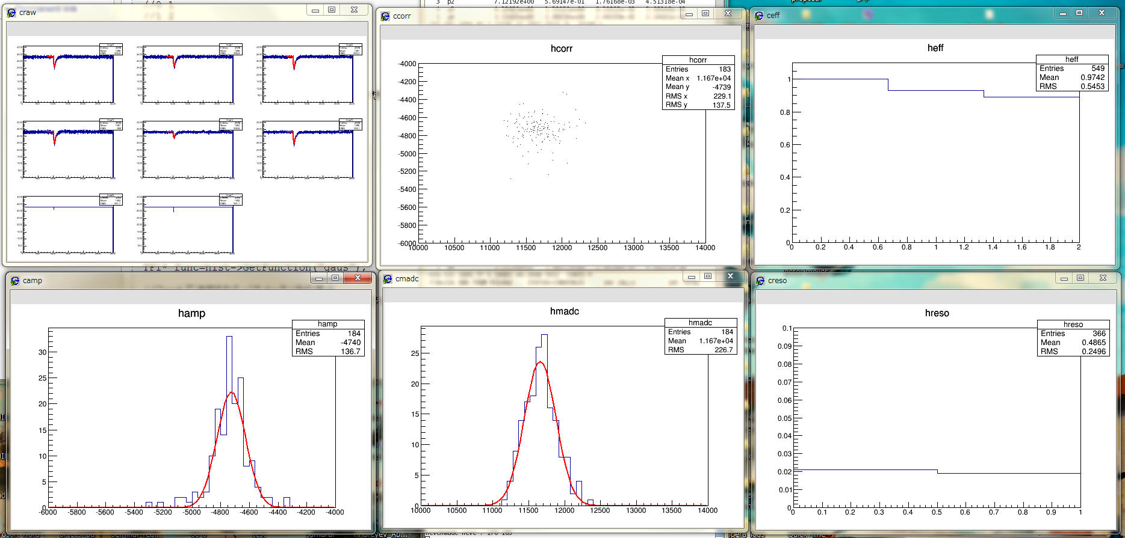
@ 50 kppp, HV(IC)=400 V, Preamp 1 micro sec., 20Ne @ 180 AMeV, P10 gas (RUN149)
Typical waveforms in FADC
IC
90% survival
MADC
FADC
Seems to be not correlated…
(DAQ problem in Ne runs)
Plastic
FADC
(summed
for 6 planes)
MADC
(summed)
FADC
MADC
~2% (sigma)

Slide 11
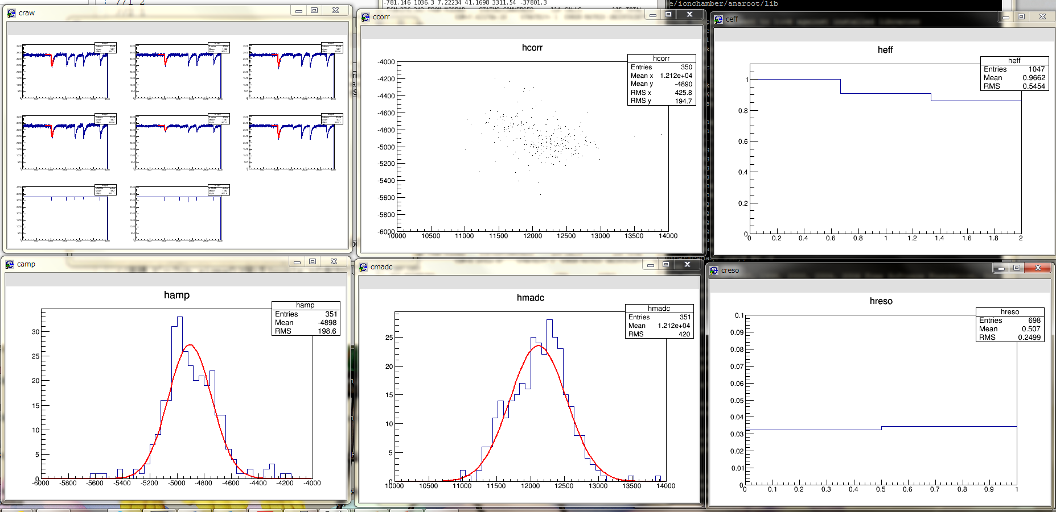
@ 150 kppp, HV(IC)=400 V, Preamp 1 micro sec., 20Ne @ 180 AMeV, P10 gas (RUN163)
Typical waveforms in FADC
IC
90% survival
MADC
FADC
Seems to be not correlated…
Plastic
FADC
(summed
for 6 planes)
MADC
(summed)
MADC
FADC
~3% (sigma)

Slide 12
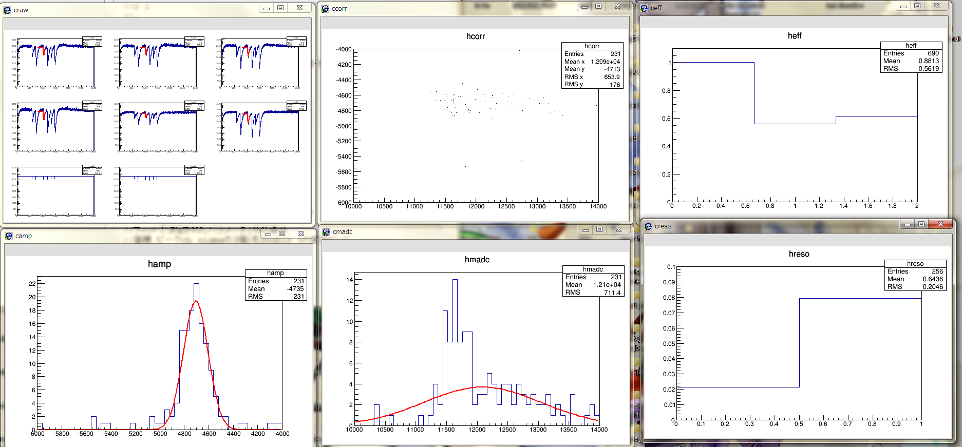
@ 600 kppp, HV(IC)=400 V, Preamp 1 micro sec., 20Ne @ 180 AMeV, P10 gas (RUN162)
Typical waveforms in FADC
IC
60% survival
MADC
FADC
Seems to be not correlated…
Plastic
FADC
(summed
for 6 planes)
MADC
(summed)
MADC
FADC
~2% (sigma)

Slide 13
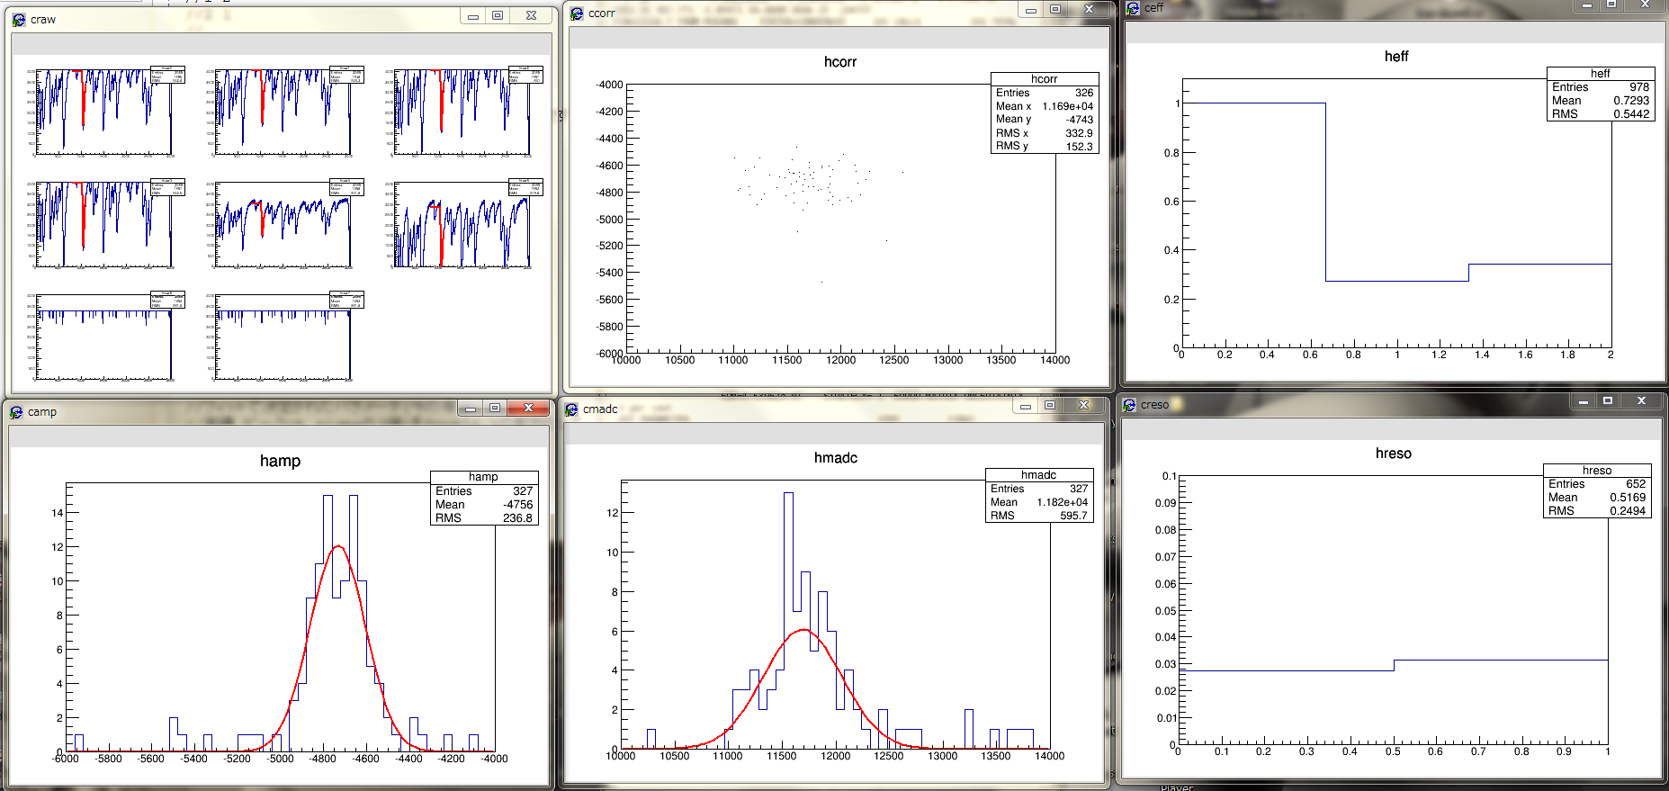
@ 1.5 Mppp, HV(IC)=400 V, Preamp 1 micro sec., 20Ne @ 180 AMeV, P10 gas (RUN161)
Typical waveforms in FADC
IC
30% survival
MADC
FADC
Seems to be not correlated…
Plastic
FADC
(summed
for 6 planes)
MADC
(summed)
Centroid
is shifted…
~4% (sigma)
FADC
MADC

Slide 14
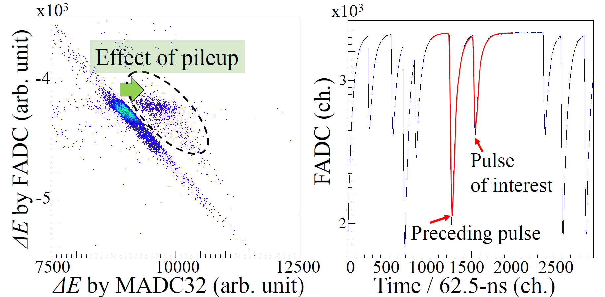
Xe @ 50 kppp (DAQ synchronization fixed…)
~50 kHz in this timing window
(10 particles in 188 micro seconds)

Slide 15
Summary & outlook
IC readout : preamp time constant 1 micro seconds + 62.5 ns sampling rate with 12 bit FADC
Gives a resolution similar to the method using preamp. + shaping amp + peak-sensitive ADC
Save pile up events up to ~100 kHz
Energy resolution in Xe runs will be evaluated
>5x10⁵ Hz
preamplifier with 1 micro seconds (drift time ~400 ns) is not enough
(large baseline shift / saturation)
The limit of this method (drift along the beam direction)
Segmentation, vertical drift, ...
Fast data throughput

