Slide 1
Maintenance and improvement of beam-line detectors for the BigRIPS fragment separator
Yuki Sato
RIKEN Nishina Center
Detector team

Slide 2
My work
Maintenance, research, and improvement of the beam line detectors
Task of Detector team
□ Parallel Plate Avalanche Counter : PPAC
□ Multiple Sampling Ionization Chamber : MUSIC
Search of the new detector
□ Diamond detector （SPDR 基礎特研）

Slide 3
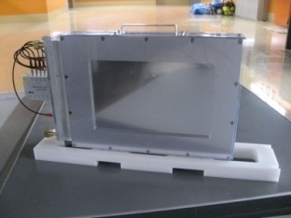
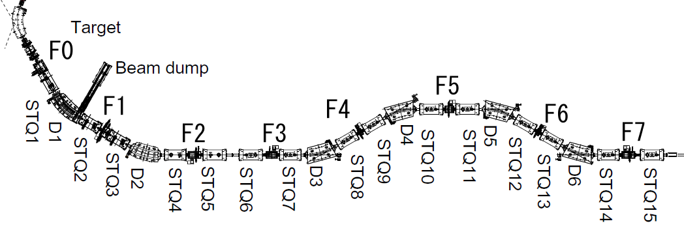
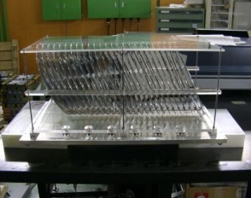
MUSIC and PPACs
PPAC: Position detector
MUSIC and PPACs
are gas detectors.
MUSIC: ΔE detector
MUSIC
ΔE detector
PPAC
Position measurement

Slide 4
Parallel Plate Avalanche Counter : PPAC

Slide 5
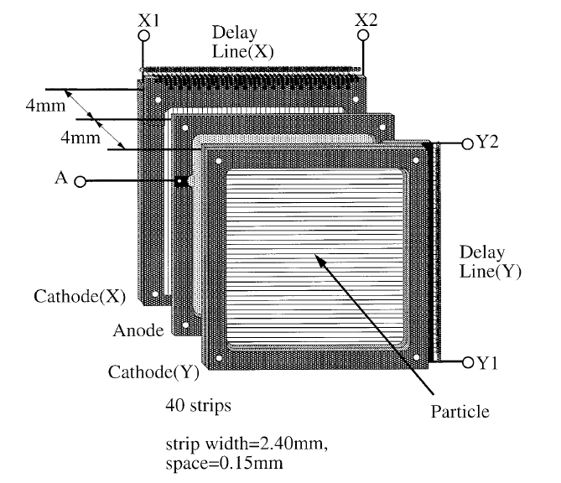
Parallel Plate Avalanche Counter : PPAC
2D position sensitive detector
●iso-C₄H₁₀, C₃F₈, 10～50 torr
●～100V/mm electric field
●Electron avalanche
＋
Delay-Line read-out
H. Kumagai et. al., NIMA 2001
X₁
Delay
line (X)
X₂
Pre Amp.
Fast Amp.
CFD
4.3 mm
4.3 mm
Y₂
Bias
voltage
Delay
line (Y)
Cathode (X)
Anode
Cathode (Y)
Y₁
Particle

Slide 6
Parallel Plate Avalanche Counter : PPAC
2D position sensitive detector
●iso-C₄H₁₀, C₃F₈, 10～50 torr
●～100V/mm electric field
●Electron avalanche
＋
Delay-Line read-out
H. Kumagai et. al., NIMA 2001
X₁
Delay
line (X)
X₂
Pre Amp.
Fast Amp.
CFD
4.3 mm
4.3 mm
Y₂
Bias
voltage
Delay
line (Y)
Cathode (X)
Anode
Cathode (Y)
Y₁
Particle

Slide 7
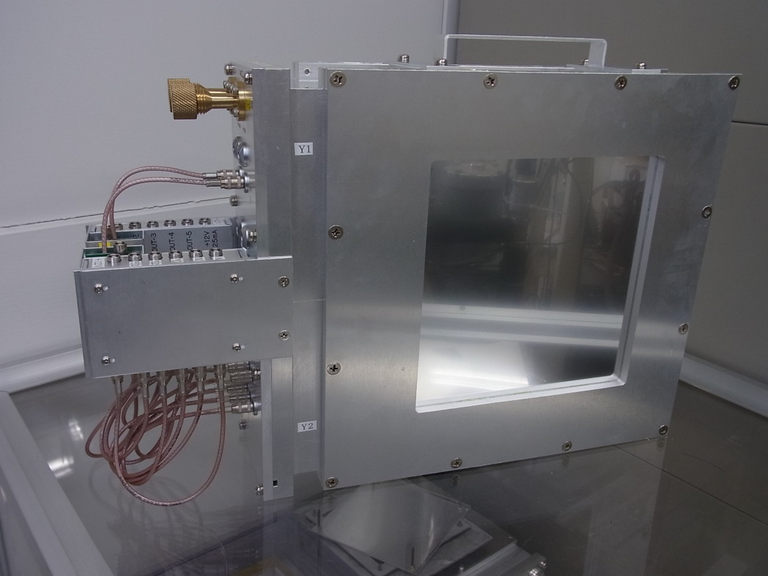
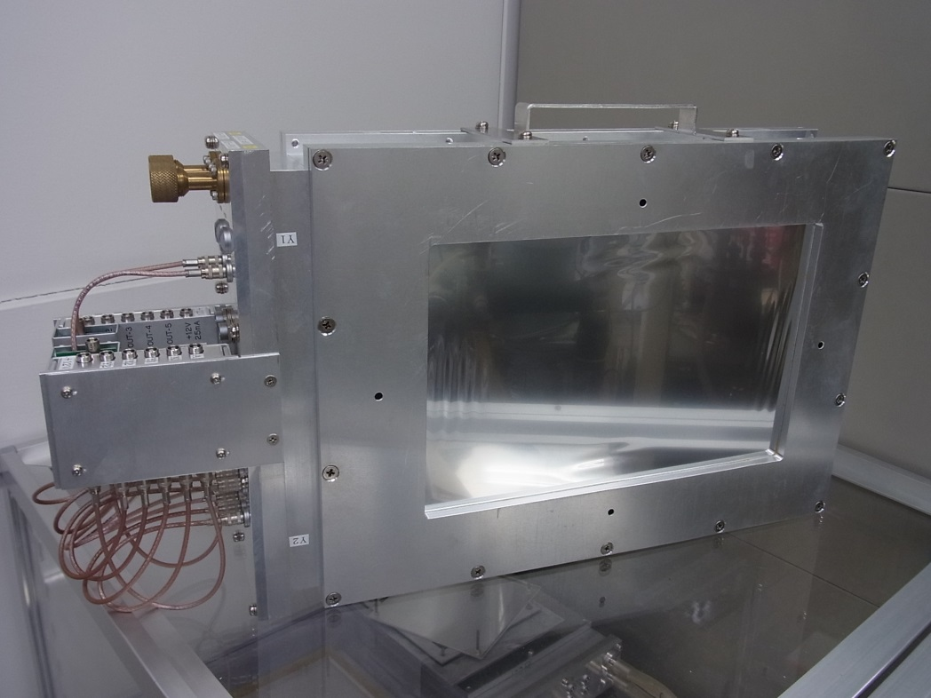
Photos of PPAC detector
●150 mm×150 mm
●240 mm×150 mm
Prepared
Pre. amp.
Al case
150 mm×150 mm
240 mm×150 mm
Entrance window
（ Aluminized mylar: 12 μm ）

Slide 8
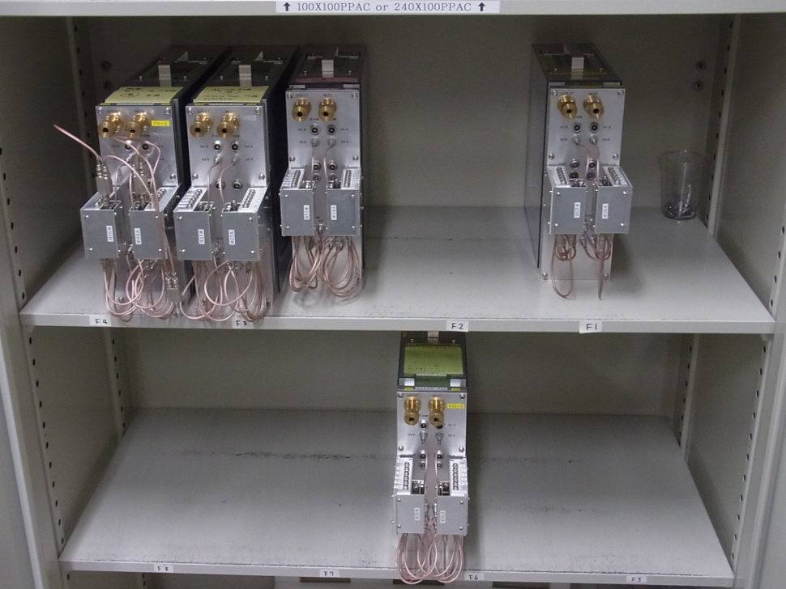
Maintenance
PPACs are necessary for all experiments.
□ Keep the operational condition.
□ Quick repair is necessary.
(Electrode-foils are expendable item.)
□ Deal with various troubles.
~30 PPACs in BigRIPS and ZDS
It is necessary to be able to make
all components of the PPAC detectors.

Slide 9
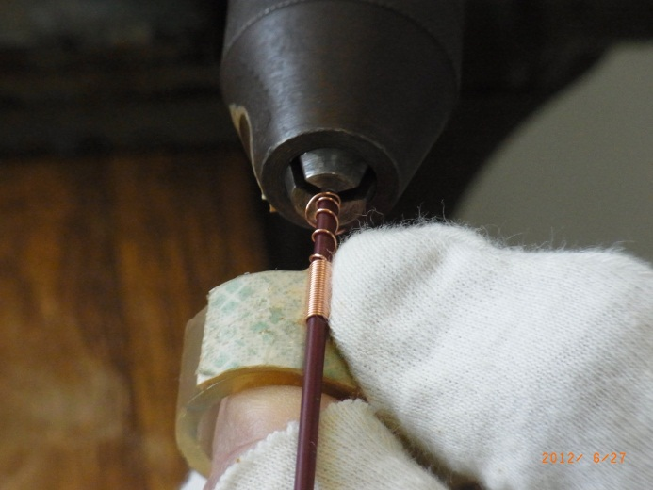
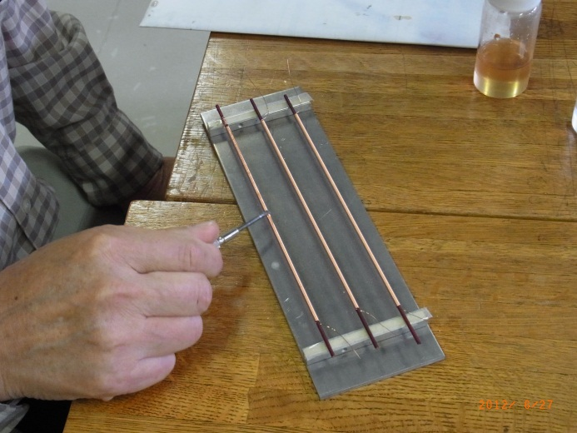
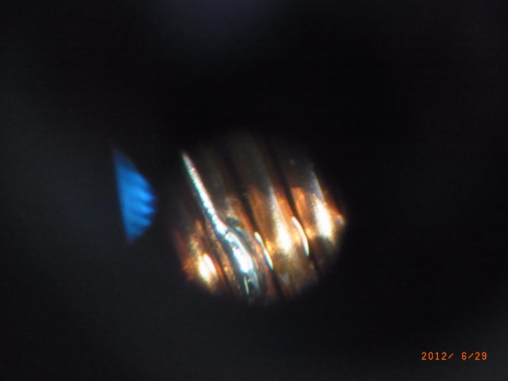
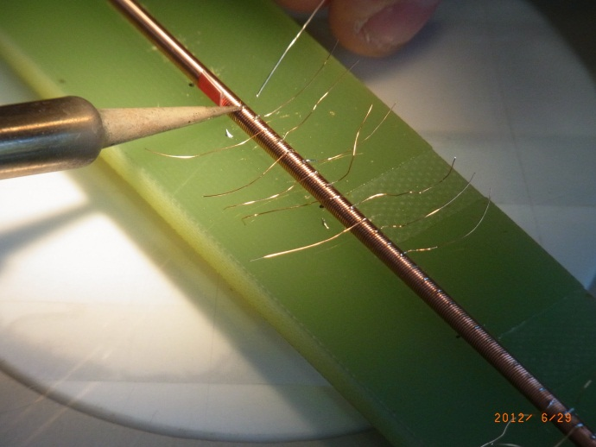
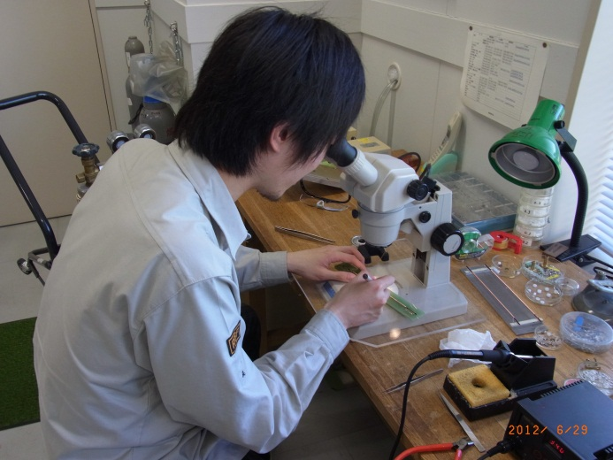
Delay-line fabrication
Cu wire coated by polyurethane
2 mmφ bakelite rod
Wound wires are coated
with epoxy resin.
Cu wire is wound.
Read-out lines are soldered.

Slide 10
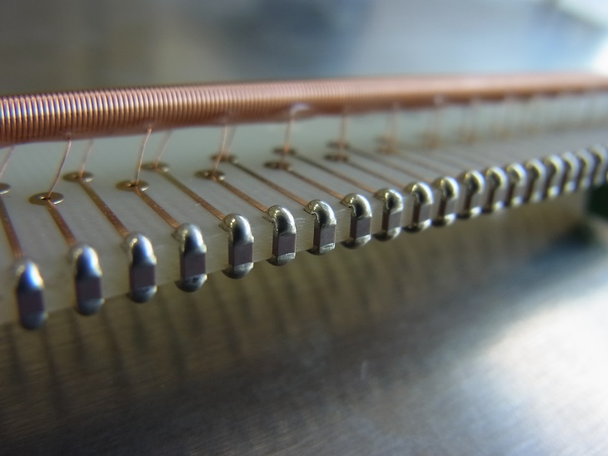
Delay-line fabrication
Mounted on printed board.
Chip capacitors (~40 pF)
LC delay-line
Z₀=50 Ω (Matching with input impedance of the pre-amplifier)
Delay：0.81 ns/mm

Slide 11
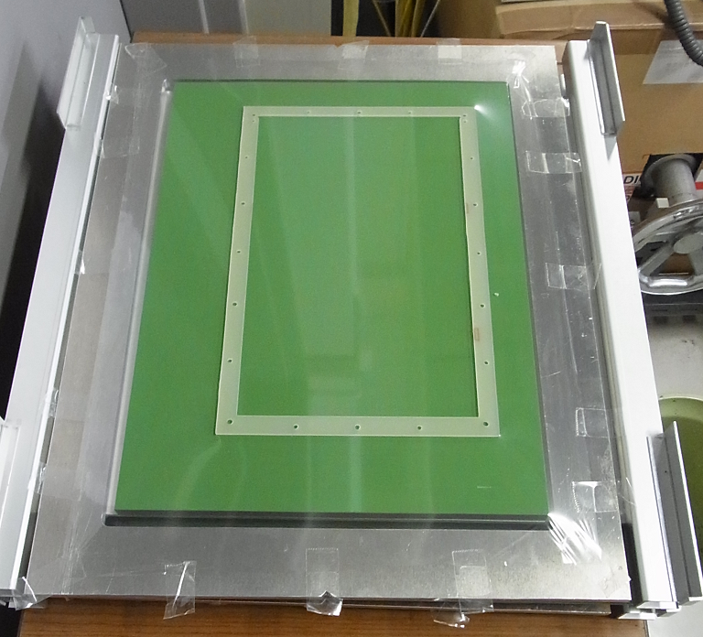
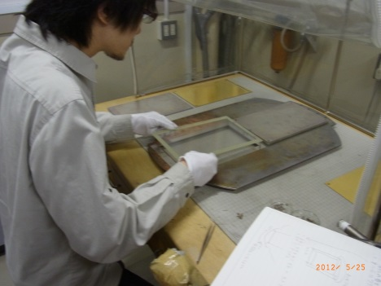
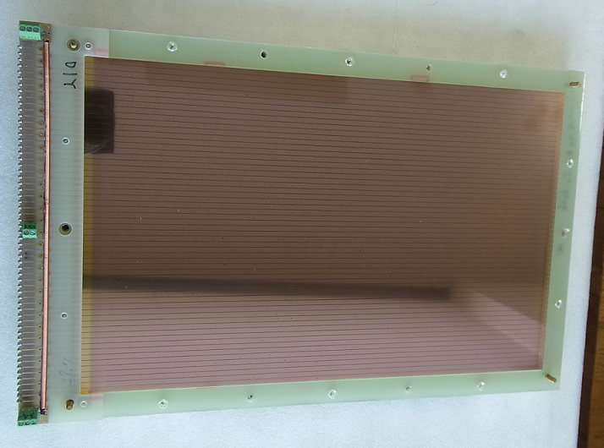
Electrode-foil fabrication
4 μm-thick-mylar is pasted and stretched
on the G10 frame.
+
Evaporation
mask
G10 frame
Vacuum metalizing
Delay line was attached.
Cathode electrode (240 mm×150 mm Y-axis)

Slide 12
Electrode-foil fabrication
4 μm-thick-mylar is pasted and stretched
on the G10 frame.
+
Evaporation
mask
G10 frame
Vacuum metalizing
2.4 mm
gap:
0.15 mm
Delay line was attached.
Cathode electrode (240 mm×150 mm Y-axis)

Slide 13
Electrode-foil fabrication
4 μm-thick-mylar is pasted and stretched
on the G10 frame.
+
Evaporation
mask
G10 frame
Vacuum metalizing
Breaking!!
Delay line was attached.
Cathode electrode (240 mm×150 mm Y-axis)

Slide 14
Position resolution for ²⁴¹Am-α particles
L=240 mm
●： D=3.3 mm
▲： D=4.3 mm
■： D=6.3 mm
Position resolution σ (μm)

Slide 15
Position resolution for ²⁴¹Am-α particles
L=240 mm
●： D=3.3 mm
▲： D=4.3 mm
■： D=6.3 mm
Position resolution σ (μm)
L=240 mm
σ~200 μm
Reachable position resolutions does not depend on the electrode distance.

Slide 16
Position resolution as a function of the signal intensity
Induced charge
(calculated)
L=240 mm
●： D=3.3 mm
▲： D=4.3 mm
■： D=6.3 mm
Electron drift time
(measured)
：Number of electron-hole pairs
before avalanche amplification
：Townsend coefficient
（by Magboltz simulation）
(calculated)
The most important factor is the S/N ratio.

Slide 17
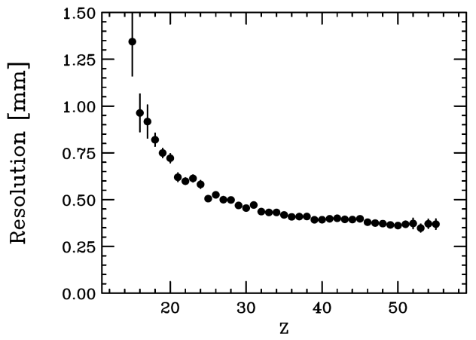
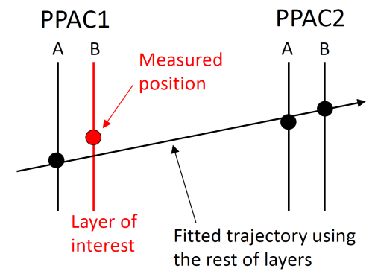
Position resolution for heavy ions
Fragment ions (reaction: ²³⁸U + ⁹Be at 345 MeV/nucleon)
C₃F₈ :10 torr
Anode bias : 1055 V
Position resolution σ (mm)
Z
Position resolutions improved.
Signal intensities are increasing.
(Q∝Z²)
σ~350 μm at Z≈50 ions.
H. Kumagai NIMB 2013

Slide 18
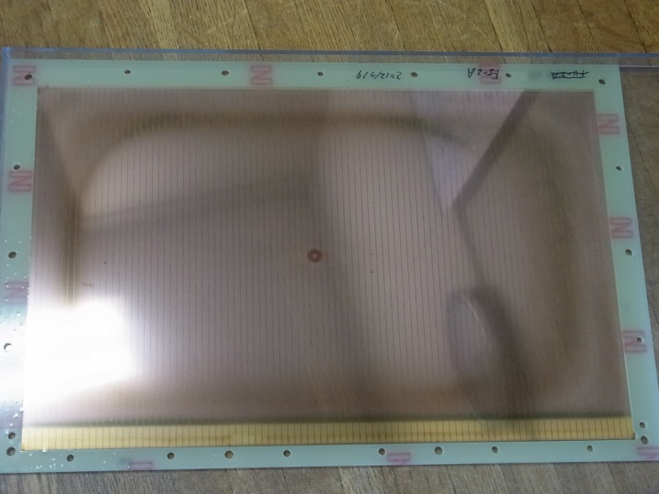
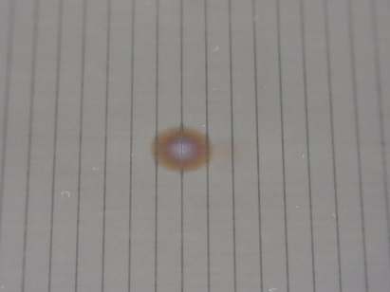
Damage on cathode electrode due to the discharge
●Z~10 ions are measurable up to 1 Mcps.
●Electrical discharge was sometimes occur above several tens of kcps beam rate for Z~50 ions.
Damaged spot
240 mm×150 mm Cu cathode

Slide 19
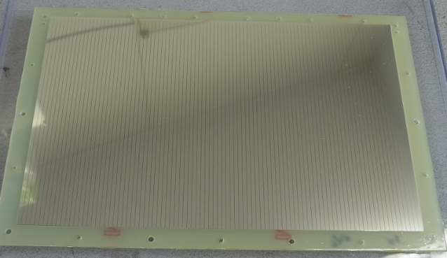
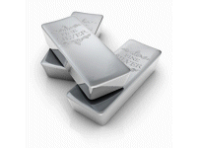
Solution 1
Changing the electrode materials.
Au, Al, Cu Ag
Ag-cathode
(~50 nm-thickness)
●Large thermal conductivity : Al < Au < Cu < Ag
●Small electrical resistivity : Al > Au > Cu > Ag
The production (evaporation) of the silver electrode is difficult…
Many spots were appeared.
Establishment of a manufacturing process is now in progress.

Slide 20
Solution 1
Changing the electrode materials.
Au, Al, Cu Ag
Ag-cathode
(~50 nm-thickness)
First test for Ag-electrode (2012/11/6)
● PPAC operation was confirmed using
~160 kcps of Ni (Z=28) ions. (irradiation within 1 hour)
In the first half-year of 2014…
● ~50 kcps of Cs (Z=55) ions for 2.5 days.
● ~70 kcps of Z~60-70 ions for ~5 hours.
No damage

Slide 21
Solution 2
Development of anti-discharge unit.
PPAC
H.V. Power supply
Anti-discharge unit
10 MΩ
Signal
separator
Anode sig.
Preamp.
220 pF
Dischage sig.
+12 V
Anode
Power MOSFET
20 μs Uni-vaibrator
Cathode
Gas: C₄H₁₀ 10 torr
10 kΩ

Slide 22
Solution 2
Development of anti-discharge unit.
PPAC
H.V. Power supply
Anti-discharge unit
10 MΩ
Signal
separator
Anode sig.
Preamp.
220 pF
Dischage sig.
+12 V
Anode
Power MOSFET
20 μs Uni-vaibrator
Cathode
Gas: C₄H₁₀ 10 torr
Large discharge current!!
10 kΩ
Reduce the damage on electrode foils.

Slide 23
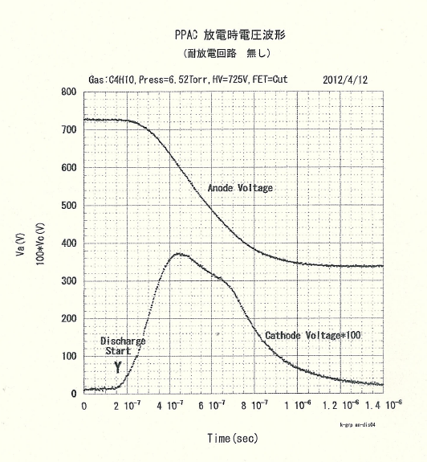
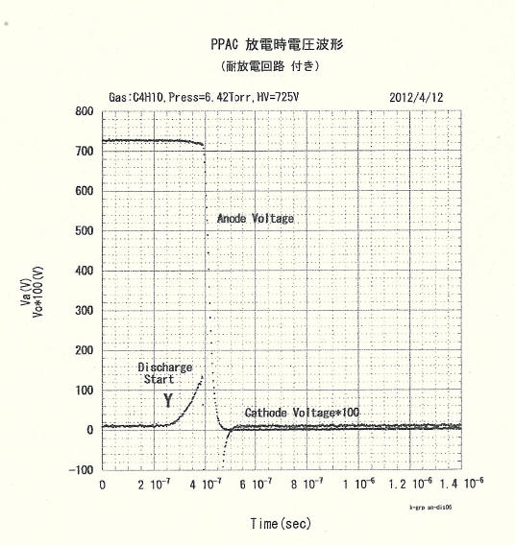
Operation test
Example: Discharge induced using ²⁴¹Am-α by applying the
too large bias voltage, intentionally.
Without anti-discharge unit
With anti-discharge unit
800
160
800
160
700
140
700
140
600
120
600
120
Anode voltage
Anode voltage
500
100
500
Discharge
growth
100
400
80
Anode voltage (V)
Anode voltage (V)
Cathode current (mA)
Cathode current (mA)
400
80
60
300
300
60
200
40
Cathode
current
200
40
100
Cathode current
20
100
20
0
0
0
0
-100
-20
0
0
0.2
0.4
0.6
0.8
1.0
1.2
1.4
0
0.2
0.4
0.6
0.8
1.0
1.2
1.4
Time (μs)
Time (μs)
The anode voltage was forcibly grounded using the anti-discharge unit.
Discharge current was suppressed.
Preventing damages on electrodes.

Slide 24
Operation test
Example: Discharge induced using ²⁴¹Am-α by applying the
too large bias voltage, intentionally.
Without anti-discharge unit
With anti-discharge unit
800
160
800
160
700
140
700
140
600
120
600
120
Anode voltage
Anode voltage
500
100
500
Discharge
growth
100
400
80
Anode voltage (V)
Anode voltage (V)
Cathode current (mA)
Cathode current (mA)
400
80
60
300
300
60
200
40
Cathode
current
200
40
100
Cathode current
20
100
20
0
0
0
0
-100
-20
0
0
0.2
0.4
0.6
0.8
1.0
1.2
1.4
0
0.2
0.4
0.6
0.8
1.0
1.2
1.4
Time (μs)
Time (μs)
The anode voltage was forcibly grounded using the anti-discharge unit.
150×150 mm² PPAC with the anti-discharge unit was installed at upper stream of F3.
Discharge current was suppressed.
Preventing damages on electrodes.

Slide 25
Summary of PPAC
●The delay-line and electrode-foil are made by hand work.
All PPAC detectors are repaired by detector team.
●The position resolution improves with the signal intensity.
●The durability against electric discharge was improved by
using Ag electrodes.
Future work
●Install of the anti-discharge unit for all PPACs
●Optimization of some parameters (Ag-layer-thickness, gas, etc…)

Slide 26
Multiple Sampling Ionization Chamber : MUSIC

Slide 27
Multiple Sampling Ionization Chamber : MUSIC
Ch.1
Ch.2
Ch.3
Ch.4
Ch.5
Ch.6
Beam
200 mmΦ
232 mmΦ
20 mm
480 mm
Cathode
Anode
13 cathodes and 12 anodes (2-μm-thick aluminized mylar foils)
Gas: Ar+CH₄ (90%:10%), 760 torr
Anode bias 500~550 V

Slide 28
Multiple Sampling Ionization Chamber : MUSIC
Ch.1
Ch.2
Ch.3
Ch.4
Ch.5
Ch.6
electron
-
-
-
-
-
-
-
Heavy ion
+
+
+
+
+
+
+
positive ion
Cathode
Anode
Beam
200 mmΦ
232 mmΦ
20 mm
480 mm
Cathode
Anode
13 cathodes and 12 anodes (2-μm-thick aluminized mylar foils)
Gas: Ar+CH₄ (90%:10%), 760 torr
Anode bias 500~550 V

Slide 29
Multiple Sampling Ionization Chamber : MUSIC
Ch.1
Ch.2
Ch.3
Ch.4
Ch.5
Ch.6
Beam
200 mmΦ
232 mmΦ
20 mm
480 mm
Cathode
Anode
13 cathodes and 12 anodes (2-μm-thick aluminized mylar foils)
Tow anode electrodes are connected to a charge-sensitive preamplifier.
1 channel : 8 cm 6 channels : 48 cm

Slide 30
Energy spectra for heavy ions produced from in-flight fission of ²³⁸U at 345 MeV/nucleon.
Average ADC value
Average ADC value
Average ADC value
38
36
50
51
39
41
33
40
43
52
34
37
35
49
42
44
46
48
31
45
47
Average ADC value
Average ADC value
Average ADC value
The resolving power increased with gas thickness.

Slide 31
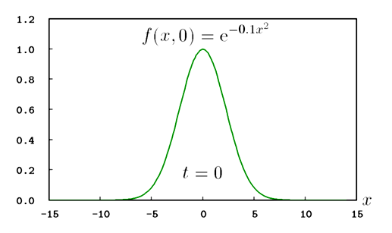
Energy resolution as a function of the gas thickness
○: Z=38
●: Z=51
σ
Energy resolution σ/ΔE (%)
ΔE
Consider only energy straggling, then
σ ∝ L^{1/2} (Bohr expression) and ΔΕ ∝ L (Bethe-Bloch formula)
thus
σ/ ΔΕ ∝ L^{-1/2} .

Slide 32
Energy resolution as a function of the gas thickness
○: Z=38
●: Z=51
σ
Energy resolution σ/ΔE (%)
ΔE
Noise level is negligibly small.
Consider only energy straggling, then
σ ∝ L^{1/2} (Bohr expression) and ΔΕ ∝ L (Bethe-Bloch formula)
thus
σ/ ΔΕ ∝ L^{-1/2} .

Slide 33
Energy resolution as a function of the atomic number of heavy ions
●: L₁=24 cm (3 Ch.)
○: L₂=48 cm (6 Ch.)
Energy resolution σ/ΔE (%)
Results of the fitting of Z⁻¹
Consider only energy straggling, then
σ ∝ Z (Bohr expression) and ΔΕ ∝ Z² (Bethe-Bloch formula)
thus
σ/ ΔΕ ∝ Z⁻¹ .

Slide 34
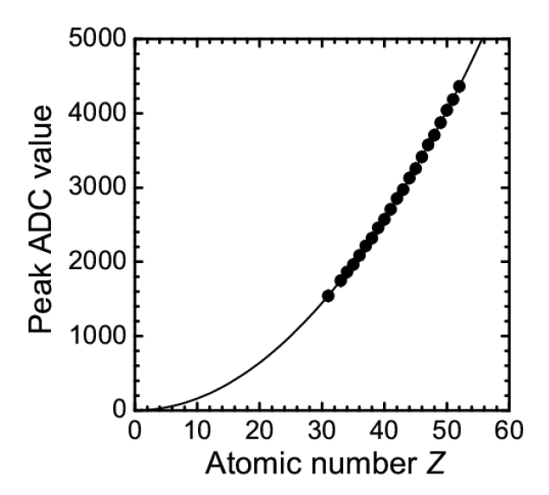
Z resolution (ΔZ)
ADC value ∝ Z²
Average ADC value
38
36
Width of peaks (σ)
51
50
39
41
33
40
43
52
34
37
ΔZ
35
49
42
44
46
48
31
45
47
Atomic number Z

Slide 35
Z resolution as a function of the atomic number of heavy ions
L=48 cm
Z resolutions : ΔZ ≈ 0.21
Performance decline is not observed up to Z=52 below 1 kcps.

Slide 36
Z resolution as a function of the atomic number of heavy ions
U (Z=92) ΔZ(σ)≈0.45
2014/10/20
tentatively
ΔZ for uranium is approximately 2 times of that of less than Z=52.
Charge state straggling ?
Under consideration

Slide 37
Z resolution as a function of the atomic number of heavy ions
U (Z=92) ΔZ(σ)≈0.45
2014/10/20
tentatively
ΔZ for uranium is approximately 2 times of that of less than Z=52.
Charge state straggling ?
Under consideration

Slide 38
Ionization chamber (@ F7) Pre. Amp. OUT
PreAmp : Mesytec MPR-16 PreAmp (10 μs decay)
～500 cps
～170 kcps
Many pile-up events !!

Slide 39
Rate dependence of Z resolution
Z resolutions decreased above several tens of kcps.

Slide 40
Dependence of energy deposition on atomic number
ΔE ∝ Z²
Recombination of electrons and positive ions is negligibly small.
Decline of ΔZ was caused by
the measurement system (pile-up events).
Z

Slide 41
Summary of MUSIC
「ΔZ」
●Z resolution did not decrease up to Z=52 below, ΔZ ≈ 0.21
U (Z=92) ΔZ(σ)≈0.45
「High rate」
●Z resolutions decreased above several tens of kcps.
●Recombination of electrons and positive ions was not observed
up to ~100 kcps.
Charge state straggling ?
New measurement system is necessary for high-rate conditions.

Slide 42
Diamond detector

Slide 43
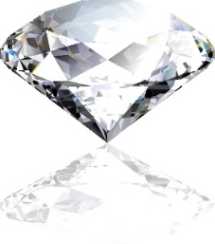
Why diamond ?
●Wide band gap (5.45 eV).
●Very high room temperature resistivity (~10¹⁶ Ω・cm)
⇒ low noise operation, no cooling,
●High charge carrier mobility (e:1800 cm²/Vs, h:1600 cm²/Vs)
Si (e:1500 cm²/Vs, h:600 cm²/Vs)
⇒ fast response of detector signals.
●High energy needed to remove carbon atom from lattice (~40 eV)
⇒ detector are radiation hard.
●Using high quality single crystal
⇒ Superior energy resolution.

Slide 44
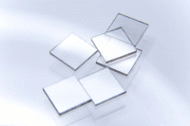
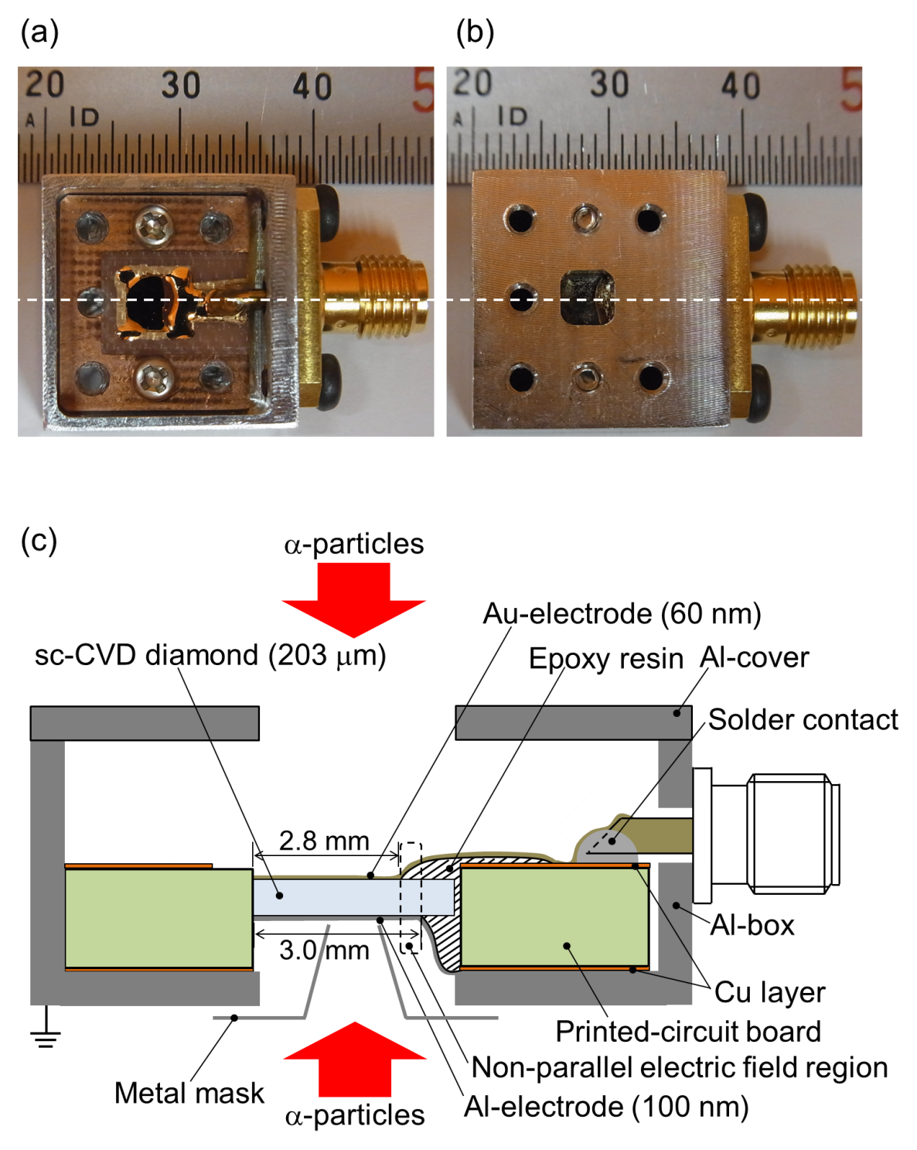
CVD diamond detector
CVD single crystal (4 mm x 4 mm x 90~200 μm)
weak point
Charged particles
e⁻
e⁻
e⁻
e⁻
e⁻
e⁻
e⁻
Signal
h⁺
h⁺
h⁺
h⁺
h⁺
h⁺
h⁺
Metal electrode (Au)
Metal electrode (Al)

Slide 45
CVD diamond detector as a
ΔE detector
Energy spectrum of ²⁴¹Am-α-particles
Single crystal by Element six.
(4 mm x 4 mm x ~200 μm)
Bias voltage: 100 V
5.486
5.443
5.389
Intrinsic energy resolution
~0.4% (FWHM)
at 5.486 MeV
5.545
Good energy resolution !!

Slide 46
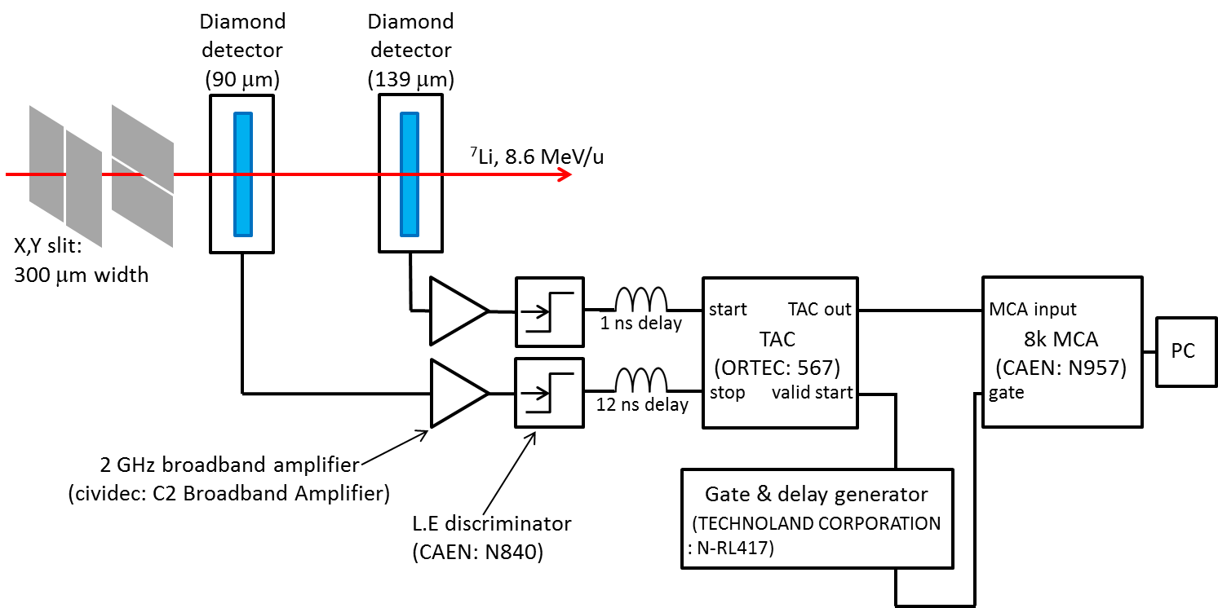
CVD diamond detector as a
TOF detector
8.6 MeV/u ⁷Li beam at E7B beam line.
Single crystal by Hokkaido univ. (4 x 4 mm² crystal)
Collaboration of Detector team, CNS, and Hokkaido univ.

Slide 47
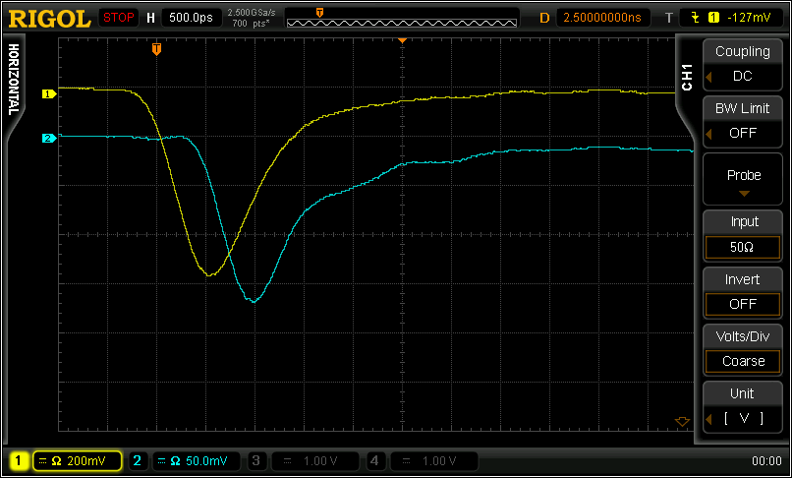
CVD diamond detector as a
TOF detector
500 ps
Front side
Rear side
FWHM < 1ns
※ oscilloscope: 1 GHz bandwidth

Slide 48
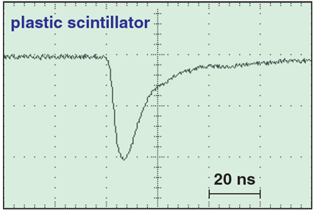
CVD diamond detector as a
TOF detector
500 ps
Front side
Rear side
FWHM < 1ns
Pulse width
~15 ns (FWHM)
A.Stolz, Expert meeting 2013 at RIKEN

Slide 49
CVD diamond detector as a
TOF detector
intrinsic detector resolution
σ_{int} = 31 ps (σ divided by $\sqrt{2}$ )
8.6 MeV/u ⁷Li
σ∼45 ps
Other Groups
σ_{int} = 57 ps
for ⁵⁸Ni, 600 MeV/u, Z=28 @ GSI
σ_{int} = 39 ps
for ²³⁸U, 1 GeV/u, Z=92 @ GSI
σ_{int} = 27 ps
⁴He, 8 MeV/u, Z=4 @ CNS
σ_{int} = 15 ps
for ⁷⁸Kr, 87 MeV/u, Z=36 @ MSU

Slide 50
Summary of diamond detector
● Single crystal diamond detector has a good energy resolution.
● Intrinsic timing resolution is σ~31 ps.
Reported value: 15~57 ps.
NSCL/MSU reported the best value of σ~15 ps.
Future work
● Understand radiation damage.
● Fast pre-amplifiers for diamond detector
● Detector with large active areas.

Slide 51
Summary of diamond detector
● Single crystal diamond detector has a good energy resolution.
● Intrinsic timing resolution is σ~31 ps.
Reported value: 15~57 ps.
NSCL/MSU reported the best value of σ~15 ps.
Future work
● Detector with large active areas.
20 mm×20 mm sc-dia.
Crystal growth technology
is making progress day by day.
Direct wafer method
AIST says “3, 4 inch size wafer in near future”.
20 mm×20 mm single crystal diamond is already commercially available.

Slide 52
Summary
Maintenance, research, and improvement of the beam line detectors
□ PPAC
・improvement of the radiation hardness
□ MUSIC
・New signal read-out system
・Study of ΔZ for heavy ions Z= 60~92.
□ Diamond detector
・large area
・Fast pre-amplifiers for diamond detector
・Study for radiation hardness
Challenges

Slide 53
fin.

