Slide 1
Determining order of chiral phase transition in QCD from bootstrap
Yu Nakayama (Kavli IPMU, Caltech)
in collaboration with Tomoki Ohtsuki (Kavli IPMU)
arXiv:1404.0489 arXiv:1407.6195

Slide 2



What is the order of chiral phase transition in our real QCD?
To make it well-defined, consider massless flavors (say up and down quarks)
At finite temperature, chiral symmetry is restored
Is it first order or second order?
Huge controversies in lattice/theory community

Slide 3

Various results in 2 flavor QCD
 | Claim
Pisarski Wilczek (RG, 1-loop) | 1st order (or O(4))
Karsch (lattice simulation) | 2nd order
Iwasaki et al (lattice simulation) | 2nd order (O(4)?)
D’Elia et al (lattice simulation) | 1st order
Ejiri et al (lattice simulation) | 2nd order
Aoki et al (lattice theoretical study) | Cannot be O(4), 1st order.
Delamotte et al (functional RG) | 1st order
Bonati et al (simulation) | 1st order
Pelissetto et al (RG,6-loop) | 2nd order (new fixed point)
Grahl (functional RG) | 2nd order
Sato et al (RG with U(1) breaking) | 2nd order
And many others… | Let me know your predictions
O(4) universality is related to the case when is not restored…

Slide 4

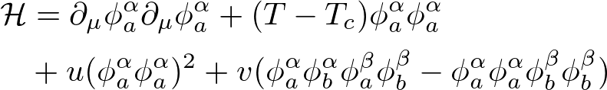

Landau’s argument (pre RG)
Order parameters:
O(4) x O(2) Landau-Ginzburg theory
O(4) x O(2) symmetric mass term is temperature
Without fluctuations/accidents, phase transition would be 2nd order (Landau’s prediction)
Assumed effective restoration of . Aoki et al suggested the restoration of . For our purpose, this is enough (getting rid of the most relevant breaking term).
Let us study the effective free energy of thermal chiral phase transition (in Landau mean field theory)
In vector x vector rep of O(4) x O(2)
O(4 x 2) symmetric

Slide 5
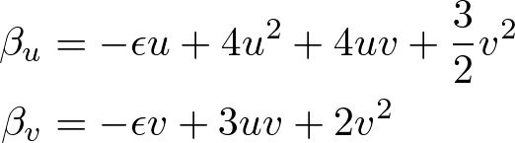
RG improvement
If the second order phase transition occurs, there should be non-trivial O(4) x O(2) symmetric fixed point in RG!
Hard to compute in d=3 directly…
1-loop epsilon expansions (Pisarsky-Wilczek)
Only fixed point at (O(8) symmetric Heisenberg)
QCD phase transition cannot be 2nd order
But are you convinced?
What happens if we consider fluctuations?

Slide 6
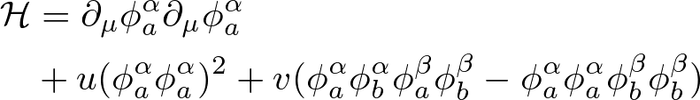
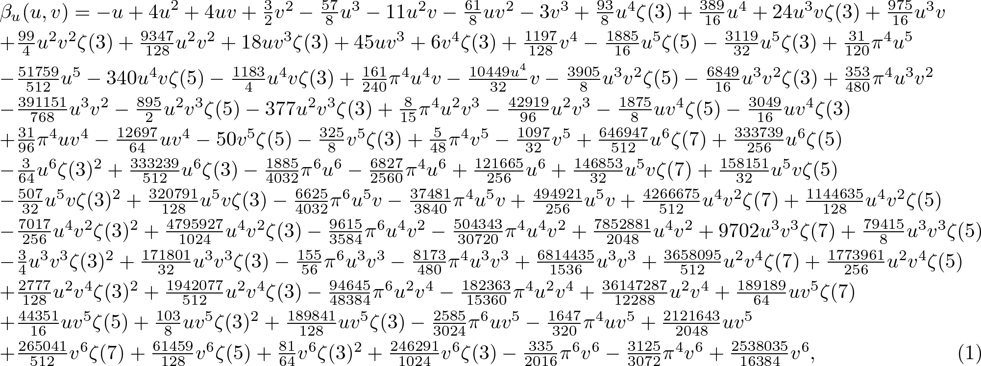
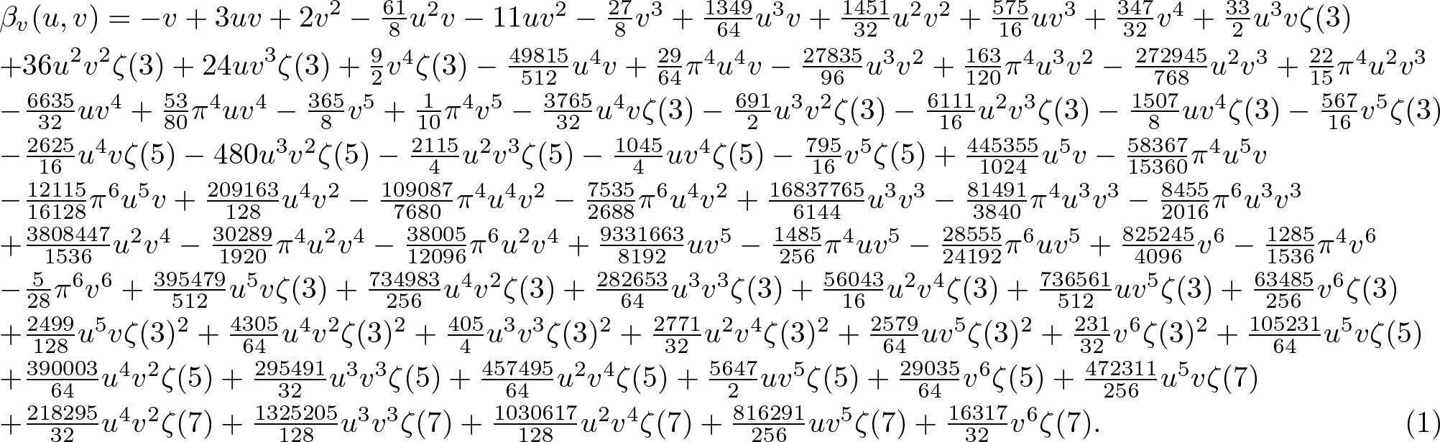
At five loop (Calabrese, Vicari, e.g. 1309.5446)

Slide 7
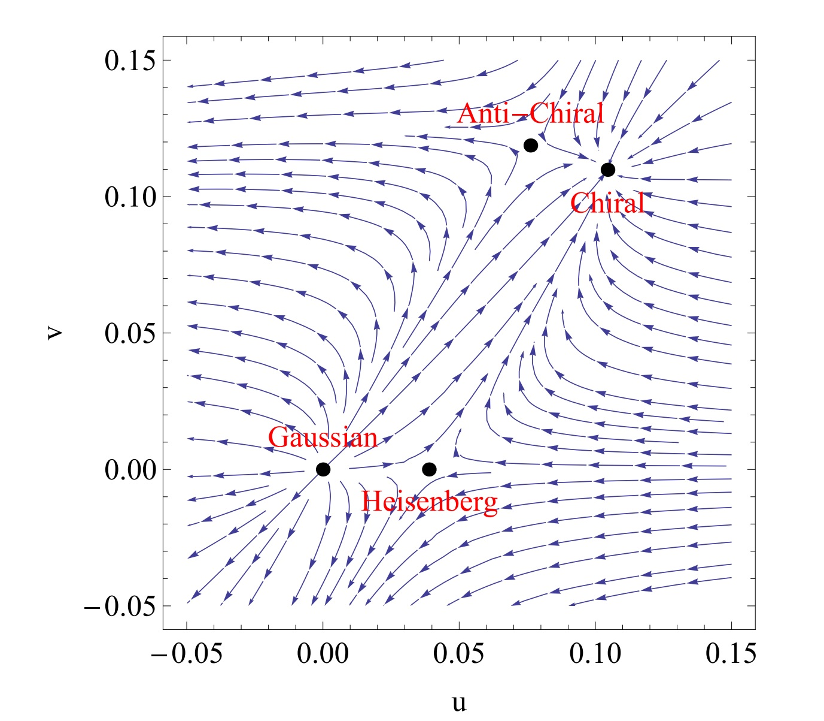

RG flow and classification of possible fixed points
Trivial Gaussian fixed point
O(8) Heisenberg fixed point
(not important in QCD)
Chiral fixed point: Stable and
(not important in QCD
but applications to some magnet)
Anti-chiral fixed point: Unstable
(not important in QCD)
Collinear fixed point: Stable and
Important in QCD chiral phase transition

Slide 8
Why controversial?
Large n (with fixed m) expansion or epsilon expansion are asymptotic
Results depend on how you resum the diverging 5-loop or 6-loop series
Functional RG directly in d=3 needs “truncation”, which is not a controlled approximation
Lattice simulation?
We use conformal bootstrap to avoid all these problems and resolve the controversies.

Slide 9
Conformal Bootstrap approach

Slide 10





Schematic conformal bootstrap equations
Consider 4pt functions
Operator product expansions (OPE)
I: SS, ST, TS, TT, AS, SA, AA … (S: Singlet, T: Traceless symmetric, A: Anti-symmetric)
Crossing relations
Assume spectra (e.g. , )
to see if you can solve the crossing relations (non-trivial due to unitarity )
→ convex optimization problem (or semi-definite problem)

Slide 11
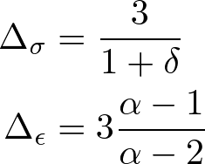




Ising CFT in d=3 (El-Showk et al arXiv:1203.6064)
No
Maybe
As of 2015, bootstrap method gives the most precise critical exponents than any other methods

Slide 12
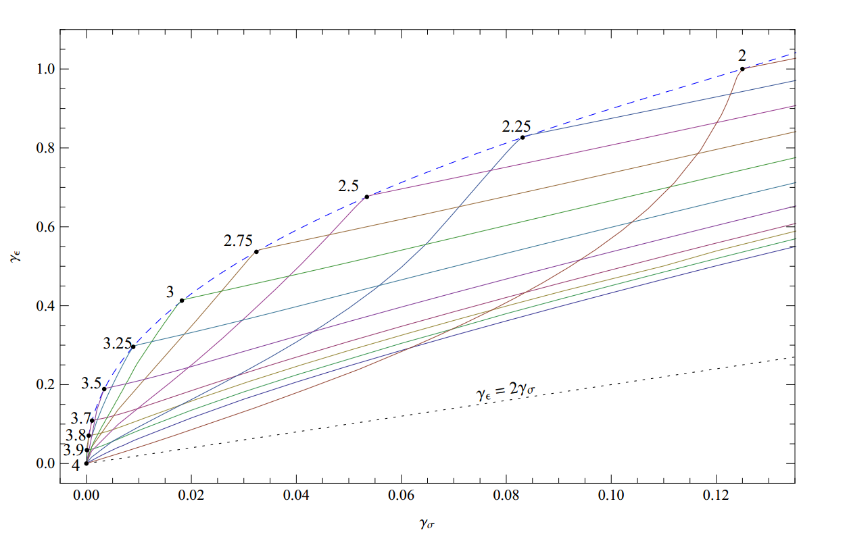

No Ising CFT in d=4 (El-Showk et al arXiv:1309.5089 )
Kink disappears in d=4
Consistent with triviality of theory
Does not mean CFT does not exist at all. It means we need more date to specify CFTs in d=4
No
Maybe

Slide 13
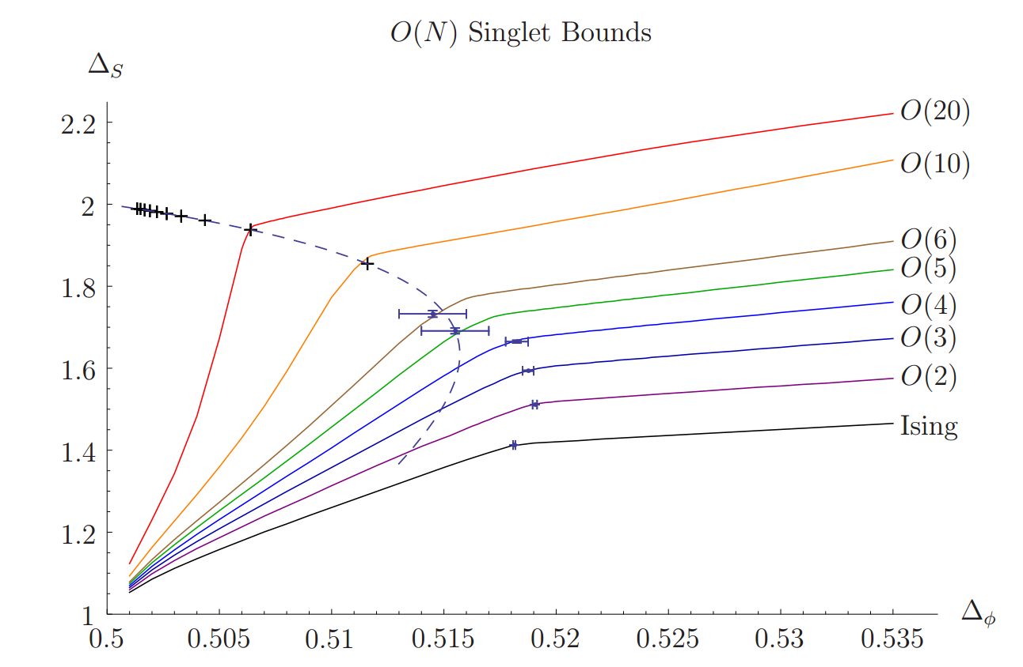
O(N) fixed points in d=3 (Kos et al arXiv:1307.6856 )
No
Maybe

Slide 14
What to expect in conformal bootstrap?
Assume fixed point is conformal invariant (conformal hypothesis)
When the conformal fixed point with a given symmetry exists, then the bound shows characteristic features of “kink”
When such CFTs do not exist (or characterization is not enough), it shows no interesting behavior
Hypothesis: non-trivial behavior of the bound indicates conformal fixed point

Slide 15
Bootstrapping QCD

Slide 16
O(4) x O(2) bootstrap
We use conformal bootstrap to ask for the existence of various fixed points (Gaussian, Heisenberg, chiral, anti-chiral, and collinear fixed points)
We do not assume any effective Hamiltonian (just symmetry!), but do assume conformal invariance
Whether we could find a “kink” corresponding to collinear fixed point → determination of the order of chiral phase transition
There are 6 different channels to study
We can read the operator spectrum at the kink

Slide 17
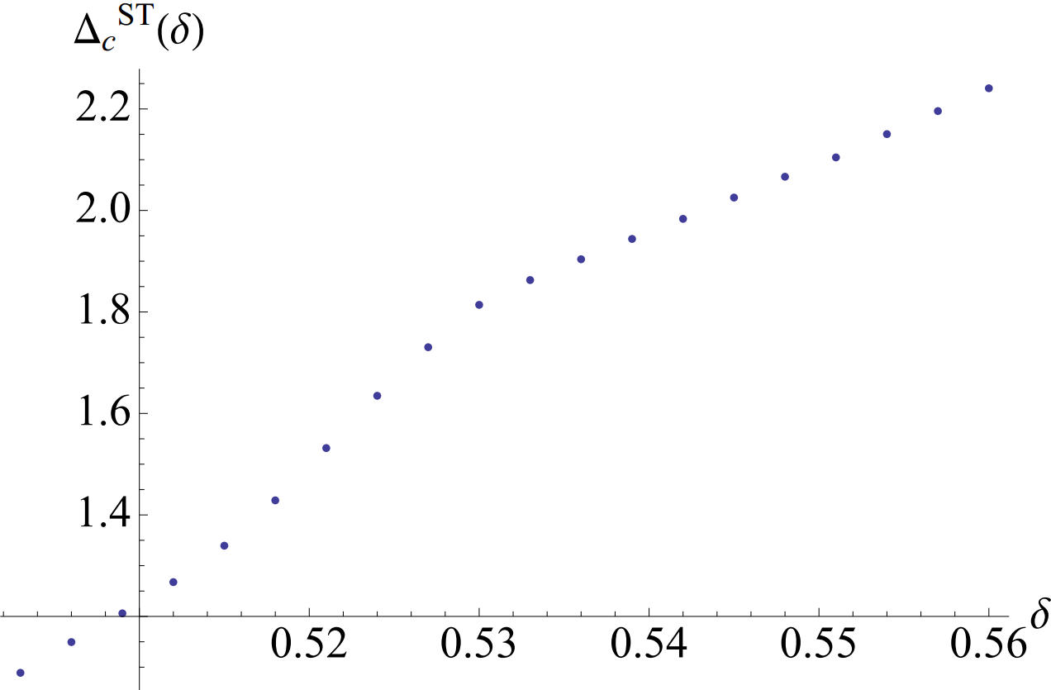
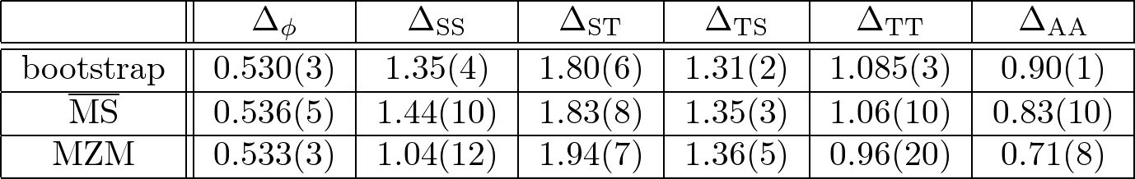
O(4) x O(2) chiral fixed point
ST sector Bootstrap (k=10)
No
Maybe
Chiral fixed point → importance in frustrated spin systems

Slide 18
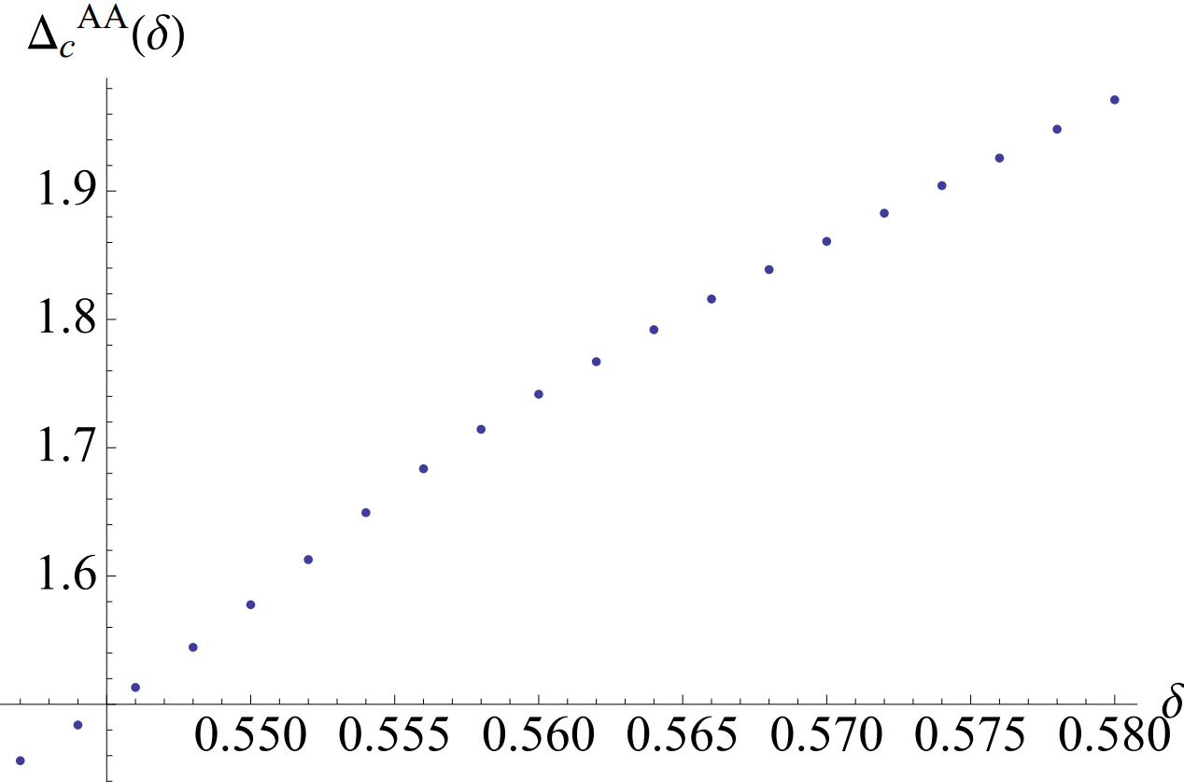
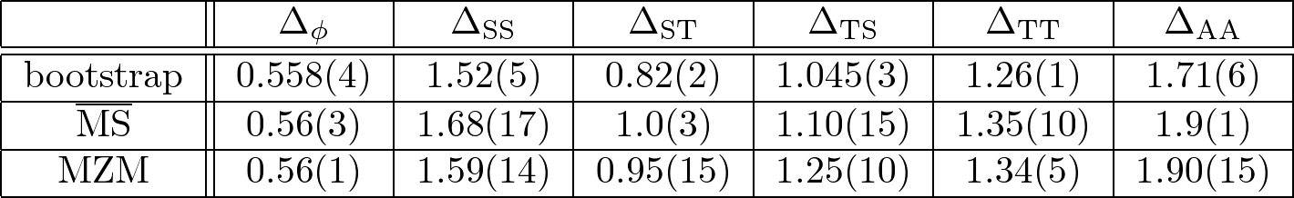
O(4) x O(2) collinear fixed point
AA sector Bootstrap (k=12)
No
Maybe
Collinear fixed points → 2nd order phase transition in QCD

Slide 19
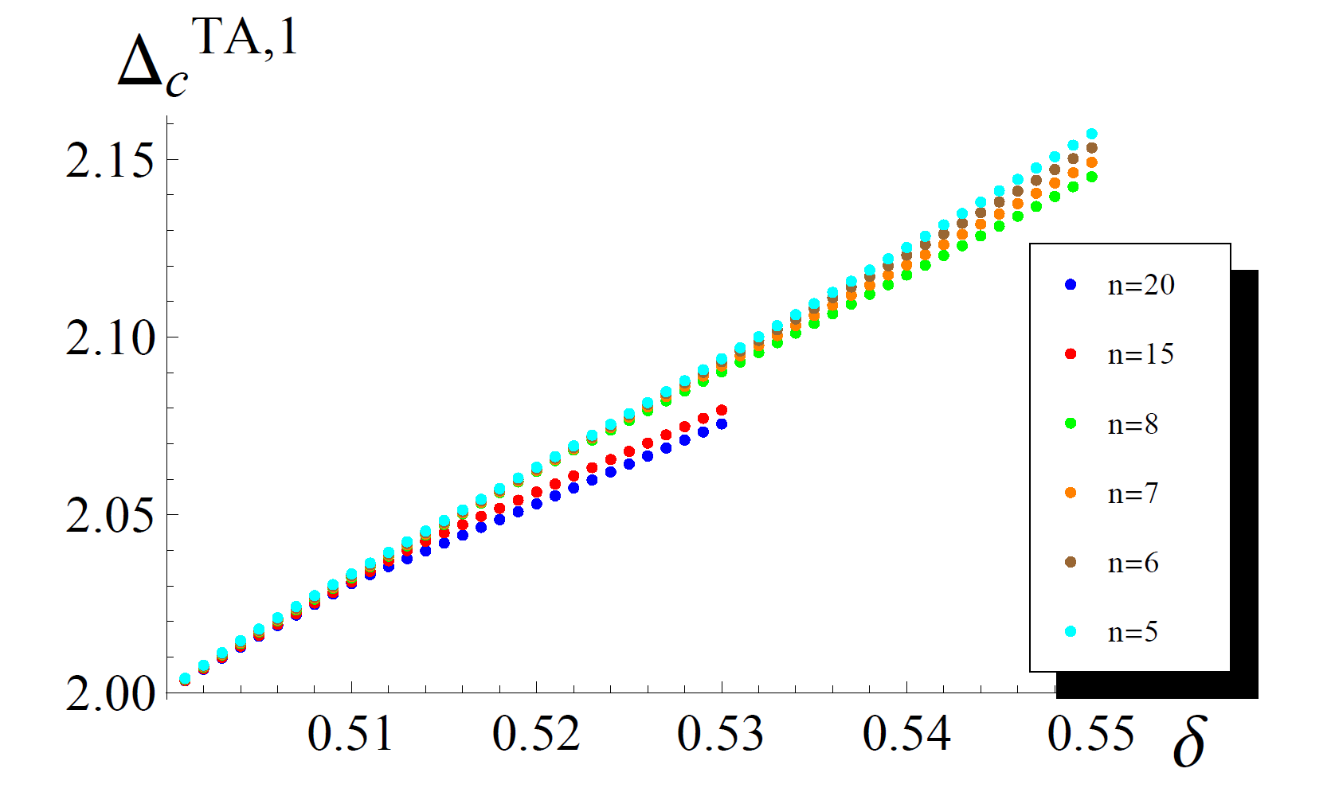
Conformal window for anti-chiral fixed point
Study the conformal window of anti-chiral fixed point in O(n) x O(m) theory
Change n (with m=3) to see if the kink disappears
n = 6~7 seems the edge of the conformal window?
No
Maybe

Slide 20
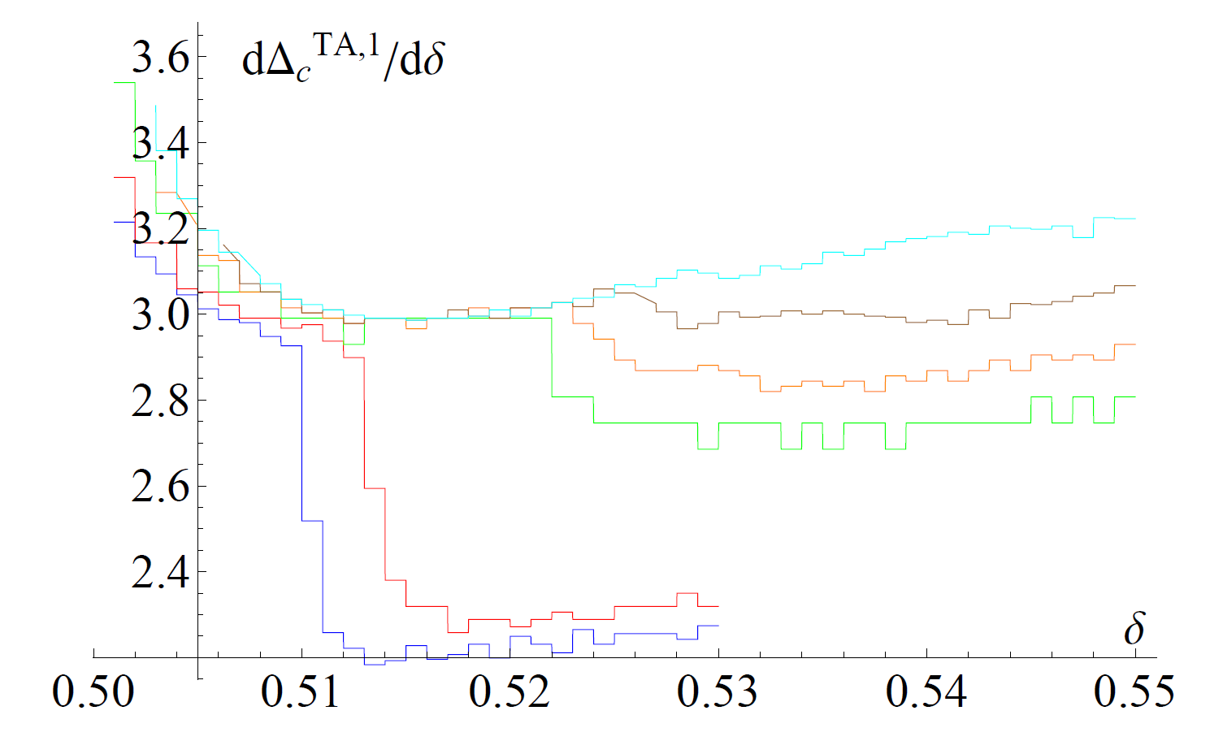
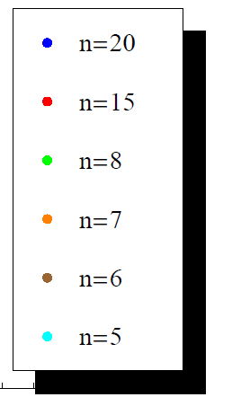
Finding conformal window
Differentiated plot
Kink disappears for n<6~7!

Slide 21
Summarizing results in O(4) x O(2)
We found chiral fixed point and collinear fixed point
No anti-chiral fixed point
Critical exponents are amazingly close to 5-loop resummation
Most probably, one-loop prediction by Pisarski-Wilczek is not trusted
It is possible QCD with massless 2 flavors show 2nd order chiral phase transition
What happens in reality depend on bare parameters though

Slide 22
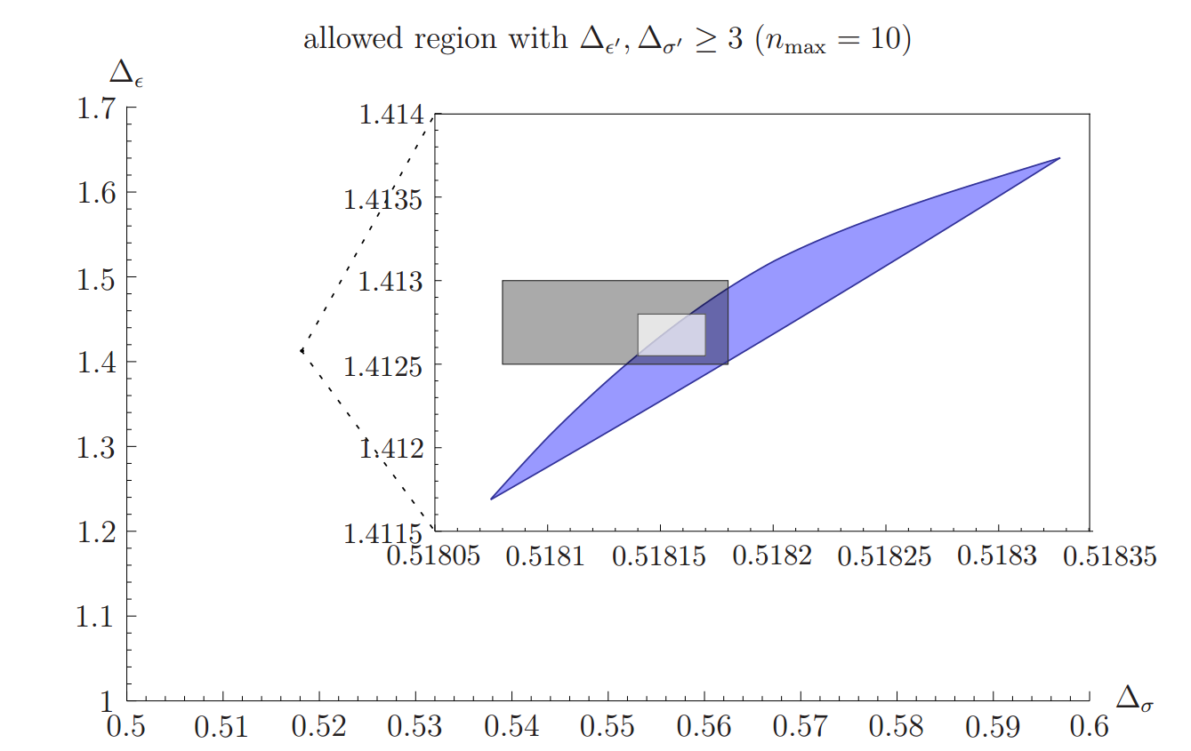
Toward the future direction (our side)
Our results are based on single bootstrap equation
Constraints from multiple correlation functions?
Success in 3d Ising universality class (Kos et al arXiv:1406.4858 )
How about O(4) x O(2) universality class?

Slide 23


Toward the future direction (your side)
Keep doing hard to determine the order of chiral phase transition in lattice simulations
Determine the critical exponents (beat the bootstrap)
Comparison between O(4) vs O(4) x O(2) fixed point is now possible
vs
→ Clue to understand the effective (or its subgroup) restoration
Show conformal invariance (rather than scale invariance)

