Slide 1
Distribution of the k^{th} smallest
Dirac operator eigenvalue : an update
Shinsuke M. Nishigaki Shimane Univ.
LATTICE2015 – The 33rd International Symposium on Lattice Field Theory
Kobe, June 16, 2015

Slide 2
I Introduction
chRM as verification tool of chSB
parameter-free ratio 〈k^{th} EV〉/〈j^{th} EV〉
from Giusti’s plenary:
Overlap D in quenched QCD
[Giusti-Luscher-Weisz-Wittig ’03]
quenched chRM prediction
[Damgaard-SMN ’01]
UPDATE - lift technical restriction on ν, N_{F} for QCD-like theories
- ease numerical evaluation

Slide 3
I Introduction
Chiral Random Matrices
[Shuryak-Verbaarschot ’93]
HS transf.
captures all
Global & Discrete
symmetries of QCD
0D reduction
of chPT
for β=2
[Jackson-Sener-Verbaarschot ’96]
and similar integrals ↔︎ Pf for β=1,4
[Smilga-Verbaarschot ’95, Nagao-SMN ’00]
analytically solvable, symmetry-based model of QCD

Slide 4
II. Individual EV distribution

Slide 5
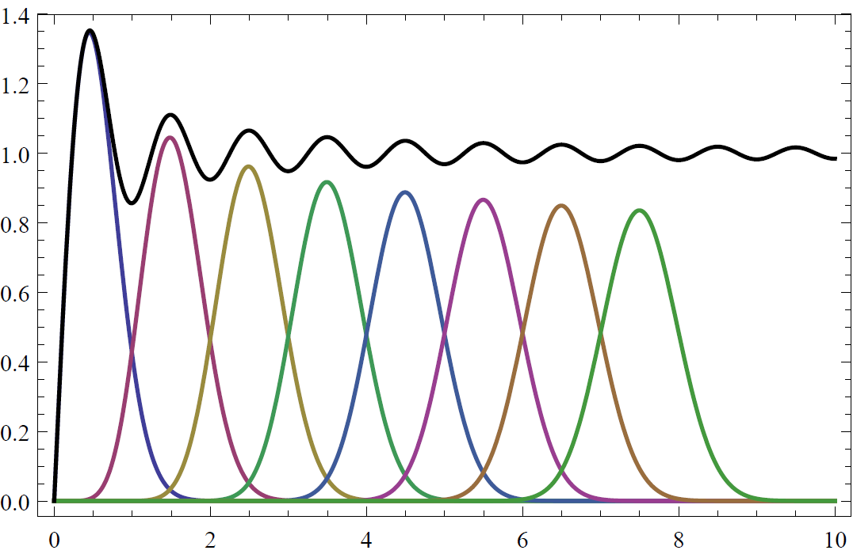
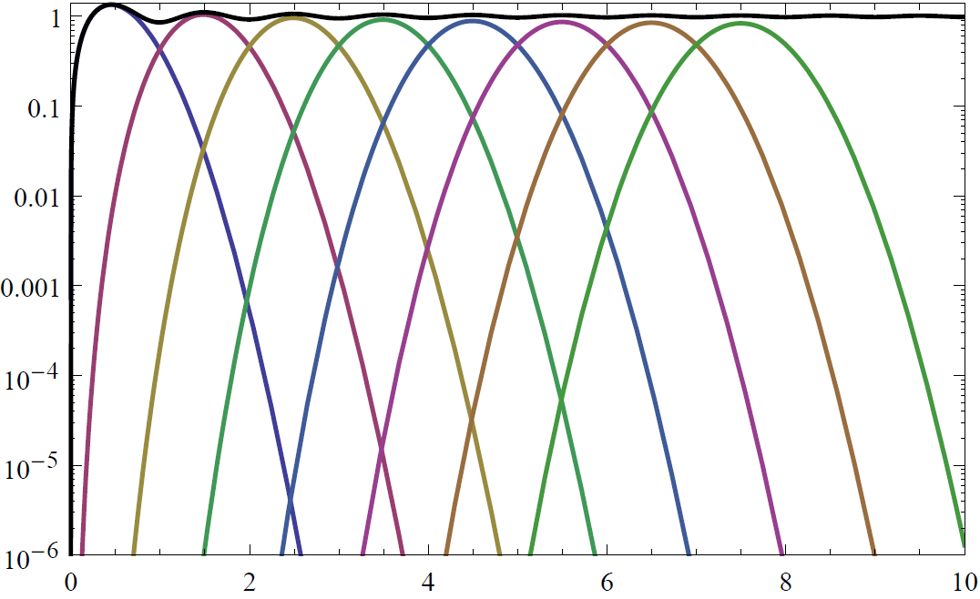
II Individual EV
Individual EV distributions
EV density vs 1st 〜8th EV distributions of chGUE
flattening oscillation ⇒ larger error for fitting
almost Gaussian ⇒ precise fitting possible
[Gustavsson ’04]

Slide 6
II Individual EV
[Damgaard-SMN ’01]
Technical problems
“Shifting” method for chRMT
… JPD of EVs
… JPD of first k EVs
for this trick to work, the exponent
practically unfeasible
for k ≥ 5

Slide 7
II Individual EV
Gap probabilty = Fredholm Det

Slide 8
II Individual EV
Nystrom-type approx to Fredholm Det
Gauss-Legendre Quadrature :
[Bornemann ’10]
ex. Largest EV distribution
Nystrom approx (M=30) for K_{Airy} vs Tracy-Widom’s analytic formula
sufficient (overkill)
for LGT data fitting!
rel. error

Slide 9
III. LECs from Individual Dirac EVs

Slide 10
III Low-Energy Const
Individual distributions
exercise 0 : 1st 〜8th EV distributions of chGUE , chGSE
almost Gaussian ⇒ precise fitting possible

Slide 11
III Low-Energy Const
Chiral condensate from Individual EV distributions
exercise 1 : quenched U(1) Dirac spectrum vs chGUE
chiral
condensate
-th EV

Slide 12
III Low-Energy Const
Chiral condensate from Individual EV distributions
exercise 2 : quenched SU(2) Dirac spectrum vs chGSE
chiral
condensate
Σ within O(10⁻⁴) error!
-th EV

Slide 13
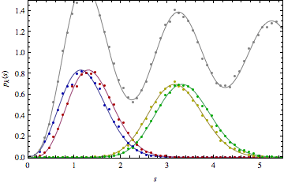
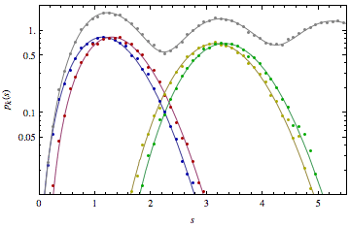
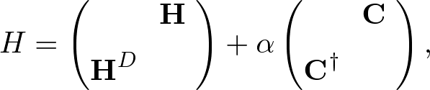
III Low-Energy Const
Pion decay const from Individual EV distributions
exercise 3 : SU(2) Dirac spectrum with imag.μ_{B} vs chGSE-chGUE
[SMN-Yamamoto LAT’14]

Slide 14
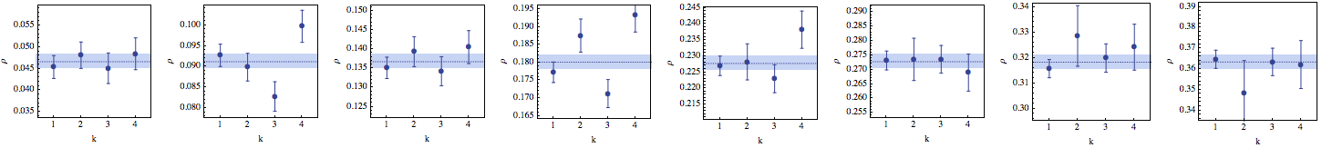
III Low-Energy Const
Pion decay const from Individual EV distributions
exercise 3 : SU(2) Dirac spectrum with imag.μ_{B} vs chGSE-chGUE
crossover parameter
F within O(10⁻²) stat+sys error!
[SMN-Yamamoto LAT’14]

Slide 15
IV. Updates

Slide 16
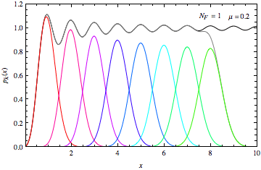
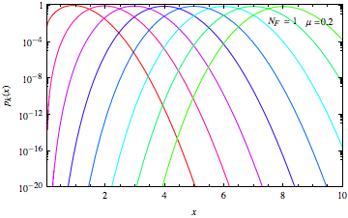
IV Updates
Quarks w/ small mass
Nystrom
method
[Damgaard-SMN ’98]
chGUE : N_{F} = 1

Slide 17
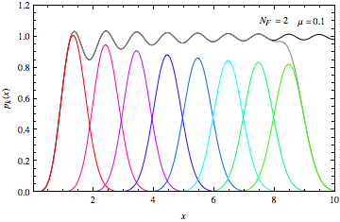
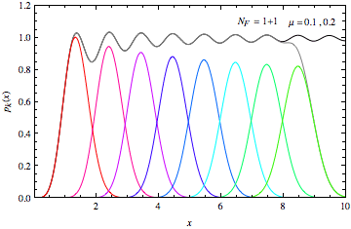
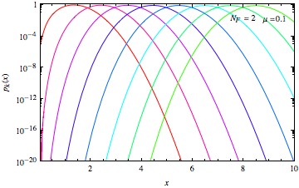
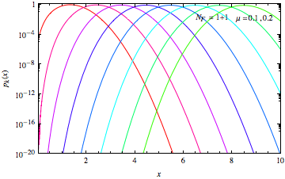
IV Updates
chGUE : N_{F} = 2
Quarks w/ small mass

Slide 18
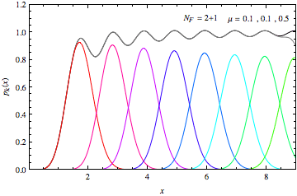
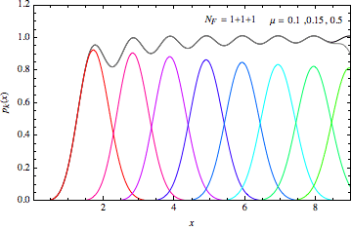
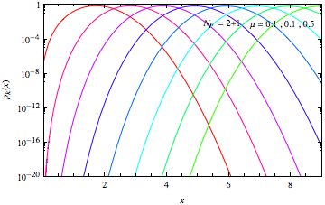
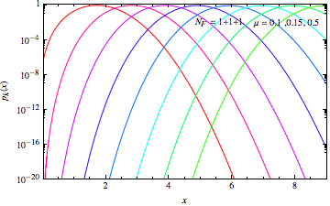
IV Updates
chGUE : N_{F} = 3
Quarks w/ small mass

Slide 19
IV Updates
chGUE : N_{F} = 3
Quarks w/ small mass
Practical difficulty of evaluating (k-1)-fold integral is now gone!
(in case you lost a memo of small quarks masses for your data,
I would guess them for you from the first k Dirac EVs)

Slide 20
IV Updates
chGSE & chGOE
・Orthnorm function
for massive chGUE
polyn. EV
order coord.
[Damgaard-SMN ’98]
consider Fredholm Det of f (t, x) !
・Interrelationship between Generating Painleve_{V} τ −fn’s of Tracy-Widom
[Forrester ’06]
proven (so far) for Bessel J_{ν} kernel (→ Airy, sine kernels by degeneration)
numerically consistent with [DN’01] ⇒ conjecture to hold for ∀massive Bessel kernel

Slide 21
IV Updates
chGSE & chGOE
・Orthnorm function
for massive chGUE
polyn. EV
order coord.
[Damgaard-SMN ’98]
consider Fredholm Det of f (t, x) !
・Interrelationship between Generating Painleve_{V} τ −fn’s of Tracy-Widom
[Forrester ’06]
Individual EV distr. for
massive chG(S,O)E
・Nystrom-type approx to Det(1± f_{I} ) and Tr’s
[Bornemann ’10]

Slide 22
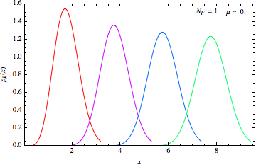
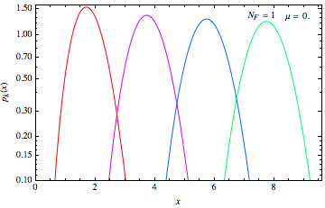
IV Updates
chGSE & chGOE
chGSE : N_{F} = 1
Technical restrictions on N_{F} , ν for massive chG(S,O)E are now lifted!

Slide 23
Summary
for ∀k altogether
for ∀n, ∀N_{F} , ∀m_{f}
for ∀b=1,2,4 or Xover
k^{th} EV distribution is now easily computable
⇨ verify/negate chSB , determine LECs in walking techni-candidates
N_{C} = 3 , N_{F} = 8 ; N_{C} = 3 , N_{F}^{2-sym} = 2 ; N_{C} = 2 , N_{F}^{adj} = 2 ; …
Prospect
chGOE → GOE CI
↓ ↓ ↓
chGUE → GUE → C
↑ ↑
chGSE → GSE
[Kieburg Verbaarshot
Zafeiropoulos 12]
[Forrester Nagao
Honner 99]
[Mehta Pandey 83]
[Nagao 03]
[Damgaard Sprittorff
Verbaarschot 10]
[Koziy Skvortsov 11]
[Forrester Nagao
Honner 99]
WchPT W_{6,7,8}
[Mehta Pandey 83]
?
→ : χ−sym violated = Wilson chPT
→ : reality violated = “iso” iμ

