Slide 1
Proceedings of Lattice 2015
Will be published from PoS
Page limit
20 pages for 45 min talks
15 pages for 30 min talks
7 pages for parallel talk and poster presentations
Deadline
31st October, 2015
Every presenter will receive an email for instructions shortly after the conference

Slide 2
Please remove your poster
If you have not retrieve your poster yet, please do that during the coffee break
Kindly ask you to bring your poster back

Slide 3
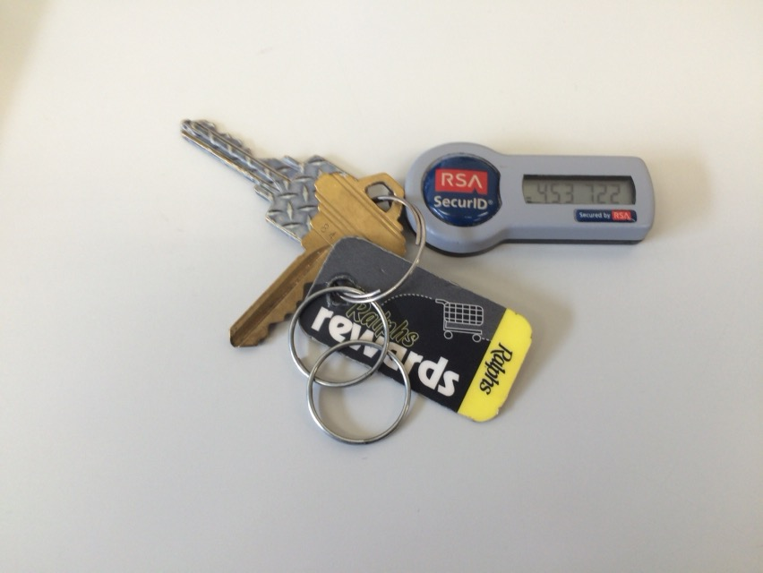
Lost & found
Found
Folding umbrella x2
Something which looks important
Please come to the conference desk @ 4F

