Slide 1
Eigenspectrum calculation of the non-Hermitian O(a)-improved Wilson-Dirac operator using the Sakurai-Sugiura method
H. Sunoª, Y. Nakamura^{a,b}, K.-I. Ishikawa^{c},
Y. Kuramashi^{a,d,e}, Y.Futamura^{f}, A. Imakura^{f}, T. Sakurai^{f}
ªRIKEN Advanced Institute for Computational Science,
^{b}RIKEN Nishina Center,
^{c}Department of Physical Science Hiroshima Univ.,
dCenterfor Computational Science, Tsukuba Univ.,
^{e}Faculty of Pure and Applied Science, Tsukuba Univ.,
^{f}Department of Computer Science, Tsukuba Univ.
LATTICE 2015, Kobe International Conference Center, Kobe, July 14-18, 2015.

Slide 2
Motivation
The determinant of the Wilson-Dirac operator
plays an important role in lattice QCD.
This can be written as
where λ_{i}’s satisfy the eigenequation:
Low-lying eigenvalues (small Re(λ_{i})) are particularly important, since they determine
  the sign of detD
  the condition number of the matrix D
Our goal: develop a way to calculate eigenvalues of D in a given domain of the complex plane.

Slide 3
O(a)-improved Wilson-Dirac operator
n,m=1,2,…,L_{x}L_{y}L_{z}L_{t} (lattice volume)
α,β=1,2,3,4 (spin indices)
a,b=1,2,3 (color indices)
(U_{μ}(n))^{a,b}: gauge field at site n w/ 4D indices μ=1,2,3,4
Gamma matrices:
Sparse matrix: only 51 elements out of 12L_{x}L_{y}L_{z}L_{t} are nonzero.

Slide 4
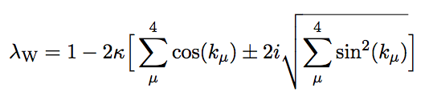
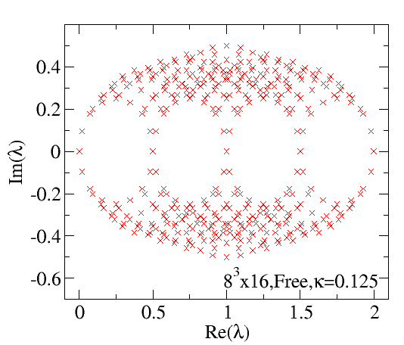
Eigenspectrum for the free case
For the free case U_{μ}(n)=1, the eigenspectrum can be analytically calculated.

Slide 5
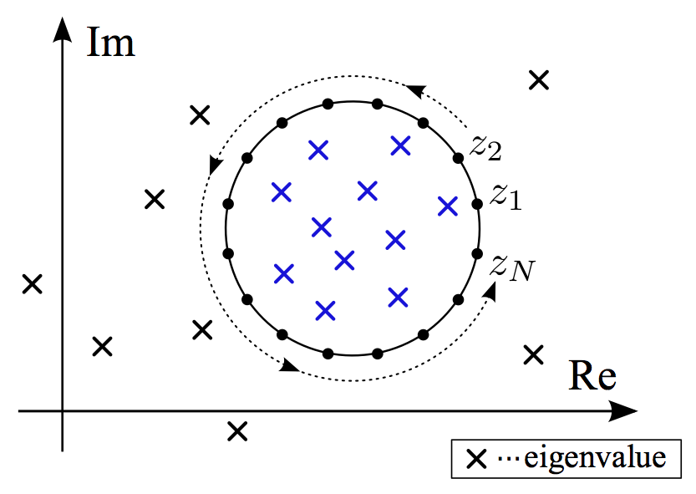
Sakurai-Sugiura (SS) method
The SS method allows us to calculate eigenvalues and eigenvectors of sparse matrices in a given domain of the complex plane.
Produce a subspace with contour integrals
Max. momentum degree
# of source vec.
# of quadrature pts.

Slide 6
Sakurai-Sugiura (SS) method
1.
2.
3. From Σ, we obtain the rank m of S.
4.
5. Solve a smaller eigenproblem:
6. Obtain approximatively eigenpairs:
Accuracy evaluated by relative residual norms:
T. Sakurai and H. Sugiura, J. Comput. Appl. Math. 159 (2003) 119.
Software named “z-Pares” available at the web site
http://zpares.cs.tsukuba.ac.jp/.

Slide 7
Calculating (zI-D)⁻¹
Matrix inversion is carried out at each quadrature points z_{i} by solving the shifted linear equations
using the BiCGStab algorithm.

Slide 8
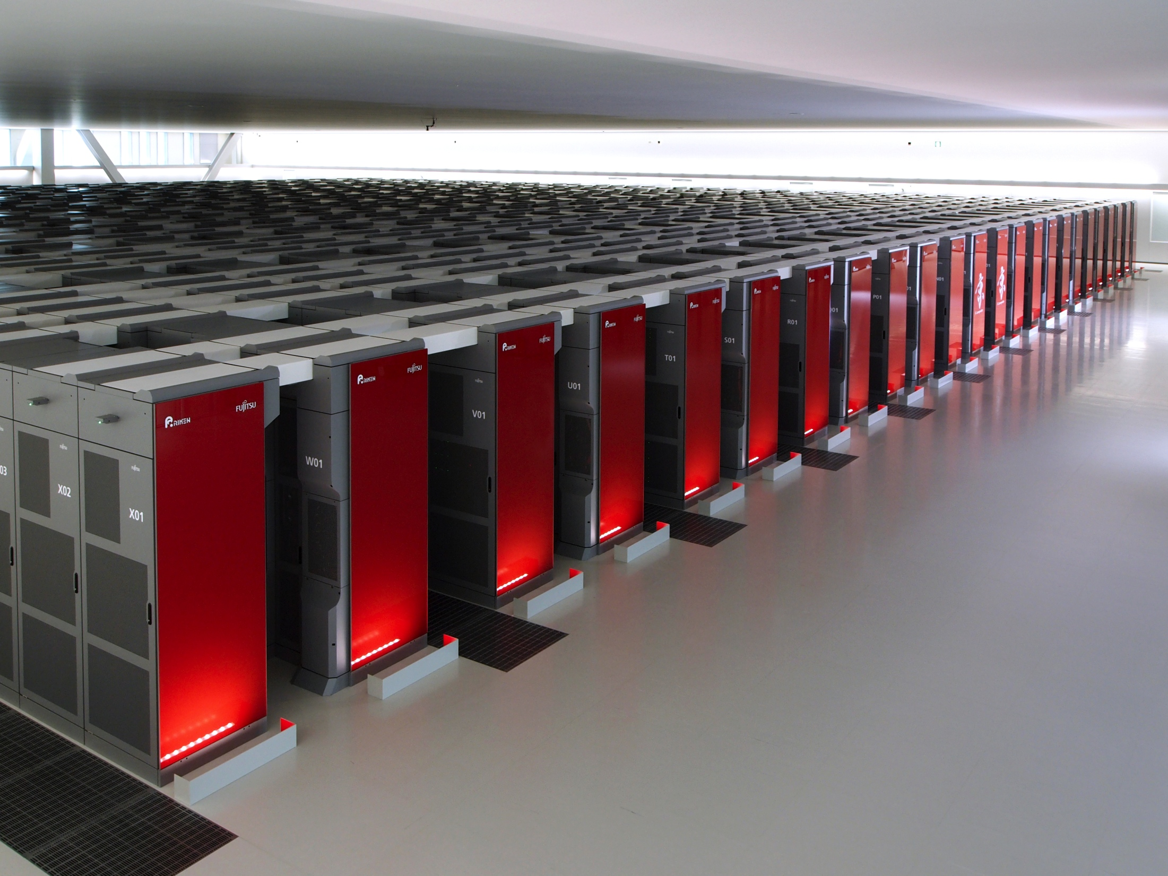
K computer at RIKEN AICS
82944 compute nodes+5184 I/O nodes connected by “Tofu” 6D network, 11.28 Pflops
Each node has a 2.0GHz SPARC64 VIIIfx with 8 cores, SIMD enabled 256 register, 6MB-L2 cache, 16GB memory, 32KB/2WAY(instr.)&32KB/2WAY(data) L1 cache/core.
We use up to 16384 nodes, or 131072 cores.

Slide 9
Results for the free case
BiCGStab converges very slowly at some z_{i} points, but we use the solutions obtained after 1000 BiCGStab iterations.  converged,  not converged to 10⁻¹⁴.
Convergence slow when # of eigenvalues is large close to z_{i}.
N=32,L=64,M=16, Relative residual norms ≈ 10⁻⁷

Slide 10
Results
We use U_{μ}(n) generated in quenched approximation with β=1.9.
N=32,L=96,M=16,Relative residual norms ≈ 10⁻⁵

Slide 11
Results
We also try a larger size of lattice.
N=32,L=64,M=16, Relative residual norms ≈ 10⁻⁴

Slide 12
Results
N=32,L=196,M=16,Relative residual norms ≈ 10⁻⁴

Slide 13
Results
N=32,L=128,M=16,Relative residual norms ≈ 5x10⁻⁴

Slide 14
Results
N=32,L=32,M=16,Relative residual norms ≈ 10⁻⁶

Slide 15
Results
Full QCD (near the physical point) U_{μ}(n) data courtesy of Dr. Ukita (Tsukuba Univ.)
N=32,L=16,M=16, Relative residual norms ≈ 5x10⁻⁴

Slide 16
Summary
We have tried to calculate low energy eigenspectrum of the O(a)-improved Wilson-Dirac operator.
We have implemented the Sakurai-Sugiura method.
We have dealt with the lattice size up to 96⁴.
We have considered gauge field configurations for free case, quenched approximation, and full QCD.
Relative residual norms vary from 10⁻⁷ to 5x10⁻⁴.
Accuracy limited due to slow convergence of the BiCGStab used to solve the shifted linear equations, but we can think that the eigenvalues can be estimated with 3 or more digits of accuracy.
We need a more efficient iterative solver to the shifted linear equations in order to improve the accuracy.

