Slide 1
Exploring finite density QCD phase transition with canonical approach - Power of multiple precision computation -

Slide 2
Introduction

Slide 3
Motivation

Slide 4
Canonical approach

Slide 5
Canonical approach vs. Sign problem

Slide 6
Our study #1 – Multiple precision calculation

Slide 7
Our study #1 – Multiple precision calculation

Slide 8
Tips : Cancellation of significant digits

Slide 9
Our study #1 – Multiple precision calculation

Slide 10
Our study #1 – Multiple precision calculation

Slide 11
Our study #2 – Physical quantities at finite density

Slide 12
Our study #2 – Physical quantities at finite density

Slide 13
Numerical setup

Slide 14
Our study #2 – Physical quantities at finite density

Slide 15
Our study #2 – Physical quantities at finite density

Slide 16
Summary

Slide 18
Fourier transformation

Slide 19
Plaquette & Susceptibility

Slide 20
Our study #1 – Multiple precision calculation

Slide 21
LYZs in complex fugacity plane

Slide 22
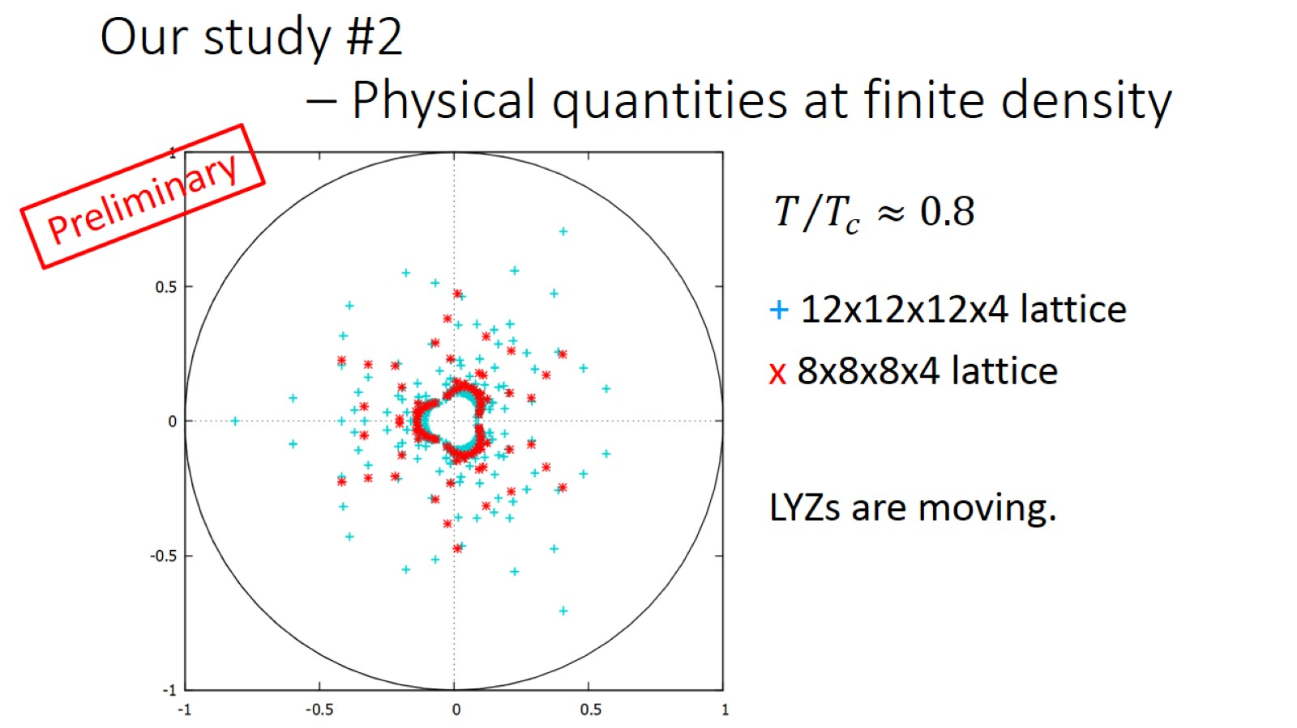
Our study #2 – Physical quantities at finite density

Slide 23
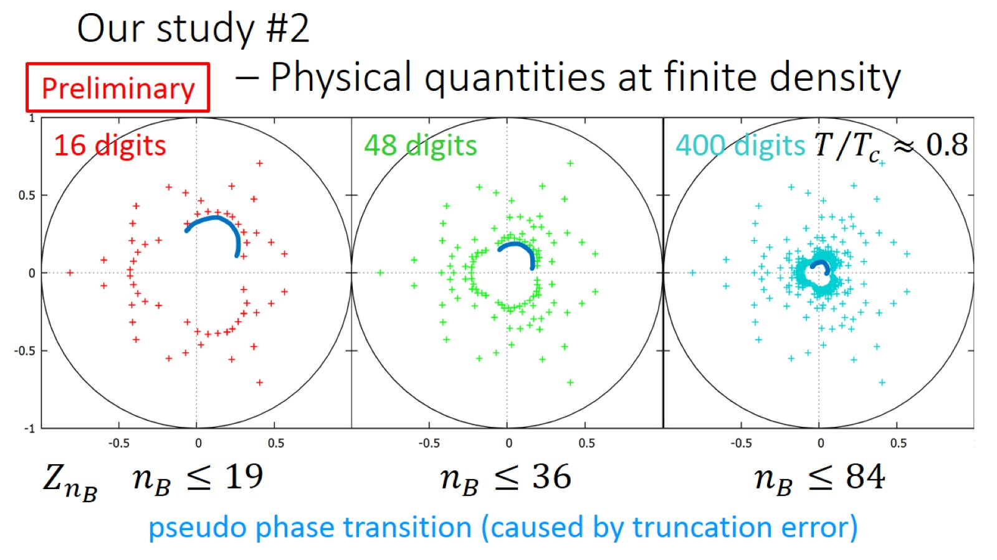
Our study #2 – Physical quantities at finite density

Slide 24
Our study #2 – Physical quantities at finite density

