Slide 1
IR fixed points and conformal window in SU(3) gauge Theories
Yu Nakayama (Caltech/Kavli IPMU)
On behalf of Prof. Iwasaki (KEK/Tsukuba)
Based on arXiv:1503.02359 by
K. -I. Ishikawa, Y. Iwasaki, Yu Nakayama and Y. Yoshie

Slide 2
Scaling hypothesis on finite space-time
We study “temporal propagator” on Lattice
Up to 1/N correction, it satisfies the RG equation
Suppose we are near the fixed point (and tune )
Define effective mass and plot as a function of scaled time
At the fixed point, it is “Scale Invariant”: it does not depend on N
We can determine the fixed point value of g

Slide 3
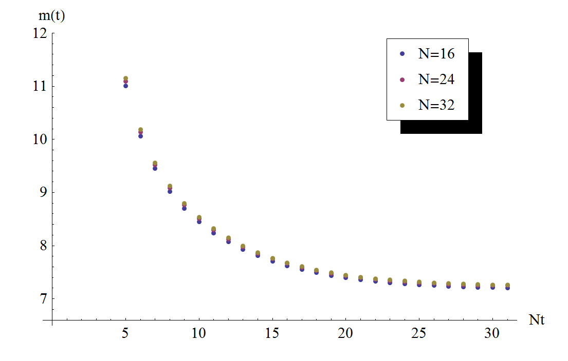
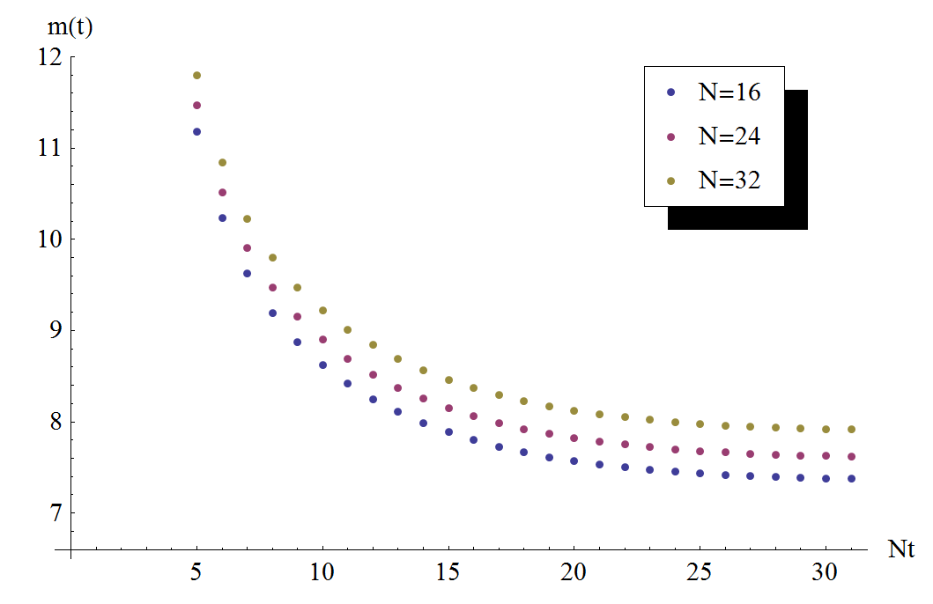
Free fermion examples
In the massless limit, effective mass of free fermion shows “Scale Invariance” (in any choice of the boundary condition)
If it is massive (e.g. confining case), “Scale Invariance” is violated
Massless vs massive ( in lattice unit)
Good barometer for the scale invariance
(See also Akerlund-de Forcrand in d=2 at Lattice 2014)
We chose Z(3) twisted boundary condition for later purpose

Slide 4
Strategy to find zero of beta functions
We study lattice size of N=8, 12 and 16
Change the coupling constant and compute the effective mass to see “Scale Invariance”
Need to tune the quark mass to be zero (we use Wilson fermion with periodic BC and RG improved gauge action)
Generically, three plots do not coincide at all
When all three coincide, we claim at
It is very non-trivial because three functions must coincide

Slide 5
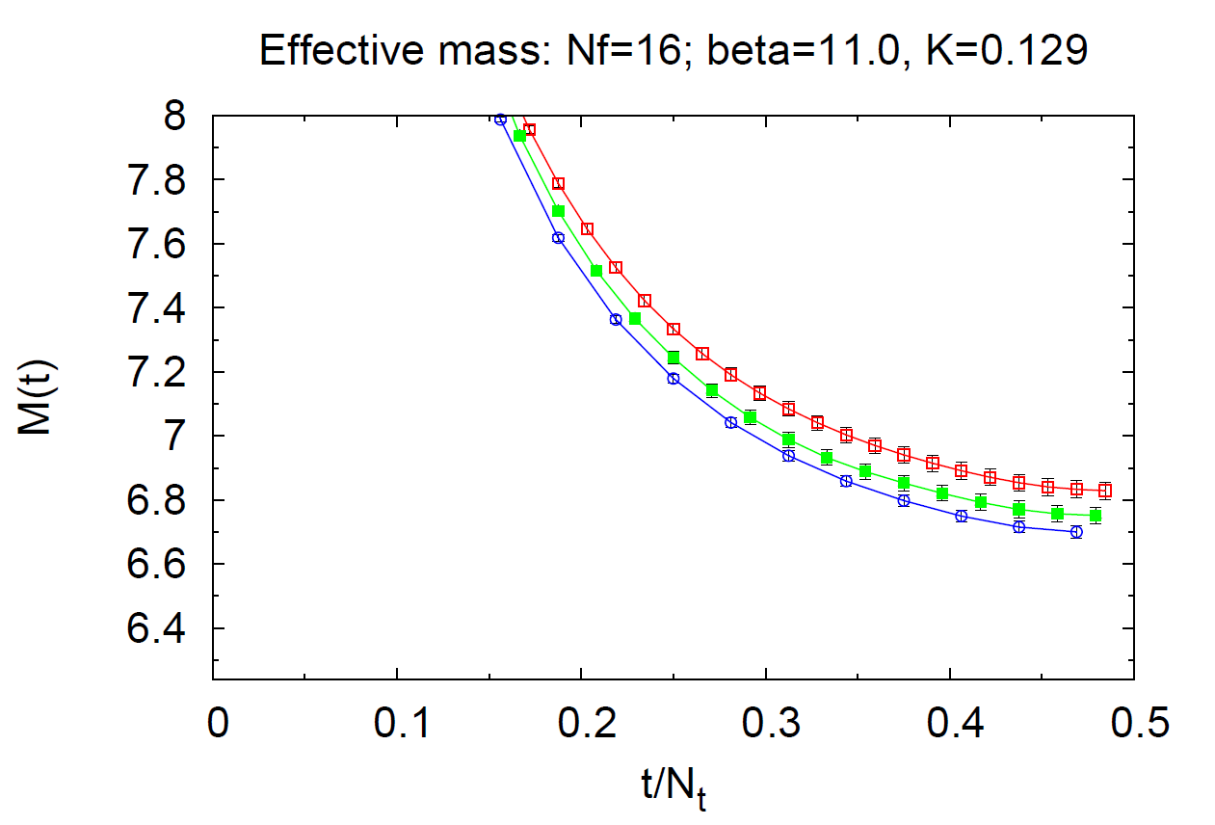
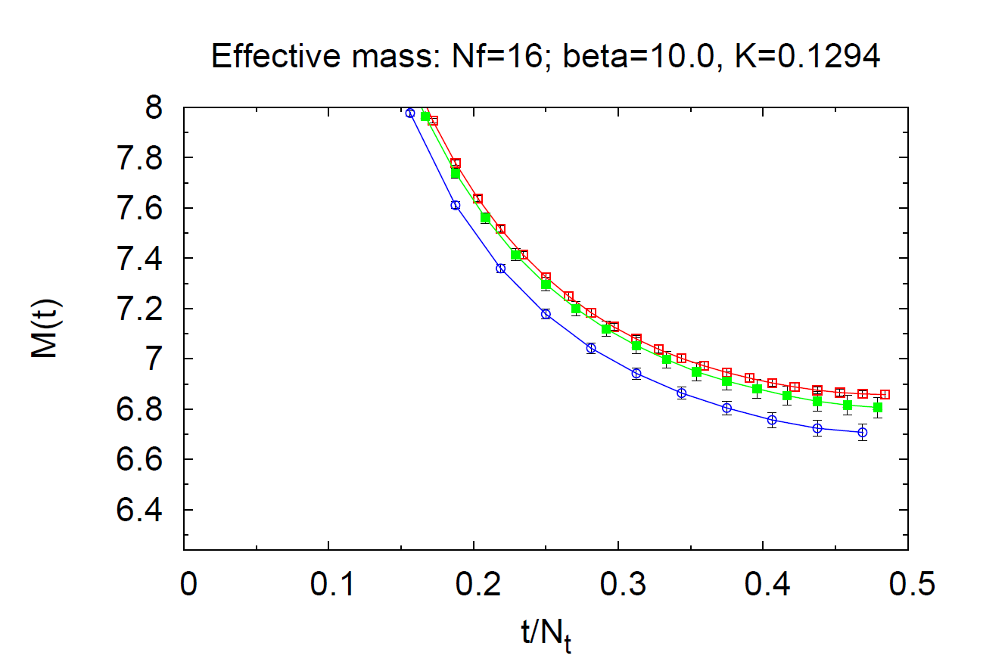
case study
We should all agree that the Banks-Zaks fixed point exists when at a perturbative coupling constant
We claim that these coupling constants are not fixed points

Slide 6
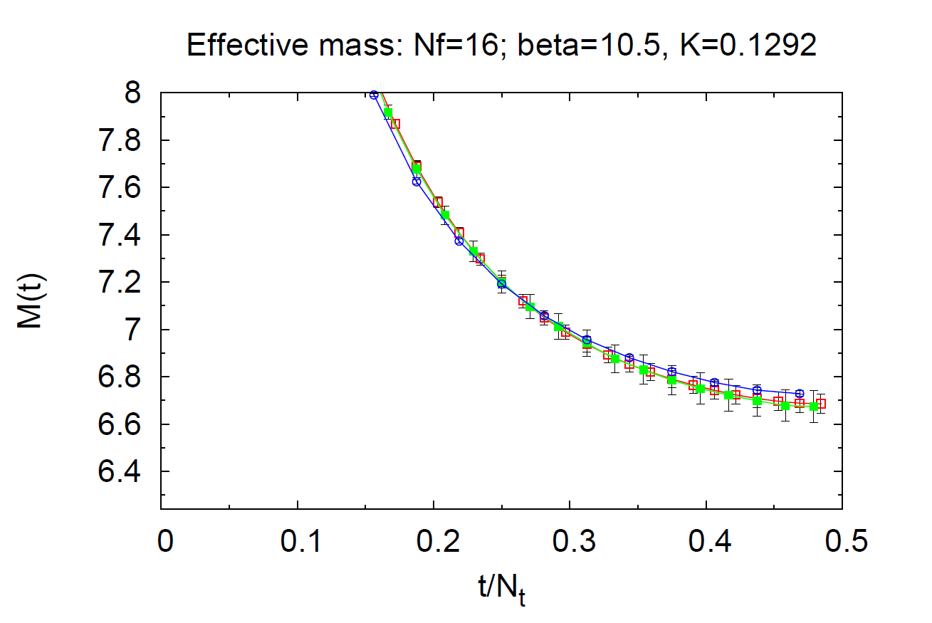
case study
We look for the coupling constant such that three curves coincide!
We claim that is the fixed point
c.f.

Slide 7
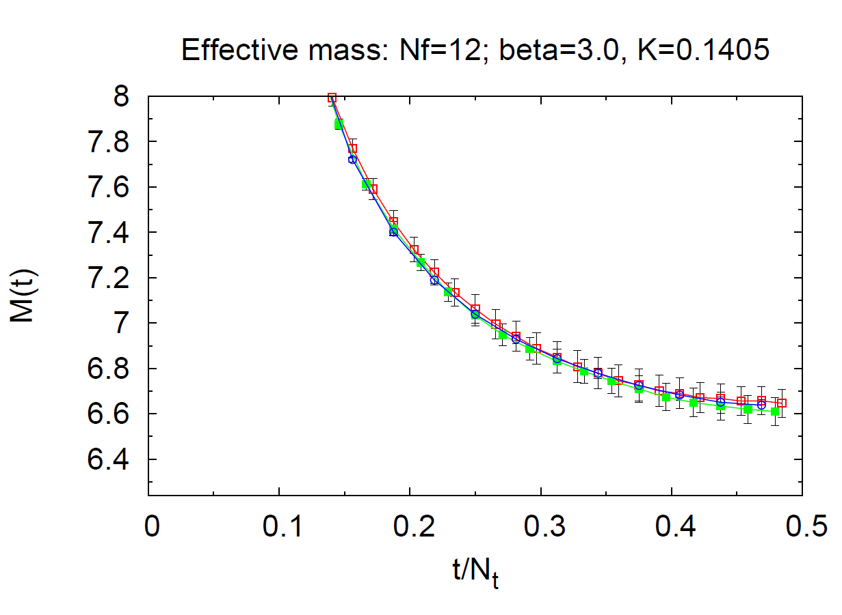
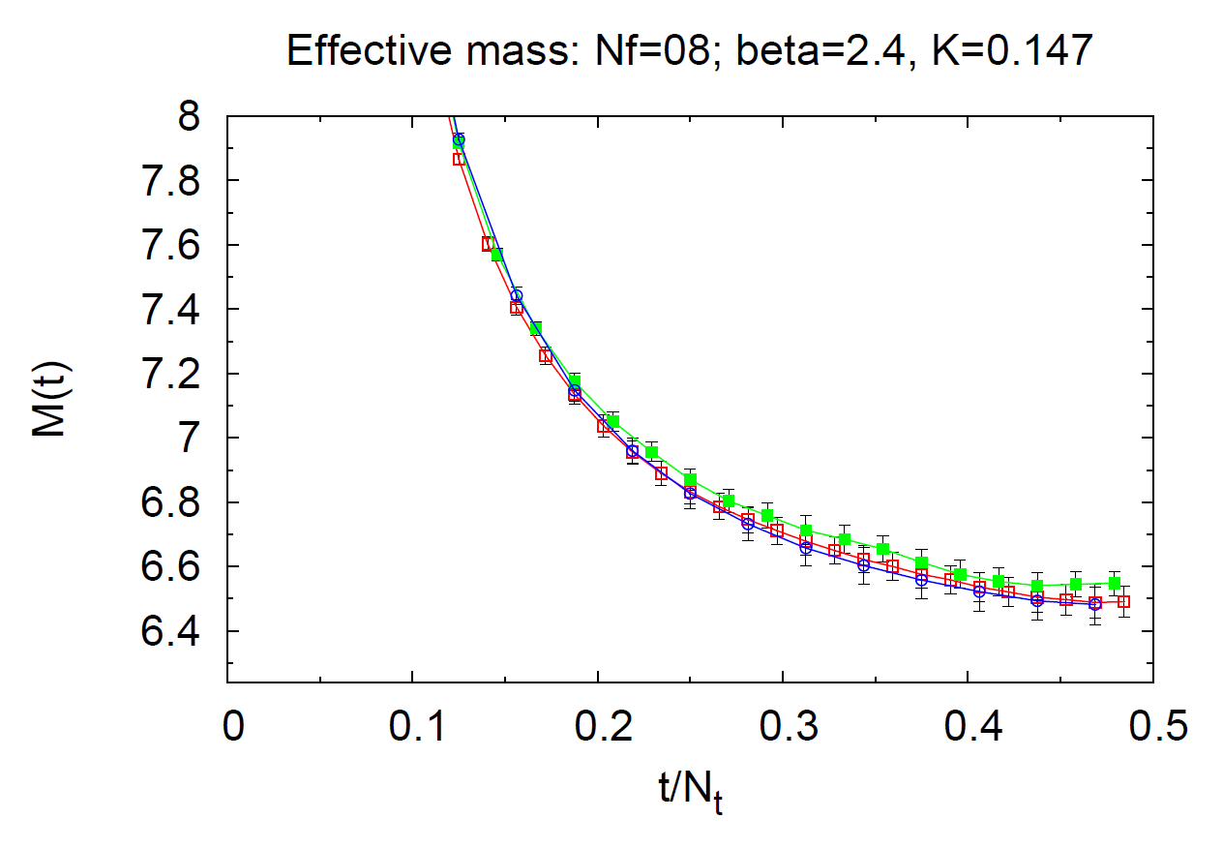
and
We claim that are the fixed points
Smaller gives larger coupling constant as expected.

Slide 8
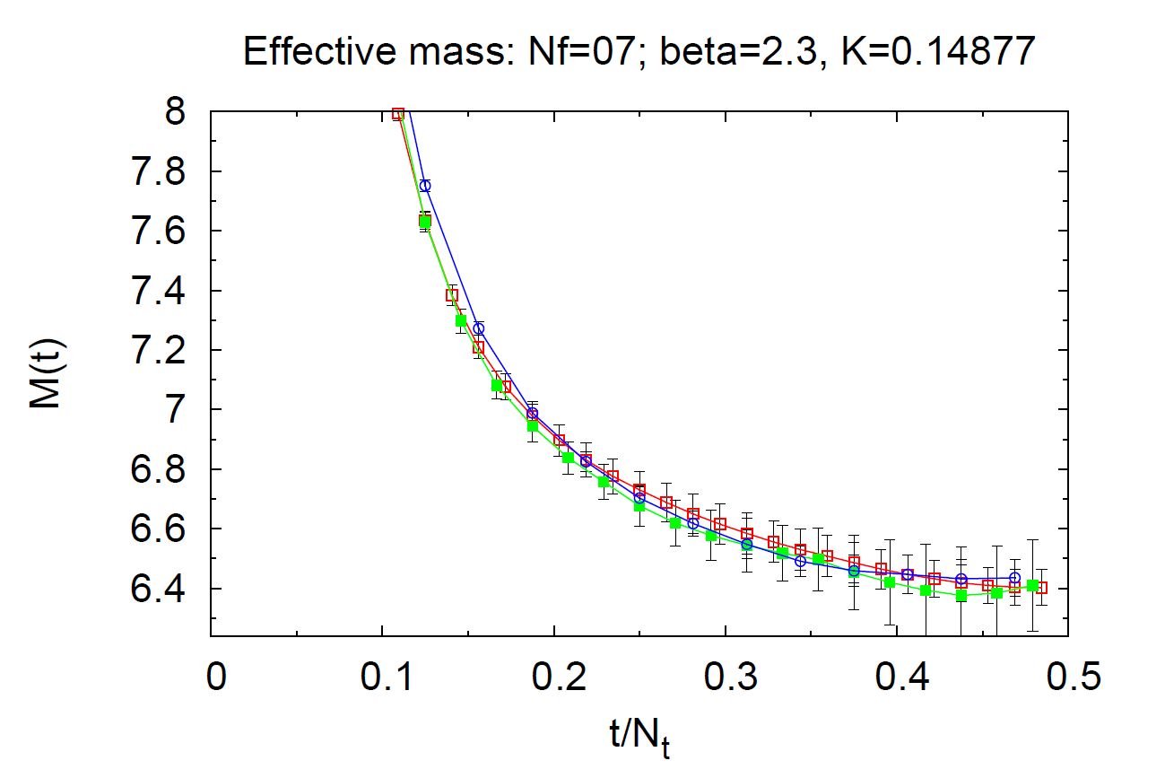
… and
We claim that is the fixed point
Within this lattice size, does show a fixed point
But 1/N correction may not be neglected. I feel that the three curve coincidence is a little bit too good.

Slide 9
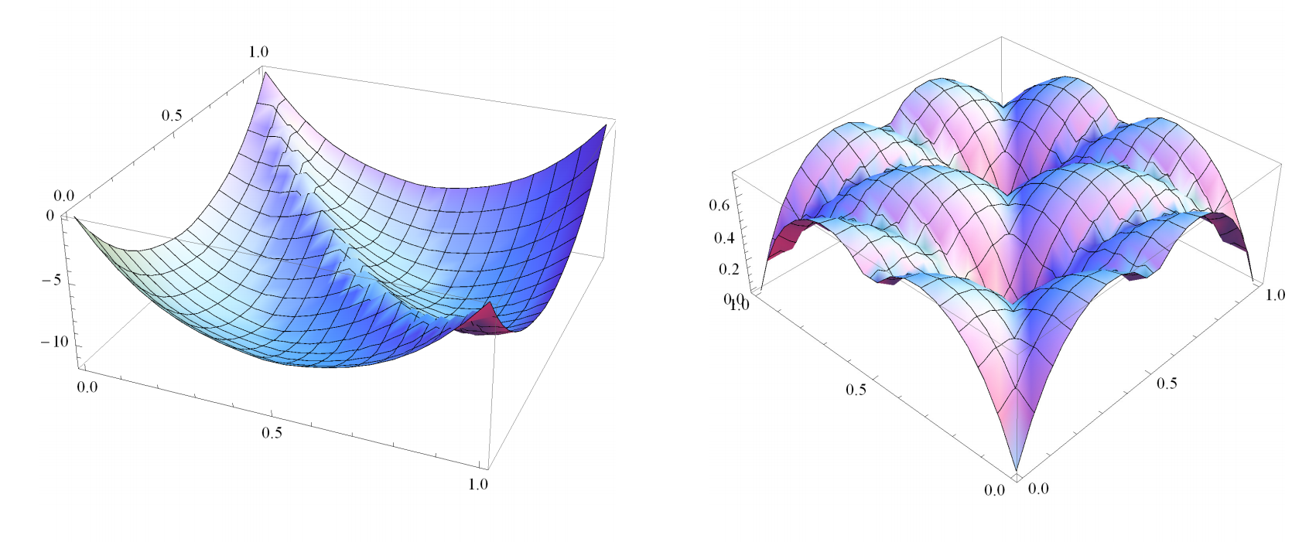
Comments on the shape of effective mass
In contrast to our naïve guess, the effective mass was non-zero at “conformal fixed points”
This is because on finite lattice, VEV of spatial Wilson loop is non-trivial
due to the potential for gauge zero modes. The “vacuum” imposes the dynamical twisted boundary condition on fermions
If we increase mass (non-conformal), then the non-trivial vacuum structure disappears and may confine (1st order “phase transition”)

Slide 10
Comments on the shape of effective mass
Since conformal theories do not have any mass scale, the boundary condition/effects can never be ignored in (integrated) propagator or in effective mass
I feel this point has been misunderstood somehow. It is important to take large N limit, but the purpose is NOT to reduce the effect of boundary condition.
The “Yukawa-type power behavior” of the propagator may be used to read the mass anomalous dimension (conjecture: see our earlier works)

Slide 11
Future directions
Study the larger lattice size
Study different actions
Understand the physical meaning of “Yukawa-type power behavior” of the propagator better (in relation to soft wall model of AdS/CFT?)

