Slide 1

Early Performance Evaluation of Lattice QCD on POWER+GPU Cluster
Jun Doi (doichan@jp.ibm.com)
IBM Research – Tokyo
17 July 2015

Slide 2


POWER Gains New Power of Computation
POWER + GPU
  OpenPOWER foundation
    Open architecture
    Collaborative development of system & software
  Nvidia’s GPU
    Now supports POWER processors
Next generation supercomputers
  CORAL collaboration
    More than 100 Peta-Flops, SUMMIT and SIERRA
  NVLINK
    Faster data link between hosts and GPUs

Slide 3
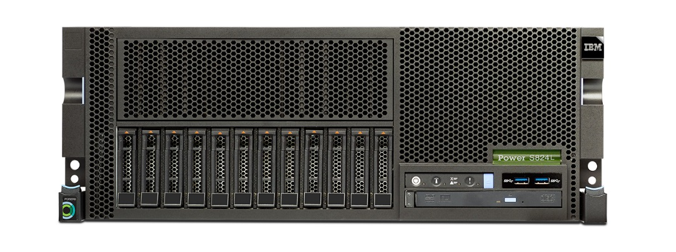
IBM POWER8 and Nvidia Tesla GPU
The first IBM POWER product with GPU
  IBM Power System S824L
2 sockets of POWER8 processors per node
Supports up to 2 Tesla GPUs per node
  Connected via PCI express (Gen3 x16)
  Tesla K40 or K80
Linux and little endian support
  Ubuntu 14.04

Slide 4
Overview of POWER8 processor
12 cores per socket
  @3.02 GHz (S824L)
  8 hardware threads (SMT) per core
    96 threads per socket (192 threads per node)
SIMD instructions (VMX/VSX)
  2x 2-way double precision FMA instruction per cycle (2x 4-way for single precision)
  289.92 GFlops (double) / 579.84 GFlops (single) per socket (@3.02 GHz)

Slide 5
Development Environment of POWER+GPU systems
Very similar environment to usual x86+GPU Linux cluster
  POWER processor supports little endian
  Most of software runs as similar to x86 clusters
Compilers
  gcc : can optimize for POWER8
  IBM XL compilers : strong optimizer for C/C++ and FORTRAN
CUDA7.0

Slide 6
Performance Consideration of Wilson-Dirac Operator
Per lattice site: 1,488 flops (1,464 flops for even-odd preconditioning)
Double: 2,688 byte load, 192 byte store
Single: half of above
Double: 2.06 byte/flop (2.03 even-odd)
Single: 1.03 byte/flop (1.01 even-odd)
Memory bandwidth bottleneck
Byte/flop | Double | Single
POWER8 | 0.66 | 0.33
Tesla K40 | 0.20 | 0.067
Reducing memory access is important for performance
(Especially for GPUs)

Slide 7
Data Structure Comparison
AoS (Array of Structures)
For POWER8
Better for cache optimization on CPU
1 structure of 3x4 spinor
...
Spin1_1[0]
Spin1_2[0]
Spin1_3[0]
Spin2_1[0]
Spin2_2[0]
Spin2_3[0]
Spin4_2[0]
Spin4_3[0]
...
Array
Spin1_1[1]
Spin1_2[1]
Spin1_3[1]
Spin2_1[1]
Spin4_2[1]
Spin4_3[1]
...
Elements: complex numbers
...
Spin1_1[N-1]
Spin1_2[N-1]
Spin1_3[N-1]
SoA (Structure of Arrays)
For GPU
Better for coalescing on GPU
Array of 1 element of 3x4 spinor
...
Spin1_1[0]
Spin1_1[1]
Spin1_1[2]
...
Spin1_1[N-1]
Spin1_2[0]
Spin1_2[1]
Spin1_2[2]
...
Spin1_2[N-1]
Spin1_3[0]
Spin1_3[1]
Spin1_3[2]
Spin1_3[N-1]
...
3x4 spinor elements
Spin2_1[0]
Spin2_2[0]
...
Spin2_3[0]
...

Slide 8
Offloading Wilson-Dirac Operator to GPU
All the data is ready to use on GPU
  Limit the problem size to fit in GPU memory
  Gauge matrices are transferred previously on GPU
  Spinor fields used in BiCGStab solver are transferred and allocated previously on GPU
  No data transfer between host and GPU (except for boundary exchange needed for parallelization)
Multi GPU offloading
  There is no support for GPU direct (p2p copy)
    GPU to GPU transfer is performed via host memory
  Single thread / Multi-GPU execution

Slide 9
Optimization of Wilson-Dirac Operator on GPU
Warp size fitting
  Setting the number of threads per thread block to multiple of 32 (Warp size)
  Defined by size of X : Least common multiple of X and 32
    E.g.) For X=48, using 2*48 = 96 threads (3 warps)
Gauge field parameterization
  Loading 6 elements of SU(3) gauge matrix
  Reconstruct 3 elements by calculation
  42 extra flops, 2/3 memory access to gauge field

Slide 10
Parallelization of Lattice QCD on GPU Cluster
X-dimension
We do not divide lattice in X dimension
To avoid non-sequential access on the inner-most boundary
Y,Z and T dimensions
We divide lattice in T dimension by 2 GPUs in node
Also we divide lattice in T by nodes, and in Z and Y dimension by nodes
POWER8 Node
POWER8 Node
GPU0
GPU1
GPU0
GPU1
POWER8 Node
POWER8 Node
GPU0
GPU1
GPU0
GPU1

Slide 11
Offloading and Data Transfer of Wilson-Dirac Operator
Spinor
Gauge field
(1) Making half-spinor of boundary
(2) GPU-> Host transfer
Send buffer
Send buffer
(3) Node-to-node transfer(MPI)
(4) Inner calculation
Recv. buffer
(5) Host->GPU transfer
Recv. buffer
(6) Boundary calculation
Host
GPU
Spinor (output)

Slide 12
Asynchronous Data Transfer Using CUDA Streams
(Number of parallel dimensions)x2+1 streams to execute asynchronously
Y-
Y+
Z-
Z+
T-
T+
Inner
Inner calculation
Y+
Y-
Z+
Z-
T+
T-
Making half-spinors
GPU-Host transfer
MPI transfer (Async)
Boundary calculation
Minus direction
Matrix multiply
Plus direction
Matrix multiply
Minus direction
Plus direction

Slide 13
Testing Environment
IBM Power System S824L
GPU
Tesla K40
GPU
Tesla K40
P8
P8
4 nodes, connected via Infiniband
 | CPU | GPU
 | IBM POWER8 | Nvidia Tesla K40
# of cores | 12 | 2,880
Clock speed | 3.02 GHz | 0.745 GHz
Peak perf.: Double Single | 289.92 GFlops 579.84 GFlops | 1,430 GFlops 4,290 GFlops
Memory | 512 GB | 12 GB
Memory Bandwidth | 192 GB/s | 288 GB/s
Ubuntu 14.04.1, CUDA Toolkit version 7.0

Slide 14
POWER8 Performance: Strong Scaling (Double)
Wilson-Dirac
Even-Odd preconditioned
BiCGStab

Slide 15
POWER8 Performance: Weak Scaling (Double)
Wilson-Dirac
Even-Odd preconditioned
BiCGStab

Slide 16
K40 Performance: Strong Scaling (Double)
Wilson-Dirac
Even-Odd preconditioned
BiCGStab

Slide 17
K40 Performance: Weak Scaling (Double)
Wilson-Dirac
Even-Odd preconditioned
BiCGStab

Slide 18
K40 Performance: Strong Scaling (Single)
Wilson-Dirac
Even-Odd preconditioned
BiCGStab

Slide 19
K40 Performance: Weak Scaling (Single)
Wilson-Dirac
Even-Odd preconditioned
BiCGStab

Slide 20
Summary
POWER obtained new power of calculation
  POWER8: High bandwidth/flop, high efficiency
    350- GFlop/s on 4 nodes
    Higher efficiency than GPU
    Can be improved more by hand coding of SIMD
  Tesla GPU: High computational capacity, high performance
    1000- GFlop/s with 8 K40 (in double precision)
    2000- GFlop/s with 8 K40 (in single precision)
Future work
  Optimization with newer GPUs and NVLINK
  Workload balancing POWER and GPUs
  Other solvers and algorithms for more efficiency

