Slide 1
Chiral behavior of light meson form factors in 2+1 flavor QCD with exact chiral symmetry
Takashi Kaneko (KEK, SOKENDAI)
for JLQCD Collaboration
Lattice 2015, Kobe, July 14-18, 2015

Slide 2
introduction
kaon semileptonic form factors (FFs) :
normalization : f₊(0) = f₀(0)
determination of CKM ME |V_{us}| through K→πlν decay rate Γ
non-lattice inputs (Γ, I, δ_{SU(2),EM}) 0.2% ⇒ need ≲1% accuracy
direct calculation @ t = 0 + physical m_{ud} ⇒ FNAL/MILC, RBC/UKQCD,…
shape : d f_{+,0} / d t, …
comparison w/ exp’t and ChPT ⇒ reliability of precision calc.
a different approach exploiting exact chiral symmetry

Slide 3
this talk
study FF normalization and shape simultaneously
by chiral extrapolation based on NNLO ChPT
light meson (π⁺, K⁺, K⁰) EM form factors : share LECs
⇒ chiral behavior of these light meson FFs
simulation set up
FFs in ChPT
EM FFs
kaon semileptonic FFs

Slide 4
simulation set up
JLQCD’s simulations using overlap quarks
N_{f} = 2 + 1 QCD w/ exact chiral symmetry
a = 0.1120(5)(3) fm ⇒ O((aΛ)²) ∼ 8% error
4 m_{ud}’s ⇒ M_{π} = 290 – 540 MeV
m_{s} = 0.060, 0.080 ⇔ m_{s,phys} = 0.081
16³ x 48 or 24³ x 48 ⇒ M_{π}L ≳ 4 ⇒ suppress finite V correction
extra-Wilson fermions det[H_{W}²] / det[H_{W}²+μ²] ⇒ speed-up + fixed Q
finite V effects ∝ 1/V (Aoki et al., 2007); ≲ stat. error for F_{V}^{π+}(t) (JLQCD, 2009)
2500 HMC trajectories @ each simulation point
all-to-all propagator, reweighting, twisted boundary conditions

Slide 5
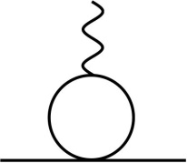
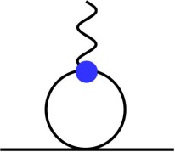
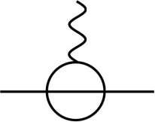
chiral expansion of FFs
in NNLO SU(3) ChPT
LO = 1 (CVC)
NLO 1-loop f_{+,2,B}, NNLO 2-loop f_{+,4,B}
parameter-free w/ ξ-expansion
m_{q} / (4πF₀)² → ξ = M_{P}² / (4πF_{π})²
???
NLO, NNLO analytic, NNLO one-loop
f_{+,2,L}, f_{+,4,L} : “O(p⁴)” couplings L_{i} in O(p⁴) chiral Lagrangian L₄
f_{+,4,C} : O(p⁶) couplings C_{i} in L₆
chiral extrapolation = fix unknown LECs

Slide 6
O(p⁴) couplings L_{i}
have been studied phenomenologically
“fit 10”, Amoros-Bijnens-Talavera, 2001 : M_{{π,K,η}}, F_{{π,K}}, K_{e4} FFs
“new fit”, Bijnens-Jemos, 2012 : M_{{π,K,η}}, F_{{π,K}}, K_{e4} FFs, ππ, Kπ, …
“BE14”, Bijnens-Ecker, 2014 : (updated) M_{{π,K,η}}, F_{{π,K}}, K_{e4} FFs, ππ, Kπ, …
in our analysis of f₊
L₉ @ NLO : shared w/ charged meson EM FFs
⇒ can be determined from EM FFs
L₁₋₈ @ NNLO ⇒ reasonably small NNLO corrections
⇒ input “BE14” values

Slide 7
O(p⁶) couplings C_{i}
poorly known ⇒ have to be determined on the lattice
for f₊(t)
NNLO analytic term ⇒ 8 C_{i}’s in 4 coefficients (Bijnens-Talavera, 2003)
⇒ 4 fitting parameters ; too many to obtain a stable fit?

Slide 8
O(p⁶) couplings C_{i}
3 of them : determined from π⁺, K⁺, K⁰ EM FFs
only 1 free parameter c_{+,πK} @ NNLO + possible N³⁽⁺⁾LO ⇒ a stable fit

Slide 9
O(p⁶) couplings C_{i}
for f₀(t)
many additional C_{i}’s through f₋(t) (Bijnens-Talavera, 2003) ⇒ naïve fit
use a quantity inspired by Callan-Treiman th. (Bijenns-Talavera, 2003)
no LECs @ NLO : L₅ does NOT appear even @ t≠0
huge cancellation b/w NNLO analytic terms
⇒ only 1 additional parameter C₁₂ @ NNLO
⇒ simultaneous fit to f₊(t) and f₀(t) : a viable option

Slide 10
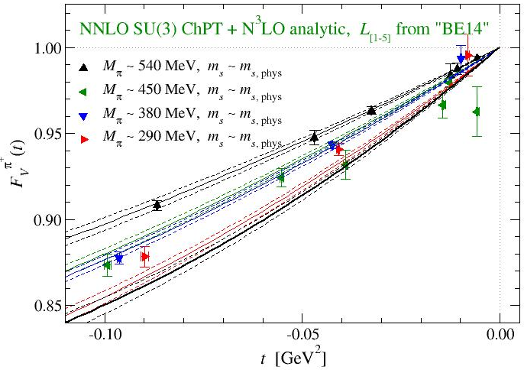
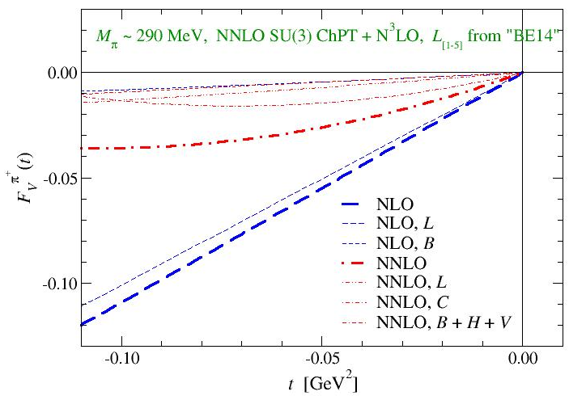
EM FFs
simultaneous fit to π⁺, K⁺, K⁰ EM FFs
NNLO
NLO
χ²/dof ～ 1.8
NLO analytic
π⁺ EM FF
π⁺, K⁺, K→π
reasonable convergence
= dominated by NLO 2L₉t / F²
L₉(M_{ρ})= 4.6(1.1)(0.5) x 10⁻³ ⇔ 5.9(0.4) x 10⁻³ (F_{V}^{π+}, Bijnens-Talavera, 2002)
C_{t} = C₈₈ – C₉₀ = - 6.4(1.1)(0.1) x 10⁻⁵ ⇔ - 5.5(0.5) x 10⁻⁵ (BT, 2002)
|C^{π+}_{πt}|, |C^{π+}_{Kπt}|, |C^{K0}| ～ 1 - 6 x 10⁻⁵ ⇔ poorly known, C_{i} ～ (4$π$) ^{– 4} = 4 x 10⁻⁵

Slide 11
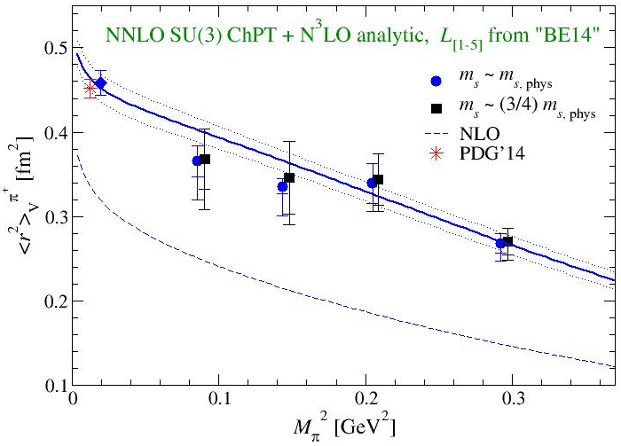
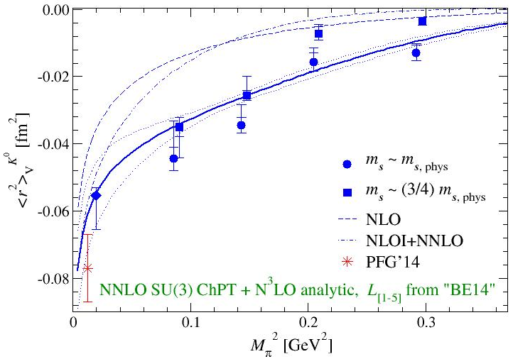
EM FFs
charge radii
K⁰
π⁺
circles/squares : value @ simulation pts. from F(t) = 1 / (1- t /M_{V}²) + …
radii are consistent with experiment
⇔ PDG’14 :

Slide 12
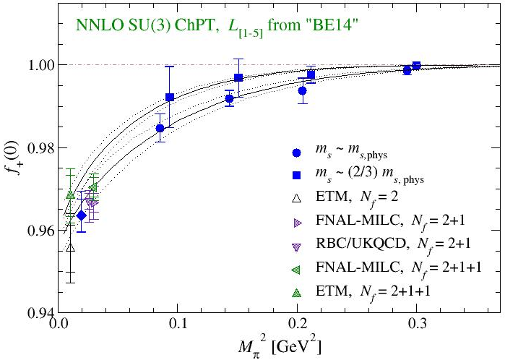
K→π FFs
conventional analysis : f₊(0) vs M_{{π,K}}²
estimate f₊(0) @ each (M_{π}², M_{K}²) by f_{+,0}(t) = f₊(0) / (1- t /M_{pole}²) + …
extrapolate to physical point based on (NNLO) ChPT
reasonable fit
χ² / dof $≈$ 0.2
C_{+,πK} x 10⁵
= 0.52(7)_{stat}(6)_{Li}
⇔ C_{i} $\sim$ (4π)⁻⁴
⇔ 0.46(4)(9)
(FNAL/MILC, Nf=3, 2012)
f₊(0) = 0.964(4)(+4)_{Li}

Slide 13
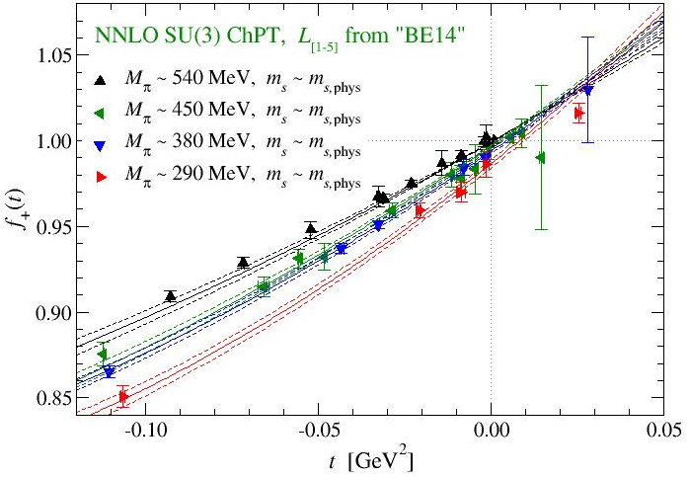
K→π FFs
a global fit of f₊(t) vs M_{{π,K}}² and t
reasonable fit
χ² / dof $≈$ 0.2
C_{+,πK} x 10⁵
= 0.43(7)_{stat}(7)_{Li}
f₊(0) = 0.969(4)(+5)_{Li}
consistent w/ conventional analysis

Slide 14
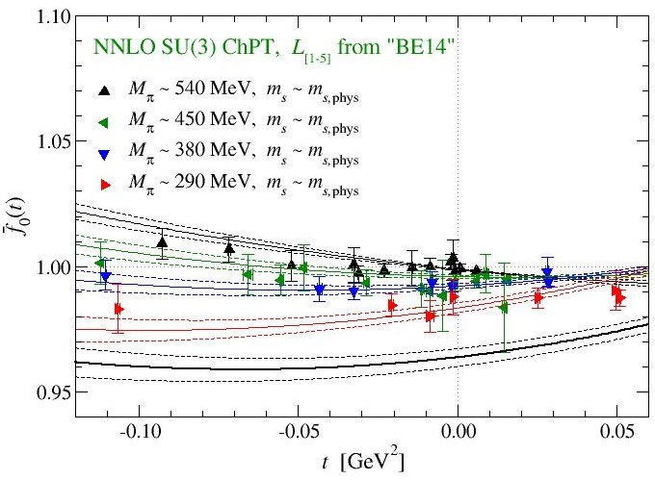
K→π FF
simultaneous fit to f₊(t) and f₀(t) vs M_{{π,K}}², t
reasonable fit
χ² / dof $≈$ 0.7
C_{+,πK} x 10⁶
= 0.52(6)(-7)_{Li}
C₁₂ x 10⁶ = -2.3(0.7)
C₃₄ x 10⁶ = +7.6(1.1)
f₊(0) = 0.964(4)(+5)_{Li}
no NLO analytic ⇒ mild dependence on t
mainly use this fit to study FF normalization and shape

Slide 15
FF normalization
systematics
N³⁽⁺⁾LO : fits incl. various N³LO terms
{L₁, …, L₈} input : fits w/ different {L_{i}}
a ≠ 0 : order counting O((aΛ)²)
finite V : ≲ 0.2% (neglected)
f₊(0) - 1 = NLO + NNLO + … (≲10%)
exp[-M_{π}L] ≅ 2% effects to these corrections
stat., chiral fit, $a≠0$ give equally large errors
independent calculation of f₊(0) w/ sub-% accuracy

Slide 16
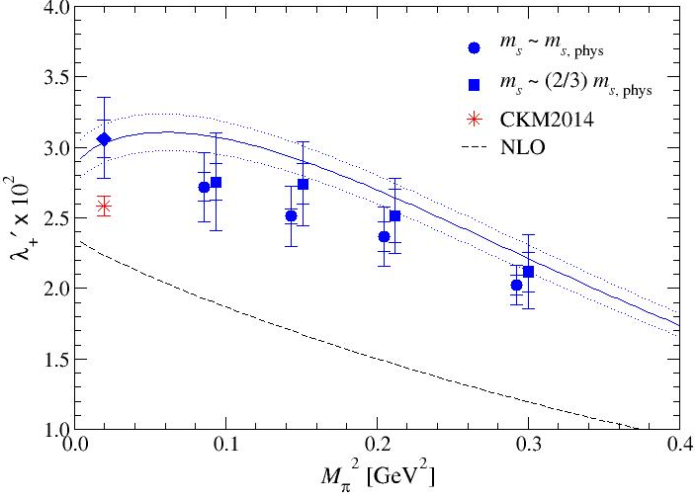
FF shape
slope of f₊(t)
NNLO is significant
λ₊’ x 10² = 3.08(14)(31)
consistent wit exp’t
2.58(7) (CKM 2014)
consistency also for λ₀’ x 10² = 1.98(15)(44) ⇔ 1.37(9) (CKM 2014)
largest uncertainty = discretization (8%, λ₊’), N³⁽⁺⁾LO (21%, λ₀’)

Slide 17
summary
JLQCD’s study of light meson FFs
exact chiral symmetry + chiral fits based on NNLO ChPT
normalization and shape of K→π FFs from a unique fit
small model dependence through small N³⁽⁺⁾LO corrections
precision calculation of f₊(0)
independent determination with sub-% accuracy
reliability check
different fits ( f₊(0), f₊(t) and f₀(t) ) yield consistent results for f₊(0)
charge radii, λ₊’, λ₀’ : in reasonable agreement with experiment
future directions
heavy flavor physics ⇒ T. Suzuki, Thu 16, D semileptonic decays

Slide 18
backup slides

Slide 19
ＮＮＬＯ analytic : EM FF
NNLO analytic terms
symmetries ⇒ 11 parameter dependences of $F_{V}^{π^{+}}, F_{V}^{K^{+}}, F_{V}^{K^{0}}, f_{+}$
L₆ vertex
11 coefficients involve 8 LECs $C_{12,} C_{13}, C_{34}, C_{63}, C_{64}, C_{65}, C_{88}, C_{90}$

Slide 20
ＮＮＬＯ analytic : EM FF
NNLO analytic terms
can be written by using 5 independent linear combinations
L₆ vertex
these combinations are poorly known in general
⇒ treated as fit parameters
⇒ fix by fitting lattice data to ChPT formulae

Slide 21
higher order corrections

Slide 22
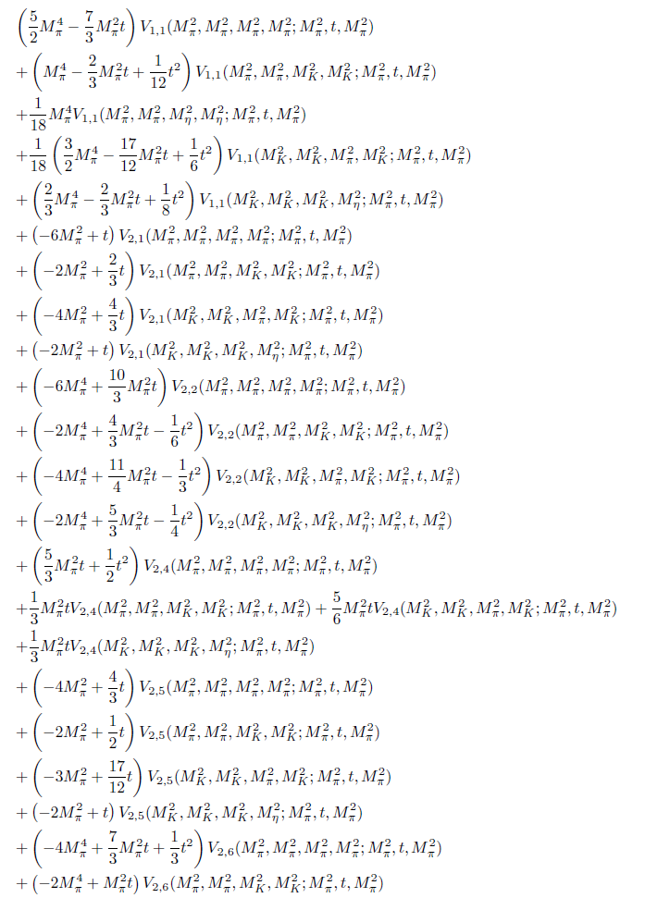
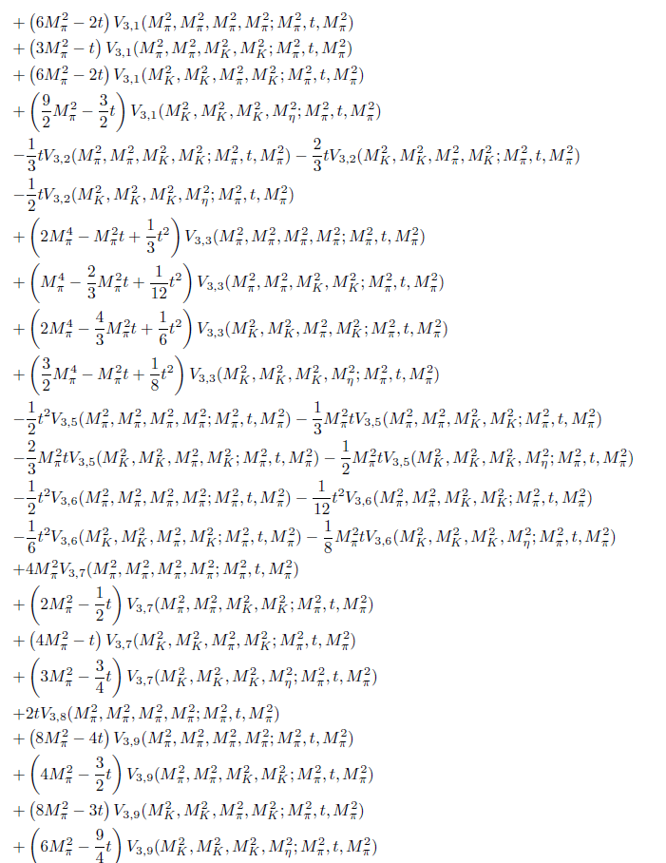
genuine 2-loop correction
only a part of F_{V,4,B}^{π} …

Slide 23
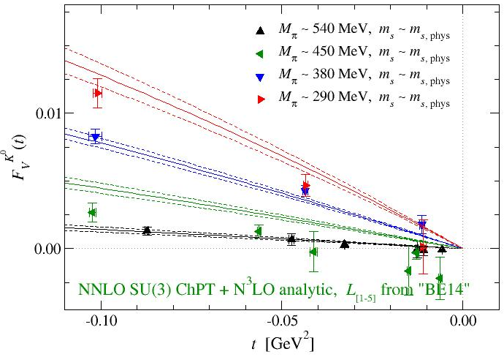
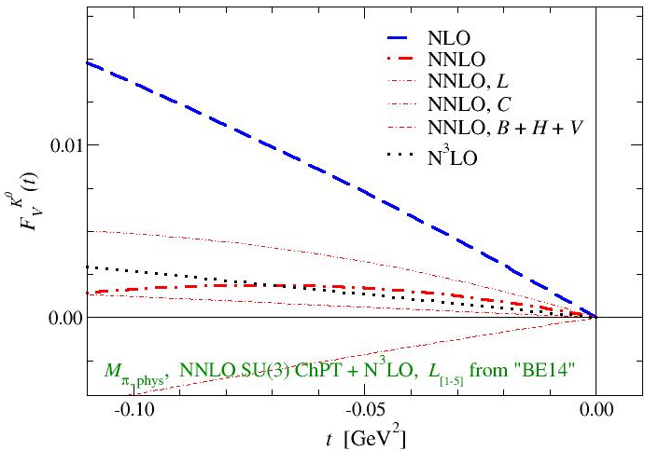
EM FFs
neutral kaon
NNLO, N³LO total
$F_{V}^{K^{0}}∝ \left\langle \overline{s}γs−\overline{d}γd\right\rangle$ : $F_{0}^{K^{0}}, F_{2,L}^{K^{0}}$ vanish ⇒ poor convergence
simulated $M_{π}$: NNLO $≤$ NLO, N³LO
physical $M_{π}$ : NLO $≫$ NNLO $\sim$ N³LO

Slide 24
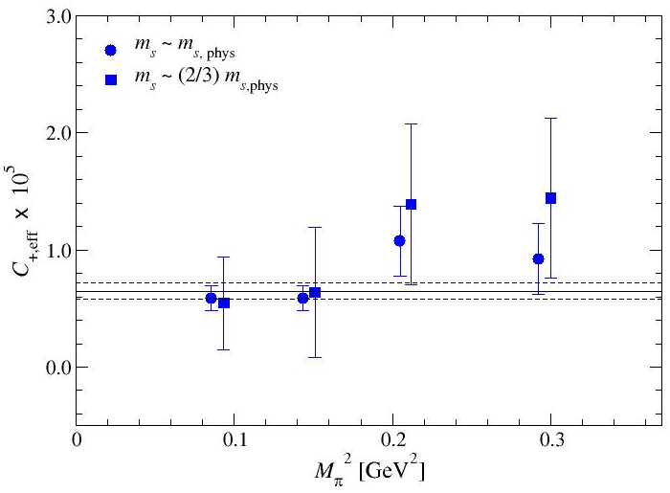
K→π FF
N³LO is significant?
if N³LO is small
⇒ $C_{+,\text{eff}}$ is constant
$M_{\left\{π,K\right\}}^{2}$ dependence
⇒ N³LO is not small
our data : small dependence on $M_{\left\{π,K\right\}}^{2}$ ⇒ N³LO can be neglected

Slide 25
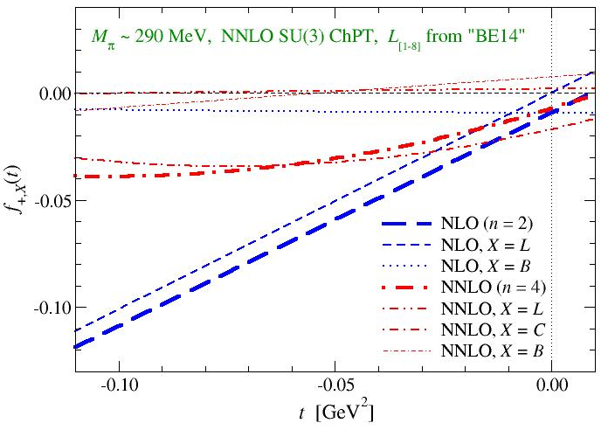
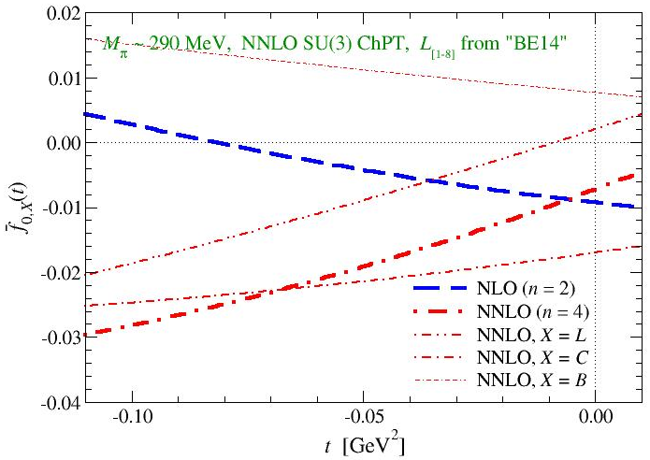
K→π FFs
convergence of NNLO fit
NNLO analytic
NNLO
NLO
NLO analytic
f₀(0)
f₊(0)
reasonable convergence
total nontrivial correction = dominated by NLO 2L₉t / F²
analytic terms dominate NLO and NNLO contributions
cancellations b/w loop corrections ?

Slide 26
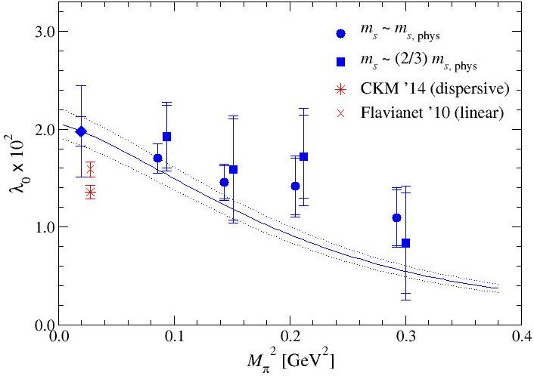
FF shape
slope of f₀(t)
λ₀’ x 10² = 1.98(15)(44)
consistent wit exp’t
1.37(9) (CKM 2014)
uncertainty larger than λ₊’ : L_{i} (↑), NN³⁽⁺⁾LO (↓）

