Slide 1
Calculation of high-order cumulants with canonical ensemble method in lattice QCD
Contents
Asobu Suzuki
Univ. of Tsukuba
for Zn Collaboration
S. Oka (Rikkyo Univ.)
S. Sakai (Kyoto Univ.)
Y. Taniguchi (Univ. of Tsukuba)
A. Nakamura (Hiroshima Univ.)
R. Fukuda (Tokyo Univ.)
Quark number cumulant
Sign problem
Canonical ensemble method
Winding number
Numerical results
Conclusion

Slide 2
Motivation
$$T$$
QGP phase
critical
point
Hadronic phase
$$μ$$
QCD phase diagram
Hadronic phase : Hadron Resonance Gas
QGP phase : Quark Gluon Gas
Hadronic phase → Quark-Gluon phase
from the viewpoint of quark number cumulant

Slide 3
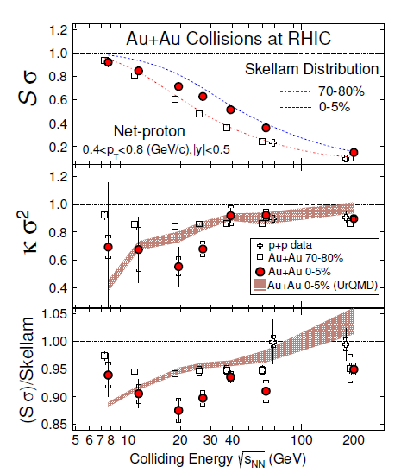
Quark number cumulant
${\left\langle {\hat{N}}^{k}\right\rangle }_{C}≔\frac{∂^{k}}{∂{\left(μ/T\right)}^{k}}\log{Z_{G.C.}}$
H.R. Gas
$$\frac{1}{3}\frac{{\left\langle {\hat{N}}^{3}\right\rangle }_{C}}{{\left\langle {\hat{N}}^{2}\right\rangle }_{C}}$$
$$=tanh\left(3\frac{μ}{T}\right)$$
(dotted line)
$$\frac{1}{9}\frac{{\left\langle {\hat{N}}^{4}\right\rangle }_{C}}{{\left\langle {\hat{N}}^{2}\right\rangle }_{C}}$$
$$=1$$
$$\frac{1}{9}\frac{{\left\langle {\hat{N}}^{3}\right\rangle }_{C}}{{\left\langle {\hat{N}}^{1}\right\rangle }_{C}}$$
$$=1$$
deviation from H.R. Gas
STAR Collaboration
Phys. Rev. Lett. 112 (2014) 032302
something interesting?

Slide 4
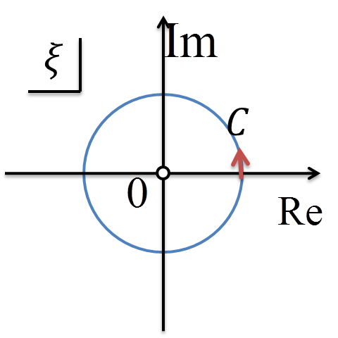
Canonical ensemble method A.Hasenfratz , D.Toussaint (1992)
$$Z_{G.C.}\left(T,μ;V\right)=\sum_{n}{Z_{can.}\left(T;n,V\right)ξ^{n} ,ξ=e^{\frac{μ}{T}}}$$
Fugacity expansion
Canonical partition function
Equivalent
Grand canonical partition function
Residue theorem
$$Z_{can.}\left(T;n,V\right)=\frac{1}{2πi}\oint_{C}{dξ ξ^{−\left(n+1\right)}Z_{G.C.}\left(T;ξ,V\right)}$$
pure
imaginary
$$C:ξ=e^{i\frac{μ}{T}} ,\frac{μ}{T}∈[−π,π)$$
$$=\frac{1}{2π}\int_{−π}^{π}{d\frac{μ}{T}} e^{−i \frac{μ}{T}n}Z_{G.C.}\left(T;iμ,V\right)$$
Fourier transformation！

Slide 5
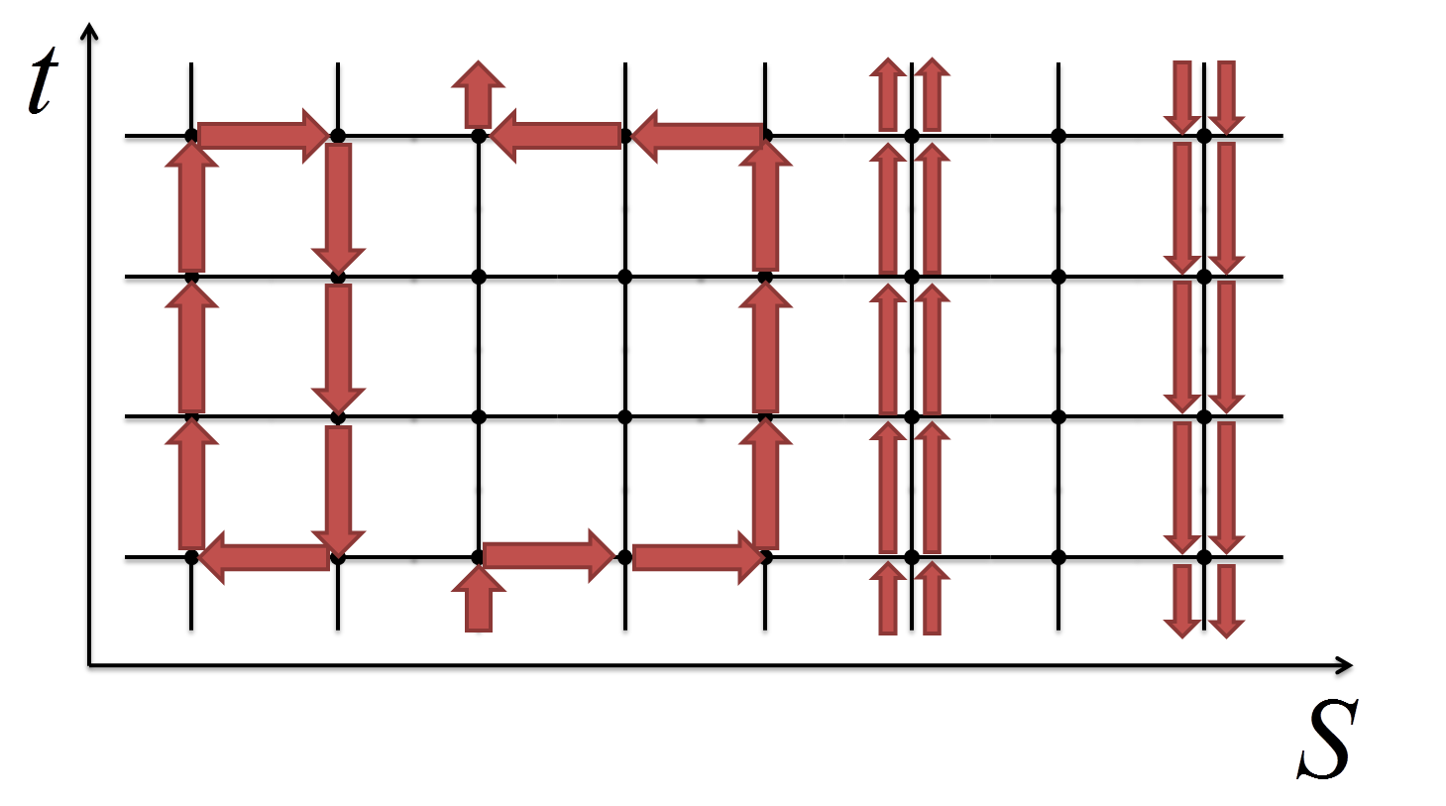
Winding number expansion Li, X. Meng, A. Alexandru,K. F. Liu (2008)
Canonical partition function
Fourier trans.
Grand canonical partition function
$$Z_{can.}\left(T;n,V\right)={\left\langle \frac{1}{2π}\int_{−π}^{π}{d\frac{μ}{T}} e^{−i \frac{μ}{T} n} \frac{Det\left\{D\left(iμ\right)\right\}}{Det\left\{D\left(0\right)\right\}} \right\rangle }_{g}$$
sign
real , positive
calculate $Det\left\{D(iμ)\right\}$
at low cost !
$$γ_{5}D\left(μ\right)γ_{5}=D{\left(−μ^{∗}\right)}^{†}$$
$$Det\left\{D\left(μ\right)\right\}=Det\left\{1−κQ\left(μ\right)\right\}=e^{Tr\left\{\log\left(1−κQ\right)\right\}}$$
$κ :$ hopping parameter
$Tr\left\{\log\left(1−κQ\right)\right\}=−\sum_{n}{\frac{κ^{n}}{n}Tr\left\{Q^{n}\right\}}$
$$=\sum_{k}{W_{k}e^{\frac{μ}{T}k}}$$
$k ;$winding number

Slide 6
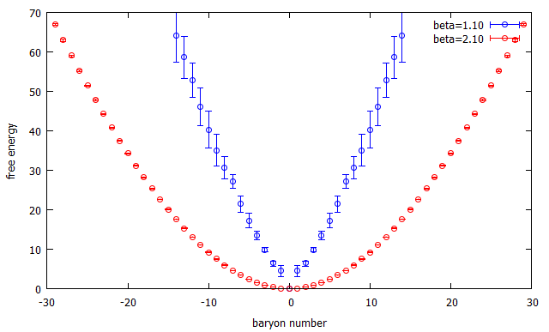
Numerical results
Iwasaki gauge action
2-flavor Wilson Clover
Lattice Size :$8^{3}×4$
$$β$$ | $$κ$$ | $${T/T}_{C}$$
0.9 | 0.137 | 0.644
1.1 | 0.133 | 0.673
1.3 | 0.133 | 0.706
1.5 | 0.131 | 0.813
1.6 | 0.130
1.7 | 0.129 | 1.00
1.8 | 0.126
1.9 | 0.125 | 1.68
2.1 | 0.122 | 3.45
$$−\log\left(Z_{can.}\left(N\right)\right) β=1.1$$
$$−\log\left(Z_{can.}\left(N\right)\right) β=2.1$$
$$\left\langle {\hat{N}}^{k}\right\rangle =\frac{\sum_{N}{N^{k}Z_{can.}\left(N\right)e^{\frac{μ}{T}N}}}{\sum_{N}{Z_{can.}\left(N\right)e^{\frac{μ}{T}N}}}$$
$$T_{C}\left(μ=0\right)=222.5\left(11\right) MeV$$
small $β$ $→$ low temperature
large $β$ $→$ high temperature

Slide 7
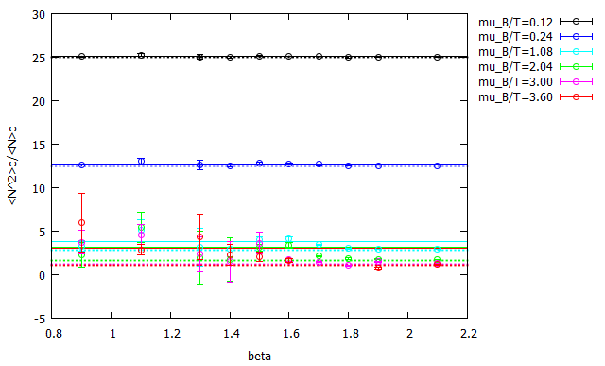
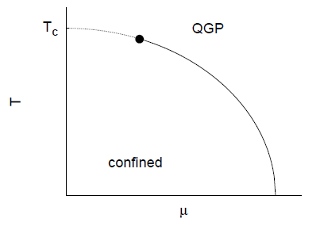
$${\left\langle {\hat{N}}^{2}\right\rangle }_{C}/{\left\langle {\hat{N}}^{1}\right\rangle }_{C}\left(β\right)$$
H.R. gas
(solid line)
$$\frac{{\left\langle {\hat{N}}^{2}\right\rangle }_{C}}{{\left\langle \hat{N}\right\rangle }_{C}}=3 coth\left(\frac{μ_{B}}{T}\right)$$
not depend
on $β$
$$\frac{{\left\langle {\hat{N}}^{2}\right\rangle }_{C}}{{\left\langle \hat{N}\right\rangle }_{C}}=\frac{1+\frac{3}{π^{2}}{\left(\frac{μ_{B}}{3T}\right)}^{2}}{\frac{μ_{B}}{3T}+\frac{1}{π^{2}}{\left(\frac{μ_{B}}{3T}\right)}^{3}}$$
Q.G. gas
(dotted line)

Slide 8
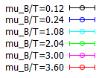
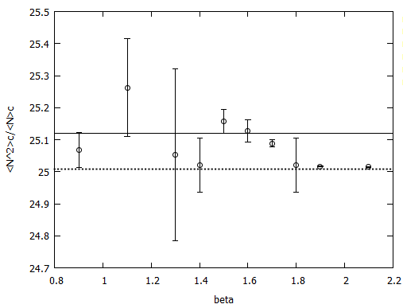
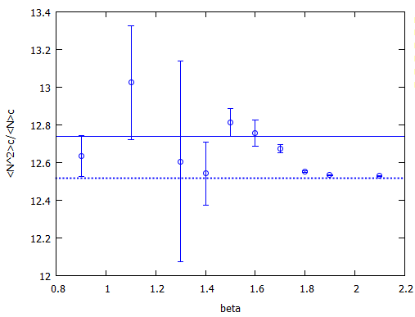
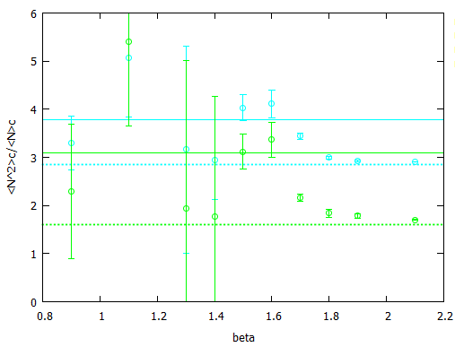
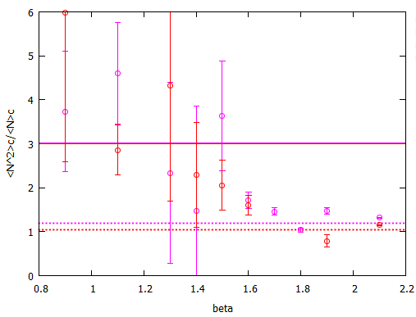
$${\left\langle {\hat{N}}^{2}\right\rangle }_{C}/{\left\langle {\hat{N}}^{1}\right\rangle }_{C}\left(β\right)$$
$$μ_{B}/T=0.12 ,0.24 ,1.08 ,2.04 β≾1.6$$
$$μ_{B}/T =3.00 β≾1.5 ,μ_{B}/T=3.60 β≾1.4$$
consistent with H.R. gas
$$β∼2.1$$
approach to Q.G. gas

Slide 9
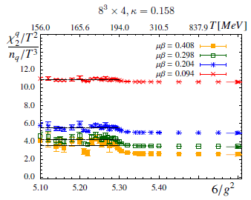
Comparison with previous work
T[MeV]
143.3
157.1
222.5
374.7
767.0
Christof Gattringer and Hans-Peter Schadler
Phys. Rev. D 91, 074511
This work
consistent behavior
application range of HR gas becomes small as $μ/T$ increases
measure the H.R. gas / Q.G. gas transition

Slide 10
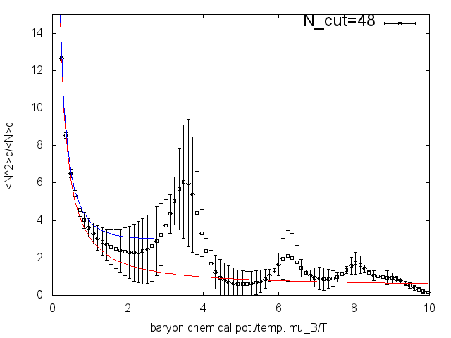
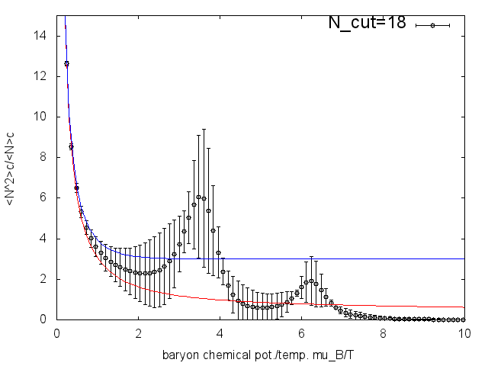
Function of $μ_{B}/T$
We truncate
the fugacity expansion
deviate from HR gas
approach to QG gas
$$Z_{G.C.}\left(μ_{q}/T\right)∼\sum_{n=−N_{cut}}^{N_{cut}}{Z_{can.}\left(3n\right)e^{3n\frac{μ_{q}}{T}}}$$
$$Z_{can.}\left(3n\right)=0 , \left|n\right|>N_{cut}$$
deviate from QG gas
not depend on $N_{cut}$
$${\left\langle {\hat{N}}^{2}\right\rangle }_{C}/{\left\langle {\hat{N}}^{1}\right\rangle }_{C}\left(μ_{B}/T\right),β=0.9$$
HR gas(blue line)
QG gas(red line)
$N_{cut}$ creates
artificial phase transition

Slide 11
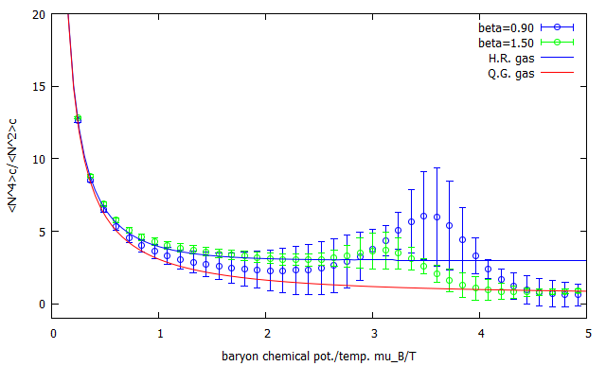
${\left\langle {\hat{N}}^{2}\right\rangle }_{C}/{\left\langle {\hat{N}}^{1}\right\rangle }_{C}\left(μ_{B}/T\right)$ at low temperature
HR gas(blue line)
QG gas(red line)
$$β=1.5$$
$$β=0.9$$
consistent
small $μ_{B}/T$ $∼$ H.R. gas
$μ_{B}/T$ $∼4$ for $β=0.9$
$μ_{B}/T$ $∼3.5$ for $β=1.5$
large $μ_{B}/T$ $∼$ Q.G. gas
Application range of HR gas becomes small as $β$ increases.
circumstantial evidence of phase transition

Slide 12
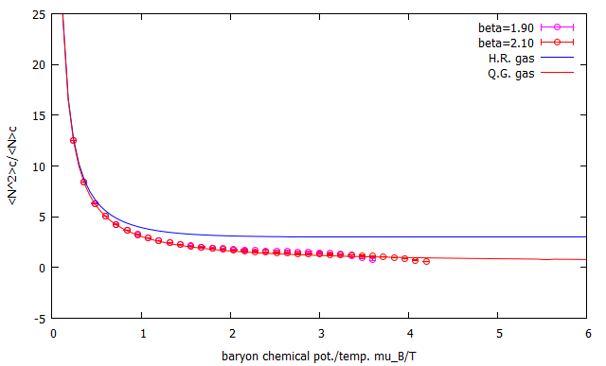
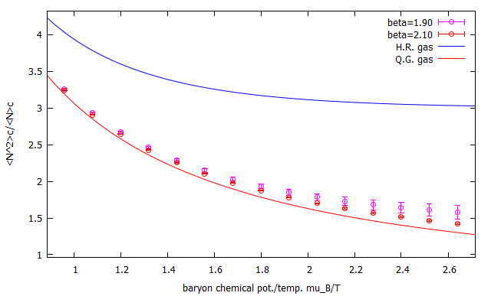
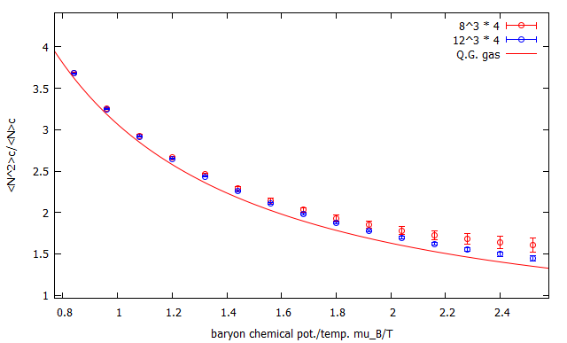
${\left\langle {\hat{N}}^{2}\right\rangle }_{C}/{\left\langle {\hat{N}}^{1}\right\rangle }_{C}\left(μ_{B}/T\right)$ at high temperature
$$β=2.1$$
HR gas(blue line)
QG gas(red line)
$$β=1.9$$
approach to QG gas
as $β$ increases
$$β=1.9$$
volume dependence
$$8^{3}×4$$
$${12}^{3}×4$$
approach to QG gas
as volume increases
interaction remains

Slide 13
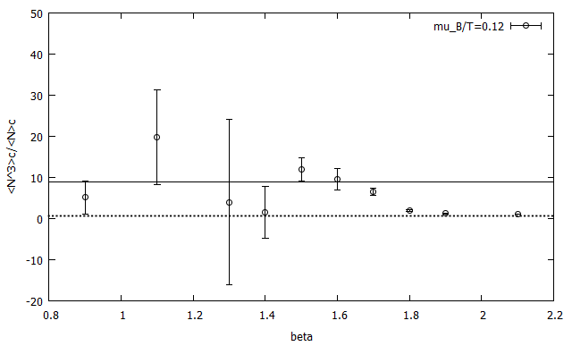
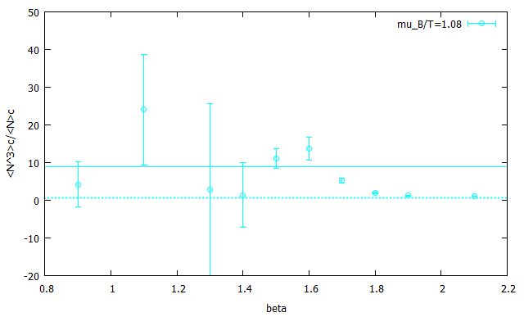
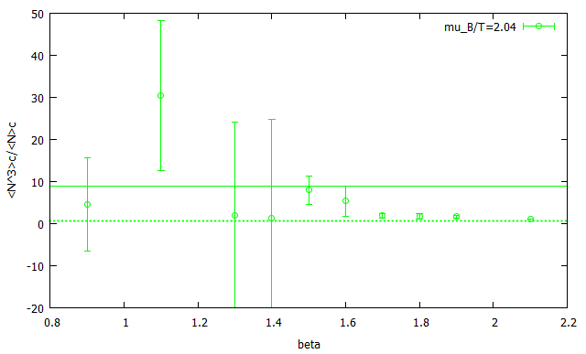
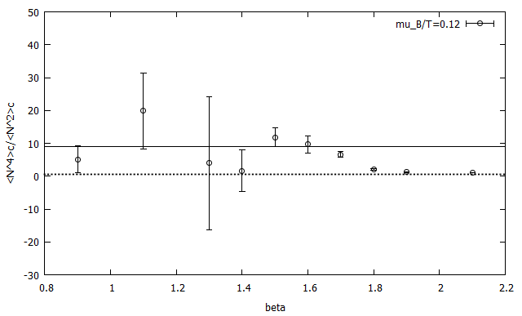
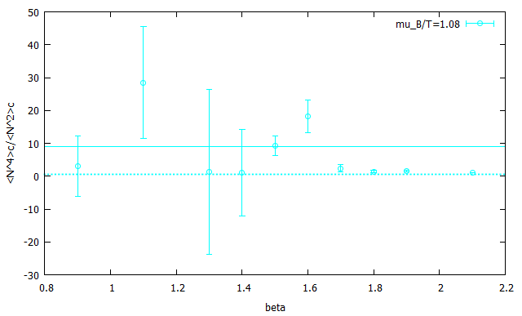
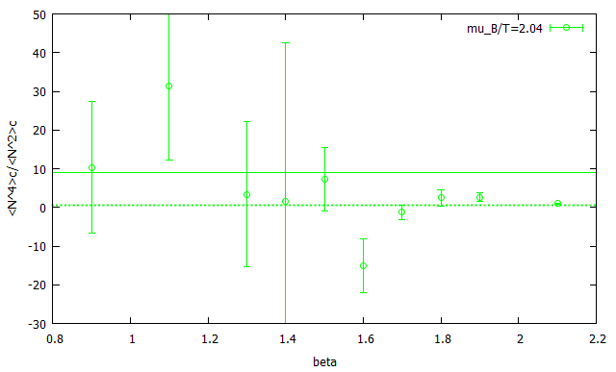
$$\frac{{\left\langle {\hat{N}}^{3}\right\rangle }_{C}}{{\left\langle {\hat{N}}^{1}\right\rangle }_{C}}$$
$$\frac{{\left\langle {\hat{N}}^{4}\right\rangle }_{C}}{{\left\langle {\hat{N}}^{2}\right\rangle }_{C}}$$
$$\text{Skewness} \text{, }\text{Kurtosis} \left(vs. β\right)$$
solid line : H.R. gas
dotted line : Q.G. gas
Skewness (fig. above)
Kurtosis (fig. bottom)
$$μ_{B}/T=0.12 ,1.08 ,2.04 β≾1.6$$
$μ_{B}/T=2,04 ,β=1.6$
deviate from H.R. gas
negative value
consistent with H.R. gas
as same as ${\left\langle {\hat{N}}^{2}\right\rangle }_{C}/{\left\langle \hat{N}\right\rangle }_{C}$

Slide 14
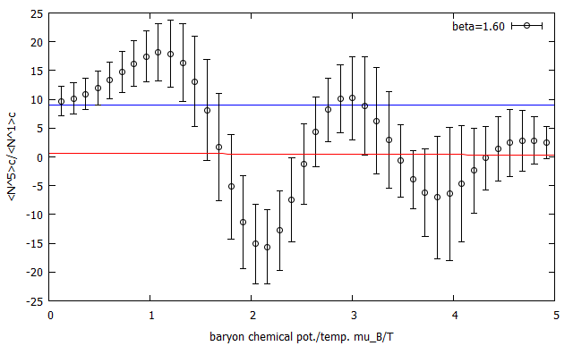
Kurtosis $\left(vs. μ_{B}/T\right)$,$β=1.6$
consistent with H.R. gas
approach to Q.G. gas
singularity
circumstantial evidence of phase transition

Slide 15
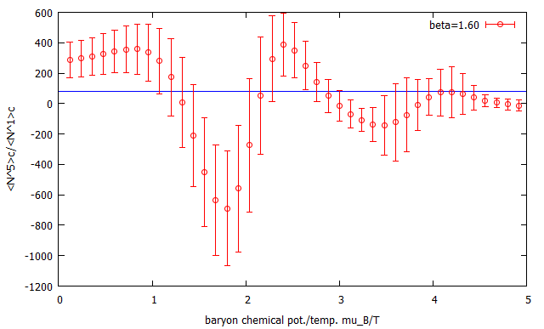
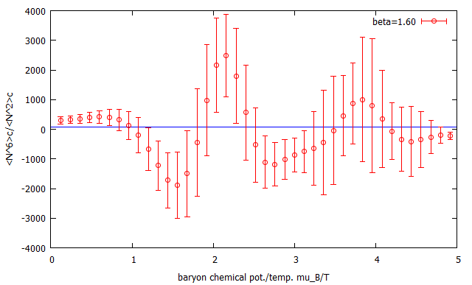
more high-order cumulant $\left(β=1.6\right)$
$${\left\langle {\hat{N}}^{5}\right\rangle }_{C}/{\left\langle {\hat{N}}^{1}\right\rangle }_{C}\left(μ_{B}/T\right)$$
$${\left\langle {\hat{N}}^{6}\right\rangle }_{C}/{\left\langle {\hat{N}}^{2}\right\rangle }_{C}\left(μ_{B}/T\right)$$
$$≠81\left(μ_{B}/T\sim 0\right)$$
$$≠81\left(μ_{B}/T\sim 0\right)$$
H.R. gas
(blue line)
$$\frac{{\left\langle {\hat{N}}^{5}\right\rangle }_{C}}{{\left\langle \hat{N}\right\rangle }_{C}}=\frac{{\left\langle {\hat{N}}^{6}\right\rangle }_{C}}{{\left\langle {\hat{N}}^{2}\right\rangle }_{C}}=81$$
2nd ,3rd ,4th : consistent with H.R. gas
5th ,6th : inconsistent with H.R. gas
(suggestion)

Slide 16
Conclusion
Canonical ensemble method
Sign problem become mild.
We can see as a function of $μ_{B}/T$ .
$N_{cut}$ makes an artificial phase transition!
Hadron Resonance gas model
Less than 4th-order → HR gas is good model.
It may be difficult to adapt HR gas for 5th and 6th.
Quark Gluon gas model
large $β$ or $μ/T$ → approach to Q.G. gas
Circumstantial evidence of phase transition
We measured singular behavior for $β=1.6$ .
We saw HR gas / QG gas transition.

Slide 17
back up

Slide 18
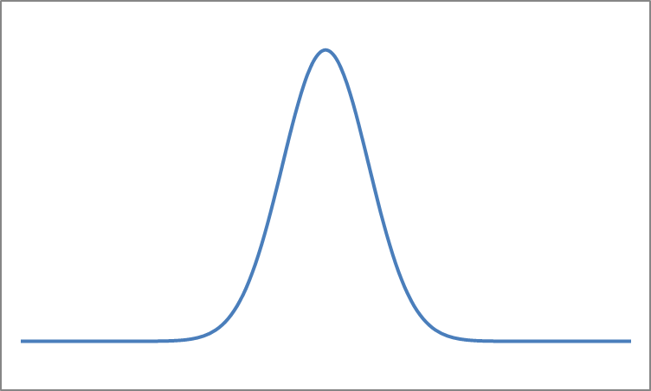
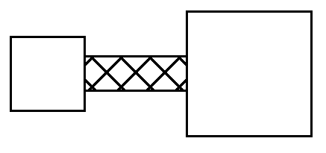
Quark number cumulant
$${\left\langle {\hat{N}}^{k}\right\rangle }_{C}≔{\left.\frac{∂G\left(θ\right)}{∂θ^{k}}\right|}_{θ=0}$$
$$G\left(θ\right)≔\log{∫dn{ e}^{θn}P(n)}$$
Distribution
$P(n)$
characterize
$${\left\langle {\hat{N}}^{1}\right\rangle }_{C}=μ$$
$${\left\langle {\hat{N}}^{2}\right\rangle }_{C}=σ^{2}$$
$${\left\langle {\hat{N}}^{k}\right\rangle }_{C}=0 , for k>2$$
$$P\left(n\right)=\frac{1}{\sqrt{2π}σ}e^{−\frac{{\left(n−μ\right)}^{2}}{2σ^{2}}}$$
$$2σ^{2}$$
ex. Gaussian
$$μ$$
non-Gaussian
Grand Canonical ensemble
$$P\left(n\right)≔\frac{e^{\frac{μ}{T}n}Z_{can.}(n)}{Z_{G.C.}(μ)}$$
system
heat bath
$${\left\langle {\hat{N}}^{k}\right\rangle }_{C}=\frac{∂^{k}}{∂{\left(μ/T\right)}^{k}}\log{Z_{G.C.}}$$
energy
particle

Slide 19
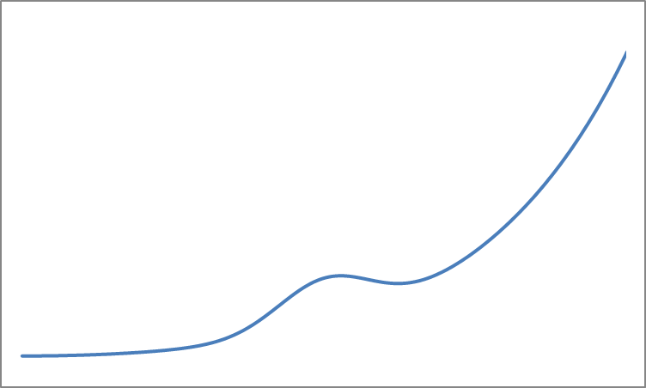
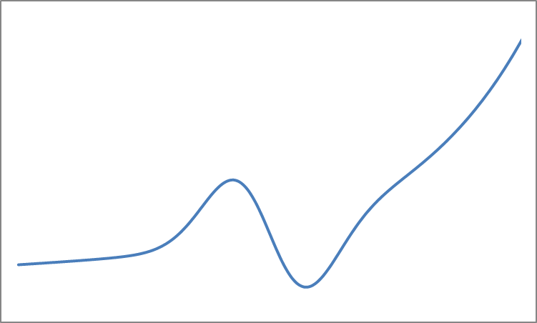
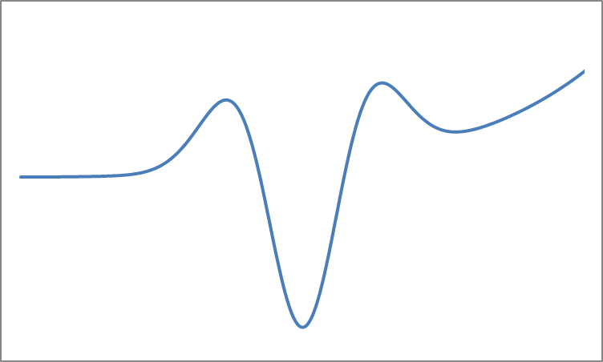
Quark number cumulant
$${\left\langle {\hat{N}}^{k}\right\rangle }_{C}=\frac{∂^{k}}{∂{\left(μ/T\right)}^{k}}\log{Z_{G.C.}}$$
$${\left\langle {\hat{N}}^{2}\right\rangle }_{C}=\left\langle δN^{2}\right\rangle$$
$${\left\langle {\hat{N}}^{3}\right\rangle }_{C}=\left\langle δN^{3}\right\rangle$$
$${\left\langle {\hat{N}}^{4}\right\rangle }_{C}=\left\langle δN^{4}\right\rangle −3{\left\langle δN^{2} \right\rangle }^{2}$$
2nd
3rd
4th
$$\frac{{\left\langle {\hat{N}}^{3}\right\rangle }_{C}}{{\left\langle {\hat{N}}^{2}\right\rangle }_{C}}$$
around phase transition line
$$\frac{{\left\langle {\hat{N}}^{4}\right\rangle }_{C}}{{\left\langle {\hat{N}}^{2}\right\rangle }_{C}}$$
$$\left\langle {\hat{N}}^{k}\right\rangle$$
$${\left\langle {\hat{N}}^{k}\right\rangle }_{C}$$
expectation
value
$$\frac{{\left\langle {\hat{N}}^{3}\right\rangle }_{C}}{{\left\langle {\hat{N}}^{1}\right\rangle }_{C}}$$
sign problem
STAR Collaboration
Phys. Rev. Lett. 112 (2014) 032302
finite density lattice QCD

Slide 20
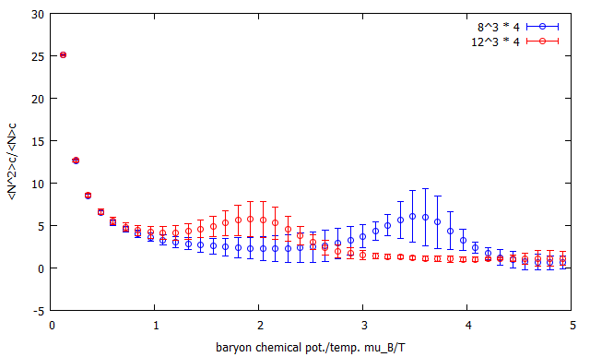
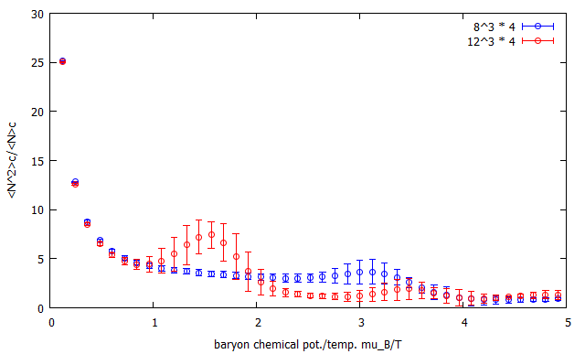
Volume dependence
$$8^{3}×4 vs. {12}^{3}×4$$
$${\left\langle {\hat{N}}^{2}\right\rangle }_{C}/{\left\langle {\hat{N}}^{1}\right\rangle }_{C}\left(μ_{B}/T\right)$$
$$β=0.9$$
$${\left\langle {\hat{N}}^{2}\right\rangle }_{C}/{\left\langle {\hat{N}}^{1}\right\rangle }_{C}\left(μ_{B}/T\right)$$
$$β=1.5$$

Slide 21
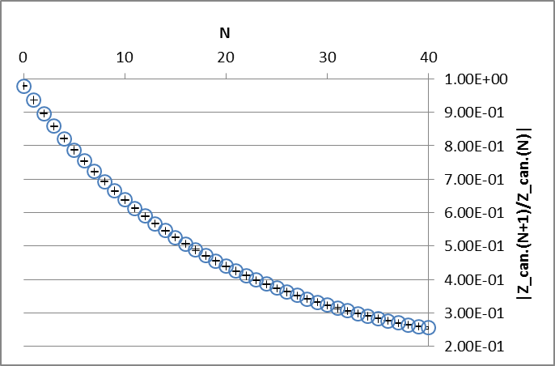
How to determine $N_{cut}?$
d’Alembert
$$\sum_{n}{a_{n}} \lim_{n→∞}\left|\frac{a_{n+1}}{a_{n}} \right|<1$$
$$Z_{G.C.}(μ)=\sum_{n}{Z_{can.}\left(n\right)e^{μn/T}}$$
$$\frac{Z_{can.}\left(n+1\right)}{Z_{can.}\left(n\right)}e^{\frac{μ}{T}}<1$$

