Slide 1
Many flavor approach to study the critical point in finite density QCD
Ryo IWAMI (Niigata Univ.)
In collaboration with
Norikazu YAMADA(KEK/GUAS), Shinji EJIRI(Niigata Univ.)

Slide 2
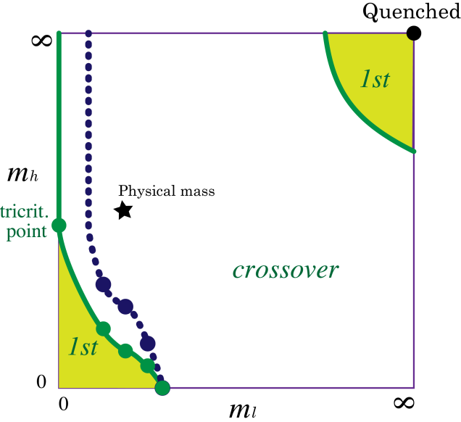
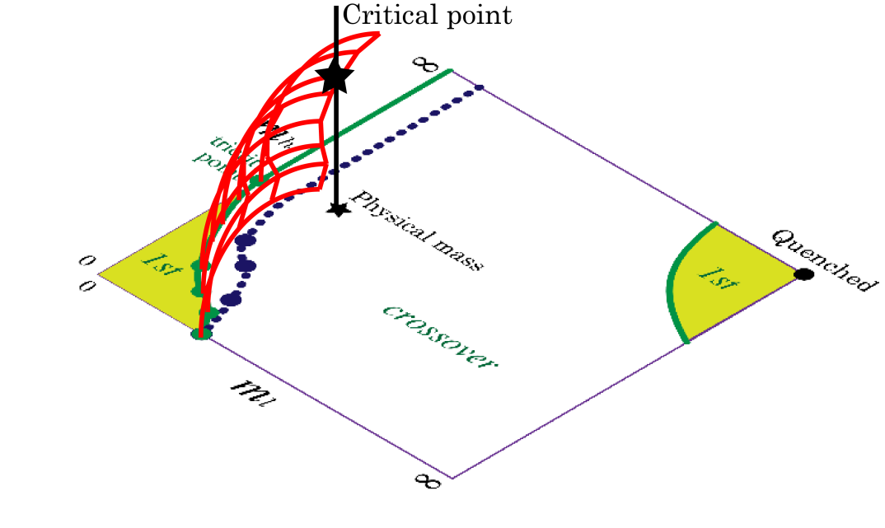
Introduction
It is very important to study the nature of QCD phase transition as a function of mass to understand μ≠0 QCD.
There is 1st order region in light and heavy quark region
If 1st order region become wider, We can find the critical point at physical mass.
?
Notes:
It is very important to find he critical point.
We try to find the critical point.
We use following approach.
We study nature of phase transition as a function of mass.
This is well-known plot, columbia plot.
As shown this fugure,
There is 1st order region in light and heavy mass region.
Order of transitions is crossover at physical mass in \mu=0 QCD.
In right plot, black line represents \mu dependence of transition's order at physical quark mass.
If 1st order region become wider,
We can find the critical point at physical mass.
So we investigate \mu dependence of 1st order region.

Slide 3
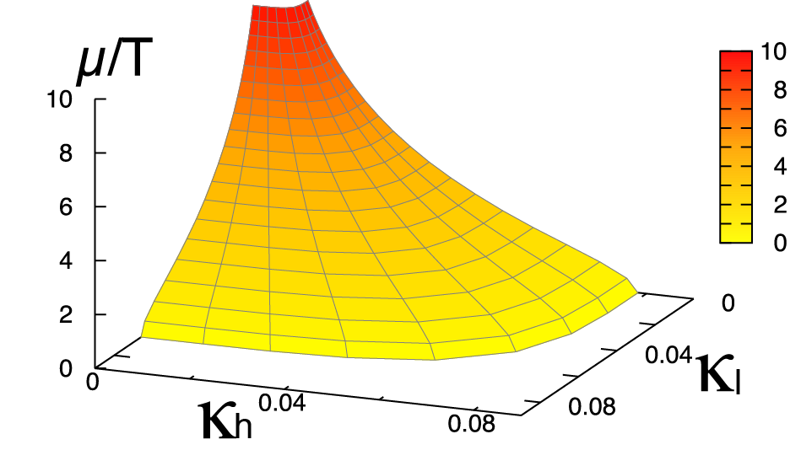
Critical surface in heavy quark region
Critical surface in heavy quark region
H. Saitoh, et al(WHOT-QCD), Phys. Rev. D89, 034507, (2014)
Hopping Parameter Expansion(HPE)
Critical surface is controlled by only 1 parameter,
1. κ_{c} decreases exponentially as increasing μ/T.
2. HPE tells us that critical surface has a simple dependence of (κ,μ)
First order
We want to apply this method to investigate nature of phase transition in (2+1) QCD
Notes:
At first, we discuss critical surface in heavy quark region.
WHOT-QCD collab. investigate it.
They study it by using reweighting method with HPE.
This is their results. This plot is critical surface in heavy quark region.
The 1st order region is behind this critical surface.
From this plot, 1st order region is narrower as increasing \mu/T.
On the critical surface, (k,mu) satisfied this equation.
This kappac is appropriate const.
For large mu, kappac decreases exponentially narrower as increasing mu/T.
We want to apply this method to investigate nature of phase transition in (2+1) QCD

Slide 4
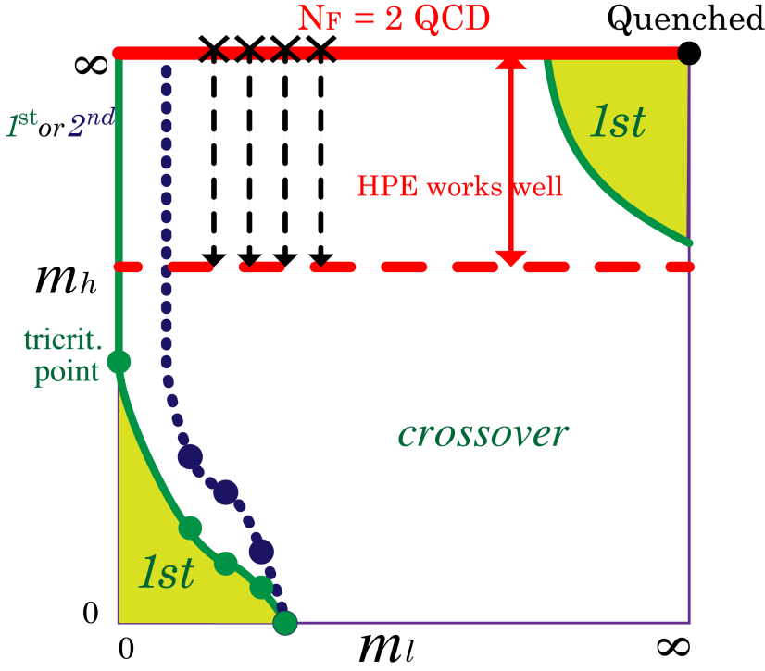
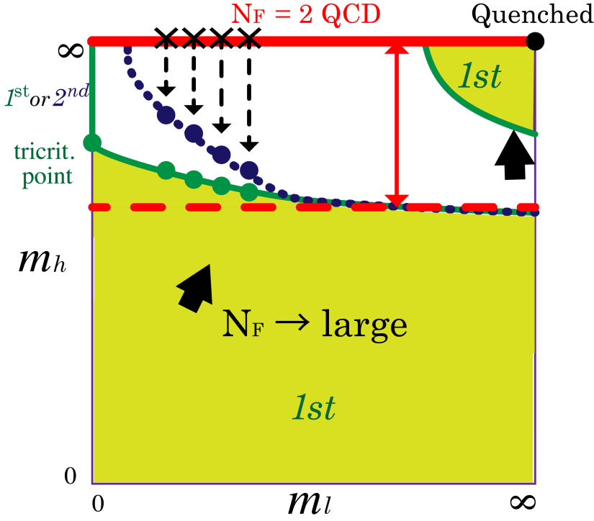
N_{f}=(2+1) QCD with HPE
We study the system where 2 light quarks and 1 heavy quark exist.
HPE is applicable when the strange quark is very heavy.
1. Critical surface in heavy quark region ( previous slide )
2. Order of chiral transition of massless N_{f} =2 QCD (Today 16:30~ Yamada’s talk )
However, we can't investigate the critical surface in this system.
Notes:
In (2+1) QCD, HPE is applicable when the strange quark is very heavy.
In this plot, red region is a application region of HPE.
In this region, interesting topics are only 2.
1 is ~~.
2 is the nature of the chiral phase transition in massless Nf=2 QCD.
This is a famous open problem.
In the next session, yamada sun will give a talk about this topic.
However, we can't investigate the critical surface in light quark region
since 1st order region is too narrow.

Slide 5
Many flavor system
We apply HPE for the system where 2 light quarks and N_{f} heavy quarks exist.
It is known that 1st order region is wider as increasing N_{f} S. Ejiri, N. Yamada, Phys. Rev. Lett. 110, 172001 (2013)
For large N_{f}, we can discuss μ dependence of boundary of 1st order region
→ From this property, we want to discuss nature of (2+1) QCD results
Notes:
Then, we apply HPE for the system where 2 light quarks and Nf heavy quarks exist.
It is known that 1st order region is wider as increasing Nf.
As shown this figure, 1st order region is wider as increasing Nf.
In this system, we can investigate 2 things.
1 is ~~.
From this property, we want to discuss nature of (2+1) QCD results

Slide 6
highly dense s quark system
We also apply HPE for the system where 2 light quarks and highly dense s quark exist.
As we will show, κ_{c} decrease exponentially as increasing μ_{h}/T
μ_{l} dependence of critical point in “strange” (2+1) QCD
Notes:
Moreover, We apply HPE for the system where there are 2 light quarks and highly dense s quark.
As we will show in this talk , κ_{c} decrease exponentially as increasing μ_{h}/T
In this system, we can investigate ~~.

Slide 7
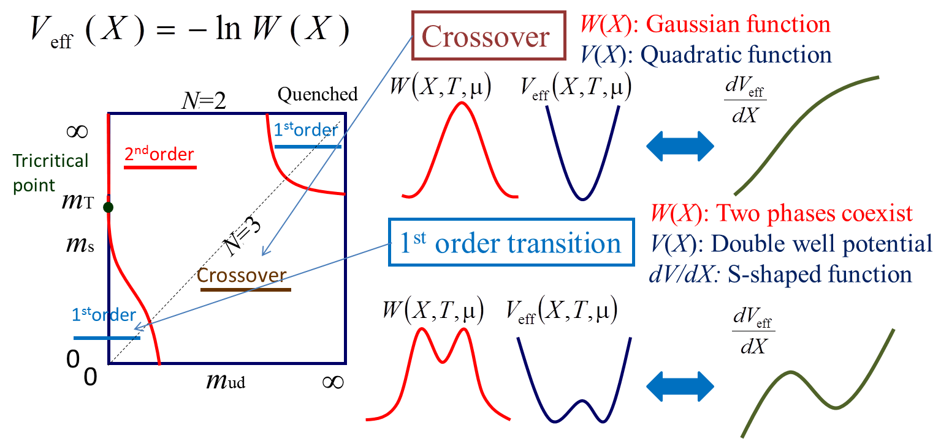
How to identify 1st order transitions
S. Ejiri, PRD77,014508(2008)
Histogram:
Effective potential:
Notes:
In this slide, I'll talk about How to ~~
We define Histogram by this equation.
This delta function fix \hatX to X.
X are order params., plaq, .. etc.
And we define effective potential as this eq.
If we perform a simulation in the crossover region,
Veff is a single-well potential.
on the other hand,
If we perform a simulation in 1st order region,
the shape of Veff is a double-well.
If we plot the curvature of double well potetial.
we expect this shape.
Around this region, the curvature of Veff must be negative.

Slide 8
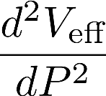
Reweighting technique
Histogram:
Effective potential:
Reweighting factor:
We can calculate at (∀β, κ) using at (β₀,κ₀)
→
Notes:
We calculate plaquette Veff.
We use reweighting method to study parameter depedence of the Veff
This is a ratio of histograms at different beta.
We denote it R.
The R is given by the quark determinant.
Veff at different beta can be calculated by this eq.
This is Nf=2 Veff.
This is logalithm of R.
Then , We obtain the Veff at different beta.
If this is a double well potential, the transition is of 1st order.
Then, curvature of potential is negative.

Slide 9
Reweighting technique -light quark part-
Reweighting factor:
Taylor expansion of the light quark determinant wrt. μ_{l}
calculate first term and second term.
At small μ_{l}/T, evaluate light quark determinant up to O(μ_{l}²)
do not use reweighting method for κ_{l}.
perform simulation at different κ_{l} .
Notes:
Reweighting factor is given as this equation
This is a product of the light quark part and the heavy quark part
We evaluate the light quark part by Taylor exp. In terms of \mu
We calculate first derivative term and second term derivative.
This analisys is valid at small ml/T.
We evaluate light quark determinant up to O(ml2)
We do not use reweighting method for kl.
To study kl dependence, We perform simulations at 2 kl.

Slide 10
Reweighting technique -heavy quark part-
Reweighting factor:
Hopping Parameter Expansion (HPE) for heavy quark mass κ_{h}
This factor is controlled by only 3 params.
We change by reweighting technique.
Especially, complex phase of heavy quark determinant is controlled by
Notes:
Next, heavy quark part.
we evaluate it by using HPE.
In the leading order of HPE, there is 3 terms: plaquette term, real polya. and im polya term.
Corresponding to these terms,
This factor is controlled by only 3 combination of params.
We change (\beta,h,tanh) by reweighting method.
Especially, Complex phase of heavy quark determinant is controlled by tanh(mu/T)
This parameter is easily controlled because tanh is smaller than 1 .

Slide 11
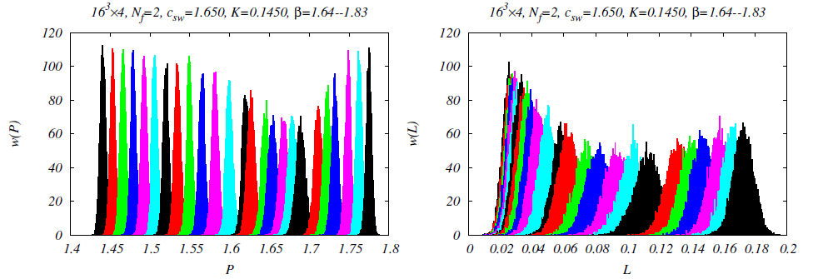
Simulations
We perform Iwasaki + N_{f} =2 clover wilson (16³ x4) at κ_{l} = 0.14500, 0.14750 (m_{PS}/m_{V} ≃ 0.6647, 0.5761 around T_{c} in N_{f}=2 QCD)
We add the dynamical heavy quark effect and light quark density effect by using reweighting technique.
Complex phase [heavy quark : HPE, light quark : Taylar up to Ο( μ_{l}² )]
For avoiding “sign problem”, we use the cumulant exp. method
H. Saitoh, et al(WHOT-QCD), Phys. Rev. D89, 034507, (2014)
Notes:
We use Iwasaki + Nf=2 clover wilson action.
We perform 2 simulations at (m_{PS}/m_{V} = 0.6647, 0.5761)
We add the dynamical heavy quark effect and light quark density effect by using reweighting technique.
We evaluate complex phase of heavy quark with HPE, and light quark with Taylar expansion for \mu_l up to \mu^{2}
For avoiding “sign problem”, we use the cumulant exp. method.

Slide 12
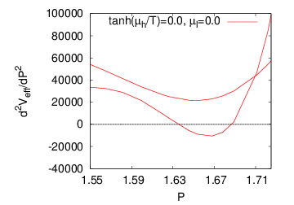
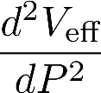
h dependence of V_{eff} shape
h=0.1 h=0.3
h large
m_{PS}/m_{V} ≃ 0.6647
Crossover
1st order
d²V/dP² become smaller as increasing h
If there is a region of P where d²V/dP² is negative, phase transition is of 1st order
We determine h_{c} as the value at which negative curvature appears
Notes:
Let me show our results.
This figure shows the second derivative of Veff.
This is h=0.1 results. This is h=0.3 results.
As increasing h, d2V/dP2 become smaller.
If there is a region of P where d2V/dP2 is negative, transitions is of 1st order.
We determine the critical value of h at which the negative curvature appears

Slide 13
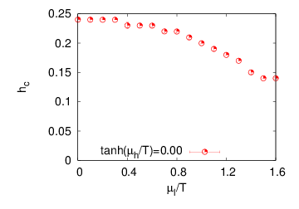
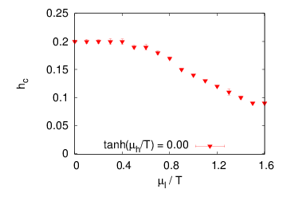
μ_{l} dependence of h_{c} at μ_{h}=0
1st order
m_{PS}/m_{V} ≃ 0.5761
1st order
m_{PS}/m_{V} ≃ 0.6647
Crossover
Crossover
h_{c} decrease as increasing μ_{l}/T
→ κ_{c}(～1/m_{c}) decrease as increasing μ_{l}/T
κ_{c} (～ 1/m_{c}) decrease as increasing μ_{l}/T
→ 1st order region become wider as increasing μ_{l}/T
Notes:
Next, I'll show \mu_l dependence of hc at \mu_h=0.
The left plot mps/mv=0.6647 result, the right plot mps/mv=0.5761 result. (x,y)=(mu_l/T, hc)
As shown these plot,
hc decrease as increasing \mu_l /T.
From this equation,
1/mc decrease as increasing \mul /T.
Therefore, 1st order region become wider as increasing ml/T.

Slide 14
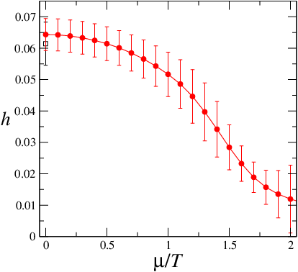
μ_{l} dependence of h_{c} at μ_{h}=0 ～Wilson vs. Staggered～
1st order
m_{PS}/m_{V} ≃ 0.7
1st order
m_{PS}/m_{V} ≃ 0.6647
Crossover
Crossover
compare our results with a previous results obtained by the p4-improved staggered quarks.
These values of hc are different because lattice spacing is cause ( N_{s}³x N_{t} = 16³ x 4 )
κ_{c}(～1/m_{c}) decrease as increasing μ_{l}/T in both results
Notes:
Let me compare our results with a previous results obtained by the p4-improved staggered quarks.
This is a result of staggerd.
These values of hc are different because lattice spacing is cause (Nt=4).
However they show the same qualitative behavior.
That is, both of Kc decreases as increasing \mu_l/T.
So, these results confirm Wilson results with Staggerd results qualitatively.

Slide 15
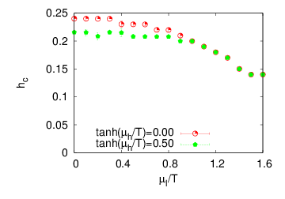
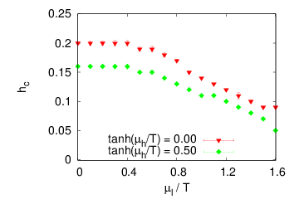
μ_{l} dependence of h_{c} at μ_{h}≠0
1st order
m_{PS}/m_{V} ≃ 0.5761
1st order
m_{PS}/m_{V} ≃ 0.6647
Crossover
Crossover
h_{c} decrease as increasing (μ_{l}/T, μ_{h}/T)
( tanh(μ_{h}/T)=0.0,0.5,1.0 ⇔ μ_{h}/T=0.00, 0.55, ∞ ⇔ red, green, blue)
Notes:
Next, I'll show \mu_h dependeence of hc.
green plot represents \mu_h=0.55 result.

Slide 16
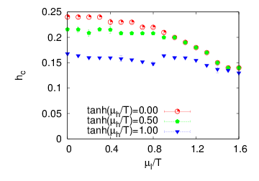
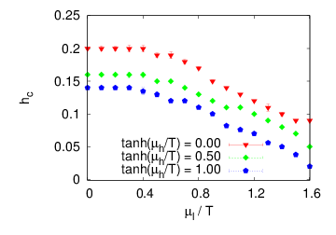
μ_{l} dependence of h_{c} at μ_{h}≠0
1st order
m_{PS}/m_{V} ≃ 0.5761
1st order
m_{PS}/m_{V} ≃ 0.6647
Crossover
Crossover
h_{c} decrease as increasing (μ_{l}/T, μ_{h}/T)
Dependence of h_{c} on tanh(μ_{h}/T) is ONLY 30%.
( tanh(μ_{h}/T)=0.0,0.5,1.0 ⇔ μ_{h}/T=0.00, 0.55, ∞ ⇔ red, green, blue)
From these results, μ_{h}/T has little effect on hc.
Notes:
And, blue plot represents \mu_h=\infty result.
Therefore, hc decrease as increasing (mul/T,muh/T),.
And so, dependence of hc on tanh(mu_h/T) is ONLY 30%.
From these results, mu_h/T has little effect on hc.

Slide 17
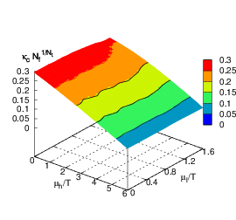
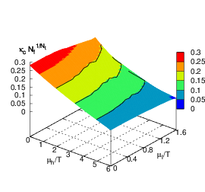
(μ_{l},μ_{h}) dependence of κ_{c}N_{f}^{1/Nt}
m_{PS}/m_{V} ≃ 0.6647
m_{PS}/m_{V} ≃ 0.5761
Therefore, we can take μ_{h}/T as large as we want.
κ_{c} exponentially decrease as increasing μ_{h}/T
(κ_{c} N_{f}^{1/Nt} = 0.25,0.20,0.15,0.10,0.05,0.00)
Notes:
Therefore,
To be easily understandable, make 3D plot about (\mu_l, \mu_h) dependence of kappa_c
(x,y,z)=(\mu_h,\mu_l. Normalized Nf^{1/Nt} \kappa_c)
Since critical k exponentiallydecrease as increasing mu_h/T,
Valid region of HPE become wider.
\kappa_c also decrease as increasing (\mu_l/T,\mu_h/T)
Especially, kappa_c exponentially decrease as increasing \mu_h/T according to this equation.

Slide 18
valid region about HPE
m_{PS}/m_{V} ≃ 0.6647
m_{PS}/m_{V} ≃ 0.5761
We assume that the valid region κ_{c} < 0.1
For the case (2+1) QCD, the vertical axis is κ_{c} (N_{f}=1).
In highly dense region, (μ_{h}/T > 5.0, light blue region) We can investigate critical surface using HPE.
N_{f} must be less than 16 → κ_{c} N_{f}^{1/Nt} must be less than 0.2
At N_{f} = 1, We can get the valid region (μ_{h}/T > 5.0) also
(κ_{c} N_{f}^{1/Nt} = 0.25,0.20,0.15,0.10,0.05,0.00)
Notes:
Finally, we discuss valid region of HPE.
If we assume that HPE is valid when kc is less than 0.1.
For the case (2+1)QCD, that is a Nf=1, the vertical axis is \kappa_c.
In the light blue region, \kappa_c is smaller than 0.1.
We expect HPE works well in this region.
In highly dense region, mh/T > 5.0,
We can investigate critical surface using HPE.

Slide 19
Summary
We investigated the nature of phase transitions in (2+N_{f}) QCD
For large N_{f}, we can determine critical point where the 1st order transition terminated relatively easily.
We obtained the following results.
1st order region is wider as increasing μ/T in both cases by staggered and Wilson
Especially, critical value of heavy k is exponentially smaller as increasing μ_{h}/T
In high heavy quark density region (μ_{h}/T > 5.0),
There is 1st order PT in N_{f} =(2+1) flavor QCD.
future work
Evaluate h_{c} w/o HPE
Calculate h_{c} on larger lattice volumes.
Notes:
Both results

Slide 20
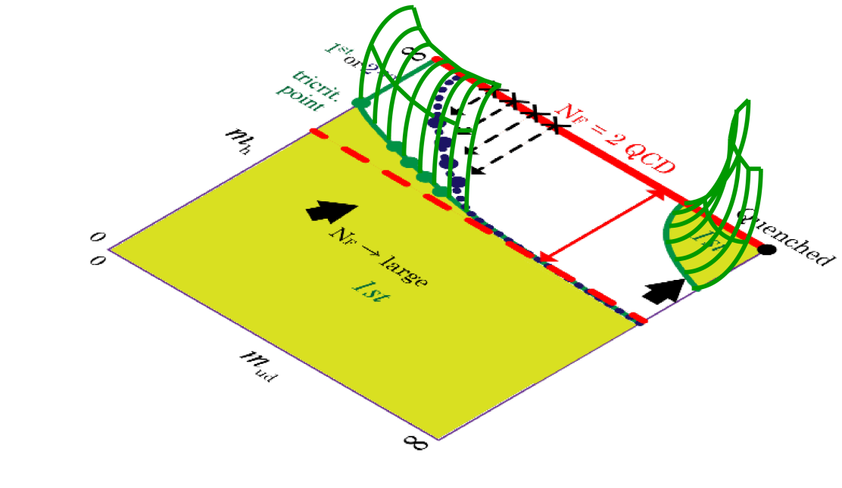
Summary
We investigated the nature of phase transitions in (2+N_{f}) QCD
For large N_{f}, we can determine critical point where the 1st order transition terminated relatively easily.
We obtained the following results.
1st order region is wider as increasing μ/T in both cases by staggered and Wilson
Especially, critical value of heavy k is exponentially smaller as increasing μ_{h}/T
In high heavy quark density region (μ_{h}/T > 5.0),
There is 1st order PT in N_{f} =(2+1) flavor QCD.
future work
Evaluate h_{c} w/o HPE
Calculate h_{c} on larger lattice volumes.
Notes:
Both results

Slide 22
Hopping Parameter Expansion(HPE)
HPE is very useful to get the rough outline
Deformation!!
Quark effrct is given by P term and L term.
The system is controlled by only 3 params.
Especially, Heavy quark phase is controlled
HPE works well in heavy quark region
We want to study critical behavior
in light quark region using HPE !! → How to use??

Slide 23
Reweighting technique in μ≠0 QCD
Cumulant expansion method
Quark phase cause “sign problem”
For avoiding this problem, we use the above method
Use cumulant expansion for the sign factor
Odd term must be vanished from symmetry
Higher term will be vanished in thermodynamic limit

