Slide 1
Lattice gauge theory treatment of Dirac semimetals at strong coupling
Yasufumi Araki ^{1,2}
Kentaro Nomura ¹
¹ Institute for Materials Research, Tohoku Univ.
² Frontier Research Institute for Interdisciplinary Sciences, Tohoku Univ.
Paper in preparation
“Applications beyond QCD”
Lattice 2015 – Kobe International Conference Center : July 17, 2015

Slide 2
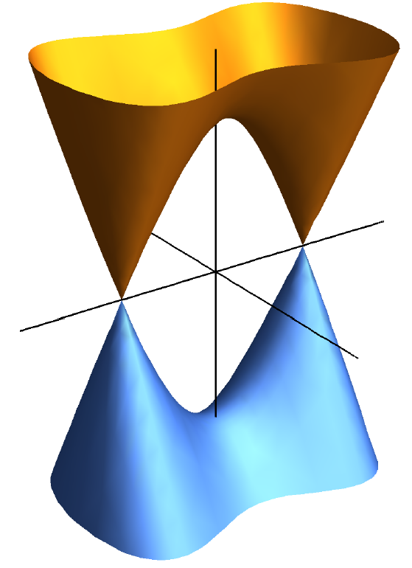
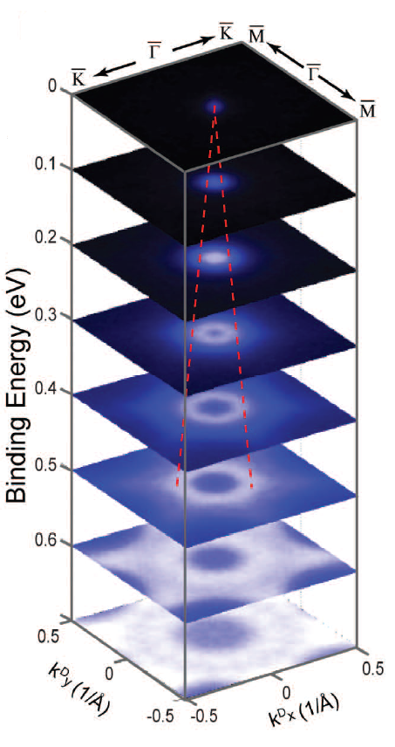
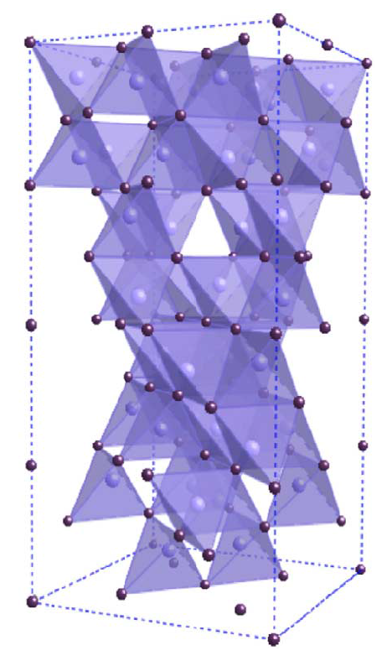
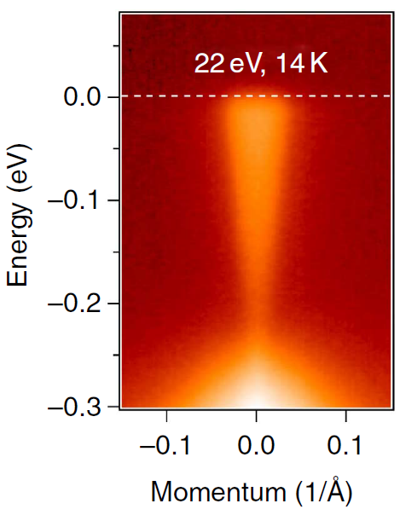
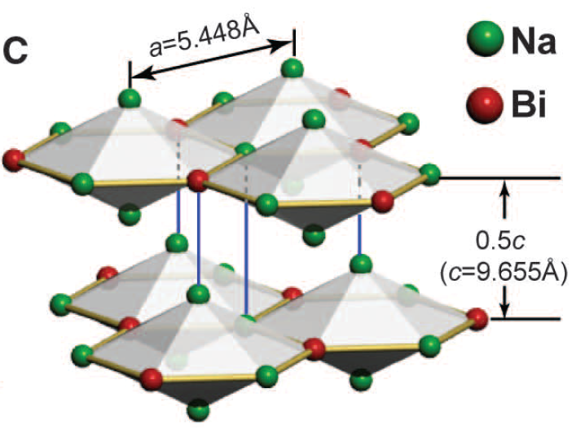
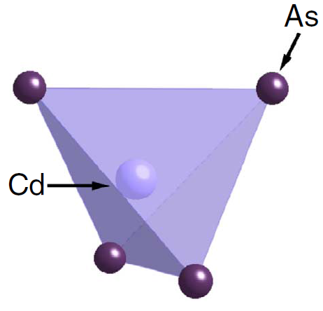
Dirac semimetals
Dirac band structure realized in electronic spectrum:
E
- gapless, band touching at “Dirac points”
- protected by topology, crystalline symmetry, ...
k_{z}
2D
k_{x}, k_{y}
graphene (sheet of carbon atoms)
surface states of topological insulators (gapped in the bulk)
3D counterpart...?
(“3D analogue of graphene”)
Theoretical prediction: BiO₂
Young et al. PRL 108, 140405 (2012)
Experimentally realized recently.
Na₃Bi
Cd₃As₂
Liu et al. Science 343, 864 (2014)
Neupane et al. Nat. Commun. 5, 3786 (2014)

Slide 3
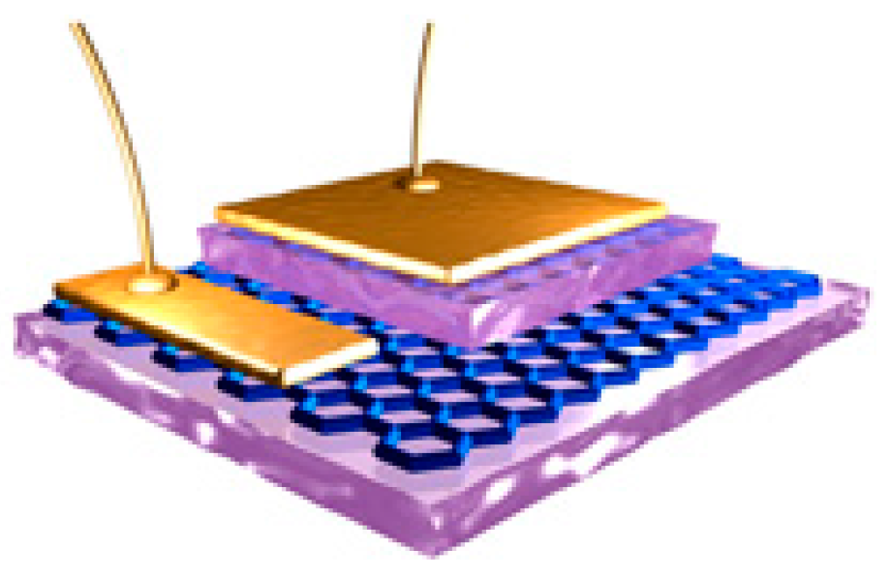
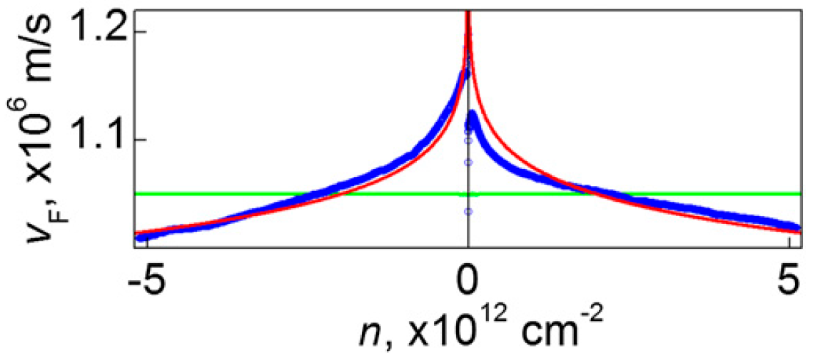
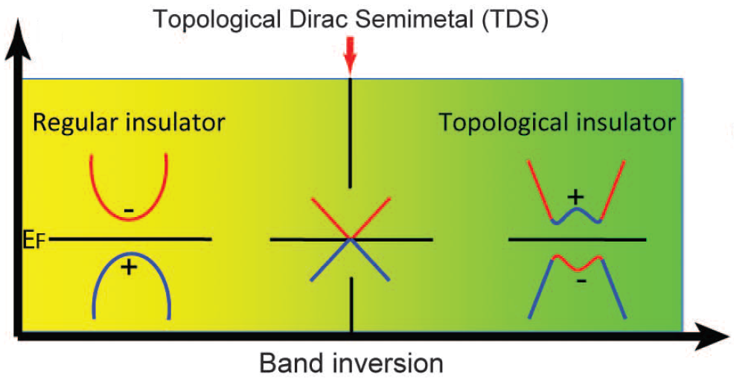
Many-body effects?
Electron-electron interaction
electron correlation can change the Dirac spctrum drastically...
Dynamical mass generation (excitonic instability, chiSB)
Renormalization of Fermi velocity (absence of Lorentz invariance)
Dynamical screening
e.g.) graphene: v_{F} renormalized at charge neutrality.
Yu et al. PNAS 110, 3282 (2013)
Many-body effects in 3D Dirac semimetals?
Change in the spectrum
turn into various phases...
e.g.) normal insulator, topological insulator, Weyl semimetal, axionic insulator, ...
Important as a platform for many novel states.
Liu et al. Science 343, 864 (2014)

Slide 4
Analysis on many-body effects
How to investigate many-body effects?
Choice of interaction:
Lorentz non-invariant QED
phenomenological potential
cf. Talks by Dr. Ulybyshev, Dr. Boyda.
coupling strength g
RG, self-consistent eqn., Lattice Monte Carlo, ... etc.
In 3D Dirac semimetals...
number of d.o.f.s N
■ RPA(large-N) analysis
Hofmann et al. PRB 92, 045104 (2015)
■ From weak coupling... self-consistent eqn.
Gonzalez, arXiv:1502.07640
RG analysis
Throckmorton et al., arXiv:1505.05154
■ From strong coupling... strong coupling expansion of lattice QED
Sekine & Nomura, JPSJ 83, 094710 (2014); PRB 90, 075137 (2014)
Improve
w/ hypothetical lattice models.
This work: Lattice QED analysis with realistic d.o.f.s/symmetries.
connect the analysis to continuum limit.

Slide 5
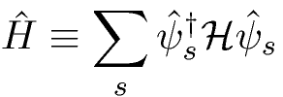
Lattice action for fermions
Lattice Hamiltonian:
background charge
(μ_{bg}→∞)
tight-binding Hamiltonian
Eigenvalue:
around Dirac points k_{D}
Path integral formalism:
Split the imaginary time β into N_{τ} steps: a_{τ}
Leave a_{τ} dependence (a_{τ} → 0 is required.)
with forward difference
cf.) A similar form appears in Astrakhantsev et al., arXiv:1506.00026
Symmetries of the Hamiltonian [e.g. spin SU(2)] is preserved.
e.g.) spin SU(2) is broken in staggered fermion formalism.

Slide 6
Coupling to gauge field
Continuum:
Scalar potential A₀: mediates 1/r Coulomb interaction.
v_{F}≪c: neglect the retardation (A_{1,2,3}) effect.
e.g.) Na₃Bi: v_{F}/c ~ 10⁻³
: local charge density
Lattice:
Define the gauge variable
on each site.
(not on the links)
The total lattice action becomes
Take the “renormalized” coupling
as an expansion parameter.

Slide 7
Strong coupling expansion
(i) Expand around the strong coupling limit g_{R}⁻²=0
(ii) Integrate out the gauge degrees of freedom U₀
Derive the effective action for fermions: S_{eff}
Strong coupling limit [g_{R}⁻²=0]:
Propagation of “photon” is suppressed.
Correlates charge density at the same site.
NLO correction [O(g_{R}⁻²)]:
S_{G} carries “photon” to a neighboring site.
Correlates charge densities between nearest neighboring sites.

Slide 8
Strong coupling limit
On-site repulsion is generated in the strong coupling limit:
Going back to Hamiltonian formalism:
Repulsive Hubbard interaction: U = 1/4a_{τ} → ∞ in the continuum limit.
requires local charge neutrality:
i.e. “one electron per one site”
The system becomes Mott insulator in the continuum limit (a_{τ}→0).

Slide 9
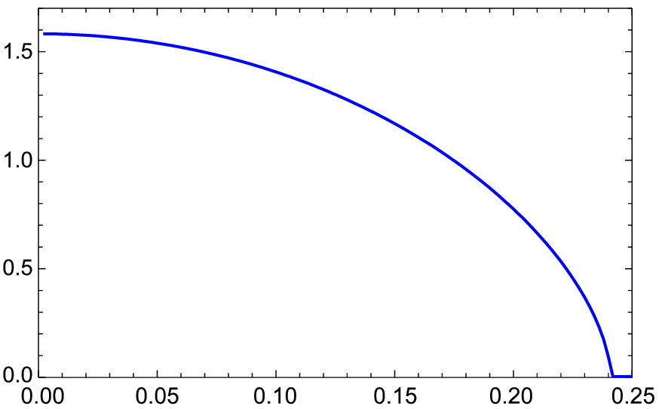
Mean-field analysis
On-site repulsion:
Introduce bosonic field
(local spin polarization)
Mean field: antiferromagnetic (Neel) order
e.g.) On the cubic lattice:
T=0
(t: hopping amplitude)
Integrate out the fermionic d.o.f.s:
Continuous
Discrete
a_{τ}→0: Mott insulator (Dirac mass generation)
2a_{τ}t

Slide 10
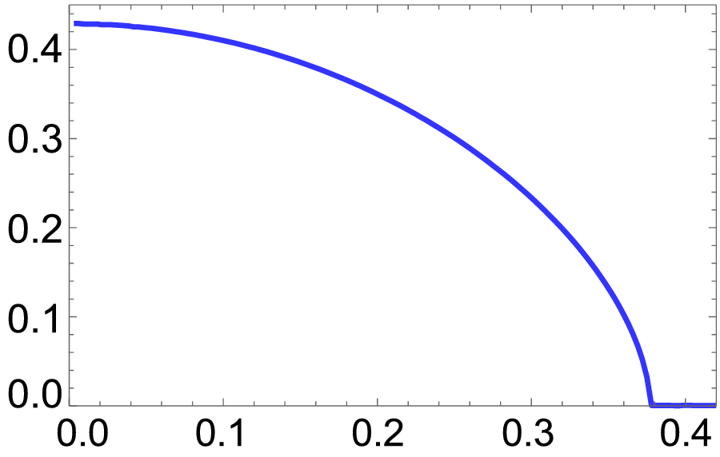
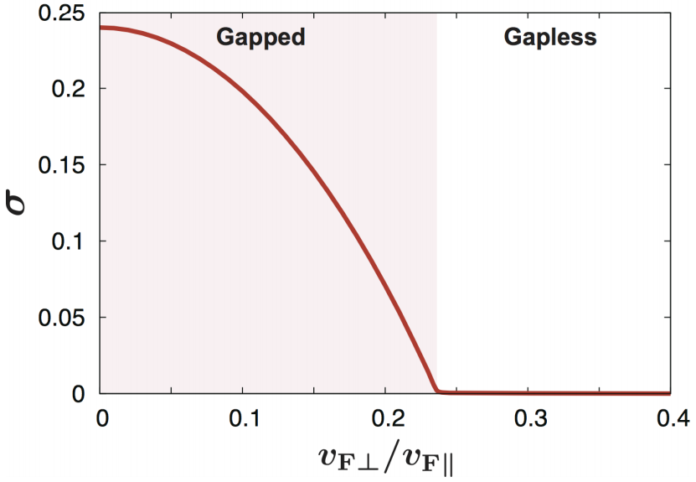
Dimensionality dependence
Introduce anisotropy in the hopping amplitude: t_{z}/t⊥ = ν
ν = 1: 3D cubic symmetry
e.g.) Na₃Bi: ν ~ 0.25
ν = 0: stacked 2D (e.g. graphene)
Observe the 3D-2D crossover at finite a_{τ} ~ O(a).
2a_{τ}t⊥ = 0.3, T = 0
t⊥
t_{z}
2D
3D
ν = t_{z}/t⊥
Consistent with previous calculation with hypothetical staggered fermion.
Sekine & Nomura, PRB 90, 075137 (2014)

Slide 11
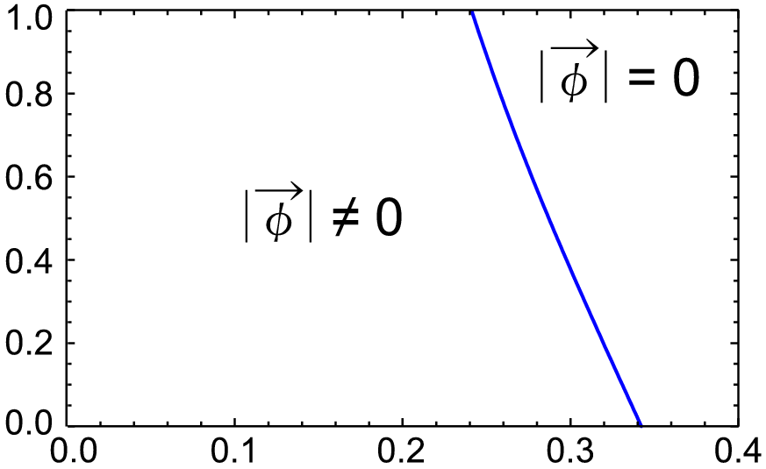
“Phase diagram”
Continuous time
Discrete time
3D
(T=0)
Dirac semimetal
ν = t_{z}/t⊥
Mott insulator (antiferromagnet)
2D
2a_{τ}t⊥
Finite a_{τ} ~ O(a): consistent with the “staggered fermion” results.
a_{τ} → 0 limit: local charge neutrality (Mott insulator) is required.
- connected by a_{τ}-dependent formalism.

Slide 12
Summary
Defined the lattice action for 3D Dirac semimetals,
imaginary time discretization a_{τ}
including
“background charge” field b
In the strong coupling limit (g_{R}⁻² = 0) of Coulomb interaction,
infinitely large on-site (Hubbard) repulsion for a_{τ}→0
Local charge neutrality is required. = Mott insulator.
Mean-field analysis for finite a_{τ} ~ O(a):
reproduces the analysis with hypothetical staggered fermion.
Necessary to connect finite a_{τ} analysis to a_{τ}→0 limit.
Away from the strong coupling limit...
consistency with RG analysis from weak coupling / RPA?
Include other novel topological phases...
Weyl semimetal, topological insulator, axionic insulator, ...

Slide 14
Many-body effects?
Dirac semimetals

