Slide 1
Sterile Neutrino Search
Jose Alonso
MIT

Slide 2
Outline
Neutrino Oscillation Physics
Anomalies
Indications for Sterile Neutrinos?
IsoDAR at KamLAND
Longer Range Plans

Slide 14
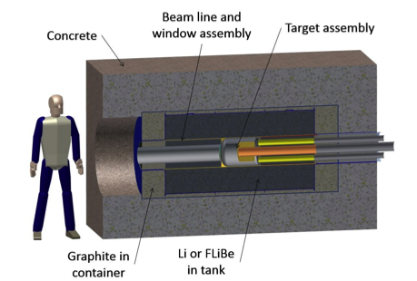
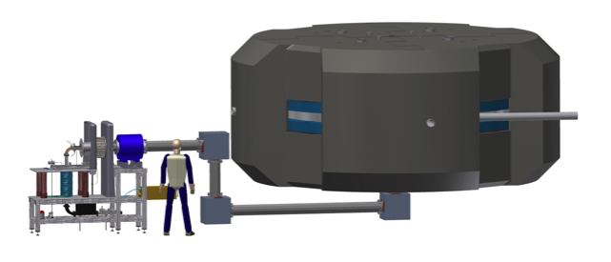
IsoDAR Configuration
60 MeV/amu 5 mA H₂⁺ Cyclotron
⁹Be/⁷Li Target and ν̅_{e} Source

Slide 15
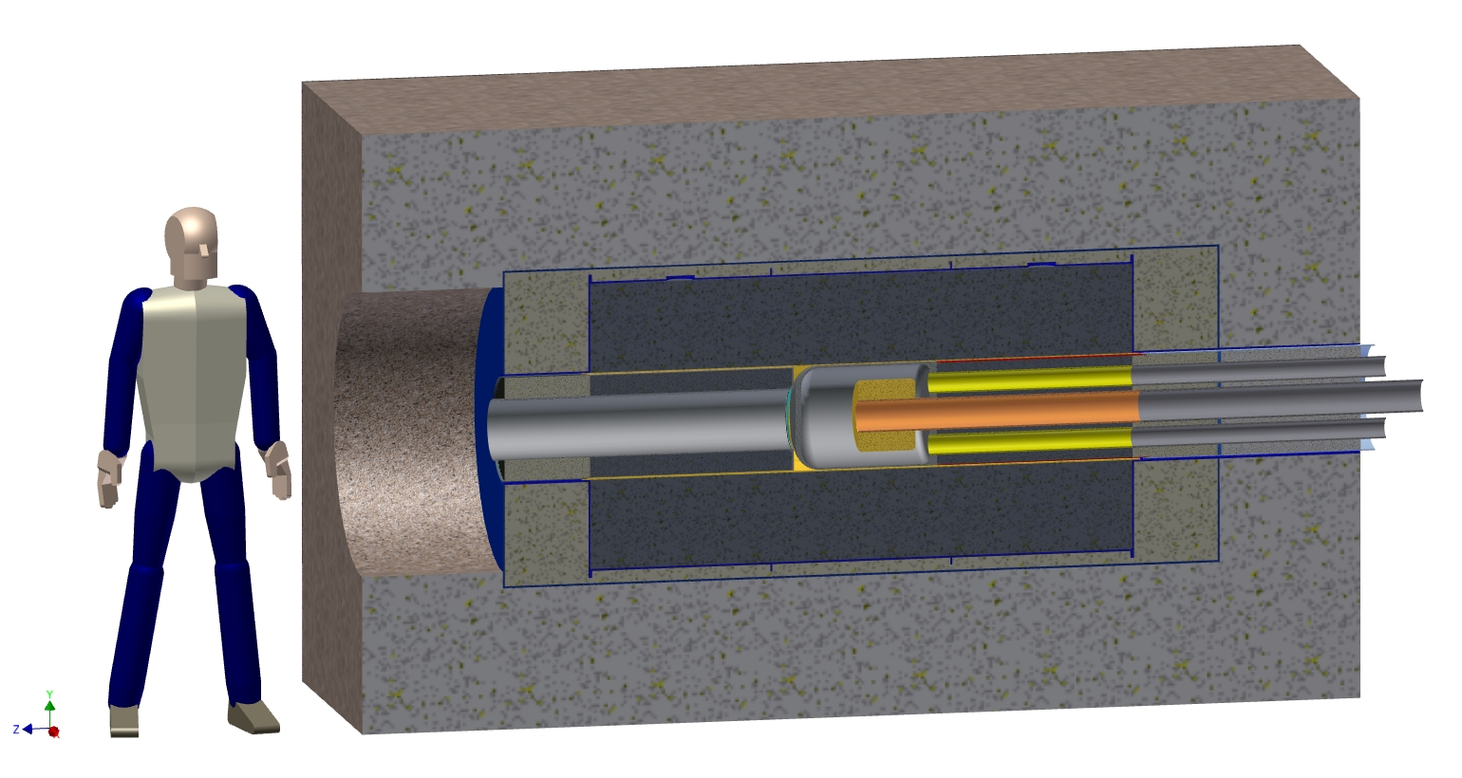
Cross section of the IsoDAR target
Beam line and window assembly
Concrete
Target assembly
⁷Li (FLiBe)
in tank
Graphite in container

Slide 16
IsoDAR Cyclotron
~ 6 meters

Slide 17
Requirements for IsoDAR
10 mA (CW) protons at 60 MeV
Lower current requires longer running time
Scenario and Constraints
H2+ compact cyclotron
H2+ offers lower risk path to highest currents
Lower space-charge forces
Conventional (septum electrostatic) extraction
Preserve H2+ ions for future uses

Slide 18
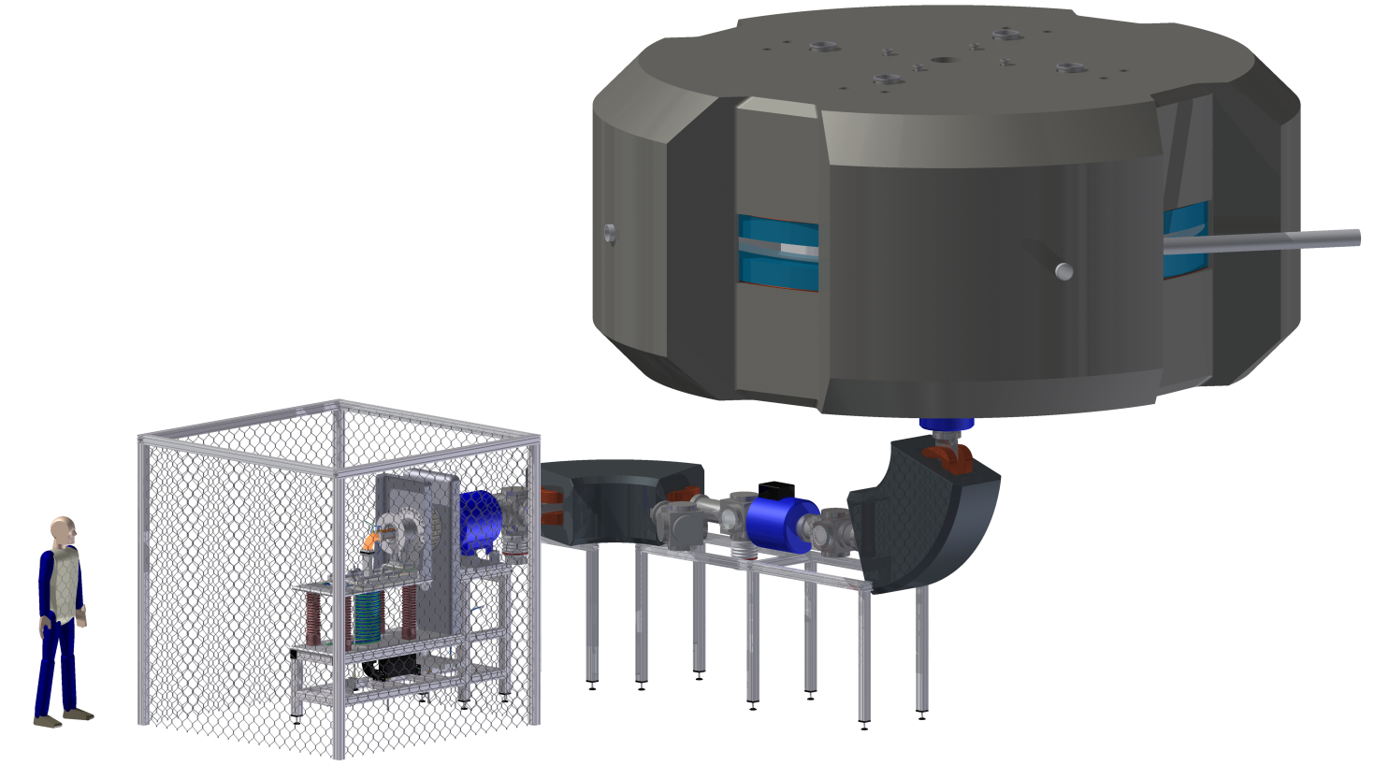
Injection
Conventional LEBT
Requires high-current source of H2+
Requires effective separation of protons from H2+

Slide 19
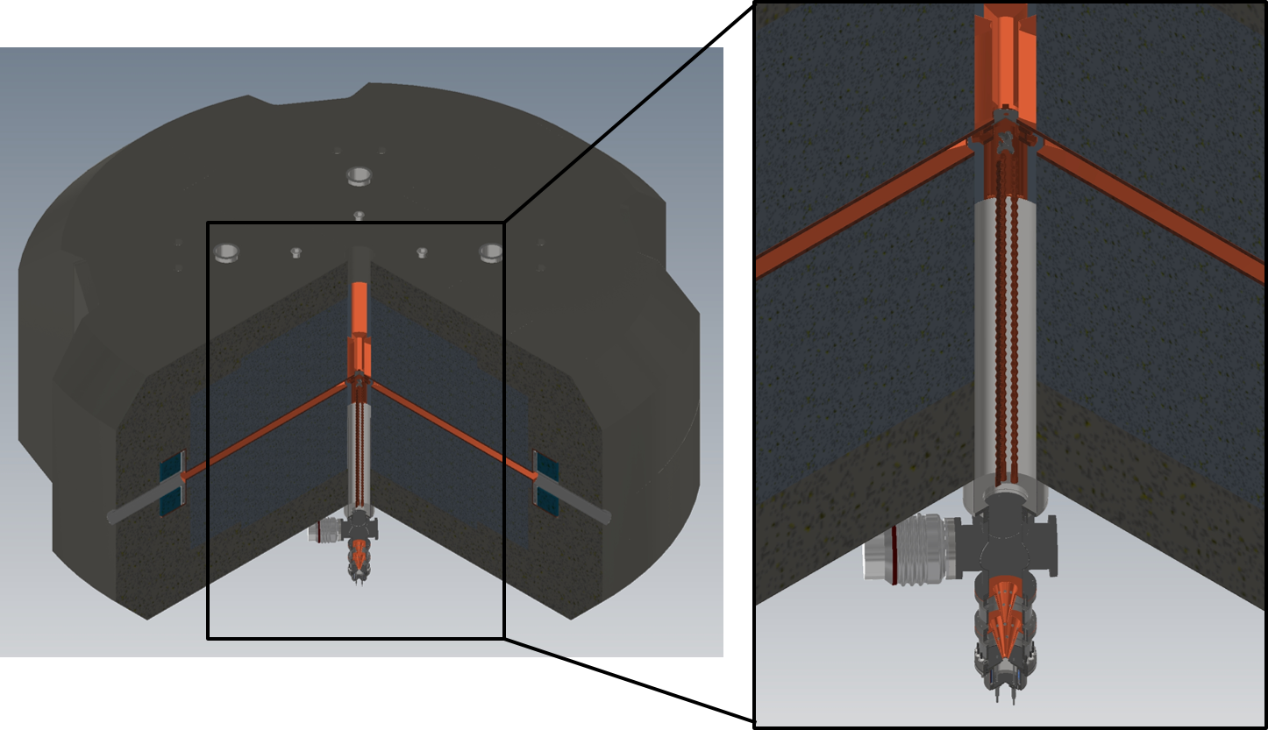
Injection
RFQ buncher (~80% efficiency)
Conventional sources adequate
Very compact
Must be very close to spiral inflector to prevent debunching

Slide 20
Extraction
Use conventional septum extraction
Preserve H2+ ions
IsoDAR cyclotron design will be the injection stage for the DAEδALUS project

Slide 22
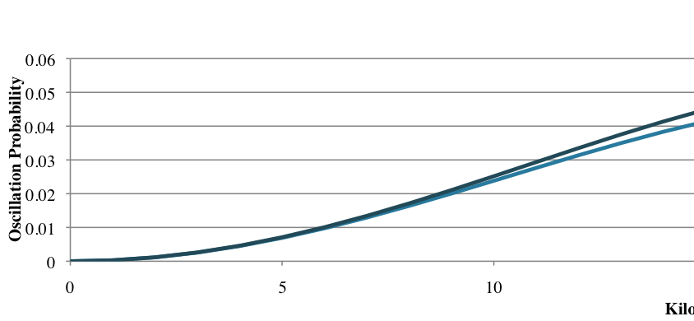
DAEδALUS (Decay At rest Experiment for δ_{CP} At Laboratory for Underground Science)
Three identical accelerator/target stations at different distances
CP violation experiment based on ν̅_{e} appearance
Very high sensitivity, especially when coupled with long-baseline beam in same detector (e.g. T2HK)
~4%

Slide 23
DAEδALUS Concept
DSRC
DIC

Slide 25
Backup slides

Slide 26
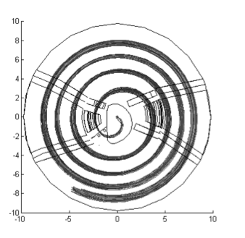
Extraction Channel
_
Extraction Process
+
GND
“Septum”
4) Avoid beam losses on the
electrostatic extraction septum
(protecting with a stripper foil,
removing 50 μA of beam)

Slide 27
Extraction Channel
_
Extraction Process
+
GND
Nth turn

Slide 28
Extraction Channel
_
Extraction Process
+
GND
ΔE
(N+1)th turn

Slide 29
Extraction Process
~0.02% intercepted
on septum
“Problem”
(120 W max)

Slide 30
Extraction Process
Notice protons
cross the
cyclotron
to exit!
That’s ok!
Protons
stripper foil
H₂⁺

