Slide 1
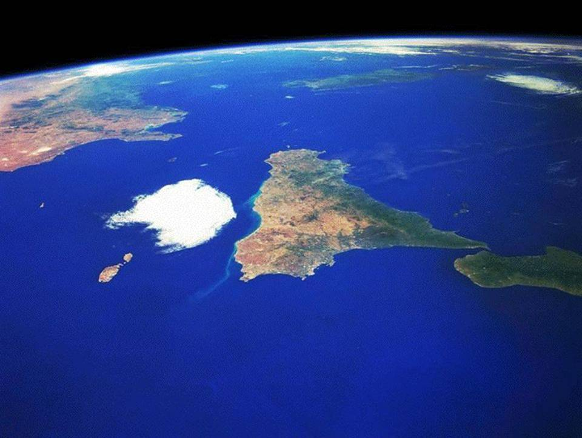

The IsoDAR Cyclotron
…or a compact cyclotron to accelerate
H₂⁺, Deuteron^{+,-} and fully stripped light ions
Luciano Calabretta,
INFN-LNS, Catania, Italy

Slide 2
Accelerator Requirements
IsoDAR
  Energy: Efficient production of neutrons in beryllium target (desired reaction is ⁷Li(n,γ)⁸Li)
  40÷80 MeV
  Beam species: beam on target: protons or deuterons
  Beam intensity: calculated to provide statistics in 5 year experiment – 10 mA
  Time structure: No timing requirements, so want greatest possible on-time (for statistics)

Slide 3
Problems to deliver10 mA proton with Cyclotrons:
- Injection
Central region: space-charge blowup
  Energy is low (~ 30 ÷ 80 keV)
  Current is high (~ x5 higher than today values)
  Electrostatic forces hard to contain
High “Perveance” value:
  (measure of space-charge forces)
  K ∝ I (q/m) (βγ)⁻³

Slide 4
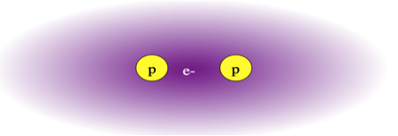
Proposed solution:
Acceleration of H₂⁺ ions
to produce
high intensity proton beam
Two protons for every ion (1 emA = 2 pmA).
  The Generalized Perveance measures the space charge effect and it is defined by the Reiser’s formula:
Perveance of 5 emA H₂⁺ at 35 keV/amu same as 2 emA of 30 keV protons
axial injection of 2 emA protons at 30 keV is an upper limit
Extraction with stripping foil may be is feasible. It requires a high-acceptance extraction channel but not a clean turn separation.
May be there is a problem with the life time of stripper foil

Slide 5
Regarding space charge acceleration of D⁺ ions
is similar to accelerate H₂⁺
D⁻
e-
D⁺
p+ n
1 Deuteron for every ion.
e-
  The Generalized Perveance measures the space charge effect and it is defined by the Reiser’s formula:
Perveance of 1 emA D⁺ or D⁻ at 35 keV/amu same as 0.4 emA of 30 keV protons
axial injection of 2 emA protons at 30 keV is an upper limit
Use of D⁺ is convenient to minimize the beam losses along the acceleration and due to interaction with the residual gas!
Use of D⁻ is convenient for the extraction! But vacuum problems!
A Cyclotron for H₂⁺ is usable for D⁺ and also for D⁻

Slide 6
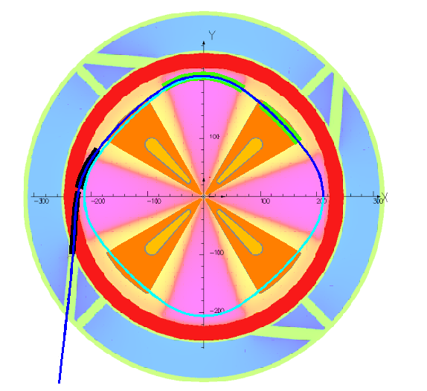
This is one of the two coils of ISODAR
Electrostatic Deflectors
extraction trajectory for H₂⁺ or D⁺
Despite we extract just one beam,
Anyway 4 extraction channel are drilled in the iron yoke to maintain the symmetry of the magnetic field!
The RF Cavity in this layout have an angular width of 30°, in the final project could be larger, about 40÷44°,
MC1
MC2
RF Cavity
Equilibrium Orbit

Slide 7
DAEδALUS Injector Cyclotron: Peak current 5 mA H₂⁺ , <I>= 1mA
E_{inj} | 35 AkeV | E_{max} | 61.7 AMeV
B₀ | 1.075 T | <B> at R_{ext} | 1.166 T
<R_{inj}> | 51.58 mm | <R_{ext}> | 2000 mm
N. Sectors | 4 | Hill width | 25.5° ÷ 36.5°
Valley gap | 1800 mm | Hill gap | 100 mm
Diameter | 6240 mm | Full height | 2700 mm
N. Cavities | 4 | Cavities λ/2 | Double gap
RF Harmonic | 4th | RF frequency | 32.8 MHz
Acc. Voltage | 70 ÷ 250 kV | Power/cavity | <160 kW
Coil size | 200x250 mm² | Current density | 3.17 A/mm²
up to 44°!
Equilibrium Orbit
IsoDAR cyclotron
Ipeak= <I> =5 mA H₂⁺
arXiv.org > physics > arXiv:1207.4895

Slide 8
Beam Extraction of H₂⁺ from IsoDar Cyclotron by stripper
is not convenient because the beam size is larger than > 10 mm!
Electrons are the main source of stripper damage. In fact, 600 kW beam @ 60 AMeV on a stripper foil 0.2 mg/cm² thick means < 4 W due to nuclear interaction, while the electrons removed by the strippers have a full power of 600 kW*M_{e}/M_{H2}=600/(2*1826)=164 W !
Electrons have to be stopped before they strike the stripper!
For D- beam with maximum current of 1 mA, maximum power on the stripper foil is about 66 W!
It is anyway quite high!
For acceleration of D- the main drawback is the beam losses during acceleration and activation of the cyclotron!
H₂⁺ beam
If B=0.4 T R_{e}=4.5 mm
Stripper foil
Center of Cyclotron
emerging
protons
electrons
catcher
Notes:
Break
Comunque, a parita di energia di fascio incidente ed a parita di protoni estratti diciamo 100 protoni estratti, nel caso di H2+ abbiamo strippato 50 elettroni, mentre nel caso di H- ne abbiamo strippato 200! é l'energia degli elettroni che danneggia primariamente lo stripper. Un'altra considerazione per sapere quanto vale l'energia degli elettroni strippati. Per un fascio di 100 MeV di H- l'energia di ciascun elettrone strippato è di 1/2000 quindi di 50 keV, pertanto l'energia dei due elettroni strippati è di 100 keV. Nel caso di H2+ da 100 MeV/amu (protoni finali sempre da 100 MeV), l'energia dell'elettrone strippato è ancora di 50 keV, ma a fronte di estrarre due protoni da 100 MeV. In potenza se estraiamo un fascio di protoni da 100 kW accelerati con H-, la potenza degli elettroni strippati è di 100W, mentre se lo abbiamo accelerato con H2+ la potenza degli elettroni strippati è di solo 25 W!

Slide 9
Beam Extraction of D⁻ from IsoDar Cyclotron by stripper
seems feasible!
But I don’t like D⁻ for the beam losses during acceleration!
Electrons are the main source of stripper damage. In fact, 120 kW beam @ 60 AMeV 1 mA on a stripper foil 0.2 mg/cm² thick means < 0.2 W due to nuclear interaction, while the electrons removed by stripper have a full power of 120 kW*2M_{e}/M_{H2}=120/(1826)=66 W !
stripping process for H₂⁺:
H₂⁺ =(p+p+e) → p, p, e
is a one step process:
stripping process for H-:
H⁻ =(p+e+e) → p, e, e
is a two steps process:
(p+e+e)→ H + e → p, e, e
stripping process for D⁻ :
D⁻ =(D+e+e) → D⁺ , e, e
is a two steps process:
(D⁺ +e+e)→ D, e → D⁺, e, e
Notes:
Break
Comunque, a parita di energia di fascio incidente ed a parita di protoni estratti diciamo 100 protoni estratti, nel caso di H2+ abbiamo strippato 50 elettroni, mentre nel caso di H- ne abbiamo strippato 200! é l'energia degli elettroni che danneggia primariamente lo stripper. Un'altra considerazione per sapere quanto vale l'energia degli elettroni strippati. Per un fascio di 100 MeV di H- l'energia di ciascun elettrone strippato è di 1/2000 quindi di 50 keV, pertanto l'energia dei due elettroni strippati è di 100 keV. Nel caso di H2+ da 100 MeV/amu (protoni finali sempre da 100 MeV), l'energia dell'elettrone strippato è ancora di 50 keV, ma a fronte di estrarre due protoni da 100 MeV. In potenza se estraiamo un fascio di protoni da 100 kW accelerati con H-, la potenza degli elettroni strippati è di 100W, mentre se lo abbiamo accelerato con H2+ la potenza degli elettroni strippati è di solo 25 W!

Slide 10
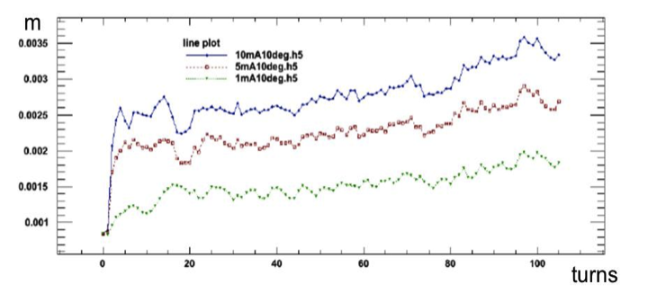
Beam dynamics in DAEδALUS Injector Cyclotron
Simulation made by J. Yang and A. Adelman @ PSI, using OPAL code.
rms
61.7 MeV/n
1 MeV/n
Beam size rms
Vertical beam size vs. turns number for different beam currents
Beam size acceptable! Initial normalized emittance is 0.6 π mm.mrad!
Realistic normalized beam emittance inside the cyclotron 1 π mm.mrad.

Slide 11
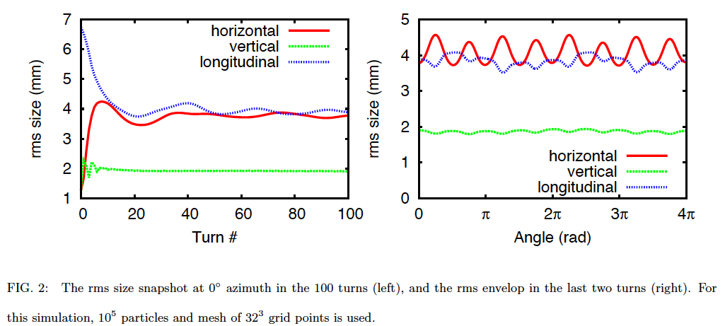
Rms Beam size along the acceleration path (on the left)
and rms beam size along the last two turns (on the rigth)
The first turn start at 1 AMeV
The first turn start at 1 AMeV and the rms normalized emittance in both radial and vertical plane was 0.6 π mm.mrad
The phase acceptance and the energy spread are ±10° RF and ±0.2%

Slide 12
Inter-turn separation vs. <R> just due to RF cavity acceleration!
A first harmonic precession is able to increase the inter-turn separation at extraction radius up to 20 mm!
E=40
AMeV
E=60
AMeV

Slide 13
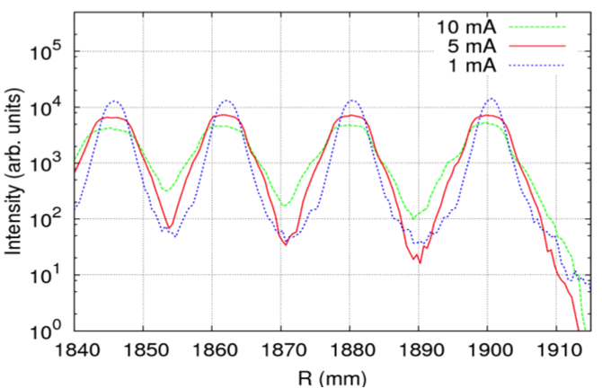
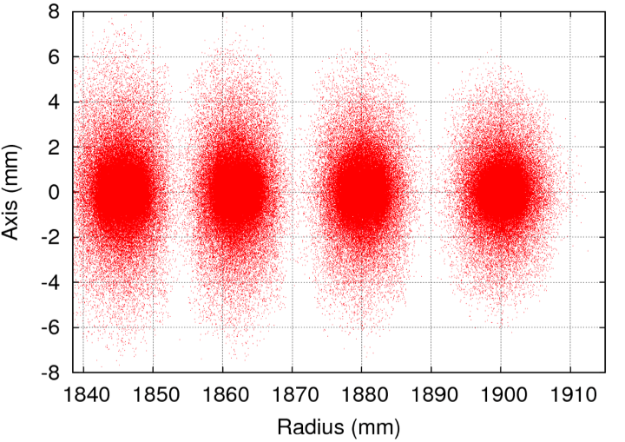
Beam dynamics in DAEδALUS Injector Cyclotron
Beam injection
Deflector septum
0.5 mm width
Be careful! The rms beam size could be misleading!
Extraction efficiency 99.98%, if beam power is 600 kW on the septum 120 W!
14 mm
20 mm

Slide 14
E=40 AMeV → <R>=163 cm ; E=60 AMeV → <R>=199 cm
<R> [cm]

Slide 15
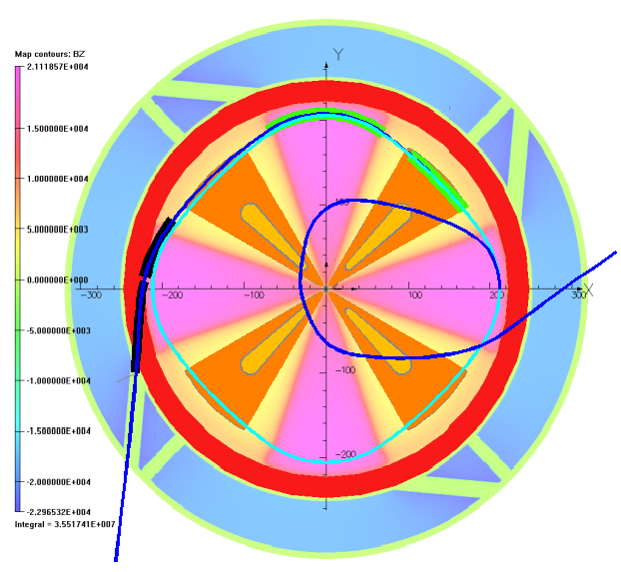
Extraction process for H2+
Safe!
Stripper at Teta=0°
If stripper position is between -65° and -10 °
spiral code is not able to evaluate the trajectory and beam envelope. Simulation made with OPERA
The vertical beam halo is ±10 cm, at this point

Slide 16
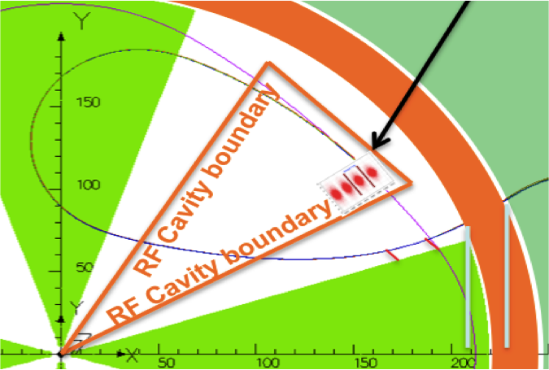

Slide 17
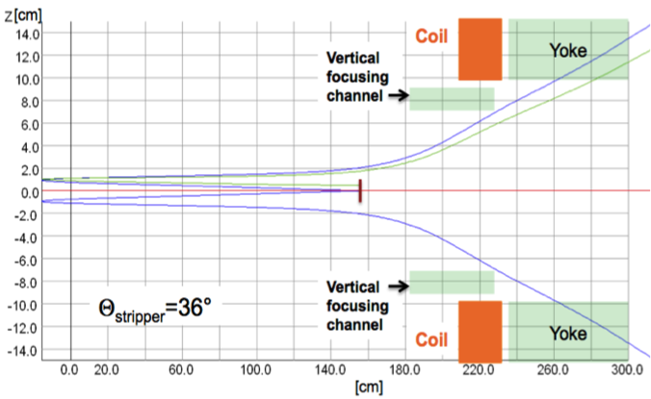
May be also for D+ beam could be possible to protect the deflector septum.
May be the beam envelope of the removed halo could be also smaller in vertical, but we need to perform additional simulation.

Slide 19
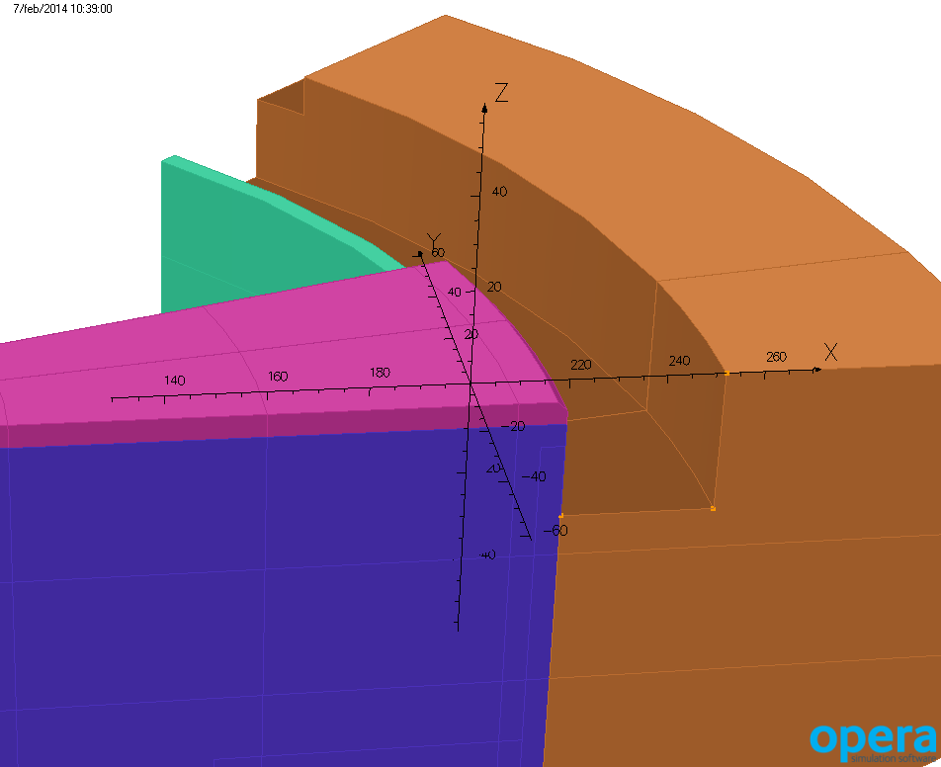
Outer radius of pole → 220 cm
Inner radius of yoke → 252 cm
Inner radis of coil → 225 cm
Outer radius of coil →250 cm
Distance yoke surface below the coil from median plane →31 cm
Coil distance from median plane → 10.5 cm.
skirt valley
yoke
hill upper part
Cyclotron Center
252 cm
31 cm
220 cm
hill

Slide 20
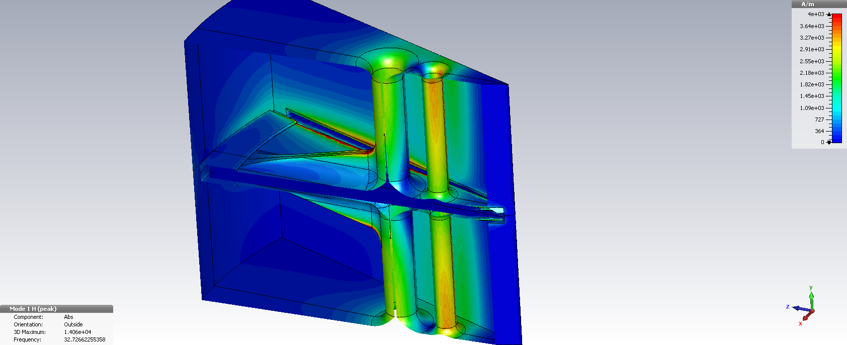
RF Cavity shape and surface H field
Courtesy by Michel Abs

Slide 21
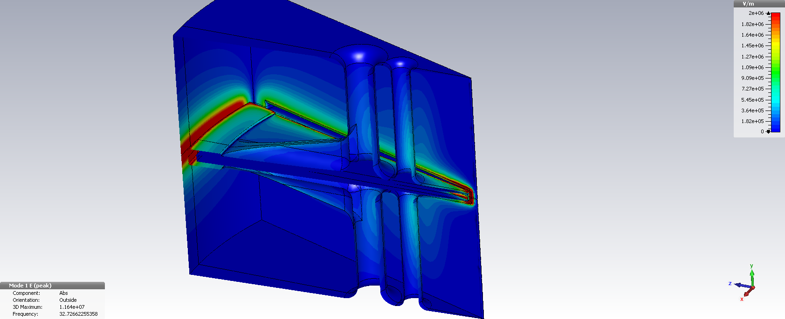
E field
Courtesy by Michel Abs

Slide 22
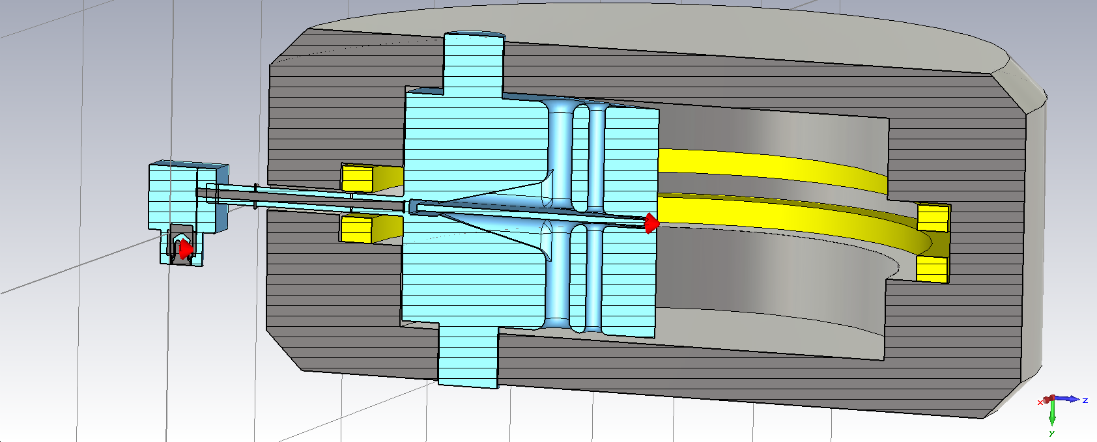
Coupling to the cavity
It is proposed to couple the power in the median plane via a quarter wave resonant line
The voltage on the RF tube is independent of the load (beam loading)
No fine tuning is needed on the amp side (reactive currents flow to the cavity)
Leaves the bottom of the cyclotron free to place ion source and vacuum pumps.
Clearly the cheapest option

Slide 23
Dee voltage law vs radius
Scaling Voltage up to 240 kV
Power increase up to 160 kW.
Beam loading per cavity 150kW
Courtesy by Michel Abs

Slide 24
Main mechanical parameters
Cavity height: 1800mm
Radial extension: 2100mm
Liner angular aperture: 38°
Dee angle: 34°
Inner Dee vertical gap: 50mm (100mm in the outer radius for deflector location)
Dee plate thickness: 20mm
Dee stems dia.(4/ Dee)= 200/120mm
Dee stiffener: 50mm width
46°
42°
Courtesy by Michel Abs

Slide 25
Electrical parameters
Unloaded Q= 9540 (theoretical)
Main mode resonance frequency: 32.7MHz
Hmax: 6900A/m
Surface resistance: 1.53mOhms
Max surface dissipation: 3.6W/cm²
Courtesy by Michel Abs

Slide 26
*RF Voltage constant=225 kV → 109 turns
Vacuum is challenging!
Cryogenic panel and/or NEG panel are mandatory!

Slide 27
80
60
40
20
*RF Voltage constant=225 kV → 109 turns
Vacuum is challenging!
Cryogenic panel and/or NEG panel are mandatory!

Slide 28
80
60
40
20
*RF Voltage constant=225 kV → 109 turns
Vacuum is not serious!

Slide 29
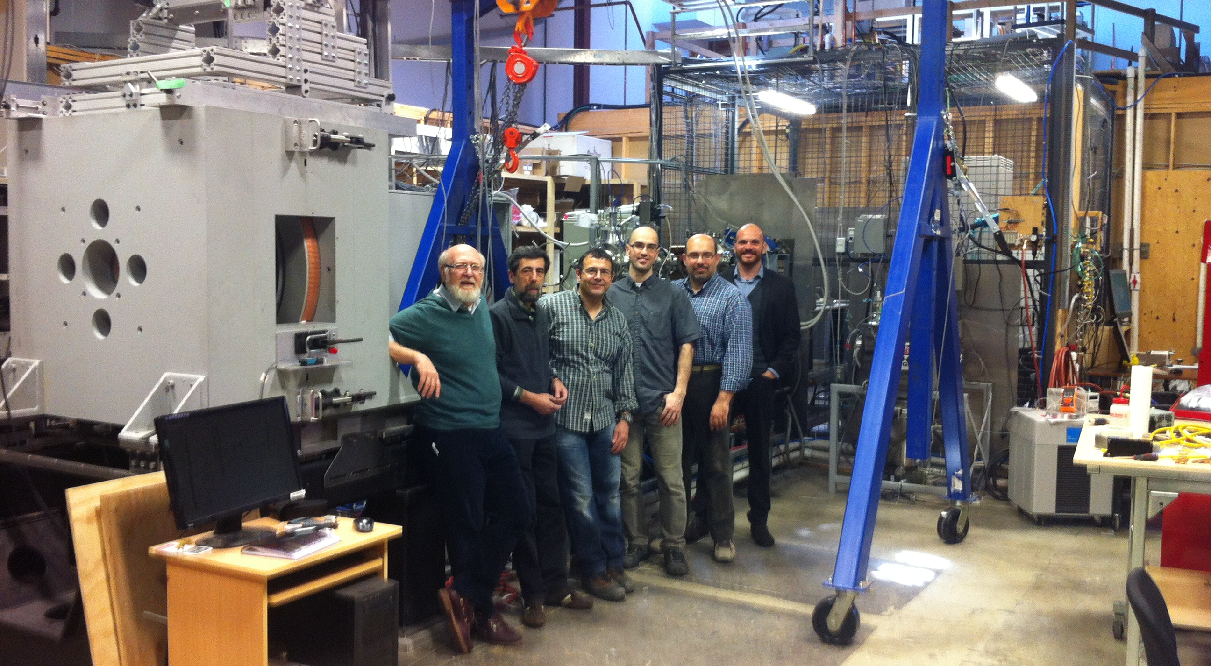
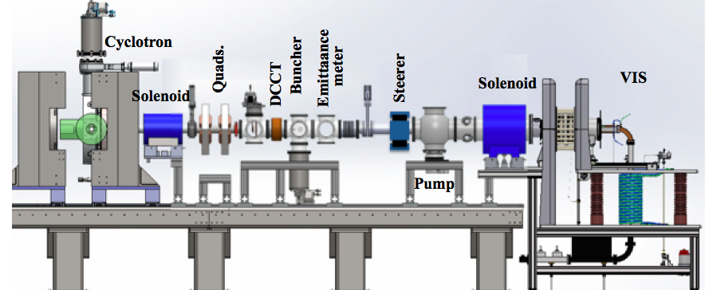
Ion Source,
Injection Tests
How much H₂⁺ can we get from a proton source? (VIS Catania)
How much can we capture in central region?
Tests performed at Best Cyclotron Systems development Lab, Vancouver BC, Summer 2014
Beam Stop

Slide 30
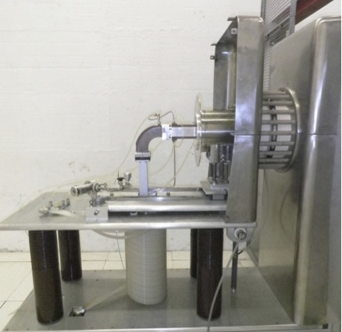
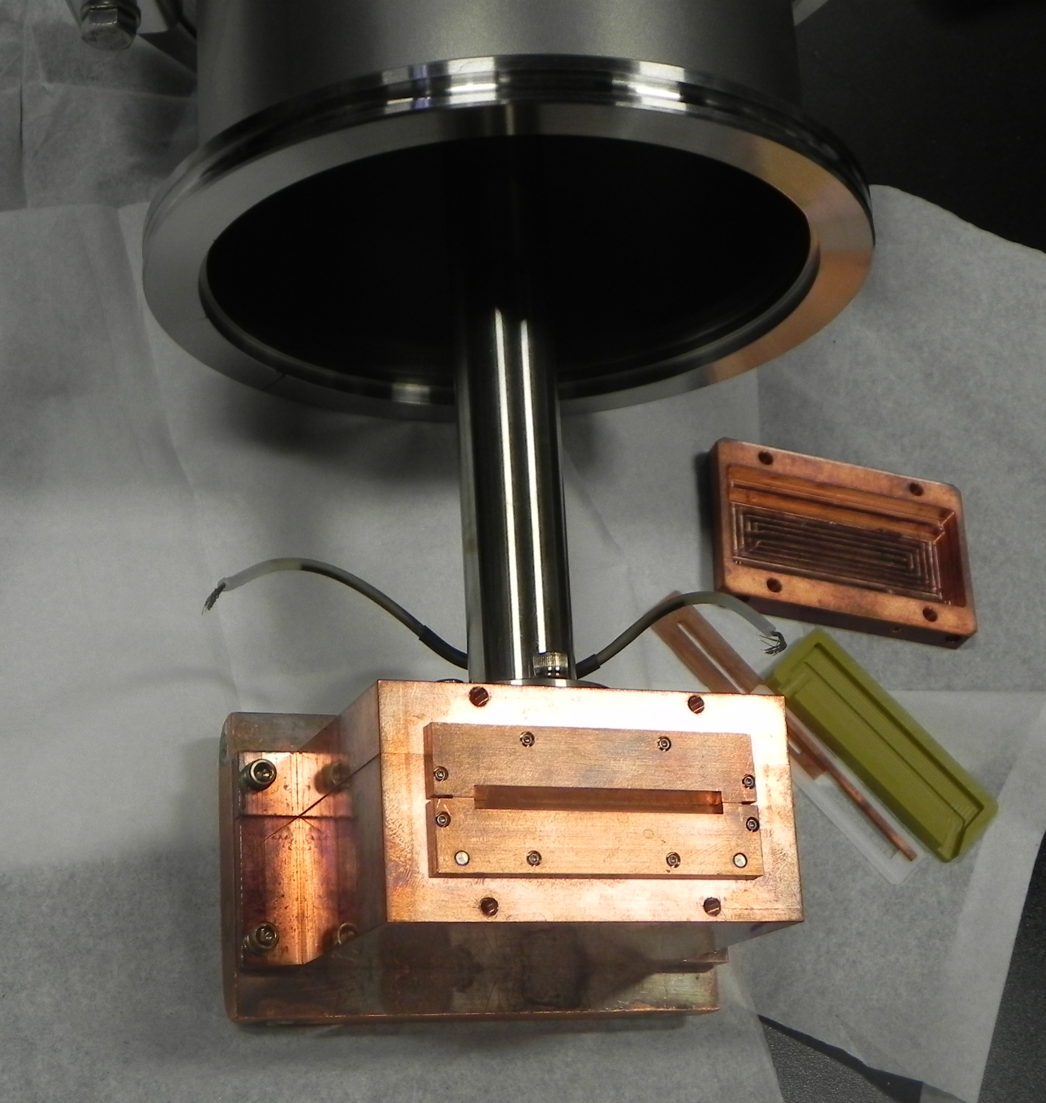
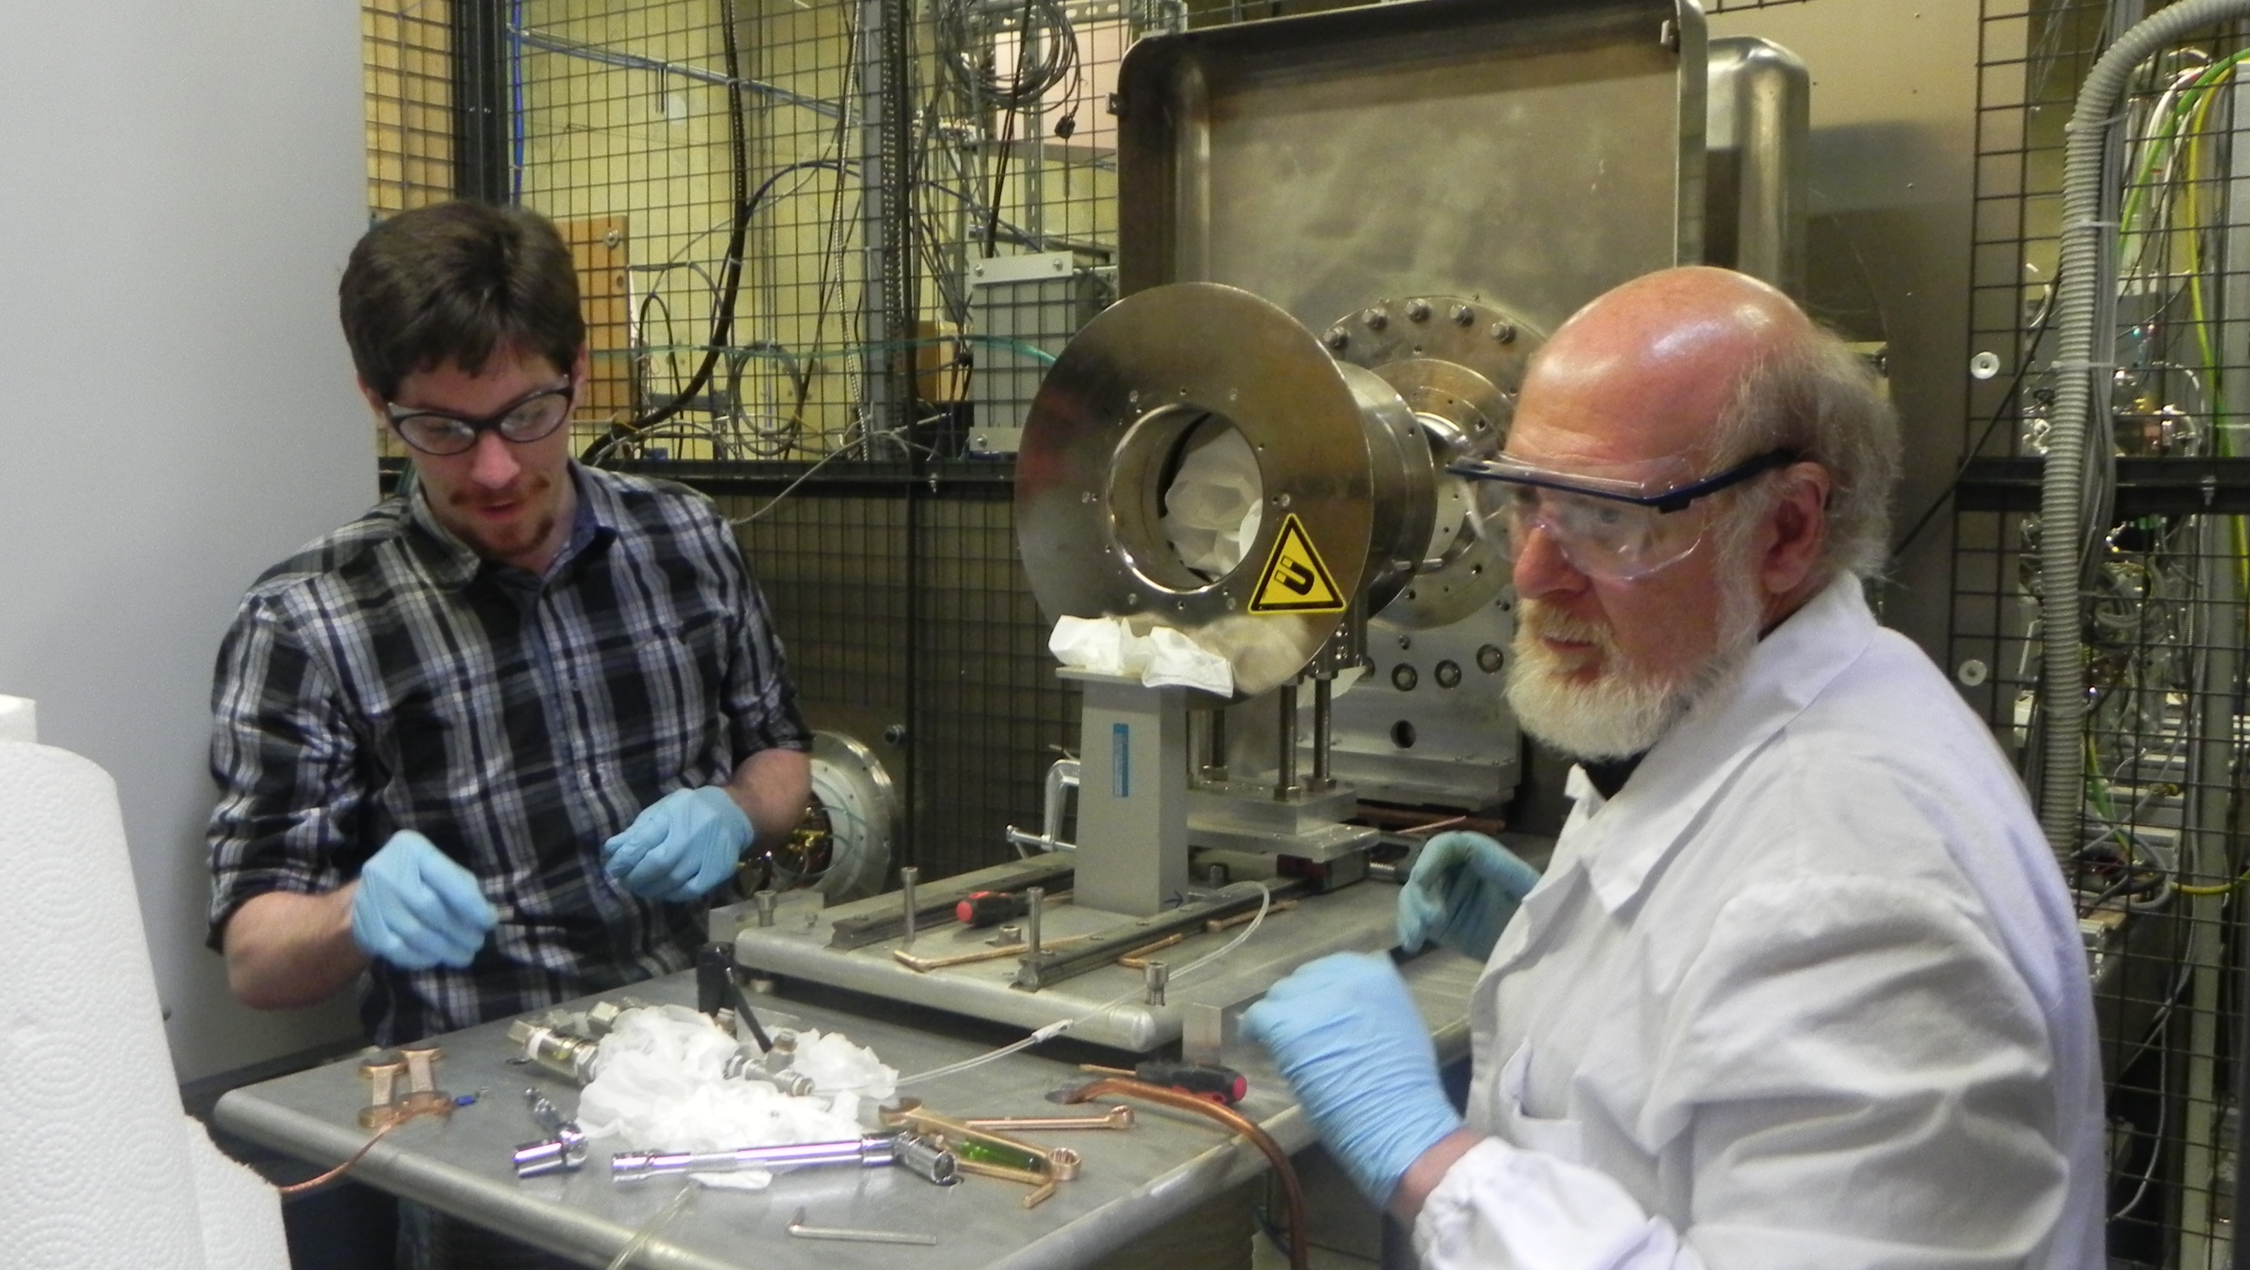
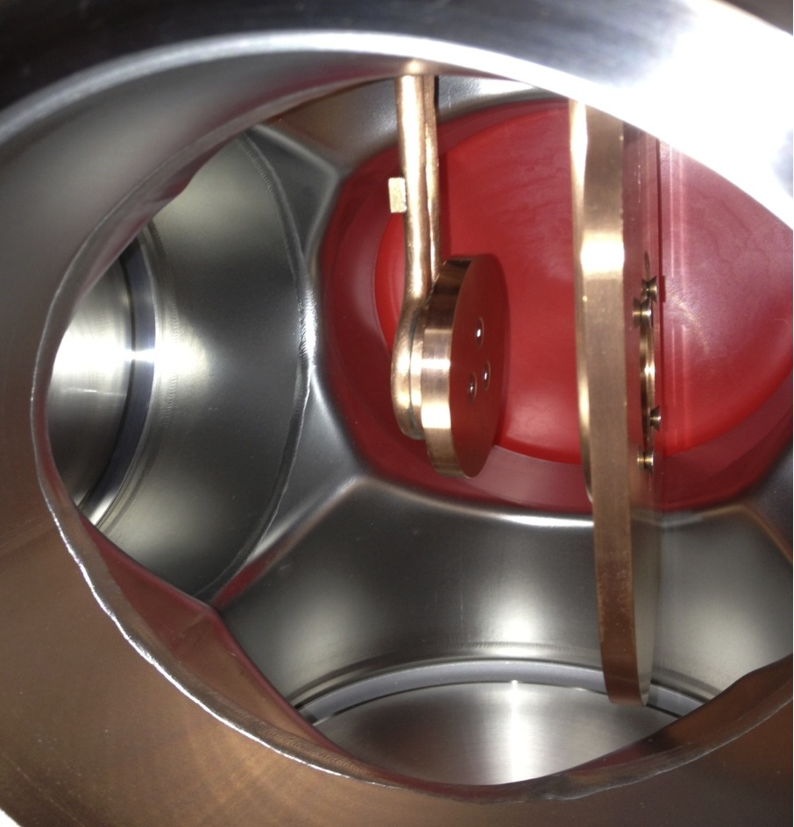
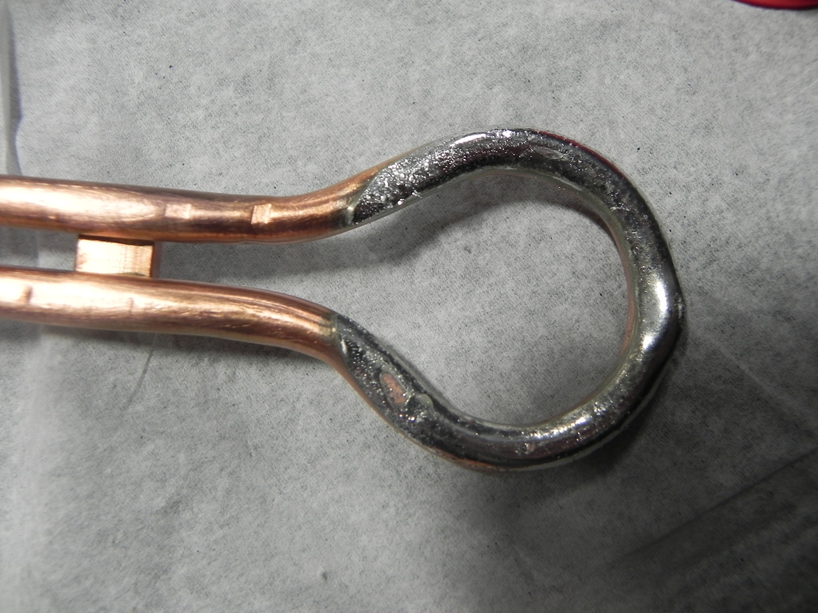
VIS Source
Allison emittance scanner collimator, beamstop

Slide 31
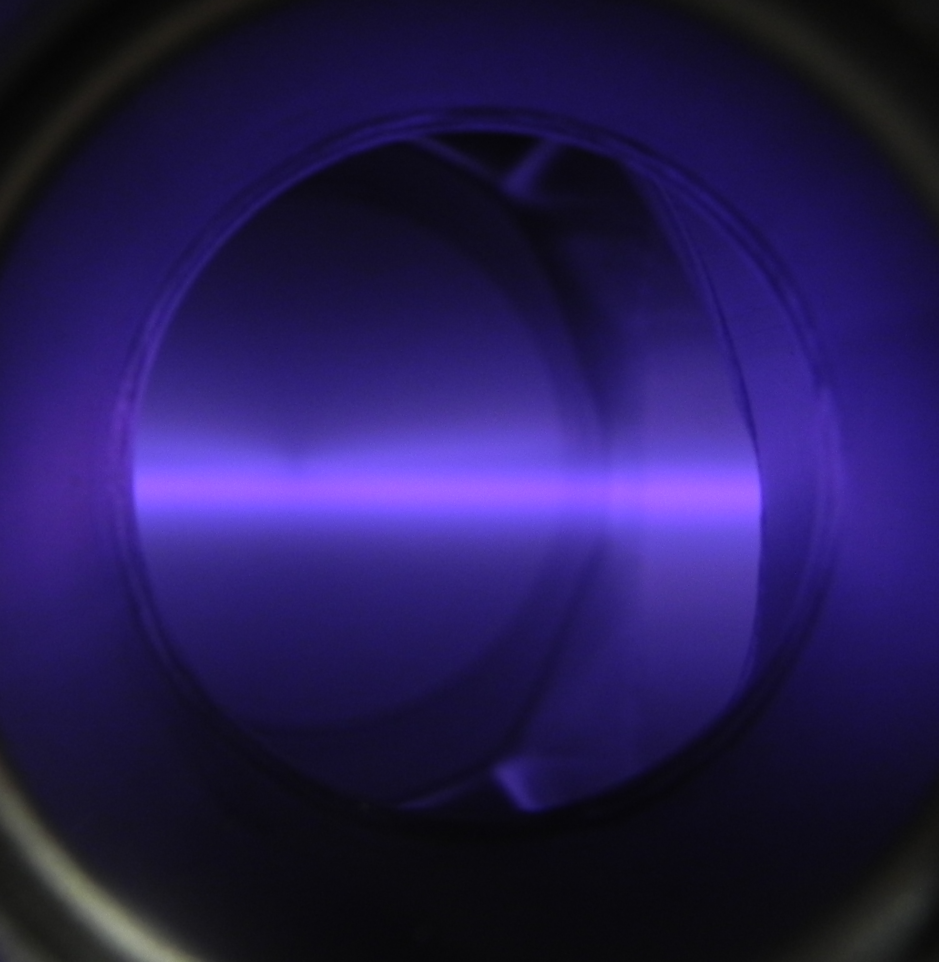
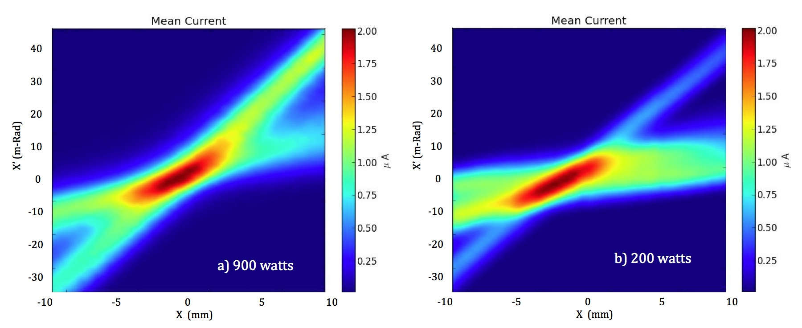
Observations

Slide 32
Summary of tests at BEST site in Vancouver
Transport maximum 10 mA of H2+ to cyclotron, focus beam at entrance to spiral inflector.
  Size: 8 mm (2-rms)
  Emittance: 1.2 π-mm-mrad (4-rms, normalized, 86% of beam)
Transport 95% of beam through spiral inflector
Accelerate 100 µA for four turns in test cyclotron, but RF Voltage <60 kV
Conclusion: Have good simulation tools in hand
Conclusion: Need more current.
How? Either better source or higher bunching efficiency
Pursue both:
  Build new ion source (multicusp)
  Develop RFQ direct cyclotron injection design

Slide 33
Results to Date
√ Characterize VIS source for H₂⁺
- Max current : 12 mA… we need much more!
  - Emittance : ~ Twice larger than expected
√ Test beam line for separation of protons/H₂⁺~OK
Inflection/capture in test cyclotron :
  RF Voltage <60 kV, instead of the 70 kV required!

Slide 34
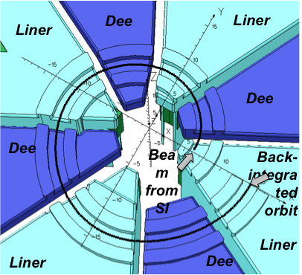
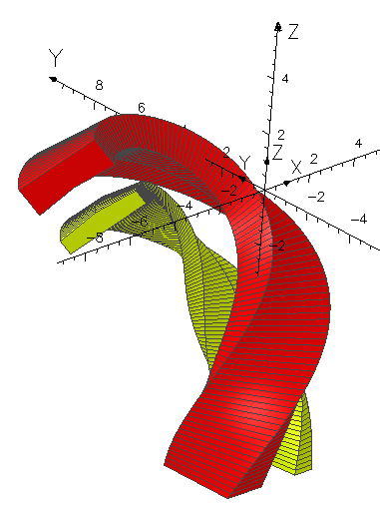
The main difference between the Test site used in Vancouver and IsoDAR cyclotron is the number of RF cavities ( 4 for IsoDAR instead of 2 in the test site) and the Harmonic mode (4th for IsoDAR instead of 6th for the test stand). The injection energy was 60 keV!
The test of the spiral inflector (15 mm gap) demonstrate that it works with +/-10 kV, when a 60 keV H2+ is injected!
Inflector tested up to +/-13.5 kV reliable!
It will be possible to inject H2+ with energy of 75-80 keV.
In this way the emittance should reduce of a factor 12-15%!

Slide 35
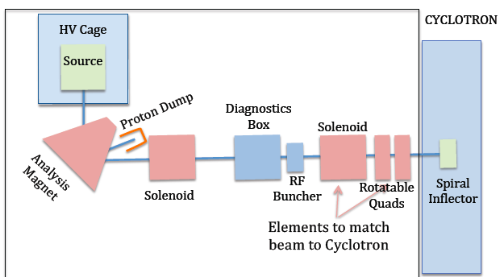
The new injection beam line for H2+, including a RF buncher
Will be build by MIT

Slide 36
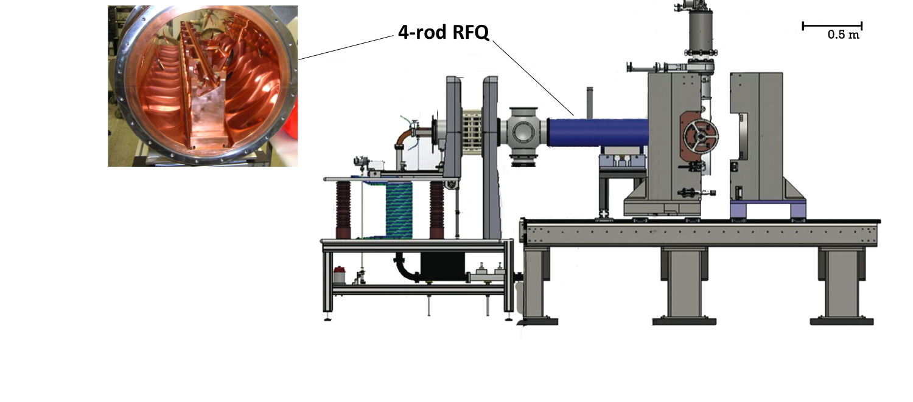
Alternative option to deliver H2+ >30 mA:
RFQ in Test Beam Line

Slide 37
What have we learned?
Existing Ion source for H₂⁺ stay in the territory 15-30 mA;
Is convenient to work with Bunching Gain Efficiency as high as possible;
ISODAR has an acceptance phase double than PSI injector 2;
With H2+ source delivering 30 mA, a bunching efficiency >3 is convenient;
The use of Isodar cyclotron to delyver 1 mA D+ beam is feasible
For a maximum energy of 40 AMeV the extraction radius should stay at 1.63 m, 15% smaller than IsoDAR cyclotron;
Many problem of IsoDAR cyclotron are relaxed!

Slide 38
The use of Isodar cyclotron to delyver 1 mA D+ beam is feasible
For a maximum energy of 40 AMeV the extraction radius should stay at 1.63 m, 15% smaller than IsoDAR cyclotron;
Many problem of IsoDAR cyclotron are relaxed!
The main advise to use IsoDAR cyclotron to accelerate Deuteron
concerns the activation of the cyclotron itself
and in particular of the RF Cavities copper made.
May be the activation could be reduced covering all the surfaces of the median plane with 5-10 mm thick graphite layer or Aluminum!
This layer prevent the production of bad radioisotope of cupper.

Slide 39
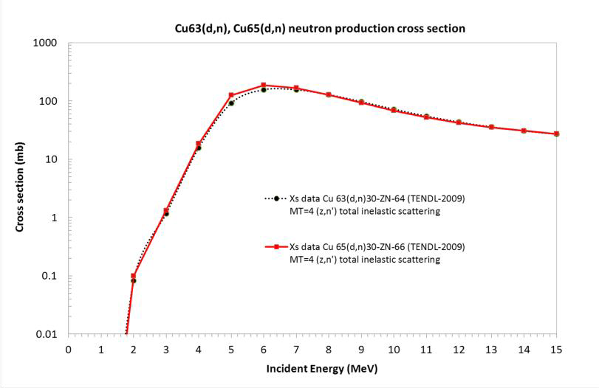
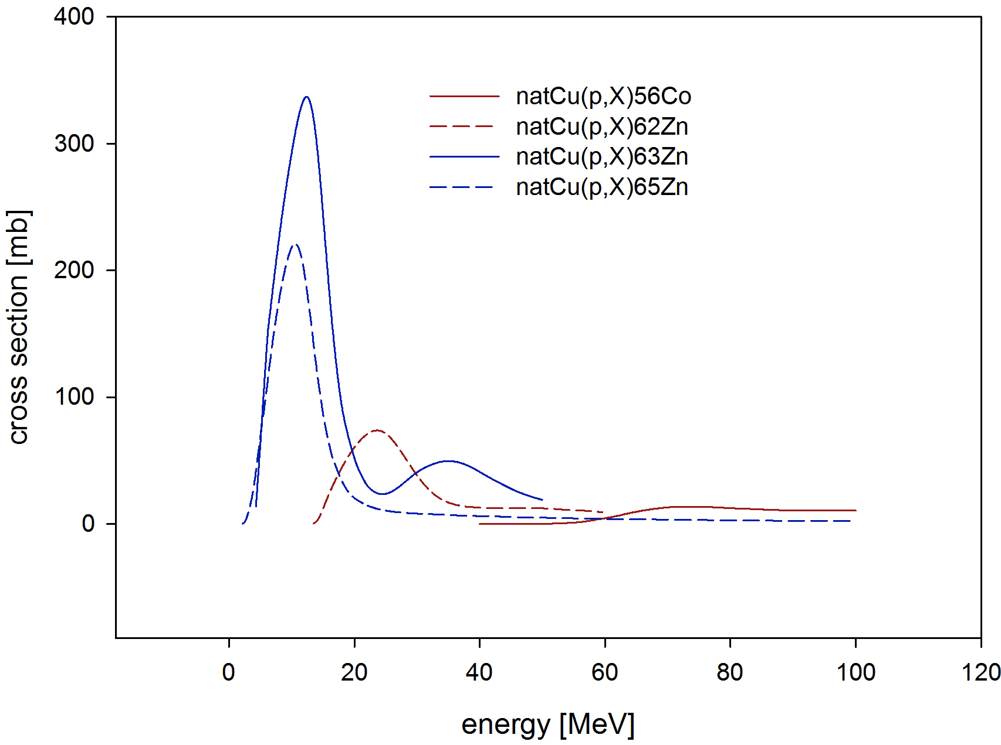
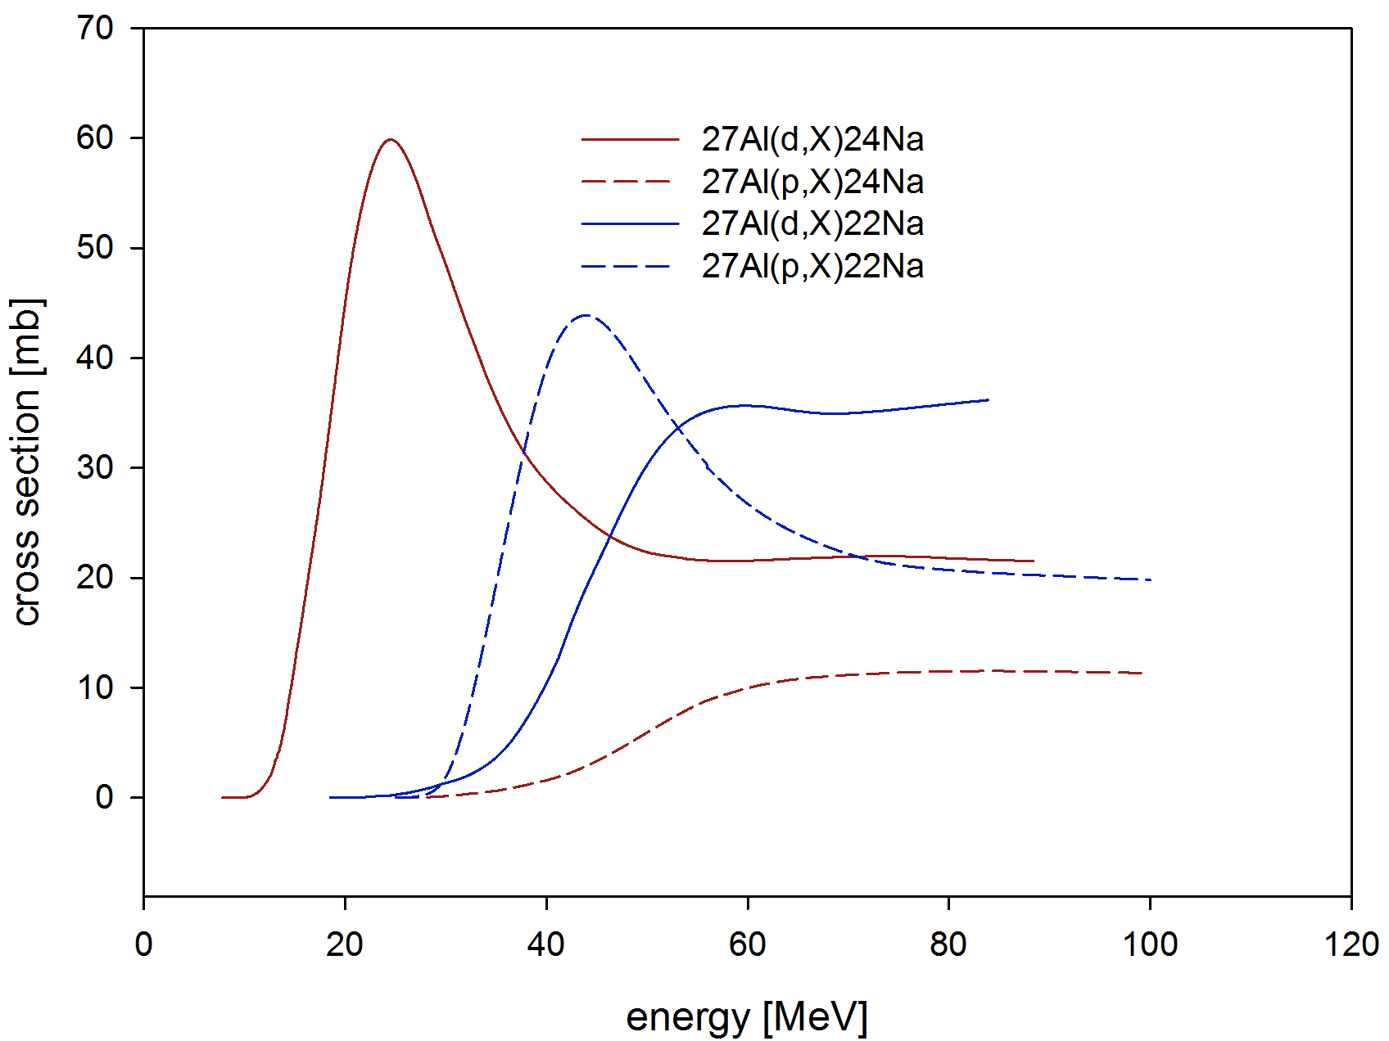

Slide 40
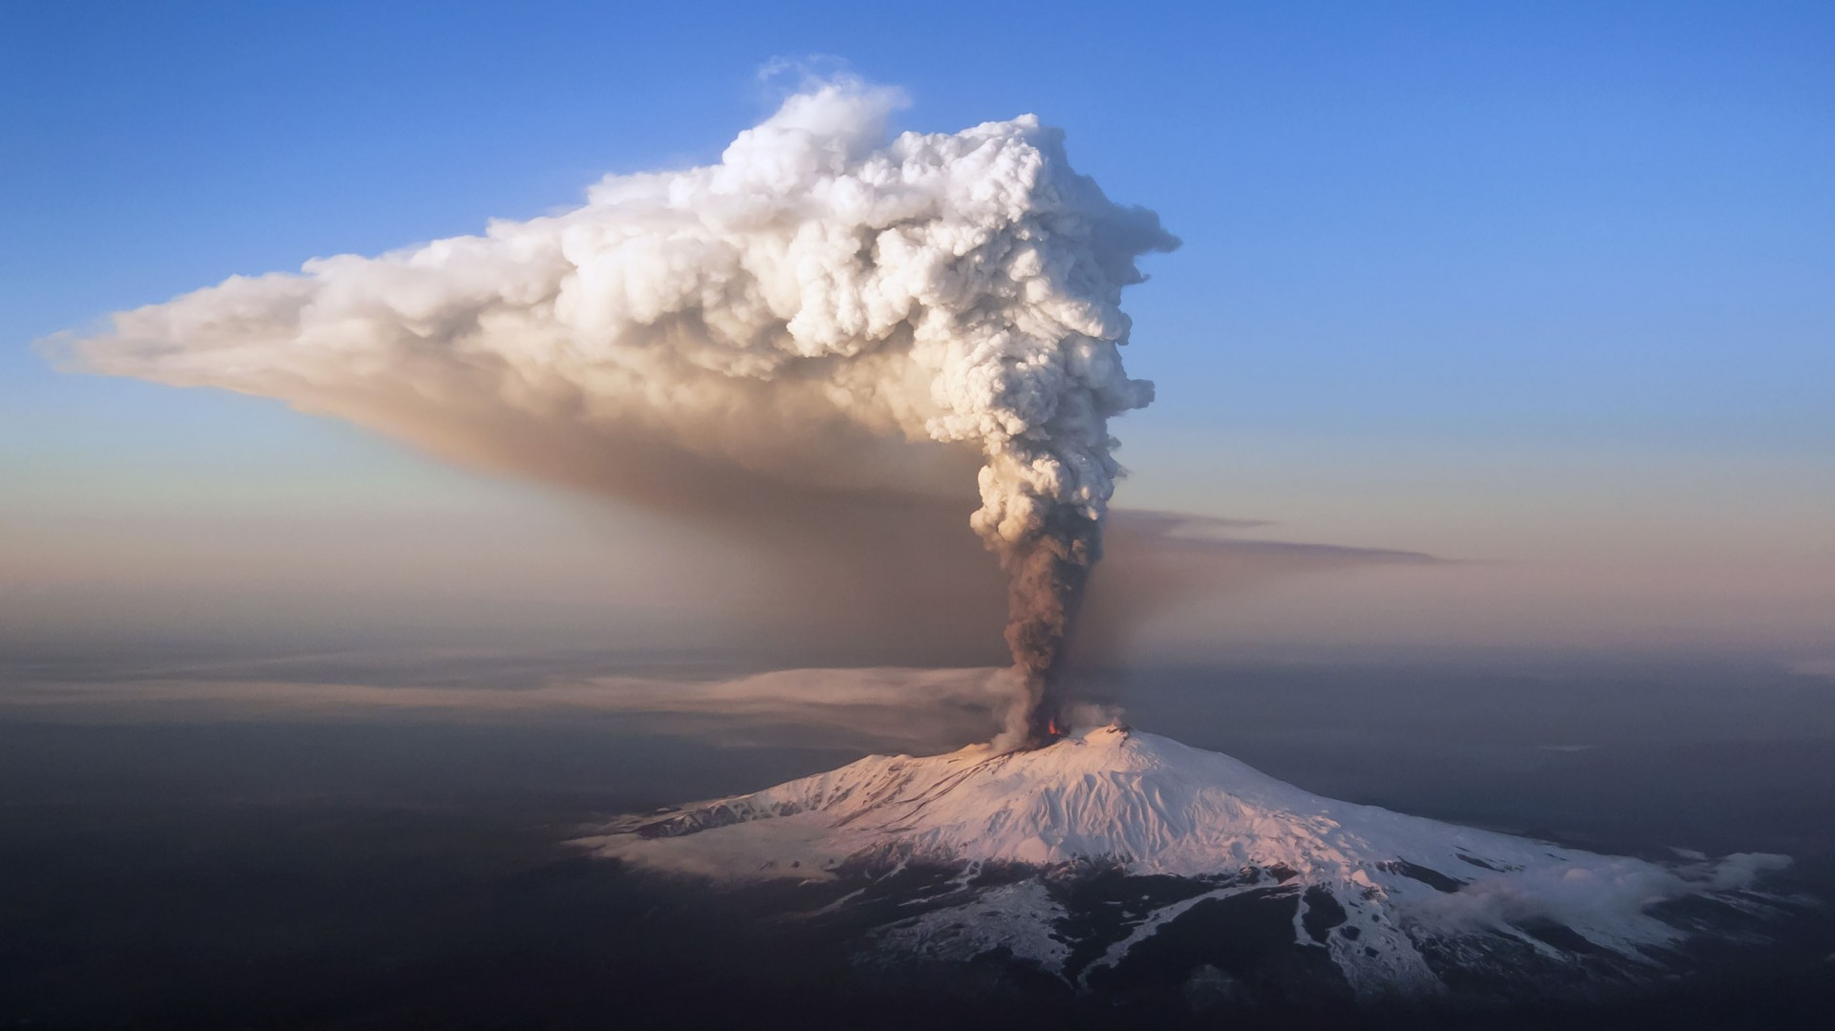
Thanks for your attention!

Slide 41
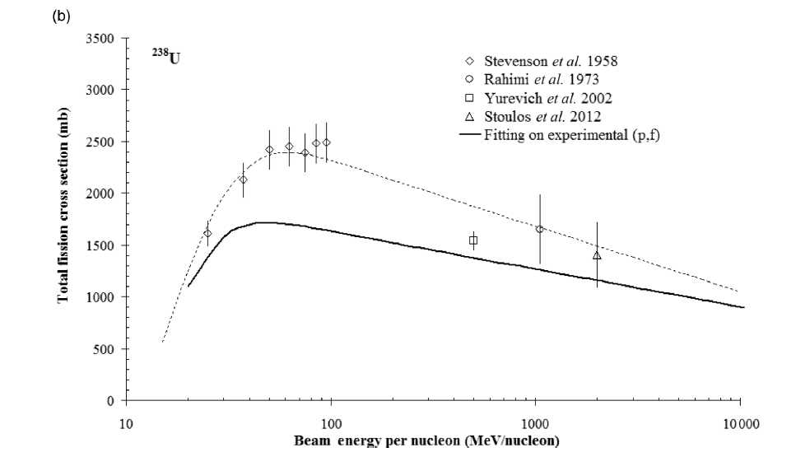
Range of 40 MeV proton in Uranium target →1.85 mm
Range of 40 MeV Deuteron in Uranium target → 1.18 mm
Range of 40 AMeV Deuteron in Uranium target → 3.77 mm
Gain a factor 1.6 due to cross section, + a factor 2 for double range, + a x factor due to the secondary neutron production and the fragments are more neutron rich!
40 AMeV
60 AMeV

Slide 42
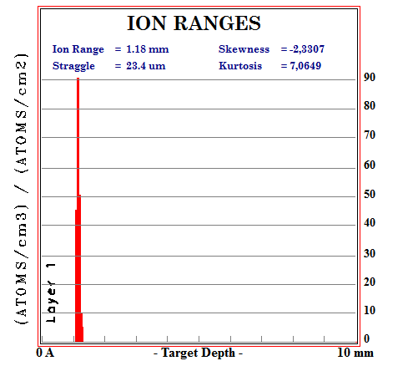
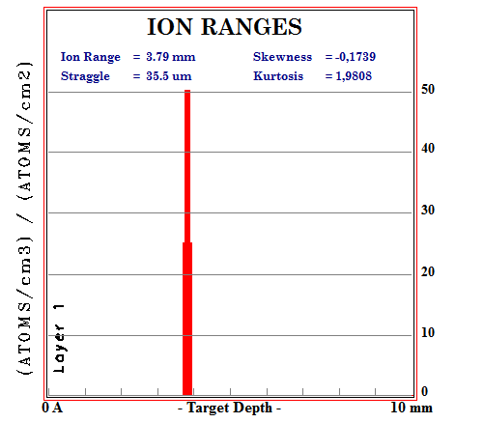
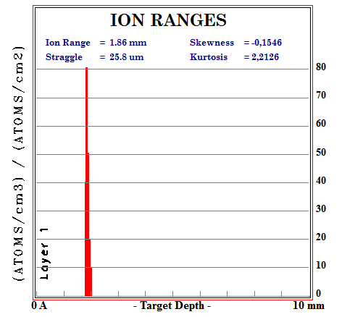
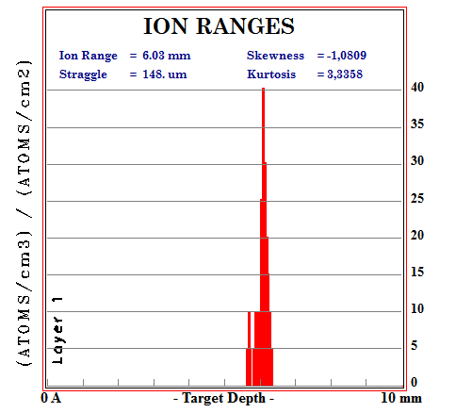
Range 3.77 mm
D @ 40 MeV
D @ 80 MeV
500 microA → 40 kW
Range 1.85 mm
p @ 40 MeV
500 microA → 20 kW
p @ 80 MeV

