Slide 1
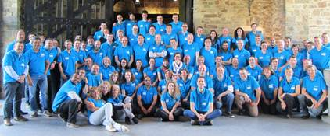
Cyclone 70
IBA Radiopharma’s high energy, high current cyclotron

Slide 2
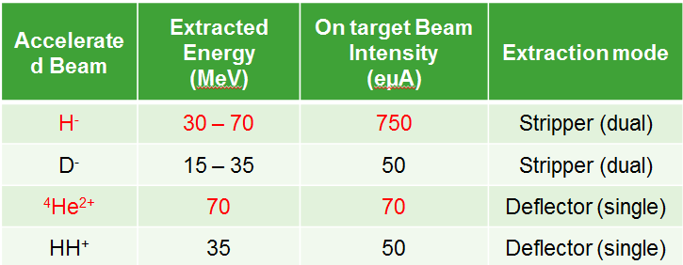
Cyclone 70 = 2 models
Cyclone 70 XP → research + production solution
Proton (H-)
Deutons
Alpha
HH+
Cyclone 70P → production solution (Sr82 production)
Proton only (H-)

Slide 3
Main characteristics of Cyclone 70
Extracted beams ~1.23 T.m
Beam exit | 2 exits | 2 x 3 ports (*)
Cyclotron weight | 145 Tons | On 4 pillars
radius | 1240 (pole) | 1910 mm (overall)
Vacuum system | Cryo pumps | Clean vacuum cyclotron
 | Turbo pumps | Clean vacuum ion source
Electrical load | 60 kW | Stand-by
 | < 250 kW | Full beam /2 Beam lines (%)
(two beam lines) | ~25 kW | Load included in (%)
Cooling load | < 200 kW | Full beam, water chiller
RF
Frequency | 30 (xp) ot 58 (p) MHz
Dee’s voltage | Mean 65 kV
Power - cavity | 22 kW (2 cavities)
Power – full beam | 56 kW (beam load)
NB: loads of details at cyclotrons & ECPM conferences as from 2007

Slide 4
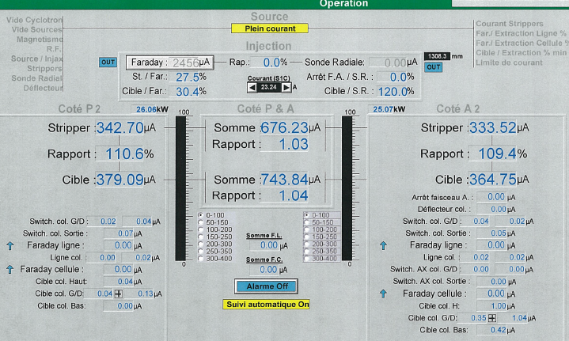
Current status – multi-particle
70 MeV / 750 µA proton - World record established 10/2010

Slide 5
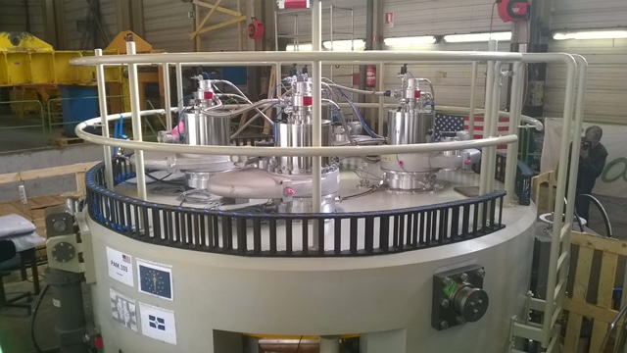
Current status of the proton only
Zevacor project being shipped soon, CDMN under mapping this summer
20 months from order to shipment of 1st Unit

Slide 6
Overview: from source to extraction

Slide 7
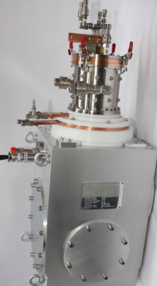
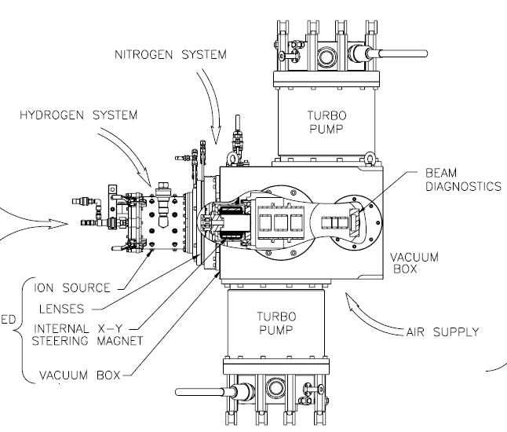
Sources
H-/D- => multicusp ion source from D-pace
q/M=0.5 => supernanogan from Pantechnik
Capacity 10mA H-, superbright emittance
30 kV platform
Easy maintenance (one back plate with 4 filaments)
Differential pumping system for high vaccum level

Slide 8
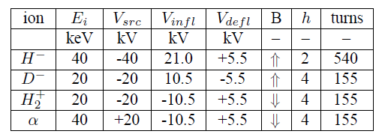
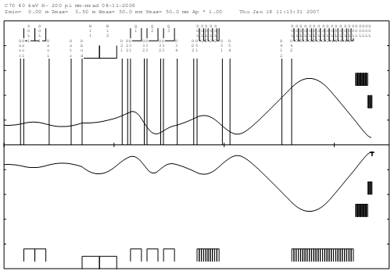
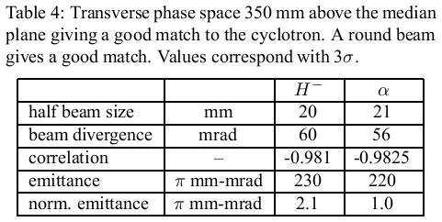
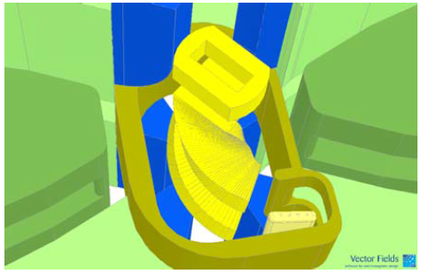
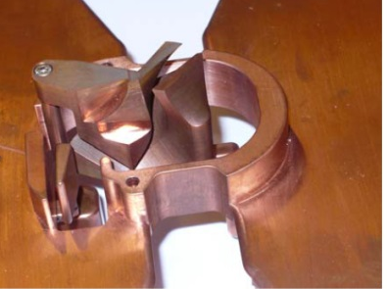
Injection Line overview
Multi-particle machine
Quad triplet
solenoid
solenoid
90°bend
Buncher
solenoid
« good match »: particle accepted for more than 50 turns)
Notes:
Injection efficiency: 10-20%
Acceptance for H- 43-22 pi mm mrad
For He: 23 pi mm mrad

Slide 9
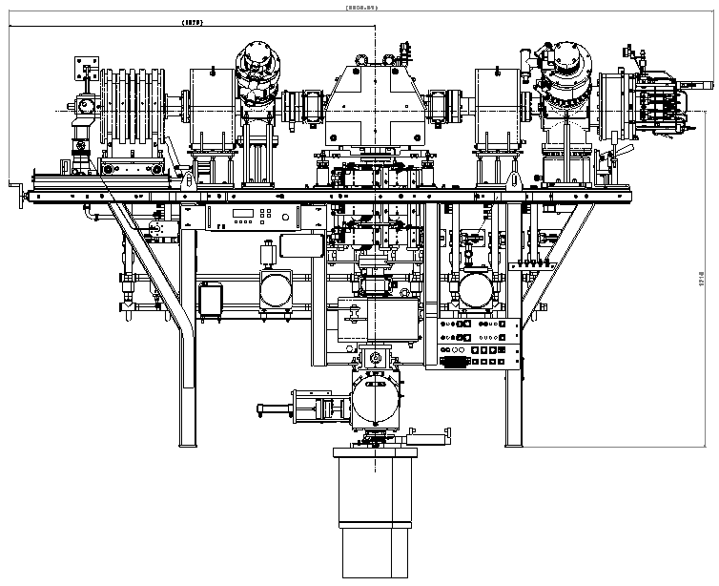
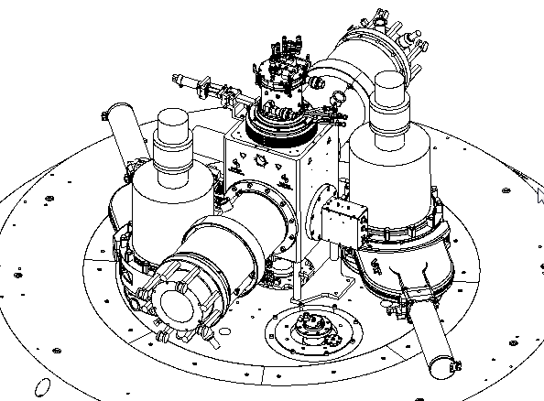
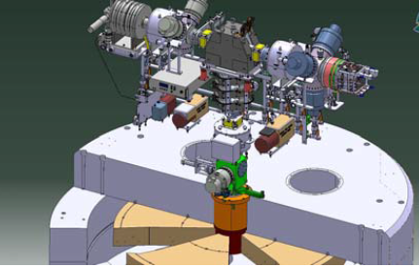
Injection line overview
Proton only: simplified design
H- proton source and injection (same as high current Cyclone 30 HC)

Slide 10
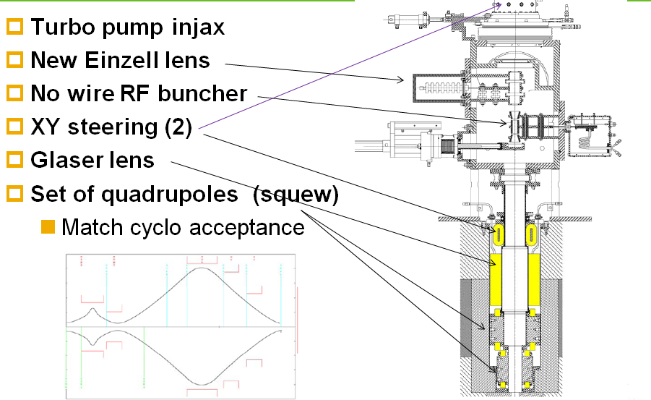
Injection line overview
Proton only, cont’d

Slide 11
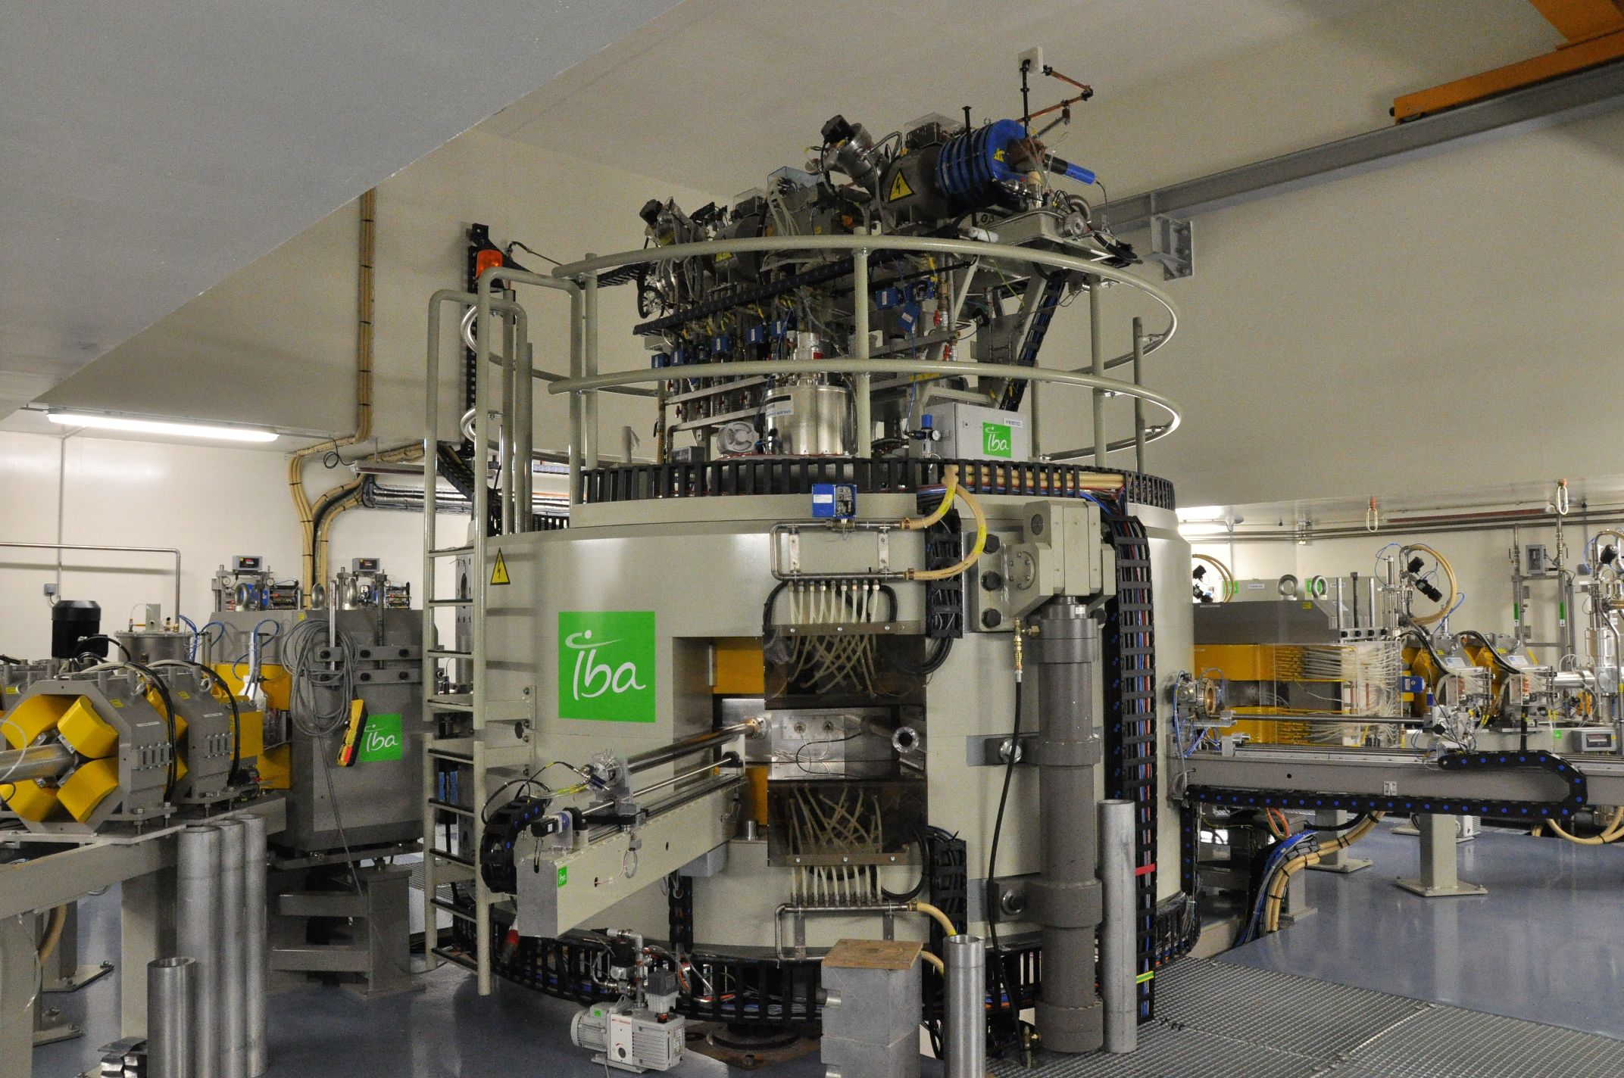
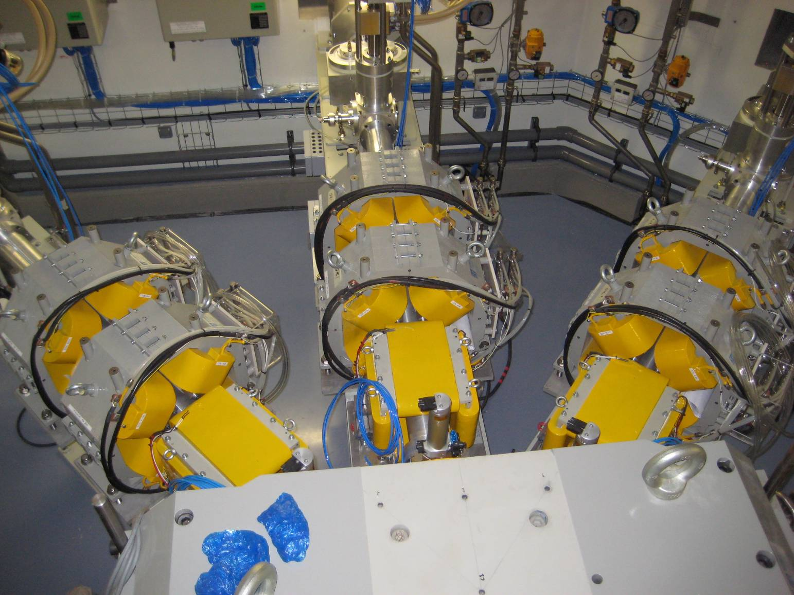
Magnet

Slide 12
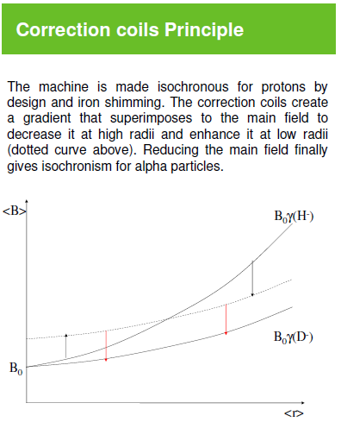
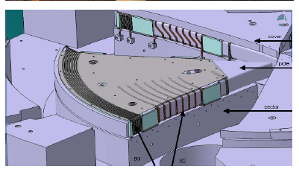
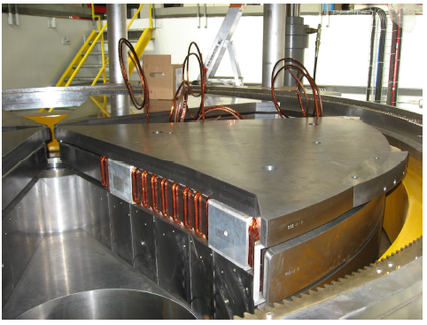
Magnet
Multi-particle machine

Slide 13
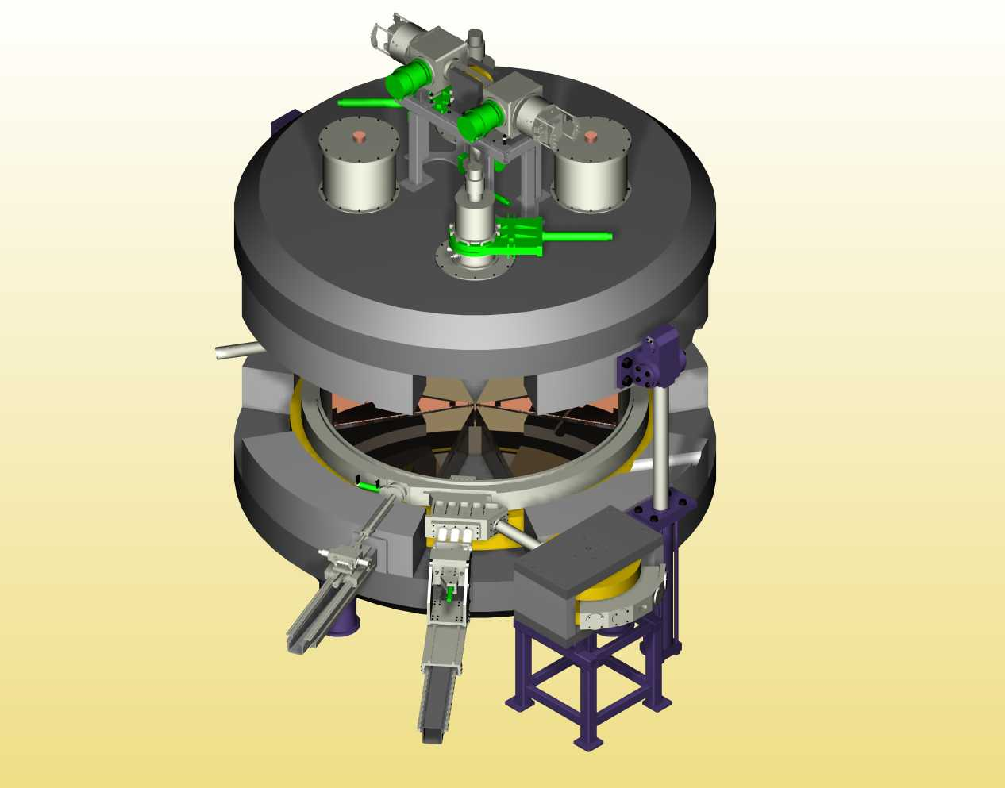
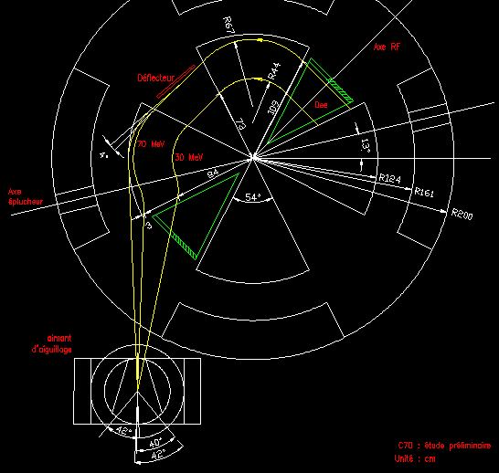
Magnet : compromise for all particle
Computation, CA Design and engineering

Slide 14
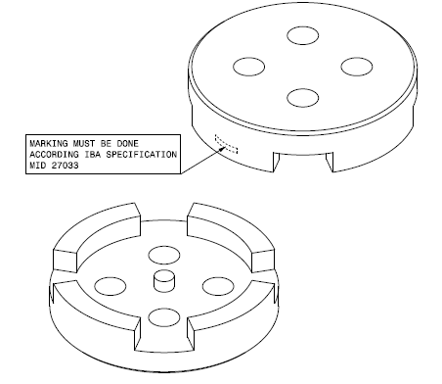
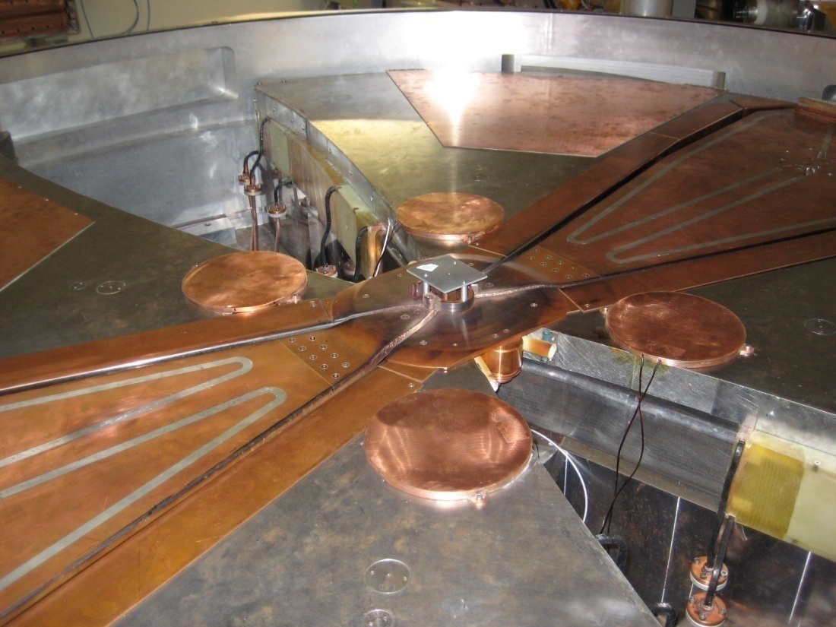
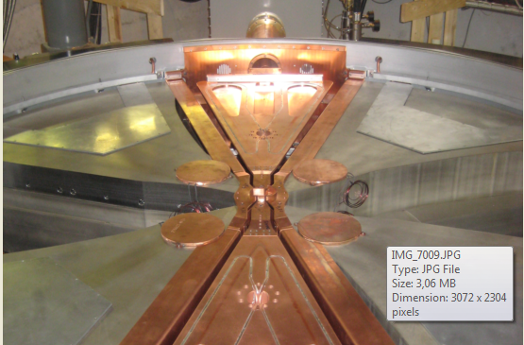
Magnet
Main differences between proton only and multi-particle
Yokes/flux returns in 1 piece
No more compensation coil
No more pole extension (He++ focalisation)
Optimisation of pole thickness and profile
Gap increasing (30mm ->40mm)
Why?
Assembly optimised
Better vacuum level
Reduce power consumption (main coil + harmonic coils)
Improve vacuum pumping

Slide 15
RF system
Cyclone 70Xp - ~30 MHz in H2 for protons, H4 for M/Q=2
Different stem configurations have been tested in order to find the best compromise between mechanical/RF/beam parameters.
Large number of turns for protons; possible higher losses in acceleration
Arronax case (H2)
V Dee centre: 65kV
#of turns: 625
P Diss.: 20kW (measured)

Slide 16
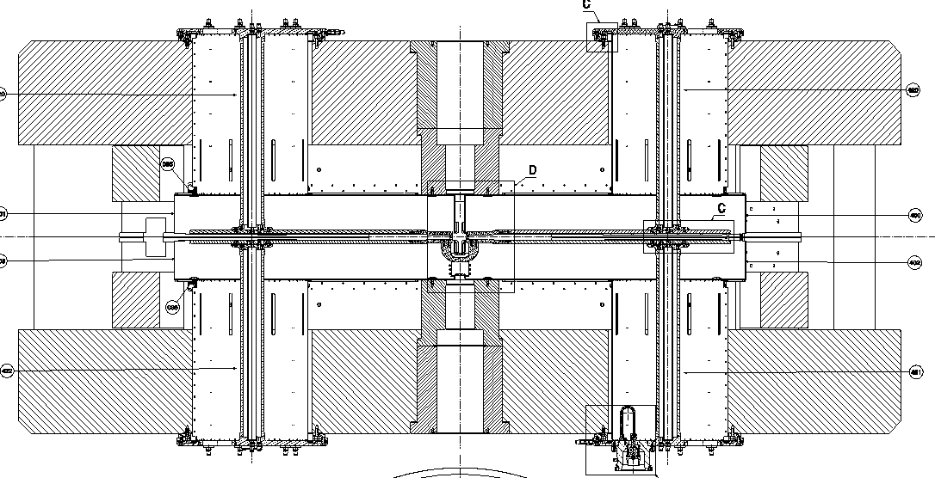
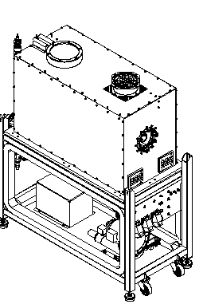
RF system
Cyclone 70Xp - H2 for protons, H4 for M/Q=2
Harmonic 2 for proton acceleration – 30Mhz (compromize with other particles)
Inductive coupling (in the pit)

Slide 17
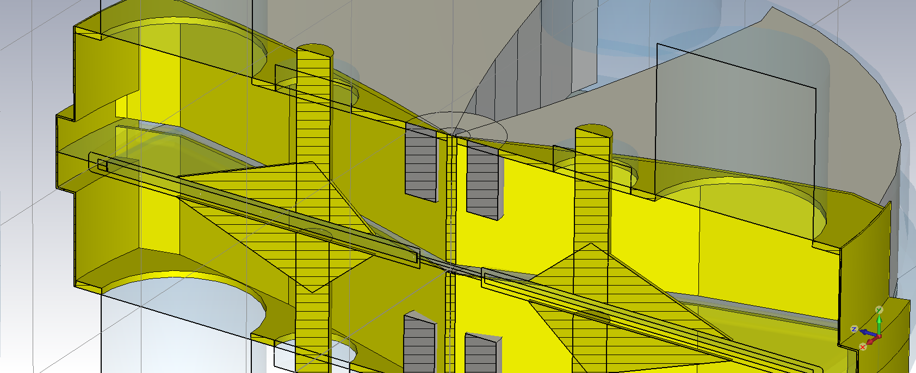
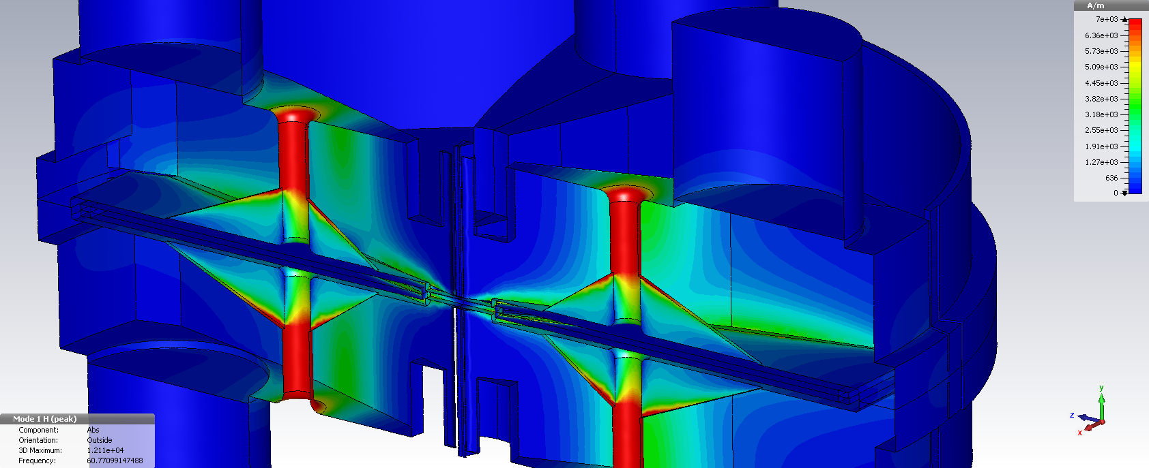
RF system – proton only
Protons on 4th harmonic
RF H2->H4 allow to gain ~4% of transmission
Straight pillar 110mm (better rigidity)
Vcentre: 50kV
P diss: 32.7kW
#of turns: 625=>321
Notes:
Beam losses: 59% (of H2 cavities)

Slide 18
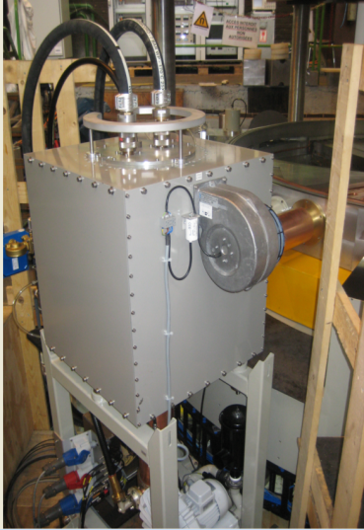
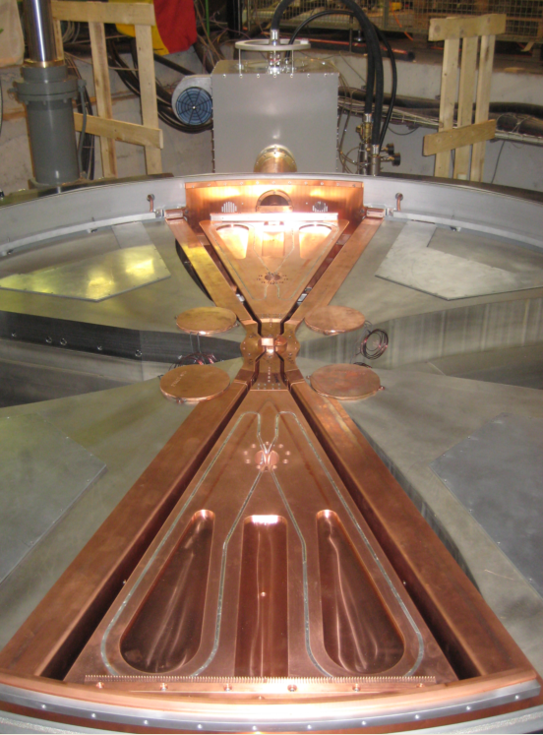
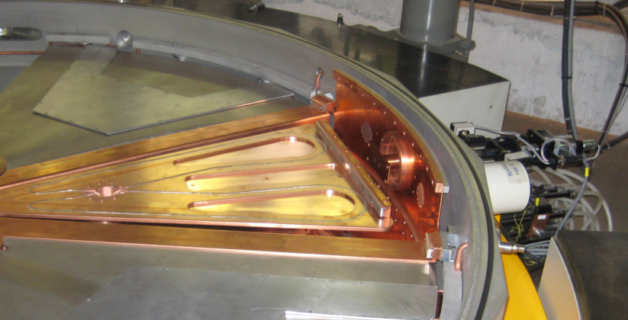
RF system – proton only, while we’re busy with it…
Direct FPA coupling to Dee: more stable system
Cyclone 30HC amplifier
Coupling in median plane
no asymmetry between cavities
low amplifier and coupler dissipation at 80 kW total RF (100 kW available)
only one cavity tuning at the opposite side of the coupler.

Slide 19
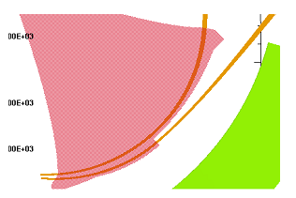
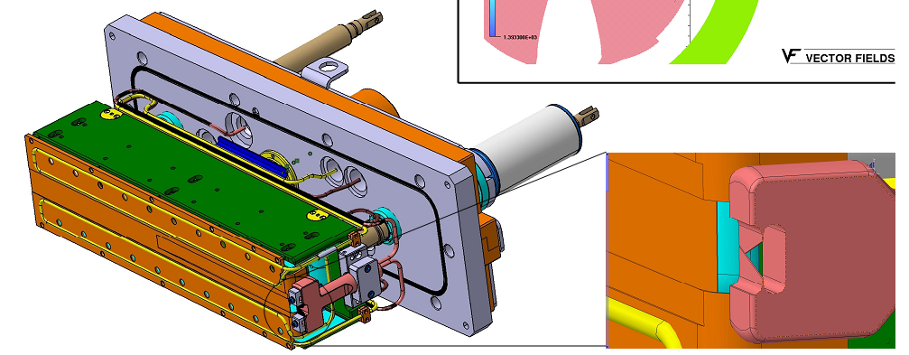
Extraction systems
Electrostatic deflector
Electrostatic deflector is coupled to pole extensions for optics correction
We burned some of these during commissioning despite the cooled pre-septum (less turn separation than IsoDAR, so we cannot remove halo)
Notes:
IsoDAR: 300kW of RF… we have less than a third of IsoDAR power ang are more compact.

Slide 20
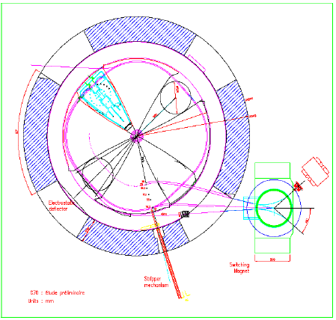
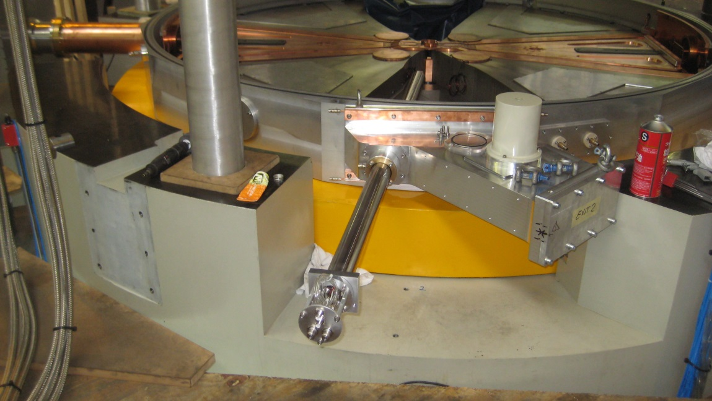
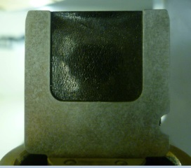
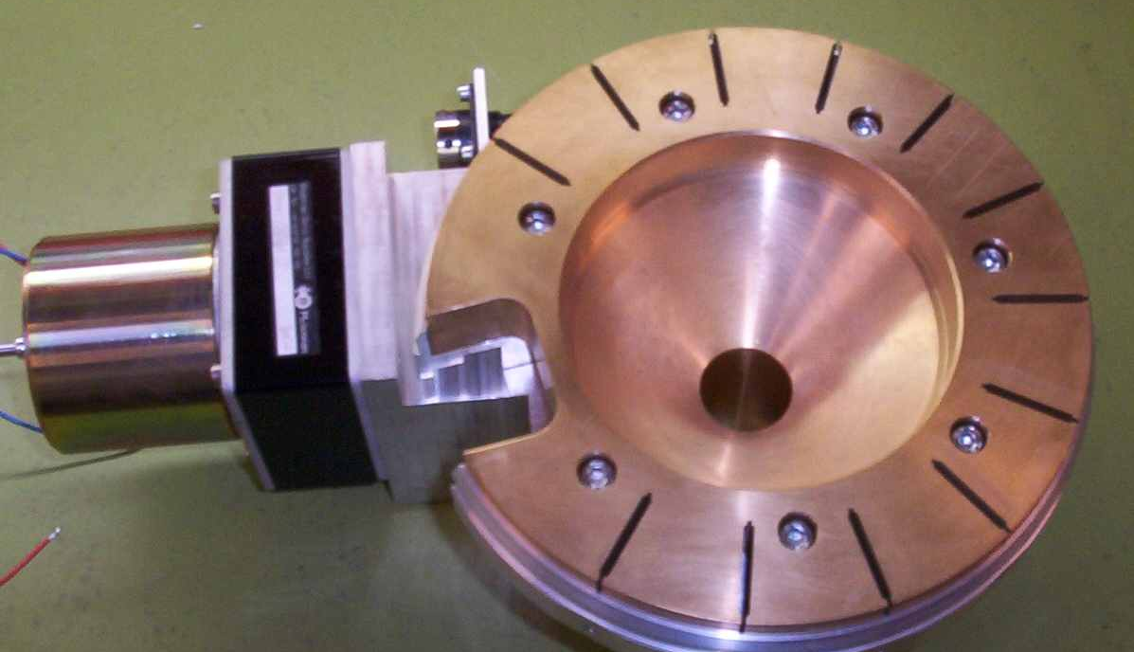
Extraction systems
Dual stripping shaft and permanent radial probe

