Slide 1
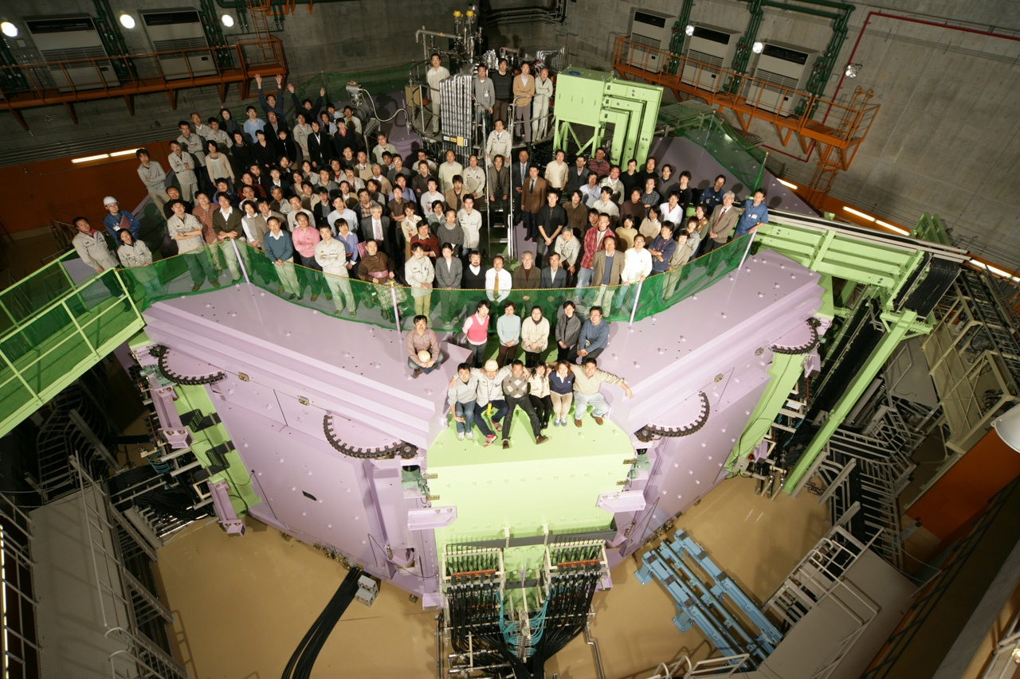
Where is a compact cyclotron in RIBF?
SRC
April 2006
RIKEN Nishina center for accelerator-based science, Accelerator group
Hiroki Okuno
Notes:
1: Thank you, Soga-san. And I’m very happy to be here again and have an opportunity to talk about RIKEN RI beam factory.
This is our memorial photo.
We were gathered on the main accelerator SRC and celebrated the establishment of Nishina center on April 2006.
Here is Yano-san and Kamitsubo-san. They are very important persons for the strong relation between IMP-Lanzhou and RIKEN.
And it is our traditional to take such photo when we build a new cyclotron.
Kamitsubo san is the only person who appear for three times in the series of three photos.

Slide 2
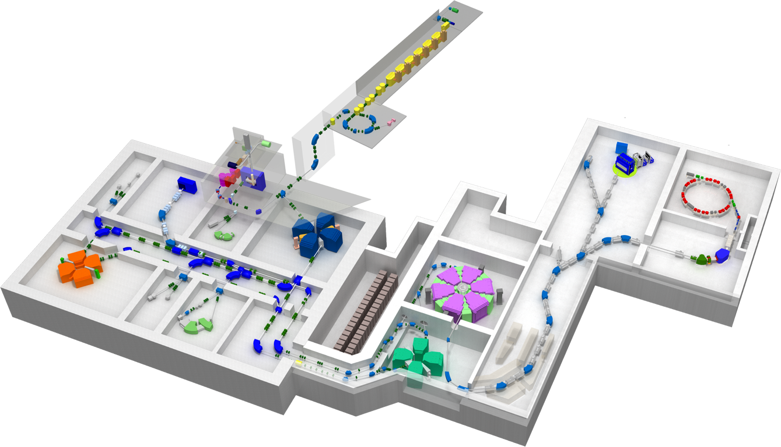
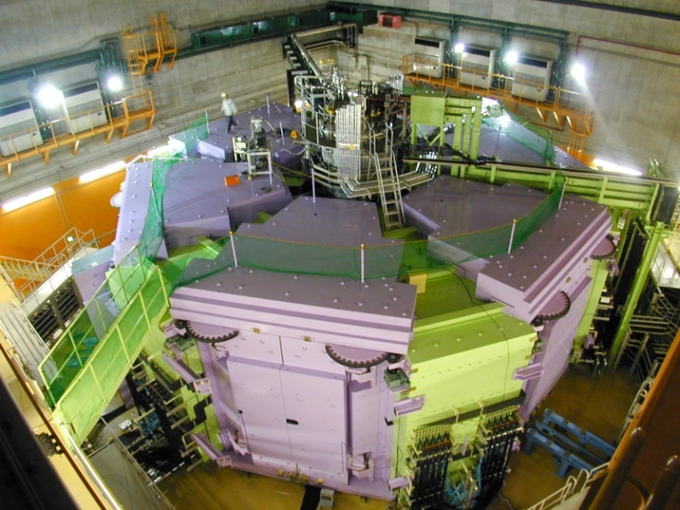
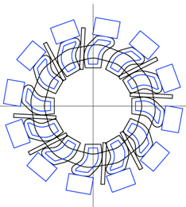
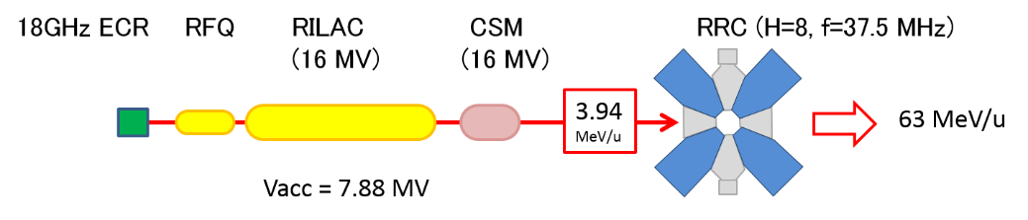
Preview
Introduction: RIBF
RIBF accelerators
What is RIBF?
Goals of RIBF
How to produce RI beam
Requirement to accelerators
Spec of accelerators
SRC: most challenging
Intensity upgrade
RIBF upgrade plans
M/Q = 2, 1 pmA at RIBF
Intensity upgrade plan
Energy upgrade plan
H8 acceleration using RILAC, CSM, and RRC
Where is a compact cyclotron in RIBF
Notes:
2: This is a preview of my talk. The first session introduces to RI beam factory.
I will talk about what RIBF is, goals of RIBF and requirement to the accelerator.
The second section overviews construction of RIBF.
Here I will focus on the superconducting ring cyclotron SRC because it is the most technically challenging in this project.
The third section describes intensity upgrade mainly for uranium beam upgrade after the first beam. Finally I will mention about the scientific topics from this facility.

Slide 3
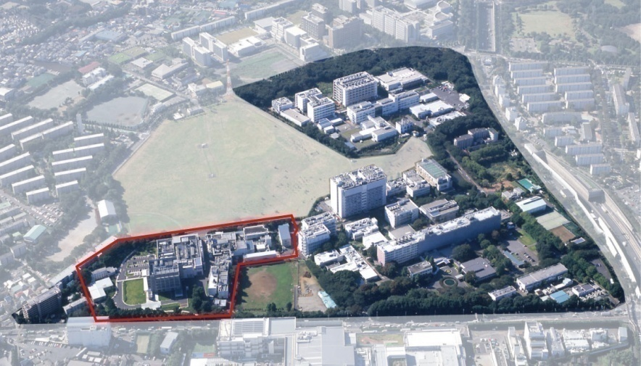
What is RIBF?
RI “Radioactive Isotope” produced by projectile fragmentation or in-flight fission
B fast (v/c~0.7) “Beam”
F production with high intensity like “Factory”
Wako campus
Saitama
USA
RIBF accelerator facility
Notes:
4: RIBF stands for the following meanings. RI is Radioactive Isotopes produced by pf and in-flight fission. B means fast beam whose velocity is around 70% of light speed. F means our wish to produce them with high intensity like factory. This slide shows research locations of Nishina center which was established on April 1 2006. Here is the Wako campus where RI beam factory is located. Just for your information, This area belong to USA. But in future we like to have it for the future extension of the RIBF.

Slide 4

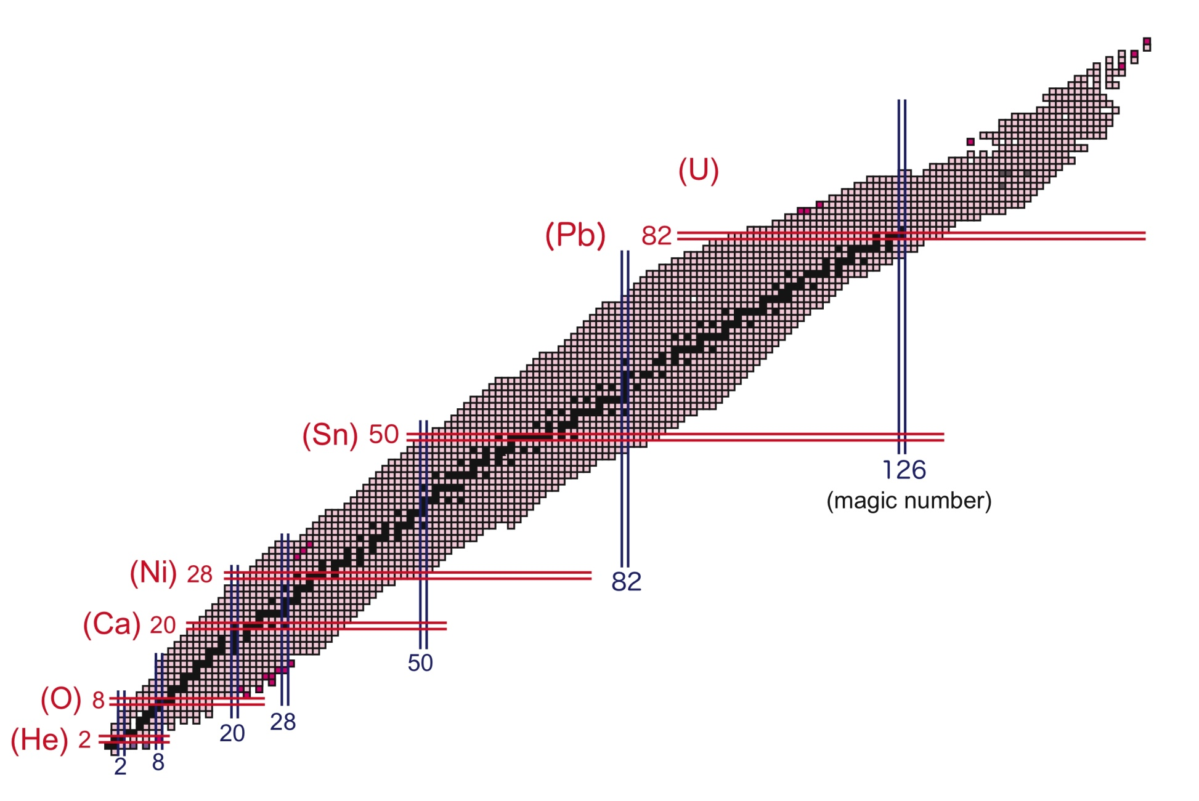
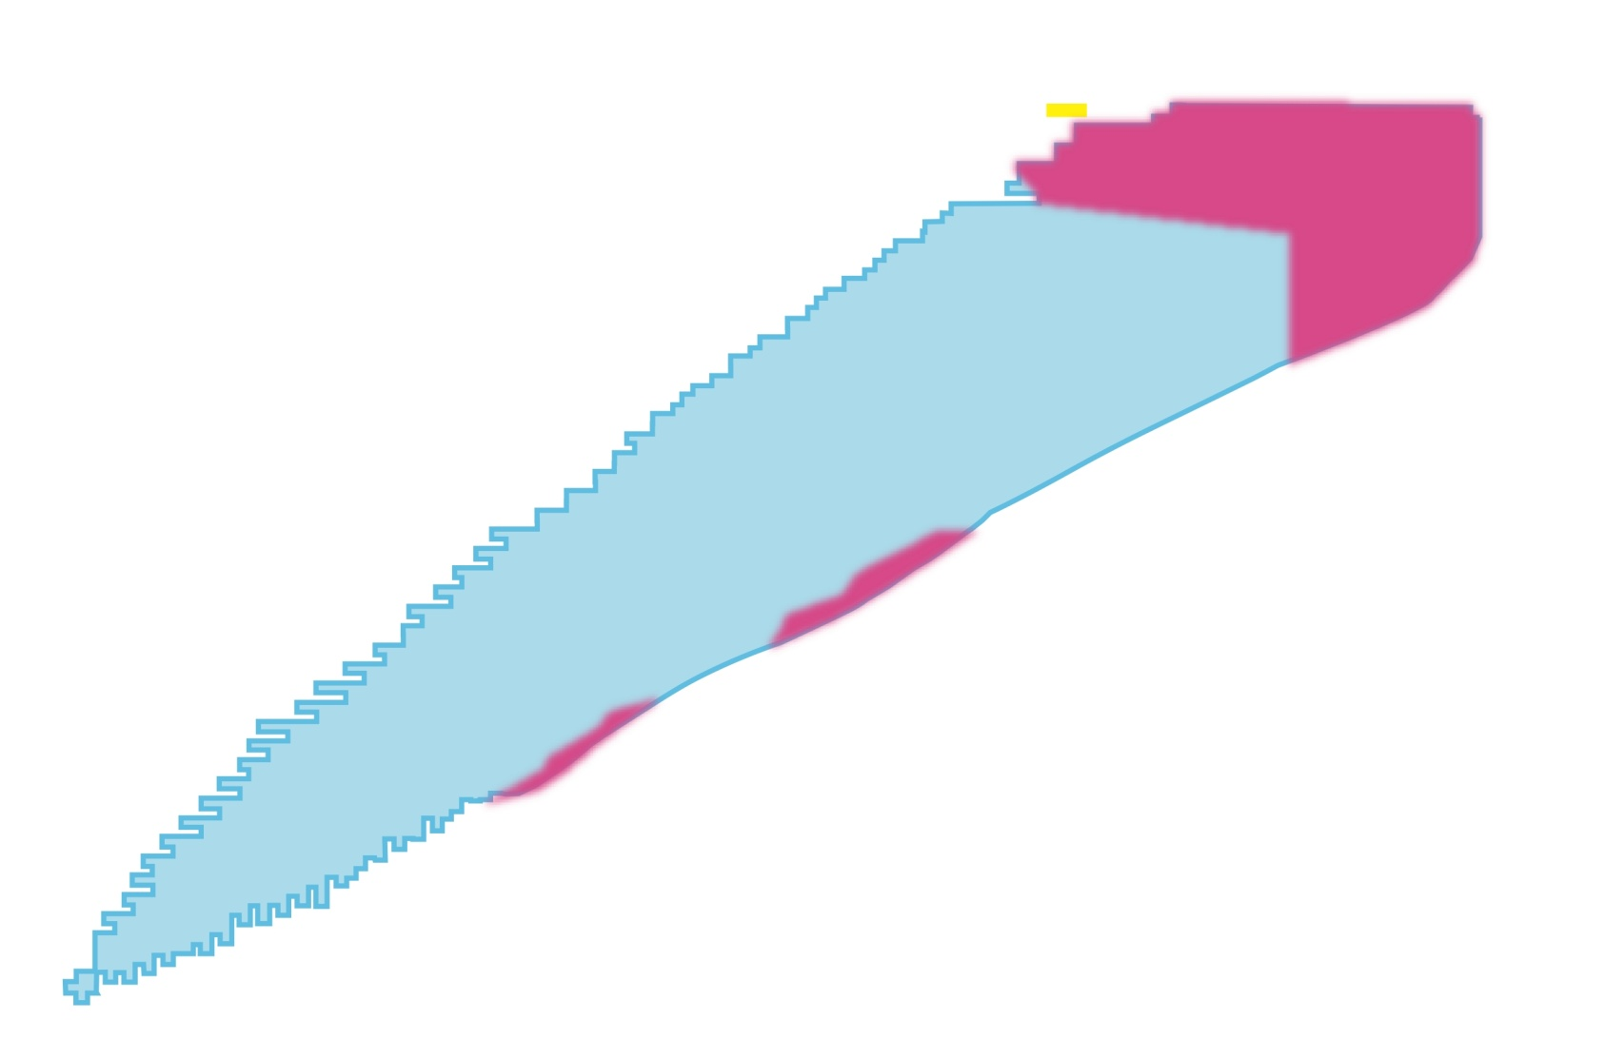
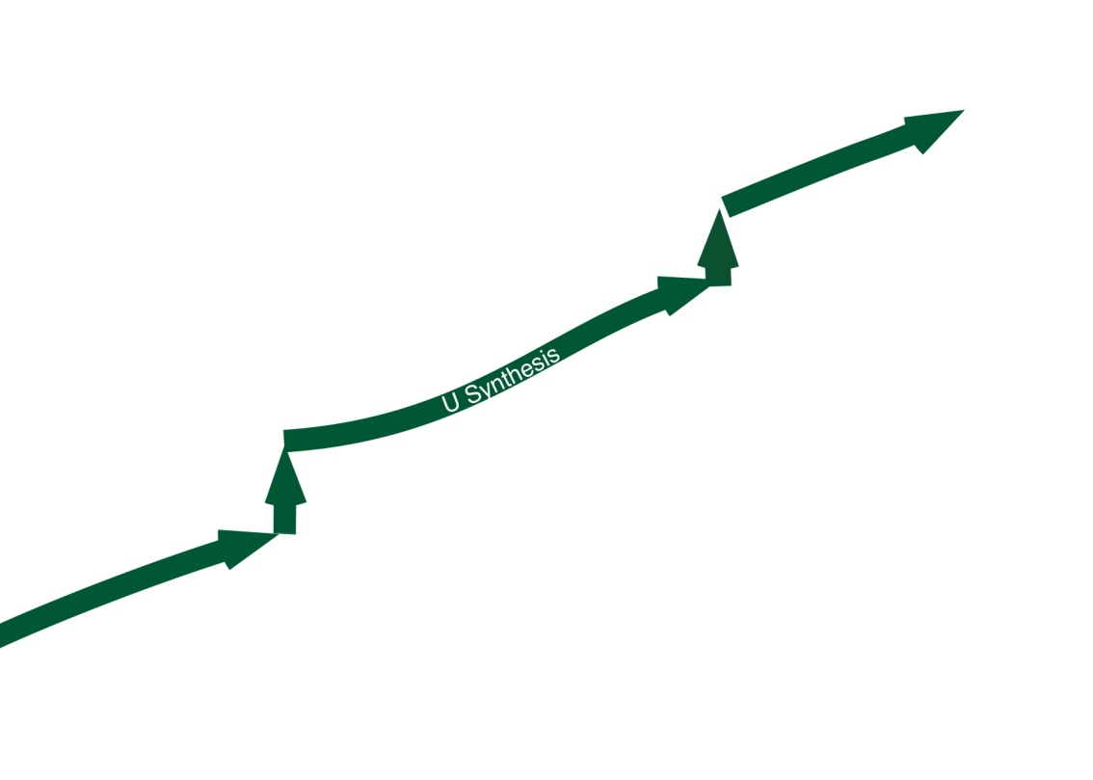
Goal of RIBF
Great expansion of the nuclear chart (1000 kinds of new RIs, Exotic nuclei)
Challenge to Big Puzzle of Element genesis (R-prosess = U-synthesis)
Promotion of industrial and biological applications
Uranium
Stability line
protons
Projectile Fragmentation
In-flight U fission & P.F.
neutrons
(Productivity larger than 1 particle/day)
Notes:
This lists the main goals of RIBF with the nuclear chart where the proton and nuclear numbers are plotted.
Black nuclei are the stable ones. Other nuclei than these are unstable nuclei which decay to more stable nuclei with a certain lifetime.
RIBF aims at great expansion of the nuclei chart, by virtue of RIBF 1000 new RIs become available.
We also like to produce super heavy element, which expand the nuclear chart to this direction.
一つ目は原子核図表の飛躍的な拡大であります。
中性子ハロー、魔法数の消滅等にみられます原子核の多様な現象を調べると共にこれらを統一して理解する究極の原子核模型を構築することにあります。
Exotic nuclei far from stability gives us opportunity study of various phenomeno of the nuclei and make the ultimate nulcear model.
2つ目は元素合成の謎にせまるということでありまして、主に鉄より重い元素合成に鍵となるrプロセスの解明することにあります。
The second goal is the challeng to big puzzle of element genesis. Especially we are focusing the Uranium synteshis.
There is a hypothesis that uranium has produced in the supernova explosion from iron very rapid-process, or r-prosess where successive rapid neutron captures occurr. But this is just hypothesis. We are challenging to solve it.
そして、3つ目は重イオンビーム育種等の産業利用の開拓にあります。
The third one is Promotion of industrial and biological applications

Slide 5
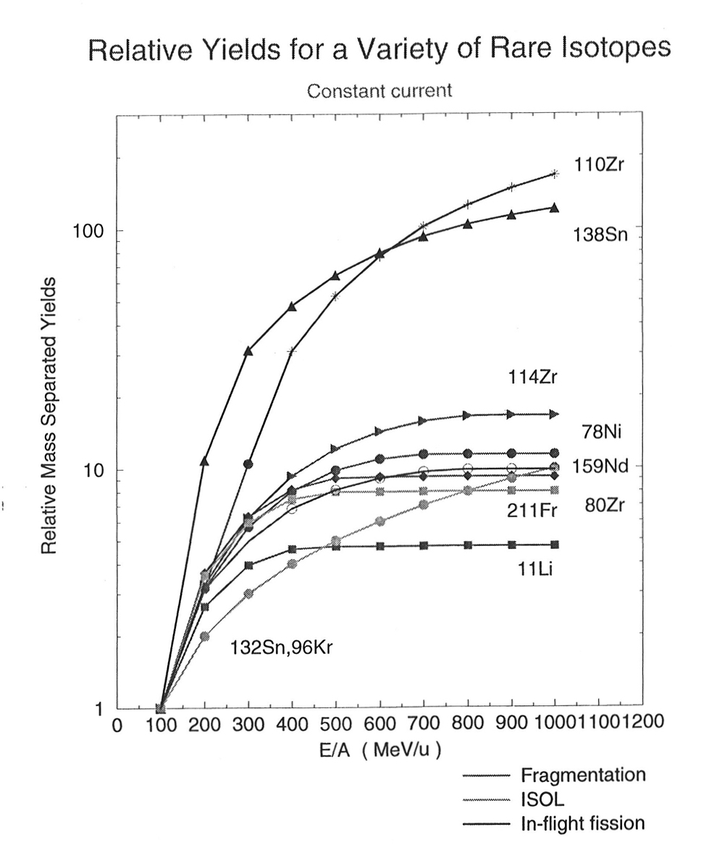
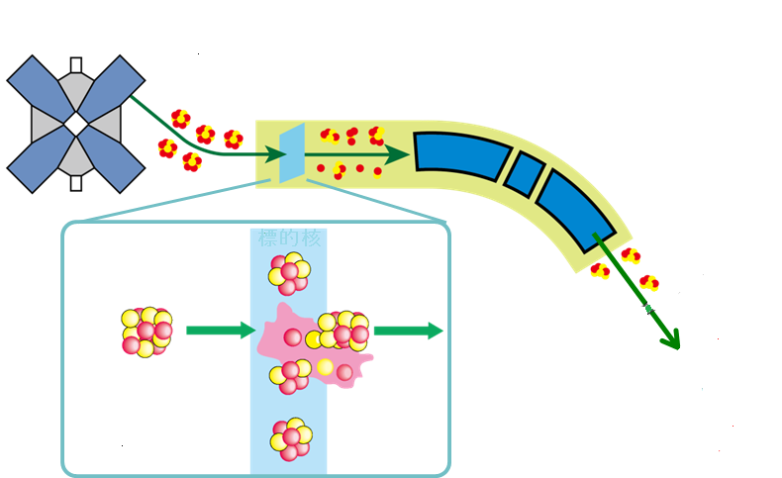
How to produce RI beam
(projectile fragmentation, in-flight fission)
Accel.
Stable ion beam
(primary)
70% of light speed
RI beams
(Secondary)
Fragment separator
Y (RI) starts saturation
Target
Projectile
Projectile Fragment
Purified RI beam
Target nucleus
350 MeV/u
A (projectile) > A (RI beam)
RI beam: secondary product
Requirement: Acceleration of heavy ions of all the elemnts (H-> U) with high intensity up to 70% of light speed
Notes:
This slide shows a way how to produce RI beam at this facility.
さて、次にRIビームの生成方法をご説明させて頂きます。
Stable ion beams from the accelerator are irradiated to the target such as delirium disk.
加速器で加速される重イオンは安定核です。
その重イオンビームをBe等の標的板に当てます。
The target nucleus abrade a part of the projectile like this and projectile fragment emitted almost without velociy loss.標的板の中ではここに示されているように入射核の一部がこの様にはぎ取られる反応が起きます。
Various kinds of the nuclei are produced in the target and an objective nucleus which researchers are interested in can be selected by the fragment separators.
どのような形で入射核がはぎ取られるかは確率現象でおき、安定核から不安定核まで様々な原子核が生成されますが、その中から自分の欲しいRIだけを後段のRIビーム生成分離装置を使って分離して、実験に用います。
ここで重要なのは、RIビームの質量は入射核の加速された重イオンの質量より小さくなることです。
This method require that mass of the projectile should be larger than that of of the projectile
We need high intensity primary beam because RI beams are secondary products.
The right graph shows the relative yield which starts to saturate around 70% of light speed.
Consequensely, the accelerators should boost the velocity of heavy ion from H to uranium up to around 70% of light speed with high intensity.
壊して作るため当然の事ですが、そのために、もし、全元素にわたるRIビームを生成するためには全元素ウランまでの重イオンを大量に加速する必要があり、またこの様な反応が主過程になるためには光の速さの7割程度まで加速する必要があるということです。

Slide 6
RIKEN RI Beam Factory
The first of the second-generation in-flight facilities
Cyclotron-base facility
Accelerators
RILAC : RIKEN Heavy-ion linac (1981~)
AVF : K70-MeV AVF cyclotron (1989~)
RRC : RIKEN Ring Cyclotron (1986~)
fRC : fixed-frequency Ring Cyclotron (2006~)
IRC : Intermediate-stage Ring Cyclotron (2006~)
SRC : Superconducting Ring Cyclotron (2006~)
RILAC2 : (2011~)
Research instruments
RIPS, BigRIPS : Fragment separator
GARIS : Gass-filled Recoil Ion Separator
ZDS : Zero-Degree Spectrometer
SAMURAI : Superconducting analyzer
SHARAQ : SHRAQ spectrometer
RRR : Rare RI Ring
RILAC
RILAC2
GARIS
SAMURAI
AVF
RIPS
RRR
ZDS
RRC
SRC
SHARAQ
(University of Tokyo)
fRC
BigRIPS
IRC
RC : Ring Cyclotron

Slide 7
Acceleration scheme for uranium acceleration
The existing facility (1986-)
The newly developed facility
1997: Approval of the construction budget, Start of design study of SRC
2003/ 3/E: Completion of accelerator building and all the parts for SRC 2005/11/07: The first excitation of SRC superconducting magnets
2006/12/28: The first beam from SRC
2007-: Start of experiments at RIBF
Notes:
This slide summarize a brief history of the RIBF construction.
This project is a facility expansion program which construct these three ring cyclotrons as an energy booster of the exisiting accelerators since 1986.
Construction of the SRC is the bottle neck for the project.
Construction budget was approved in 1997 and design study of SRC started.
At the end of march 2003, the building for the accelerator was completed and fabrication of all the parts for SRC was finished. After that we started assembling and successfully excited the superconducting magnet 11/07 2005 for the first time.
We got the first beam from the SRC at the end of 2006 to start the experiments at RIBF from 2007.
鳥瞰図ではわかりにくいのですが、これがウランを加速する時のモードです。
合計4つのリングサイクロトロンをシリーズに繋いで線型加速器から得られたU35+1イオンを３４５MeV/uまで加速します。
FRCの入り口と出口のところには荷電変換装置、チャージストリッパーを２つ使用しています。
つづいてRIBFの歴史ですけれども、1997年に建設予算が認可され、SRCの実機設計検討が開始されました。
2003年3月末に加速器棟の建屋が完成し、srcの各機器の設計が終了しました。
その後組み立てを行い、2005年にSRCセクター電磁石の定格励磁に成功し、2006年末にはSRCからファーストビームを得ることに成功しました。
2007年から実験を開始して現在に至ります。
これからしばらくはこの最終段加速器である超伝導リングサイクロトロンについてお話させて頂きます。

Slide 8
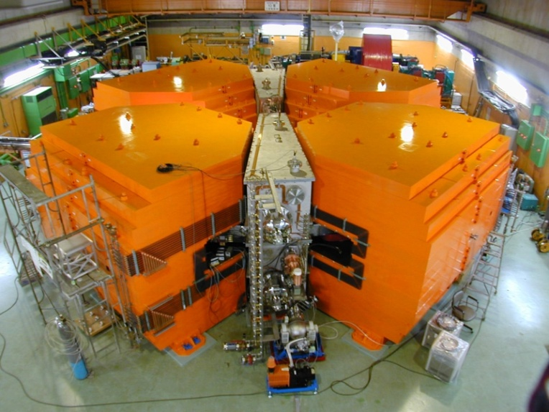
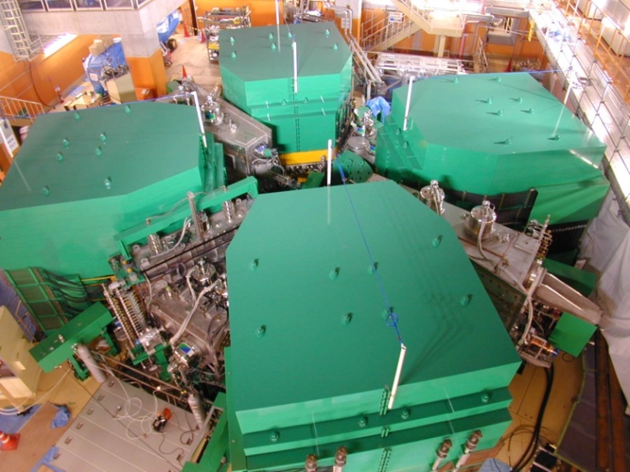
Specifications of RIBF ring cyclotrons
Challenging
 | fRC | IRC | SRC | RRC (1986~)
K-number (MeV) | 700 | 980 | 2600 | 540
Rinj (cm) | 156 | 277 | 356 | 89
Rext (cm) | 330 | 415 | 536 | 356
Weight (tons) | 1300 | 2900 | 8300 | 2400
Sector magnets | 4 | 4 | 6 | 4
Number of trim coils (/ main coil) | 10 | 20 | 4 (SC) 22 (NC) | 26
Trim coil currents (A) | 200 | 600 | 3000 (SC) 1200 (NC) | 600
RF resonators | 2+FT | 2+FT | 4+FT | 2
Frequency range (MHz) | 54.75 | 18〜38 | 18〜38 | 18〜38
Acceleration voltage (MV)* | 0.8 | 1.1 | 2.0 | 0.28
Turn separation (cm)* | 1.3 | 1.3 | 1.8 | 0.7
Company | SHI | SHI | JV** | SHI
fRC
IRC
SRC
*uranium acceleration, **JV (Melco, Hitachi, SHI)
SC : superconducting, NC : normal conducting, FT : flattop resonator

Slide 9
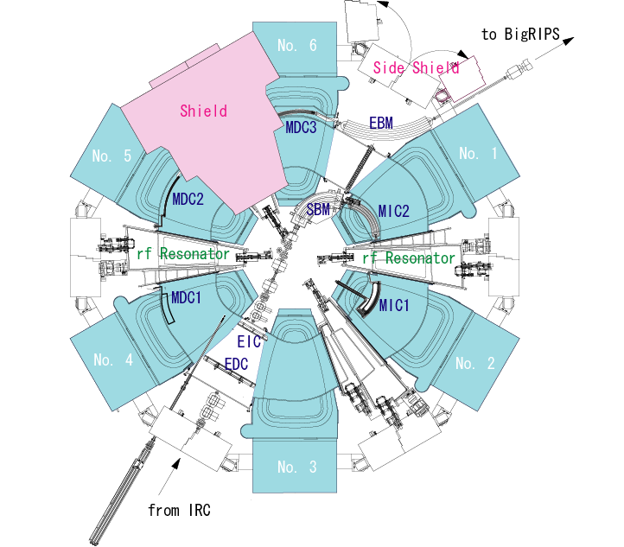
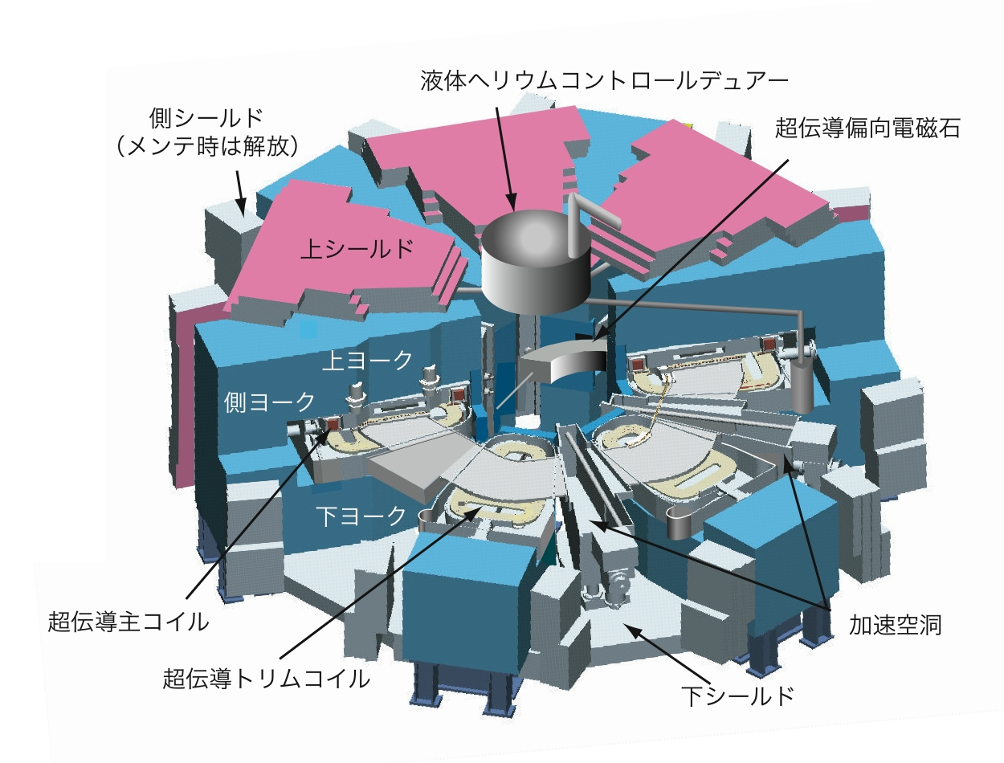
SRC: the World’s First Superconducting Ring Cyclotron
K: the maximum bending power of extracted beam from the cyclotron
K = 2,600 MeV
Max. Field: 3.8T (235 MJ)
Rf frequency: 18-38 MHz
Weight: 8,300 tons
Diameter: 19m Height: 8m
Side Shield
(Open for mainte.)
Control Dewar
Superconducting
Bending Magnet
Upper Shield
Sector Magnets :6
Rf Resonator :4
Injection elements:
Extraction elements:
Upper Yoke
Side Yoke
Lower Yoke
SC Main Coil
rf-Cavity
Self Magnetic Shield
Self Radiation Shield
SC Trim Coil
Lower Shield
Notes:
This figure shows a bird's eye view of the SRC. It is the first ring cyclotron using superconducting coils with the ever largest K-value of 2600 (two thousand six hundred) MeV. Here K-value expresses the maximum bending power of the extracted beam from the cyclotron. The maximum sector field is 3.8 T (three point eight) and the maximum stored energy is 235 MJ (two hundred thirty five). The total weight amounts to 8300 ton (eight thousand three hundred). Its diameter is 19 m (nineteen) and height is 8 (eight) m. This figure shows a plan view of the SRC. Six sector magnets generate dipole fields in these regions by exciting the superconducting coils. Four resonators generate rf fields to accelerate the circulating ion beams, These magnetic and electrostatic channels are used for beam injection and extraction. The remarkable point of this cyclotron is that the iron plates of about 1m thickness cover the magnetic valley regions as an additional magnetic and radiation shielding. They reduce the leakage field from the sector magnets and decrease magneto motive forces for the maximum bending power.

Slide 10
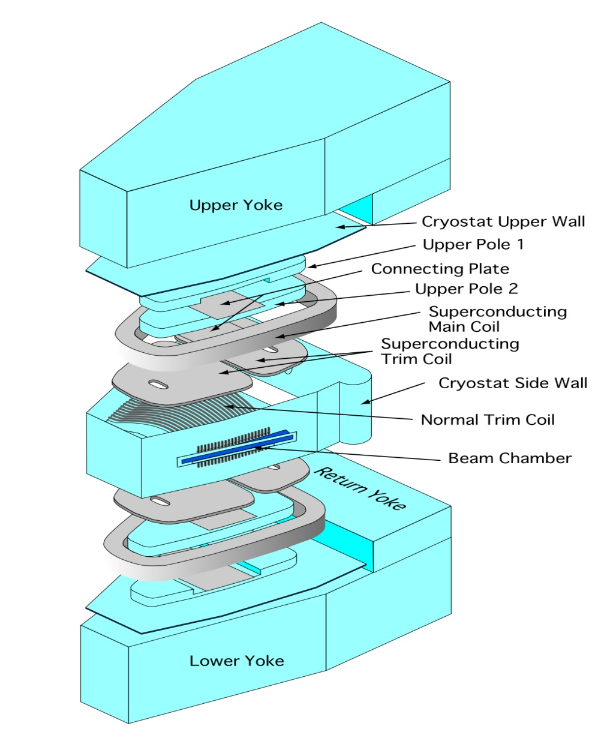
Technical challenges
(superconducting magnets)
Technical issues
Large stored energy (240 MJ)
Large EM forces (~260 Ton/m)
Non-circular coil
Tight required accuracy for the coil positions (< 1 mm)
Narrow space especially for the S.C. trim coils
Complicate structure of the cryostat
Superconducting Sector Magnet
Unfolding diagram
Notes:
The most challenging parts in the SRC is the superconducting sector magnet whose unfoolded diagram is shown here.
Technical issues are the following.
Stored energy was as large as 240 MJ
EM forces on the coil was large, typically 260 ton/m. We should carefully design the support structure of the coils.
All the superconducting coils are no-cicular, shape of the main coil is like a corn and that of the Sc trim coil is like a rib.
Winding of non –circular coil is very difficult.
Accuracy of the coil is very tight to make good field for the acceleration.
Space for the coils are very narrow.
Structuure of the cyostat which cover the cold mass is very complicated.

Slide 11
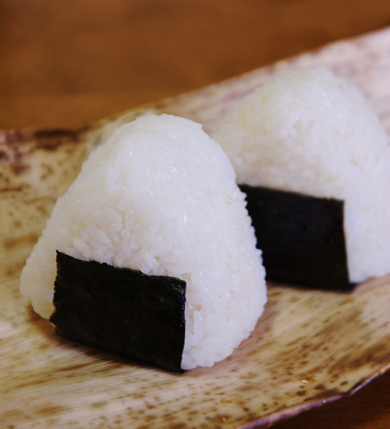
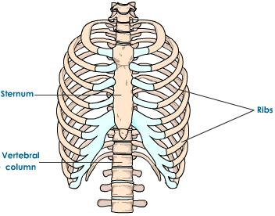

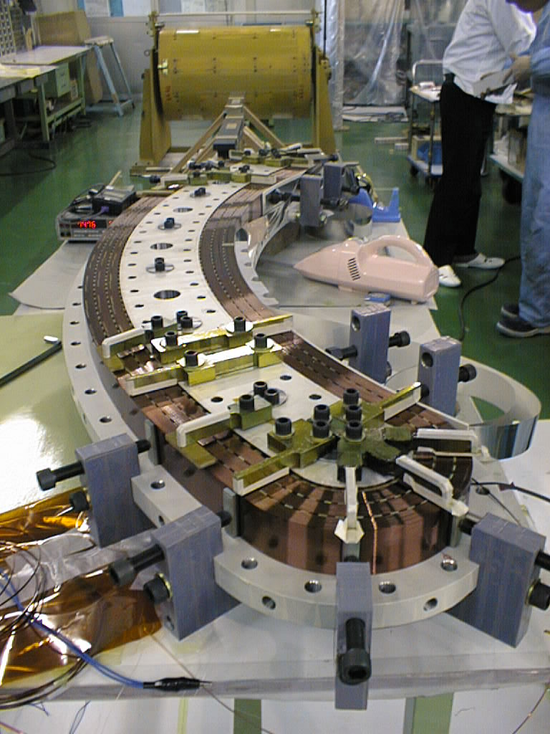
Shapes of the superconducting coils for SRC
Main coil
S.C. trim coil
SBM
(Beam injection)
Rice Ball
Ribs
Banana

Slide 12

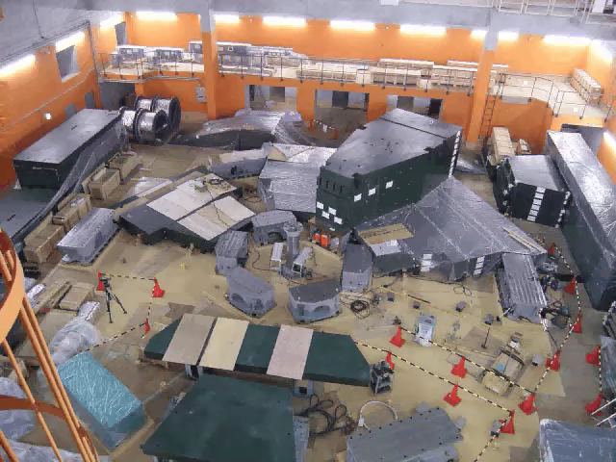
Assembling of SRC in the vault

Slide 13
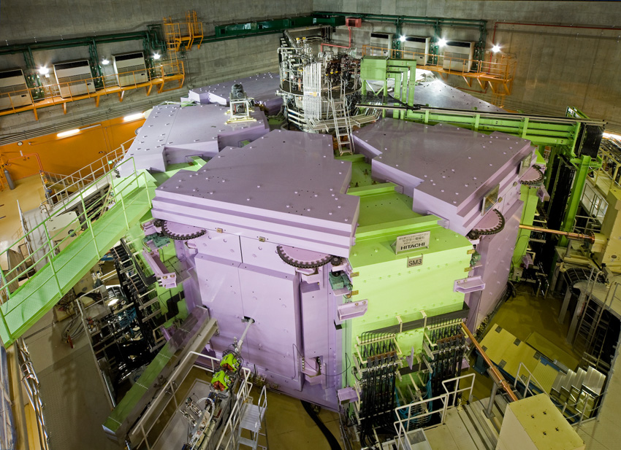
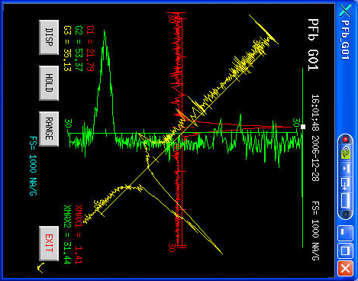
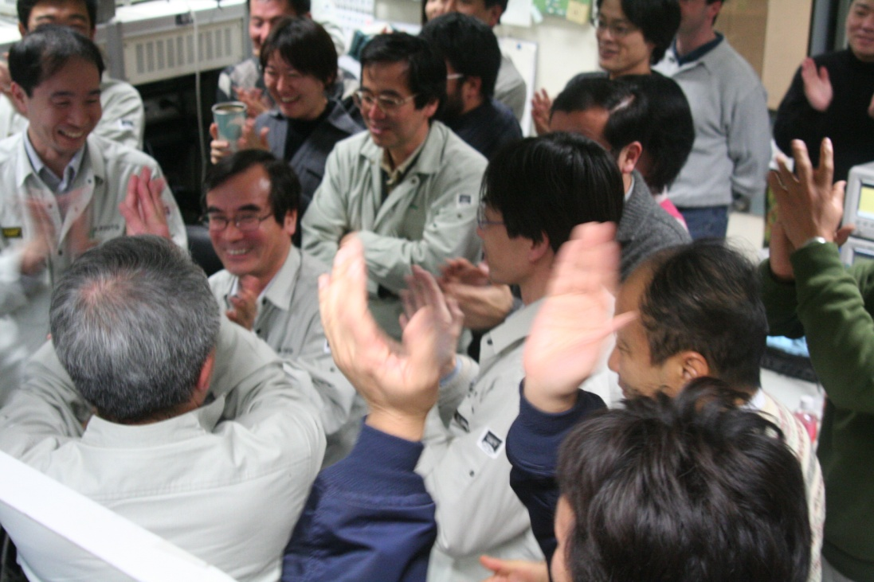
SRC
Liq. He
DC current
Control Dewar
The First Beam 2006/12/28!
Rf power
Beam profile at the exit of SRC
Beam Injection
Rf power
Notes:
After the assembling RF power connection, DC current liquid helium beam injection and extraction,
We started the beam commissioning.
And We got the first beam at the end of the 2006.

Slide 14
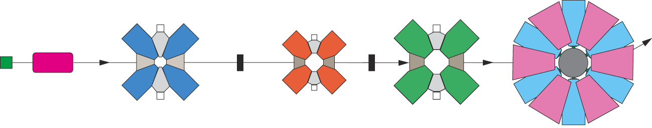
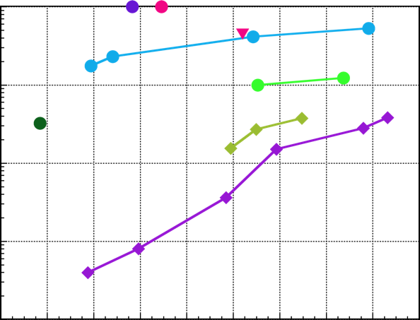
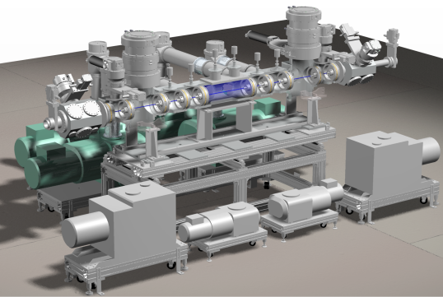
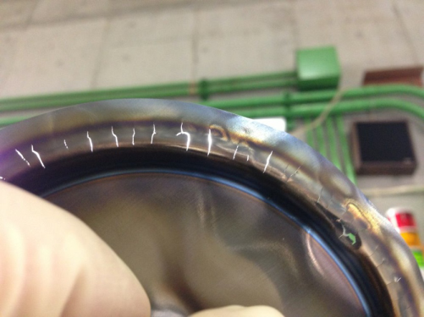
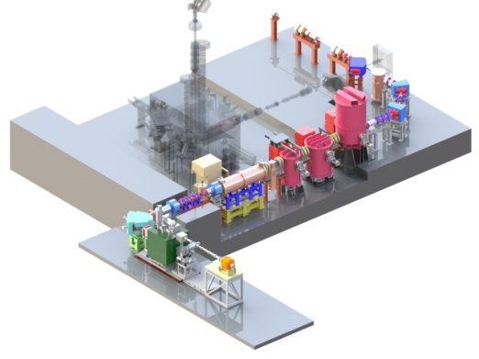
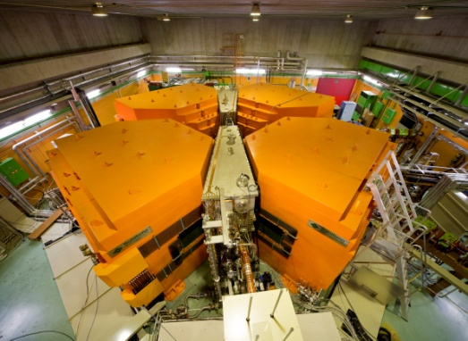
Intensity upgrade at RIBF
320A MeV ⁴He
RILAC2
RRC
fRC
IRC
¹⁸O
294A MeV ¹⁸O
1000
Goal
SCECR
⁴⁸Ca
⁷⁰Zn
Accelerators
He gas
Rotating Be disk
SRC
100
⁸⁶Kr
¹²⁴Xe
38.4 pnA U (~2.4x10¹¹ #/s)
(pnA)
10
²³⁸U
1
Germany/GSI
0.1
2007
2009
2011
2013
2015
(year)
He gas stripper Rotating Be disk
⇒Graphinity disk
RIBF starts!
The new injector
(RILAC2) starts!
fRC upgrade
(K570=>K700)
28-GHz SC-ECR
Notes:
14
19: RIBF was successfully operated for more than six years since the first beam.
Continues efforts in these six years improved the performance of the RIBF accelerator complex.
So far, we achieved the target intensity for He and O ions and about half of the target intensity for Ca ion.
However uranium beam intensity was very low at the initial operation, requiring drastic measures.
Firstly we need more ions from an ion source. We developed 28 GHz ECR ion source with a new injector linac.
Next, short life time of charge strippers was the bottle neck problem for the intensity upgrade, we replace the conventional carbon foils for the two step charge stripping with He gas stripper and rotating be disk as shown here.
As a result we successfully increased uranium beam intensity by a factor of 500 at max or by a factor of 3000 in average compared with that just after the first beam.

Slide 15
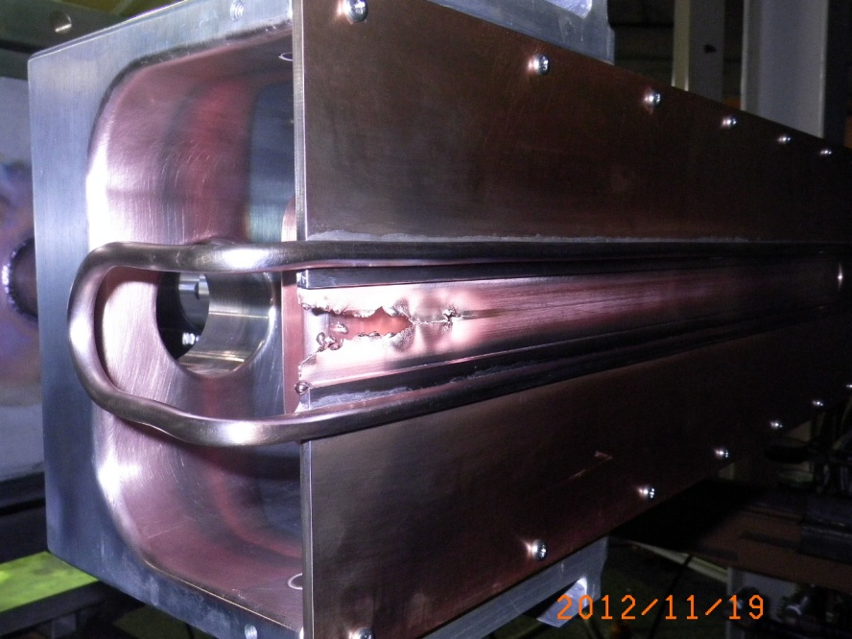
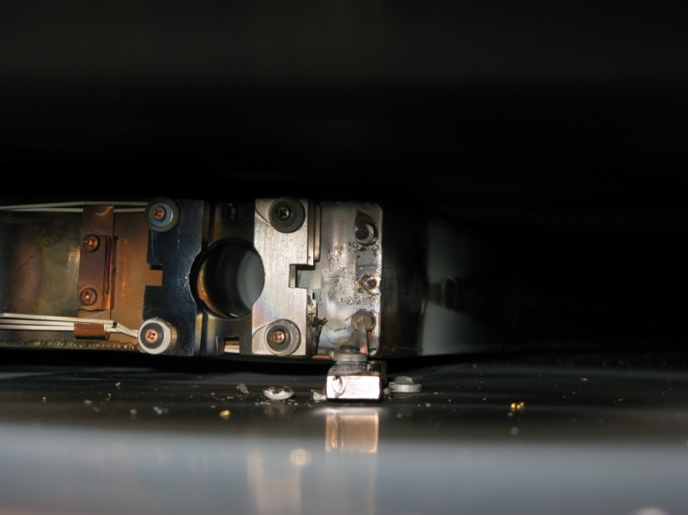
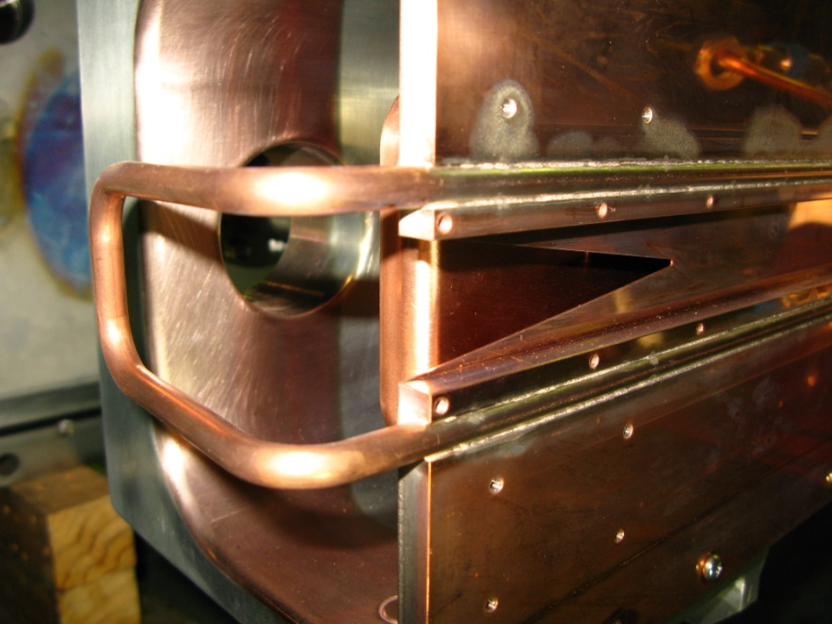
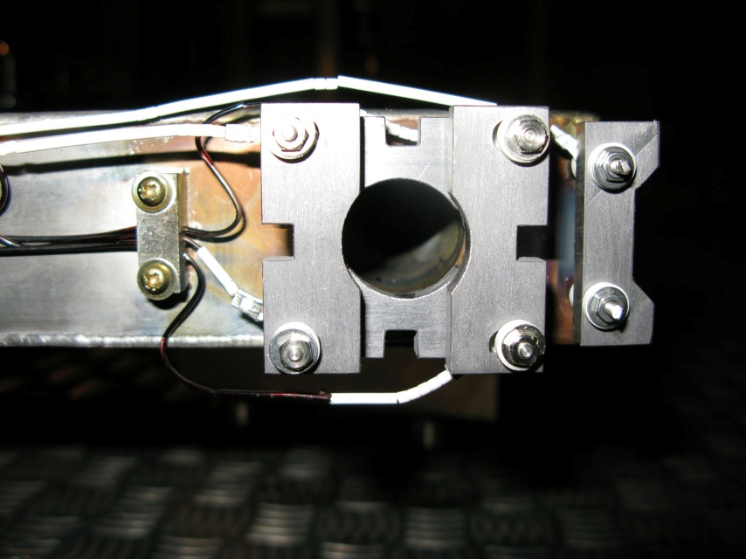
High power beam destroys inj&Ext elements
2012
Failure of RRC-MDC2 in Oct. 2010
RRC-EDC
2014
Normal MDC-2
New RRC-EDC

Slide 16

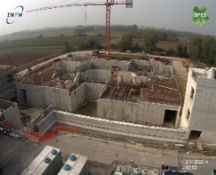
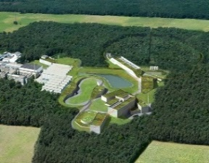
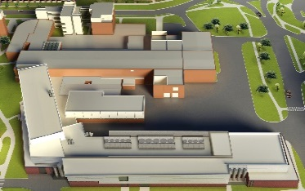







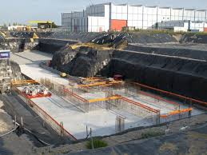
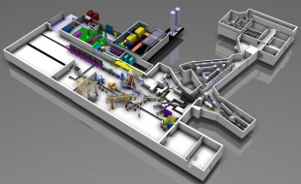
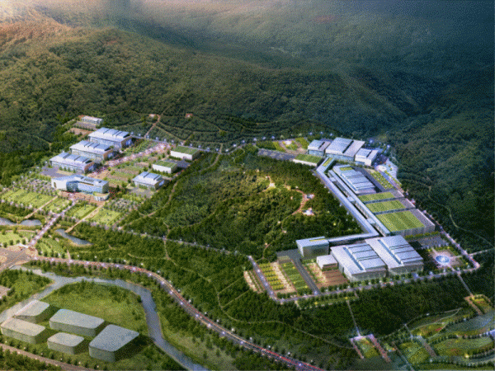
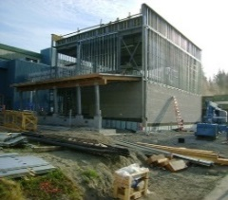





We are No.1 until 2020.
Italy
Gemany
USA
We need the further upgrade of RIBF.
SPRAL2
CERN
Korea
Canada
Year |  | 2007 | 2008 | 2009 | 2010 | 2011 | 2012 | 2013 | 2014 | 2015 | 2016 | 2017 | 2018 | 2019 | 2020 | 2021 | 2022 | 2023 | 2024 | 2025 | 2026 | 2027
Japan |  | Exp. |  |  |  |  | Facility compl. |  |  |  |  |  |  |  | RIBF upgrade
Germ. |  | Constr. |  |  |  |  |  |  |  |  |  |  |  |  |  | Exp. |  | Fac. compl.
USA |  |  |  |  |  |  |  | Constr. |  |  |  |  |  |  | Exp. |  | Fac. compl.
Canada |  |  | Constr. |  |  |  |  |  |  | Phase 1 |  |  |  |  | Fac. compl.
France |  |  | Constr. |  |  |  |  |  |  |  |  |  | Exp. |  | Fac. compl.
Italy |  |  |  |  |  |  | Constr. |  |  |  |  | Exp. |  | Fac. compl.
EU |  |  |  |  |  |  |  | Constr. |  | 4 MeV |  | 10 MeV
Korea |  |  |  |  |  |  |  |  |  | Constr. |  |  |  | Exp. |  | Fac. Compl.
16

Slide 17
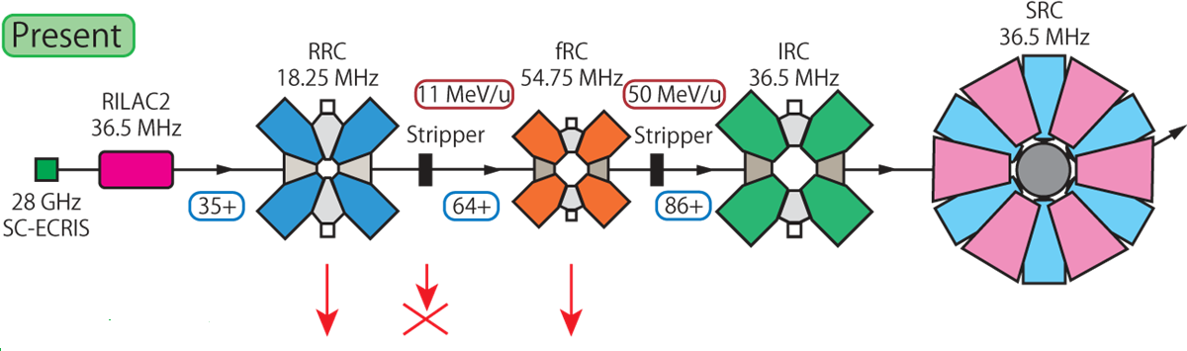
Upgrade plan for RIBF (intensity)
Weak points:
Weak against longitudinal space charge forces due to its low rf voltage low velocity.
The 1st stripper decreases the beam intensity by a factor of 1/5.
The 1st stripper degrades the beam quality.
1: increase rf voltage
2: increase injection velocity
3: replace with linacs
Increase K value
by a factor of (64/35)²

Slide 18
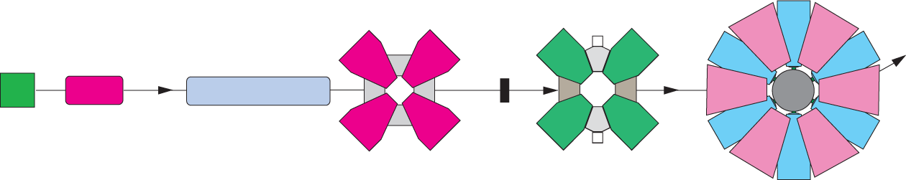
Upgrade plan for RIBF (intensity)
RRC
fRC
IRC
SRC
Charge
Stripper
Charge
Stripper
RILAC2
Present
U35+
U64+
U86+
(Intensity 1 0.2 0.05)
Super-fRC
(New)
SRF
(New)
Option1
U35+
U86+
(Intensity 1 0.25)

Slide 19
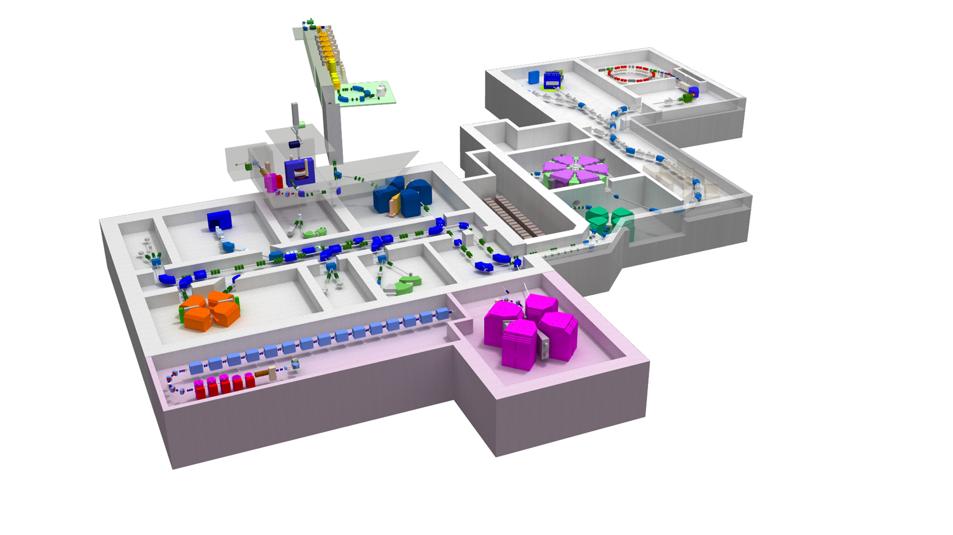
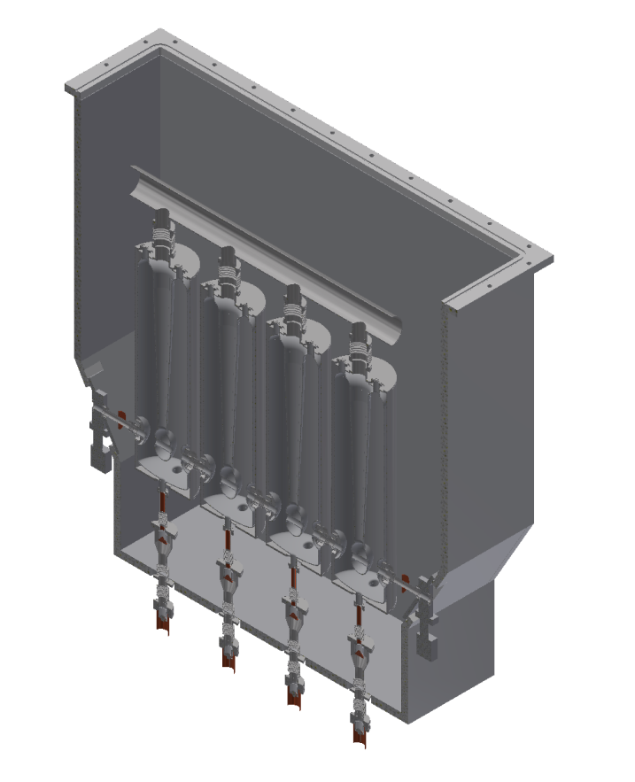
Upgrade plan for RIBF (intensity)
Cryomodule
New FRC
Superconducting Linac
Superconducting Resonator
Notes:
最後
今年度ぜひSRF空洞の開発をやらせていただきたい。
次期計画の入射器部／低エネルギー部分に使う。
設計がかなり進んでいる。
いまはチャンスである。

Slide 20
New FRC (Superconducting)
Spec. of Super-FRC
K-value | 2220 MeV
Vel. gain | 2.06
Injection energy | 10.8 MeV/u
Extraction energy | 48.0 MeV/u
Accel. frequency | 73 MHz
Harmonics | 18
Injection radius | 1.775 m
Extraction radius | 3.65 m
Spec. of sector magnet
Number of sector | 4
Weight/sector | 1200 t
Pole gap | 180 mm
Magneto motif force | 1.62 MA
Bmsax on trajectory | 3.2 T
NC trim coils | 20 pairs

Slide 21
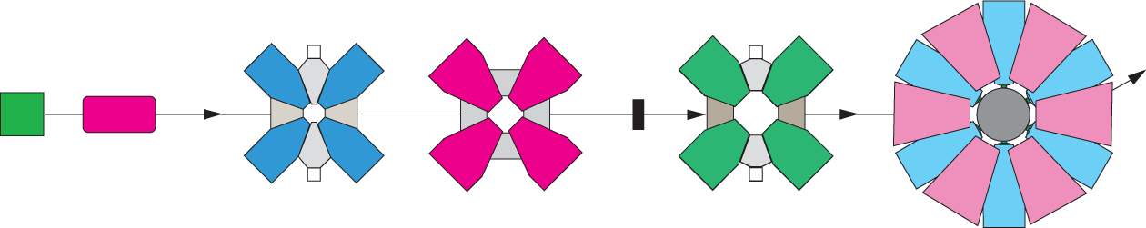


Some options for the upgrade plan
RILAC2
RRC
fRC
IRC
SRC
Cost
0
Present
New-fRC
1: Increase cavity
voltage of RRC
2: Make New-FRC
Option3
fRC
1: Increase
injection energy
2: Make New-FRC
Option2
1: Make a SRF Linac
2: Make New-FRC
Option1
high
How about performance?

Slide 22
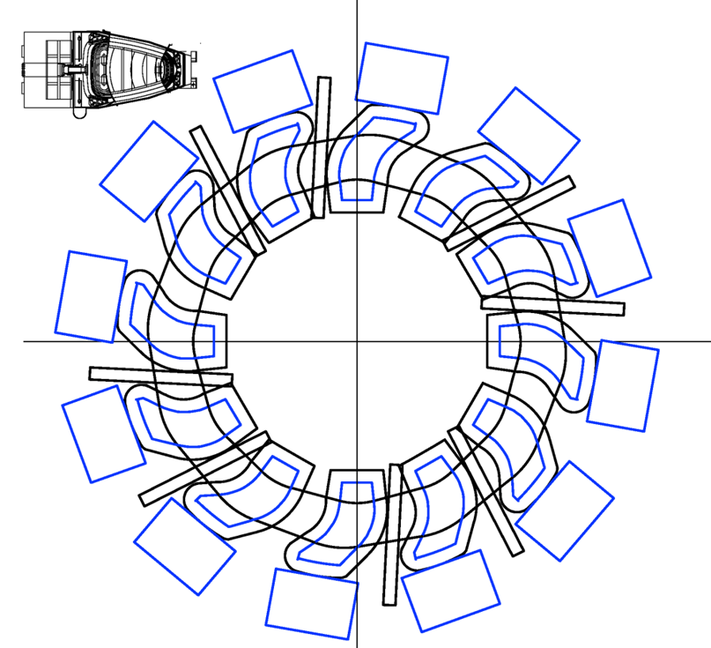
Energy upgrade for RIBF
SRC sector
Hyper SRC
K-value: 6900 MeV
# of Sector: 12
# of rf cavity：8
Einj: 345 MeV/u
Extr: 900 MeV/u
Challenge the limit of cyclotron!
Courtesy of Fukunishi

Slide 23
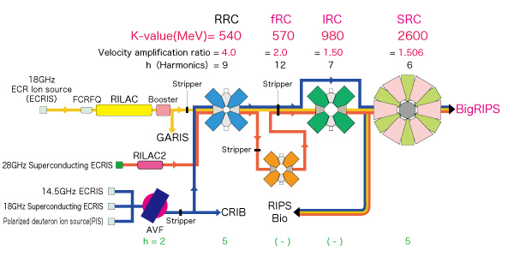
M/Q =2, 60MeV/u acceleration in RIBF

Slide 24
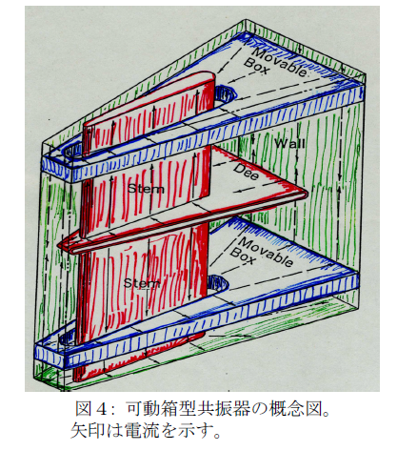
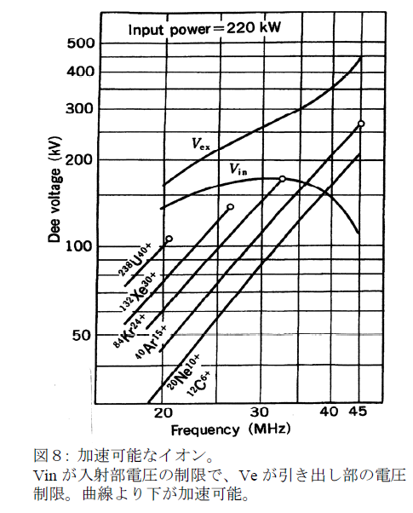
M/Q =2, 60MeV/u acceleration in RIBF
18GHz ECR
RFQ
RILAC
(16 MV)
CSM
(16 MV)
RRC (H=8, f=37.5 MHz)
3.94 MeV/u
63 MeV/u
Vacc = 7.88 MV
V/turn = 1.2 MV
dR/dN = 17 mm
Surely we can get more
than 1 pmA.
Trivial because of non-compact cyclotron.
300
37.5
Structure of RRC cavity
Dee voltage as a function of Frequency

Slide 25
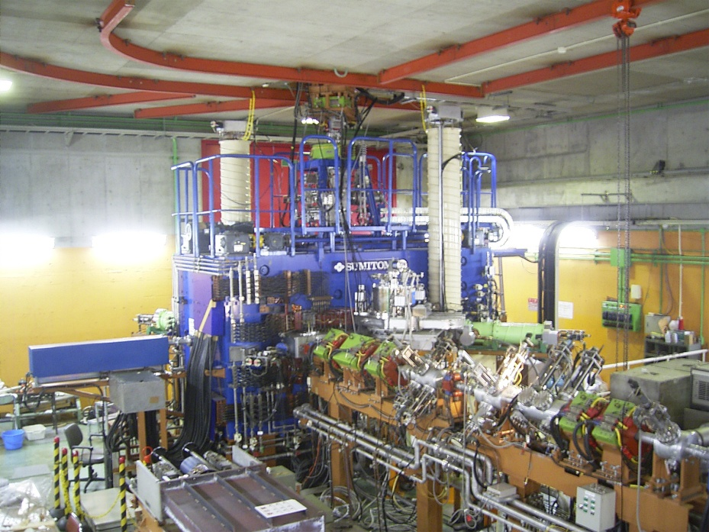


Where is a compact cyclotron at RIBF?
AVF
K = 70 MeV
Weight = 110 ton
Joho’s formula: 93 ton
Joho’s formula:
W = 5000 ton x (K/1000)^{3/2}
K = 700 MeV
Weight = 1500 ton
Joho’s fromula:2928 ton
M/Q=2, 60 MeV/u
K = 240 MeV
Joho’s fromula:588 ton
Weight = 301 ton
I would suggest design of K240
machine based on FRC.
But,
Injection is the most challenging.
(lack of space for the elements)
fRC
RRC
K = 540 MeV
Weight = 2300 ton
Joho’s formula: 1984

Slide 26
Review
Introduction: RIBF
RIBF accelerators
What is RIBF?
Goals of RIBF
How to produce RI beam
Requirement to accelerators
Spec of accelerators
SRC: most challenging
Intensity upgrade
RIBF upgrade plans
M/Q = 2, 1 pmA at RIBF
Intensity upgrade plan
Energy upgrade plan
H8 acceleration using RILAC, CSM, and RRC
Where is a compact cyclotron in RIBF
Notes:
2: This is a preview of my talk. The first session introduces to RI beam factory.
I will talk about what RIBF is, goals of RIBF and requirement to the accelerator.
The second section overviews construction of RIBF.
Here I will focus on the superconducting ring cyclotron SRC because it is the most technically challenging in this project.
The third section describes intensity upgrade mainly for uranium beam upgrade after the first beam. Finally I will mention about the scientific topics from this facility.

