Slide 1
BEST CYCLOTRON PLANS
OVER ALL OBJECTIVE AND COMPANY SCOPE
SELECTION OF CYCLOTRON ENERGIES
MEDICAL APPLICATIONS
RIB SOURCE
CONCENTRATE ON SPECIFIC SYSTEMS
HIGH CURRENT DESIGN CRITERIA
SUMMARY
RR JOHNSON
24 MAY 2015

Slide 2

Responsibility
Use nuclear physics understanding
To help people
Applications
Food
Health
Engineering
D. Hobson 2007

Slide 3
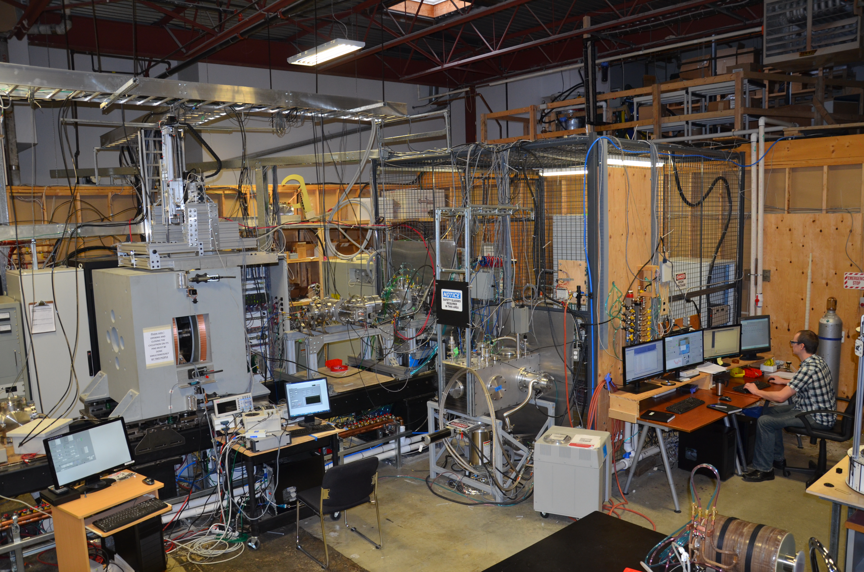


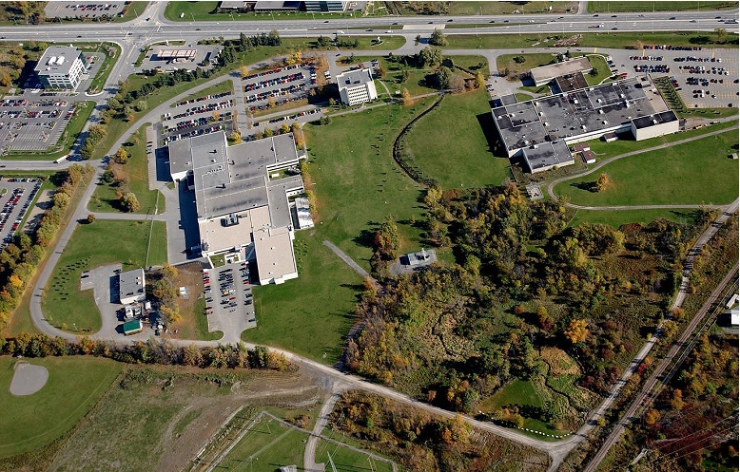
Best Products and Platforms
3. History
External Beam
  Gammatherapy (Co) Units
    ~ 1500 in Field
    Daily Treatments Delivered ~ 45,000
    Proven reliability
  IMRT
    Nomos introduced IMRT in 1992
  IGRT
    BAT – leading edge Ultrasound Based Image Guidance, ~600 Units
Brachytherapy (since 1977)
  Founding member of American Brachytherapy Society
  HDR & LDR Products & Accessories
Cyclotron Systems(since 2008)
B15
B70
B35 – B28
Vancouver Design and Test facility
Ottawa Manufacturing CNSC,NRC, FDA licensed

Slide 4
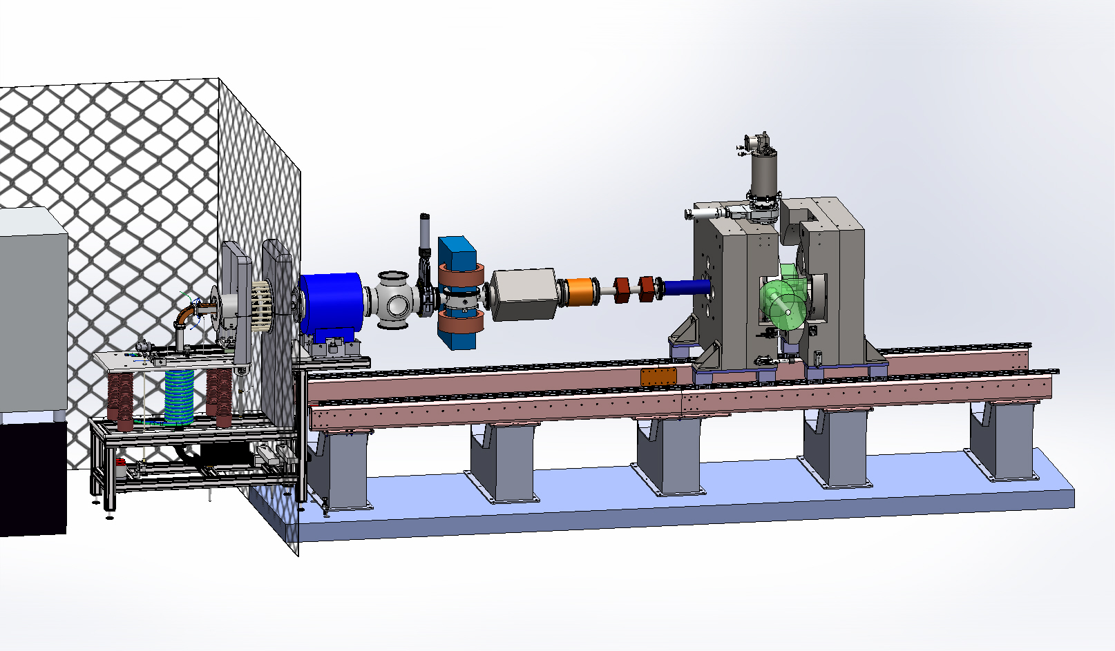
60 MeV H2+ injection line (MIT collaboration)
1
Open invitation to use test facility in Vancouver
9
4
5
8
3
6
7
10
2
1 – Ion source
5 – Slits and Buncher
9 – Main Magnet
2 – High voltage enclosure
6 – DCCT
10 – Support structure
and railing system
3 – Solenoid
7 – Quadrupole doublet
4 – Wien Filter
8 – Solenoid
Accelerator Capabilities for the Future of High Energy Physics DOE P5 Convener , W. A. Barletta October 30, 2013

Slide 5
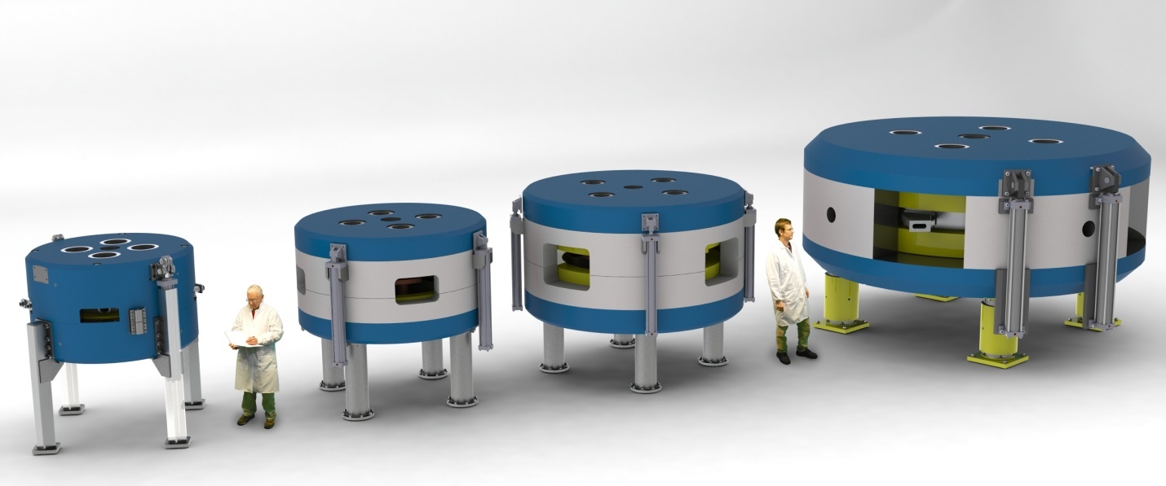
BEST CYCLOTRON SYSTEM s
14/15 MeV 25-35 MeV 70 MeV
All BEST cyclotrons have external Ion Sources
=> Extracted Currents from 100 to 1000 uA

Slide 6
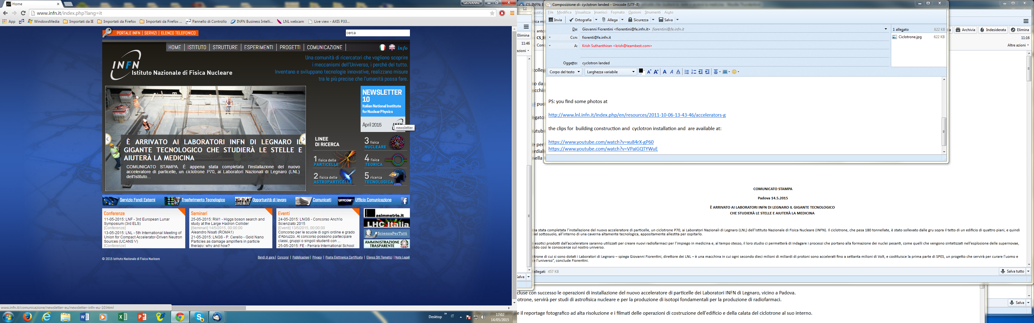

Slide 7
https://www.youtube.com/watch?v=VPaiGQTYWuE
INFN UTube video of installation.
It even has music!

Slide 8
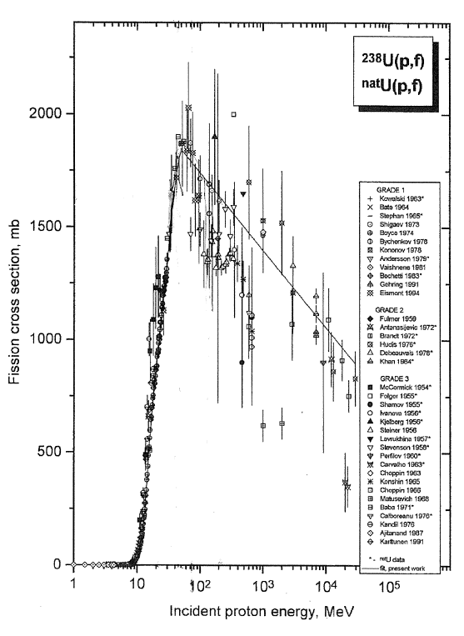
Fission
cross section versus
bombarding energy
Ani Aprahamian private communication

Slide 9
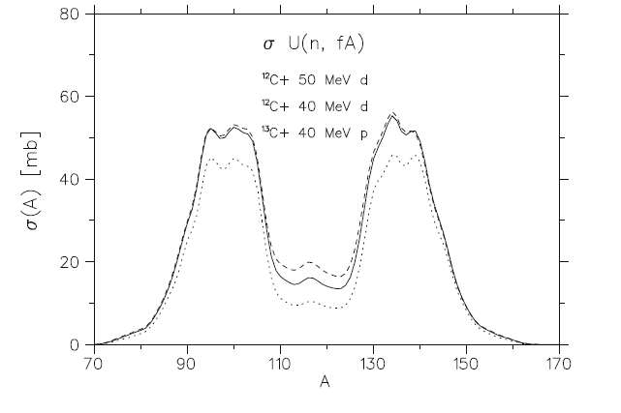
G. Lhersonneau et.al. Hyperfine Interact (2014) 223,257

Slide 10
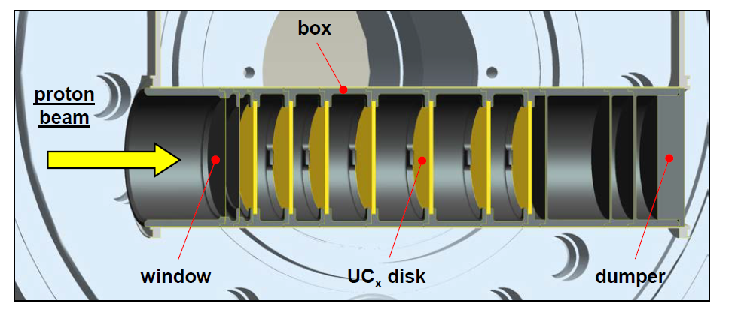
SPES RIB TARGET
DESIGNED FOR 40 MeV BEAM
M. Maggiore, INFN private communication

Slide 11
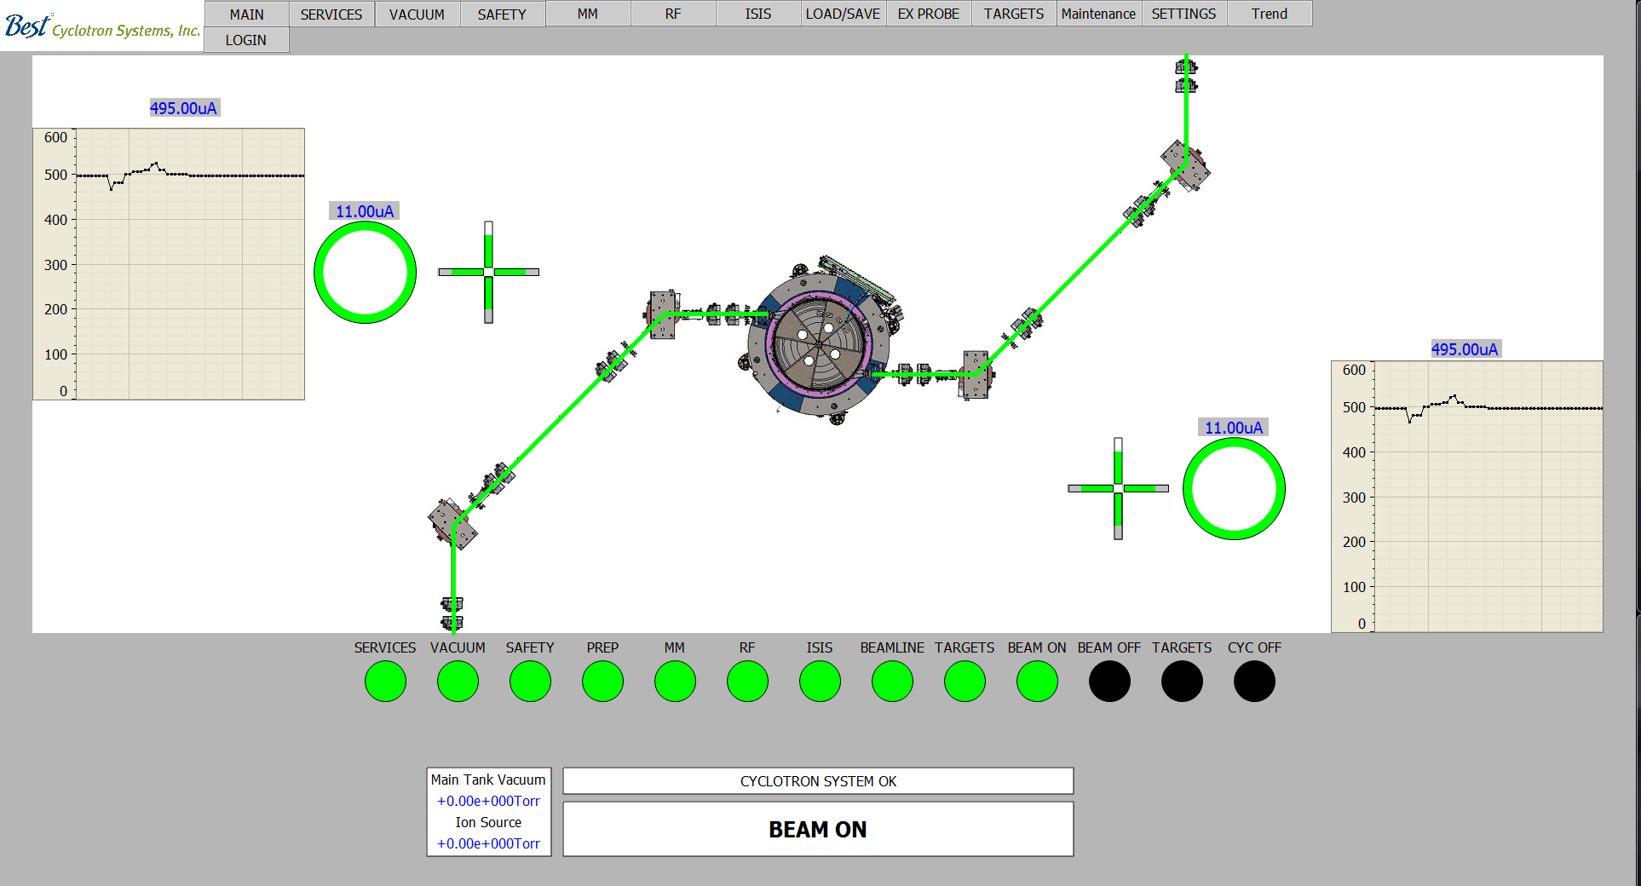
Main Control Screen
Radioactive beam Experiments
INFN Legnaro B70
Radioisotopes for Nuclear Medicine
(eg. ⁶⁷Cu)
Current Operator
Navigation Bar
Target Current
And Total Activity
Ion Source Output
Beam Diagnostics
Visible Beam On
RF Dee Voltage
Main Magnet Current
Machine Status
Alarms, Warning
Vacuum Reading

Slide 12
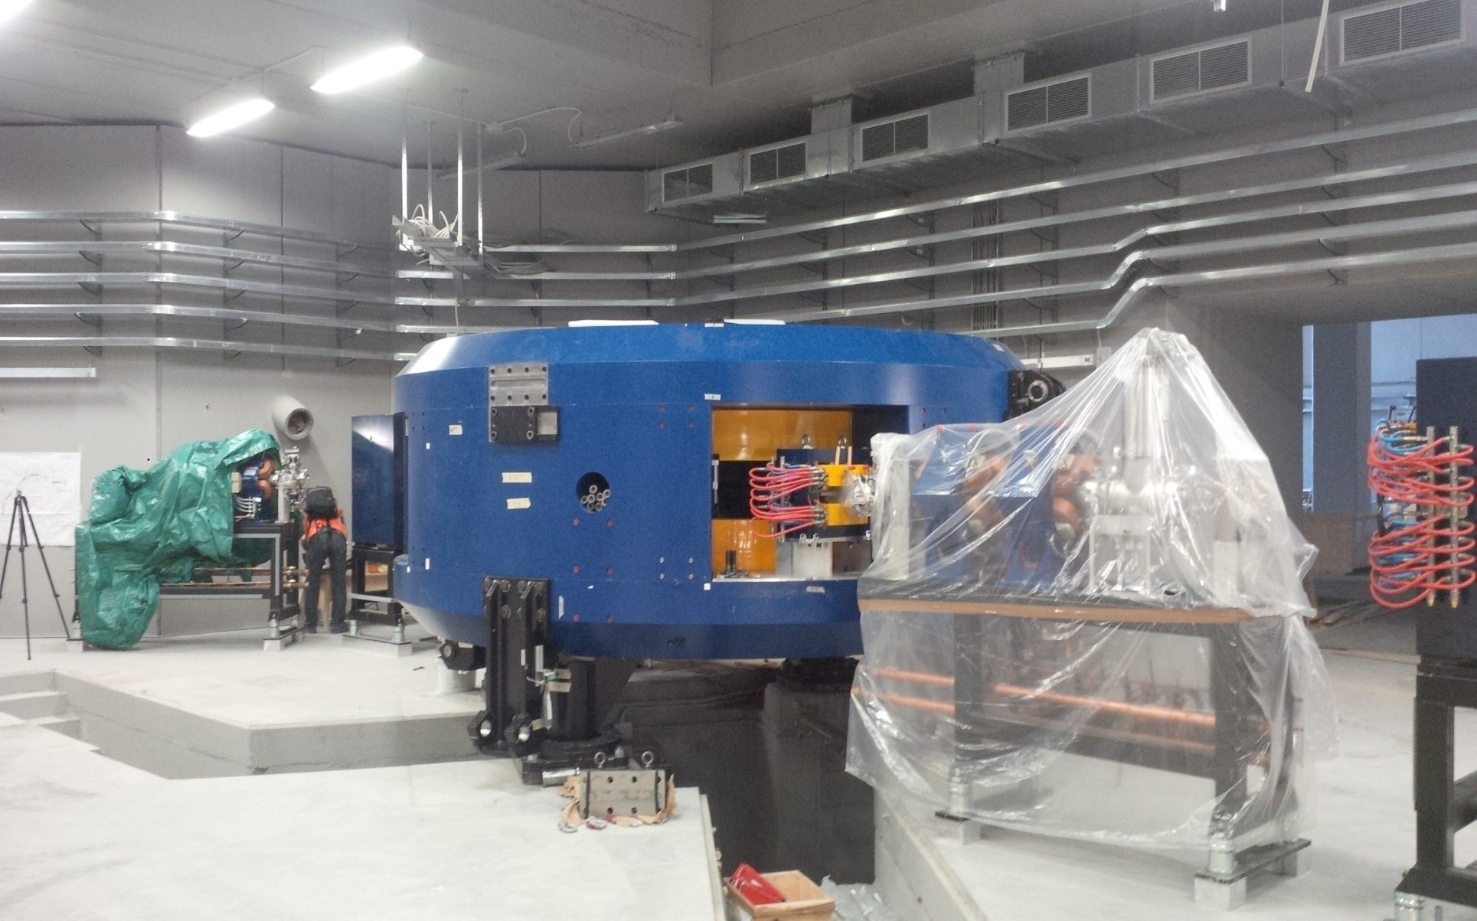
B70 for INFN legnaro
70 MeV x 700 uA = 50 kW
operation this year
“one Big, Fat,
Ugly,
PIG!
LOL”
JJ Seabrook
~2011
Loverly
Actually cusp source

Slide 13
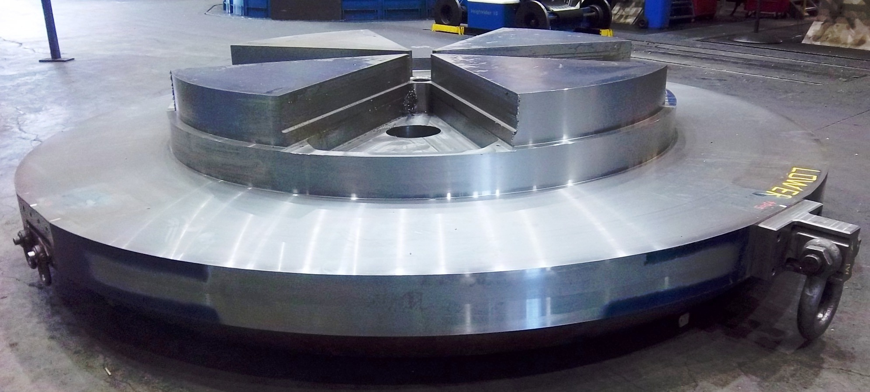
Single Forging
FORCES MINIMUM SURFACE AREA (BASE PRESSURE)
CONSTRAINS DIMENSION TOLERANCE (SINGLE CNC PROCESS)
MINIMIZES VACUUM DISPLACEMENT

Slide 14

Vacuum

Slide 15
Stripping vs. Pressure

Slide 16
Accumulated Loss vs. Energy

Slide 17
Main screen
Current Operator
Navigation Bar
Target Current
And Total Activity
Ion Source Output
Beam Diagnostics
Visible Beam On
RF Dee Voltage
Main Magnet Current
Machine Status
Alarms, Warning
Vacuum Reading

Slide 18
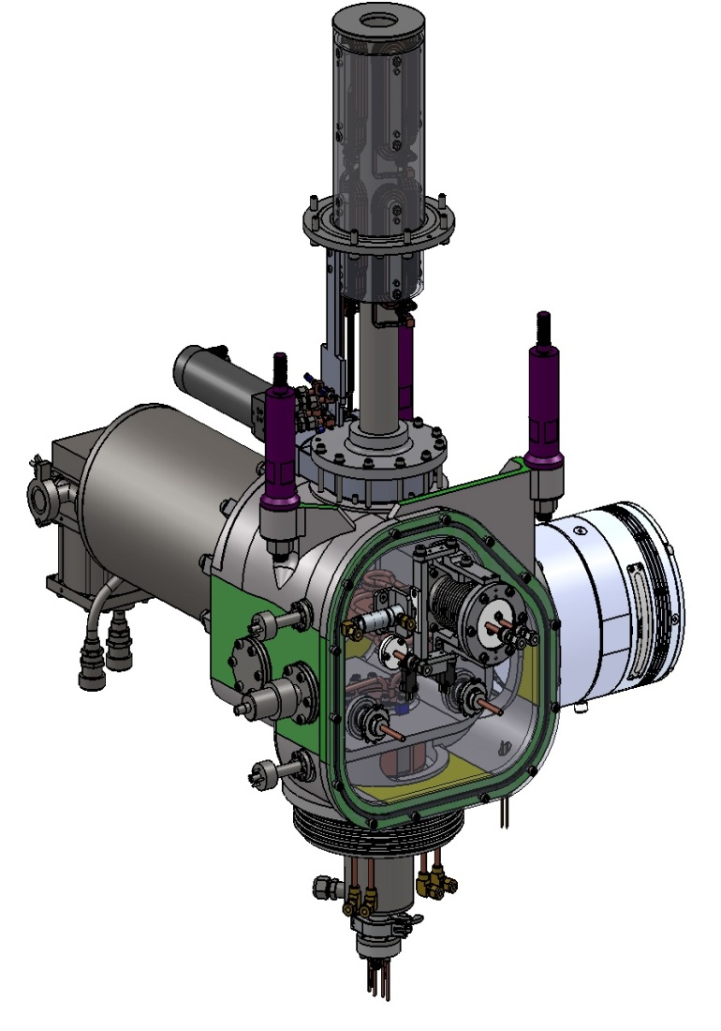
Cyclotron ion source
Emittance control
Gas loading……beam stripping
Cost?
External Source

Slide 19
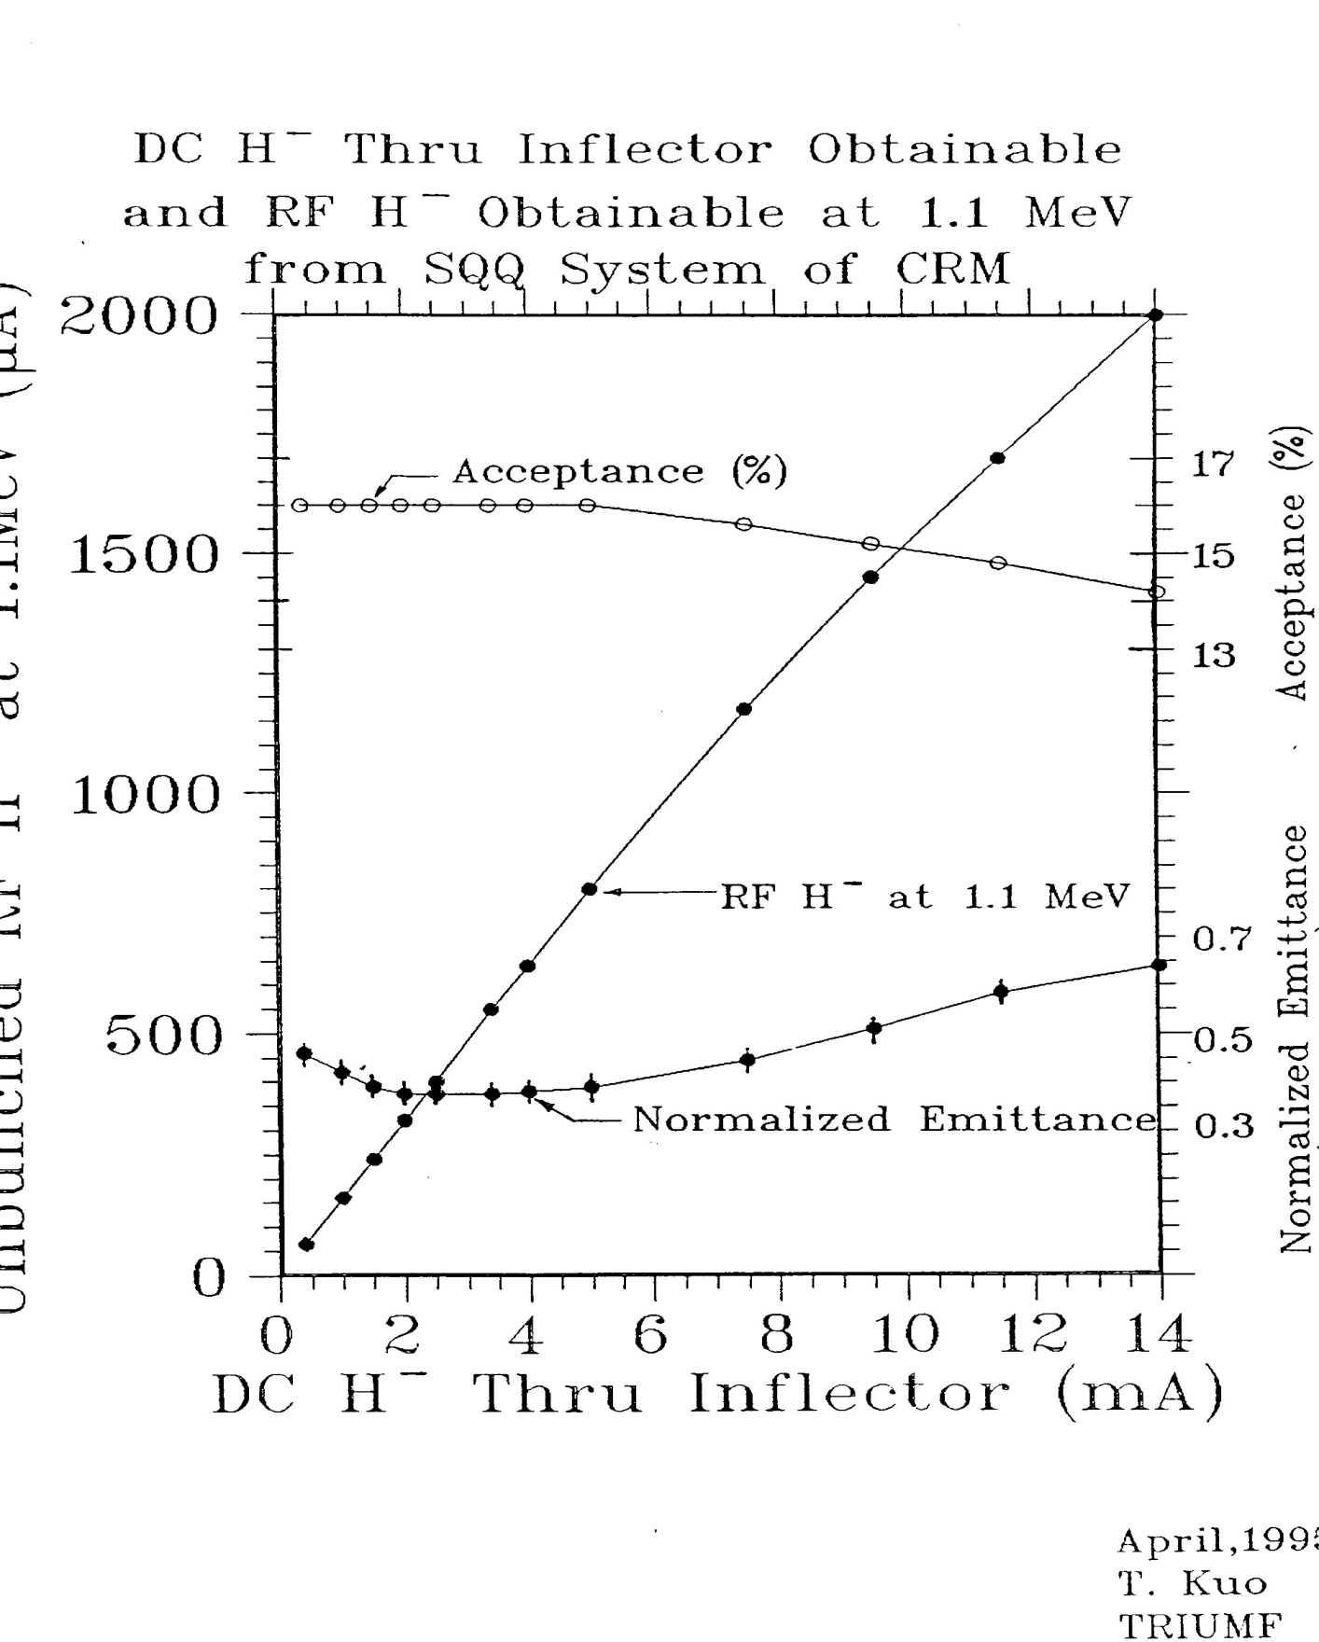
Unbunched Current at 1 MeV (μA)

Slide 20
General description
Tuner
Tuner
Coupler
Dee #1
Dee #2
Coupler
Motor
M
M
Motor
Motor
Motor
M
Tuner fix
RF Pick-up
RF Pick-up
Tuner fix
M
Phase
Phase
Power monitor
RFL
RFL
Power monitor
RF Amp
RF Amp
LLRF Digital Control
START logic
CW/Pulse operation
RF Conditioning
Master/Slave
LLRF Digital Control
START logic
CW/Pulse operation
RF Conditioning
Cyclotron Supervisory PLC
Operation control
Interlock & Safety

Slide 21
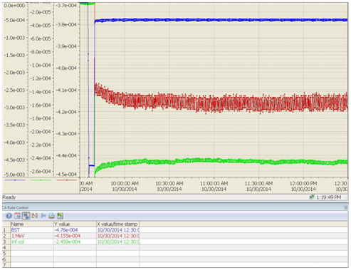
Beam stability test
Beam jitter is within +/-4uA of the average of 416µA over a two hour period (or 1%).
Stability over two hours is better than 4µA (or 1%).
Ion source warming up
2 hours
412 uA
420 uA

Slide 22
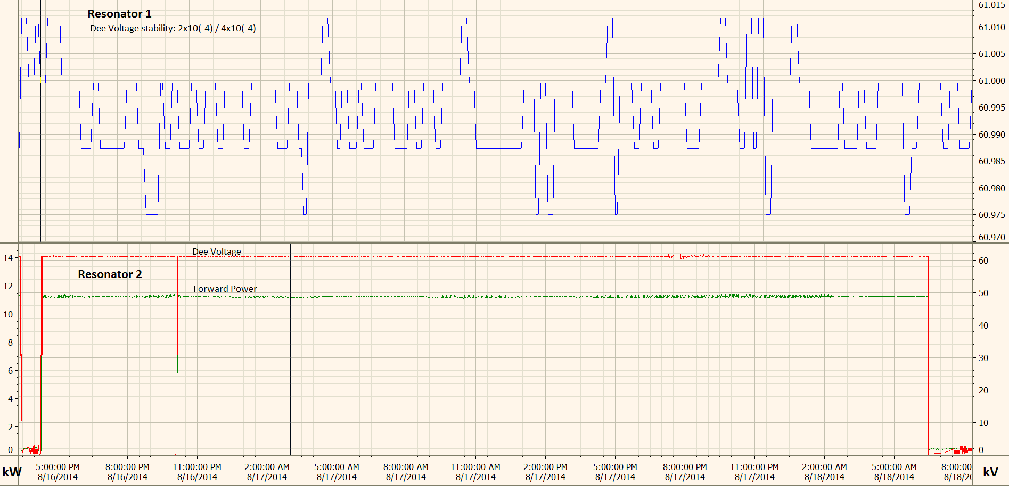
RF Endurance test
Dee Voltage stability: 4 x 10⁻⁴
5 min snapshot
40 hour test

Slide 23
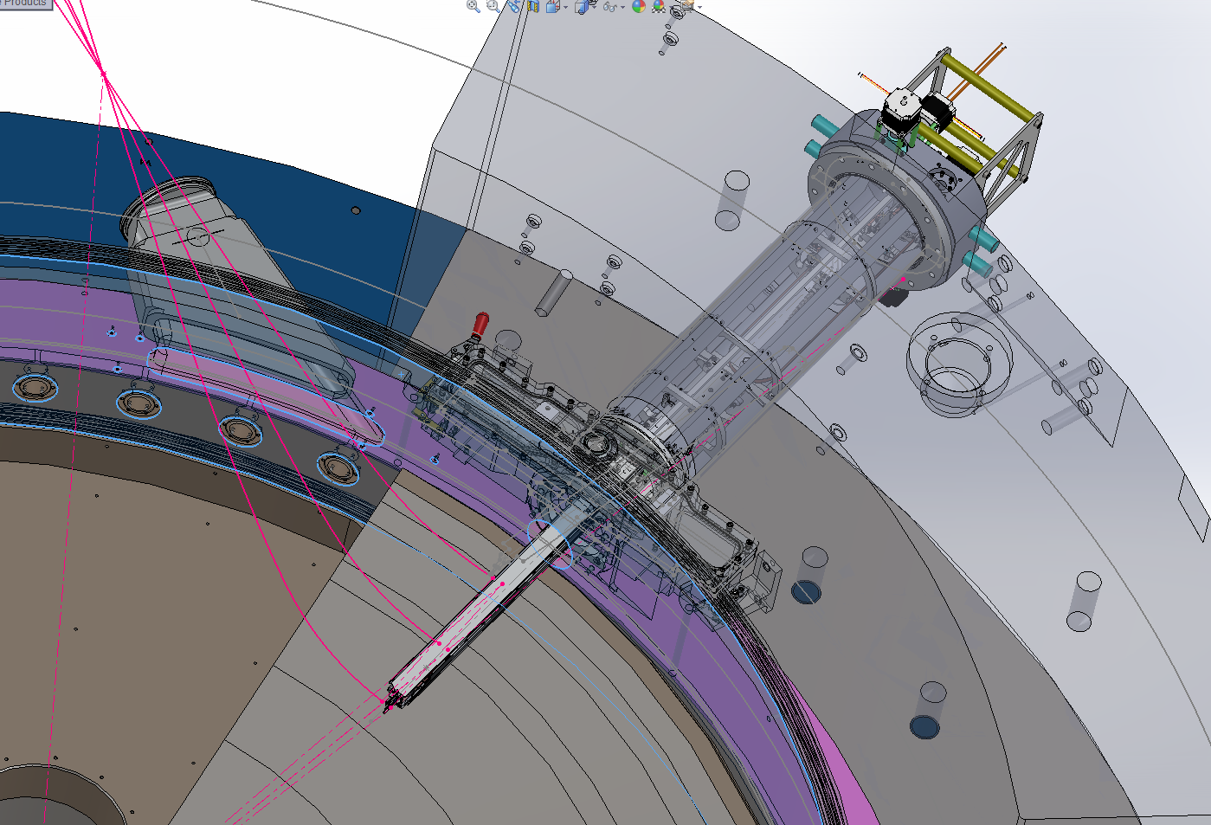
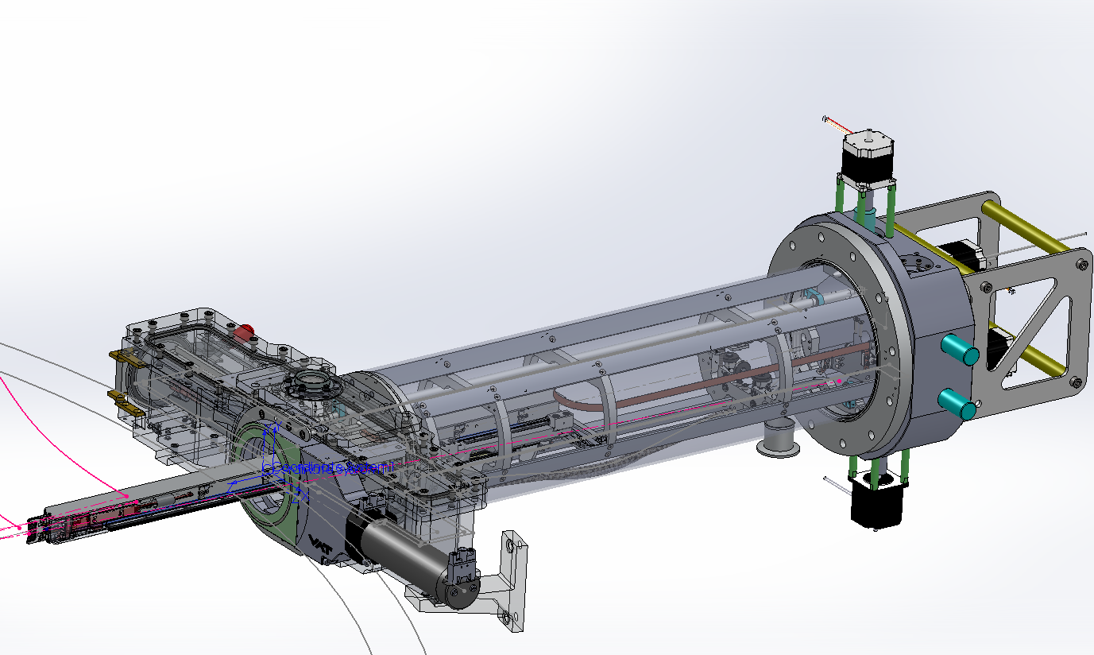
Stripper assembly provision for 40 foils
Notes:
30 MeV operation 1 week @800 uA is 5 foils

Slide 24
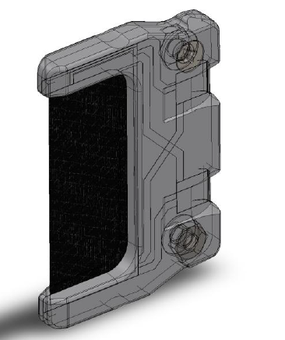
TRIUMF experience
Stripping foil life time 15,000 uAhrs
@1000 uA results in a 15 hour lifetime
Covidien experience
Stripping foil life time 20,000 uAhrs
@1000uA results in a 20 hour lifetime
Require a minimum
foil supply of 10 foils per week

Slide 25
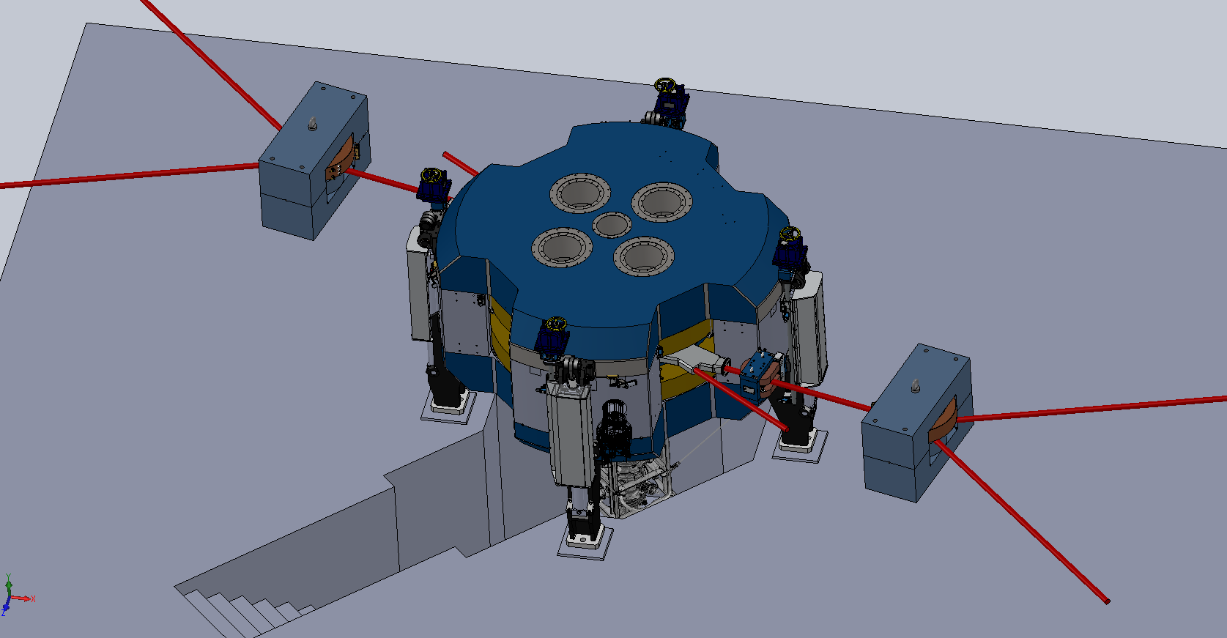
B35 under construction
Switching magnet for target caves
All energies available
Fixed energy PET beamline
15 MeV with PET target in cyclotron bunker

Slide 26
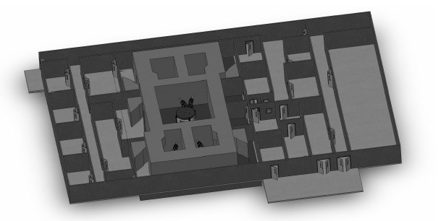
Accelerator must be optimized – so too the facility
Beam lines, targets, power supplies, shielding, laboratories

Slide 27
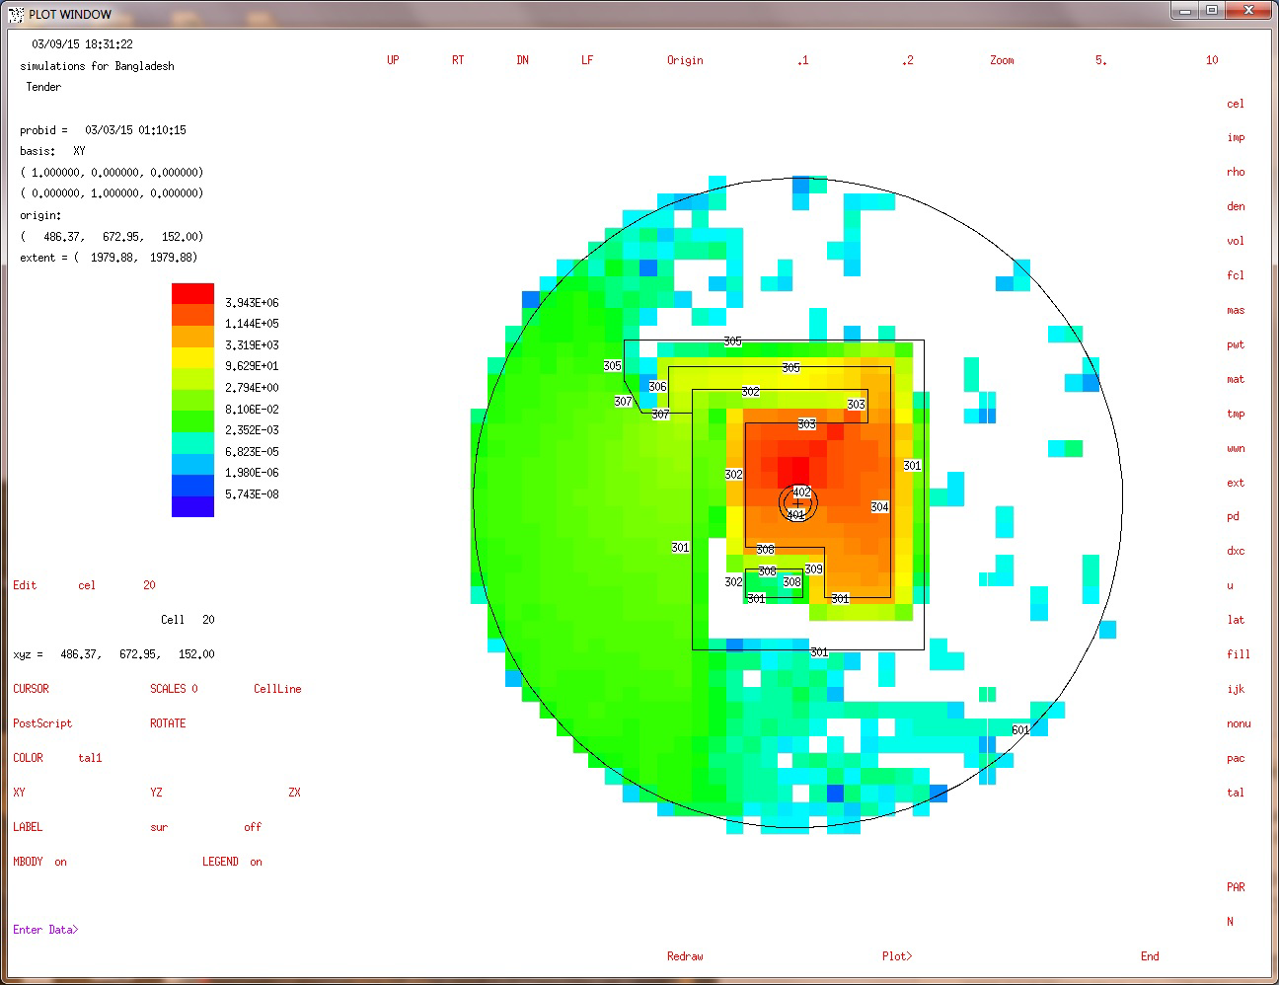
OUTLINE OF PET CYCLOTRON BUNKER IN RECENT TENDER DOCUMENT
MARCH 2015
Neutron Radiation levels n (uSv/uAhr)
MCNP CALCULATION OF NEUTRON RADIATION LEVELS
BEST MARCH 2015

Slide 28
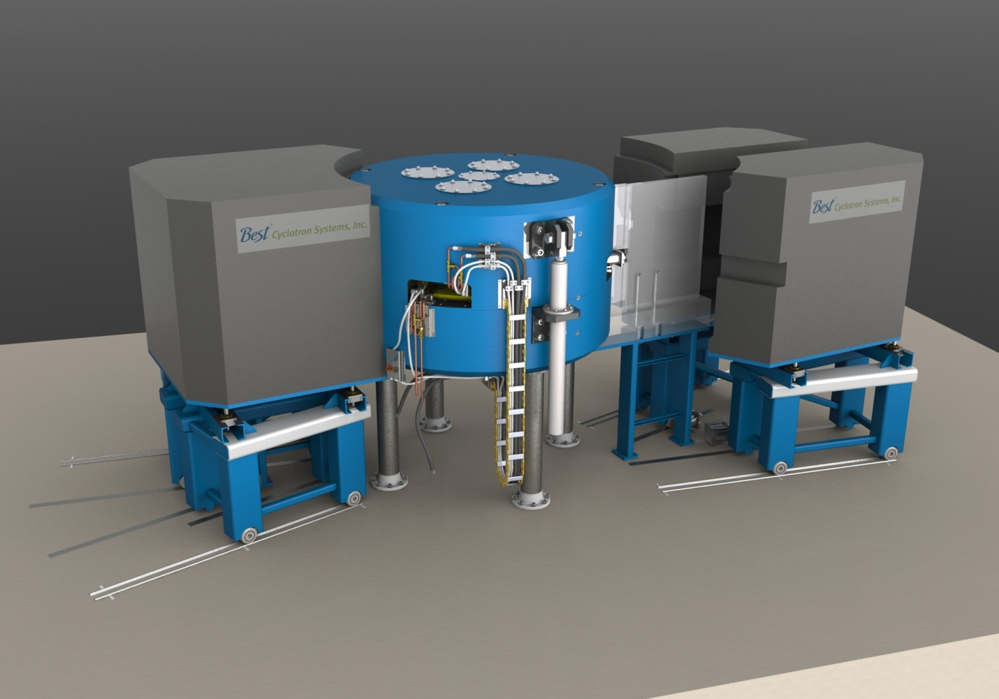
Include local shielding and simplify doors

Slide 29
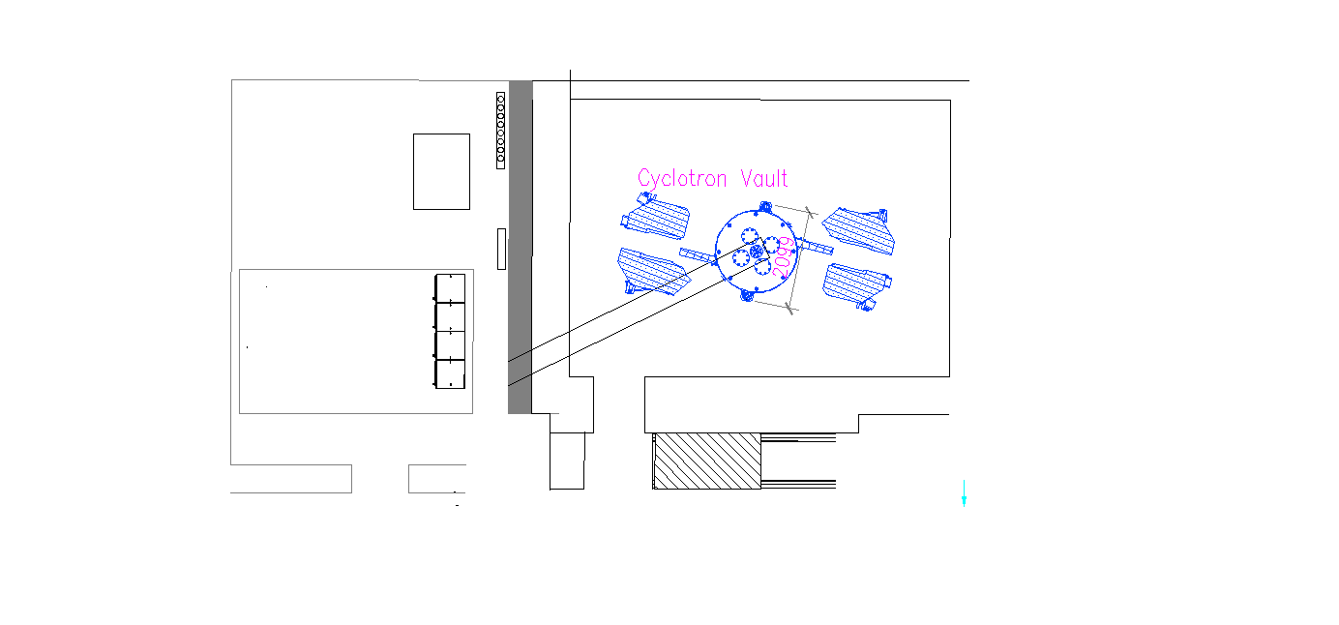
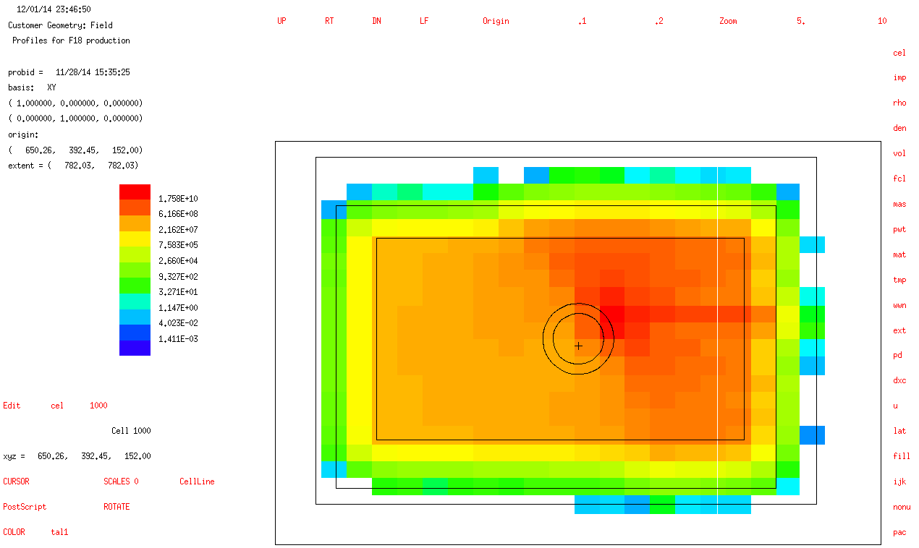
Simple block door MCNP estimate
Production target
Block door
Neutron Dose Rate per microA of beam during F18 production (on the XY plane passing on the source point)

Slide 30
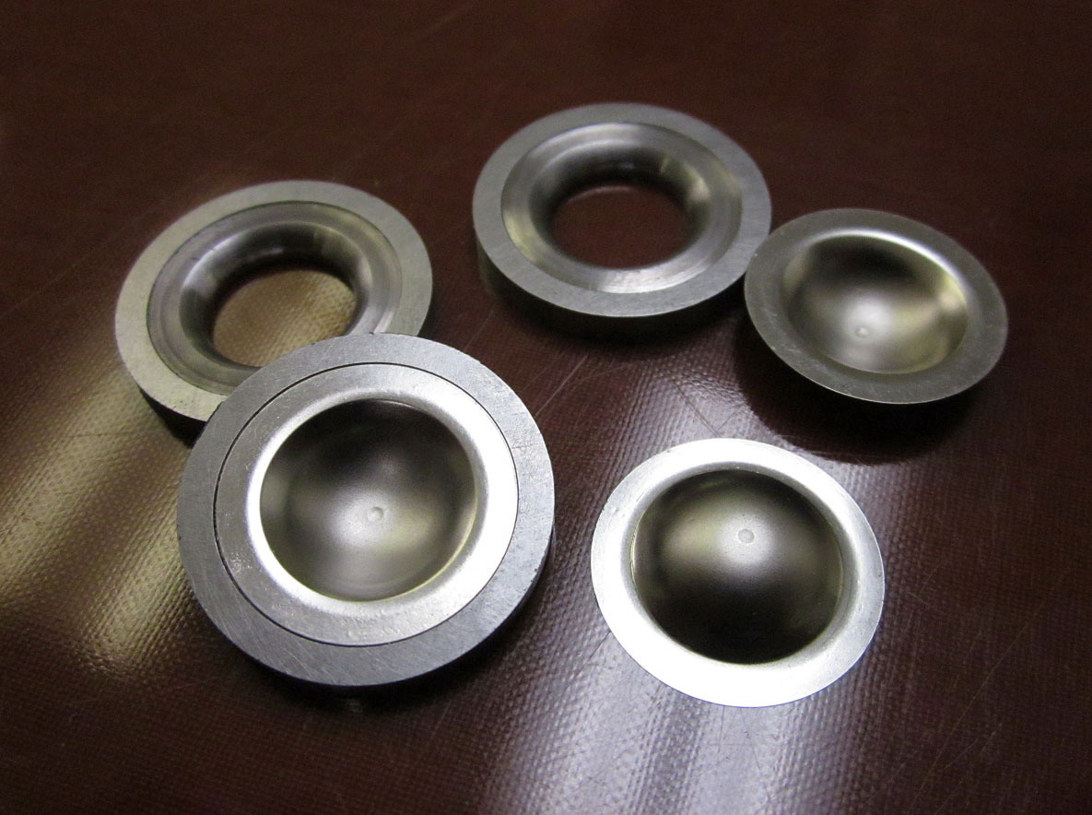
Target Windows
The isolation windows of TeamBest target cells are preformed passivated havar. Their dome shape allows a thin central region (~ 20 um) and holds a very high pressure (tested to bursting at 2500 lb/in²). This design eliminates the need for a helium cooling system for the beam windows.

Slide 31
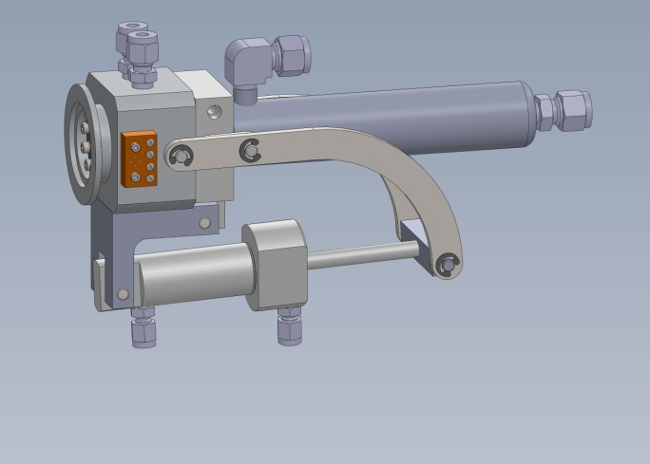
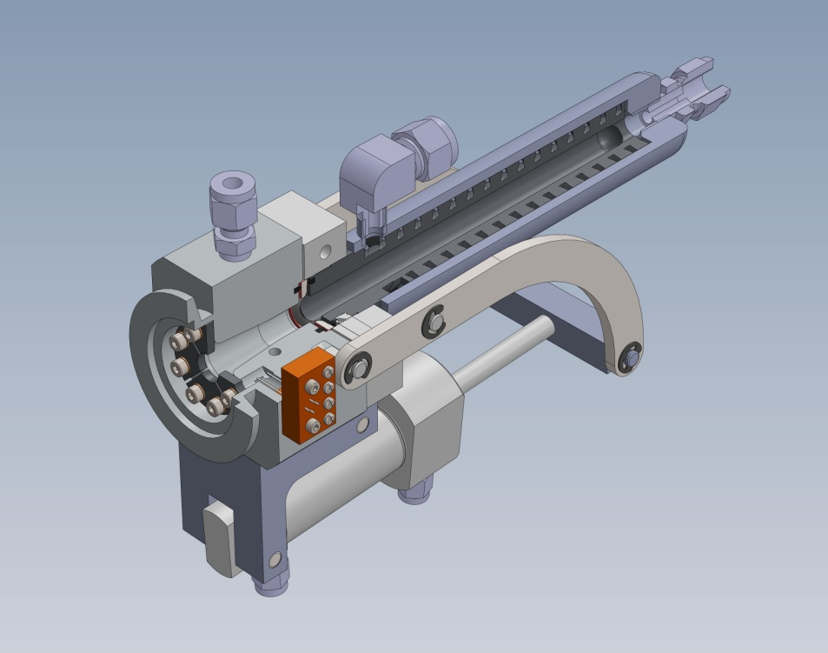
Target body: cast silver passivated with Platinum
Length: 150 mm
Shape: 10 mm entrance tapering to 15 mm
Operating pressure: 600 PSI
Gas target

Slide 32
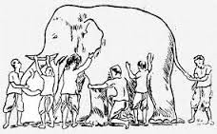
A cyclotron is a radioisotope production system. Production targets Radiochemical separation Target material and target reprocessing Site design licensing

Slide 33

BUT WE STILL HAVE AN OBLIGAITION TO USE WHAT WE HAVE AND KNOW TO HELP
Wisdom of Ages J. Neeley 2007

Slide 34
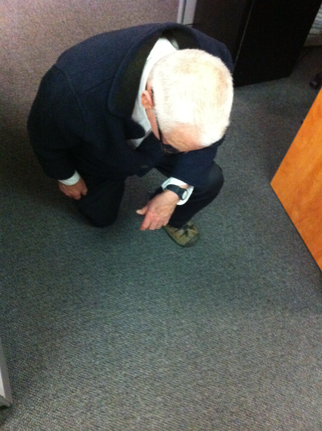
A cyclotron is a radioisotope production system. Production targets Radiochemical separation Target material and target reprocessing Site design licensing
RRJ, General MGR
richard@teambest.com

