Slide 1
Investigation of two-nucleon spatial correlation in light unstable nuclei
Fumiharu Kobayashi (Niigata Univ.)
Yoshiko Kanada-En’yo (Kyoto Univ.)

Slide 2
Introduction

Slide 3
Dinucleon correlation
Dinucleon correlation: (dineutron or diproton correlation)
strong spatial correlation between two nucleons coupled to a spin-singlet (considered as a cluster)
core
Dinucleon correlation can be enhanced in
low-density region of neutron matter
neutron-halo or -skin region of neutron-rich nuclei
(⁶He, ¹¹Li…)
M. Matsuo, PRC 73 (2006)
G. F. Bertch and H. Esbensen, Ann. Phys. (NY) 209 (1991)
M. V. Zhukov et al. Phys. Rep. 231 (1993)
M. Matsuo et al., Phys. Rev. C 71 (2005)
K. Hagino et al. Phys. Rev. Lett. 99 (2007)

Slide 4
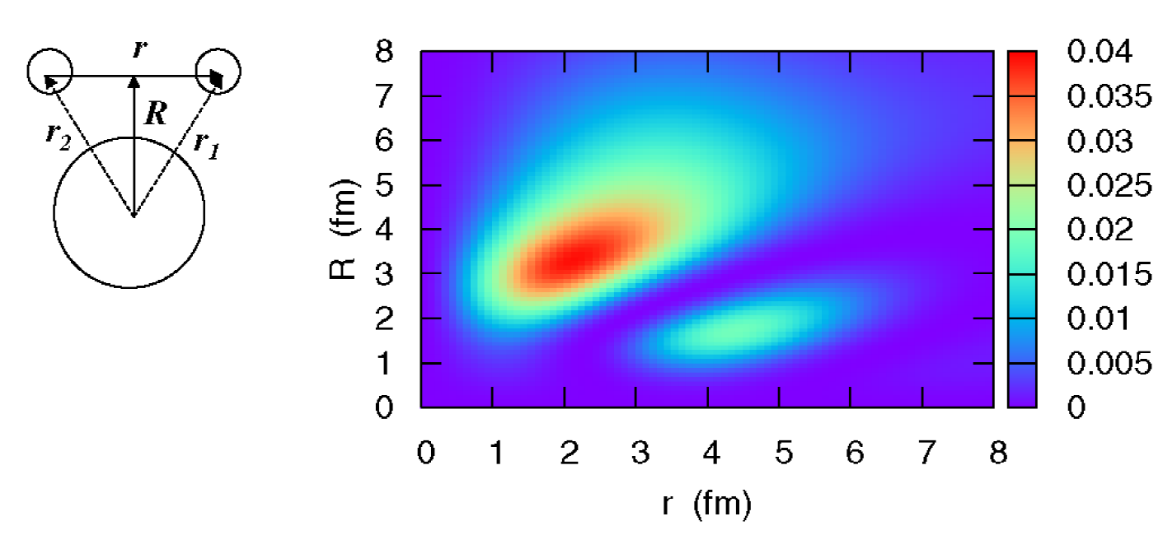
Dinucleon in finite nuclei
A three body model (core+2N) is one of the useful methods to discuss dinucleon correlation.
2n density in ¹¹Li around ⁹Li core
K. Hagino et al., PRL99 (2007)
dineutron
cigar

Slide 5
Dinucleon in finite nuclei
A three body model (core+2N) is one of the useful methods to discuss dinucleon correlation, and there are a few works where the core excitation or deformation are taken into account.
(e.g., in ⁹Li core for ¹¹Li, pairing- and tensor-type excitation,
core deformation)
But a systematic investigation has never been conducted
and the universal properties of dinucleon correlation (e.g., the effect of core structure) is not well-known.
T. Myo et al., PTP108 (2002), PRC76 (2007)
I. Brida et al., NPA775 (2006)

Slide 6
Dinucleon formation and expansion
At the surface,
core
core
independent shell-model configuration
dinucleon formation
(cluster-like correlation)
Far from the core,
core
core
dinucleon swelling
(quasi-free 2n)
dinucleon expansion
(cluster-like motion)

Slide 7
Aim of this work
We would like to clarify how
core structures (excitation, deformation, clustering…)
single-particle orbits of valence nucleons
strength of binding between a core and valence nucleons
(halo and skin structures…)
affects dinucleon correlation.
To investigate 2N motion around a core with various structure,
we extend antisymmetrized molecular dynamics (AMD)
and apply this method to ¹³O and ²²C.

Slide 8
¹³O

Slide 9
¹³O
First, we consider diproton correlation in ¹³O (¹¹C+2p),
which is a nucleus on the proton-drip line (S_{2p} ~ 2.11 MeV).
We discuss the effect of the ¹¹C core deformation on the diproton formation, and we will suggest the core structure can affect diproton formation significantly.
¹¹C

Slide 10
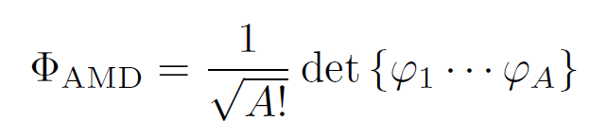

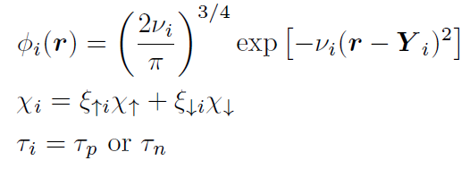
AMD wave function
(antisymmetrized molecular dynamics)
The nuclear system is described with the Slater determinant of single-particle wave functions.
single-particle w.f.:
The parameters Y_{i} and ξ_{i} are determined
by energy variation independently.

Slide 11
Energy variation
In order to describe detailed two-proton motion around a core,
we perform energy variation for an A-nucleon system in two steps.
Preparation of a ¹¹C core
deformed by β
We perform energy variation for a ¹¹C core
under β-constraint with β=0.2 and 0.5
and we fix to ν=0.19 in the core.
¹¹C

Slide 12

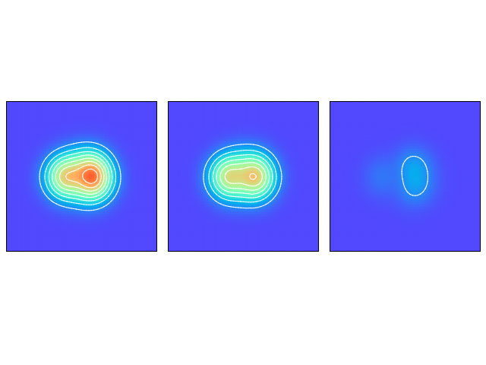
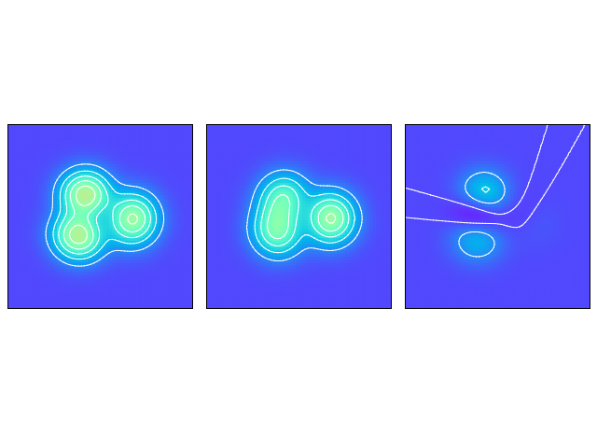
¹¹C core density (z-y plane)
ρ_{p}
ρ_{n}
ρ_{p}-ρ_{n}
β=0.2
y
z
β=0.5
Superposition of these cores approximately agrees with the GCM calculation with β = 0.0, 0.1,…, 0.7.

Slide 13
Energy variation
In order to describe detailed two-proton motion around a core,
we perform energy variation for an A-nucleon system in two steps.
Preparation of a ¹¹C core
Energy variation of only 2p around the core
deformed by β
We perform energy variation for a 11C core
under β-constraint with β=0.2 and 0.5
and we fix to ν=0.19 in the core.
¹¹C
multi width
We perform energy variation of only 2p
with multi width under d_{2p}-constraint.
(Here we calculate with d_{2p}=1, …, 4 fm (8 values)
and superpose ν_{2p}=0.19, 0.125, 0.08 fm⁻²)
d_{2p}
¹¹C
(fixed)
N. Furutachi et al., PTP122 (2009)

Slide 14
Described 2p motion
small d_{2p}
independent motion
(shell-model configurations)
diproton formation
(cluster-like configurations)
large d_{2p}
diproton expansion
(cluster development)
multi-width superposition
(ν_{2p}=0.19, 0.125, 0.08 fm⁻²)
diproton swelling
(quasi-free 2n)

Slide 15
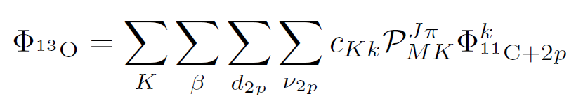
¹³O wave function
We superpose the bases calculated under the d_{2p}-constraint with the multi Gaussian width for 2p around the cores.
We project the wave functions to Jπ=3/2- and superpose them.
The coefficients c_{Kk} are determined by diagonalizing the Hamiltonian.
We compare the results obtained in the cases of larger core deformation (full) [superposing the wave functions with β=0.2 and 0.5 cores] and smaller core deformation (fixed) [superposing the wave functions with only a β=0.2 core].

Slide 16

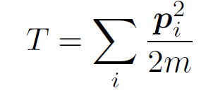
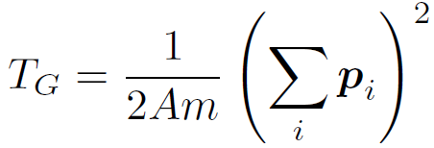


Effective Hamiltonian
Projecting the AMD wave functions to J^{π} = 3/2⁻ and diagonalizing the following Hamiltonian, we obtain ¹³O(3/2⁻₁).
: Volkov No.2 (b=h=0.125)
: LS part of G3RS
We use v_{LS} = 800 MeV in V_{LS} (reproducing the spectrum of ¹³C)
and choose the parameter m in V_{cent} to reproduce S_{2p} of ¹³O.

Slide 17
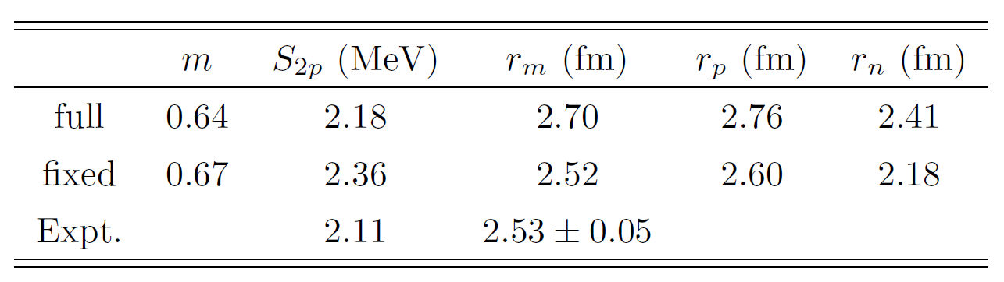
2p separation energy and radii of ¹³O
2p separation energies, S_{2p}, agree with the experimental value.
Radii are larger in the full calculation due to the larger core deformation.
Next, we examine the diproton formation in those cases.

Slide 18

2p overlap function
To examine the diproton component,
we define the overlap function for 2p as follows.
core wave function calculated with β = 0.5 (full) or 0.2 (fixed)
¹³O wave function
(full or fixed)
We integrate Ω_{r} and Ω_{rG} to examine the component of a spin-singlet 2p whose relative motion and c.o.m. motion are both the s wave.
p↑
r (ℓ=0)
r_{G} (L=0)
f(r,r_{G}) gives the information on the spatial distribution of a spin-singlet pair of two protons (ℓ=0, L=0).
p↓
In f±±, two protons occupy positive- or negative-parity orbits
and they are orthogonal.
¹¹C

Slide 19
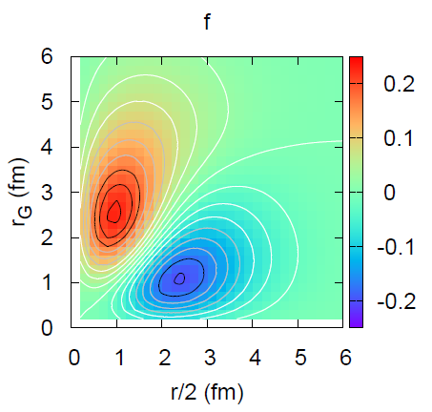
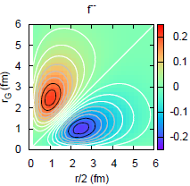
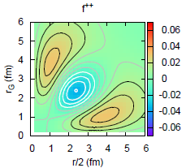
Diproton correlation in overlap function
The absolute value of the diproton peak is larger than
that of the cigar peak.
diproton enhancement
f of ¹³O (full)
f⁻⁻ (major)
Preriminary
p²
diproton
=
+
cigar
f⁺⁺ (minor)
r
(sd)²
r_{G}

Slide 20
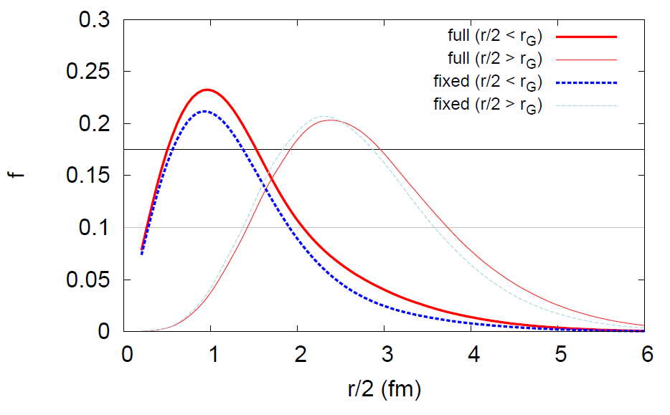
Diproton correlation dependent on core deformation
Preriminary
diproton
cigar
In the fixed-core calculation, the peaks are almost the same ((0p_{1/2})² closure).
In the full calculation, the diproton peak is enhanced because the core deformation causes the radial 2p expansion.

Slide 21
Summary of ¹³O
We have investigated diproton correlation in ¹³O by using the extended AMD.
We have suggested that the core deformation affects the degree of diproton formation.
In ¹³O, the core deformation enhances the diproton correlation.
One of the reasons for this is that the core potential is expanded due to the core deformation and, as a result, 2p can be radially expanded to form a spin-singlet diproton.

Slide 22
²²C

Slide 23
²²C
²²C is a candidate for a 2n-halo nuclei,
(S_{2n} = -0.14±0.46 MeV L. Gaudefroy et al. PRL109 (2012)
r_{m} = 5.4±0.9 fm K. Tanaka et al. PRL104 (2010))
and it has been well discussed in view of the low-lying E1 strength and so on.
In most studies about ²²C, the ²⁰C core is spherical, though it is suggested to be largely deformed.
We would like to investigate the 2n motion around a deformed ²⁰C core using the extended AMD.
Y. Kanada-En’yo, PRC71 (2005)

Slide 24
Energy variation
In order to describe detailed two-neutron motion around a core,
we perform energy variation for an A-nucleon system in two steps.
Preparation of a ²⁰C core
We perform energy variation for ²⁰C core
fixing the spins to up or down without a constraint,
and we fix to ν=0.165 in the core.
²⁰C
This variation gives the deformed ²⁰C (β=0.23).

Slide 25
Energy variation
In order to describe detailed two-neutron motion around a core,
we perform energy variation for an A-nucleon system in two steps.
Preparation of a ²⁰C core
Energy variation of only 2n around the core
We perform energy variation for ²⁰C core
fixing the spins to up or down without a constraint,
and we fix to ν=0.165 in the core..
²⁰C
multi width
We perform energy variation for only 2n (up and down)
with multi width under d_{2n}-constraint.
(Here we calculate with d_{2n}=1, …, 8 fm (14 values)
and superpose ν_{2n}=0.165, 0.125, 0.056 fm⁻²)
d_{2n}
²⁰C
(fixed)

Slide 26
Effective Hamiltonian
Projecting the AMD wave functions to J^{π} = 0⁺ and diagonalizing the following Hamiltonian, we obtain ²²C(0⁺₁).
: MV1 force (m=0.615, b=h=0.15)
: LS part of G3RS
We use v_{LS} = 2400 MeV in V_{LS} to reproduce Ex(2⁺₁) of ²⁰C
and choose the parameter m in V_{cent} to reproduce S_{2n} of ²²C.

Slide 27
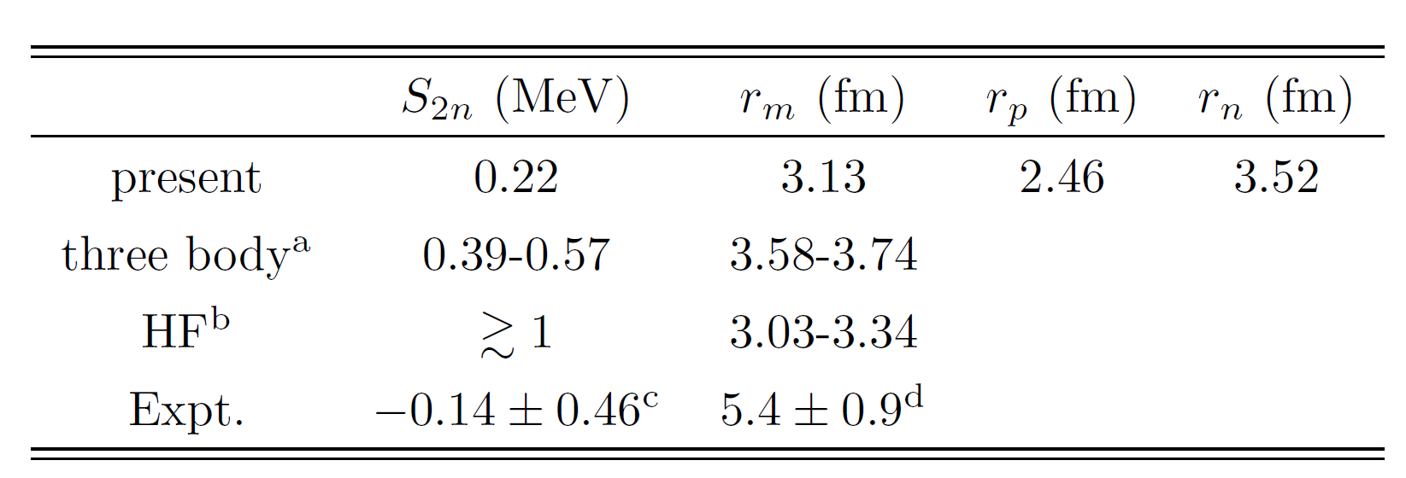
2n separation energy and radii of ²²C
ªW. Horiuchi and Y. Suzuki PRC74 (2006)
^{b}T. Inakura et al. PRC89 (2014)
^{c}L. Gaudefroy et al. PRL109 (2012)
^{d}K. Tanaka et al. PRL104 (2010)
The matter radius in the present calculation is smaller than those in the other calculations and experiment,
but the present ²²C has the neutron-halo structure.

Slide 28
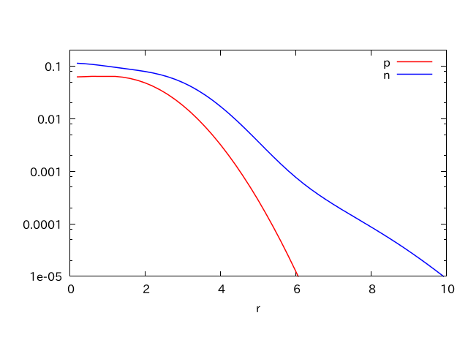
Single-particle density
Preriminary
ρ(r) (fm⁻³)
r (fm)
The neutron density has a much longer tail (halo)
than the proton density.

Slide 29
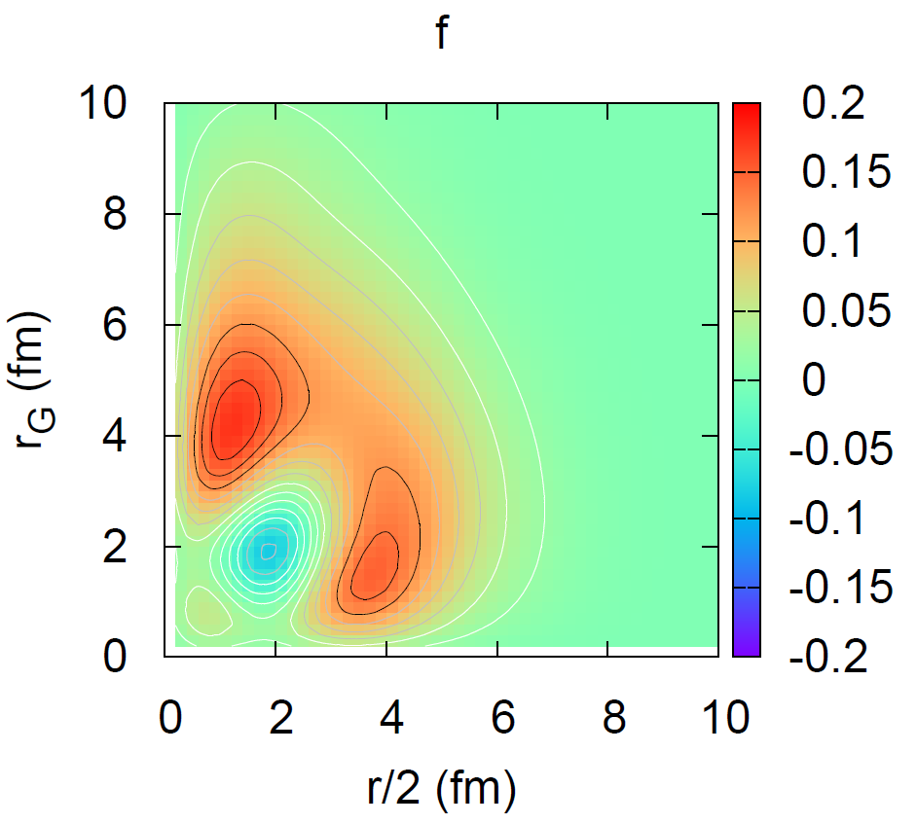
2n overlap function
We plot the 2n overlap function around ²⁰C, f(r,r_{G}).
Preriminary
The ratio between the peaks at (1.2,4.2) and (0.38,1.6) is 1:0.858.
1s_{1/2} is dominant for 2n and dineutron correlation does not extremely enhanced.
r
r_{G}

Slide 30
Summary of ²²C
We have investigated dineutron correlation in ²²C by using the extended AMD.
We have shown that the dineutron correlation is somewhat enhanced in ²²C but not extremely as that in ¹¹Li in spite of the two-neutron-halo structure.
In ²²C, two neutrons mainly occupy 1s_{1/2}, which swells the dineutron size, and the negative-parity orbits do not contribute so greatly.
This situation is quite different from ¹¹Li, in which it is suggested that p and s orbits almost degenerates and are mixed fifty-fifty.

Slide 31
Summary

Slide 32
Summary
We extended an AMD method to describe the detailed motion of two valence nucleons around the core with various structures,
and we proposed the efficient analyzing method for dinucleon correlation, that is, the 2N overlap function.
We have shown that the core deformation and the single-particle orbits of 2N play important roles in the dinucleon formation.
In future, we would like to many nuclei with various structures
(e.g., nuclei with a deformed and clusterized core and nuclei with p-orbit halo)
to clarify the universal properties of dinucleon correlation.

Slide 34
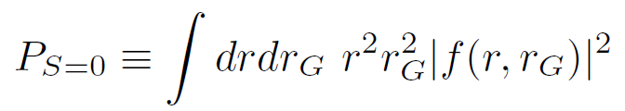
Overlap function for 2p
To examine the diproton component,
we define the overlap function for 2p as follows.
We integrate Ω_{r} and Ω_{rG} to examine the component of a spin-singlet 2p whose relative motion and c.o.m. motion are both the s wave.
p↑
r
As a measure for formation of an S=0 2p pair,
we calculate the integral of the amplitude f.
r_{G}
p↓
¹¹C

Slide 35
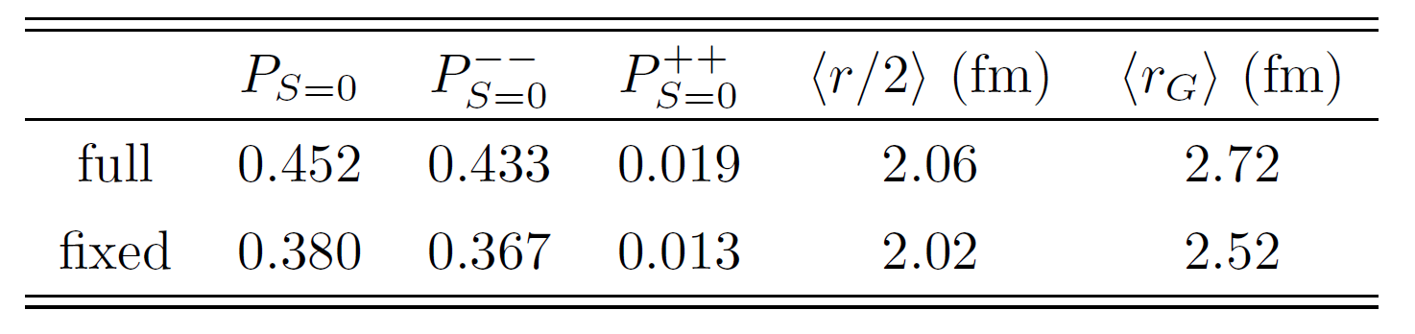
2p properties in ¹³O
In the full calculation, the S=0 component is enlarged.

Slide 36
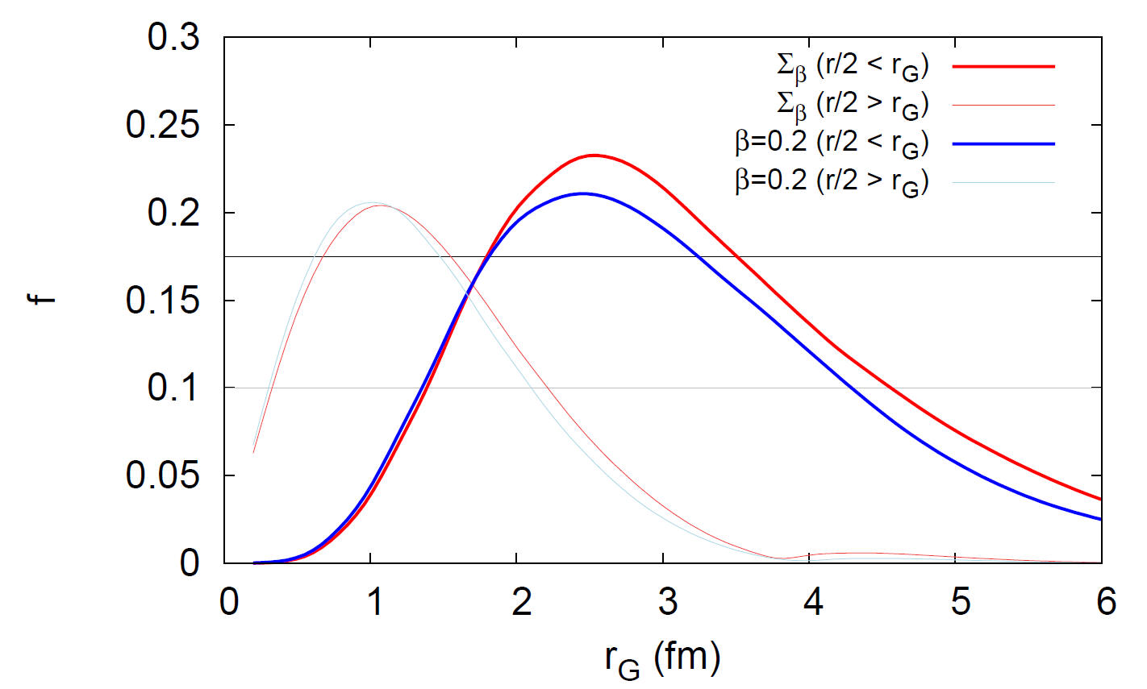
Diproton tail dependent on core deformation
Preriminary
diproton
cigar

Slide 37
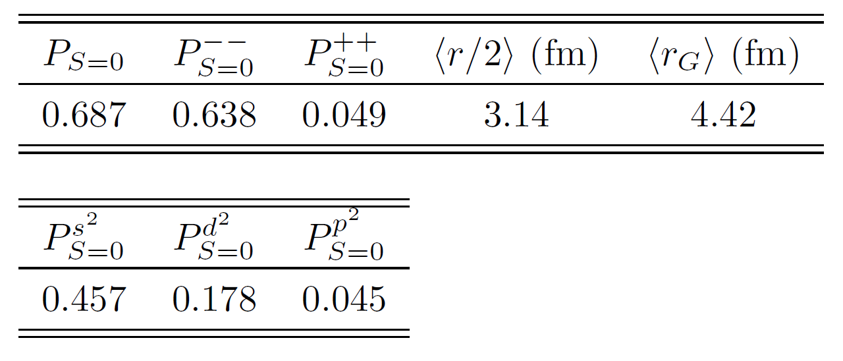
2n properties in ²²C

Slide 38
2n overlap function
Preriminary

