Slide 1
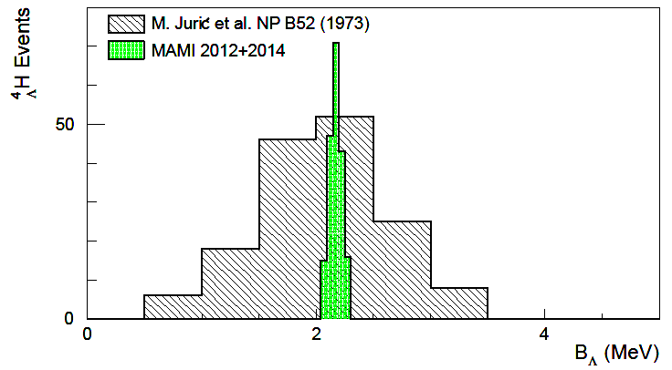
High-resolution decay-pion spectroscopy of ⁴_{Λ}H hypernuclei
MAMI
emulsion
A new era of high-resolution measurements has begun!
Patrick Achenbach
U Mainz
Sept. 2o15

Slide 2
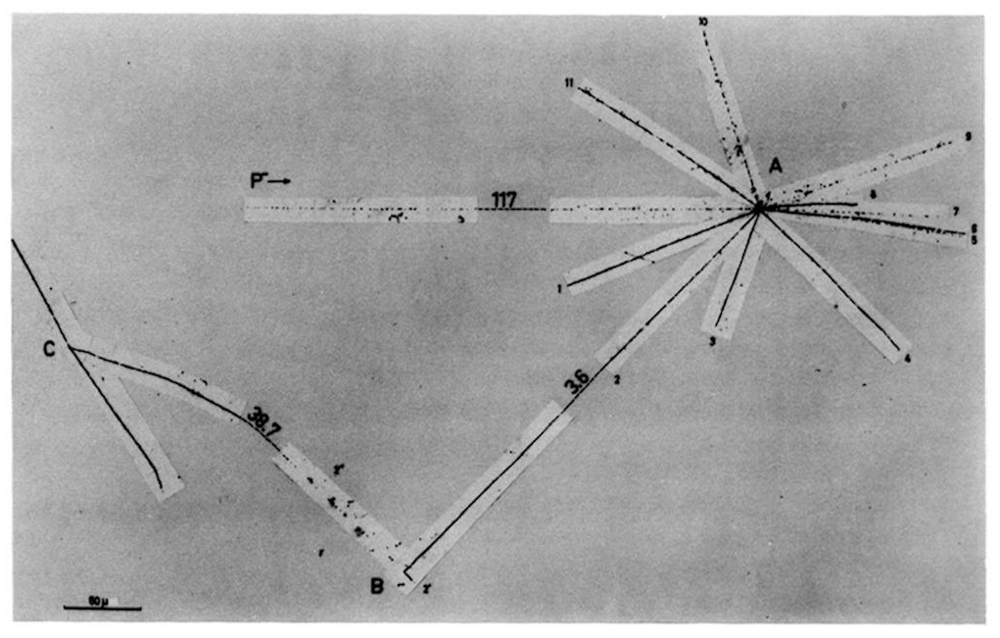
Hypernuclear decay-pion spectroscopy in emulsion
Example for _{Λ}⁴H
energy and momentum transfer to target nucleus
3.6 mm
pion detection
stopping of hyperfragment
38.7 mm
[A.G. Ekspong et al., Phys. Rev. Lett. 3 (1959) 103]

Slide 3
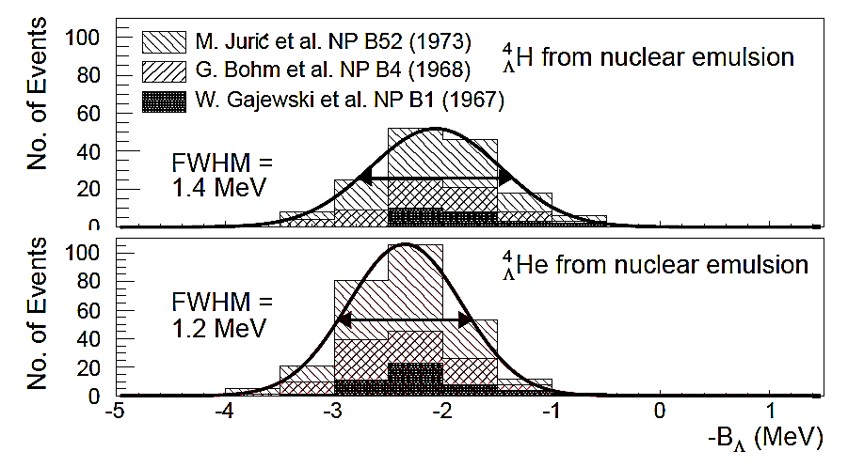
Emulsion results on _{Λ}⁴H and _{Λ}⁴He
ΔB_{Λ} = 0.35±0.06
only three-body decay modes used for hyperhydrogen
155 events for hyperhydrogen, 279 events for hyperhelium

Slide 4
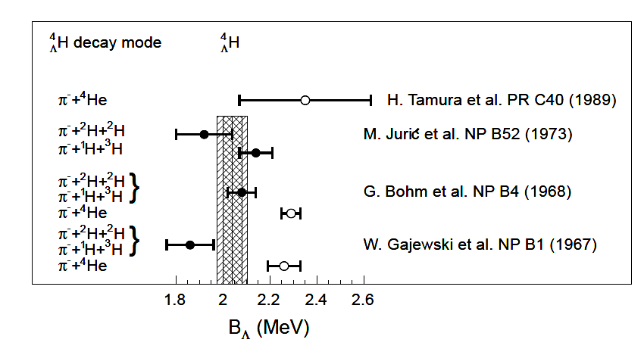
World data on _{Λ}⁴H
⁴H
decay
→ π⁻+¹H+³H: B = 2.14 ±0.07 MeV
Λ
0.22 MeV difference
decay
⁴H
→ π⁻+²H+²H: B = 1.92 ±0.12 MeV
Λ
Total: B = 2.08 ±0.06 MeV
[M. Juric et al. NP B52 (1973)]

Slide 5
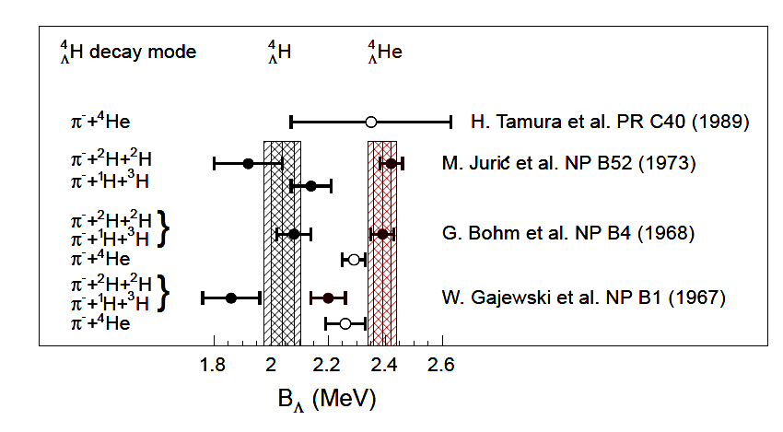
World data on A = 4 system
Λ
⁴He
decay
→ π⁻+¹H+³He: B = 2.42 ±0.05 MeV
Λ
0.02 MeV difference
decay
→ π⁻+2¹H+²H: B = 2.44 ±0.09 MeV
⁴He
Λ
Total: B = 2.42 ±0.04 MeV
[M. Juric et al. NP B52 (1973)]

Slide 6
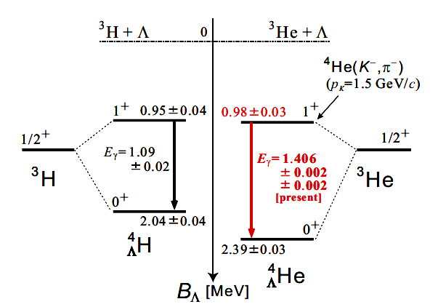
The A = 4 isospin doublet
H. Tamura: Monday 11:00
E. Hiyama: Monday 11:30
ΔB_{Λ} = 0.03±0.05
ΔB = 0.07
ΔB_{Λ} = 0.35±0.06
strong, spin-dependent charge symmetry breaking (CSB) in A = 4 mirror hypernuclei !
adapted from T. O. Yamamoto, arXiv:1508.00376
CSB for NN interactions is 70 keV in the mirror nuclei ³H and ³He
Coulomb corrections are < 50 keV for the ⁴_{Λ}H - ⁴_{Λ}He pair
R. Machleidt and H. Müther, PRC 63, 034005 (2001)
A. R. Bodmer and Q. N. Usmani, PRC 31, 1400 (1985)

Slide 7
The A = 4 CSB puzzle
Calculation | Interaction | B_{Λ}(⁴_{Λ}H_{gs}) | B_{Λ}(⁴_{Λ}He_{gs}) | ΔB_{Λ} (⁴_{Λ}He-⁴_{Λ}H)
A. Nogga, H. Kamada and W. Gloeckle, PRL 88, 172501 (2002) | SC97e | 1.47 | 1.54 | 0.07
 | SC89 | 2.14 | 1.80 | 0.34
H. Nemura. Y. Akaishi and Y. Suzuki, PRL 89, 142504 (2002) | SC97d | 1.67 | 1.62 | -0.05
 | SC97e | 2.06 | 2.02 | -0.04
 | SC97f | 2.16 | 2.11 | -0.05
 | SC89 | 2.55 | 2.47 | -0.08
E. Hiyama, M. Kamimura, T. Motoba, T. Yamada and Y. Yama PRC 65, 011301 (R) (2001) | AV8 | 2.33 | 2.28 | -0.05
world data average |  | 2.04±0.04 | 2.39±0.03 | 0.35±0.06
calculations have been made since decades but fail to explain large ΔB_{Λ}
coupled channel calculation using interaction SC89 fails to bind excited states

Slide 8
Recent approaches to A = 4 CSB puzzle
Calculation | ΔB_{Λ} (⁴_{Λ}He-⁴_{Λ}H)
A. Gal, PLB 744 (2015) | 0.226
 | 0.266
T. Rijken, RIKEN Workshop 2015 | 0.227
world data average | 0.35±0.06
A. Gal: Monday 14:00
T. Rijken: Wednesday 9:30
only very recently CSB contributions of order 250 keV calculated
the large CSB contributions in the A = 4 system place a powerful constraint on the strong-interaction YN dynamics
in A. Gal’s work a central-force ΛN-ΣN coupling model is used
in T. Rijken’s work meson-pair exchange forces (πσ) & (πρ) produce CSB

Slide 9
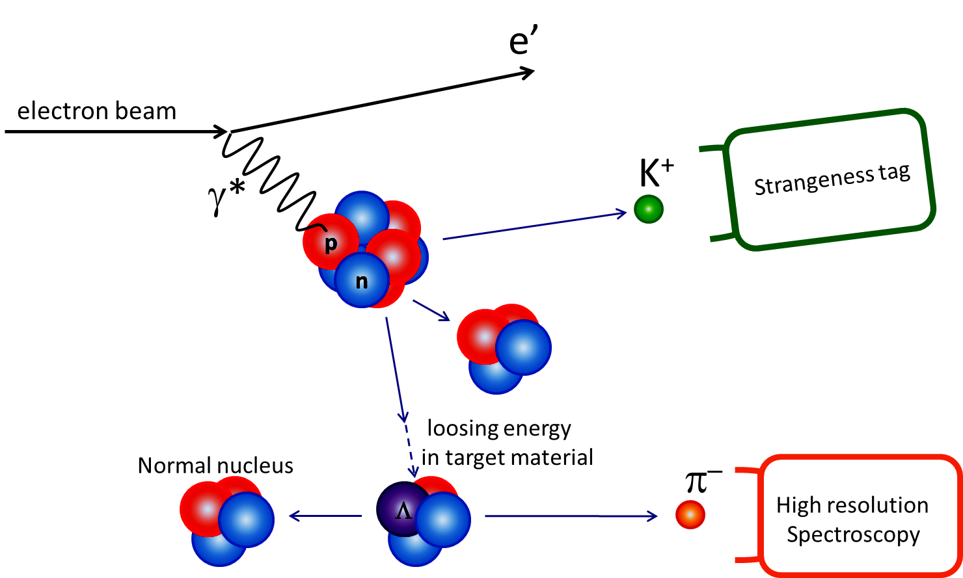
Hyperfragment decay-pion spectroscopy with electron beams
energy and momentum transfer to target nucleus
different possible fragmentation processes
stopping
detection
of pions
two-body decay at rest ⇒ mono-energetic pions

Slide 10
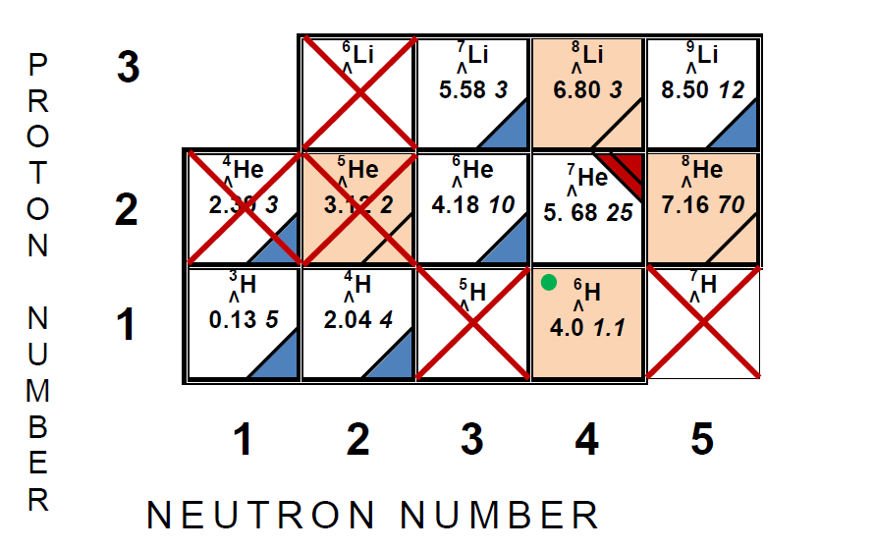
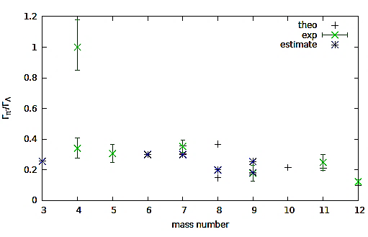
Accessible hyperisotopes
accessible isotopes with ⁹Be target
in decay-pion spectroscopy
no 2-body decay
inaccessible by missing mass
spectroscopy
highest pionic decay width
⁴_{Λ}H
Notes:
,

Slide 11
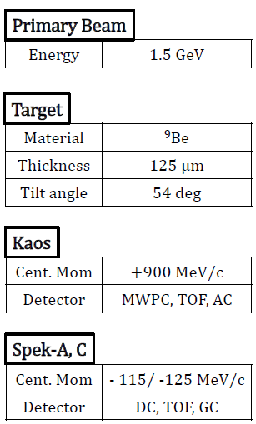
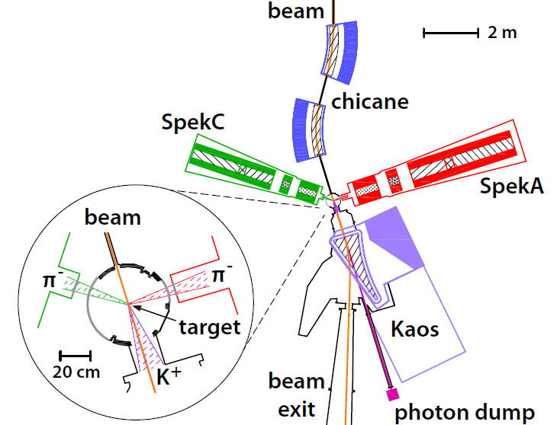
Experimental realization at MAMI

Slide 12
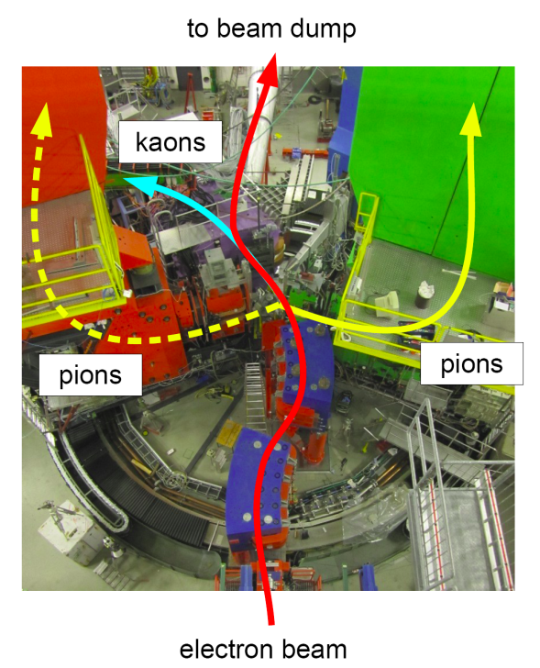
Picture of the experimental hall

Slide 13
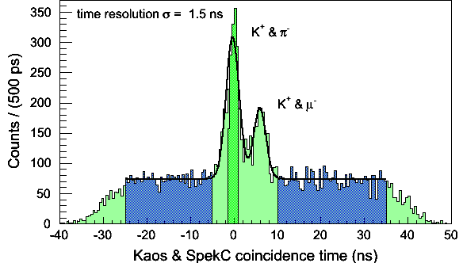
Reaction identification
with cut on gas Cherenkov signal for electron rejection
time gate for decay-pions
time gates to evaluate acciden-tal background height & shape
established clean tag on strangeness production at zero-degree
decay-pion detection with Spectrometer A & C (dp/p <10⁻⁴)
more than 1000 pion-kaon-coincidences from weak decays of hyperons

Slide 14
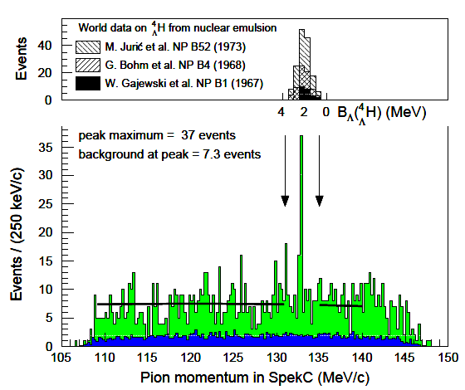
Decay-pion spectrum
Emulsion data on binding energy scale
mono-energetic pions
decays of quasi-free produced hyperon
accidental background reactions

Slide 15
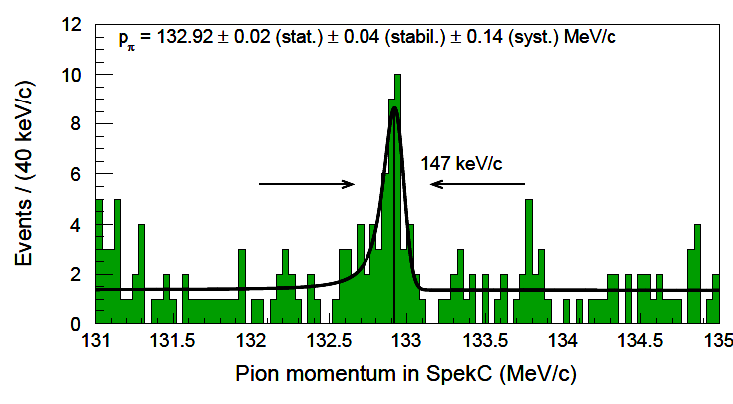
Fit to decay-pion momentum
fit composed of Gaussian resolution function convoluted with a Landau distribution representing energy loss on top of background function
observed signal shape and width consistent with simulation
significance level calculated via the likelihood ratio S = $\sqrt{−2\ln{\frac{L(BG)}{L(S+BG)}}}$ = 5.2

Slide 16
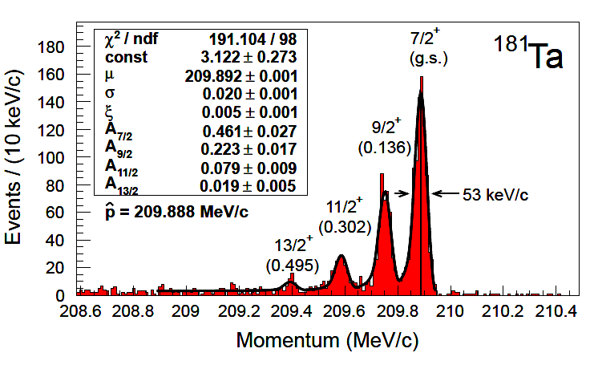
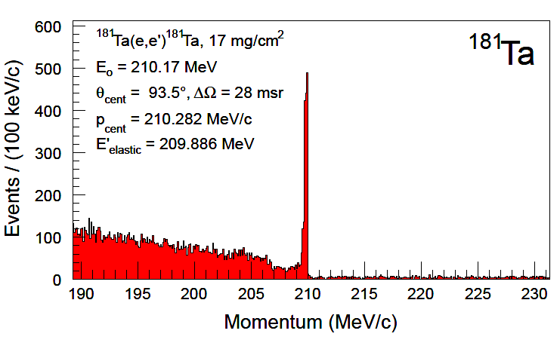
Absolute momentum calibration
calibration method: scattering off thin tantalum foil
spectrometer FWHM of 53 keV/c → δp/p ~ 2∙10⁻⁴
beam energy absolute accuracy δp_{beam} ± 160 keV/c → δE/E ~ 7∙10⁻⁴
repeated calibrations at different momenta reveal δp_{syst} ~ 5 keV/c

Slide 17
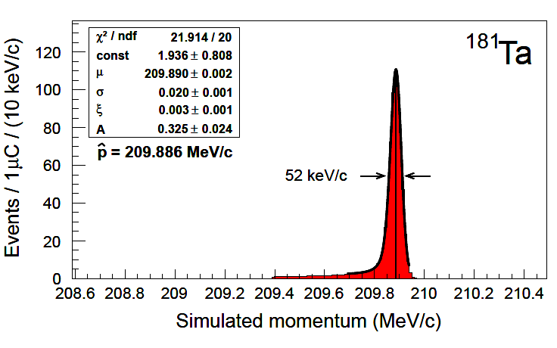
Simulation of scattering process and spectrometer
comparison of
simulation vs. data reveals highest precision
Monte Carlo code for energy-loss of incoming beam, reaction vertex distribution,
reaction kinematics, and
energy-loss of outgoing particle
→ shape & width well reproduced
calibration fixed at relative momentum closest to decay-pion line of ⁴_{Λ}H, data here shifted 7%
→ difference of only 2 keV/c

Slide 18
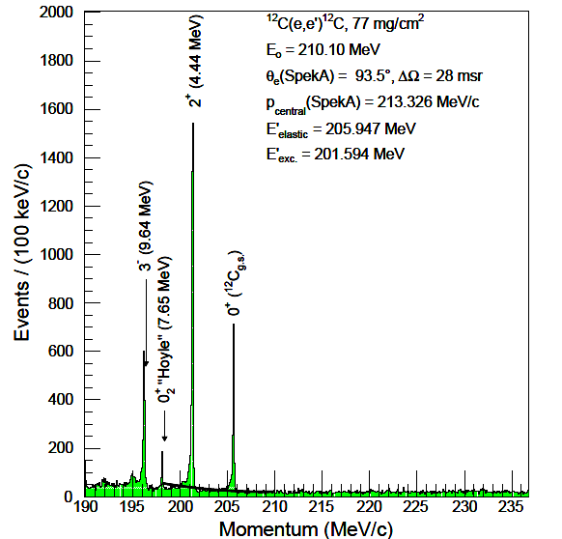
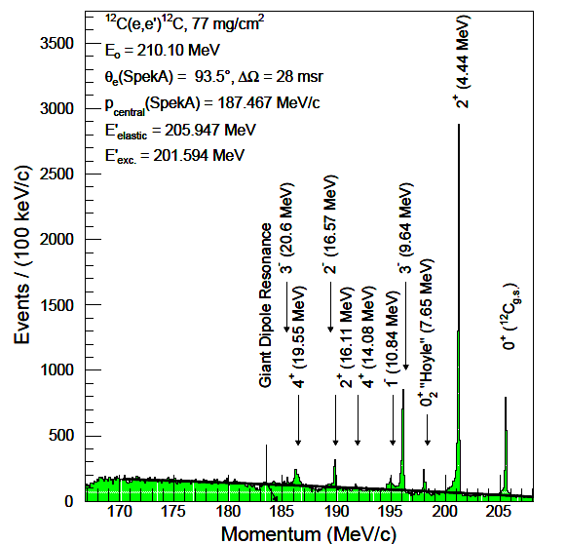
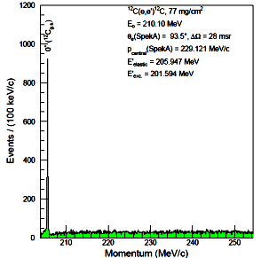
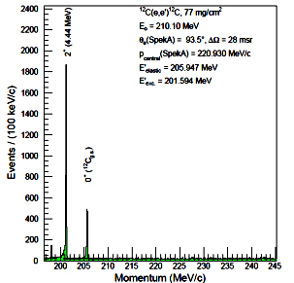
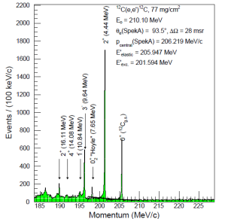
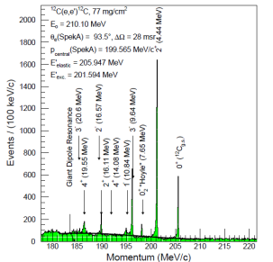
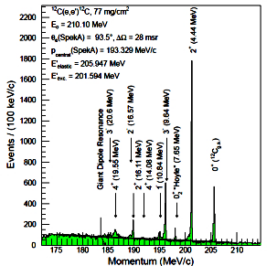
Study of spectrometer aberrations
scattering off carbon foil
several of excited states could be fitted for the same setting
from aberration effects differences of up to δp_{calib}~20 keV/c possible

Slide 19
Binding energy extraction
B_{Λ}= 2.12 ± 0.01 (stat.) ± 0.13 (syst.) MeV
A. Esser et al. (A1 Collaboration), PRL 114, 232501 (2015)
dominant calibration errors:
uncertainty on beam energy δE_{beam} = 160 keV
dominant stability error:
magnetic field instability δp_{stabil} = 40 keV/c
---------------------------------------------------------------------
total error δp: ± 140 (calib.) ± 40 (stab.) keV/c

Slide 20
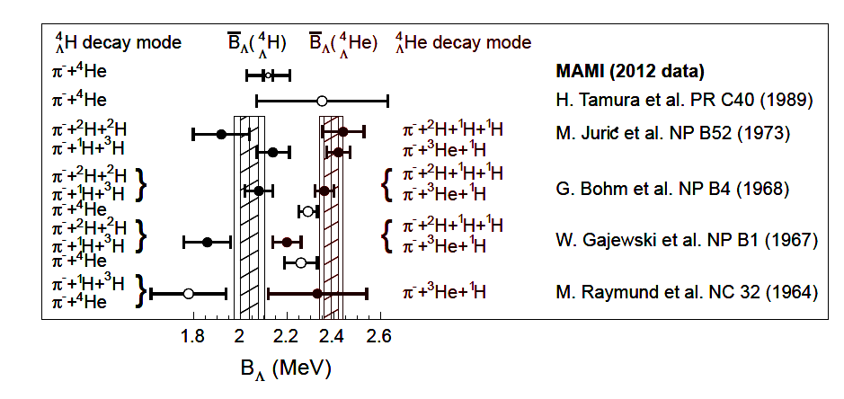
World data on A = 4 system
MAMI experiment confirmed Λ separation energy of _{Λ}⁴H:
B_{Λ} ~ 2.12 ± 0.1 MeV (2012 data)

Slide 21
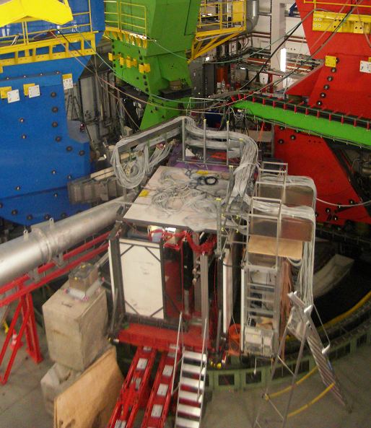
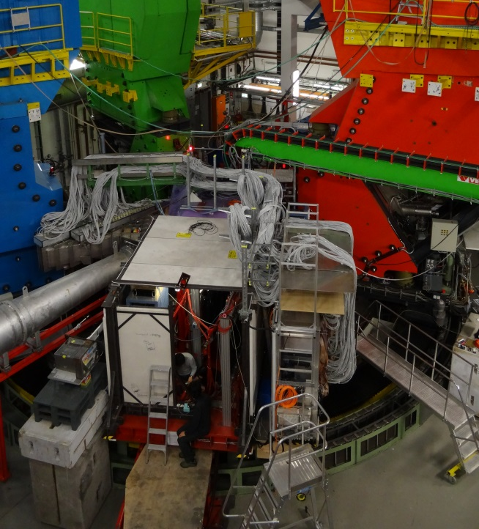
Continuation of experiment in 2o14
2o12
2o14
improved background
&
systematics
better pion rejection by improved aerogel
suppression of background by improved shielding
suppression of background by trigger upgrade in SpekA & C
suppression of background by beam-line upgrade
dedicated collimator for decay region
better control of magnet field variations
full overlap of SpekA and SpekC momentum acceptances

Slide 22
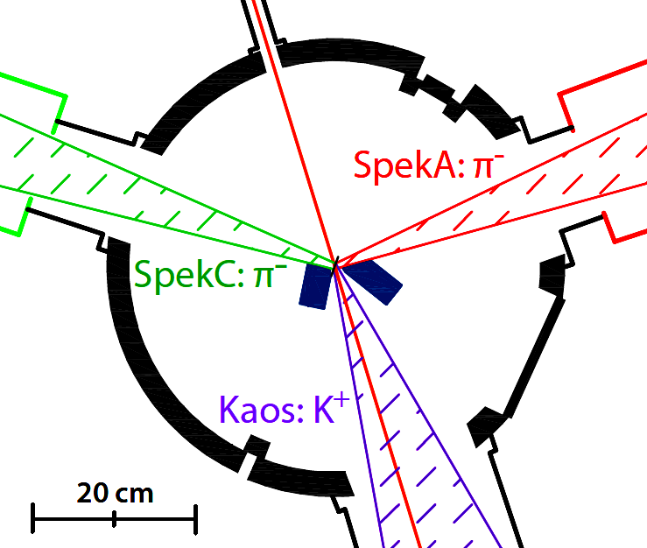
Improved experimental setup
elimination of energy-loss fluctuations in the scattering chamber windows by directly coupling the vacuum system
→ expected width of decay-pion peaks 100 keV/c

Slide 23
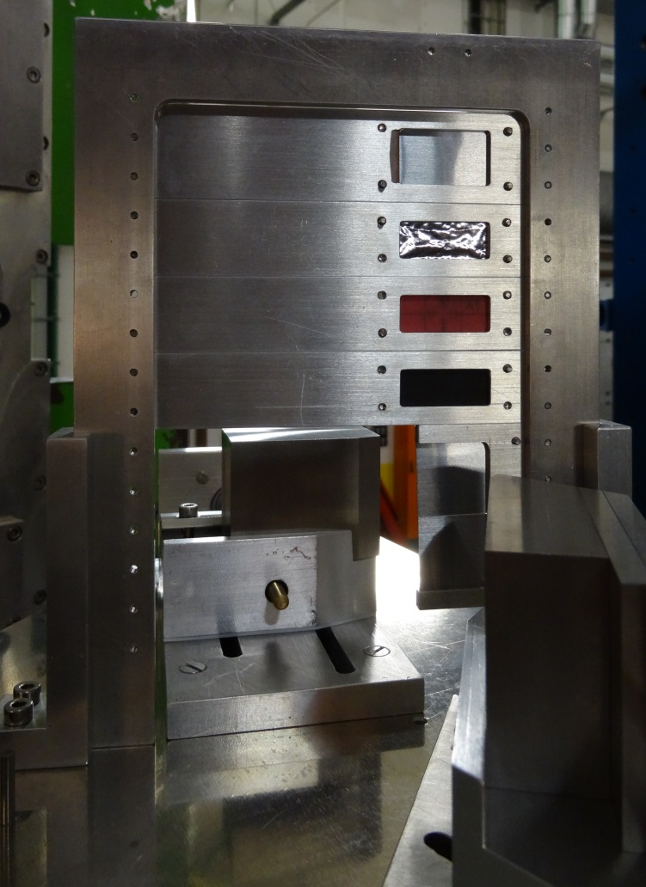
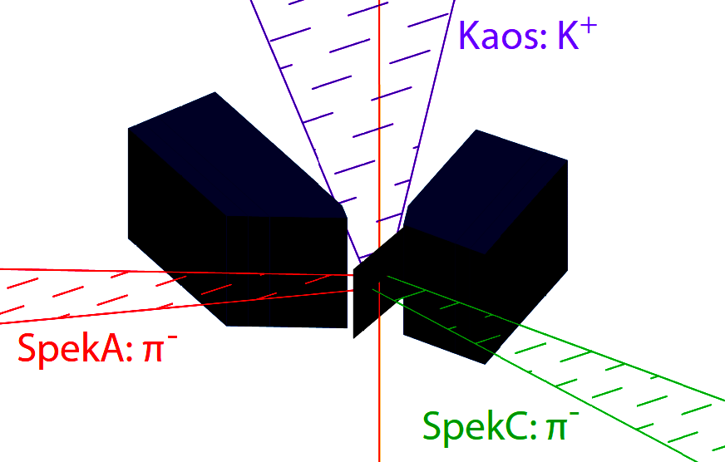
Improved background suppression
beam
beam
tungsten absorber
absorption of coincident background from decay of quasi-free Σ⁻ hyperons by tungsten alloy collimators down-stream of target
→ expected reduction of background by more than factor of 2

Slide 24
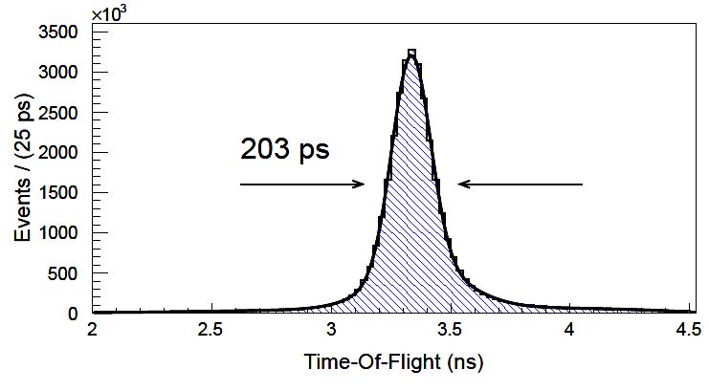
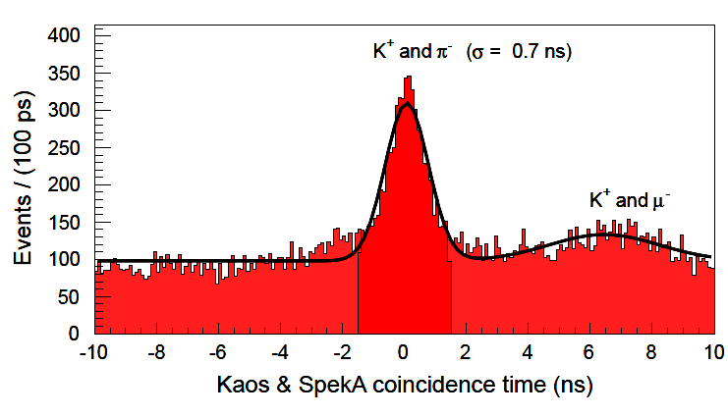
Improved kaon identification
pion time-of-flight inside Kaos
coincidence time
700 ps
(was 420 ps in 2o12)
(was 1.4 ns in 2o12)
automatic correction for control settings for all > 1200 data runs: more than 370 000 parameter values
→ single arm TOF FWHM ~ 200 ps factor 2 better than in 2o12
→ coincidence time FWHM ~ 700 ps factor 2 better than in 2o12

Slide 25
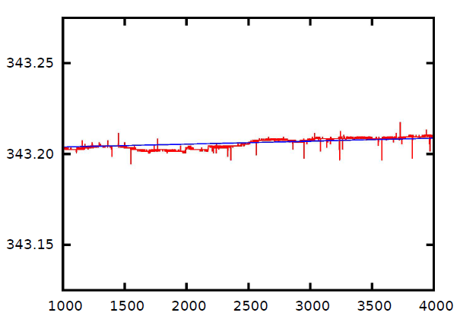
Improved control of systematic uncertainties
Magnetic field in SpekC D2 (mT)
variations over a period of 4 weeks correspond to less than p_{stabil} < 4 keV/c
NMR measurement
(was 40 keV/c in 2012)
continuous magnetic field monitoring of spectrometers with NMR
→ momentum stability improved by factor 10 compared to 2o12

Slide 26
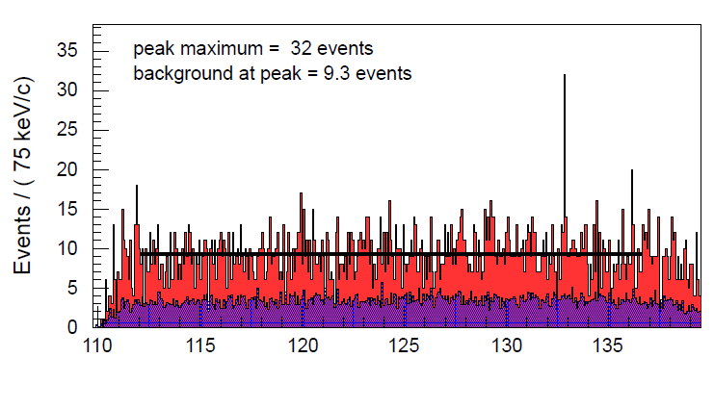
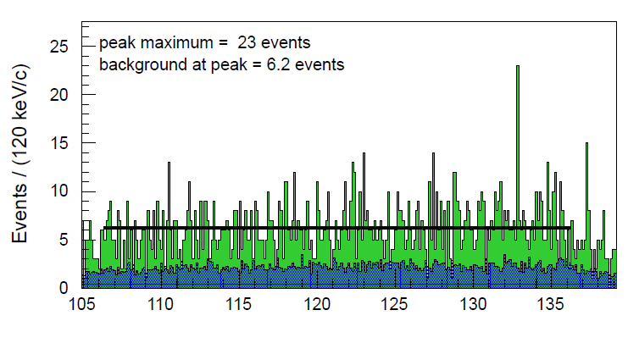
Simultaneous observation in two spectrometers
⁴_{Λ}H
B_{Λ}(⁴_{Λ}H) = 2.16 (SpekA)
preliminary
^{SpekA}
⁴_{Λ}H
B_{Λ}(⁴_{Λ}H) = 2.17 (SpekC)
preliminary
^{SpekC}

Slide 27
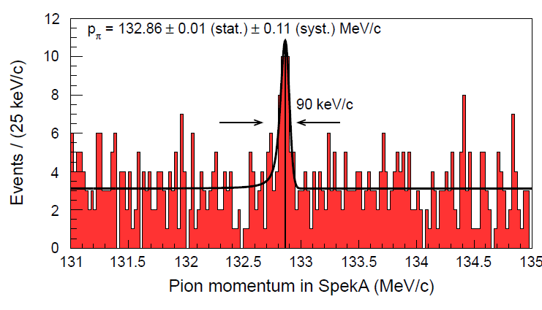
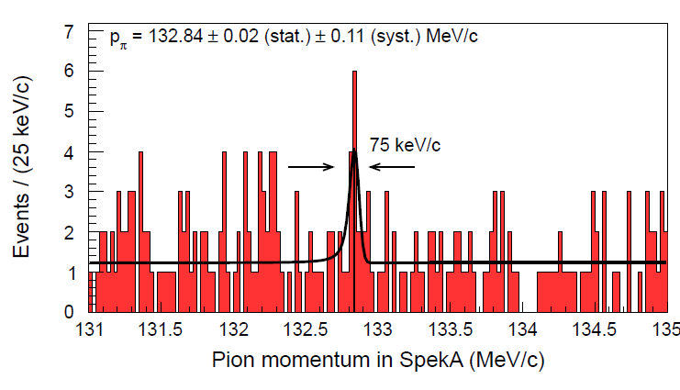
Observation with two different targets
B_{Λ}(⁴_{Λ}H) = 2.16 (thin target)
preliminary
preliminary
B_{Λ}(⁴_{Λ}H) = 2.17 (thick target)
peak FWHM ~ 100 keV/c compared to ~ 150 keV/c in 2012

Slide 28
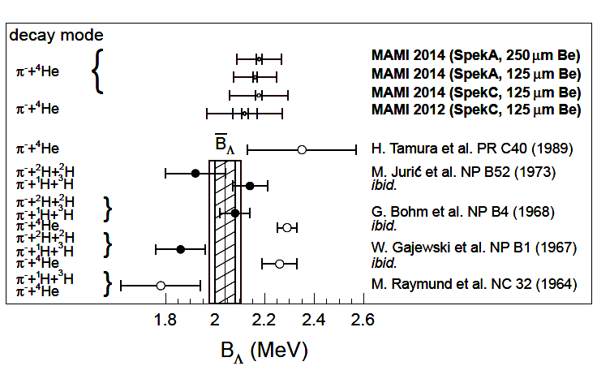
World data on ⁴_{Λ}H
outer error bars from beam energy
→ consistent result for B_{Λ}(⁴_{Λ}H) from MAMI 2012 and MAMI 2014 (prelim.)
→ independent measurement in two spectr., two targets, two beam-times

Slide 29
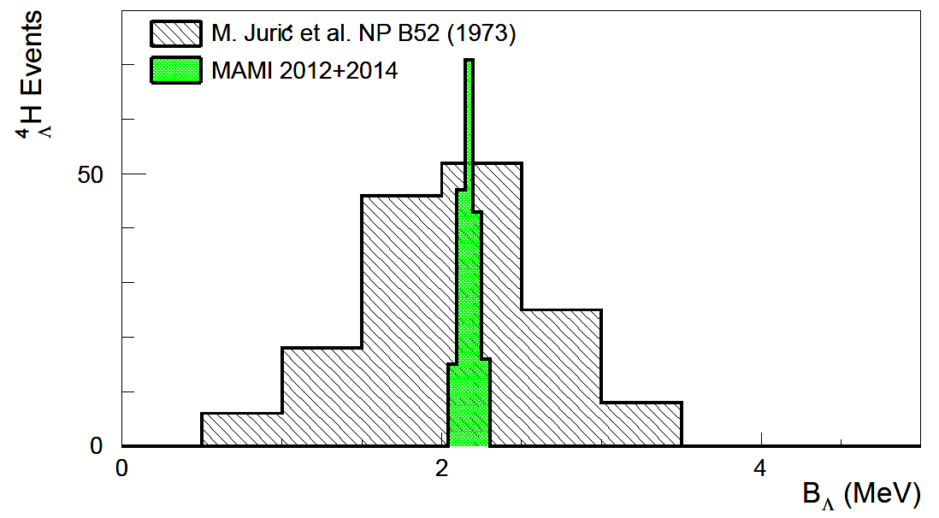
Conclusion
Decay-pion spectroscopy has become a precision science!
MAMI
emulsion
Emulsion: 2.04 ± 0.040 (stat.) ± 0.050(?) (syst.)
MAMI 2012: 2.12 ± 0.013 (stat.) ± 0.130 (syst.)
MAMI 2014: 2.17 ± 0.004 (stat.) ± 0.080 (syst.)

Slide 30
Future possibilities
MAMI energy is measured with much higher precision in a dipole:
assuming a 10⁻⁴ error in energy:
binding energies of many light hyperisotopes could be measured with improved precision by this technique !

Slide 31
Backup

Slide 32
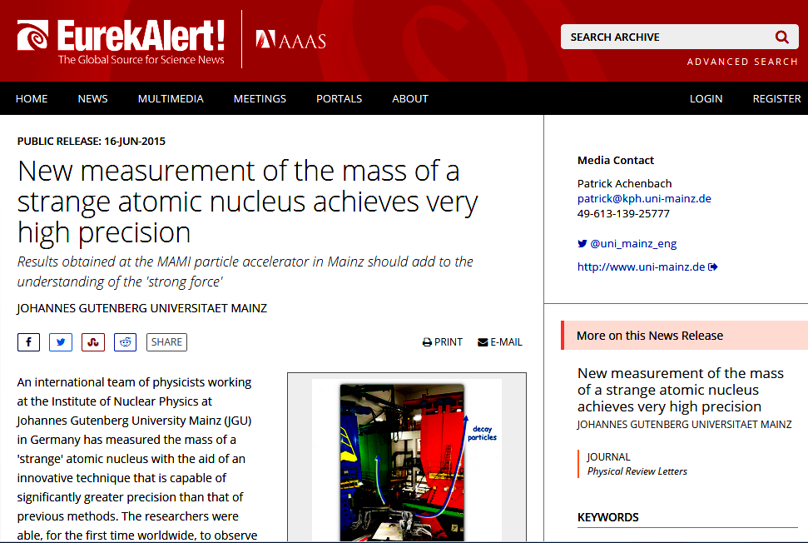

Slide 33
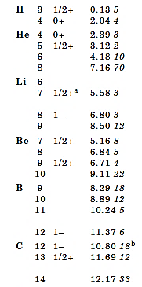
Light hypernuclear masses A ≤ 14
[Nuclear Wallet Cards, BNL, 2011]
data from emulsion experiments
often low event counts
mass error given by Λ binding energy error δB_{Λ}~ 20-700 keV
systematic difficulties because of varying emulsion properties
in addition new data by
HKS (±250 keV) on ⁷_{Λ}He
FINUDA (±1100 keV) ⁶_{Λ}Li & ⁶_{Λ}H

Slide 34
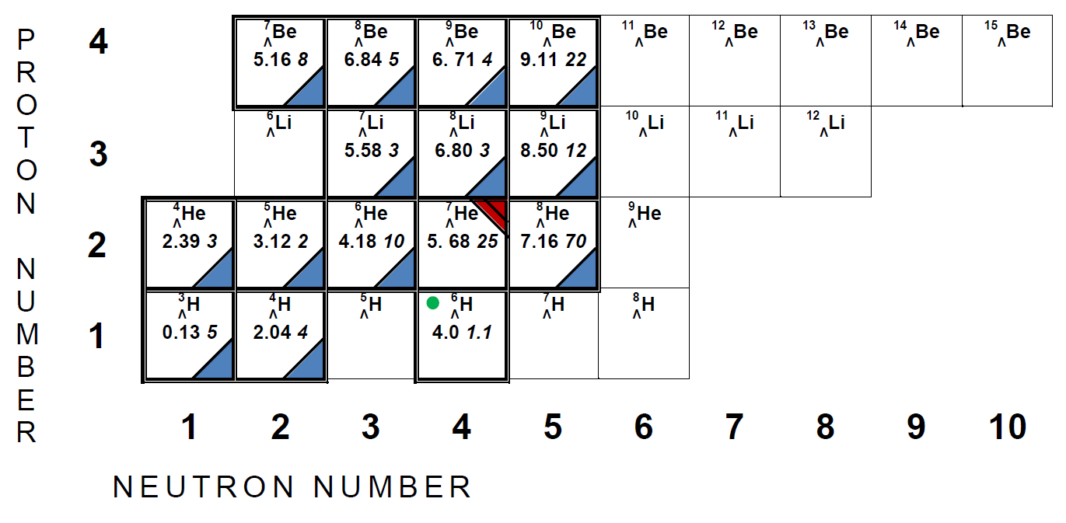
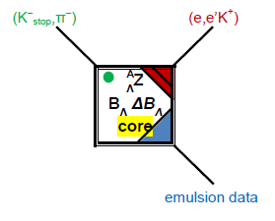
Spectroscopy of light hypernuclei
origin of 15 known binding energy values of lightest hypernuclei

Slide 35
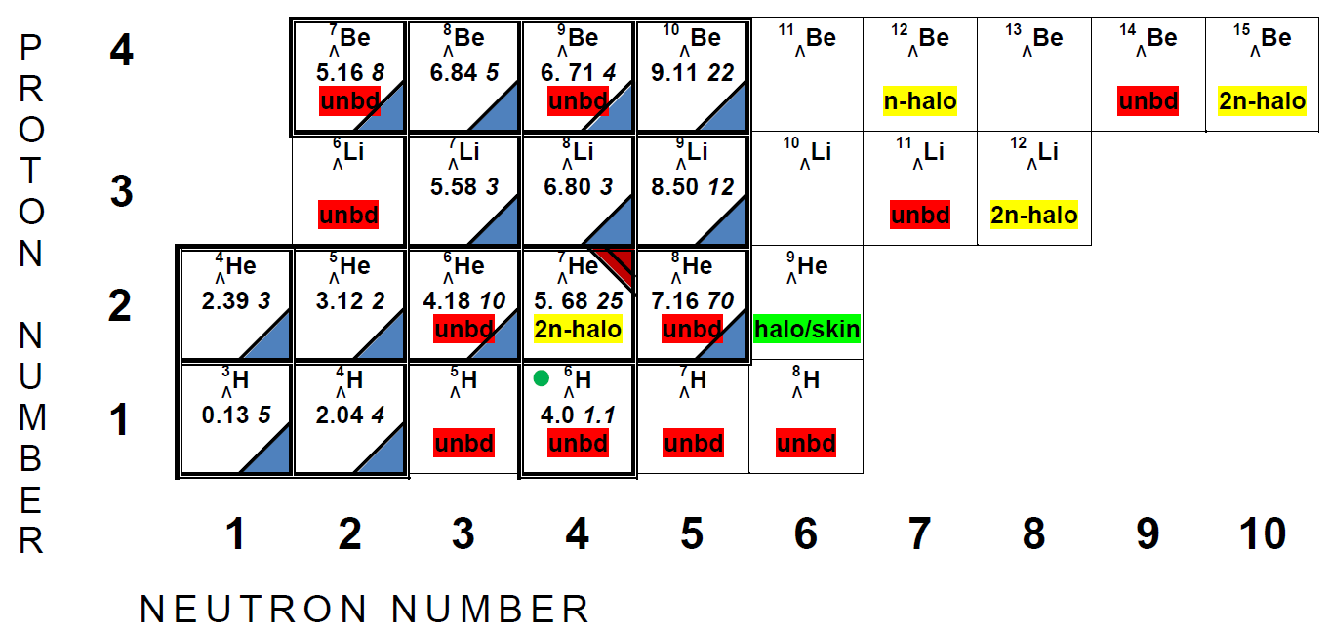
Few-body aspects of light hypernuclei
superheavy unstable-core hyperisotopes exist because of the stabilizing role of the Λ-hyperon
core nucleus
structure
[Dalitz & Levi Setti, NC 30 (1963)]
unbd

Slide 36
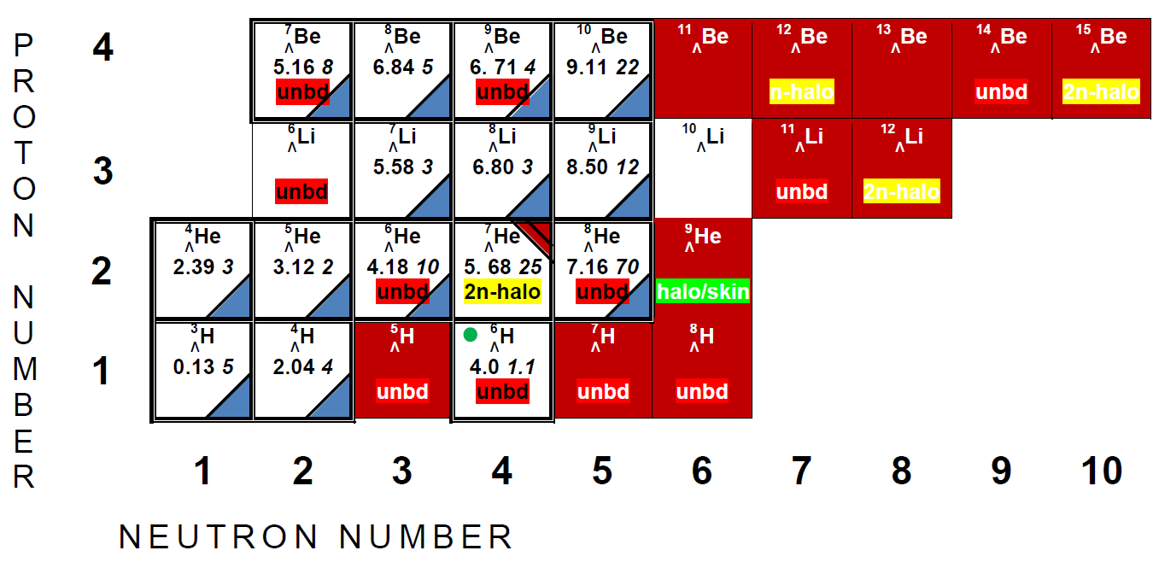
Spectroscopy of light hypernuclei
many neutron-rich and structure-rich hypernuclei still to be discovered
undiscovered

Slide 37
The mass A = 3 System

Slide 38
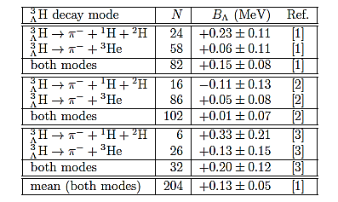
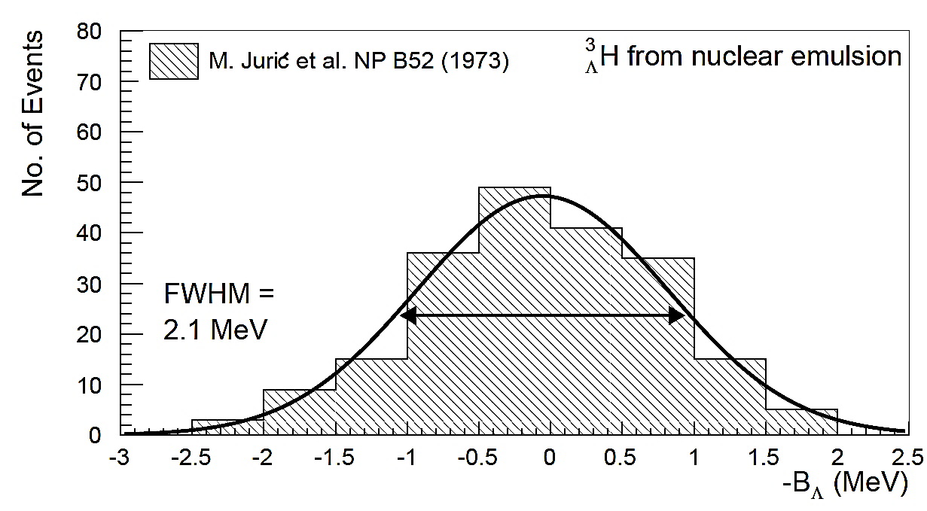
World data on ³_{Λ}H
[1] M. Juric et al., NP B52 (1973)
[2] G. Bohm et al. NP B4 (1968)
[3] W. Gajewski et al. NP B1 (1967)
hypertriton: the lightest bound hypernuclear system
about 200 analysed events from emulsion experiments

Slide 39
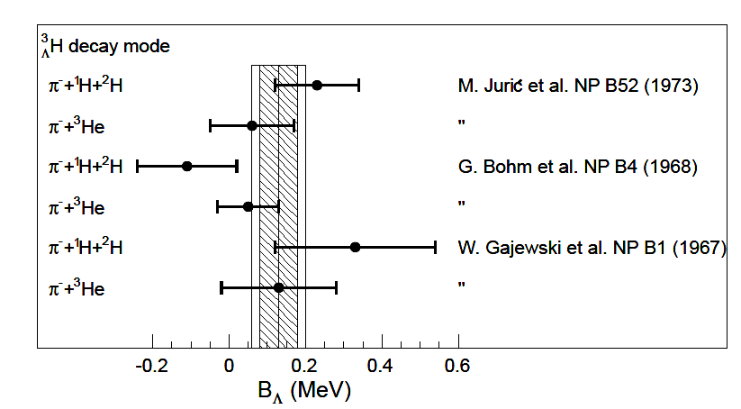
World data on ³_{Λ}H
emulsion data consistent in binding energy, but …

Slide 40
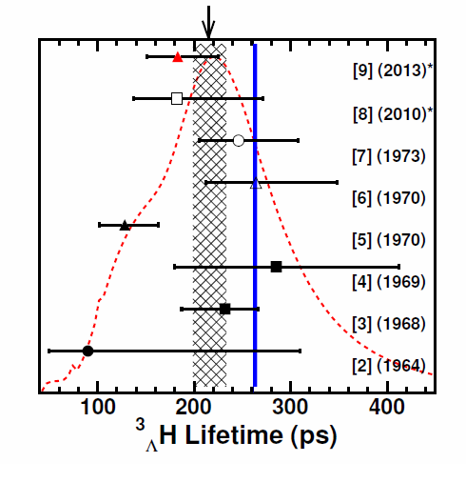
Lifetime of ³_{Λ}H
Topical session: Tuesday 16:40
most recent measurements at GSI give τ = 183+42-32 ps
also STAR and ALICE data
Fig. from [9] C. Rappold et al., PLB 728 (2013)
³_{Λ}H lifetime is significantly lower than Λ lifetime (263.2 ps)
no theory is able to reproduce the observed short lifetime

