Slide 1
Signature of Λ(1405) in K⁻d→πΣn reaction
Shota Ohnishi
(Hokkaido Univ.)
in collaboration with
Yoichi Ikeda (RIKEN)
Tetsuo Hyodo (YITP, Kyoto Univ. )
Emiko Hiyama (RIKEN)
Wolfram Weise (ECT*/TUM)

Slide 2






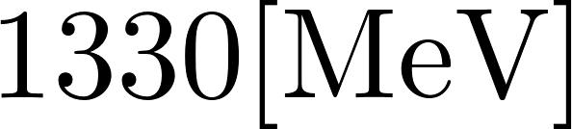

K^{bar}N interaction
In order to understand the structure of Λ(1405),
precise determination of K^{bar}N-πΣ (I=0) interaction is necessary.
experimental constraint
above K^{bar}N threshold energy: - K⁻p cross section
at/just-below KN threshold energy: - Branching ratio
- kaonic atom(new data by SIDDHARTA)
below the K^{bar}N threshold energy:
- So far, cannot perform πΣ elastic scattering experimentally
- πΣ mass spectra from Λ(1405) production reactions
(CLAS, LEPS, HADES, J-PARC)
Planed K⁻d reaction at J-PARC (E31) is our target

Slide 3
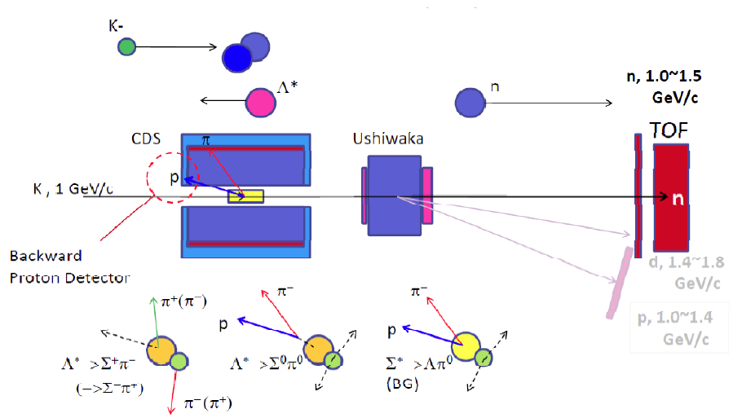






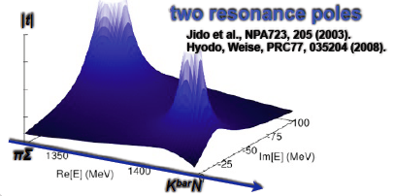
J-PARC E31 experiment
http://j-parc.jp/researcher/Hadron/en/pac_0907/pdf/Noumi.pdf
Λ(1405) production via the (K⁻,n) reaction on deuteron target.
We can access below the K^{bar}N threshold.
Λ(1405) in K^{bar}N channel
  Jido, Oset, Sekihara, EPJA42, 257(2009).
p_{K}^{lab.}= 1GeV
detect forward neutron
Missing mass distribution for π⁺Σ⁻/π⁰Σ⁰/π⁻Σ⁺

Slide 4
  Strategy of this work
Study the cross section for J-PARC E31 with K^{bar}NN-πYN Faddeev (AGS) approach based on chiral SU(3) dynamics
  Full three-body calculation for K^{bar}NN-πYN systems with relativistic kinematics and higher partial waves for 1GeV incident momentum
investigate how the signal of Λ(1405) resonance appears on πΣ mass spectrum
  Two-step: Jido, Oset, Sekihara, EPJA42, 257(2009).
  Miyagawa, Haidenbauer, PRC85,065201(2012).
  Yamagata-Sekihara, Sekihara, Jido, PTEP043D02(2013).
Faddeev: Miyagawa (Next talk)

Slide 5
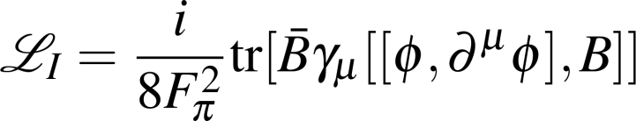
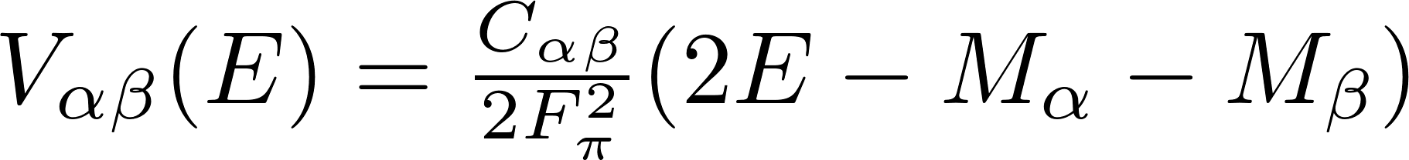
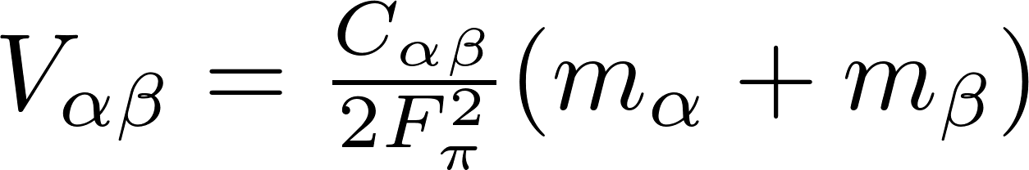



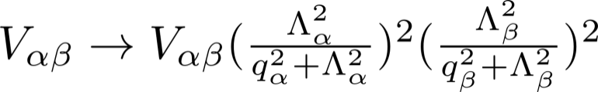
Meson-baryon potential based on chiral SU(3)
  NG boson associated with spontaneous breaking of chiral SU(3) symmetry
Leading order of chiral perturbation theory:
Weinberg-Tomozawa (WT) term
Weinberg, PRL 17, 616 (1966).
Tomozawa, Nuov. Cim. 46A, 707 (1966).
φ: PS meson fields, B: baryon fields
Derive the potentials by matching with WT amplitude
“energy-dependent” potentials
“energy-independent” potentials
Energy is fixed at threshold
E; two body scattering energy
; baryon mass
; determined by flavor SU(3) structure
; meson mass
We introduce phenomenological dipole form factor to regularize loop integrals
Cutoff parameters Λ are determined to reproduce the K⁻ p cross section

Slide 6
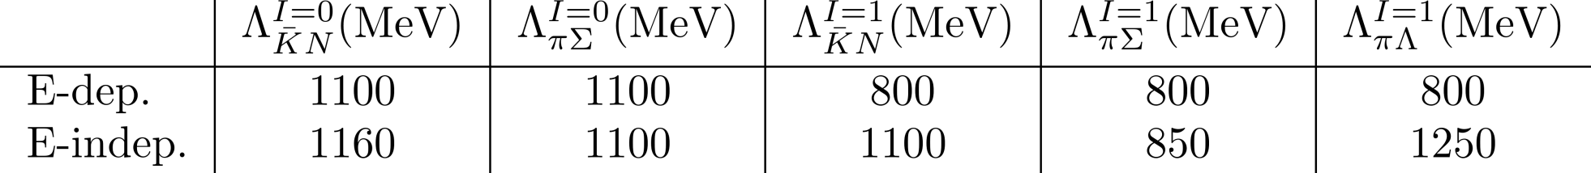
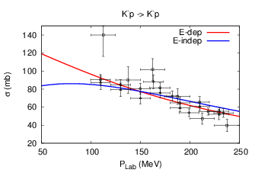
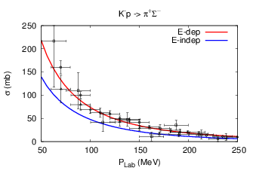
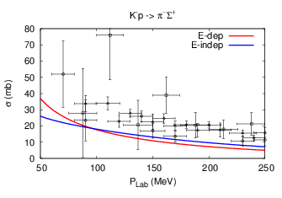
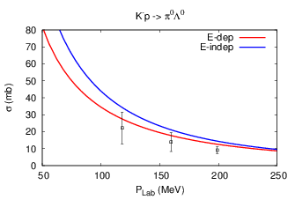
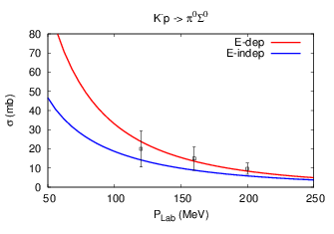
cutoff (model parameters)
We determine the cutoff parameters to reproduce K⁻p cross sections.

Slide 7
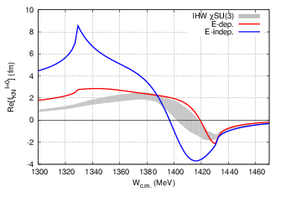
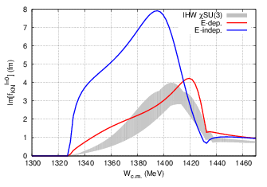
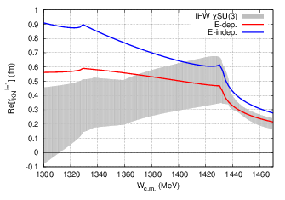
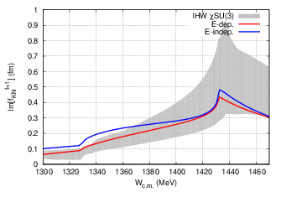
K^{bar}N amplitude and scattering length (output)
Ikeda, Hyodo, Weise NPA 881 (2012) 98.
SIDDHARTA
xSU(3) NLO
E-dep.
E-indep.

Slide 8








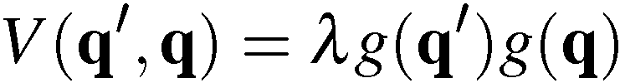

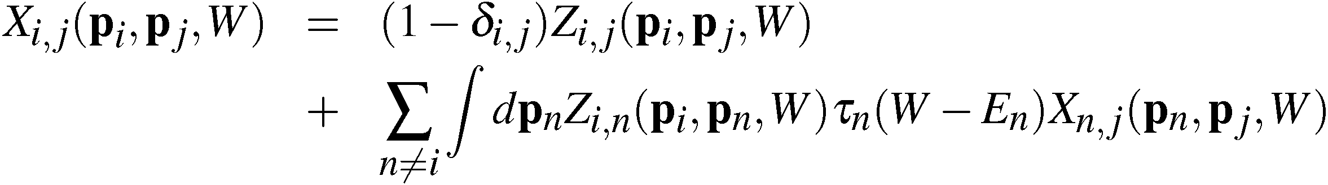
K⁻d -> πΣn reaction
=
+
X
L
X
L
L
L
L
τ
τ
g
g
+
X
L
+
X
L
L
L
τ
τ
g
g
Alt-Grassberger-Sandhas(AGS) eq. : Xij；quasi two-body amplitude

Slide 9
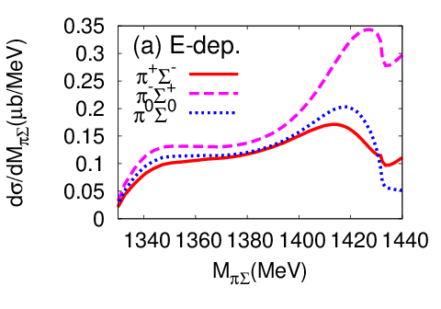
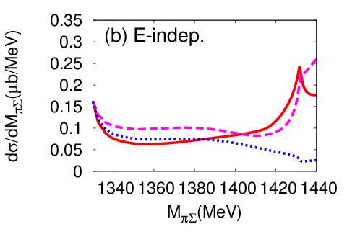
πΣ invariant mass spectrum
L
For E-dep. model, signature of Λ(1405) appears on πΣ invariant mass spectrum around the binding energy of Λ(1405)
For E-indep. model, signature of Λ(1405) is weak, and cusp appears at πΣ threshold

Slide 10
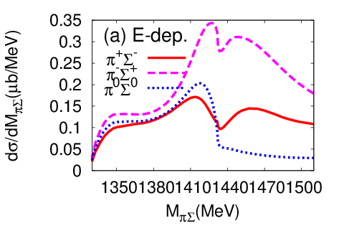
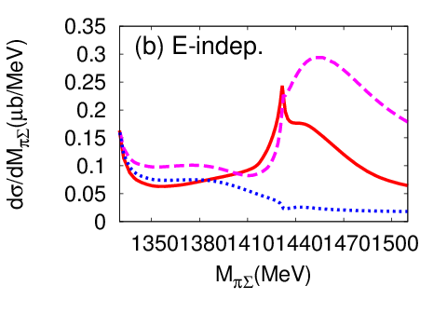
πΣ invariant mass spectrum
L
For E-dep. model, signature of Λ(1405) appears on πΣ invariant mass spectrum around the binding energy of Λ(1405)
For E-indep. model, signature of Λ(1405) is weak, and cusp appears at πΣ threshold
Bump appears above the K^{bar}N threshold

Slide 11

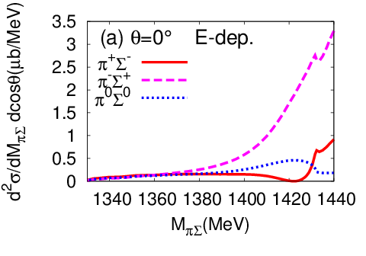
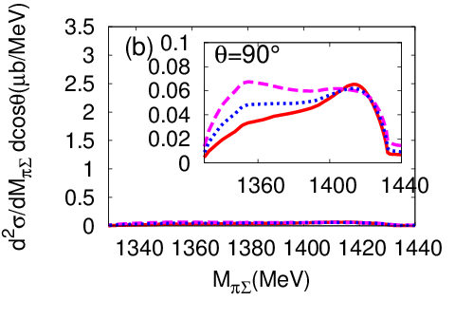
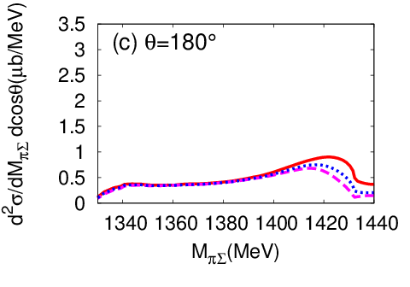
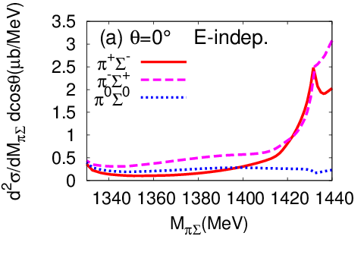
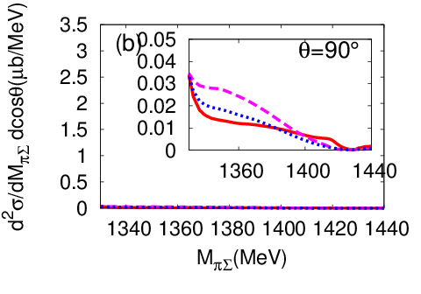
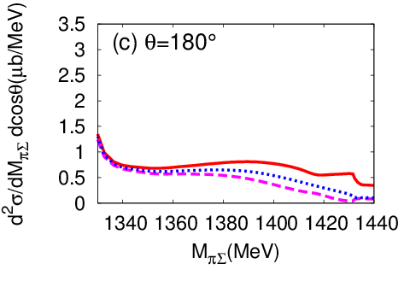
Angular dependence
θ; n angle in C.M.
L
KN threshold cusp is enhanced in forward angle
Channel dependence is also large in forward angle

Slide 12
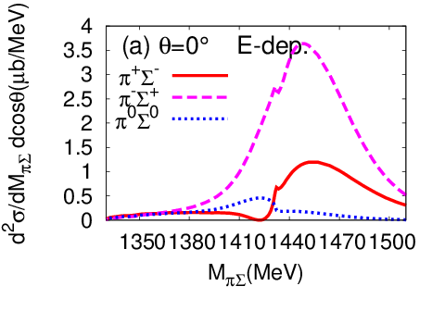
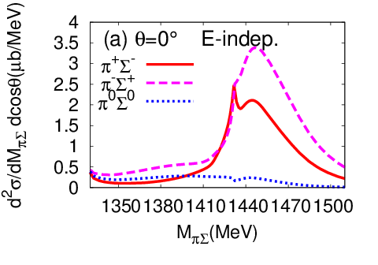
Angular dependence
θ; n angle in C.M.
L
KN threshold cusp is enhanced in forward angle
Channel dependence is also large in forward angle
bump above K^{bar}N threshold energy is enhanced in θ=0

Slide 13
Summary
We investigate how the signature of the Λ(1405) appears in K⁻d scattering reaction.
How the signatures appear depends on the two-body interaction models.
The production reaction would be used to distinguish dynamical model of Λ(1405).
Channel dependence of the cross section is large
We would also obtain the information on I=1 K^{bar}N-πΣ interactions from K⁻d scattering.
Bump appears above the KN threshold, and it is enhanced in θ=0

Slide 14
Future work
Improve the two-body interaction model
  Higher order of chiral perturbation
  Higher partial wave
Cutoff parameters dependence
Compare with forthcoming J-PARC E31

Slide 15
Backup slides

Slide 16
K⁻d -> πΣn reaction
=
+
X
L
X
L
L
L
L
τ
τ
g
g
+
X
L
+
X
L
L
L
τ
τ
g
g
Alt-Grassberger-Sandhas(AGS) eq. : Xij；quasi two-body amplitude

Slide 17




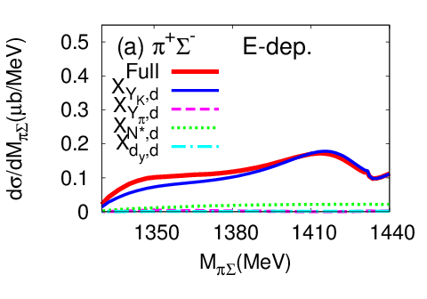
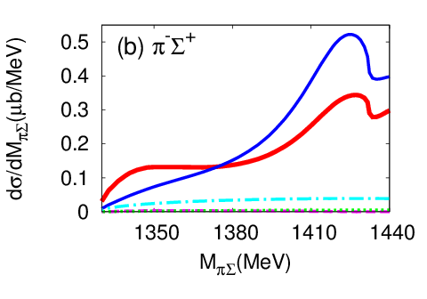
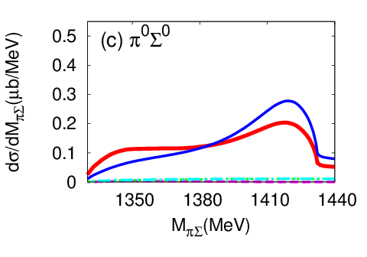
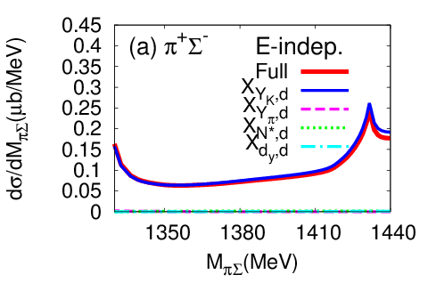
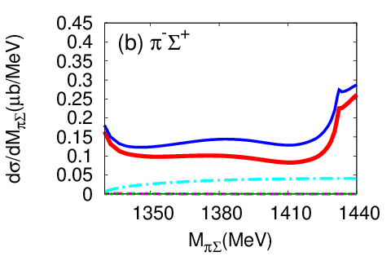
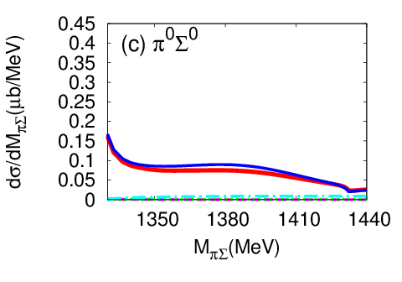
Contribution of each amplitude
X_{YK,d} component is dominant
X
L
L
τ
g

Slide 18
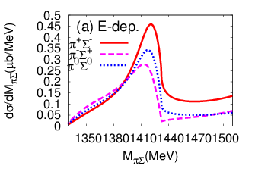
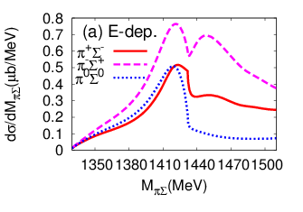
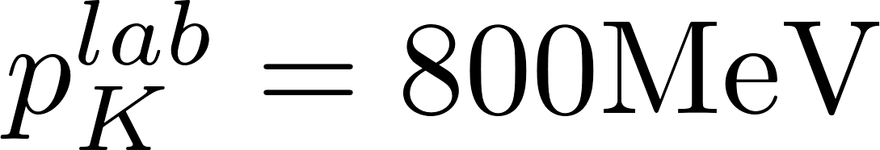
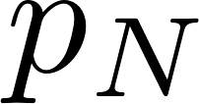


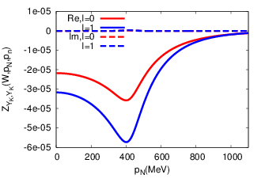
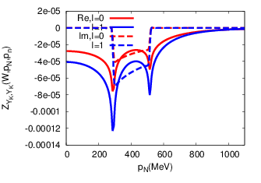
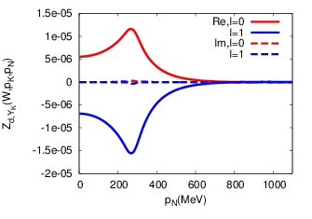

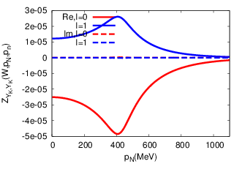
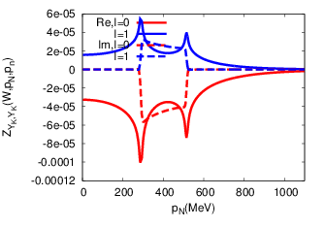

Bump structure above KN threshold
One-step
One- and two-step

Slide 19
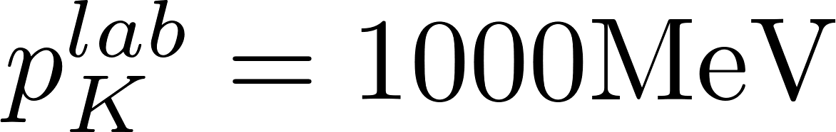
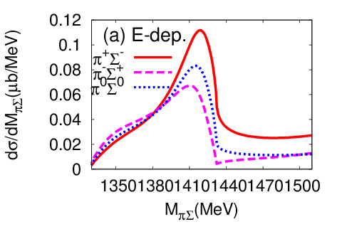
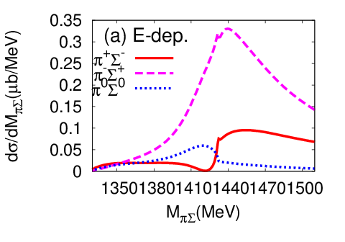
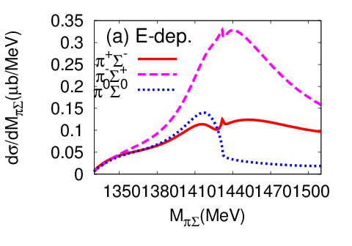






Bump structure above KN threshold
One-step
Two-step
One- and two-step

Slide 20





cutoff dependence
We determine the cutoff parameters to reproduce K⁻p cross sections.
SIDDHARTA

Slide 21






cutoff dependence
Preliminary

Slide 22






Partial wave decomposition
S- and d-wave components are dominant in low-energy region
p-wave component is also large around KN threshold energy

Slide 23




Angular dependence
θ; n angle in C.M.
L
KN threshold cusp is enhanced in forward angle
Channel dependence is also large in forward angle
bump above K^{bar}N threshold energy is enhanced in θ=0

Slide 24






Contribution of each amplitude
X_{YK,d} component is dominant
X
L
L
τ
g

Slide 25










Model of baryon-baryon interaction
NN potential
Nijimegen93
CD-Bonn
q ² φ² (1/MeV)
q (MeV)
YN potential
Torres, Dalitz, Deloff, PLB 174, 213 (1986)
Julich’04

Slide 26



Coupled channel equation for
Faddeev eq.
separable 2-body Interaction；
Alt-Grassberger-Sandhas(AGS) eq. : Xij；quasi two-body amplitude
i
i
i
τn
Xij
=
Zij
+
Zin
Xnj
j
j
n
j

Slide 27








Singularity of particle exchange interaction
Z-diagram
moon shape singularity
methods to handle moon shape singularity numerically
L. Schlessinger, PR 167, 1411(1968)
point method
Kamada, Koike, Glökle, PTP 109, 869(2003)

Slide 28



Point method
L. Schlessinger, PR 167, 1411(1968)
Kamada, Koike, Glökle, PTP 109, 869(2003)
evaluate X at finite εi
X at ε=0
continued
fraction

